Slide 1

Orthopaedic Total Joint Replacement Pre-Op Class
Presented by UCLA Nursing, Pharmacy, Physical Therapy, and Occupational Therapy
Notes:
10:00-10:10 Video: Preparing for Your Surgery

Slide 2
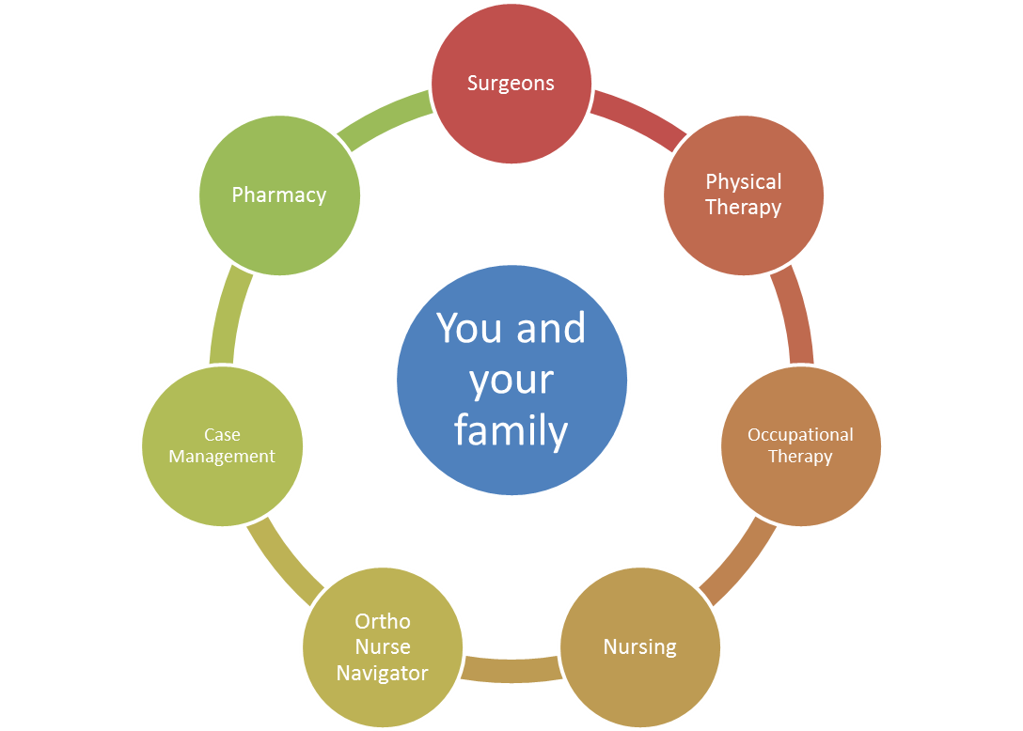
Welcome!

Slide 3
Class Outline
Nursing
Pharmacy
Physical Therapy
Rehab Demonstration
Occupational Therapy
Ortho Nurse Navigator/Case Management

Slide 4

Review these electronic attachments
Surgeon's Discharge Instructions
Class Powerpoint
Hip Rehab Brochure
Hip Exercise Program
Hip Precautions
Pain Scale Chart
Local Equipment Stores List
Fall Prevention Tips
Intimacy after Joint Replacement

Slide 5


Slide 6
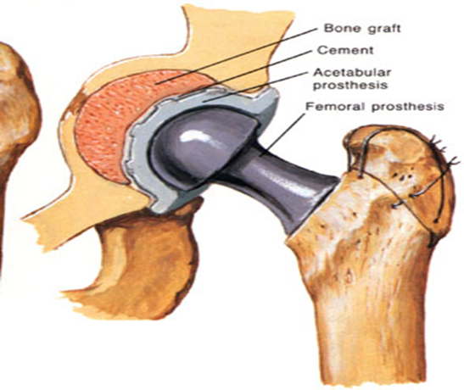
Your Surgery
Hip Replacement

Slide 7
Arrival Time to the Hospital
You will receive a phone call from UCLA Santa Monica
1 Business Day
prior to your surgical date, alerting you of your arrival time to the hospital.
  Call can come between (9am to 6pm)
  If you do not receive a call 1 business day before your surgery,
  then please call (424) 259-6337 after 3pm.
  If still no call after 6pm, please call Ortho Nurse Navigator, Wilson Phoeng at (310) 295-7403

Slide 8
Day Before & Day of Surgery
Patient Checklist – Your Diet
No food or drink after instructed time
Arrival Time | Stop Solid Foods | Drink Clear Liquids Until
6 a.m. | 10 p.m. | 4 a.m.
8 a.m. | Midnight | 6 a.m.
10 a.m. | 2 a.m. | 8 a.m.
12 p.m. | 4 a.m. | 10 a.m.
2 p.m. | 6 a.m. | 12 p.m.
Clear, see-through liquids include:
+Water +Pedialyte +Gatorade +Powerade
Clear Liquids are encouraged until 2 hours before your scheduled arrival time at the hospital

Slide 9

Day Before & Day of Surgery
Patient Checklist – Medication & Hygiene
Medications
  Take any Blood Pressure medications with small sips of water
  Hygiene
  Shower and wash your hair
  You will be given a special liquid soap prior to your surgery during you surgeon’s clinic.
  + Hibiclens – Instructions
  Do not shave at or near the site of surgery
  Remove fingernail polish and acrylic nails
Risk for Infection
  Report any changes in physical condition (cold, fever, rash, nausea vomiting, diarrhea)

Slide 10
Day Before & Day of Surgery
Patient Checklist – What to Bring & What Stay at Home
What to Bring With You
List of meds and supplements
Copy of Medical & Surgical Hx
Insurance card, Driver’s license
Co-pay (check with insurance)
Copy of Advanced Directive
Eyeglasses, Hearing Aid w/ battery
Important telephone numbers
Payment for discharge medications - credit card
CPAP, rescue inhalers
What To Leave At Home
Jewelry (Wedding bands OK)
Checkbooks
Common Medications
(If unsure, please check with Ortho Nurse Navigator to ensure that we carry your particular medications here at UCLA)

Slide 11
Day of Surgery
Admissions
Check-in (G314)
Surgical Waiting Area/PTU
Anesthesiologist Interview
Operating Room
Time-out procedure
Sign consents
Receive ID band, gown, and IV
Mark Surgical Site
Surgery
Recovery/PACU
Criteria for transfer to 3 North Wing

Slide 12
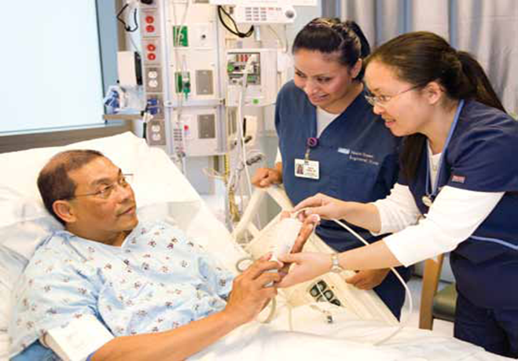
3NW Spine & Ortho
Unit Overview
Patients
  Surgeries: Knee, Hip, Spine, Shoulder
  Length of Stay: 0 to 2 days
26 Private Rooms
Staff
  Primary Nursing Team: RN & CCP
  Support: Charge Nurse, Management
  Ancillary Staff
Visiting Hours
  https://www.uclahealth.org/covid-19-visitor-restrictions

Slide 13

Focusing On Your Care
Foods, Fluids, and Elimination
Management of Issues
  Nausea
  Constipation
Progression
  IV hydration
  Clears to Regular
Importance
  Have energy, heal better
  Good nutrition, better elimination
  Stay hydrated

Slide 14

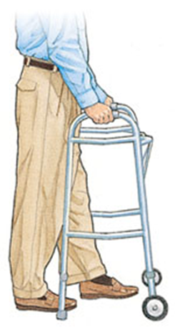
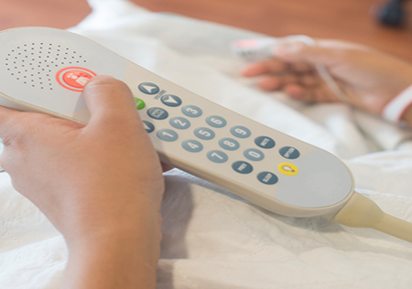
Focusing On Your Care
Mobility & Safety
Call for assistance before getting up
Everyone is a Fall Risk!!
(Medications, Lines, Pumps, and Orthostatic Hypotension)
Do not feel like calling = bothering
You can ambulate with any staff member

Slide 15
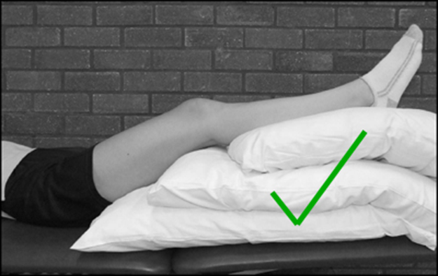
Focusing On Your Care
Swelling Management
To help reduce swelling on operated leg
  Change positions every hour
  Sit for less than 1 hour at a time
    Out of bed to chair for meals
  Elevated affected extremity above the heart
    If increased swelling is noted in foot or ankle, it is time to
    spend more time with the leg elevated
    "Toes above the Nose”
  Use ice, but do not get the surgical dressing wet
  Ankle Pumps while elevating extremity above the heart
Continue for 4-6 hours/day for 6-8 weeks after surgery

Slide 16
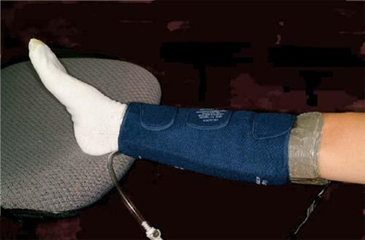
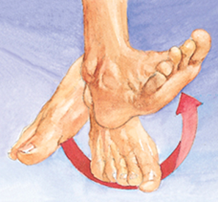
Focusing On Your Care
Deep Vein Thrombosis (DVT) Prevention
Purpose
  Better circulation – prevent blood pooling
  Prevent Blood Clots/PE
  Prevent Complications (i.e., Stroke)
Tools/Interventions
  Sequential Compression Devices (SCDs) or Foot Pumps
  Blood thinners
  Ankle pumps
  Move more!

Slide 17
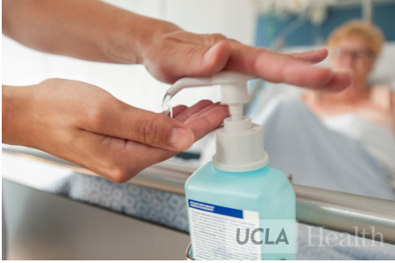
Focusing On Your Care
Infection Prevention (Continued)
Purpose
  Prevent complications
  Heal better
  Prevent readmissions
Interventions
  Post-op IV antibiotic
  Hand washing
  Dressing change
What to Watch Out For
  Redness, Swelling, Drainage, Fever

Slide 18

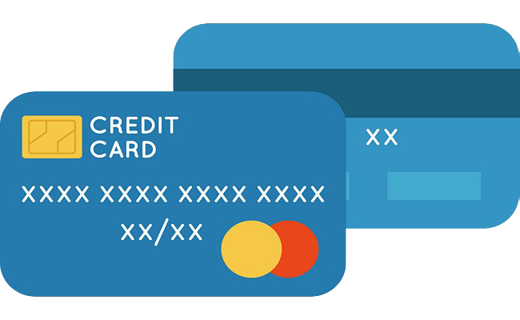


Discharge Day – Post-Op Day 0-2
MD written order is a must!
Discharge time goal 11:00am
Arrange transportation
Discharge instructions & Follow-Up
  Activities: Showering, Driving
  Incision site care/Dressing change
  Follow-up appointments
  When to call your doctor
  No formal therapy, Outpatient or Home Health
  We provide prescriptions and/or discharge medications
  (Bring payment for medication co-pay. Have credit card payment ready on day of discharge for medication co-pay)

Slide 19
Pharmacy

Slide 20
Medication Considerations BEFORE Surgery
Inform physician of medication allergies of adverse reactions
Review your current medications
  Prescription drugs
  Over-the-counter (OTC) medications
  Vitamins
  Herbal Supplements
Medications to avoid or stop prior to surgery
  Blood thinners should be stopped
  Most medications can be taken up until the night before surgery
  Consult your physician about timing
Use of personal medications
  Not allowed
  Alternatives on formulary can be ordered. (Consult the physician or pharmacist)

Slide 21
Medication Considerations AFTER Surgery
Antibiotics
Used to prevent infections at the surgical site
  Cefazolin (Ancef) and vancomycin are commonly used post-operatively
  Usually given as a one-time dose hours after the end of surgery
Pain Control
  Various drugs can be used to prevent or treat pain
  These may include, but are not limited to:
    Hydrocodone/acetaminophen (Norco, Vicodin), Oxycodone
    Tramadol, Tylenol, Celebrex
    Hydromorphone, morphine

Slide 22
Medication Considerations AFTER Surgery (Continued)
Various medications are used to prevent and treat:
  Nausea and Vomiting
    Zofran® (ondansetron), Reglan® (metoclopramide)
  Constipation
    Colace® (docusate), Miralax® (polyethylene glycol), Dulcolax® (bisacodyl), Fleet’s enemas®
  Insomnia
    Ambien® (zolpidem), Restoril® (temazepam)
  Acid Reflux/Indigestion
    Pepcid® (famotidine), Protonix® (pantoprazole), Maalox®

Slide 23

Medication Considerations AFTER Surgery (Continued)
Formation of blood clots can be a consequence of your surgery
Blood thinners are given to prevent clots
  Subcutaneous Injection
    Lovenox® (enoxaparin)
    Heparin
    Arixtra® (fondaparinux)
  Oral
    Aspirin
    Coumadin® (warfarin)
    Inform your physician if you were taking these prior to surgery or if you have a history of bleeding (such as GI bleeding, blood in the urine, or “easy” bruising)

Slide 24
Physical Therapy

Slide 25
Rehabilitation – Physical Therapy
Post-Operative Day #0
PT Begins day of surgery for Primary Total Hip Replacements
  Evaluation occurs in the recovery unit, especially if plans for possible same day discharge
    PT evaluation is around 90 minutes after surgery or after resolution of surgery side effects
    Focus on bed mobility, transfers, and household level ambulation
    Stair training to also occur on an individualized basis
    May be cleared for same day discharge after PT, provided MD and medical clearance
    If staying overnight, evaluation may occur on 3NW unit instead
  Exceptions:
    Latest scheduled cases (or those with significant unplanned delays) will be seen the following morning POD #1 by PT on the Ortho unit, but can participate in early mobility with RN the night of surgery
    Total Hip Resections or Revisions will not see PT until POD #1

Slide 26
Rehabilitation – Physical Therapy
Post-Operative Day #1
Patients staying overnight will have PT evaluation and/or treatment the morning of POD #1
PT frequency-Primary Total Hip Replacement
  1st visit am of POD #1
    Focus on bed mobility, transfers, and household level ambulation. Review of exercises.
    Stair training to also occur on an individualized basis.
    DC from PT after am session if goals are met
    If staying longer for medical reasons and/or goals are not met, 2nd session to occur in the afternoon
    **PT frequency-Total Hip Resection or Revisions to be seen 1-2 times per day during length of stay until discharge or until goals met, to be determined based on individualized needs and medical complexity

Slide 27
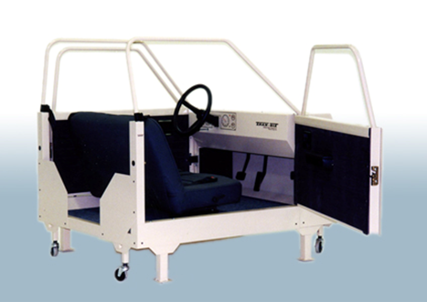
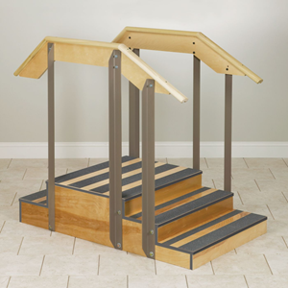
Rehabilitation
Daily Physical Therapy Treatments
Primary focus is on safe discharge
  Progressing safe household level mobility and walking
  Stair/Step training (as needed)
  Car transfer training
  Caregiver/”Coach” Training

Slide 28
Rehabilitation
Daily Physical Therapy Treatments Con’t.
Ongoing pain management is key!
  Important for optimal progression during PT sessions
  Ideal pain level is 4 or less (on a 1-10 scale) during activity
    Be sure to communicate your pain level to your nurse with movement of the surgical leg
  Alternatives to pain medicine
    Mobilize-”Movement is medicine!”
    Cold packs or ice
    Positioning

Slide 29
Rehabilitation
Coordinating Your Care
To get the most out of your session, you can best prepare by:
  Eating meals early (7-8am)
  Performing hygiene and toileting needs prior to therapy
  Defer all phone calls and/or visitors before/after therapy
    Exception: You are encouraged one visitor who will be your “coach” at discharge to participate in therapy sessions
  Manage your pain with RN
  Take oral medications on schedule

Slide 30

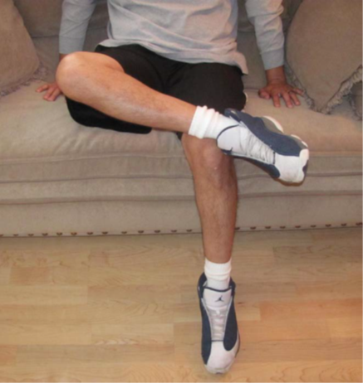
Rehabilitation
Movement/Dislocation Precautions – Hips Con’t.
Hip Precautions – Anterior Approach
  Avoid the “figure four” position with the operative leg
  Weight Bearing as tolerated

Slide 31
Questions?
Up next
  Practice sessions with PT/OT
    Getting out of bed
    Walking with a Walker
    Exercises
    Activities of daily living

Slide 32


Slide 33
Rehabilitation – Occupational Therapy
Post-Operative Day #0 or 1
Occupational Therapy
  POD #0: Cases pre-determined to be discharging same day may be seen by OT along with PT
  If staying overnight, OT begins POD #1
    DC from OT after evaluation if goals are met
  Focus on everyday activities
    Getting dressed
    Moving in the bathroom
    Home Activities

Slide 34
Rehabilitation
Preparing for Home
Preparation is key! Prior to surgery, you should:
Have an adequate support system in place to help with preparing meals, bathing, and moving around the house
Plan on having a designated person/s physically able to help you upon discharge. This can be:
  Family and/or close friends
  Private caregiver if needed
    Interview and hire ahead of time.
  Housekeeper, gardener, etc.
    Arrange in advance as needed

Slide 35
Rehabilitation
Preparing for Home
Is your home set up?
  You should have, or be able to obtain, all the durable medical equipment necessary, such as:
    Front wheeled walker
    Commode or raised toilet seat
      Not required, but may ease transfers for taller patients or those with co-morbidities struggling to rise from low surfaces
  Prepare your home ahead of time to accommodate a walker and prevent falls (see handouts)
  Set up bedroom accommodations on the first floor (if you live in a 2 story home)

Slide 36
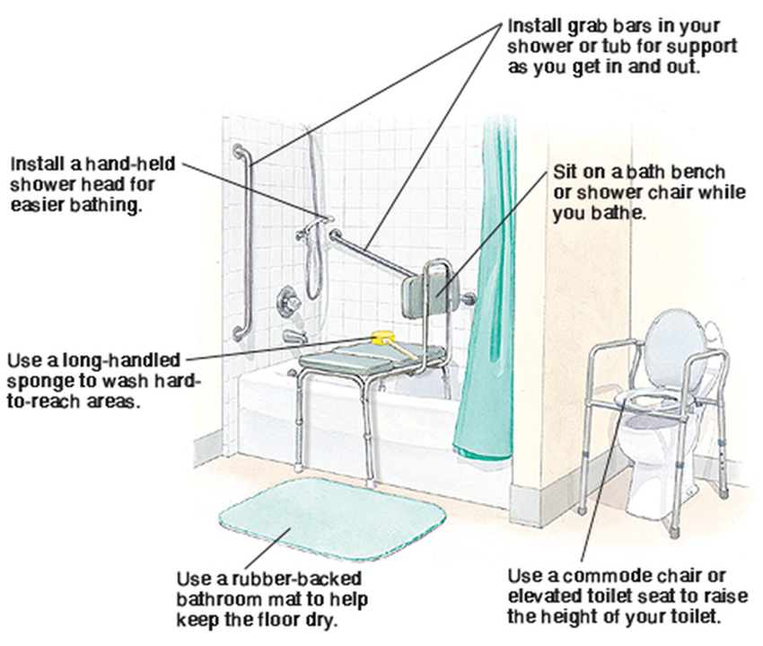
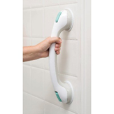
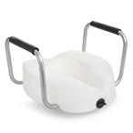
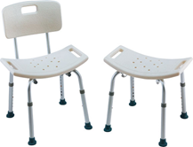
Rehabilitation
Preparing for Home – Common Bathroom Equipment
Raised toilet seat/Commode
Grab Bars
Shower seat
Tub Transfer Bench
Non-skid Bath Mat/Strips
Hand Held Shower Head

Slide 37
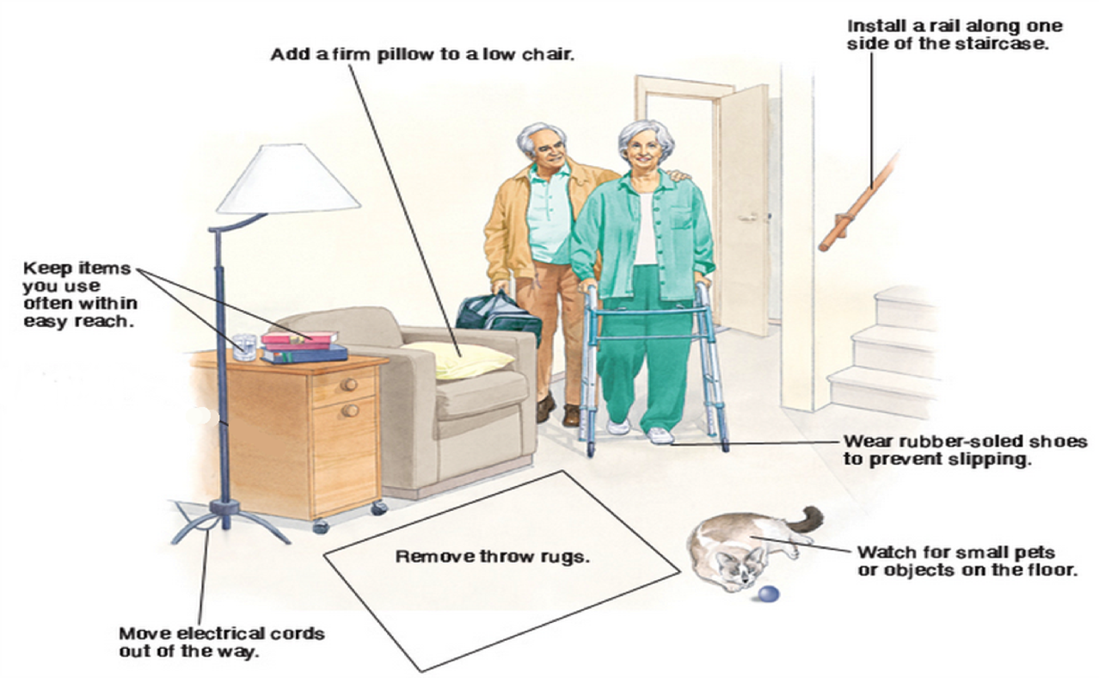
Rehabilitation
Preparing for Home – Common Home Modifications

Slide 38
Rehabilitation
Discharge Planning to Home
We hope to prepare you for a safe return home on the same day or 1st day after surgery.
  With a little assistance or supervision, you should be able to :
    Get in and out of bed
    Walk household distances with a walker
    Perform steps/stairs with the appropriate assistive device
    Use the toilet or commode
    Complete self-care activities

Slide 39


Slide 40

Designated Helper – Family/Friends
Prior to surgery, designate one or more helpers to assist you after surgery for 1 to 2 weeks.
(Time frame will vary depending on your recovery progress after surgery)
Designated Helper's possible duties:
  Cooking, cleaning, laundry.
  Assisting you with navigating your home safely.
  Driving you to your appointments.
  Encouraging you to perform your exercises safely.

Slide 41
Discharge Planning
Home → No formal therapy or Outpatient physical therapy (after cleared by MD)
Home with Home Health services (RN & PT/OT) → Outpatient physical therapy (after cleared by MD)
Skilled Nursing Facility (SNF) → Home
  Santa Monica Health Care Center – UCLA Health designated Center of Excellence for Joint Replacement
    1320 20th St, Santa Monica, CA 90404
    Phone (310) 829-4301

Slide 42
Discharge Planning Con’t.
Very few patients need SNF rehab before they are safe to go home
  Need maximal or 2 person assistance
  Cannot walk or take steps
  Frequently losing your balance
  Medical issues that require skilled nursing need

Slide 43
Medicare Part A & B
Removal of Total Hip Replacement from Inpatient Only List
  Change was made on Jan 1, 2018 for total knee replacement
  All procedures will be done as outpatient procedure, unless there is medical justification to change to inpatient.
  Cannot discharge to SNF unless made inpatient with medical justification.
  Possible Co-pay of up to 20% for outpatient procedure
    Typically covered by secondary insurance.

Slide 44
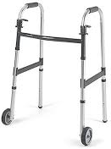
Durable Medical Equipment
Medicare Covered Items
  One item within the last 5 years
  Walker or ambulation device
Self-Pay Items
(Commode, Raised Toilet Seat, Shower Chair, Adaptive Equipment)
  Local equipment stores (see handout)
  Online/Amazon
  Hospital DME vendor
  *Non-Medicare patients: Check your insurance provider about specific DME coverage

Slide 45
Home Health Services
Agency will call you to make home visit arrangements
Nursing
  RN will visit your home within 24-48 hours after discharge
Physical Therapy/Occupational Therapy (1-3 times per week)
  Evaluation by home therapist
Home health PT/OT discontinued prior to outpatient therapy
Check with your insurance provider about your Home Health coverage

Slide 46
Skilled Nursing Facility (SNF)
Short-term rehabilitation
  Therapy 1-3 hours per day
Transportation to SNF may NOT be covered
Your case manager will arrange admission and transportation
Check with your insurance provider about your specific coverage
  May be dependent on the hospital assessment of needs and progress

Slide 47

Private Pay Caregiving Agencies
24 hour Private Caregiving Service at home
24 Hr Home Care: 310-258-9525
Accredited Home Care: 800-974-1234 ext 205
123 Home Care: 310-361-8558
  Average cost $30-40 dollars an hour – please call for rates.
  You can hire same day from 4 hours to 24 hours.
  You can interview staff ahead of time.

Slide 48
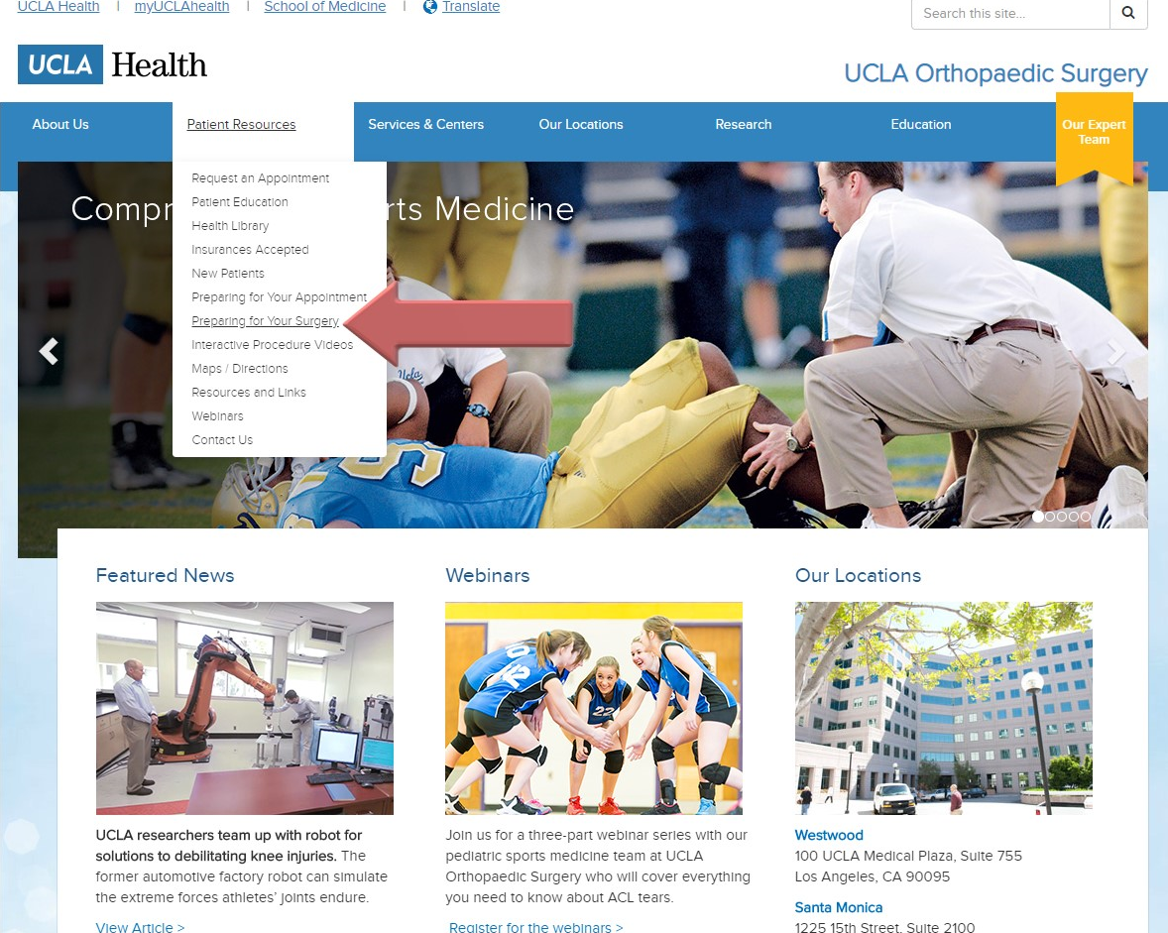
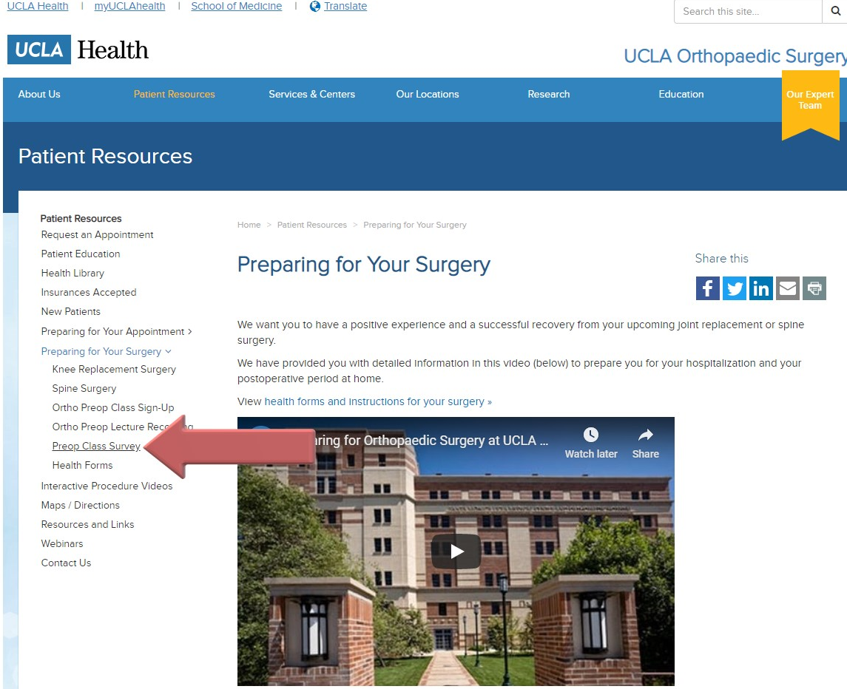
Class Survey – See instructions below!
OR, access the link at www.ortho.ucla.edu then “click”

Slide 49

Orthopaedic Nurse Navigator
For any orthopaedic related questions and concerns, please contact Orthopaedic Nurse Navigator
Contact Information:
  Wilson Phoeng RN , MSN, ONC, PHN
  Email: wphoeng@mednet.ucla.edu
  Office # 424-259-8266
  Work Cell # 310-295-7403
  Pager # 800-233-7231
    Page ID # 96637

Slide 50

Thank You All For Coming
Any Questions

