Slide 1
Introduction to head and neck imaging
Ali Sepahdari, MD

Slide 2
Imaging Modalities
CT
MRI
Plain films
PET, PET/CT
Ultrasound

Slide 3
Anatomy
Sinuses and nasal cavity
Temporal bone, skull base
“Neck”
Suprahyoid
Infrahyoid
Orbit
Mandible

Slide 4
Sinus Imaging
CT is the test of choice
MR for characterization of solid masses

Slide 5
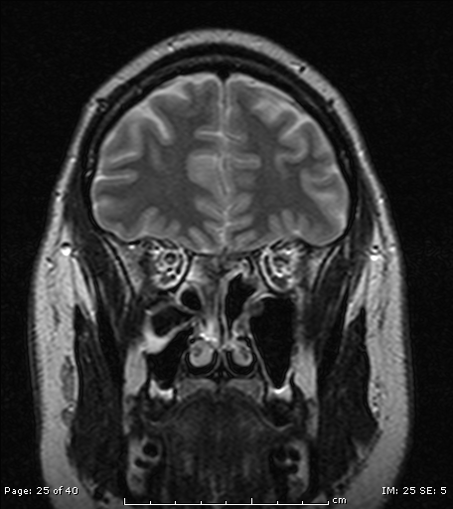
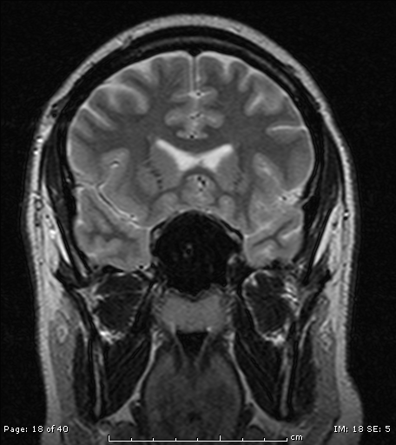
Why not MRI?

Slide 6
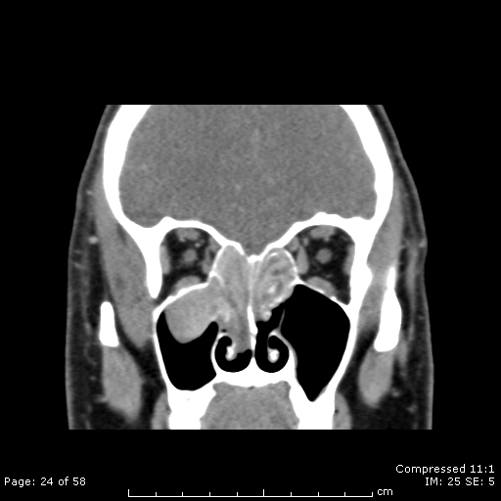
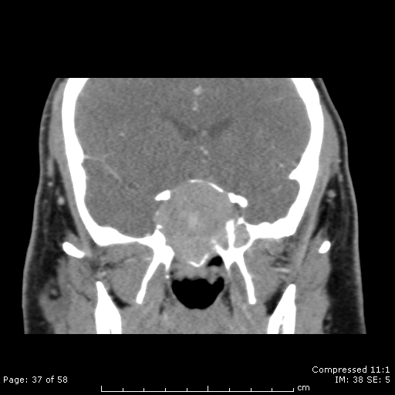
Why not MRI

Slide 7
MRI versus CT

Slide 8
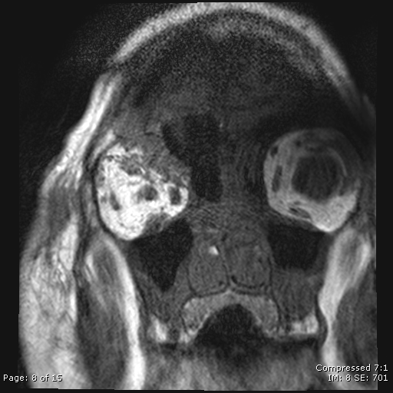
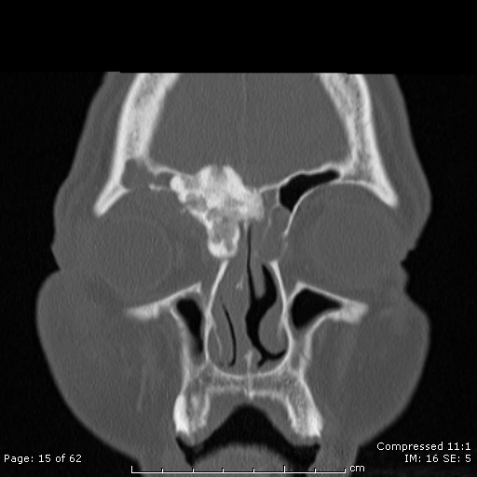
Why not MRI

Slide 9
CT - technique
Perform after medical treatment
Evaluate for residual disease to be addressed by surgery
No contrast necessary
Order with image guidance protocol (Brainlab or Medtronic Sinus Protocol) to accommodate intraoperative guidance systems

Slide 10
Drainage pathways
Superior meatus
Sphenoids via sphenoethmoidal recess
Posterior ethmoids directly
Middle meatus
Frontals via frontoethmoidal recesses
Maxillary via infundibula
Ethmoids directly

Slide 11
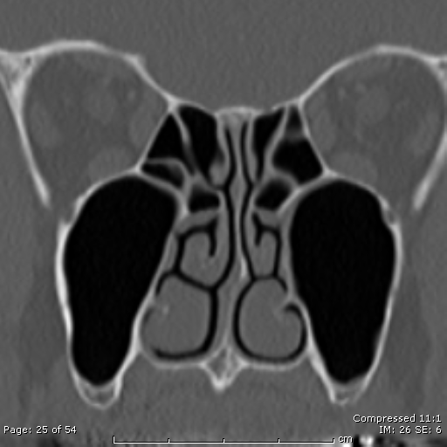
Nasal cavity
Superior, middle and inferior turbinates
Superior, middle and inferior meati lateral and inferior to the turbinates

Slide 12
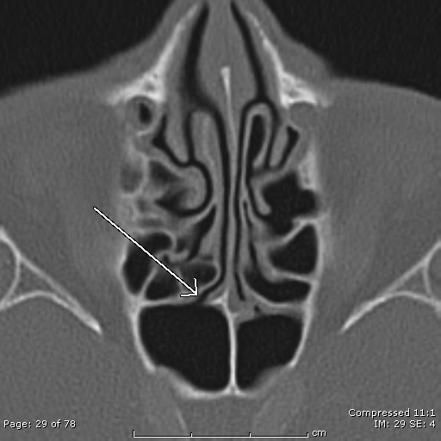

Superior meatus: sphenoid and posterior ethmoids

Slide 13
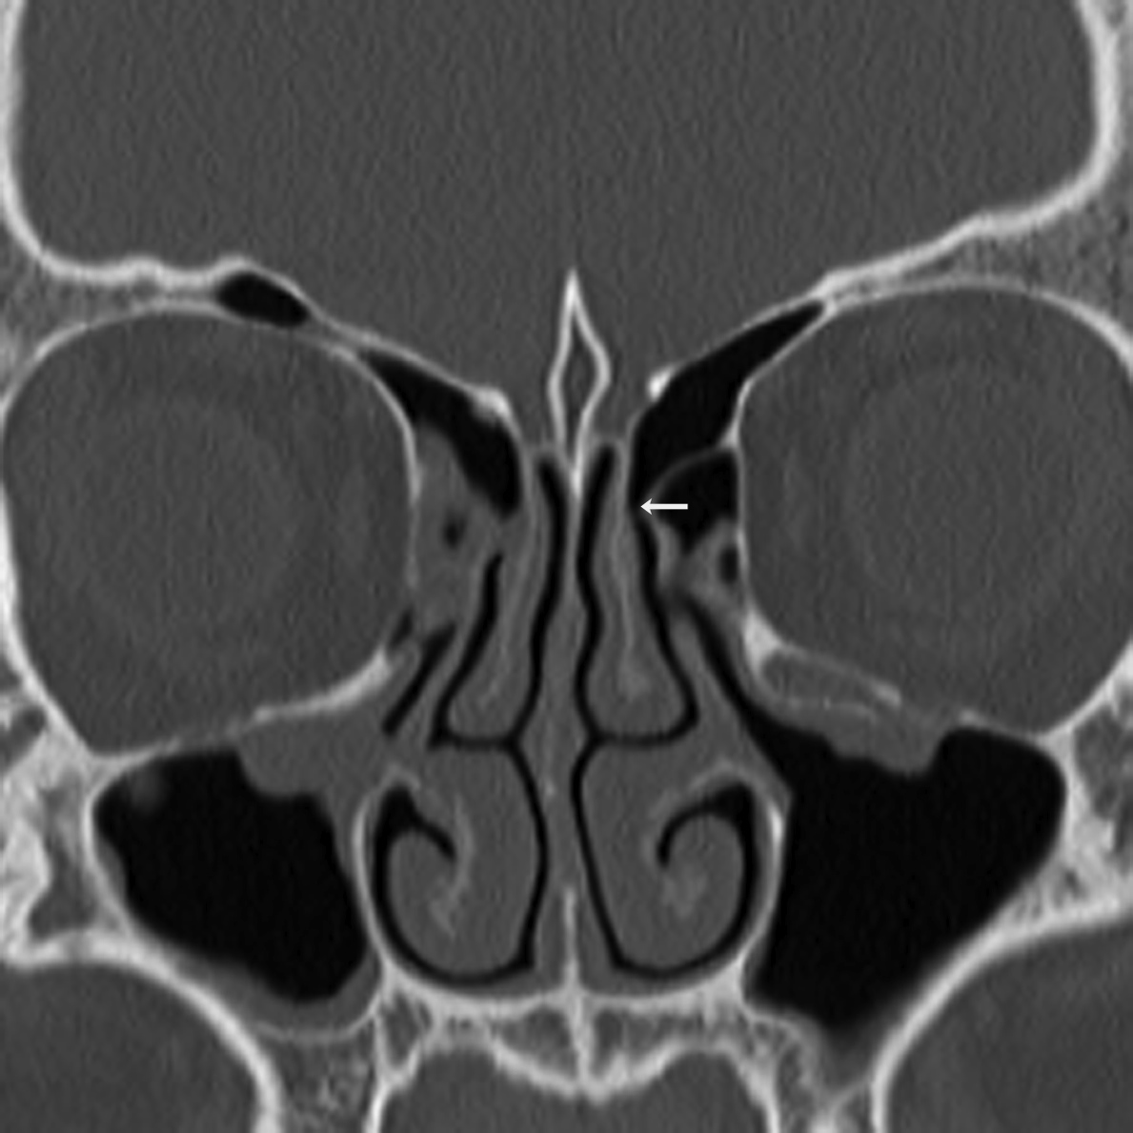
Middle meatus – frontoethmoidal recess

Slide 14
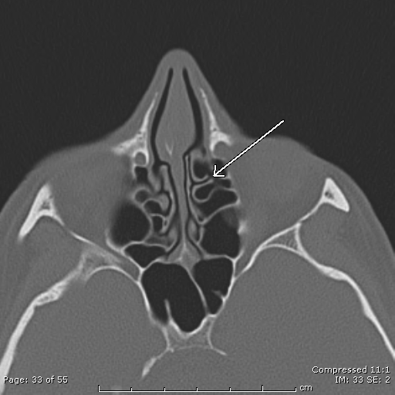
Middle meatus – anterior ethmoids

Slide 15
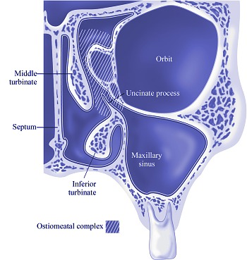
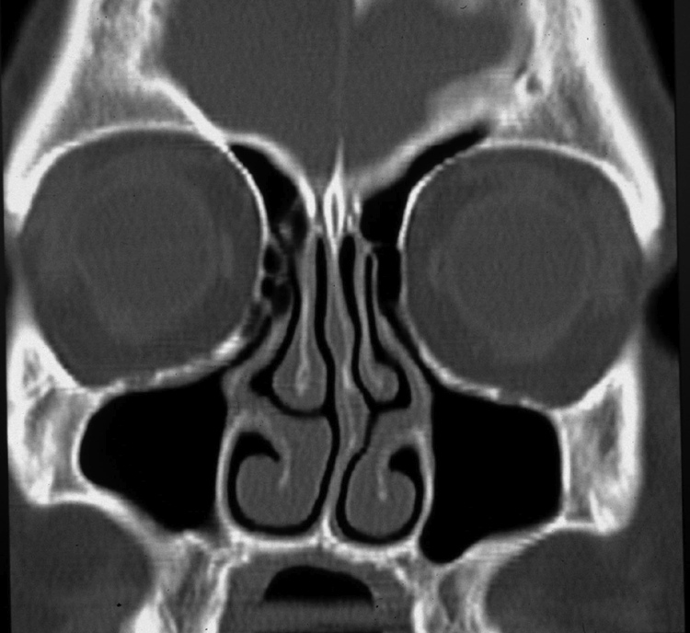
Ostium Infundibulum Hiatus Semilunaris Uncinate process Middle meatus
Ostiomeatal Complex

Slide 16
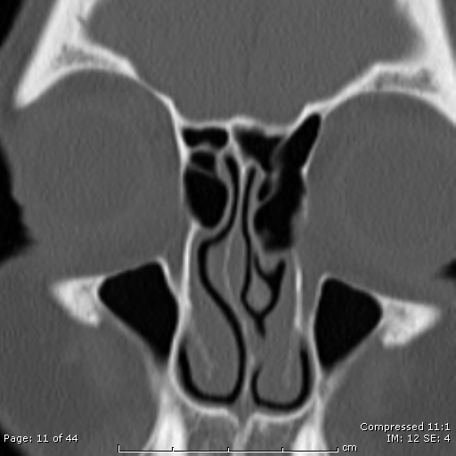
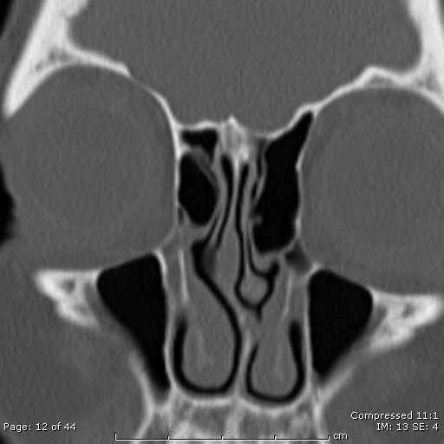
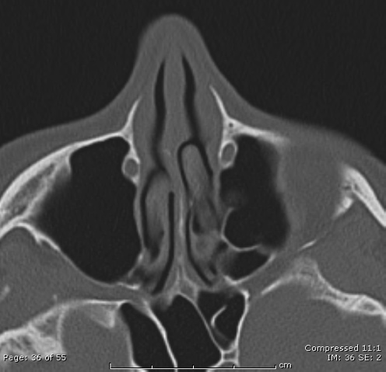
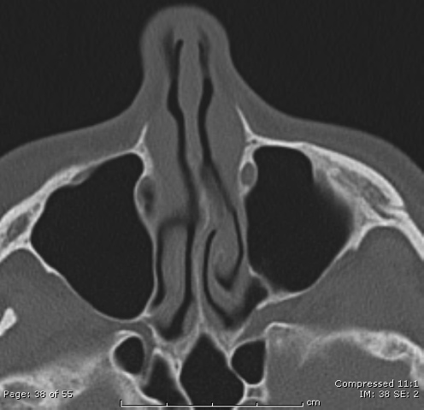
Inferior meatus – nasolacrimal duct

Slide 17
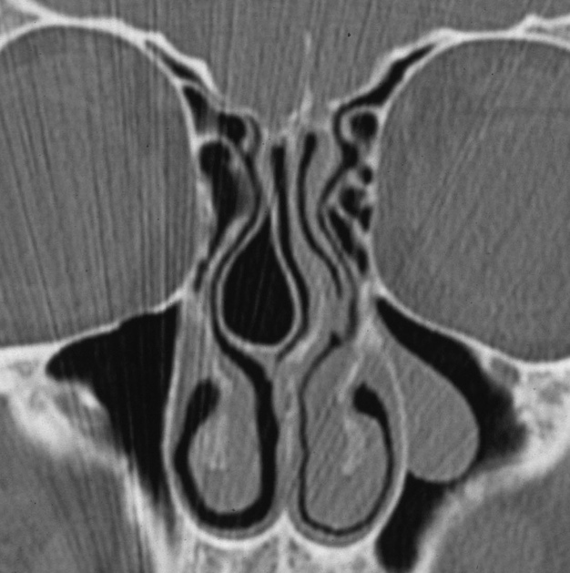
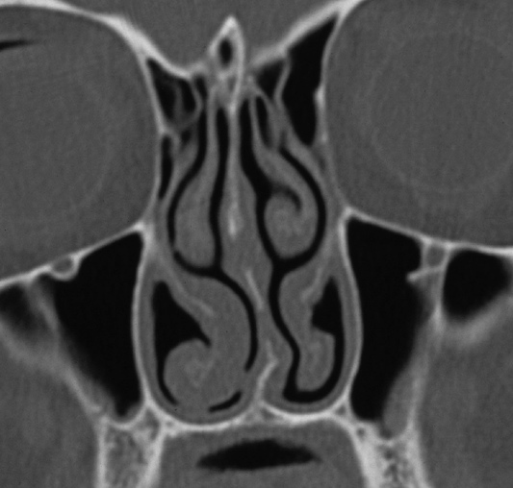
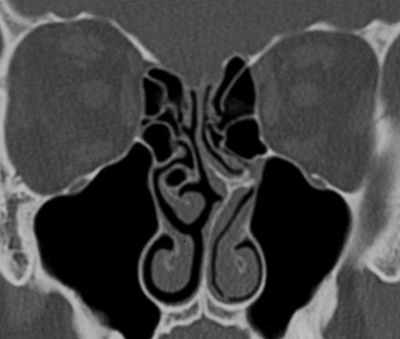
Variants in the OMC Concha bullosa Paradoxical turbinate Septal spur

Slide 18
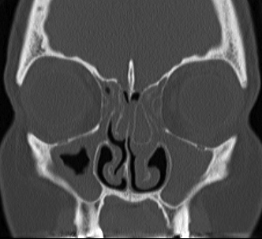
Opacified concha bullosa

Slide 19
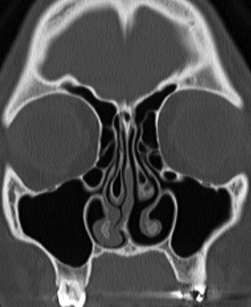
Haller cell (infraorbital cell)

Slide 20
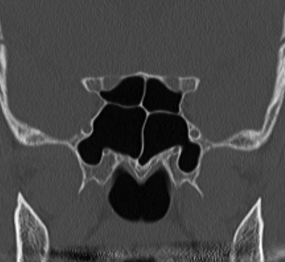
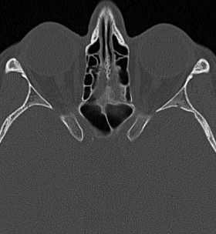
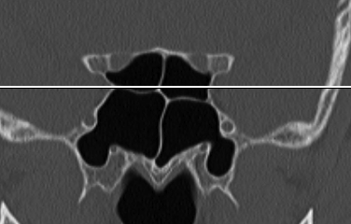
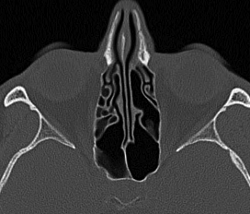
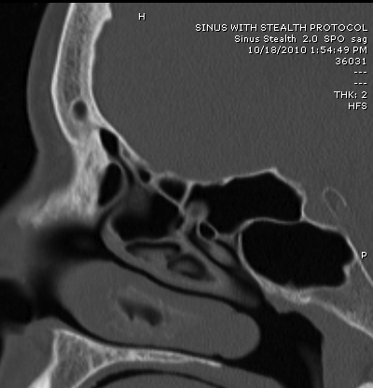
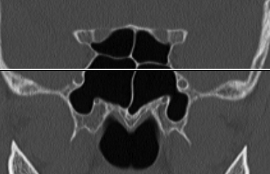
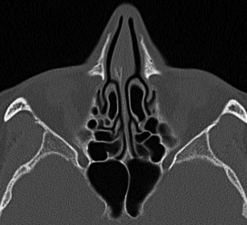
Onodi Cell

Slide 21
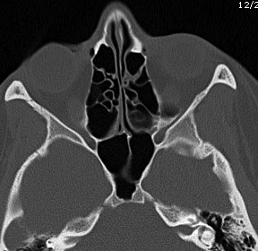
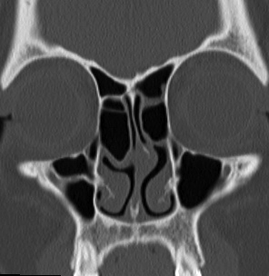
Agger Nasi Cell

Slide 22
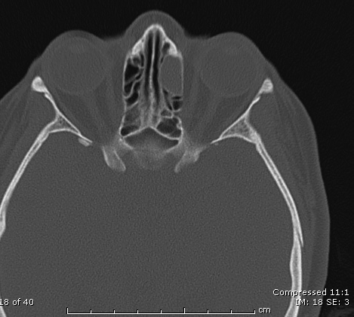
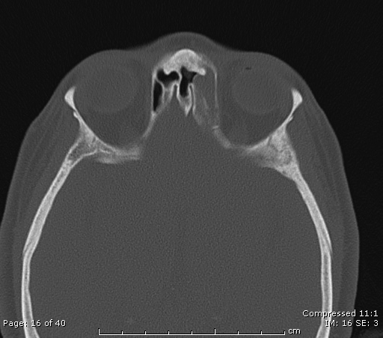
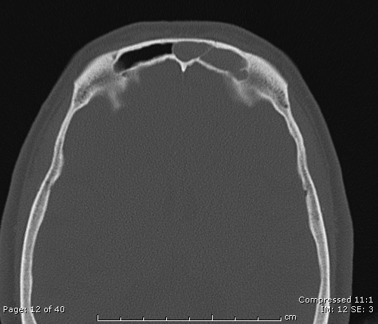
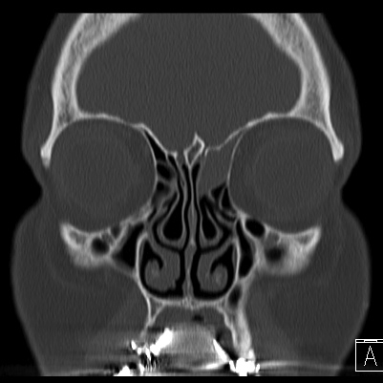
Opacification or tumor?

Slide 23
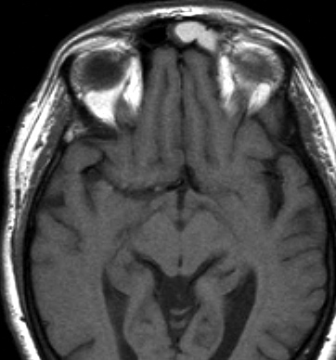
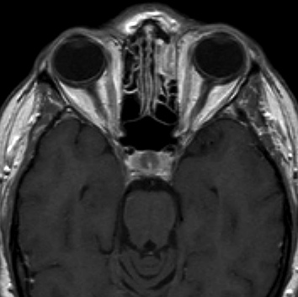
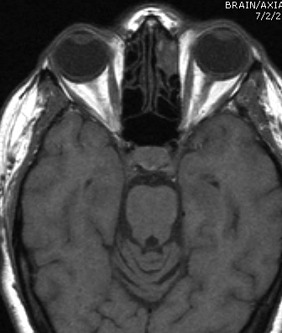
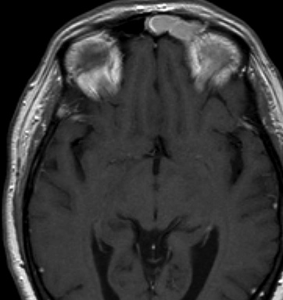

Slide 25
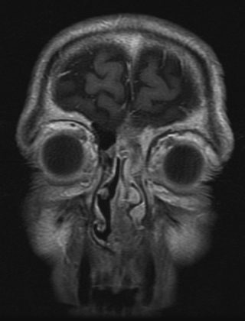
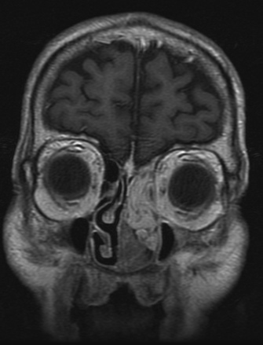

Slide 26
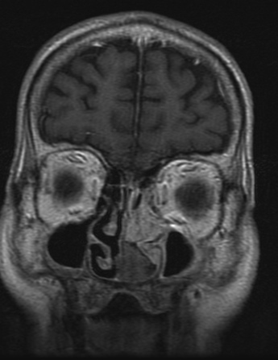
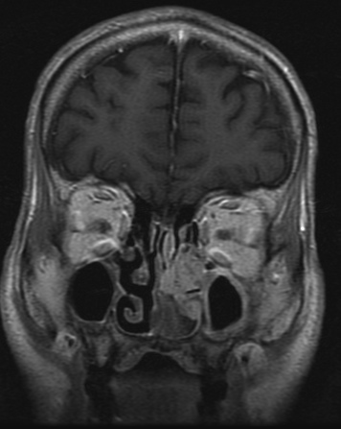

Slide 27
Temporal bone
CT for infection, inflammatory disease, trauma
CT for conductive hearing loss
MR to rule out vestibular schwannoma
MR in place of second look surgery to rule out recurrent cholesteatoma

Slide 28
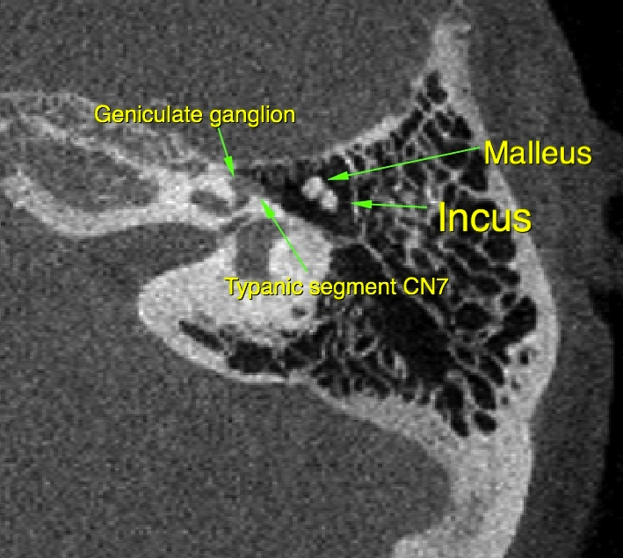
Axial anatomy

Slide 29
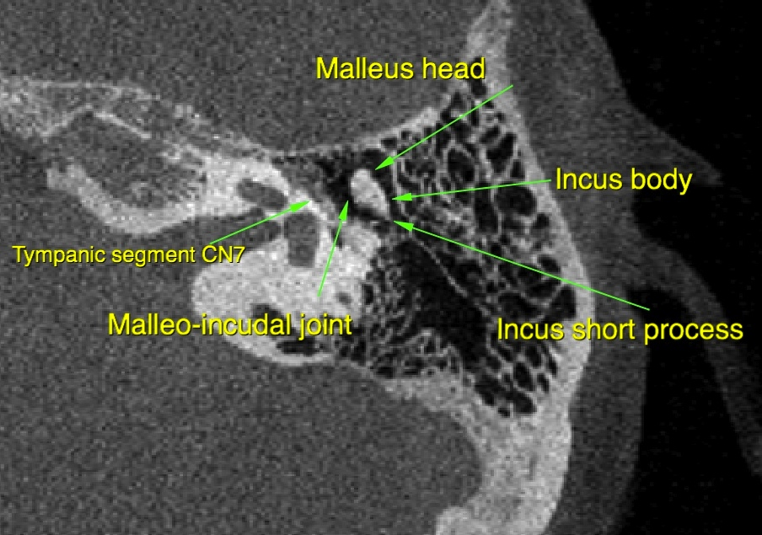

Slide 30
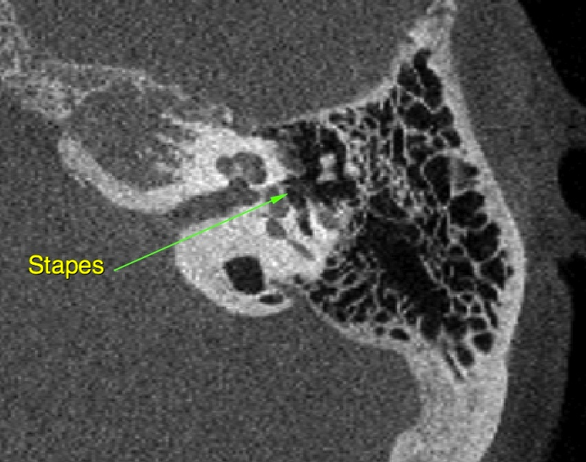

Slide 31
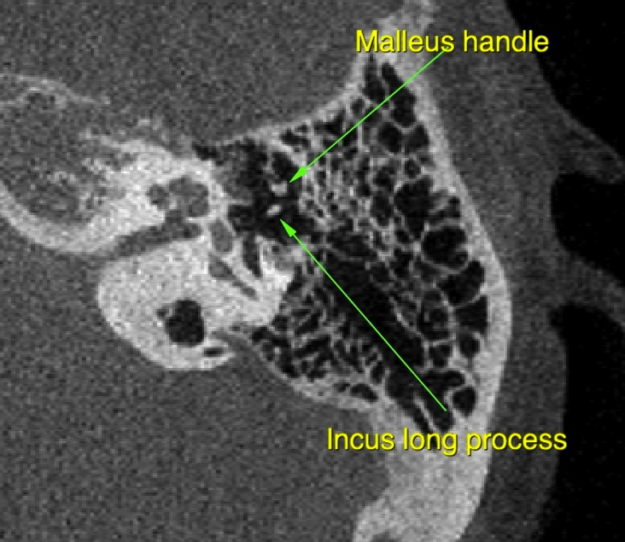

Slide 32
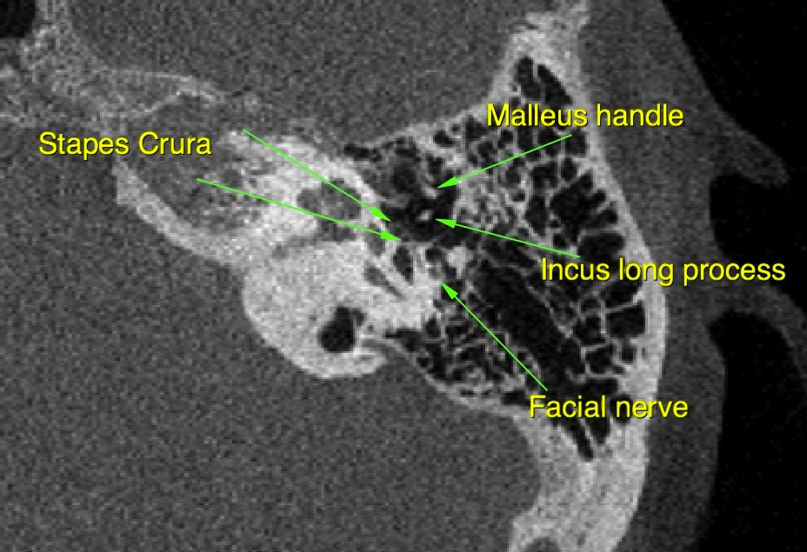

Slide 33
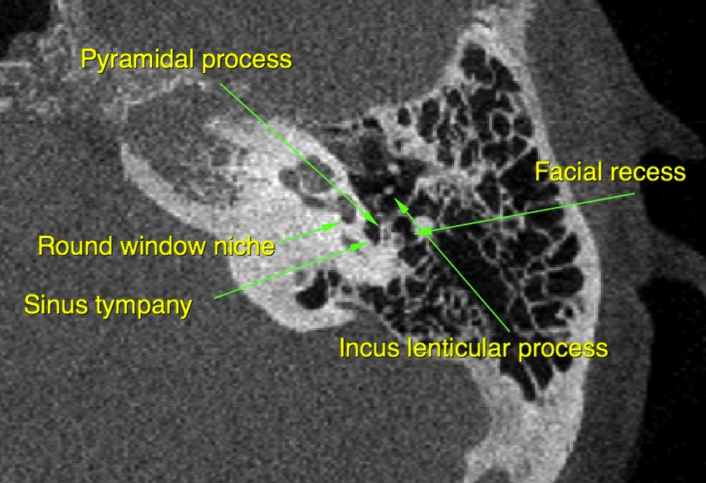

Slide 34
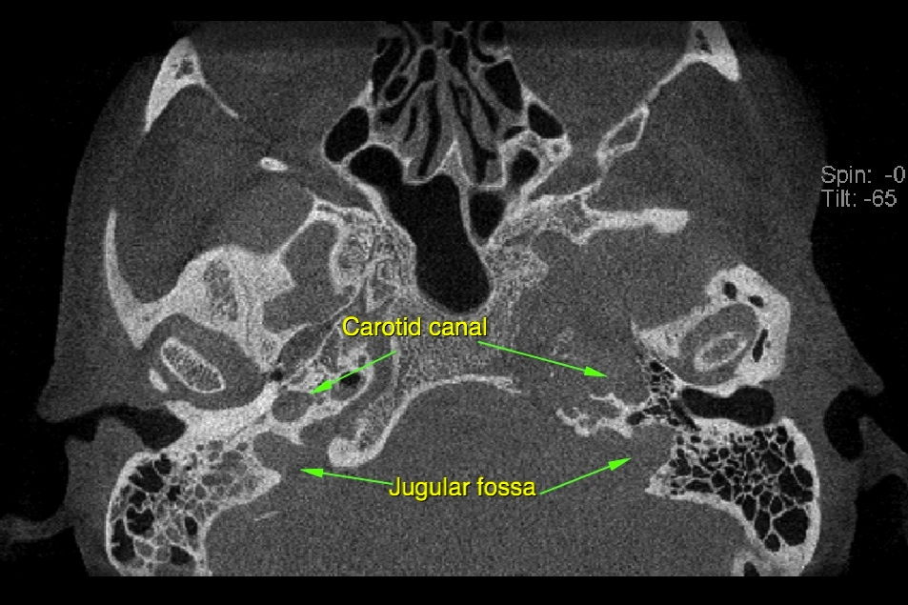

Slide 35
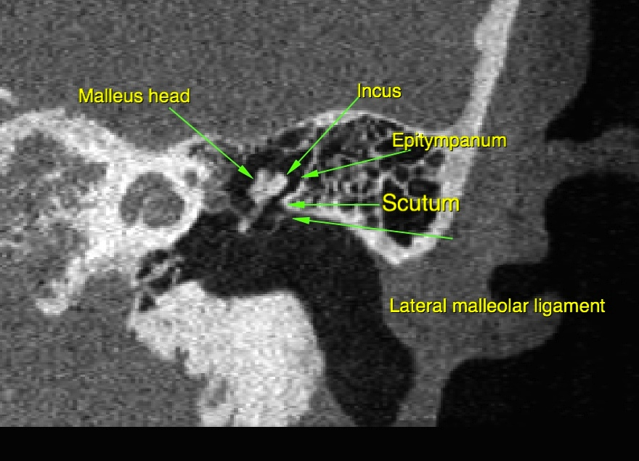
Coronal anatomy - middle ear

Slide 36


Slide 37


Slide 38


Slide 39


Slide 40


Slide 41


Slide 42



Slide 43



Slide 44


Slide 45
Suprahyoid neck
Oral cavity
Nasopharynx
Oropharynx
Parapharyngeal space
Masticator space
Retropharyngeal space
Prevertebral space
Submandibular space

Slide 46
Oral cavity imaging
Done for cancer staging
CT can show bone invasion, but otherwise limited by artifact from jaw/teeth
MR usually preferred

Slide 47





Slide 48





Slide 49





Slide 50



Slide 51




Slide 52
Nasopharynx
MR usually preferred over CT, superior for showing local extent of disease
Nodal evaluation (2, 3, 5A)

Slide 53


Nasopharynx

Slide 54



Slide 55
Oropharynx
Tonsil, base of tongue, pharyngeal wall
Either CT or MR can be used (many centers prefer CT, we prefer MR at UCLA)
Size, invasiveness, and extent of primary
Nodal disease

Slide 56


Slide 57



Slide 58



Slide 59



Slide 60


Parapharyngeal space

Slide 61


Masticator space
Notes:
osteosarcoma

Slide 62


Notes:
hemangioperictyoma

Slide 63
Infrahyoid neck
Hypopharynx
Larynx
Thyroid
Parathyroid

Slide 64



Slide 65


Slide 66


Notes:
Papillary thyroid

Slide 67
Lymph nodes
Classification by echelon
Criteria for pathology
Size
Necrosis
Extracapsular spread

Slide 68



Slide 69


Slide 70



Slide 72

Necrosis, ECS
Notes:
NPC with necrosis, ECS

