Slide 1
Chapter 31:
Liposuction
Sameer Ahmed
11/14/2012

Slide 2
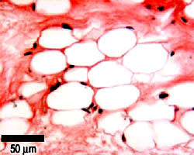
Background
Adipocyte physiology
  Hyperplasia occurs after a critical mass has been reached
Liposuction reduces # of adipocytes, regardless of their size
  Should provide long lasting results
Lipocontouring happens in the subQ plane
  Healthy skin flap (don’t get too superficial)
  Avoid damaging deeper structures (nerves, muscles)

Slide 3
Ideal Candidate
Ideal for liposuction:
  Diet-resistant fat pockets, congenital in nature
    e.g.: double chin since childhood
Anatomical sites:
  Submental, melolabial, submandibular, and buccal areas
Younger patients
  Greater skin elasticity, skin contracts better on new subQ contour
Pt. is not obese/overweight. These pts have excess adipose in multiple layers and do not respond to lipocontouring
  Lipocontouring does not replace weight control

Slide 4
Types of Lipocontouring
Liposuction
  Involves negative pressure through a hollow cannula
  No cutting surface, Fat avulsed “atraumatically”
Liposhaving
  Soft tissue shaver w/ gentle suctioning
  After the blade is activated, care should be taken at the incision site to avoid damage to the skin margins
Ultrasonic Liposuction
  Mechanical agitation of cannula → microcavities within adipocytes implode → liquefaction of fat

Slide 5
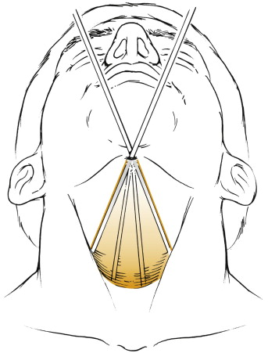
Liposuction Technique
5-10mm incision
  Identify subQ plane w/ Metz
  Increasing size cannulas to bluntly dissect, “spokelike”, without suction
  Suction aspiration of fat
Sequence:
  Submental, jaw & posterior cervical, melolabial
1 atm of negative pressure
Cannula tips 3-6mm in size
  Smaller size for melolabial region
Post-operative dressing

Slide 6
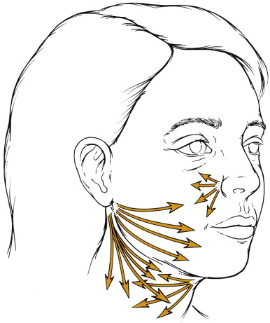
Incision Sites and Access
Post-auricular
Melolabial
Submental

Slide 7
Liposuction Technique
“Open” Liposuction combined with face lift
  Completely cross-hatch each area, reduce the risk of banding.
Hollowing and inconsistent flap elevation can be avoided
  Palpate cannula tip and preserve some fat on the flap’s undersurface
Avoid repeated passes in the immediate submental area
  Can result in a cobra neck deformity.
Release vacuum when withdrawing/repositioning the cannula
  To avoid creating grooves over posterior face & parotid
A criss-crossed pattern of passes helps create a smoother, more natural contour

Slide 8
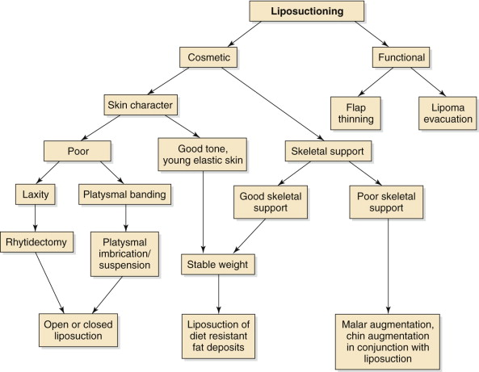
Integrating Liposuction

Slide 9
Pitfalls
1. Significant ptosis of facial skin may appear accentuated after lipocontouring, thereby creating a more aged appearance; → Perform face lift.
Skeletal insufficiency may reduce structural definition and give the illusion of excess fullness of a certain area
→ Chin implant or genioplasty may improve blunted cervicomental angle
3. Ptotic submandibular glands and hypertrophy of parotid glands can mimic areas of excess adipose collection and should be appreciated and not traumatized.

Slide 10
Complications
Hematoma
  Can get infected and cause skin flap necrosis
  Pigment changes from undiagnosed hematomas
Contour irregularities
  From asymmetric liposuctioning
Motor or sensory nerve injuries
  Rare but if they occur, are usually temporary
Cardiovascular instability does not happen w/ only H&N liposuctioning
  Can happen with total body suctioning 2/2 massive fluid shifts

Slide 11
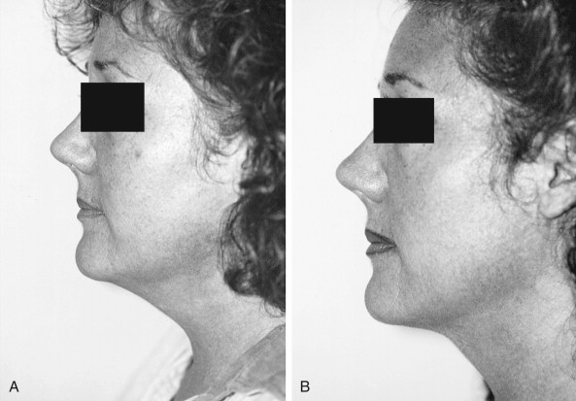
Preoperative (A) and postoperative (B) photographs show the illusion of enhanced chin projection after submental and submandibular liposuction, as well as the enhancement of the mandibular margin with improvement of the cervicomental angle.

