Slide 1

GLOBAL HEALTH
IS
LOCAL HEALTH
BRUNO LEWIN, MD, DTMH
DIRECTOR, TRAVEL ADVISORY SERVICE
CHAIR, REGIONAL IMMUNIZATION PRACTICE
DEPARTMENT OF FAMILY MEDICINE, KAISER PERMANENTE LOS ANGELES

Slide 2
Disclosure of Relevant Financial Relationships
Under the ACCME Standards for Commercial Support, everyone who is in a position to control the content of an education activity must disclose all relevant financial relationships with any commercial interest. A “commercial interest” includes any proprietary entity producing health care goods or services, with the exemption of non-profit or government organizations and non-health care related companies. A financial relationship is relevant if it pertains to the activity’s content matter including any related health care products or services to be discussed or presented.
Dr. Bruno Lewin has disclosed that he has no relevant relationships with commercial or industry organizations. The CME Department has reviewed the disclosure information for the planner(s) and/or committee/faculty for this program and they do not have relationships that present a relevant conflict of interest.

Slide 3
OBJECTIVES
LATENT TUBERCULOSIS
HEPATITIS B
CHAGAS DISEASE
OTHER LOCALLY ENDEMIC DISEASES
EMERGING INFECTIONS

Slide 4
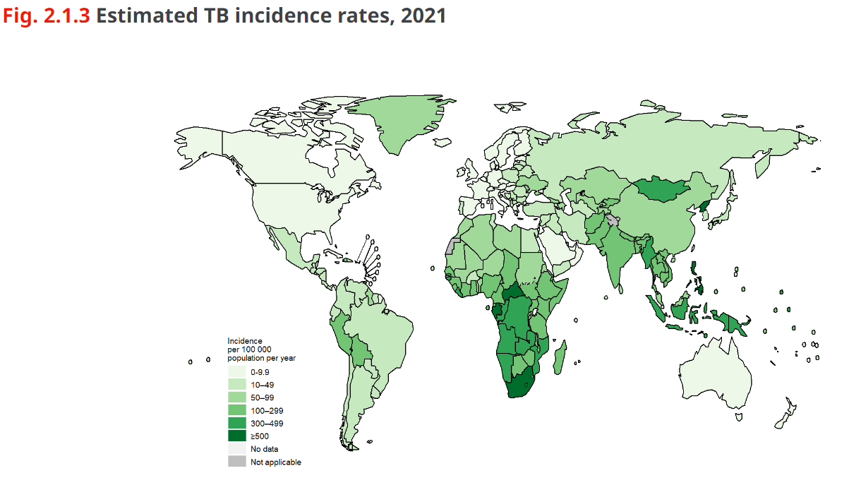
WHO Global Tuberculosis Report 2022
2.1 TB incidence (who.int)

Slide 5
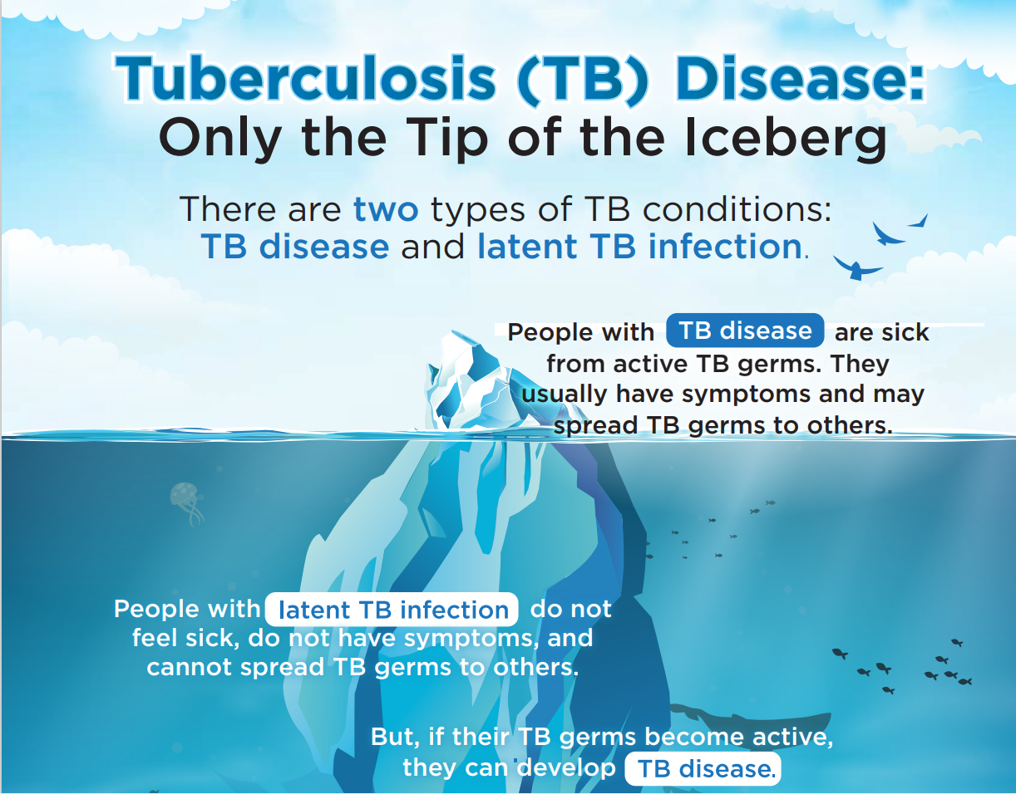

Slide 6
Persons at high risk for developing TB disease fall into two categories:
Recently Infected or Weakened Immune System
Close contact of a person with infectious TB
Immigrated from area with high rates of TB
Under 5 years of age with positive TB test
In a group with high rates of TB transmission (homeless persons, injection drug users, and persons with HIV infection)
Work or reside in facility with high risk (hospitals, homeless shelters, correctional facilities, nursing homes, and residential homes)
HIV infection
Substance abuse
Silicosis
Diabetes mellitus
Severe kidney disease
Low body weight
Organ transplants
Head and neck cancer
Medications that suppress the immune system such as in RA, IBD

Slide 7
Preferred treatment for Latent TB
CDC and the National Tuberculosis Controllers Association (NTCA) preferentially recommend short-course, rifamycin-based, 3- or 4-month latent TB infection treatment regimens over 6- or 9-month isoniazid monotherapy.
Three months of once-weekly isoniazid plus rifapentine (3HP)
Four months of daily rifampin (4R)
Three months of daily isoniazid plus rifampin (3HR)

Slide 8
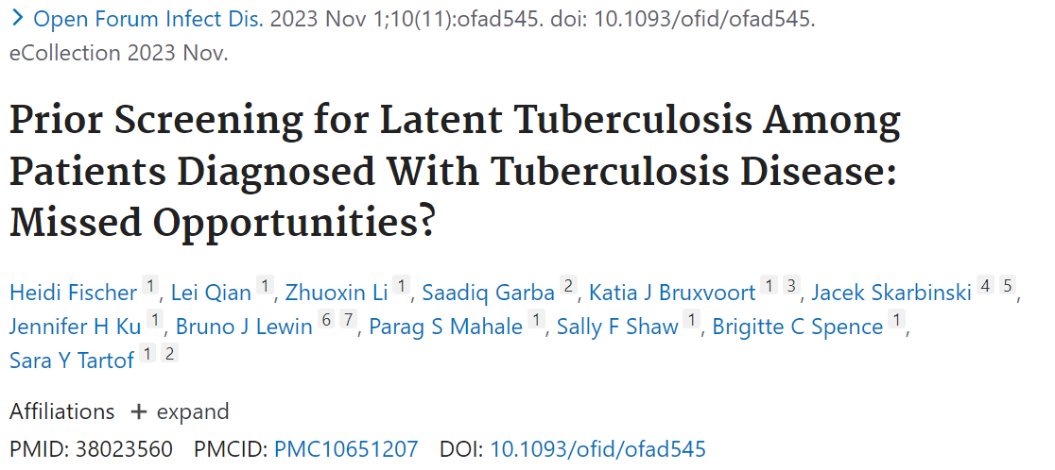
Screening for Latent TB in Those Later Diagnosed with Active TB
Results: A total of 1289 patients with observed TB disease were identified; 148 patients were LTBI positive and 84 were LTBI negative. Patients not prescreened for LTBI made up 82.0% of observed TB disease cases (1057/1289). Adding the hypothetical maximum estimate for prevented cases decreased the percentage of patients who were not prescreened for LTBI to 61.7% [1057/(1289 + 424)].

Slide 9
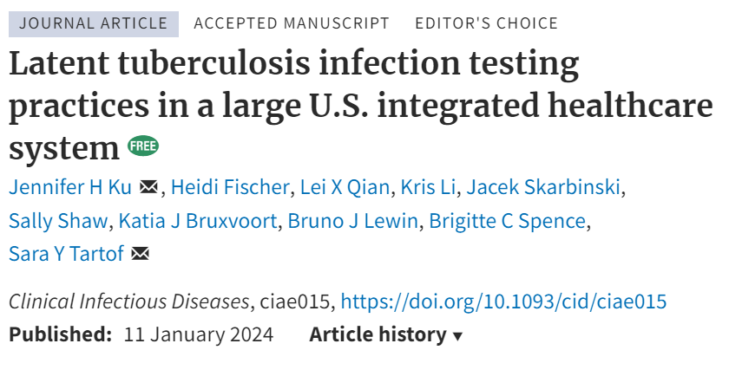
Testing Practices for Latent TB
Results: Among 1,211,971 individuals who met ≥1 screening criteria for LTBI, 210,025 (17%) were tested for LTBI. Factors associated with higher adjusted odds of testing positive included male sex (1.32; 95% confidence interval, 1.30–1.35), Asian/Pacific Islander (2.78, 2.68–2.88), current smoking (1.24, 1.20–1.28), diabetes (1.13, 1.09–1.16), hepatitis B (1.45, 1.34–1.57), hepatitis C (1.54, 1.44–1.66), and birth in a country with an elevated TB rate (3.40, 3.31–3.49). Despite being risk factors for testing positive for LTBI, none of these factors were associated with higher odds of LTBI testing.

Slide 10
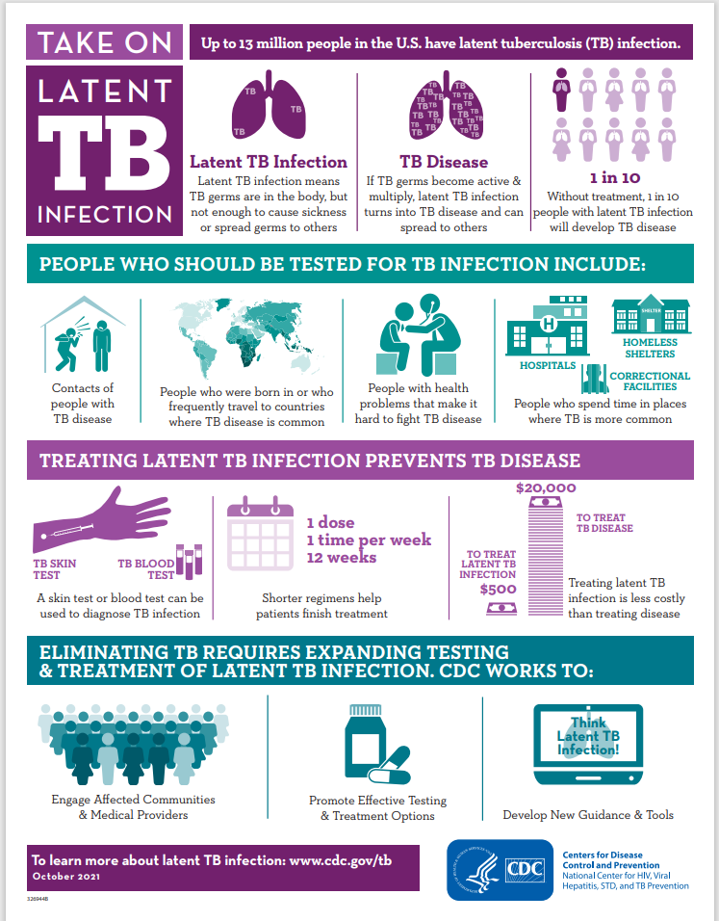
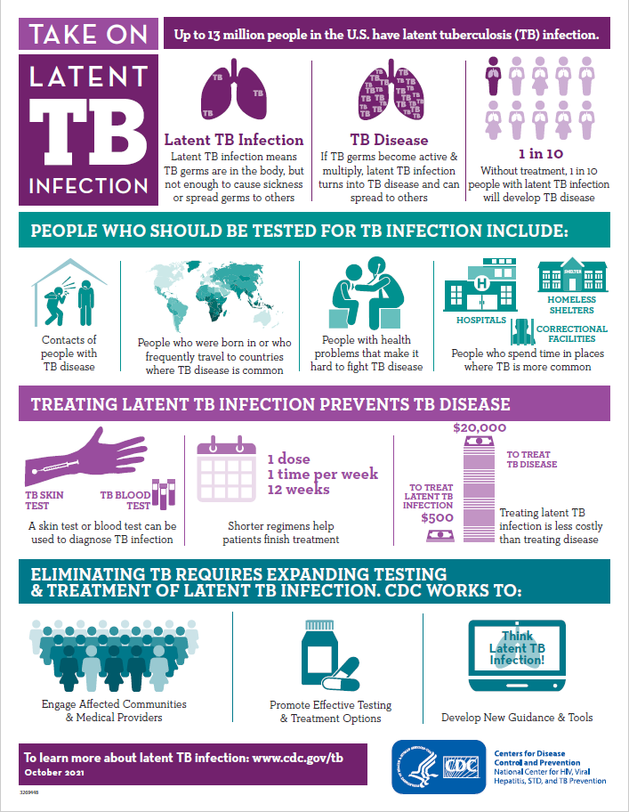

Slide 11
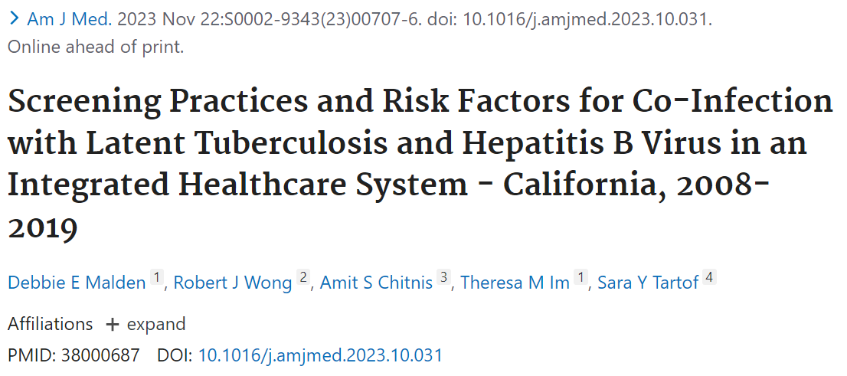
Latent TB and Hepatitis B Co-Infection
Results: Among 1997 HBV patients screened for latent tuberculosis, 23.1% were co-infected, and among 35,820 patients with latent tuberculosis screened for HBV, 1.3% were co-infected. Among HBV patients, co-infection risk was highest among Asians compared with White race/ethnicity (29.4% vs 5.7%, aOR 4.78; 95% confidence interval [CI], 2.75-8.31), and persons born in a high-incidence country compared with low-incidence countries (31.0% vs 6.6%; aOR 4.19; 95% CI, 2.61-6.73). For patients with latent tuberculosis, risk of co-infection was higher among Asian (aOR 9.99; 95% CI, 5.79-17.20), or Black race/ethnicity (aOR 3.33; 95% CI, 1.78-6.23) compared with White race/ethnicity. Persons born in high-incidence countries had elevated risk of co-infection compared with persons born in low-incidence countries (aOR 2.23; 95% CI, 1.42-3.50). However, Asians or persons born in high-incidence countries were screened at similar rates to other ethnicities or persons born in low-incidence countries.

Slide 12
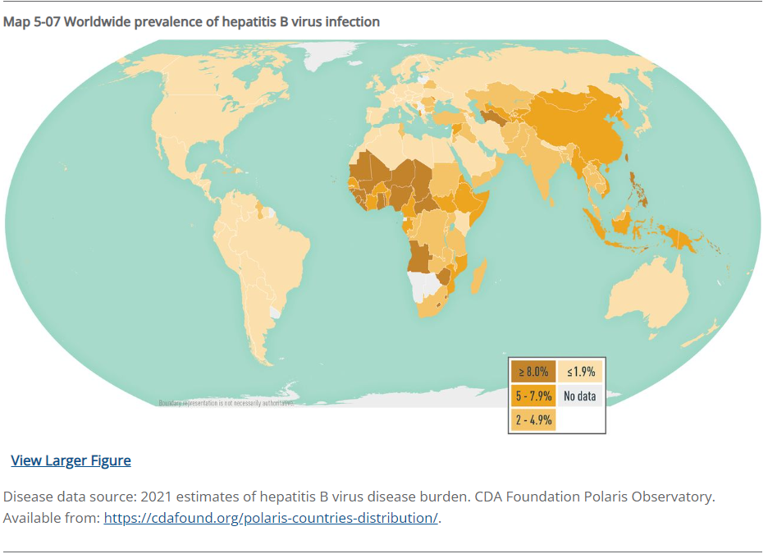
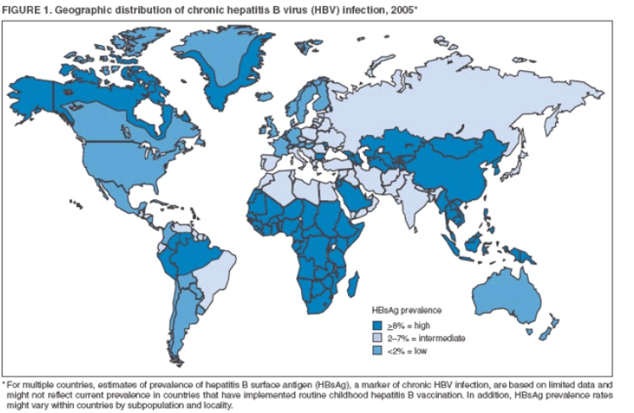
Change in Hepatitis B Worldwide Prevalence

Slide 13
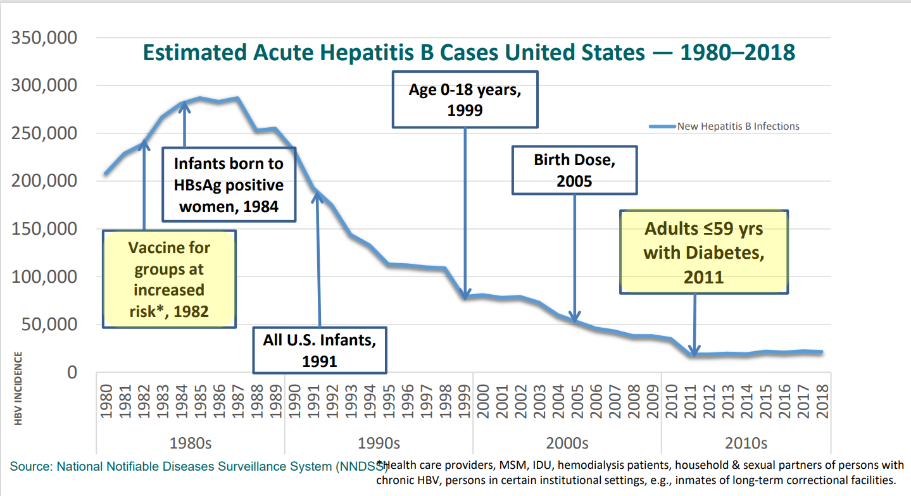

Slide 14
Global, regional, and national burden of hepatitis B, 1990–2019
Findings
There was a 31·3% (29·0 to 33·9) decline in all-age prevalence between 1990 and 2019, with a more marked decline of 76·8% (76·2 to 77·5) in prevalence in children younger than 5 years.
The number of HBV-related deaths increased between 1990 and 2019 (by 5·9% [–5·6 to 19·2]).
HBV-related diseases resulted in 555 000 global deaths (487 000 to 630 000) in 2019.
Interpretation
The prevalence of chronic HBV infection declined over time, particularly in children younger than 5 years, since the introduction of hepatitis B vaccination.
But HBV-related death counts increased as a result of population growth, ageing, and cohort effects.
There are marked disparities in burden and progress across the world.
HBV interventions, such as vaccination, testing, and treatment, must be strategically supported and scaled up to achieve elimination.
Global, regional, and national burden of hepatitis B, 1990–2019:
a systematic analysis for the Global Burden of Disease Study 2019.
GBD 2019 Hepatitis B Collaborators Open Access Published: June 20, 2022.

Slide 15
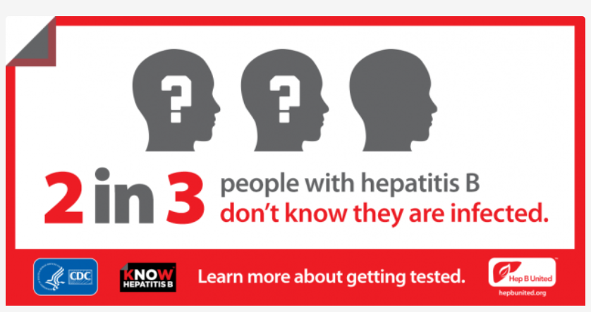
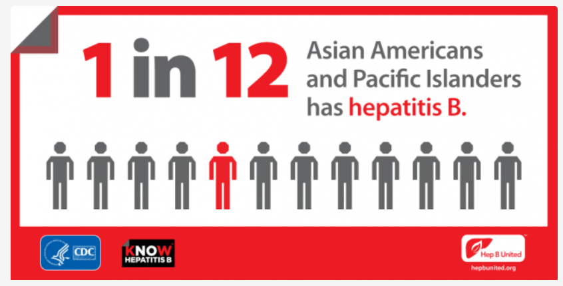
Chronic Hepatitis B

Slide 16
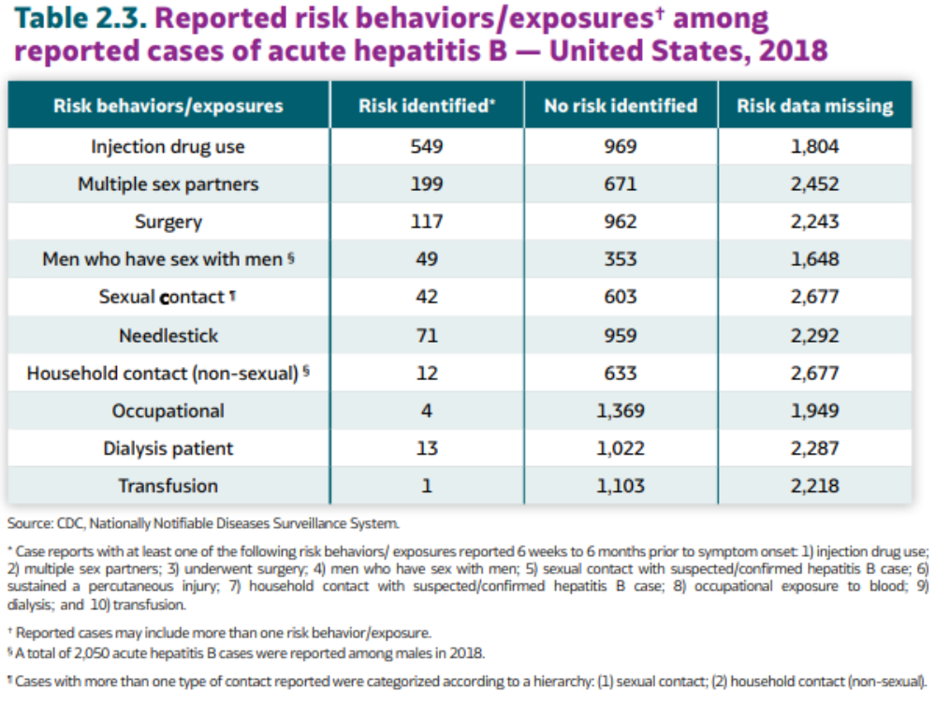

Slide 17
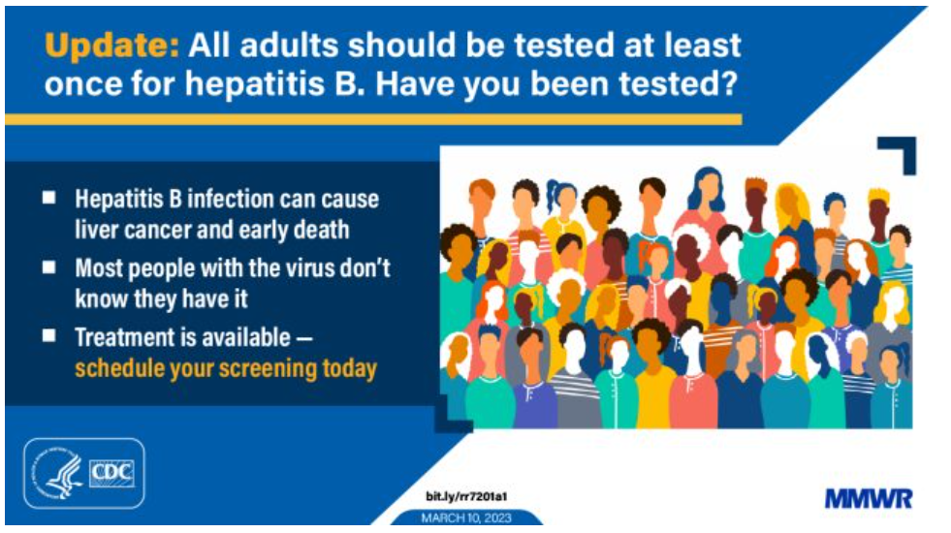
New Universal Hepatitis B Screening Recommendation

Slide 18
Universal Hepatitis B Screening Rationale
Universal screening: Universal screening of adults is cost-effective compared with risk-based screening and averts liver disease and death
Triple panel screening: Using the triple panel (HBsAg, anti-HBs, and total anti-HBc) is recommended for initial screening because it can help identify persons who have an active HBV infection, have resolved infection and might be susceptible to reactivation, or are vaccinated
Adults aged ≥18 years: An “all adults” recommendation was considered more feasible to implement (e.g., for integrating into electronic medical record alerts) than one among specific age groups.
Children and adolescents aged <18 years: Children and adolescents aged <18 years were not included in the universal screening recommendation because of the low prevalence of HBV infection in this age group and high levels of HepB vaccination.
New risk groups: The addition of three new risk groups was based on the HBV infection prevalence cutoff of ≥1%. (persons incarcerated or formerly incarcerated; persons with a history of sexually transmitted infections or multiple sex partners; and persons with a history of hepatitis C virus infection)

Slide 19
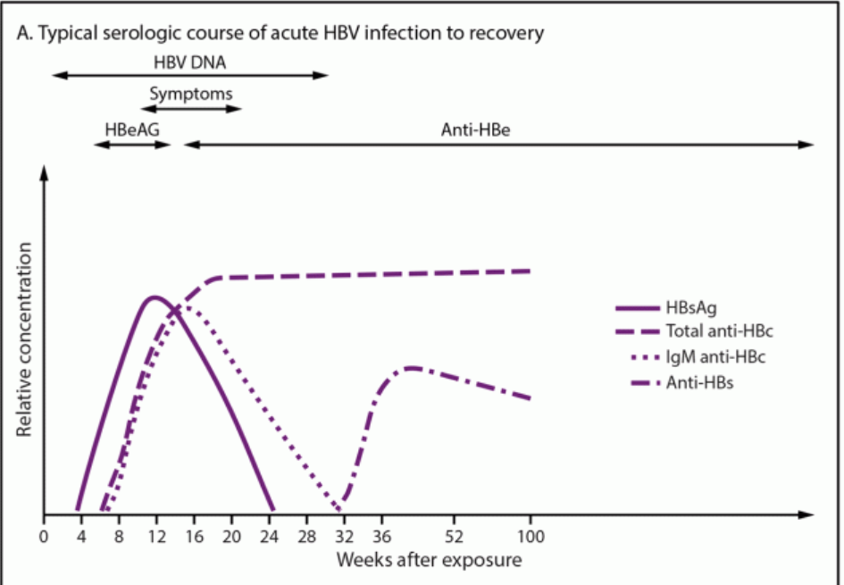
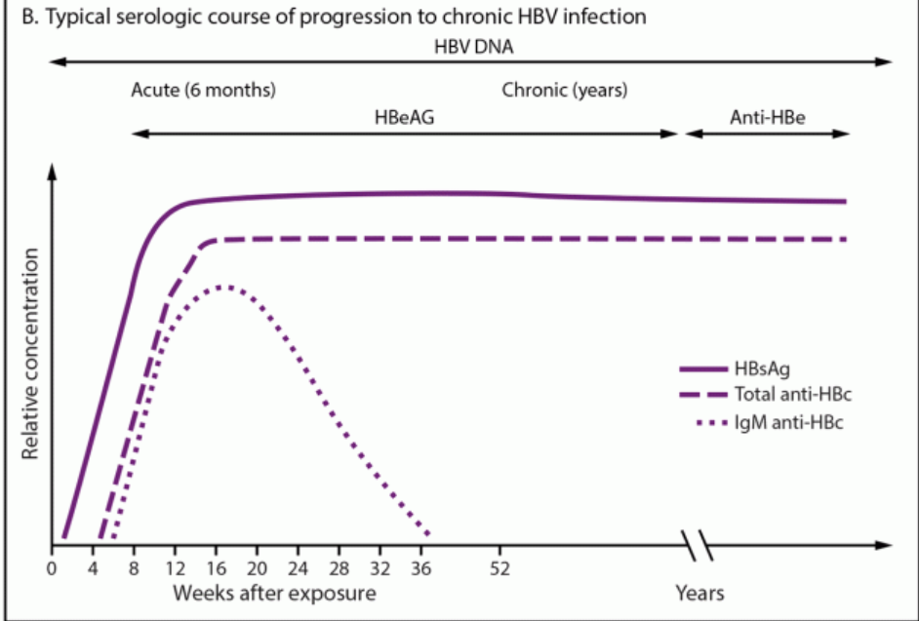
Typical serologic courses of acute and chronic hepatitis B virus infection

Slide 20
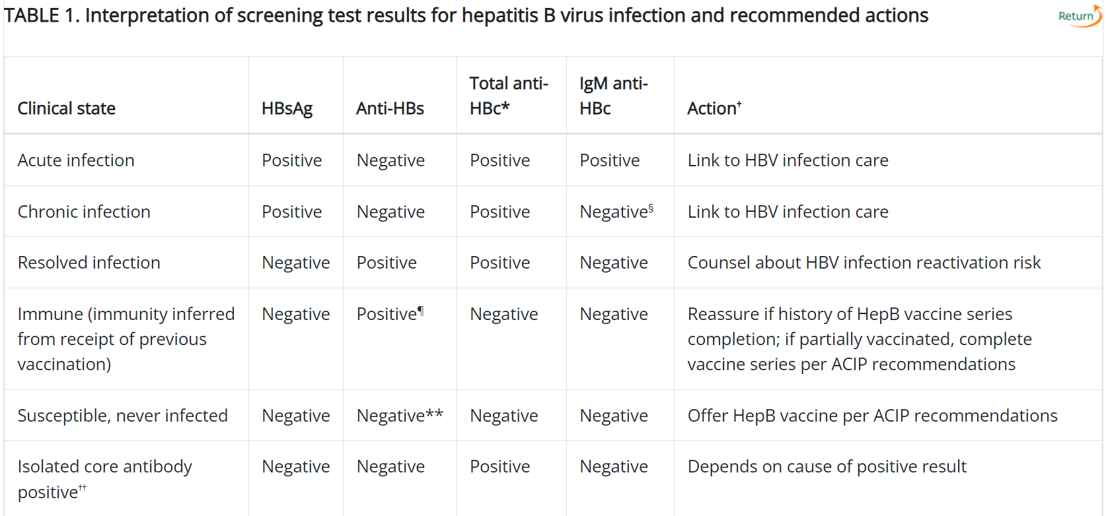

Slide 21
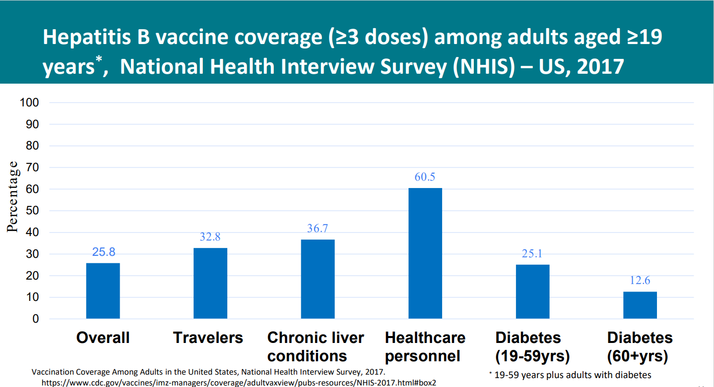

Slide 22
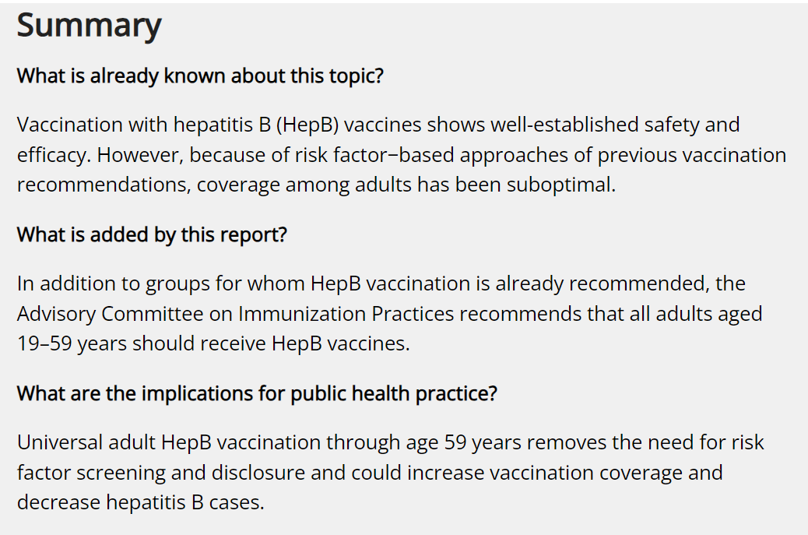
Universal Hepatitis B Vaccination in Adults Aged 19–59 Years: Updated Recommendations of the Advisory Committee on Immunization Practices — United States, 2022
Weekly / April 1, 2022 / 71(13);477–483

Slide 23
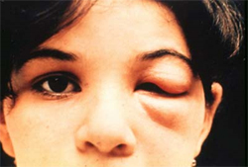
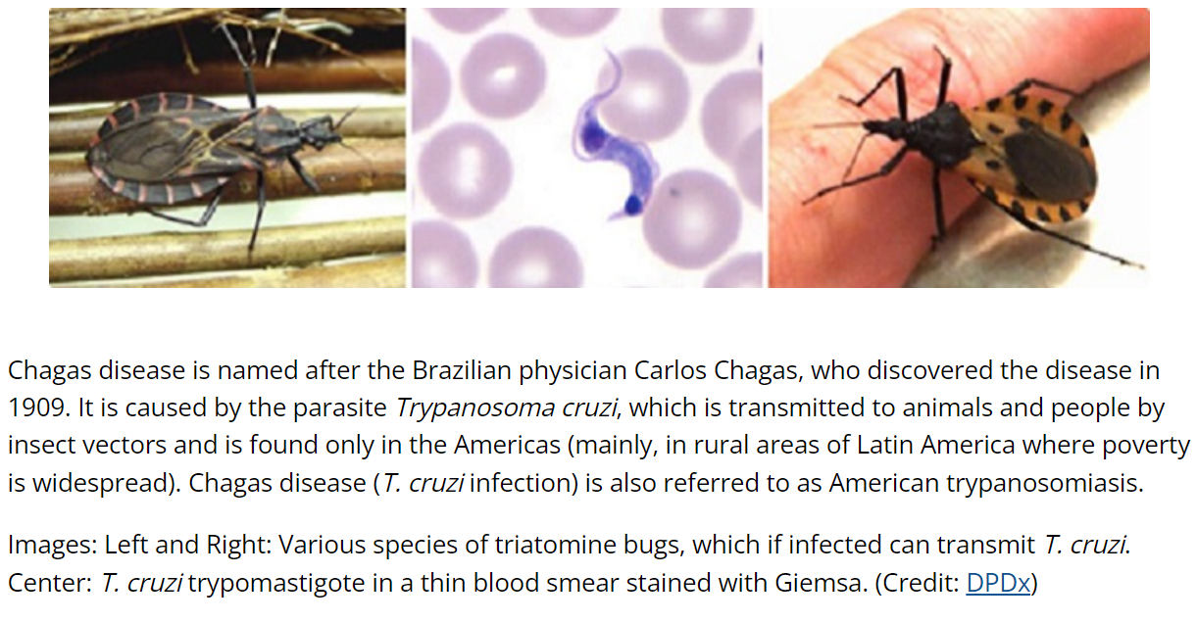
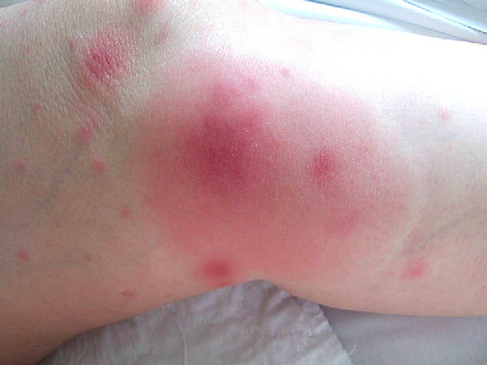
CHAGAS DISEASE – NOT SO EXOTIC
Slides courtesy of David Hamer, MD, Department of Global Health, Boston University as well as CDC (www.cdc.gov/parasites/chagas/)

Slide 24
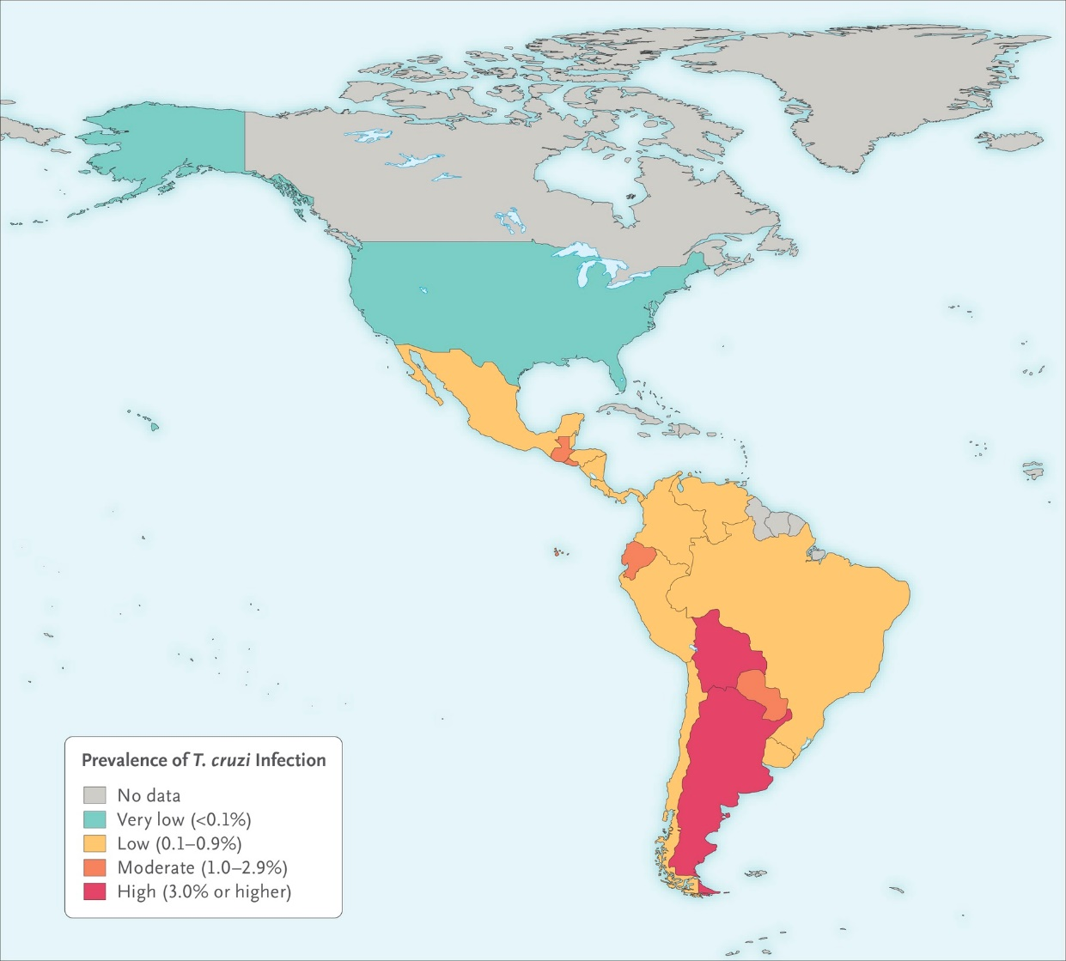
Where is Chagas disease endemic?
6-7 million people infected worldwide
21 endemic countries:
  13% of population is at risk
US is not considered an endemic country
  326,000–347,000 cases in the U.S (estimated)
Bern, NEJM 2015
Notes:
Maja -
The estimated national infection is highest in Bolivia (6.1%), followed by Argentina (3.6%) and Paraguay (2.1%), whereas the largest number of individuals living with Chagas disease, 42% of all cases, reside in Brazil (nearly 1.2 million people) and Argentina (1.5 million people).

Slide 25
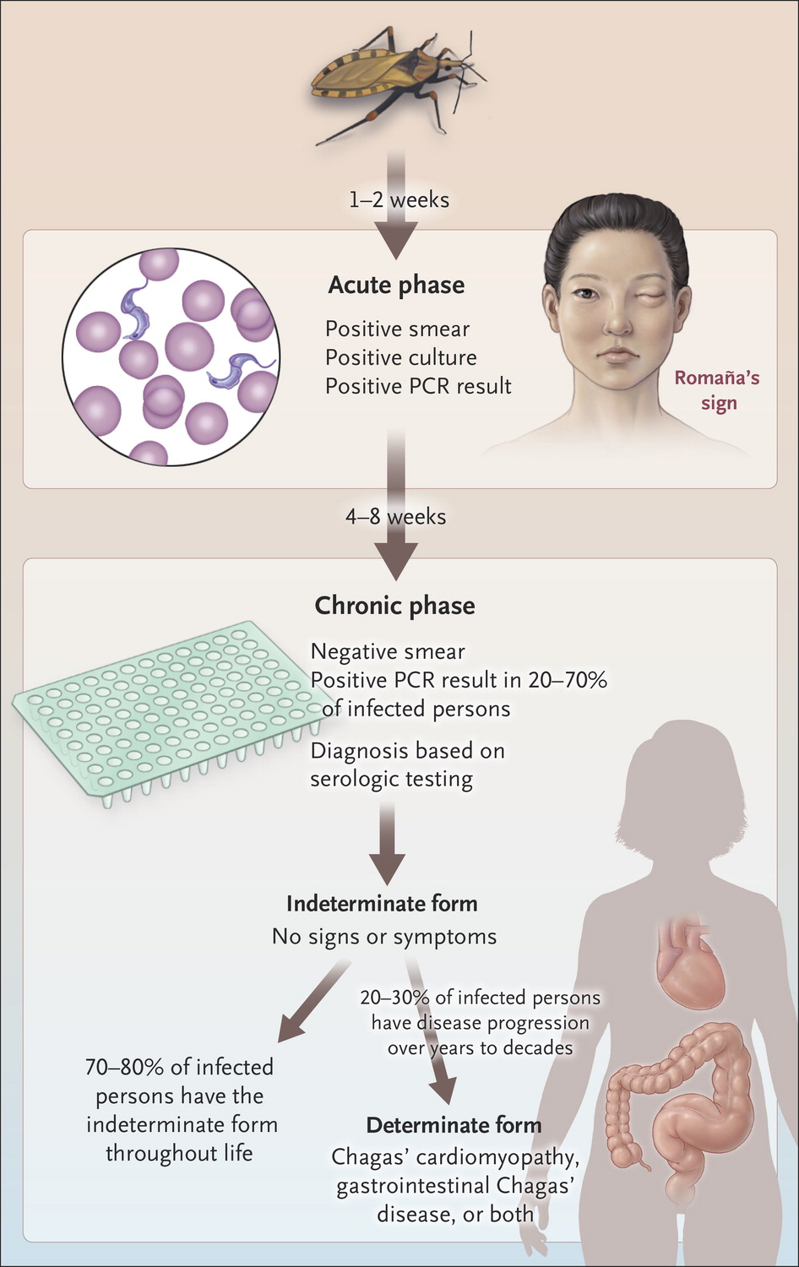
Exposure
Acute phase
Chronic phase
Bern C, NEJM 2015.
Notes:
Dan

Slide 26
Congenital Chagas Disease
Approximately 40,000 women of reproductive age with Chagas disease in US
Estimated 63–315 cases of congenital Chagas disease occur annually
Women at risk should be screened before or during pregnancy (Mexico, C. America, S. America)
10-40% of infants symptomatic at birth
  May present with prematurity, hepatosplenomegaly, jaundice, anemia and thrombocytopenia
  Less commonly hydrops fetalis, pneumonitis and meningoencephalitis
20-30% may develop later cardiac complications
    References: Bern CID 2009; Montgomery AJTMH 2014; Oliveira Exp Rev Anti Infect Ther 2010

Slide 27
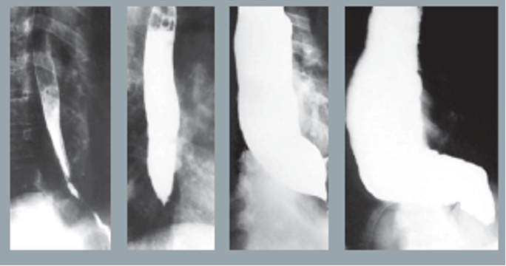
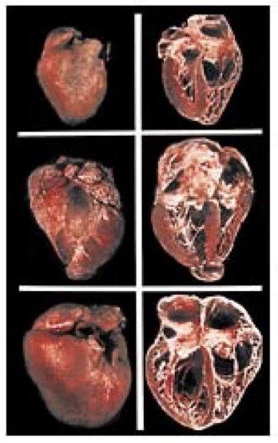

Adult Manifestations

Slide 28
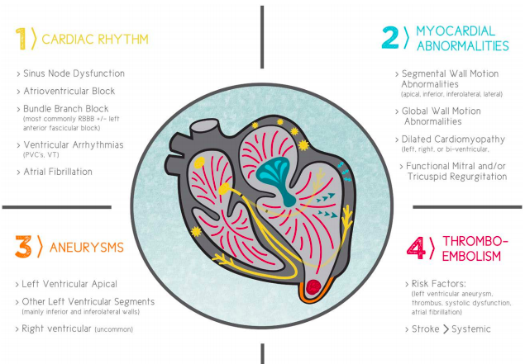
Myocardial
Abnormalities
Cardiac
Rhythms
Aneurysms
Thrombo-
embolism
Carmo, Circulation 2018
Notes:
Chagas cardiomyopathy is the most important clinical manifestation of Chagas disease, resulting in the majority of Chagas morbidity and mortality.
Occurs over several decades with indeterminate form. Fibrosis of the posterior and apical regions of the LV, Involvement of the SA node, AV node, and bundle of His
Arrhythmias overall cause of death (55%–60%), followed by heart failure (25%– 30%) and embolic events (10%–15%), but the proportions vary depending on the population studied

Slide 29
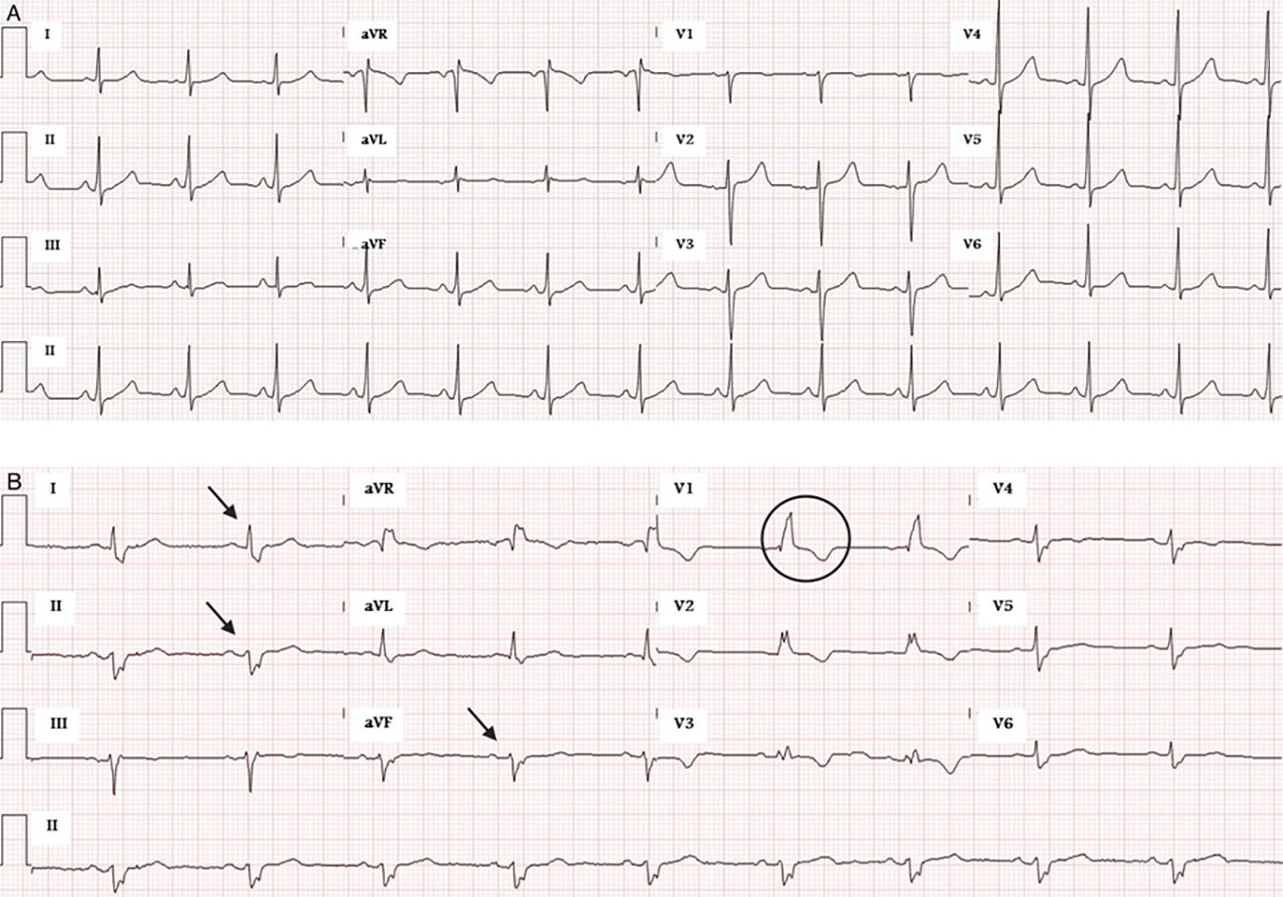
Arrhythmias
Bradyarrhythmias
Tachyarrhythmias
Conduction delays
  RBBB most common
  LAFB, PVCs
Carmo et al, Circulation 2018
Notes:
-Mediated by fibrosis to the posterior and apical regions of the LV and involvement of the sinus node and electric conduction system.
-Patients can present with first-, second-, or third-degree atrioventricular block. In a population-based study in an endemic area, patients self-reporting -Chagas disease were 4 times more likely to present with second- or third-degree atrioventricular block and 13 times more likely to have an implanted pacemaker compared to the general population
-Bradyarrhythmia may be how pt with sick sinus syndrome may present
-RBBB usually first ECG marker- (10-50%)
-LBBB much more rare but a marker of worse prognosis (indicative of LV size and function)
-Atrial fibrillation is the most common supraventricular arrhythmia, found in up to 5% of electrocardiographic tracings of patients with chronic Chagas disease (typically seen in dilated cardiomyopathy and predictor of mortality
-ventricular tachyarrhythmias that are associated with substantial morbidity and mortality and are the leading cause of sudden death in these patients
-Caused by necrotic and fibrotic myocardial lesions -> reentrant circuits for ventricular arrhythmias and also thought that coexistence of denervated and hypersensitive partly denervated or hyperinnervated ventricular myocardium results in electrophysiological heterogeneity that predisposes to malignant ventricular arrhythmia

Slide 30
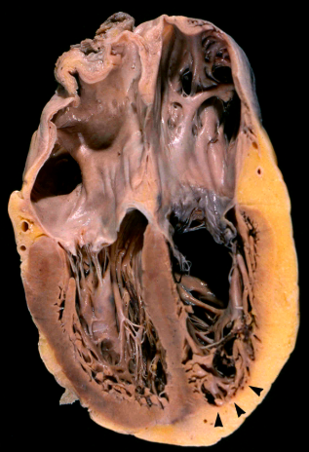
Chronic Chagas Cardiomyopathy
#1 cause non-ischemic cardiomyopathy in Latin America
25-35% deaths in patients with Chagas heart disease
Rassi et al, Infect Dis Clin North Am 2012; Carmo et al, Circulation 2018
Notes:
-Regional WMA precede global LV dysfunction -> Progressive dilated cardiomyopathy (Segmental wall motion abnormalities, most commonly in the apical and inferolateral walls, are common in patients with Chagas heart disease and typically precede global changes in systolic function -- refer to imaging)
-Systolic and diastolic dysfunction coexist. Cardinal symptoms related to pulmonary congestion.
typical physical examination reveals a prominent apical impulse, regurgitation murmurs from mitral and tricuspid valves, and wide splitting of the second heart sound caused by RBBB. An accentuated pulmonic component of the second heart sound caused by pulmonary hypertension can also be detected

Slide 31
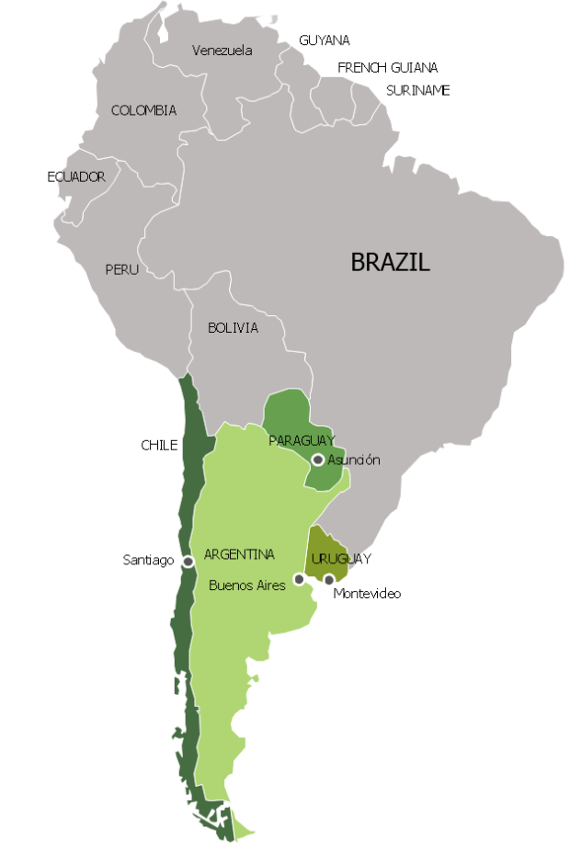
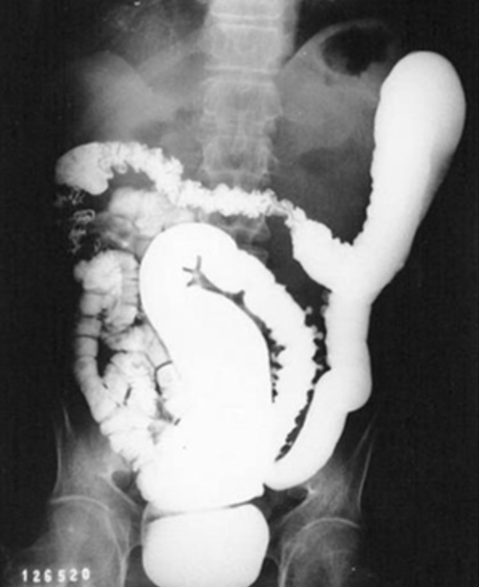
Chagas GI Disease
More common in Southern Cone of South America
Any part of the GI tract may be affected
  Esophagus and colon most common
20% may be asymptomatic
Esophageal disease often manifests as dysphagia
Colon involvement most commonly presents as progressive constipation

Slide 32
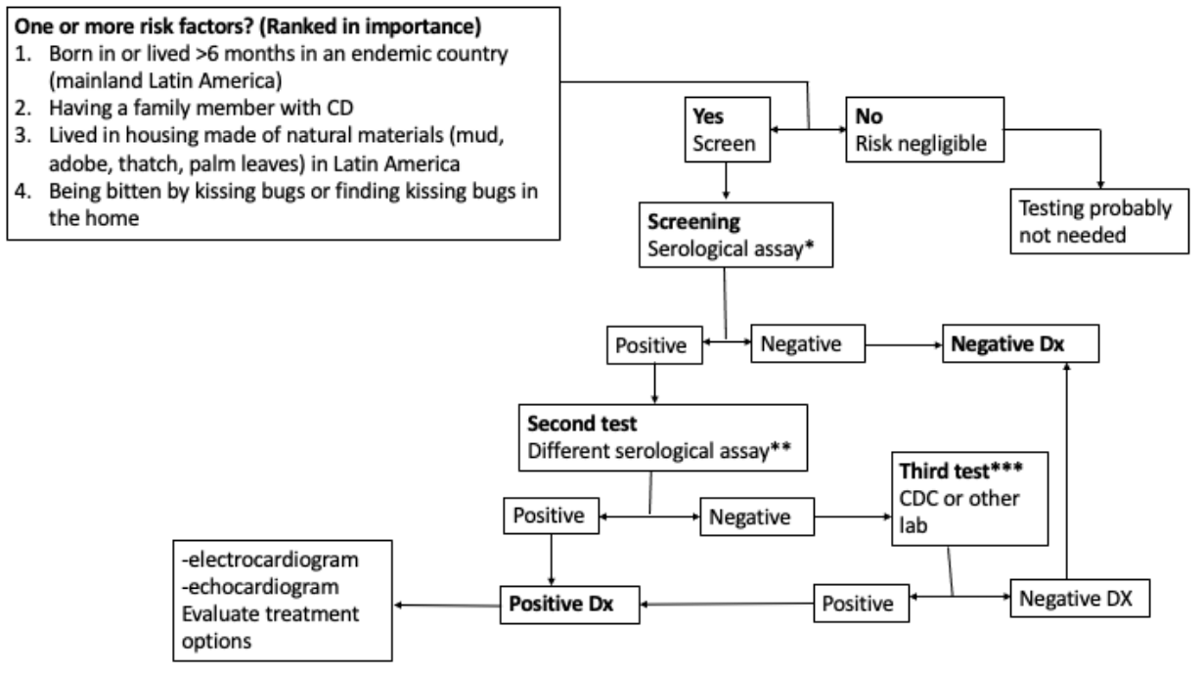
Diagnosing T. cruzi infection
Serologic testing single positive result does NOT confirm the diagnosis
Need at least two tests (different techniques/ antigens - whole-parasite lysate and recombinant)
Forsyth CJ et al. JID 2021
Notes:
The sensitivity of PCR in the chronic phase of Chagas’ disease is highly variable and depends on specimen volume and processing, population characteristics, and PCR primers and methods.
Diagnosis of chronic Chagas infection requires serologic methods to detect immunoglobulin (Ig)G antibodies to T. cruzi, most commonly enzyme-linked immunosorbent assay (ELISA) and immunofluorescent antibody assay (IFA). No available assay has sufficient sensitivity and specificity to be used alone; a positive result by a single assay does not constitute a confirmed diagnosis. Two serologic tests based on different antigens (eg, whole-parasite lysate and recombinant antigens) and/or techniques (eg, ELISA and IFA) are used in parallel to increase the accuracy of the diagnosis. Prefer different formats (not 2 ELISAs)
Data suggest that the sensitivity of serologic assays varies by geographic location, possibly due to T. cruzi strain differences and resulting antibody responses
radioimmune precipitation assay and IgG trypomastigote excreted-secreted antigen immunoblot are promoted as reference tests, but even these do not have optimal sensitivity and specificity and may not be capable of resolving the diagnosis
InBios - multiepitope fusion protein

Slide 33
Chagas Treatment
Benznidazole (first line option) or nifurtimox
Indicated in all acute and congenital infections
Cure in >90% of congenitally infected infants during the first year of life
Prevents progression to cardiac and GI complications
Treatment better tolerated in children
Notes:
Benznidazole and nifurtimox are the only drugs with proven efficacy against Chagas disease
August 30, 2017, the FDA approved benznidazole to treat Chagas disease in children between the ages of 2 to 12 years old.
Both medicines are almost 100% effective in curing the disease if given soon after infection at the onset of the acute phase including the cases of congenital transmission. The efficacy of both diminishes, however, the longer a person has been infected (WHO)
Treatment is recommended for all cases of congenital Chagas disease. The cure rate is >90% when treatment is given in the first year of infection. Nifurtimox and benznidazole are both effective for treatment of congenital Chagas disease (CDC)

Slide 34
TREATMENT CONSIDERATIONS
Antitrypanosomal treatment is recommended for all cases of acute and congenital Chagas disease, reactivated infection, and chronic T cruzi infection in individuals 18 years or younger.
In adults aged 19 to 50 years without advanced heart disease, etiologic treatment may slow development and progression of cardiomyopathy and should generally be offered; treatment is considered optional for those older than 50 years.
Individualized treatment decisions for adults should balance the potential benefit, prolonged course, and frequent adverse effects of the drugs.
Strong consideration should be given to treatment of previously untreated patients with human immunodeficiency virus infection or those expecting to undergo organ transplantation.
Reference: Bern C, Montgomery SP, Herwaldt BL, et al. Evaluation and Treatment of Chagas Disease in the United States: A Systematic Review. JAMA. 2007;298(18):2171–2181. doi:10.1001/jama.298.18.2171

Slide 35

You Are What You Eat
What is worse than finding a worm in your salad?
Finding half a worm
A Destructive Worm by F. Graetz
This image is available from the United States
Library of Congress's Prints and Photographs division

Slide 36
Case: 49 year old construction worker from Mexico
Clinical history: 4 weeks of headache, blurry vision
One month of intermittent episodes of throbbing bilateral frontal headache , followed by a darkened vision, dizziness, and a feeling of being about to pass out. Episodes happen around 3-4 times a week and each episode lasts a few seconds.
On day of admission, pt was outside with his wife when she noticed that his R eye was smaller than the left, and his mouth was crooked, prompting her to bring him into the ED.
Pt reports a similar episode around 10 years ago of headache, blurred vision and was diagnosed with migraine
Physical Exam: Significant for hyporeflexia
Lab Tests: CBC, lytes normal
Imaging: CT head with diffuse hydrocephalus
Lumbar puncture: opening pressure 33 cm H2O, 70 wbc (86% L), glucose 102, protein 75

Slide 37
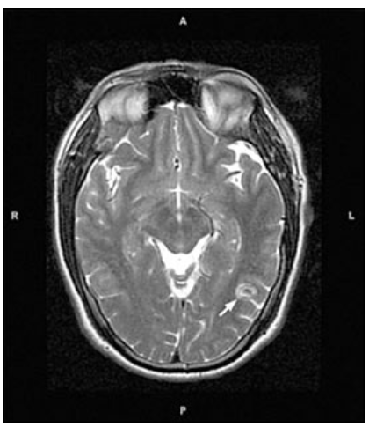
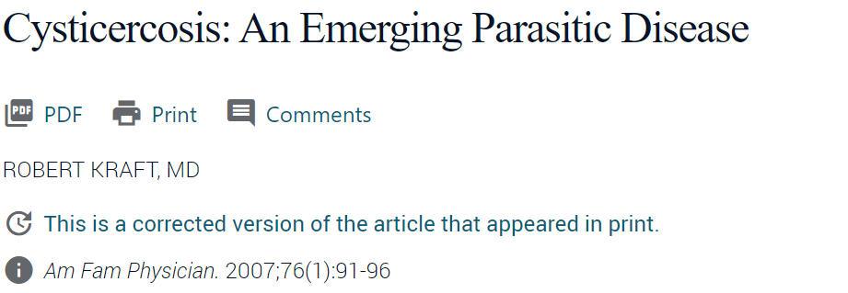
CYSTICERCOSIS

Slide 38
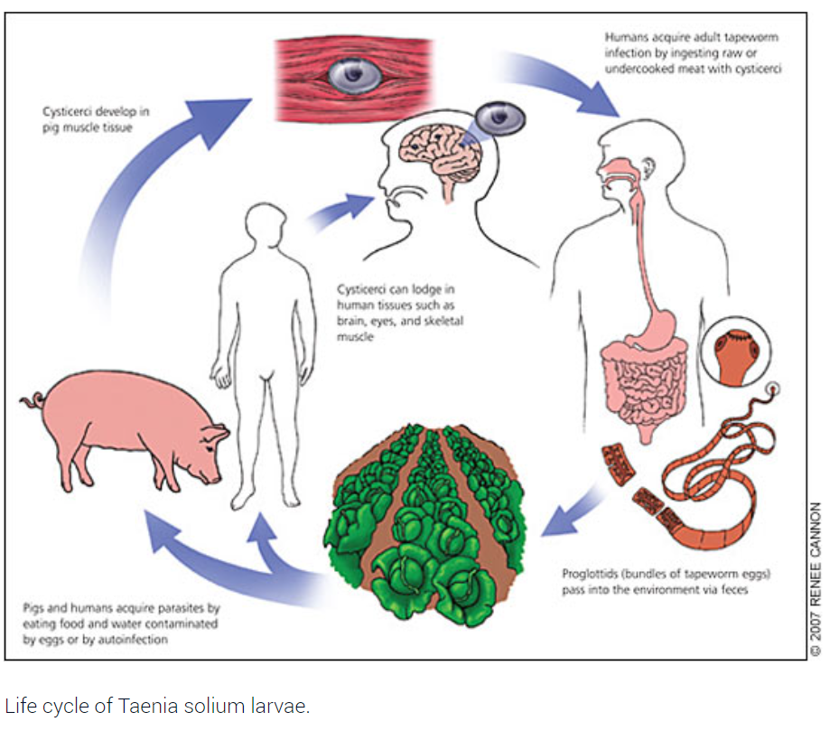

Slide 39
Cisticercosis
The larval stage of the pork tapeworm, Taenia solium, causes the clinical syndrome of cysticercosis, with humans as dead-end hosts after ingestion of T. solium eggs.
The most common parasitic disease worldwide, with an estimated prevalence greater than 50 million persons infected
Neurocysticercosis is the most prevalent infection of the brain worldwide
Endemic in Mexico, Central and South America, and parts of Africa, Asia, and India

Slide 40
Evaluation and Treatment
Symptoms can include seizures, headaches, focal neurologic symptoms, visual disturbances, and localized skeletal muscle nodules and pain
All patients with cysticercosis should have an ophthalmologic examination to rule out ocular involvement
Calcified or heavy-infection (50 or more cysts) neurocysticercosis does not warrant antihelminthic therapy
Non-enhancing and enhancing cystic parenchymal neurocysticercosis should be treated with seven to 14 days of albendazole
For neurocysticercosis with seizures, steroids should be used concomitantly with antihelminthic therapy.

Slide 41
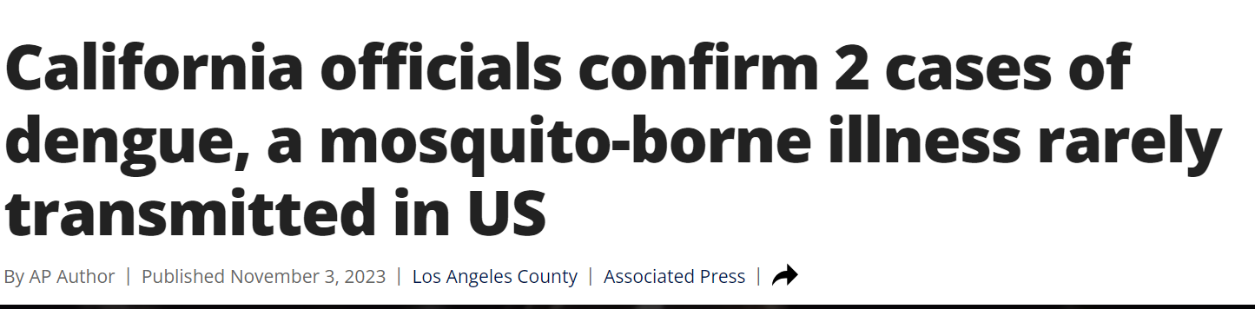

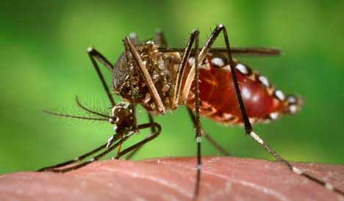

Slide 42
Summary
Ask a geographic history as part of your social history
Place of birth / residence and exposures
Latent TB
Screen persons born or residing in endemic countries & Treat
Hepatitis B
Screen for chronic hepatitis B & immunity, Vaccinate if non-immune
Chagas Disease
Screen women at risk before or during pregnancy & symptomatic newborns Treat persons under 18 years old, selected persons 19 to 50 years old, and persons with HIV or anticipating transplant

Slide 43
THANK YOU

