Slide 1
Family Medicine Research Unit
Monthly Meeting
October 2023

Slide 2
WebClock
Effective November 12, non-exempt (bi-weekly) employees will utilize WebClock Timekeeping System
Timesheets will now autofill from WebClock
You must clock in at the start and clock out at the end of your shift
Overtime must be approved in advance
Supervisors must approve timesheets
Instructions went out via email last week
Invited Speakers: Monica Bolanos and Sandra Fernandez will answer questions

Slide 3
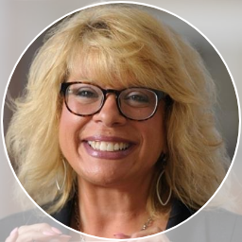
New Personnel: Chris Ashikyan
Pre- and Post-Award Senior Analyst
All future proposal/pre-award requests
Post-award fund management for Drs. Moreno, Tarn, Bholat, Sur, and other clinical faculty
Comes to us with 11 years of experience at University of Illinois, Urbana-Champaign, including 8 years of Post-Award management and 3 years of Pre-Award
“I’m amazed at the research that develops from proposal stage to close-out and have always been excited to see the dreams of our Principal Investigators and their teams come to life.”
What is a personal accomplishment you’d like to share?
One thing that I’m proud of is that 2 years ago I was the first person in my family to ever get my Master’s Degree in Business Administration.

Slide 4
Volunteers
Volunteers must apply through and approved by the UCLA Health Sciences Volunteer Office (UHSVO) before starting volunteer activities
https://www.uclahealth.org/volunteer/programs/uhs-volunteer-programs
Determine if clinical or non-clinical. Non-clinical volunteers cannot have:
Patient or human research subject contact/interaction
Access to/handling of any identifiable/clinical/medical information
Any duties involving activity within clinical settings and areas
Complete an Opportunity form about the position, so that UHSVO can create a link for volunteers to apply with
Volunteers will then work with UHSVO to complete requirements

Slide 5
Hiring Work-Study Students
To post a work-study position, the supervisor should send the following to Staff HR:
Job description
Qualifications
Working Hours
Work Location
HR will post the position and you will
receive resumes for review
Supervisor will select candidate and
inform HR for onboarding

Slide 6
Winter Closure
Sat Dec. 23 – Tues Jan. 2
Includes 4 paid holidays (Dec 25-26, and Jan1-2)
Wed-Fri, Dec 27-29 should be reported as vacation (or leave without pay)
Must have supervisor permission to work during closure

Slide 7
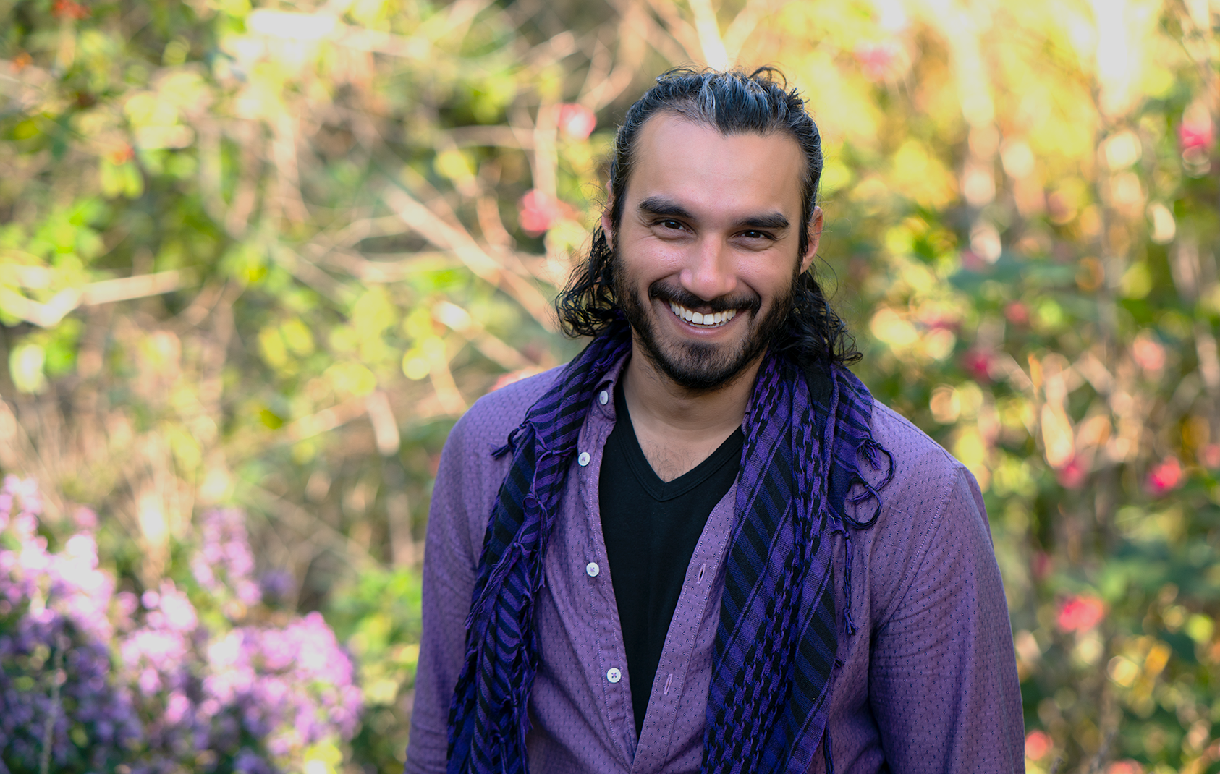
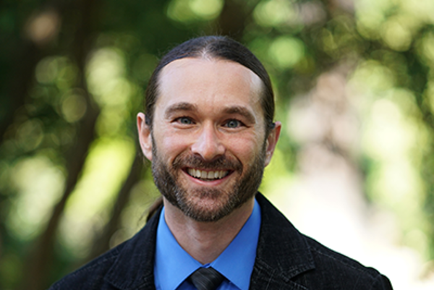
Research Technology and Data Management Support
Ibraheem Ali, PhD
iali@mednet.ucla.edu
UCLA Health IT, DGIT Research Informatics
Oct 2023, Family Medicine Research Unit Meeting
Clifford Kravit
ckravit@mednet.ucla.edu

Slide 8
Overview
Data Management Strategy and Planning
Safe Data Sharing
Identifying Storage and Compute Resources
Consultations and Referrals

Slide 9
Data Management Strategy and Planning
NIH 2023 Data Management & Sharing Requirements
File Management & Naming Conventions
Identifying Data Security Requirements
Budgeting for Data Management & Curation

Slide 10
Identifying Storage and Compute Resources
Depends on data type & collaboration requirements
Use Health Box for storing files, syncing to cloud and collaborating (HIPAA compliant)
Leverage cloud storage or compute using Amazon Web Services (HIPAA compliant)
Network drives available up to 2 Terabytes of storage per lab
Hoffman2 Compute Cluster Storage

Slide 11
Safe Data Sharing and Management
Identify storage options for protected health data
Identify deidentification options, and repositories for sharing protected data
Consultation will likely be required to collect information on specific use cases

Slide 12
Consultations and Referrals
Consult with your Business Relationship Manager (BRM) for more information on services (Jose Gil)
Connect with us (Clifford and Ibraheem)

Slide 13
Recently Processed Awards (since August)
PI | Award Title | Sponsor | Prime Sponsor | Action Type | Project Period Begin Date | Project Period End Date
Gelberg, Lillian | Subthreshold Opioid Use Disorder Prevention (STOP) Trial | NEW YORK UNIVERSITY | NIH-NIDA | Continuation | 02/15/2019 | 02/29/2024
Shoptaw, Steven | Screen, Treat and Retain Meth-Using Opioid Drug Users at Methadone Clinics (STAR-OM) | Hanoi Medical University (Vietnam) | NIH-NIDA | Continuation | 06/01/2020 | 03/31/2025
Donohoe, Thomas J | Ending the HIV Epidemic: A Plan for America – Technical Assistance Provider | Cicatelli Associates | DHHS-HRSA | Continuation | 03/01/2020 | 02/28/2025
Tarn, Derjung | Medicare Annual Wellness Visit Practice Redesign Toolkit: A Tailored Intervention to Improve Preventive Health Service Use | NIH-NIA National Institute on Aging | - | Continuation | 08/15/2020 | 07/31/2025
Sur, Denise Kc | SBPCR-1000497: UCLA Family Medicine Residency Program (Song-Brown 2020) | CA-Dept of Health Care Access and Information | - | Continuation | 06/30/2021 | 06/29/2024
Shoptaw, Steven J | UCLA Alcohol Medication Research Unit - Base Contract | NIH-NIAAA | - | Modification/ Amendment | 03/25/2021 | 03/14/2028
Shoptaw, Steven J | HPTN 094 Integra | FHI 360 | NIH-NIAID | Modification/ Amendment | 10/01/2020 | 03/31/2025

Slide 14
Recently Submitted Proposals (since August)
PI | Title | Sponsor | Prime Sponsor | Type
Gelberg, Lillian | Effect of an Adapted Community-Based Biofeedback Program on Heart Rate Variability and Mental Health among People Experiencing Homelessness | UNIVERSITY OF CALIFORNIA, IRVINE | NIH | Resubmission - New
Sur, Denise Kc | CalMedForce Grant (2023-2026) | Physicians for a Healthy California | - | New
Sur, Denise Kc | HCAI Song-Brown Grant Primary Care Residency Program | CA-Department of Health Care Access and Information | - | New
Tarn, Derjung | iCARE, Improving the Quality of Care in Asthma Patients at Risk of Exacerbations | BRIGHAM AND WOMEN'S HOSPITAL | PCORI | New
Li, Michael Jonathan | A whole-person approach to biomarker assessment in substance use and HIV intervention | NIH-NIDA National Institute on Drug Abuse | - | New
Li, Michael Jonathan | Midwest Integration of the National HIV Curriculum (MINHC) Grant (Yr 2) | UNIVERSITY OF ILLINOIS | DHHS-HRSA | Modification/ Amendment
Shoptaw, Steven J | CTN-0110 MURB Non-HEAL YR19 | Univ of Texas-Southwestern Med Center at Dallas | NIH-NIDA | Supplement
Shoptaw, Steven J | CTN-0109: Randomized, placebo-controlled trial of injectable naltrexone and monthly injectable buprenorphine for cocaine use (CURB-2) | Univ of Texas-Southwestern Med Center at Dallas | NIH-NIDA | Supplement

Slide 15
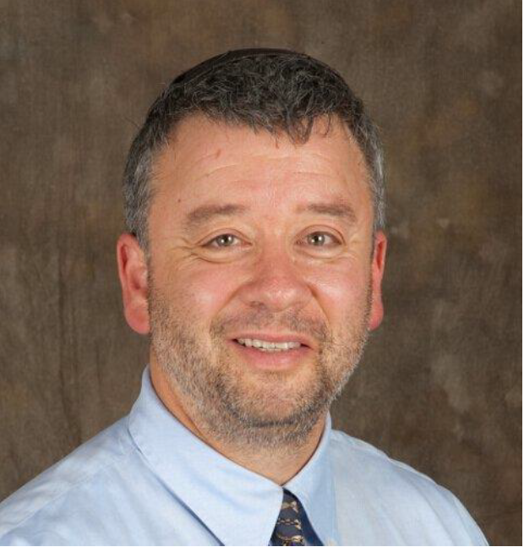
Grand Rounds
October Grand Rounds
Friday, October 27, 2023
12:00pm-1:00pm
Theodore C. Friedman, MD PhD
Chairman, Dept. of Internal Medicine
Charles R Drew Univ.

Slide 16
Transitioning from Desktops to Laptops
Department wants to sunset all desktops and transition to laptops (with docking stations)
Personnel should bring their laptop to the office for in-person work, and home for remote work
Please reach out to Laura if you are still using a desktop computer so that we can add you to the transition list

Slide 17
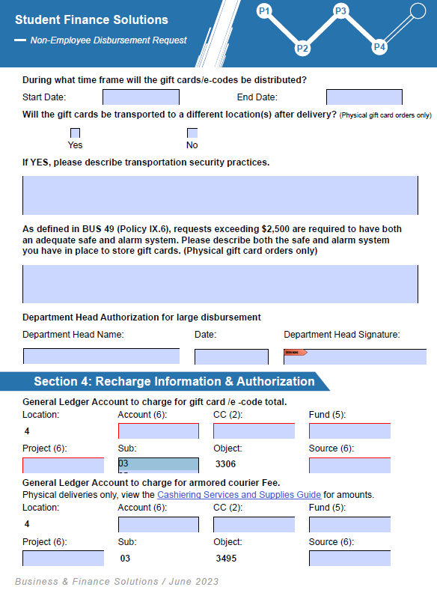
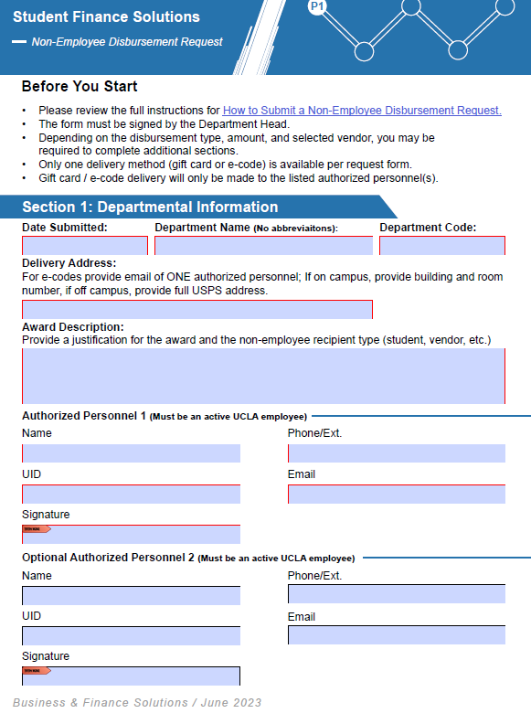
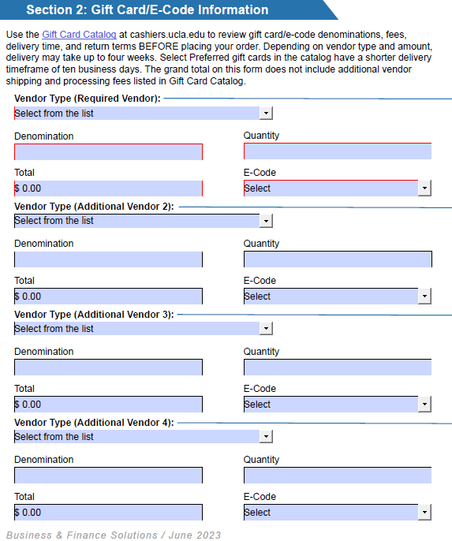
Non Employee Disbursement Requests

Slide 18
Non Employee Disbursement Requests
Please remove the word “compensation” from any future requests. Per G-42 policy, gifts are allowed for volunteering or completing a survey or questionnaire, or participation.
Please pay close attention to “Deliver Address” field, e-codes should list authorized personnel’s email address and physical cards should shows the campus address for delivery
New Process: Please route future non-employee requests to the fund manager via Docusign. This allows all signatures to be captured and submitted to the processing department without any issues.

Slide 19
Preparing for BruinBuy Plus
The Ascend 2.0 Program is launching BruinBuy Plus, UCLA’s new procure-to-pay system, on January 2, 2024
BruinBuy Plus brings modernized, streamlined, and efficient procurement processes that will benefit the current and future Bruin community
BruinBuy Plus will further support Accounts Payable (AP) efforts currently underway to provide faster payments and less payment uncertainty
End-user training kicks off on October 30, 2023

Slide 20
Preparing for BruinBuy Plus
There will be a procurement blackout/shut down from December 23 through January 2
You will not be able to place orders during this time unless they are emergent, and those will require special approval and processing
Please plan ahead! We encourage you to place supply orders, pay invoices, set up subawards, etc. no later than early December
Delay non-urgent requests in December until after roll-out

Slide 21
Preparing for BruinBuy Plus
The invoicing process will change. PO’s will be automatically sent to the vendor and they will be instructed to submit invoices to a centralized email address
Starting December 14, vendors must submit invoices through the new centralized email address. Transcepta and the Invoice Submission Portal will be decommissioned on this date!
Non-procurement transactions (e.g. guest speaker fees) will follow a different process, which will be announced shortly
All active vendors will be notified of these changes in the coming weeks

Slide 22
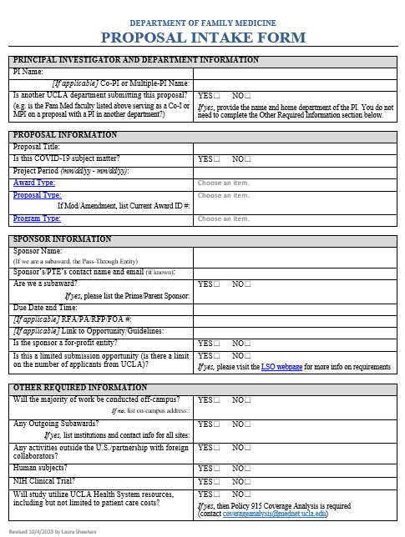
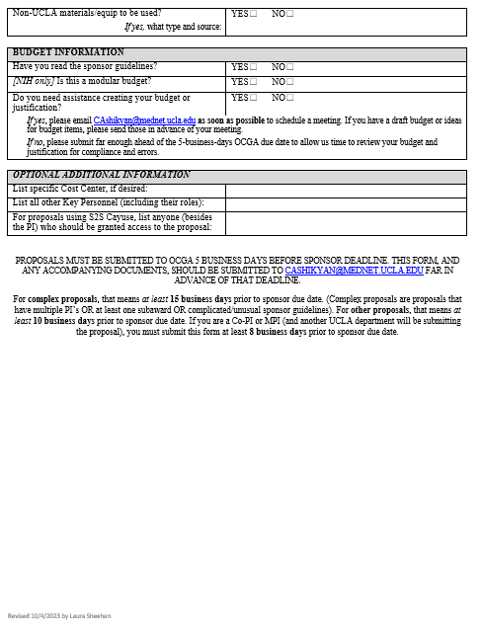
Updated Proposal Intake Form

Slide 23
Required Subaward Documents
UCLA Subrecipient Letter of Intent (LOI) or UCOP MCA Commitment Form must be completed and signed by the subrecipient's or participating campus' authorized official
Scope of work (SOW) that describes the subrecipient‘s objectives, tasks or deliverables, milestones, and timeframes
Subrecipient's detailed budget and budget justification in prime sponsor's format
Other proposal documents required by the sponsor (e.g. biosketches, facilities, etc.)
If the subrecipient is a for-profit entity, the UCLA Principal Investigator completes a Fair & Reasonable Cost Analysis.

Slide 24
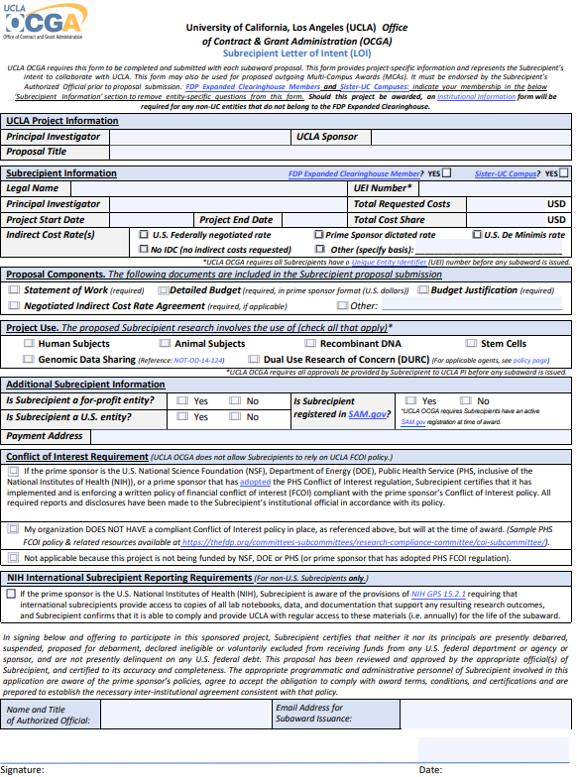
Subrecipient LOI

Slide 25
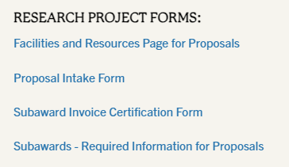
New Guidance Updated on Website

Slide 26
NIH Reporting Requirements for International Subrecipients
OCGA will include this language in both proposal- and award-stage documents to international subrecipients

Slide 27
Other Support Pages
Overlap section should not be blank (state “No overlap” if applicable)
Three types:
Scientific
Budgetary
Effort
Overlap

Slide 28
Other Support Pages
Both ScienCV and the UCLA PI Portal can help generate your OS page
Be sure to review for accuracy and details

Slide 29
Other Support Pages
The Other Support page asks for the Year (YYYY), but my project starts in one calendar year and ends in another. Which year do I list on the OS page?

Slide 30
Other Support Pages
If you are reporting person-months that span two calendar years, you should enter the latter year. For example, if the budget period runs from Aug 2023 through July 2024, you should enter “2024” for the year and include the corresponding person months.

Slide 31
Budgeting for Data Management and Sharing Costs
Effective for applications submitted for due dates on or after October 5, 2023, NIH will no longer require the use of the single DMS cost line item. NIH recognizes that DMS costs may be requested in many cost categories.
Therefore, DMS costs must be requested in the appropriate cost category, e.g., personnel, equipment, supplies, and other expenses, following the instructions for the R&R Budget Form or PHS 398 Modular Budget Form, as applicable.
While the single cost line item is no longer required, NIH will require applicants to specify estimated DMS cost details within the budget justification.

Slide 32
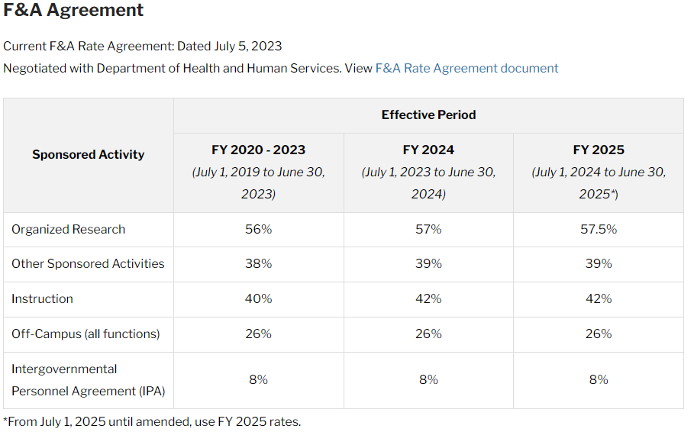
Updated F&A Rate Agreement
https://ocga.research.ucla.edu/facilities-and-administrative/

Slide 33
State-Funded Travel Restrictions - LIFTED
SB 447 "Building and Reinforcing Inclusive, Diverse, Gender-Supportive Equity Project (BRIDGE Project)“ was signed into law on September 13, 2023.
Law creates new public awareness project to promote acceptance and inclusion of the LGBTQ+ community.
Law also ends California’s restriction on taxpayer-funded travel by state agencies and departments to states that have adopted discriminatory anti-LGBTQ+ laws (AB 1887).
That means if you have any state-funded projects (e.g. TRDRP), you can now use those grant funds to pay for business travel to scientific conferences irrespective of location.

Slide 34
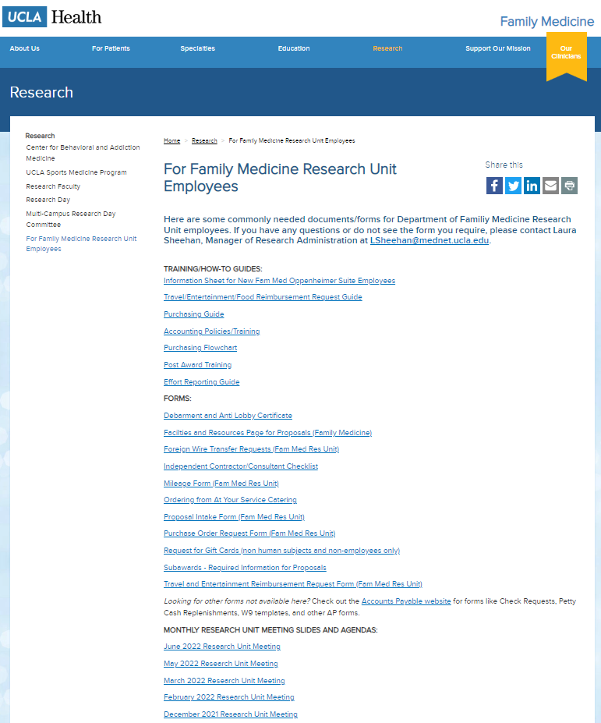
Upcoming Meetings/Events
Next Research Unit Meeting: Thu Nov 2
Next Grand Rounds: Friday, Oct 27
Prior monthly meeting agendas/slides are available on the website

