Slide 1
FPRS Inservice Review
2-15-12

Slide 2
Facial Analysis
The Frankfort horizontal plane connects the:
Nasion and pogonion
Nasion and porion
Porion and orbitale
Stomion and rhinion

Slide 3
Facial Analysis
The Frankfort horizontal plane connects the:
Nasion and pogonion
Nasion and porion
Porion and orbitale
Stomion and rhinion

Slide 4
Facelift
Most commonly injured nerve:
Marginal mandibular branch
Frontal branch
Buccal branch
Great auricular nerve

Slide 5
Facelift
Most commonly injured nerve:
Marginal mandibular branch
Frontal branch
Buccal branch
Great auricular nerve

Slide 6
Facelift
Most commonly injured MOTOR nerve:
Marginal mandibular branch
Frontal branch
Buccal branch
Great auricular nerve

Slide 7
Facelift
Most commonly injured MOTOR nerve:
Marginal mandibular branch
Frontal branch
Buccal branch
Great auricular nerve

Slide 8
Forehead Rhytids
Horizontal rhytids in the glabella are cause by contraction of which muscles?
Procerus
Corrugator supercilii

Slide 9
Forehead Rhytids
Horizontal rhytids in the glabella are cause by contraction of which muscles?
Procerus
Corrugator supercilii

Slide 10
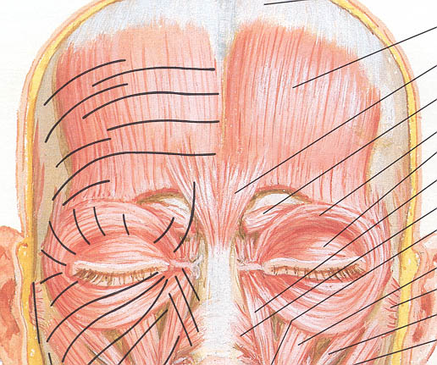
Forehead Anatomy
Elevator muscle
Frontalis
Depressor muscles:
Procerus
Corrugator supercilii
Orbital portion of the orbicularis oculi)

Slide 11
Unilateral Cleft Lip Nose
Tip and columella deviate toward:
Cleft side
Non-cleft side

Slide 12
Unilateral Cleft Lip Nose
Tip and columella deviate towards:
Cleft side
Non-cleft side

Slide 13
Unilateral Cleft Lip Nose
Caudal septum deviates toward:
Cleft side
Non-cleft side

Slide 14
Unilateral Cleft Lip Nose
Caudal septum deviates toward:
Cleft side
Non-cleft side

Slide 15
Unilateral Cleft Lip Nose
Cartilaginous and bony septum deviates toward:
Cleft side
Non-cleft side

Slide 16
Unilateral Cleft Lip Nose
Cartilaginous and bony septum deviates toward:
Cleft side
Non-cleft side

Slide 17
Unilateral Cleft Lip Nose
Cleft side alar base is positioned:
Posteriorly, laterally and inferiorly
Medially and inferiorly
Posteriorly and medially

Slide 18
Unilateral Cleft Lip Nose
Cleft side alar base is positioned:
Posteriorly, laterally and inferiorly
Medially and inferiorly
Posteriorly and medially

Slide 19
Unilateral Cleft Lip Nose
The lower lateral cartilage on the cleft side has an elongated:
Lateral crus
Medial crus

Slide 20
Unilateral Cleft Lip Nose
The lower lateral cartilage on the cleft side has an elongated:
Lateral crus
Medial crus

Slide 22
Rhinoplasty
What incisions comprise an open rhinoplasty incision?
Mid-columellar and rim
Mid-columellar and marginal
Mid-columellar and intracartilaginous
Mid-columellar and intercartilaginous

Slide 23
Rhinoplasty
What incisions comprise an open rhinoplasty incision?
Mid-columellar and rim
Mid-columellar and marginal
Mid-columellar and intracartilaginous
Mid-columellar and intercartilaginous

Slide 24
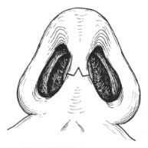
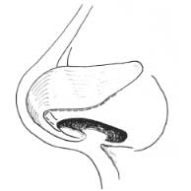
Open Rhinoplasty Incisions

Slide 25
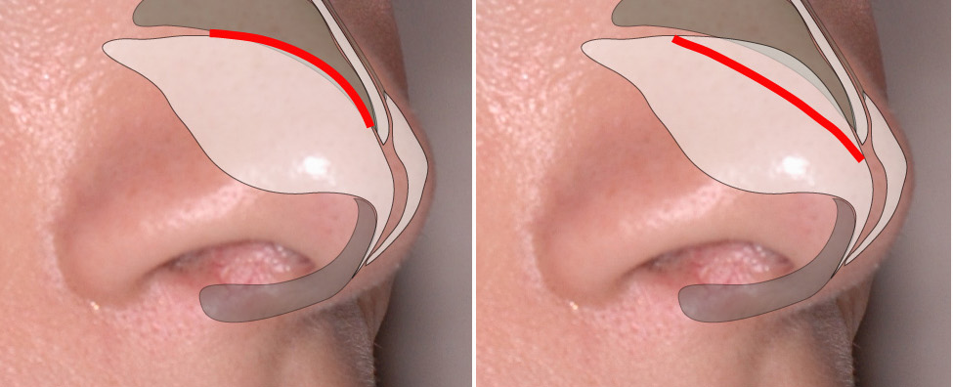
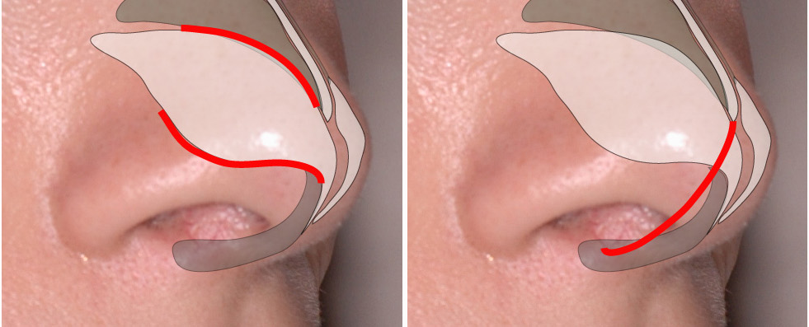
Closed Rhinoplasty Incisions

Slide 26
Rhinoplasty Maneuvers
Cephalic trim / cephalic turn-in
Spreader grafts / auto-spreader grafts
Lateral crural steal / Lateral crural overlay
Tongue-in-groove
Domal sutures

Slide 27
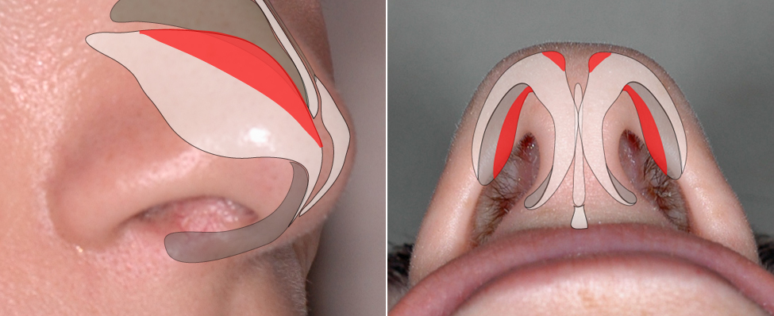
Cephalic Trim (Turn-in)

Slide 28
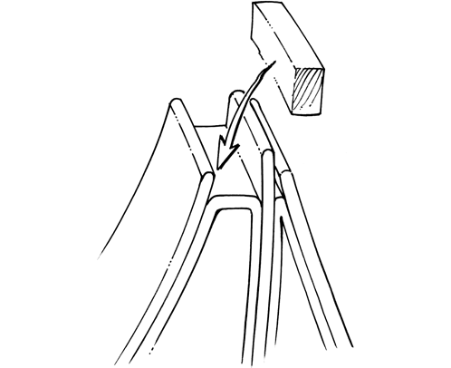
(Auto) Spreader Grafts

Slide 29
Lateral Crural Steal
– Increases tip rotation and projection

Slide 30
Lateral Crural Overlay
– Increases tip rotation, decreases tip projection

Slide 31
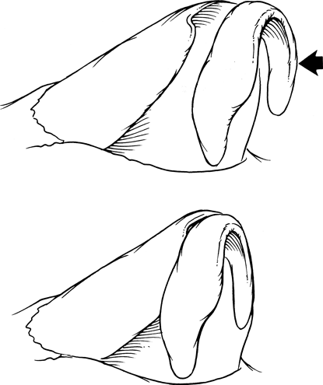
Tongue-in-groove
Introduced to treat hanging columella
Stabilizes tip, prevents ptosis
Can be used to set tip projection

Slide 32
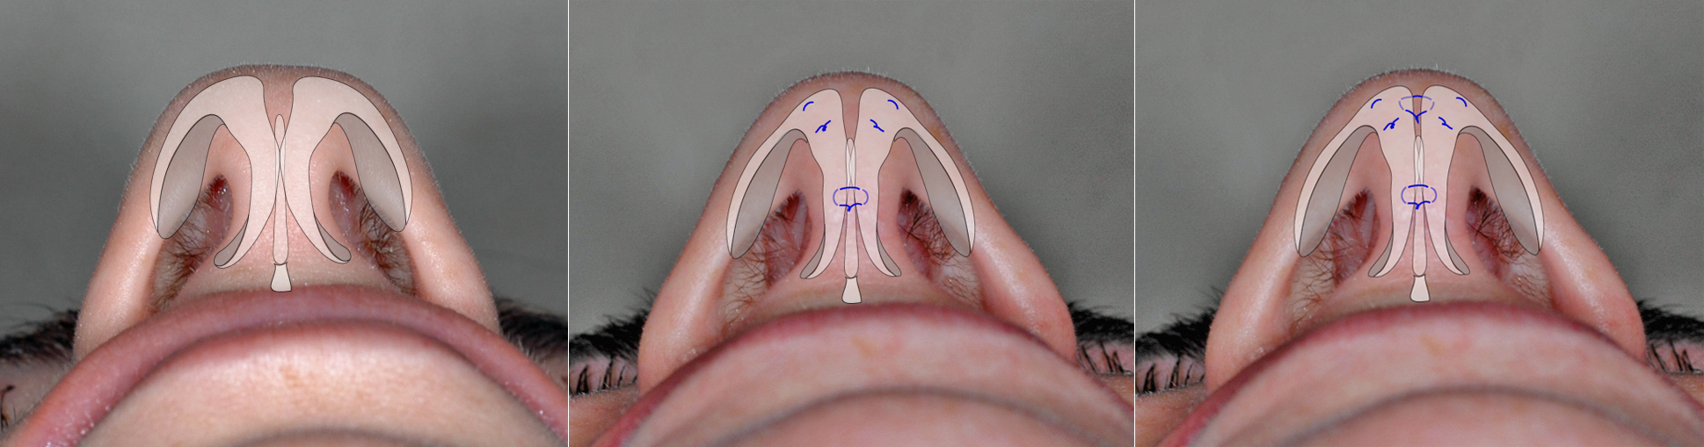
Intra/Interdomal Sutures

Slide 33
Dynamic Tip Ptosis
What causes tip ptosis with smiling?

Slide 34
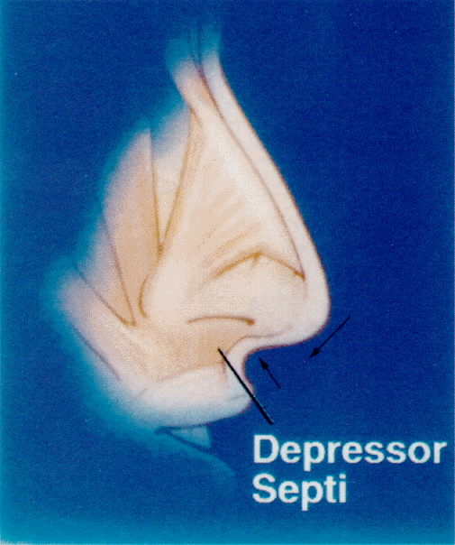
Tip Ptosis
Depressor septi muscle can accentuate drooping nasal tip and shorten upper lip on animation
Dissection and transposition of muscle during rhinoplasty can improve tip-upper lip relationship

Slide 35
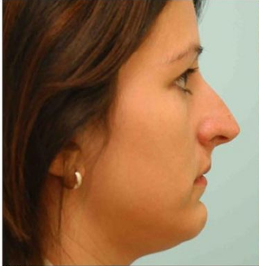
What is wrong with this nose?
Radix too high
Over-rotated
Tension nose deformity
Rhinion too low

Slide 36
What is wrong with this nose?
Radix too high
Over-rotated
Tension nose deformity
Rhinion too low

Slide 37
Tension Nose
Overdeveloped quadrangular cartilage
Tents tip away from nose
Tethers upper lip
Abnormal exposure of maxillary gingiva
Narrowed nostrils
Increased columellar show

Slide 38
Nasal Tip Defect
7mm defect on nasal tip. Repair with?
Bilobed flap
Primary closure
Secondary intention
STSG

Slide 39
Nasal Tip Defect
7mm defect on nasal tip. Repair with?
Bilobed flap
Primary closure
Secondary intention
STSG

Slide 40
Hair Transplantation
Most common complication of follicular unit hair transplantation?
Erythema
Cellulitis
Hair loss
Scarring

Slide 41
Hair Transplantation
Most common complication of follicular unit hair transplantation?
Erythema
Cellulitis
Hair loss
Scarring

Slide 42
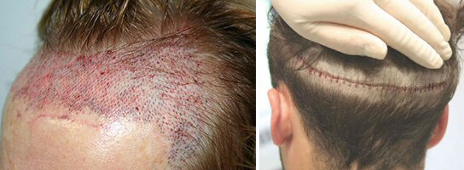
Hair Transplantation

Slide 43
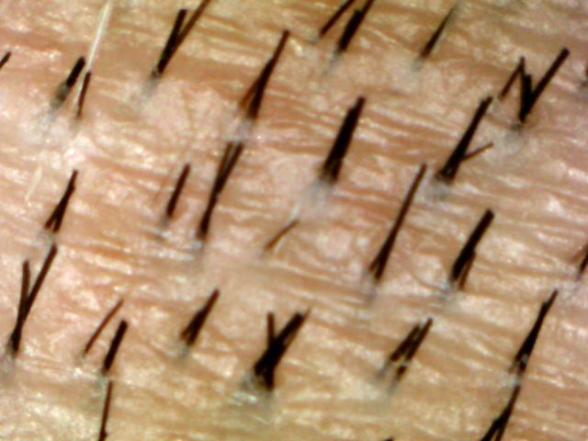
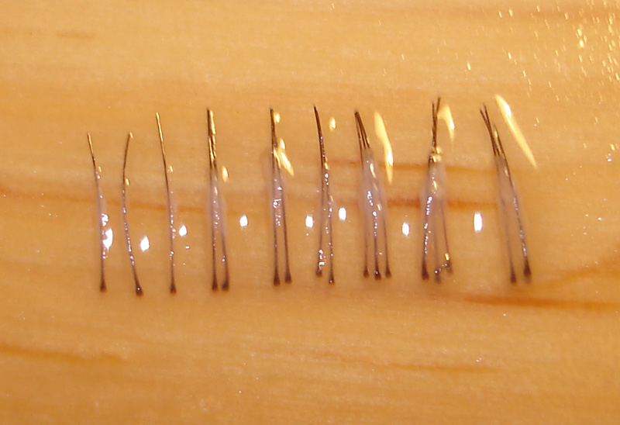
Hair Transplantation

Slide 44
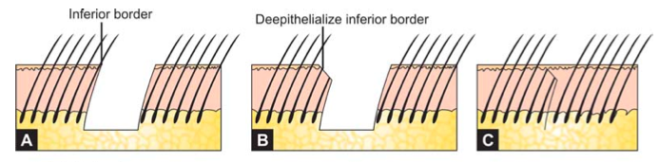
Hair Transplantation
Follicular units (as opposed to “hair plugs”)
Telogen effluvium
Trichophytic closure

