Slide 1
Cochlear Implantation
Akira Ishiyama, M.D.
UCLA SCHOOL OF MEDICINE

Slide 2
Deafness
Newborn: 1 in 1000 live birth, another 1 in 1000 by school age
Newborn screening is critical
Know your office and audiologists
Educate colleagues (early referral, meningitis)
2. Aging population: Increase deafness
3. Devastating illness with serious socioeconomic consequences
4. Many etiologies for deafness: be familiar

Slide 3
Cochlear implantation
1.Since 1985, steady acceptance and growth
2.Improved electronics and mapping strategy
3.Less controversial than ever before
4.Safer surgery with less complications
5.More cost effective

Slide 4
Cochlear implantation Outcome
Goal is to acquire speech and ability to hear
2.Improvement of signing ability
3.Concept of bilingualism
4.Cochlear implantation as a tool of rehabilitation

Slide 5
Cochlear implantation Outcome
The younger the patient, the better the outcome (FDA 12 months, 6months)
Facial nerve: be careful at the mastoid tip
2. The older the patient, outcome appears to deteriorate
3. Duration of deafness: shorter the better
4. Age of implantation: optimal to be before age 3
5. Status of inner ear anatomy is important

Slide 6
Tests used to establish candidacy
1. HINT
Hearing in noise test. HINT sentences are presented at 70dB in quiet and noise (60dB), signal to noise ratio 10dB
2. AzBio Sentence Test
Medicare criteria:
Severe to profound hearing loss with sentence recognition ability less than 40%

Slide 7
Tests used to measure CI performance
1. CNC Monosyllabic Word Recognition
Open set word consisting of 10 record lists of 50 monosyllabic words (such as laud and duck). Presented in quiet at 60dBA.
2. AzBio Sentence Test
33 lists of 20 sentences that contain low contexual information. (He cried when the pet goat was sent to the market) Each list includes 5 sentences from each of 4 different speakers (2 male, 2 female). Presented at 60 dBA with competing noise.

Slide 8
Hearing in prelingual deaf children
ABR: tone specific information, limited frequency specificity
ASSR: continuous tone with a carrier frequency that is amplitude and frequency specific
Monitor the progress with hearing aids with behavioral testing if possible

Slide 9
Cochlear implantation team
Critical to have a team approach
Otolaryngologist
Audiologist Speech pathologist
Developmental pediatrician
Psychologist
Social worker
Implant coordinator
School teacher
Do not start the surgery unless you have a team

Slide 10
Expectation needs to be adjusted
Remember that many parents and patients think that surgery will restore hearing completely
It is important for patients and families to know that extensive rehabilitation is needed following surgery
Important to relay realistic expectation to the patient

Slide 11
Genetic testing
Half of 1 in 1000 infants born with severe/profound deafness have genetic factors
Importance of newborn hearing screening
Additional 1 in 1000 children will lose hearing before starting school
GJB2 (connexin 26), maps to DFNB1 locus
GJB2 and GJB6 (connexin 30) cause 50% of bilateral severe to profoud deafness
21 currently identified connexins, 5 in mammalian cochlea

Slide 12
Connexin
Dominant Cx26 mutations identified with skin condition
Keratitis-Ichthyosis-Deafness syndrome
Palmoplnantar keratoderma with deafness
Cx26 not associated with vestibular problems
Cx26: usually presents without syndromic features

Slide 13
Connexin
Presence of Cx26 mutation is not a strong prognostic indicator of auditory perception after implantation.
Cx26 temporal bone study demonstrates preservation of primary afferent neurons and nerve fibers (90% of cases)

Slide 14
Jervell and Lange-Nielsen
A deaf girl collapses and dies when disciplined at school (Freidrich Meissner, 1856)
Jervell and Lange-Nielsen:1957 complete description
Syncope, arrythmia (QT interval > 0.44 in males and >0.46 in females), sudden death and congenital hearing loss
Elevated QT interval can lead to torsades des points leading to syncope and sudden death

Slide 15
Jervell and Lange-Nielsen
KCNQ1 and KCNE1 gene defects
Temporal bone pathology: Reissner’s membrane collapse obliteating the scala media
EKG prior to surgery is important
Use beta blockers
Loud noise can trigger torsades des points
Quiet induction is recommended

Slide 16
Imaging study
Presence of primary or secondary bone disease involving the cochlea.
Appearance of the IAC on the CT (oblique sagittal T2 for the nerves on the MRI).
Hypoplastic IAC: usually correlates with congenital cochleovestibular nerve deficiency. Normal CN7.

Slide 17
Hypoplastic IAC
Stenosis or complete occlusion of the cochlear nerve aperture at fundus correlates with cochlear nerve deficiency.
Type1: total absence
Type 2a: hypoplastic cochlear nerve, dysplastic labyrinth
Type 2b: absent or hypoplastic cochlear nerve, morphologically normal labyrinth

Slide 18
Imaging study
3. Enlarged vestibular aqueduct.
4. Cochlear or vestibular malformation.
5. Cochlear-carotid interval.
6. When diffuse inner ear malformation is seen: always consider connection between CSF and cochlea.
7. Abnormal ear canal, inner ear : always consider anomalous facial nerve location.

Slide 19
Internal Auditory canal
Length: 11 mm
Vertical height: 4 mm, (2-8)
Symmetry less than 1mm: 99%
Symmetry less than 1-2 mm: 1%
When narrow; consider exostosis/osteoma

Slide 20
X-Linked Progressive Mixed Deafness
Wide IAC
Carefully examine the bony partition between IAC and base of cochlea and vestibule
Absence of partition: strong potential for fistulous subarachnoid space-inner ear communication with perilymphatic gusher.
X-linked mode of progressive mixed hearing loss

Slide 21
Anatomical consideration
Always consider fistulous connection within the ear when inner ear anomalies are present.
SAS-inner ear: IAC fundus, cochlear aqueduct
Potential for CSF leak and anomalous migration of the electrode in the ear.
Migration of the electrode placed in the scala tymani to the internal auditory canal.

Slide 22
Meningitis case
In early labyrinthine ossificans, fibrotic changes in the cochlea may not be seen on the CT. Thus MRI is critical (T2).
In severe case, compressed electrode may need to be selected. (Med-el 10mm) Split electrode can be utilized.
16 mm: hybrid electrode
19-24mm: standard electrode

Slide 23
Meningitis case
Meningogenic cause
Usually bacterial and it is usually bilateral
Spread of inflammation and infection from the fundus to lamina cribrosa, vestibule and cochlear nerve foramen into the cochlear apex with internal dissemination via modiolus.

Slide 24
Meningitis case
The fibrous stage of the disorder can start 2 weeks after the infection.
T2 images are useful: replacement of fluid containing space with fibrous tissue
First place to involve is the cochlear apex: Gad enhancement persists due to angiogenesis
Ossification can be localized or diffuse
Most common: Localized type at base: cochlear aqueduct drains to scala tympani at basal turn

Slide 25
Status of Temporal Bone Anatomy
The primary afferent neurons (spiral ganglia neurons) preservation appears to be important
Unknown how many nerve fibers you need to achieve good functional outcome
Absolute spiral ganglia neuronal number vs preservation of neuronal volume

Slide 26
Status of Temporal Bone Anatomy
Status of the dendrites
Relationship between primary and secondary changes following implantation unknown
Aging effect needs to be considered
Total number of temporal bone specimens available following CI is limited
Exact anatomic correlation yet to be determined
Etiology specific outcome not well defined

Slide 27
Definition of terms
Acoustic stimulation: acoustically delivered sound only on one or both sides
Electric stimulation: cochlear implant only
Bimodal: Acoustic one side, cochlear implant on the other side
Hybrid: use of acoustic and electric hearing on the same ear

Slide 28
Ear selection
If anacusic, the ear with more residual hearing is favored.
If one ear has had profound deafness more than 10-15 years, select the ear with better hearing.
If hearing aid can be used for sound awareness, preserve the better ear for hearing aid use.

Slide 29
Ear selection
If abnormality exists on the imaging study, results of the imaging study dictates which side needs to be implanted.
Choose the ear with better anatomy.

Slide 30
Bilateral implantation
Improved speech understanding in noise
Better sound localization
Better music appreciation
Facilitates language acquisition
For sequential in children, shorter time correlated with improved language development

Slide 31
Contraindication of surgery
Deafness due to lesions of the acoustic nerve or CNS pathway
Active middle ear infection
Absence of cochlear development
Tympanic membrane perforation in the presence of active middle ear disease

Slide 32
Surgical Consideration
Preoperative planning
Check the integrity of the tympanic membrane and absence of ear infection
If chronic ear disease is present, it needs to be staged. Complete eradication of infection, mastoid obliteration is needed.
Abundant subcutaneous tissue: flap over the implant needs to be thinned.

Slide 33
Surgical Consideration
Patient with connective tissue or long history of smoking: Be cautious for the flap design.
Extremely thin patient or systemic disease: TPF
Key fact: at least 1 cm of tissue from all margins of the implant.
Avoid making the vertical limb incision too close to the postauricualr sulcus: mastoid cutaneous fistula.

Slide 34
Surgical Technique
Be aware of head orientation and position
Complete mastoidectomy
Facial recess approach: adult size at birth. Critical to have adequate opening to ensure optimal electrode placement
Facial nerve needs to be identified: leave the thin layer of bone on the nerve intact
Important to preserve chorda tympani, especially for bilateral implantation

Slide 35
Surgical Technique
Remember that the drill can not make any contact with the facial nerve. Use H2O
Round window insertion is considered to have less trauma to the inner ear.
Do not be dogmatic if round window can not be identified. No problem using cochleostomy.
If confused, use tympanic plexus and oval window as the guide.

Slide 36
Surgical Technique
Small cochleostomy is preferred.
Always use tissue to seal the cochleostomy
Fascia or periosteum. Muscle use discouraged.
Slow and gentle electrode insertion. Especially important for hybrid surgery when hearing preservation is attempted.

Slide 37
Surgical Technique
Secure the implant if possible
Make the well deep enough to hide the implant
If the well is holding the implant securely, no need to secure it
Careful soft tissue closure over the implant
Careful closure of the postauricular incision: avoid suture related problems
Perioperative use of antibiotics is critical

Slide 38
CI and vaccination
Age appropriate pneumococcal vaccine and H flu type B conjugate and annual influenza vaccination
At 24 month: single dose of 23 valent pneumococcal vaccine, at least 2 weeks prior to surgery

Slide 39
CI and otitis media
Otitis media within 2 weeks after surgery
IV Abx: Ceftriaxone
Otitis media after 2 weeks after surgery
Oral Augmentin

Slide 40
CI and meningitis
Meningitis within 2 weeks after surgery
IV Abx: Meropenum (Gram negative coverage) and Vancomycin
Meningitis after 2 weeks after surgery
IV Abx: Ceftriaxone and Vancomycin

Slide 41
CI with hearing preservation
Hybrid Study
Down sloping hearing loss: problems with hearing aids
EU study: younger patients with round window insertion
More women than men.
80% hearing preservation
US study
Older patients (21-76), 50 patients at 10 centers
Both round window and cochleostomy
60% total hearing loss

Slide 42
CI with hearing preservation
If hearing is preserved and hybrid can be used:
Better sound localization ability
Better music appreciation
Good tinnitus suppression
Unknown what results in preservation of hearing
Slow cochleostomy with gentle slow insertion of electrode
Minimizing the leak from the electrode entry site

Slide 43
CI with unilateral deafness
Unilateral sudden hearing loss in adult is devastating
For sudden hearing loss, common to see debilitating tinnitus
Unilateral implantation appears to be effective in tinnitus suppression
Appears to improve sound localization
Unknown for better hearing and speech comprehension

Slide 44
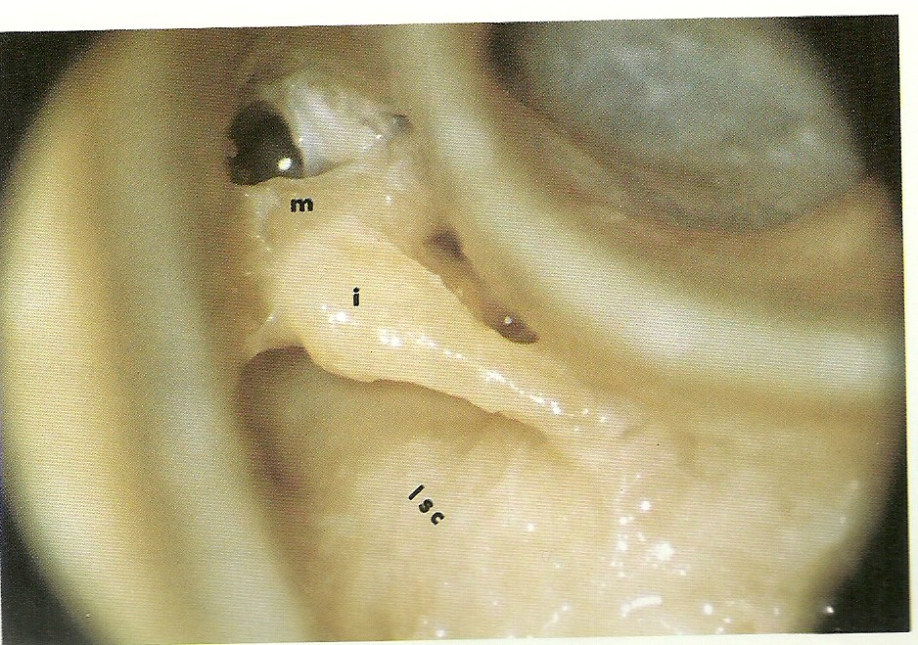

Slide 45
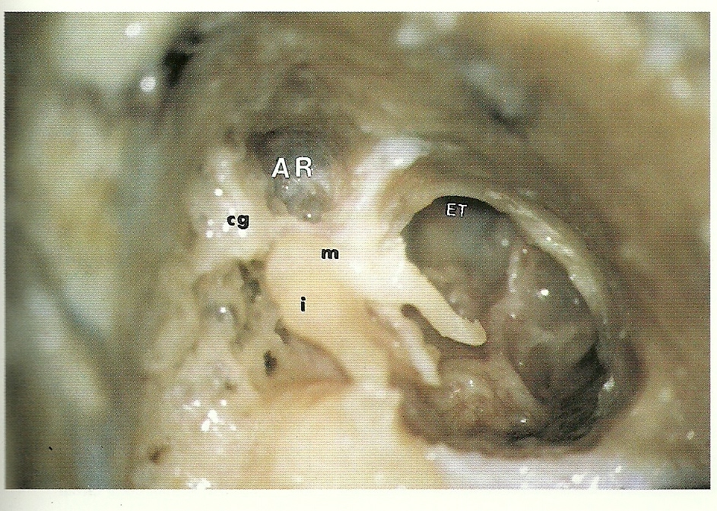

Slide 46
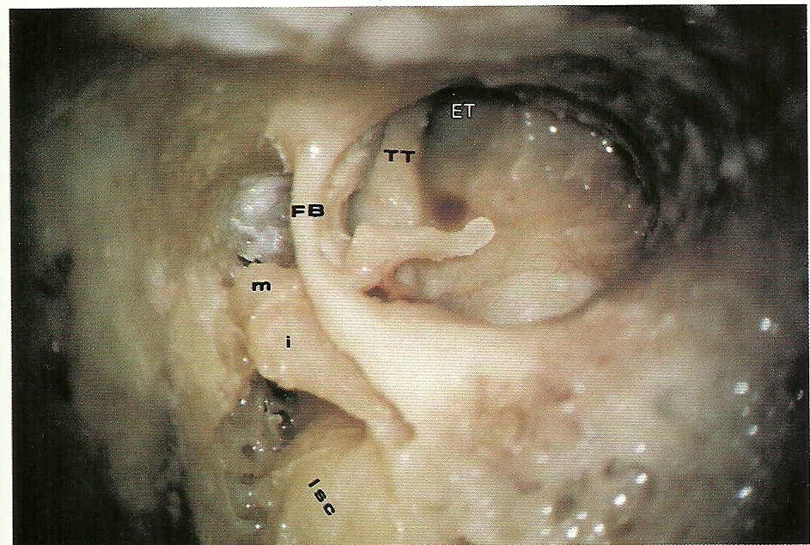

Slide 47
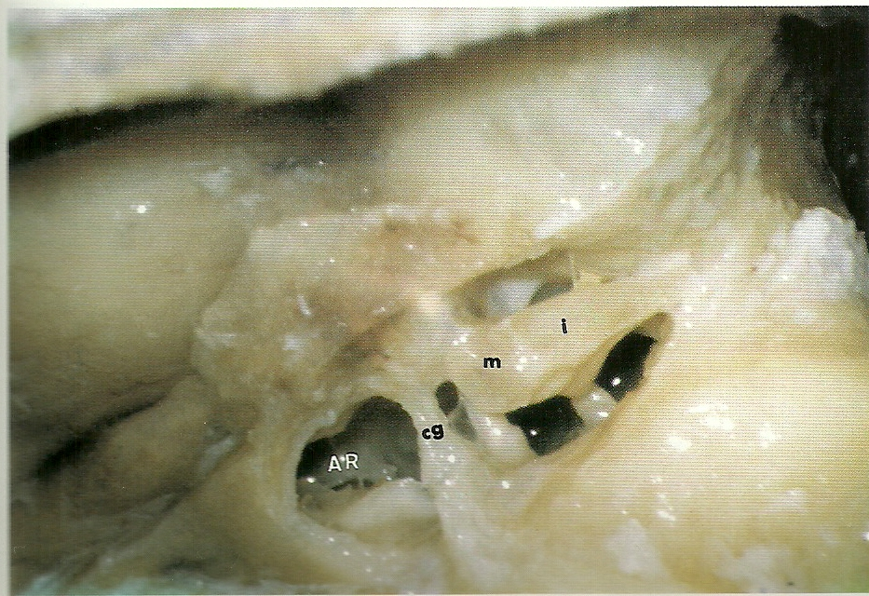

Slide 48
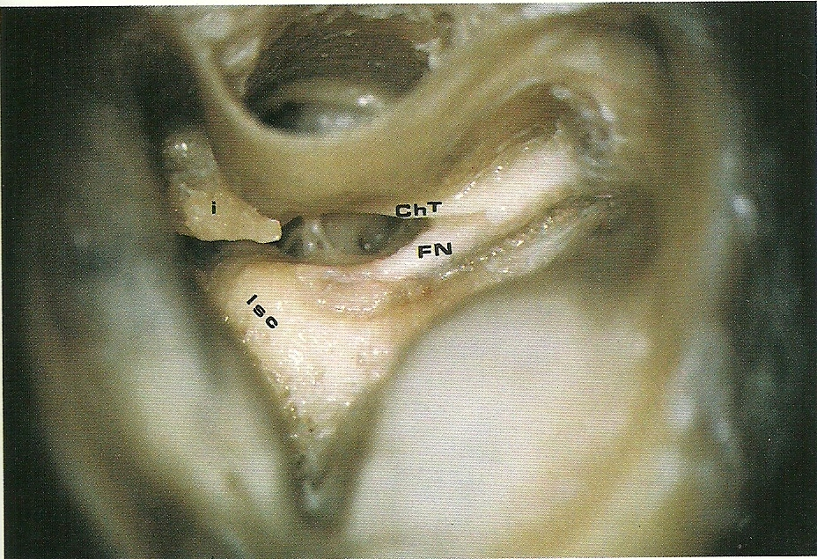

Slide 49
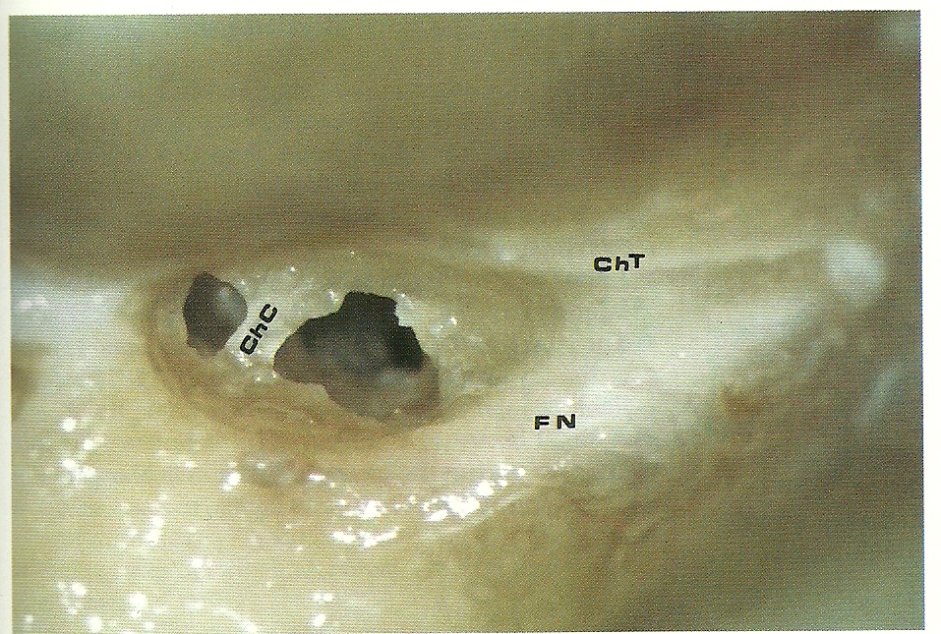

Slide 50
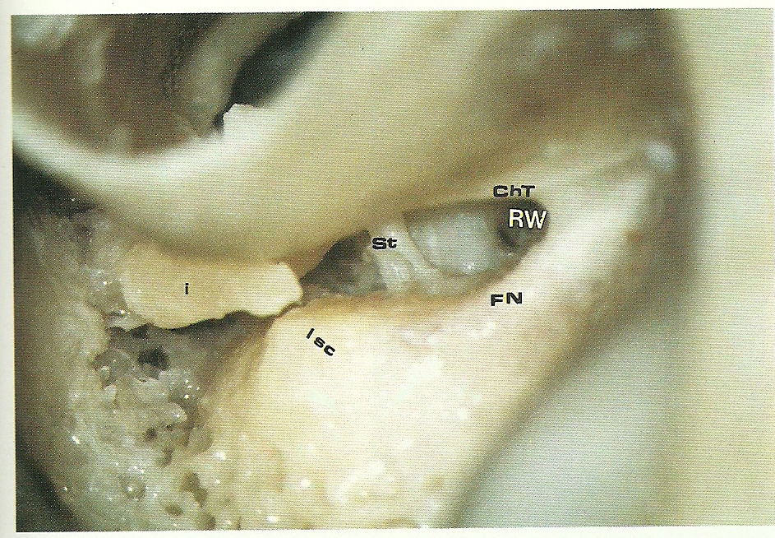

Slide 51
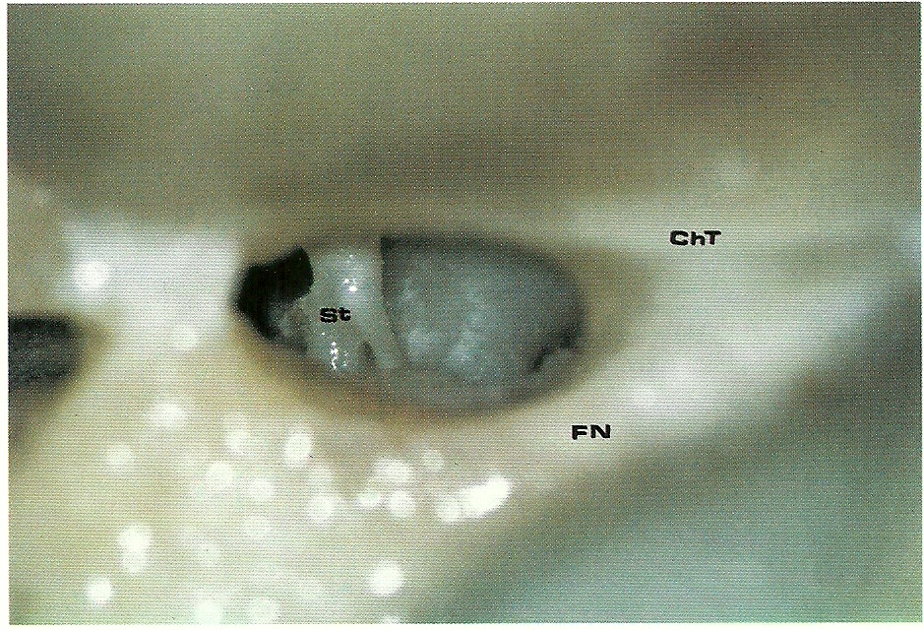

Slide 52
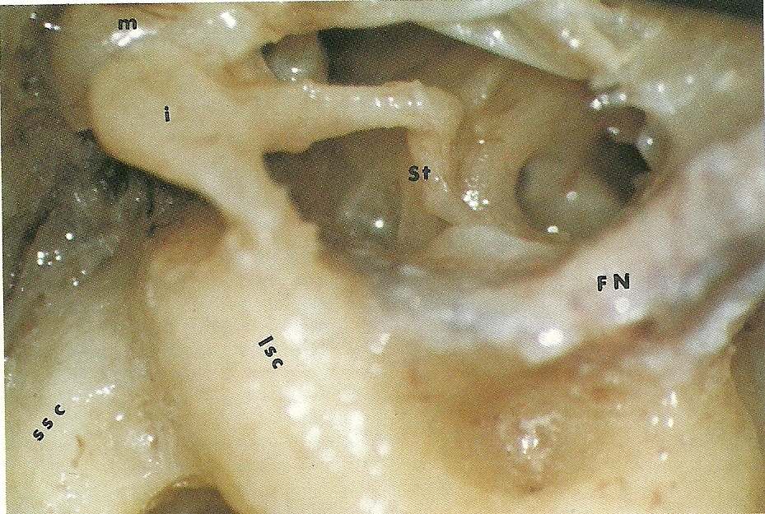

Slide 53
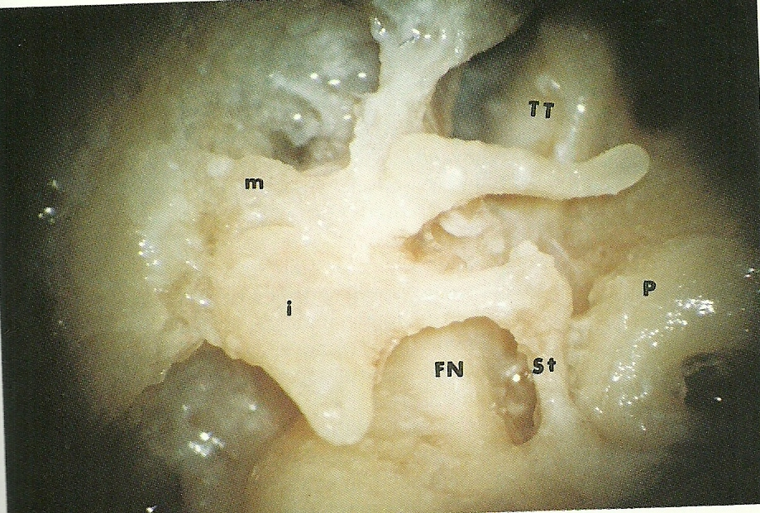

Slide 54
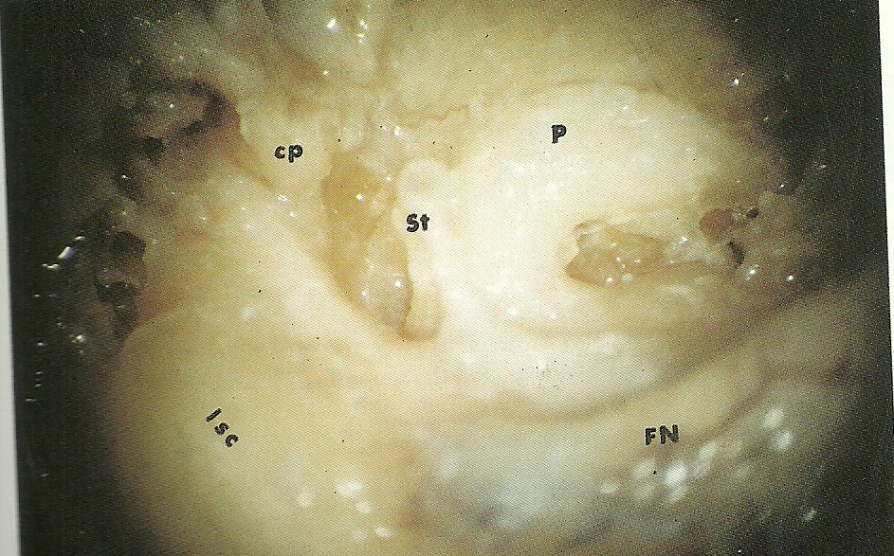

Slide 55
