Slide 1

Carcinoma of Unknown Primary:
The Role of Transoral Robotic Surgery
Christine M. Kim, MS4
Georgetown University School of Medicine

Slide 2
CC: Right neck swelling
HPI: JD is a 63M initially presented to PCP with a painful R neck mass after URI, thought to be neck abscess
Saw outside HNS and received antibiotics and needle aspiration showing frank pus
Sent to WHC ED and admitted to HNS
ROS: Negative
Notes:
Painful? Enlarging? Responsive to abx?
ROS: Negative for (for odynophagia, SOB, weight loss, F/C) - denies weight loss, dysphagia, odynophagia, nasal obstruction or bleeding. No voice changes.
Make it two separate slides
PMH and PSH were non-contrib
Don’t read meds
Read social Hx

Slide 3
CC: Right neck swelling
PMH: HTN
PSH: Lithotripsy for left renal calculus, arthroscopy R knee
Meds: Atenolol-Chlorthalidone, Aspirin
Fam Hx: Denies
Social Hx: Employed as mailman. Never smoked. Occasional EtOH
Notes:
PMH and PSH were non-contrib
Don’t read meds
Read social Hx

Slide 4
Physical Exam
Gen: NAD, AAOx3
Eyes: EOMI, PERRLA
Ant nares: Clear
Ears: Clear, TM intact
OC/OP: Tonsils symmetric 1+ b/l, tongue mobile, no palpable masses, no erythema
Neck: Right levels II and III LAD. Salivary glands soft and symmetric b/l. Thyroid normal to palpation. Trachea midline, no masses or tenderness.
Notes:
“”unremarkable except…”

Slide 5
Flexible laryngoscopy
Nasal mucosa: no signs of inflammation
Turbinates: normal morphology
Polyps: No polyps or masses
Septum: No performations
Nasopharynx: No significant adenoid enlargement, eustachian tube orifices clear
Oropharynx: Pharyngeal walls normal
Hypopharynx: No pooling of secretions; no lesions or erythema
Larynx: Vocal cord motion is normal; no lesions
Vocal Folds: No vocal fold lesions
Notes:
Was normal with no NP OP masses

Slide 6
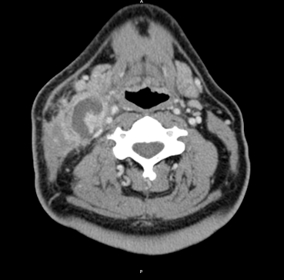
CT
Notes:
Axial contrast CT showing R cervical LAN.
3 rim-enhancing lesions R neck, likely necrotic LN. Largest deep to R SCM (3.5 cm x 2.2 cm). R level III node (1.4 cm x 0.7 cm). Stranding along the fat planes R neck. No LAD in L neck.
Axial concordant PET CT, saggital with FDG avidity
1. Concordant FDG-PET and CT images of the neck with necrotic
lymphadenopathy in the right neck .
2. FDG-PET finding at the level of the thoracic inlet, raises suspicion
for adenopathy (negative CT scan). Otherwise, no evidence of metastatic
disease involving the rest of the chest in both PET and CT scans.
3. FDG-PET images of the abdomen, pelvis and visualized skeleton without
evidence for metastatic disease (there are no diagnostic CT scans of the
abdomen and pelvis for comparison).

Slide 7
Evaluation
FNA: no signs of malignancy
Taken to OR for LN biopsy and I&D of neck abscess:
2 large nodes → Frozen (+) for metastatic SCCa
DL completed
PET/CT
Notes:
Persistent neck mass,
Excisional bx of neck mass that showed SCCa on frozen so ND completed
“was FDG avid”
Move CT to before going to OR
He had CUP. We did DL to then evaluate for masses.
CT: Three rim enhancing lesions in the right neck, likely
necrotic lymph nodes. The largest is deep to R SCM (3.5 cm x 2.2 cm). A smaller one is
immediately posterior to the right submandibular gland and measures 1.5
cm. Third lesion is in the right lower neck at the level of the cricoid
and measures 9 mm in diameter. Additionally there are other enlarged lymph
nodes without low attenuation center in the right neck. There is a right
level III node measuring 1.4 cm x 0.7 cm. There are no enlarged lymph
nodes in the left neck. Stranding is seen along the fat planes in the
right neck. The right sternocleidomastoid is edematous
1. Concordant FDG-PET and CT images of the neck with necrotic
lymphadenopathy in the right neck .
2. FDG-PET finding at the level of the thoracic inlet, raises suspicion
for adenopathy (negative CT scan). Otherwise, no evidence of metastatic
disease involving the rest of the chest in both PET and CT scans.
3. FDG-PET images of the abdomen, pelvis and visualized skeleton without
evidence for metastatic disease (there are no diagnostic CT scans of the
abdomen and pelvis for comparison).

Slide 8
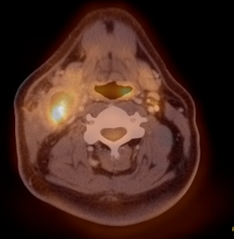
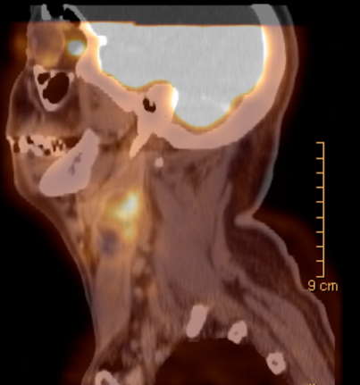
PET/CT
Notes:
3 rim-enhancing lesions R neck, likely necrotic LN. Largest deep to R SCM (3.5 cm x 2.2 cm). R level III node (1.4 cm x 0.7 cm). Stranding along the fat planes R neck. No LAD in L neck.
Axial concordant PET CT, saggital with FDG avidity
1. Concordant FDG-PET and CT images of the neck with necrotic
lymphadenopathy in the right neck .
2. FDG-PET finding at the level of the thoracic inlet, raises suspicion
for adenopathy (negative CT scan). Otherwise, no evidence of metastatic
disease involving the rest of the chest in both PET and CT scans.
3. FDG-PET images of the abdomen, pelvis and visualized skeleton without
evidence for metastatic disease (there are no diagnostic CT scans of the
abdomen and pelvis for comparison).

Slide 9
Evaluation
FNA: no signs of malignancy
Taken to OR for LN bx and I&D of neck abscess: 2 large nodes. Frozen positive for metastatic SCCa.
DL completed
PET/CT: Concordant FDG-PET and CT images with necrotic LAD R neck
R MRND: 2/44 R level III nodes with metastatic SCCa
Diagnosis: TxN2bM0 SCCa, primary site unknown
Notes:
He had CUP. We did DL to then evaluate for masses.
CT: Three rim enhancing lesions in the right neck, likely
necrotic lymph nodes. The largest is deep to R SCM (3.5 cm x 2.2 cm). A smaller one is
immediately posterior to the right submandibular gland and measures 1.5
cm. Third lesion is in the right lower neck at the level of the cricoid
and measures 9 mm in diameter. Additionally there are other enlarged lymph
nodes without low attenuation center in the right neck. There is a right
level III node measuring 1.4 cm x 0.7 cm. There are no enlarged lymph
nodes in the left neck. Stranding is seen along the fat planes in the
right neck. The right sternocleidomastoid is edematous
1. Concordant FDG-PET and CT images of the neck with necrotic
lymphadenopathy in the right neck .
2. FDG-PET finding at the level of the thoracic inlet, raises suspicion
for adenopathy (negative CT scan). Otherwise, no evidence of metastatic
disease involving the rest of the chest in both PET and CT scans.
3. FDG-PET images of the abdomen, pelvis and visualized skeleton without
evidence for metastatic disease (there are no diagnostic CT scans of the
abdomen and pelvis for comparison).

Slide 10
Carcinoma of unknown primary
Definition
Presentation
Evaluation
Management
Emerging diagnostic modalities - TORS
Outcomes
Notes:
Summarize pt. cancer with mets to neck but no primary site ie. CUP

Slide 11
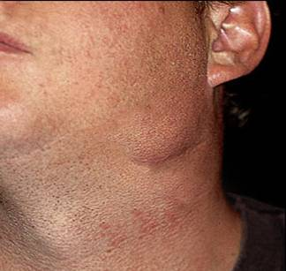
Carcinoma of unknown primary
WHO definition: histologic dx of malignant neoplasm metastatic to cervical LN without identifiable 1º tumor following comprehensive evaluation
SCC: 53-77% of CUP histologies¹
Constitutes 2-4% of head and neck SCCa²
Presentation³
  Neck mass 94-100%
  Pain 9%
  Weight loss 7%
  Dysphagia 4%
  M:F = 75% : 25%
  Mean age 55
1. Strojan P et al. Contemporary management of lymph node metastases from an unknown primary to the neck, I: a review of diagnostic approaches. Head Neck, 2013. 2. Nieder et al. Curr Treat Options Oncol, 2000; Karni et al; Laryngoscope, 2011 3. Issing et al; Eur Arch ORL, 2003, Grau et al; Radiother Oncol, 2000. Photo: http://www.aafp.org/afp/2002/0901/p831.html
Notes:
***What % is squamous?
Make subtitles bigger
Cite pictures
Incidence overall decreasing due to better diagnostic modalities

Slide 12
Evaluation
H&N exam, FFL, CT, FNA, panendoscopy, PET/CT
Directed biopsies
Only 17 – 63% of primary tumors identified^{1,2}
Failure to find primary³:
  Small size
  Cryptic location
  Tumor regression
Most common primary sites identified in workup of CUP are palatine tonsils and BOT⁴
1. Mehta et al. “A new paradigm for diagnosis and management of unknown primary tumors of the head and neck: a role for transoral robotic surgery.” Laryngoscope, 2009 2. Haas I et al. “Diagnostic strategies in cervical carcinoma of an unknown primary.” Eur Arch Otorhinolaryngol 2002 3. Eisele, D. “Squamous cell carcinoma of the neck with unknown primary.” Auto-Digest Otolaryn 2013. 4. Cianchetti M et al. “Diagnostic evaluation of SCC metastatic from an unknown primary to neck: II. A review of therapeutic options.” Head Neck 2013.
Notes:
Make sure CUP = squamous
Cite! State that this is one study, and that there exists a range
HAVE RANGE IN THERE!
Incidence overall decreasing due to better diagnostic modalities

Slide 13
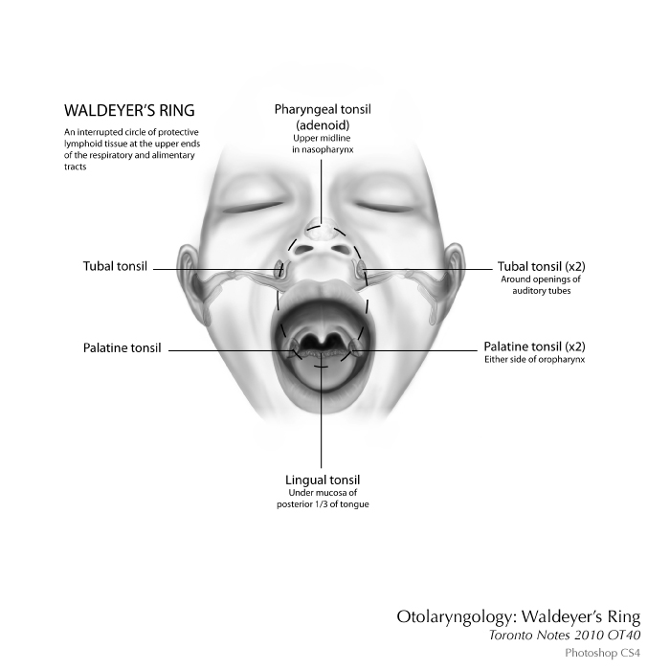
Waldeyer’s Ring
Notes:
Explain why they used to do endoscopies of WALDEYER’S RING (have a slide)
What is widefield? All mucosal sites that could’ve possibly missed on bx- from skull base to hypopharynx?
NCCN guidelines- whether there is extracapsular extension?
Extracapsular extension???

Slide 14
What if 1º site is not found?
Remaining true CUP cases are treated with either primary wide-field radiation or chemoradiation therapy with or without neck dissection
5-year actuarial survival¹:
  69% for N1
  58% for N2
  30% for N3
1. Grau C, Johansen LV, Jakobsen J, Geertsen P, Andersen E, Jensen BB. "Cervical lymph node metastases from unknown primary tumors.” Radiother Oncol 2005.
Notes:
Explain why they used to do endoscopies of WALDEYER’S RING (have a slide)
What is widefield? All mucosal sites that could’ve possibly missed on bx- from skull base to hypopharynx?
NCCN guidelines- whether there is extracapsular extension?

Slide 15
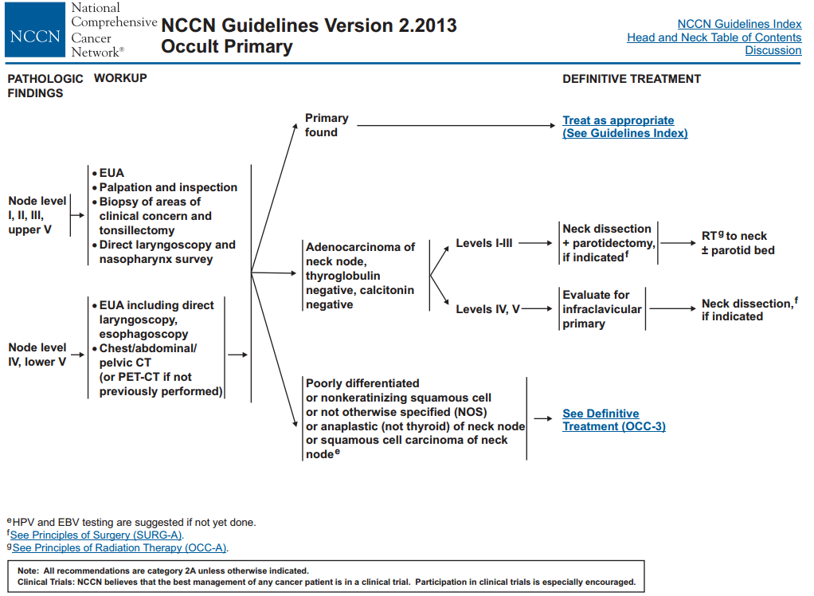

Slide 16
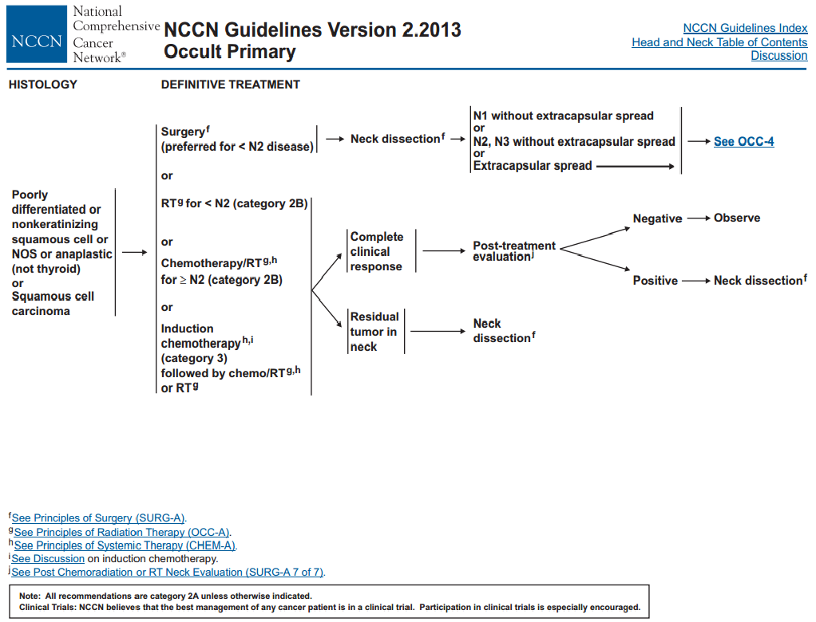
Notes:
Explain why they used to do endoscopies of WALDEYER’S RING (have a slide)
What is widefield? All mucosal sites that could’ve possibly missed on bx- from skull base to hypopharynx?
NCCN guidelines- whether there is extracapsular extension?
Extracapsular extension???

Slide 17
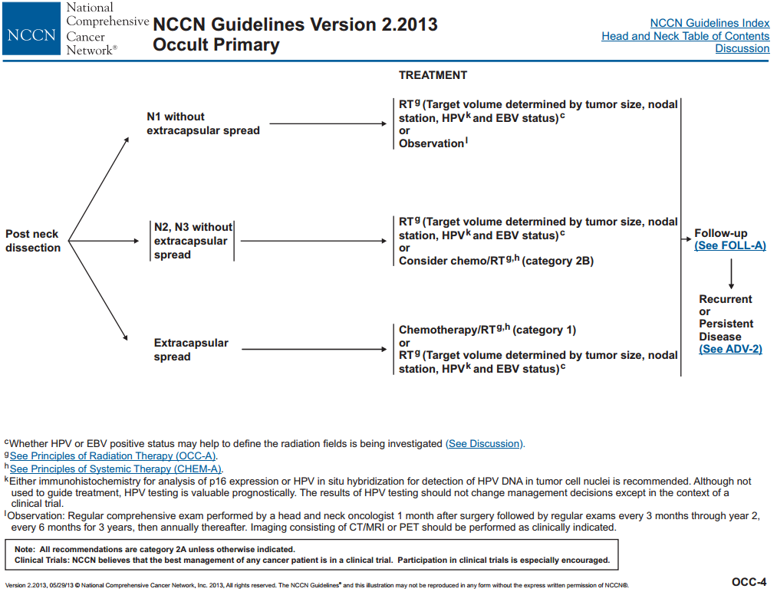
Notes:
Explain why they used to do endoscopies of WALDEYER’S RING (have a slide)
What is widefield? All mucosal sites that could’ve possibly missed on bx- from skull base to hypopharynx?
NCCN guidelines- whether there is extracapsular extension?
Extracapsular extension???

Slide 18
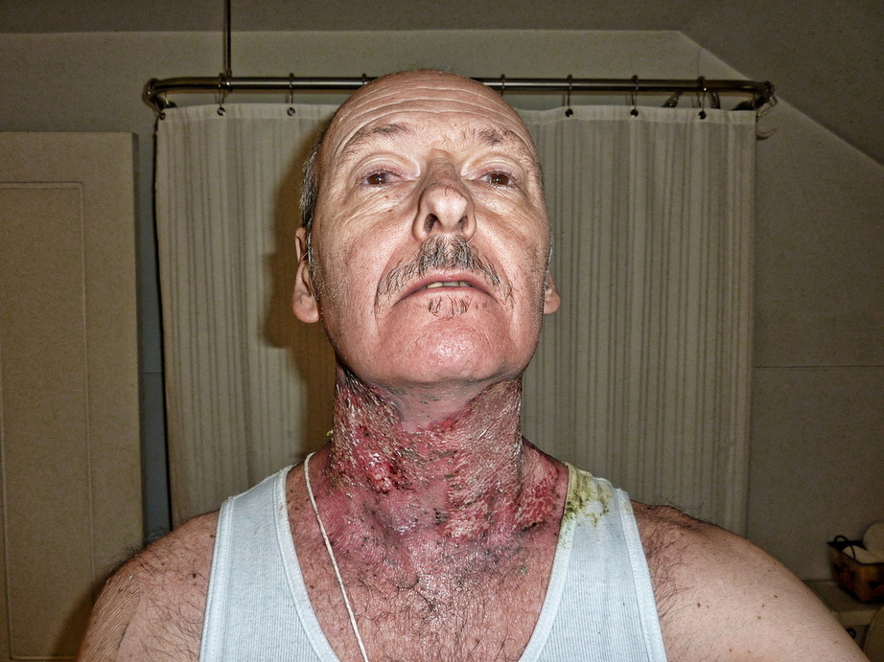
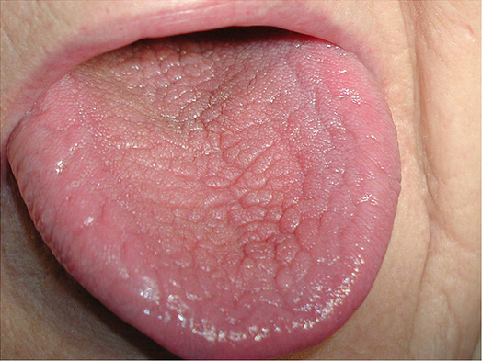
Toxicity of chemoradiation
  25% with grade 2 xerostomia
  32% grade 3 radiation dermatitis
  72% grade 1-2 dysphagia → 95% had G tube for median of 6 mo
  50% grade 3 mucositis
  46% esophageal stricture
  40% skin fibrosis
Madani I, Vakaet L, Bonte K, Boterberg T, De Neve W. Intensity-modulated radiotherapy for cervical lymph node metastases from unknown primary cancer. Int J Radiat Oncol Biol Phys 2008.
Top photo: http://www.headandneckcancerpatient.com/uploads/1/3/8/1/1381721/1368688.jpg?922. Bottom photo: http://ida.cdeworld.com/courses/4587-Oral_Pretreatment_of_the_Cancer_Patient
Notes:
Cite pictures
Specific study dealing with CUP toxicity.
Be more specific about what these grades mean!
Xerostomia is mild, mod, severe. Grade 2: symptomatic and significant oral intake alteration
Grade 3 rad dermatitis: moist desquamation not just limited to skin folds and bleeding induced by minor trauma
Dysphagia: grade 1-2 able to swallow some solids or semi solids (grade 3 is liquids only)
Mucositis: ulceration, able to eat liquids

Slide 19
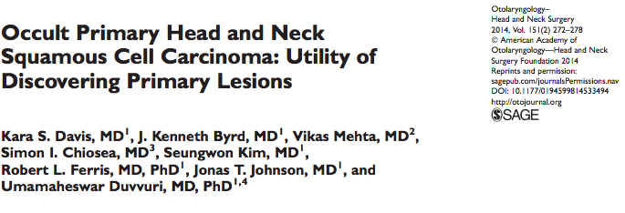
N=44 CUP patients from the University of Pittsburgh
Match-paired analyses
Improved overall, disease-free, and cause-specific survival
Notes:
Underwent DL and b/l tonsillectomy or TORS
Mention: didn’t mention difference in morbidity but I would’ve liked to see that

Slide 20
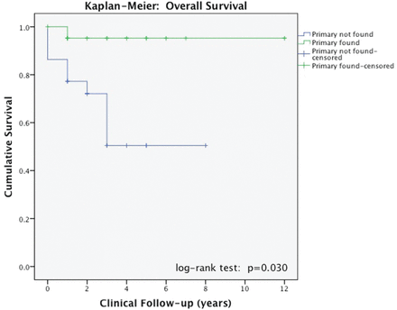
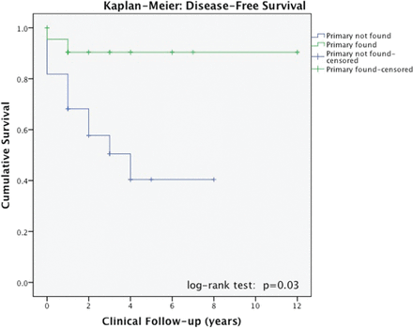
5-year overall survival:
95.7% (1º found) vs. 52% (1º not found)
Notes:
ID of primary site has shown therapeutic impact with vast improvement in 5-yr survival rates and potential reduction in radiation toxicity.
What does kaplan-meier mean? Need to know what graphs mean
Drop off from time from dx to time of death
series of horizontal steps of declining magnitude which, when a large enough sample is taken, approaches the true survival function for that population. The value of the survival function between successive distinct sampled observations ("clicks") is assumed to be constant.

Slide 21
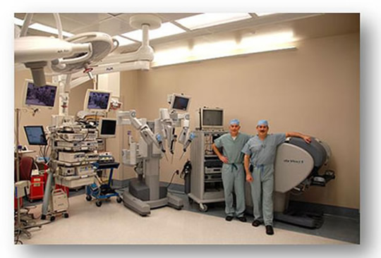
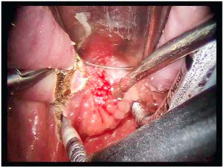
TORS
daVinci robot system with 3D magnified view
Improved visualization
Freedom of motion
Access to OP subsites
Useful for both ablative purposes and potentially as diagnostic modality
Top: http://www.uphs.upenn.edu/pennorl/education/images/daVinci_ Machine2.jpg
Bottom: http://www.medicalgrapevineasia.com/mg/2013/03/17/
minimally-invasive-head-and-neck-surgery/
Notes:
Some investigators have begun to start using TORS to try to ID primary site with the theory that the robot… etc. Write this out.
Better look and better biopsies of waldeyer’s ring
Show view of TORS in mouth!

Slide 22
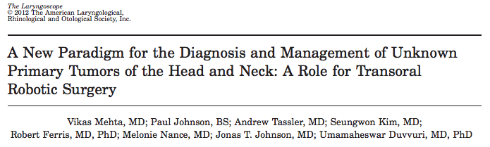
N = 10 CUP patients from the University of Pittsburgh
All patients underwent cervical bx, PET/CT, formal endoscopy, bilateral tonsillectomy, random bx BOT
When 1º site not found → TORS lingual tonsillectomy
9/10 (90%) with pathologic exam revealing invasive SCCa
Mean diameter = 0.9 cm
Notes:
Through TORS lingual tonsillectomy, this is a small case series illustrating highly efficacious technique for finding primary sites in CUP for whom traditional diagnostic paradigms have failed.
**Despite having had previous BOT bx, malignant tumor was not identified until after a TORS BOT resection was performed, suggesting ineffectiveness of a superficial, focal bx of the BOT

Slide 23
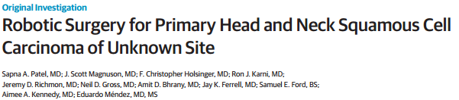
JAMA Otolaryngol Head Neck Surg. 2013
Multi-institutional study: University of Washington,
MD Anderson, University of Alabama-Birmingham, UT-Houston, Johns Hopkins, Oregon Health Sciences
N = 47 patients with CUP
Tumor site identified by TORS in 34 of 47 (72.3%)
18 with no suspicious findings → 72.2% identified
Suggests that regardless of the preoperative findings,
TORS had a consistently high diagnostic rate
Notes:
Variability in terms of imaging
Previous EUA and random biopsies not standard
Say this was only 18 that didn’t have localizing findings (compared to 10 pts in previous)
We should do TORS no matter what (methods state, why this is diff than previous)
All pts diagnosed as having HNSCC without known primary site despite PE and/or preoperative radiographs and who underwent biopsies with TORS to aid in the workup of primary site were included.
Suspicious findings (Palatine tonsils asymmetric, increased uptake and irregular supraglottis)
All presented initially with neck mass
Cianchetti- panendoscopy with directed bx and uniltaeral or bilateral tonsillectomy

Slide 24
Primary identified
Management appropriate for size and extent of disease
Allows options for surgical resection
Better definition of primary tumor target volume
Focused radiation field
Assists in post-treatment surveillance
Eisele, D. “Squamous cell carcinoma of the neck with unknown primary.” Auto-Digest Otolaryngology 2013.

Slide 25
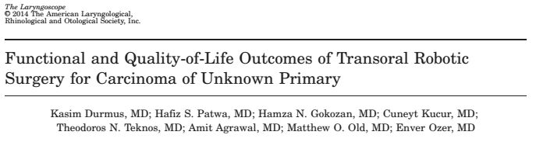
N = 22 at Ohio State University
Long-term QOL scores collected at baseline, 3 weeks,
3 months, 6 months, 12 months post-op
Four domains: speech, eating, aesthetics, social disruptions
Notes:
SCC detected in palatine tonsil in 12 pts (54.5%) and BOT in 4 pts (18.2%) → overall 72.2%

Slide 26
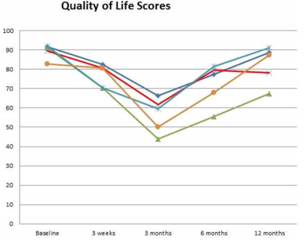
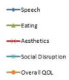
Notes:
Find out if this includes pts in which not found
Zoom
Frame numbers – X number of people with TORS, primary found in ___, these were QOL scores.

Slide 27
Patient JD
Palatine tonsillectomy and TORS lingual tonsillectomy
Path: Infiltrating SCC, moderately differentiated, left BOT
Chemoradiation for definitive treatment
Notes:
Why is he doing chemoradiation?
Discussed at tumor board, consensus was chemorad with narrow field ratdiation directed at BOT and decrewase morbidity

Slide 28
Conclusions
CUP is a devastating diagnosis with previously poor treatment options and prognoses
Wide-field radiation therapy causes significant morbidity
Finding primary site leads to much better survival outcomes
TORS has potential to improve both discovery of primary tumor sites and overall survival in these pts
Analysis of quality-of-life studies after TORS has shown minimal disruptions in day-to-day functions
Notes:
Tors has potential to…
Don’t praise it too much
Worth further study and long-term outcome data

Slide 29
Thank you

Slide 30
TORS Quality-of-Life study
SCC detected in palatine tonsil in 12 pts (54.5%) and BOT in four pts (18.2%)
No primary tumor identified in six patients (27.3%)
Complete tumor resection with negative margins achieved in 12 of 16 pts (75%)

Slide 31
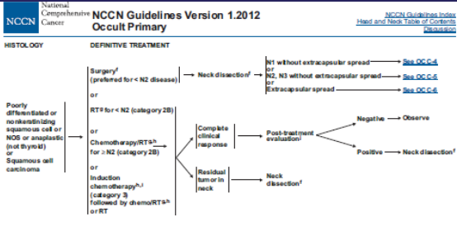
SCC detected in palatine tonsil in 12 pts (54.5%) and BOT in four pts (18.2%)
No primary tumor identified in six patients (27.3%)
Complete tumor resection with negative margins achieved in 12 of 16 pts (75%)

Slide 32
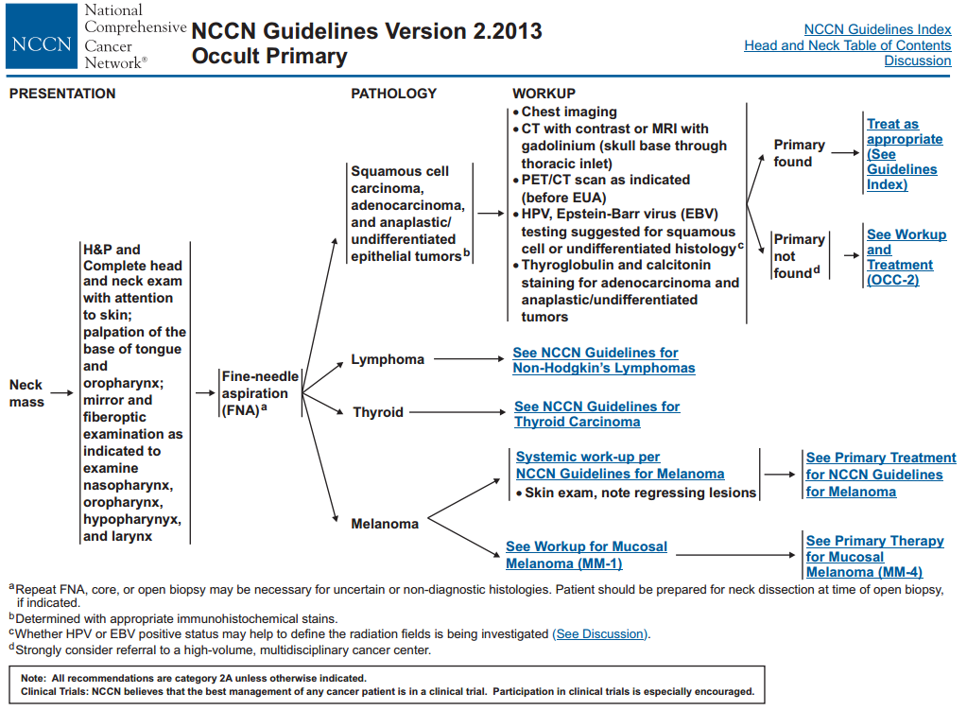
Grau et al; Radiother Oncol, 2000
Notes:
Explain why they used to do endoscopies of WALDEYER’S RING (have a slide)
What is widefield? All mucosal sites that could’ve possibly missed on bx- from skull base to hypopharynx?
NCCN guidelines- whether there is extracapsular extension?

Slide 33
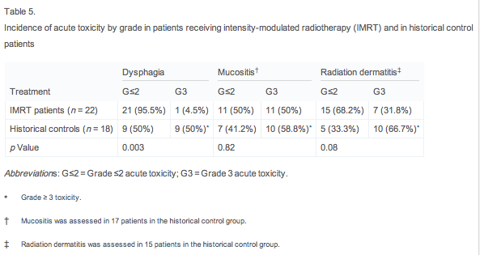
Notes:
Explain why they used to do endoscopies of WALDEYER’S RING (have a slide)
What is widefield? All mucosal sites that could’ve possibly missed on bx- from skull base to hypopharynx?
NCCN guidelines- whether there is extracapsular extension?

Slide 34
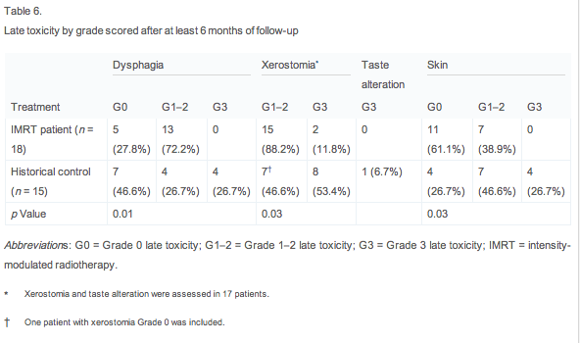
Notes:
Explain why they used to do endoscopies of WALDEYER’S RING (have a slide)
What is widefield? All mucosal sites that could’ve possibly missed on bx- from skull base to hypopharynx?
NCCN guidelines- whether there is extracapsular extension?

