Slide 1
Chapter 5: Outcomes Research
Soroush Zaghi, MD. Sept 2014.

Slide 2
Outcomes research
“Clinical Epidemiology” - Scientific study of treatment effectiveness
It allows researchers to gain knowledge about treatment effectiveness from observational data in the nonrandomized, real-world setting.
Study Design
Internal and External Validity
Confounding
Different types of bias in clinical research

Slide 3
History
In 1900, Dr. Ernest Codman proposed to study what he termed the “end results” of therapy at the Massachusetts General Hospital.
He asked his fellow surgeons to report the success and failure of each operation and developed a classification scheme by which failures could be further detailed. His attempts were scorned by the medical establishment.
Over the next 50 years, the medical community accepted the randomized clinical trial (RCT) as the dominant method for evaluating treatment.
By the 1960s, the authority of the RCT was rarely questioned.
A landmark 1973 publication by Wennberg and Gittelsohn spurred a sudden re-evaluation of the value of observational (nonrandomized) data.
This led to the realization that there was huge variations in the rates of surgery from region to region despite similar demographics and rates of disease.
Congress to establish the Agency for Health Care Policy and Research in 1989 (since renamed the Agency for Healthcare Research and Quality, or AHRQ), which was charged with “systematically studying the relationships between health care and its outcomes.”
In 2010, Congress authorized the establishment of Patient-Centered Outcomes Research Institute (PCORI) in the Patient Protection and Affordable Care Act of 2010.

Slide 4
Key terms and concepts
Bias – systematic error is introduced into sampling or testing by selecting or encouraging one outcome or answer to others.
Confounding- Similar to bias, confounding also has the potential to distort results. However, confounding refers to specific variables.
Some degree of bias and confounding is nearly ALWAYS present in published research.
The key is to identify the source of bias and consider the degree to which bias was prevented by proper study design and implementation.

Slide 5
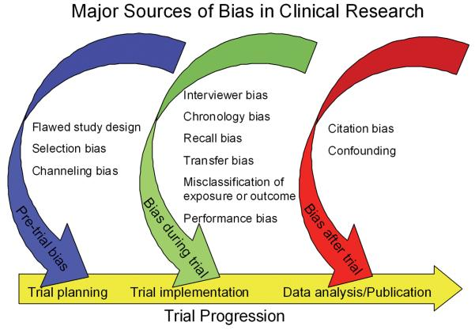
Bias in ClinIcal Research

Slide 6
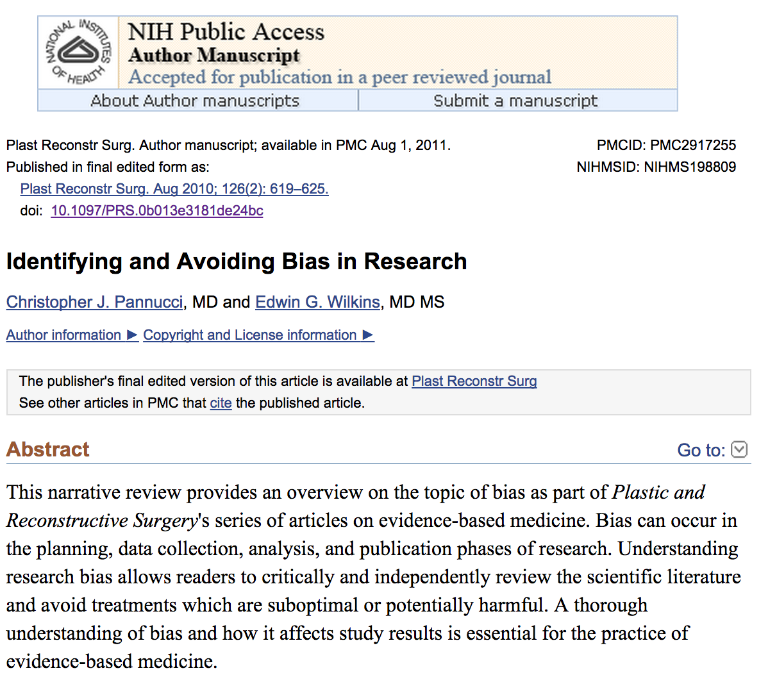

Slide 7
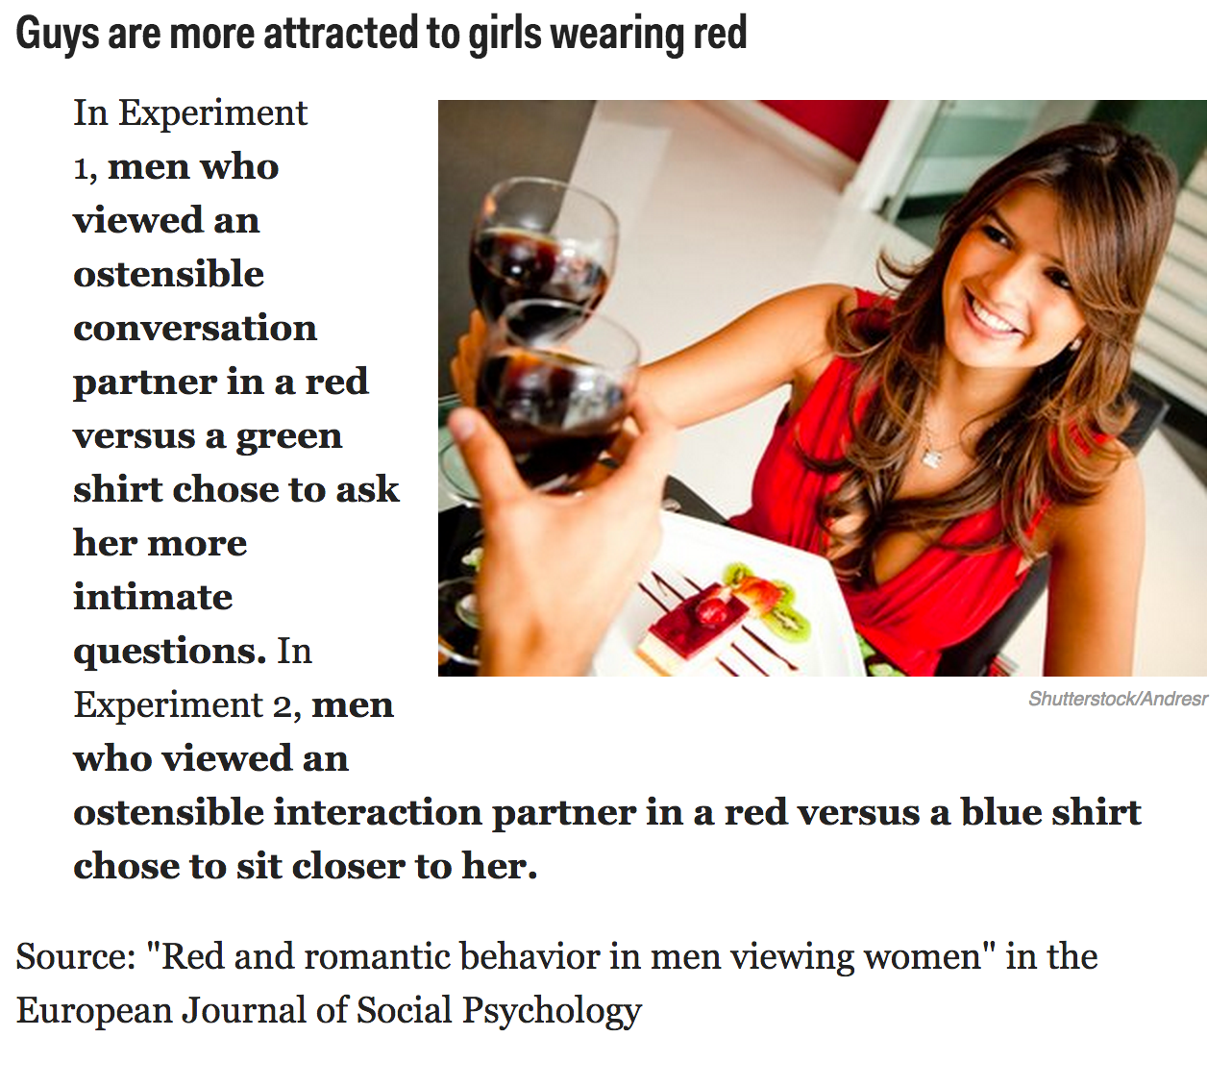
Red and romantic behavior in men viewing women

Slide 8


Slide 9
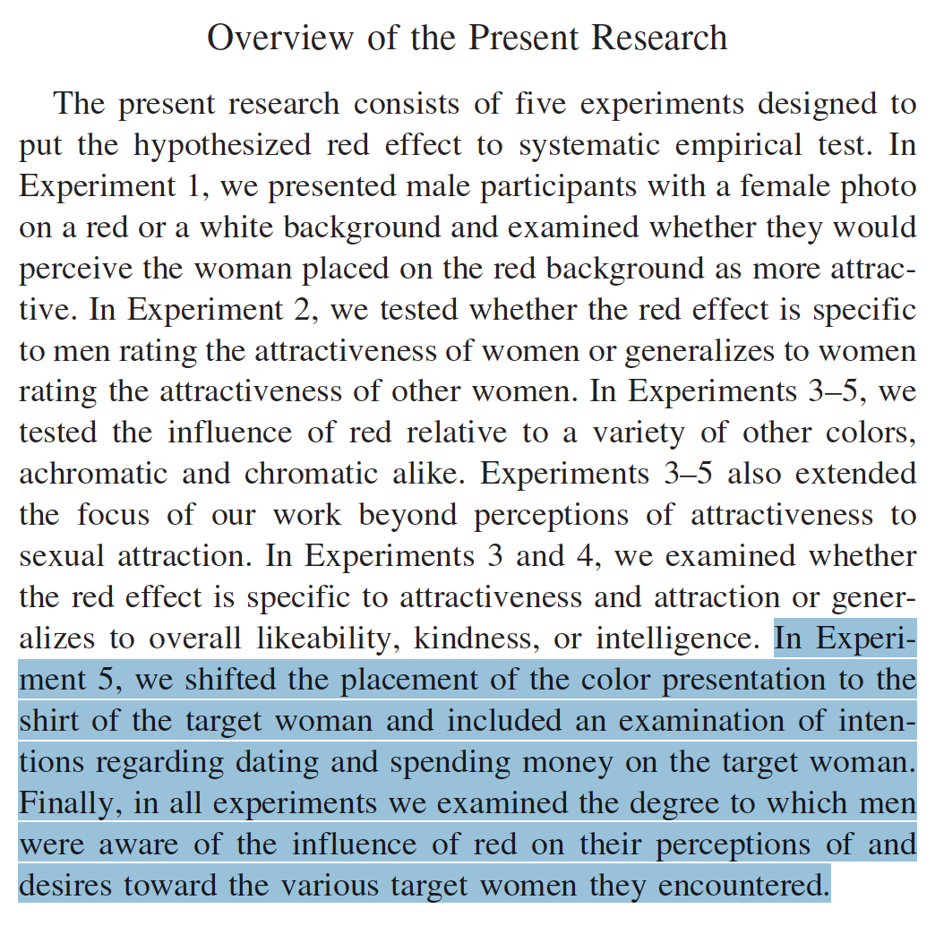

Slide 10
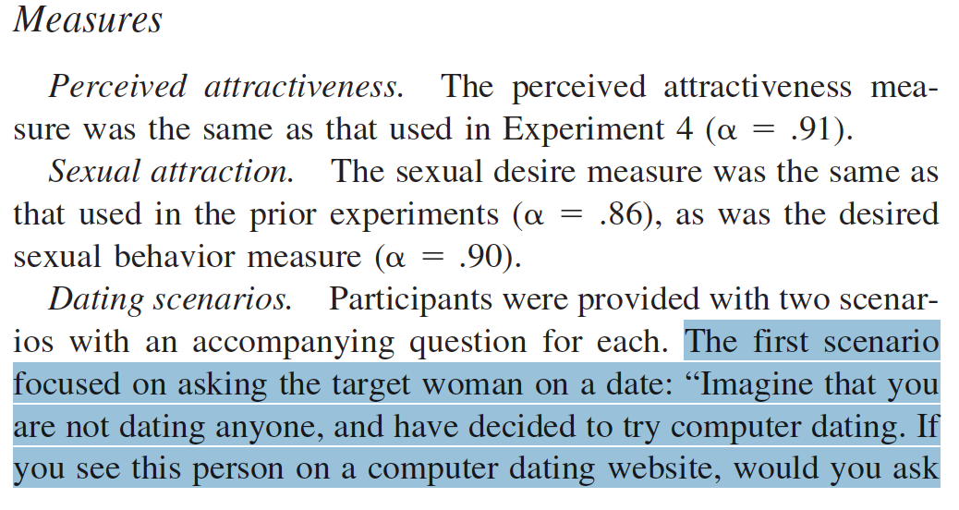
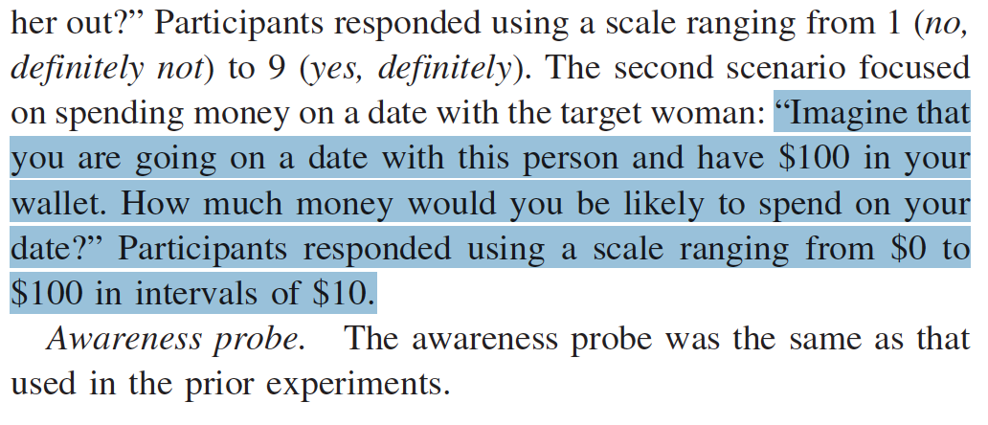

Slide 11
Bias due to flawed Study Design
Recommendation: Clearly define risk and outcome, preferably with objective or validated methods. Standardize and blind data collection.
Internal vs. External Validity
Internal validity refers to the reliability or accuracy of the study results.
The study design, implementation, and data analysis have minimized or eliminated bias
The findings are representative of the true association between exposure and outcome.
Studies with high internal validity are usually conducted under idealized conditions in a highly selected population.
However, high internal validity often comes at the expense of ability to be generalized.
External validity of research design deals with the degree to which findings are able to be generalized to other groups or populations.
Designed to assess the benefits of interventions under real clinical conditions.
These studies usually include study populations generated using minimal exclusion criteria, making them very similar to the general population.
The loose inclusion criteria, however, may compromise the study's internal validity.

Slide 12
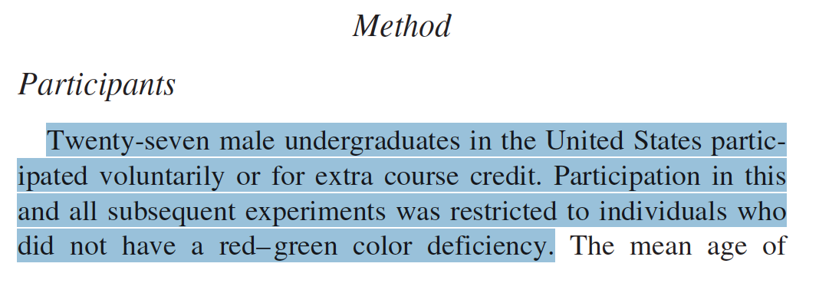
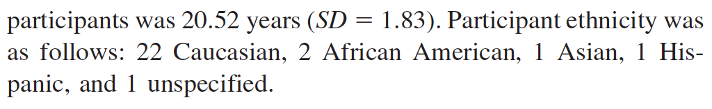
Controlling for confounding variables

Slide 13
Psychometric Validation
An important contribution of outcomes research has been the development of questionnaires to quantify these “soft” constructs, such as symptoms, satisfaction, and QOL
Reliability. A reliable scale reproduces the same result in precise fashion.
For example, assuming there is no clinical change, a scale administered today and next week should produce the same result. This is called test-retest reliability.
Other forms of reliability include internal consistency and interobserver reliability.
Validity. A valid scale measures what it is purported to measure.
Responsiveness. A responsive scale detects clinically important change.
Burden. Burden refers to the time and energy that patients must spend to complete a scale, as well as the resources necessary for observers to score the questionnaire.

Slide 14
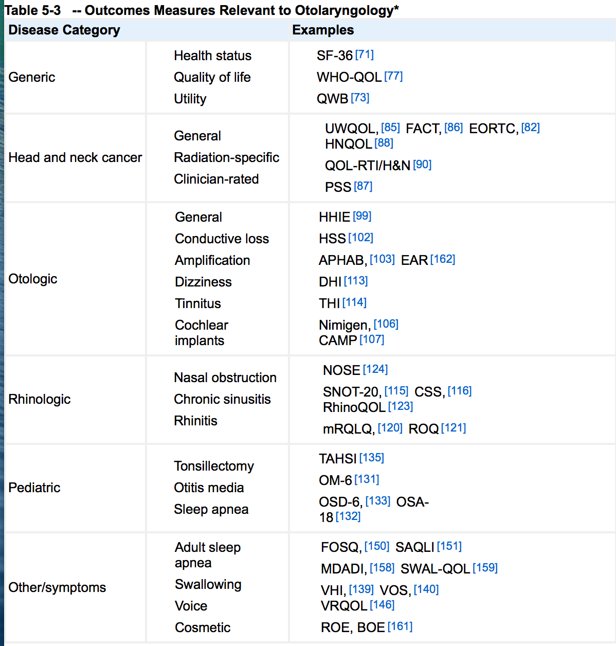

Slide 15
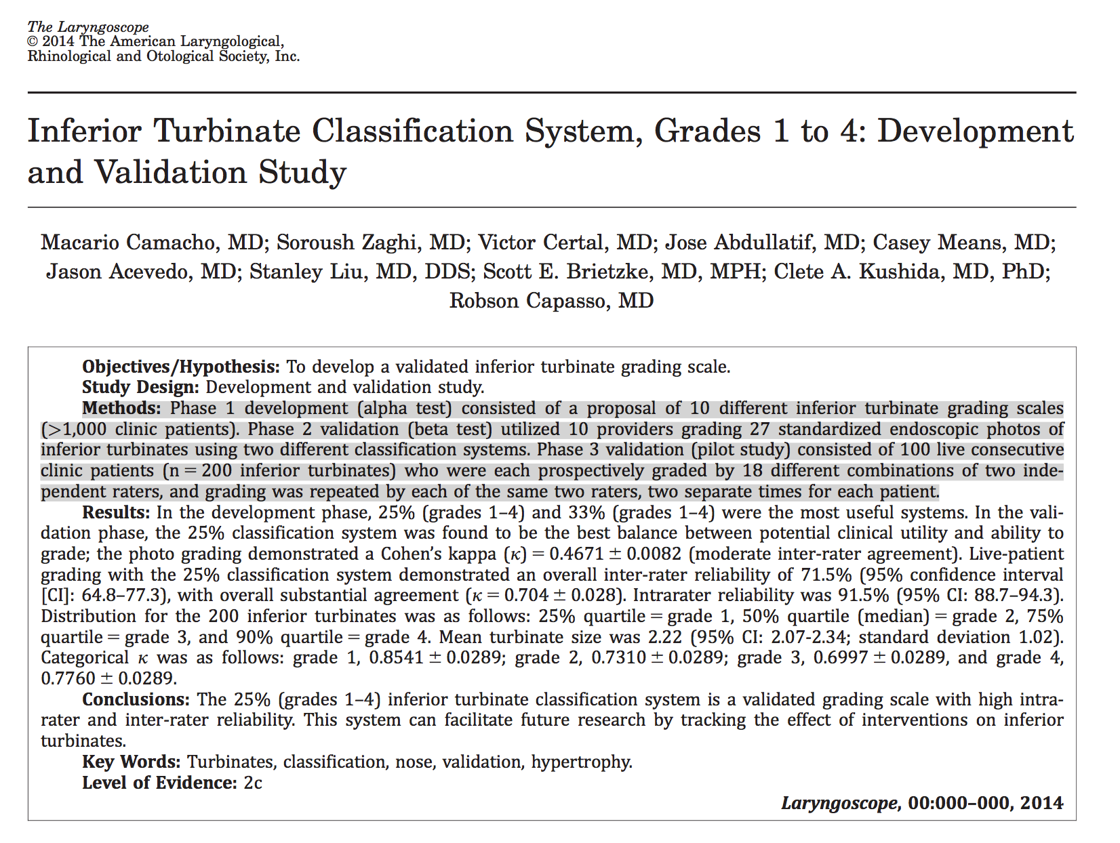

Slide 16
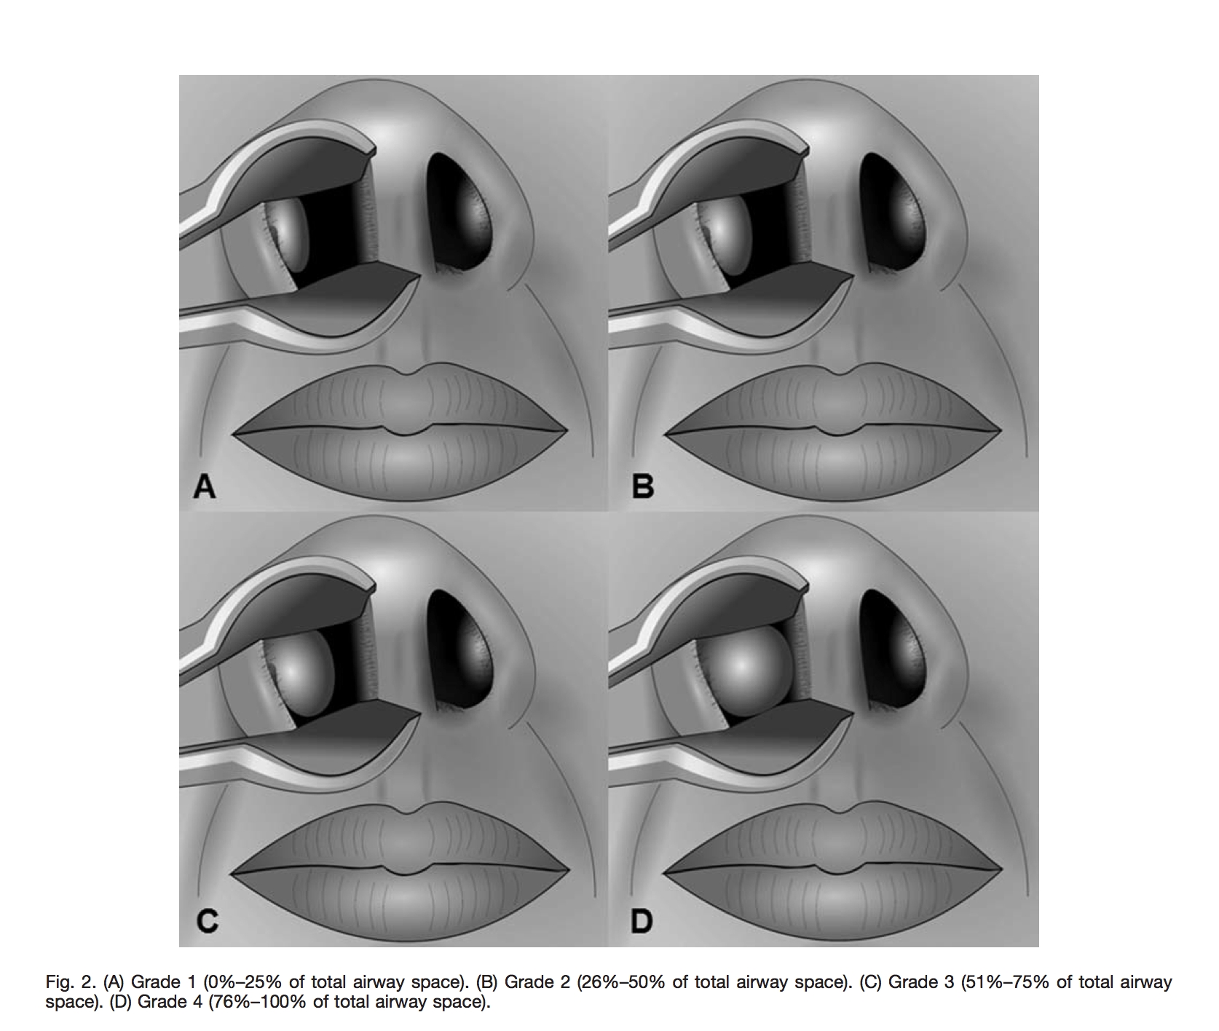

Slide 17
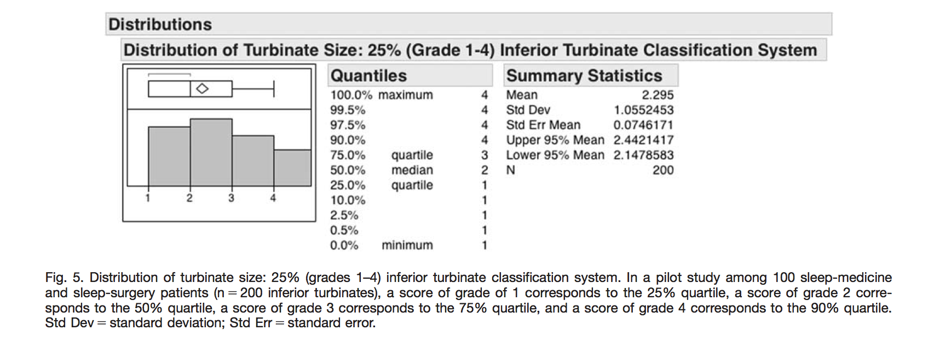

Slide 18
Recap of learning Points
Study Design- Asking the right questions. Validated, well-thought out, appropriate for the objective.
Controlling for Confounding- eg. color blindness, gender, age, college major, education-level.
Internal Validity- Reproducibility within the same sample population. (eg. Young, white, undergraduate males who are not color blind).
External Validity- Generalizing results to others in the general population.

Slide 19
Bias in ClinIcal Research

Slide 20
Selection BiaS
Selection bias may occur during identification of the study population.
When a study population is identified, selection bias occurs when the criteria used to recruit and enroll patients into separate study cohorts are inherently different.
Recommendation: Select patients using rigorous criteria to avoid confounding results. Patients should originate from the same general population. Well designed, prospective studies help to avoid selection bias as outcome is unknown at time of enrollment.

Slide 21
Bias in ClinIcal Research

Slide 22
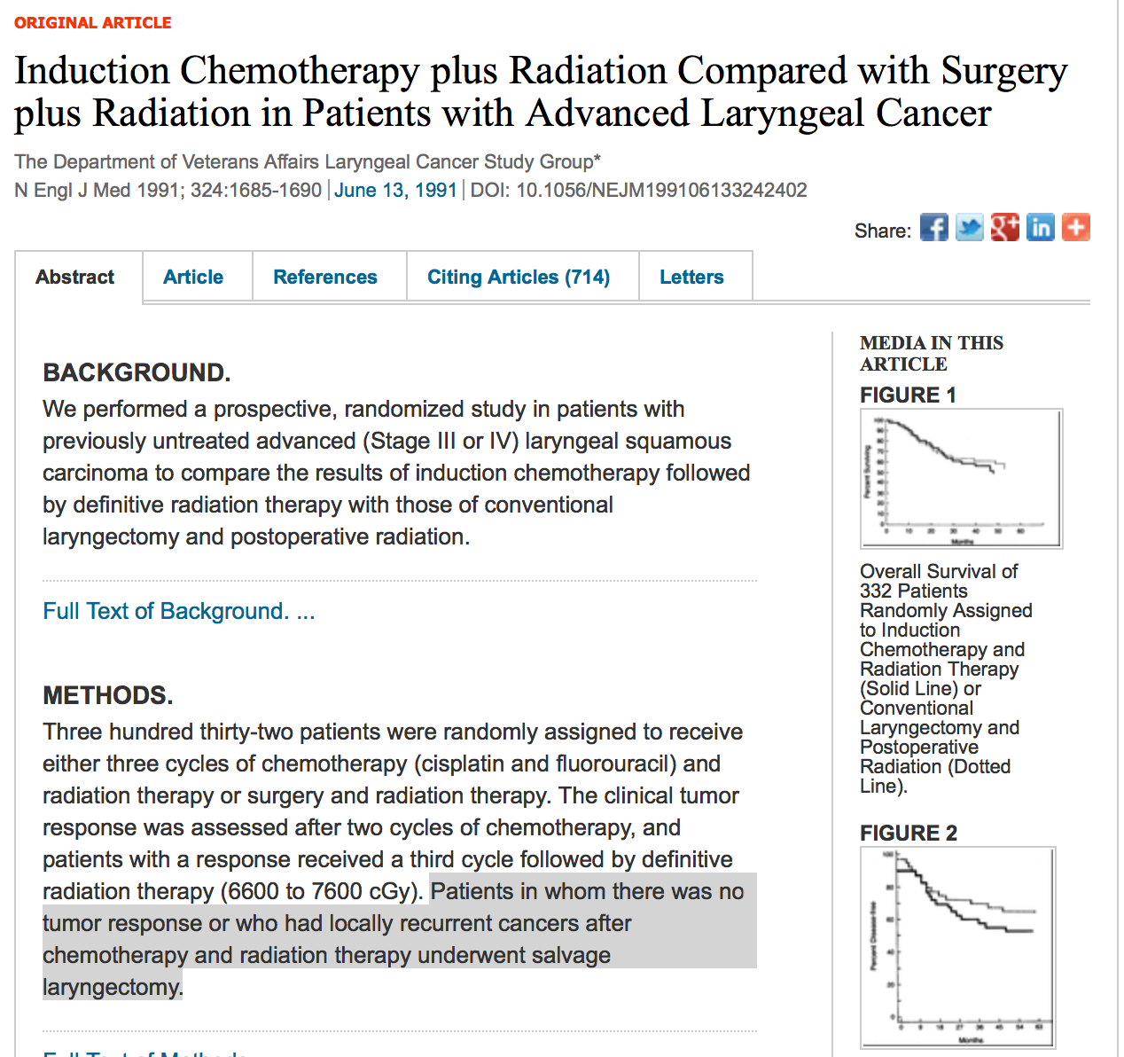

Slide 23
Identifying sources of bias: Pre-Trial Bias
The landmark paper by the VA Laryngeal Cancer Study Group: “Induction Chemotherapy plus Radiation Compared with Surgery plus Radiation in Patients with Advanced Laryngeal Cancer” published in NEJM 1991 assigned laryngeal cancer patients to chemotherapy + XRT vs. surgery + XRT on the basis of response to 2 rounds of chemotherapy.
This is an example of:
Selection Bias
Channeling Bias
Interviewer Bias
Chronology Bias
Recall Bias
Performance Bias
Transfer Bias

Slide 24
Channeling Bias vs. Selection Bias
Channeling bias occurs when patient prognostic factors or degree of illness dictates the study cohort into which patients are placed. This bias is more likely in non-randomized trials when patient assignment to groups is performed by medical personnel.
In surgical studies, channeling bias can occur if one intervention carries a greater inherent risk and there is an inherent difference in terms of which patients are assigned to the intervention.
Older patients vs. younger healthy patients
Aggressive, resistant tumors vs. less aggressive tumors

Slide 25
Chronology Bias
Chronology bias occurs when historic controls are used as a comparison group for patients undergoing an intervention.
Secular trends within the medical system could affect how disease is diagnosed, how treatments are administered, or how preferred outcome measures are obtained.
Advent of CT scans changes the rate and stage of disease diagnosis
Chronology bias can be minimized by conducting prospective cohort or randomized control trials, or by using historic controls from only the very recent past.

Slide 26
Identifying sources of bias: BIAS During Trial
A patient with Buerger's disease is enrolled in a case control study which attempts to retrospectively identify risk factors.
If the interviewer is aware that the patient has Buerger's disease, he/she may probe for risk factors, such as smoking, more extensively than in control patients.
“Are you sure you've never smoked? Never? Not even once?”
This is an example of:
Selection Bias
Channeling Bias
Interviewer Bias
Chronology Bias
Recall Bias
Performance Bias
Transfer Bias

Slide 27
Interviewer Bias
Interviewer bias refers to a systematic difference between how information is solicited, recorded, or interpreted.
Interviewer bias is more likely when disease status is known to interviewer.
Interviewer bias can be minimized or eliminated if the interviewer is blinded to the outcome of interest or if the outcome of interest has not yet occurred, as in a prospective trial.

Slide 28
Interviewer Bias
Interviewer bias can be minimized by using structured interviews.
Interviewer should follow a script and be conscientious about their potential influence on responses.
Advantages of unstructured interviews:
Respondents may be more likely to discuss sensitive and painful experiences if they feel the interviewer is sympathetic and understanding.

Slide 29
Identifying sources of bias: BIAS During Trial
A quality of life survey was performed among patient who underwent mandibular resection and free-flap reconstruction for ORN.
The researchers attempted to contact 68 patients by telephone. Patient death was confirmed in 10.3% (7/68) of cases. The remaining 35% (24/68) of patients were deemed as lost to follow up. 37 patients were successfully reached and 33 of them volunteered to participate in the study.
The patients were who lost to follow up may have been part of an ORN cohort with lower quality of life scores.
Differential losses to follow up is an example of:
Selection Bias
Channeling Bias
Interviewer Bias
Chronology Bias
Recall Bias
Performance Bias
Transfer Bias

Slide 30
Transfer Bias
In almost all clinical studies, subjects are lost to follow-up. In these instances, investigators must consider whether these patients are fundamentally different than those retained in the study.
Researchers must also consider how to treat patients lost to follow-up in their analysis. Well designed trials usually have protocols in place to attempt telephone or mail contact for patients who miss clinic appointments.
Transfer bias can occur when study cohorts have unequal losses to follow-up. This is particularly relevant in surgical trials when study cohorts are expected to require different follow-up regimens.
Some authors suggest that patient loss to follow-up can be minimized by offering convenient office hours, personalized patient contact via phone or email, and physician visits to the patient's home

Slide 31
Identifying sources of bias: BIAS During Trial
A quality of life survey was performed among patient who underwent mandibular resection and free-flap reconstruction for ORN.
37 patients were successfully reached and 33 of them volunteered to participate in the study.
The patients who agreed to volunteer for the telephone survey may have been part of an ORN cohort with higher quality of life and satisfaction scores.
This is an example of:
Selection Bias
Channeling Bias
Interviewer Bias
Chronology Bias
Recall Bias
Performance Bias
Transfer Bias

Slide 32
Identifying sources of bias: BIAS During Trial
After a clinic appointment patients are asked:
“How long did you have to wait after you arrived in the waiting room for your appointment?
Patients who were satisfied with the clinical encounter might estimate lower wait times as compared to patients dissatisfied with the encounter.
This is an example of:
Selection Bias
Channeling Bias
Interviewer Bias
Chronology Bias
Recall Bias
Performance Bias
Transfer Bias

Slide 33
Recall BiAS
Recall bias refers to the phenomenon in which the outcomes of treatment (good or bad) may color subjects' recollections of events prior to or during the treatment process.
Very important to consider when collecting data retrospectively.
Patient’s memory of pre-op pain, quality of life, dysphagia, etc. can be unreliable.

Slide 34
Identifying sources of bias: BIAS During Trial
A multi-institutional study is performed to assess the reliability of osteocutaneous free flaps for mandible reconstruction.
Fibula flap in the study were primarily performed at UCLA by Dr. Blackwell
Osteocutaneous radial forearm flaps were performed by some random doctor at Pittsburgh.
Fibula flaps are found to have superior outcomes in comparison to osteocutaneous radial forearm free-flaps.
This conclusion in this study that fibula flap has superior outcomes is confounded by:
Selection Bias
Channeling Bias
Interviewer Bias
Chronology Bias
Recall Bias
Performance Bias
Transfer Bias

Slide 35
Performance bias
In surgical trials, performance bias may complicate efforts to establish a cause-effect relationship between procedures and outcomes.
Variations by surgeon commonly occur in surgical plan, flow of operation, and technical maneuvers used to achieve the desired result.
The surgeon's experience may have a significant effect on the outcome.
Examples:
Outcome research studying stapedectomy vs. stapedotomy.
Fibula flap at UCLA vs. radial bone flap at another hospital. Are you comparing the outcomes in surgery or the different performance of the surgeons?

Slide 36
Bias in ClinIcal Research

Slide 37
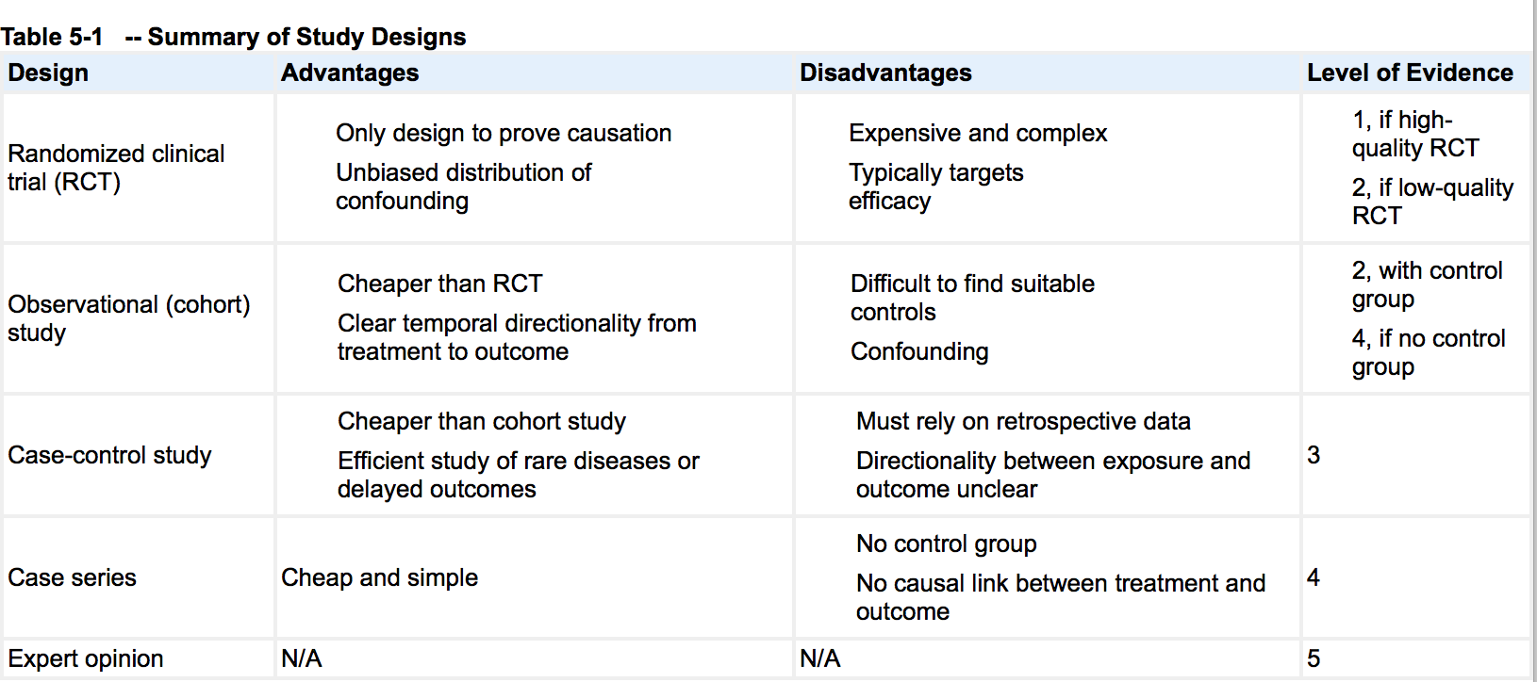
Study Design

Slide 38
Study Design
Observational Study (Level 2 – if control group)
patients are identified at baseline before treatment (or “exposure” ),
Similar to randomized trials.
However, these studies accrue patients who receive routine clinical care.
Inclusion criteria are substantially less stringent, and
Treatment is assigned by the provider in the course of clinical care.
Patients and providers are neither randomized nor blinded.
Case-Control Study (Level 3 )
Case-control studies are typically used by traditional epidemiologists to identify risk factors for the development of disease.
In contrast to randomized and observational studies, which identify patients before exposure to a treatment (or a pathogen), and then follow patients forward in time to observe the outcome, case-control studies use the opposite temporal direction.
ORN: Identify patients with the disease vs. XRT patient who didn’t get ORN and then ask them questions about potential causative factors
Food poisoning: who has food poisoning and who doesn’t; what did you eat, where did you dine, etc.
This design is particularly valuable when prospective studies are not feasible, either because the disease is too rare or because the time interval between baseline and outcome is prohibitively long.

Slide 39
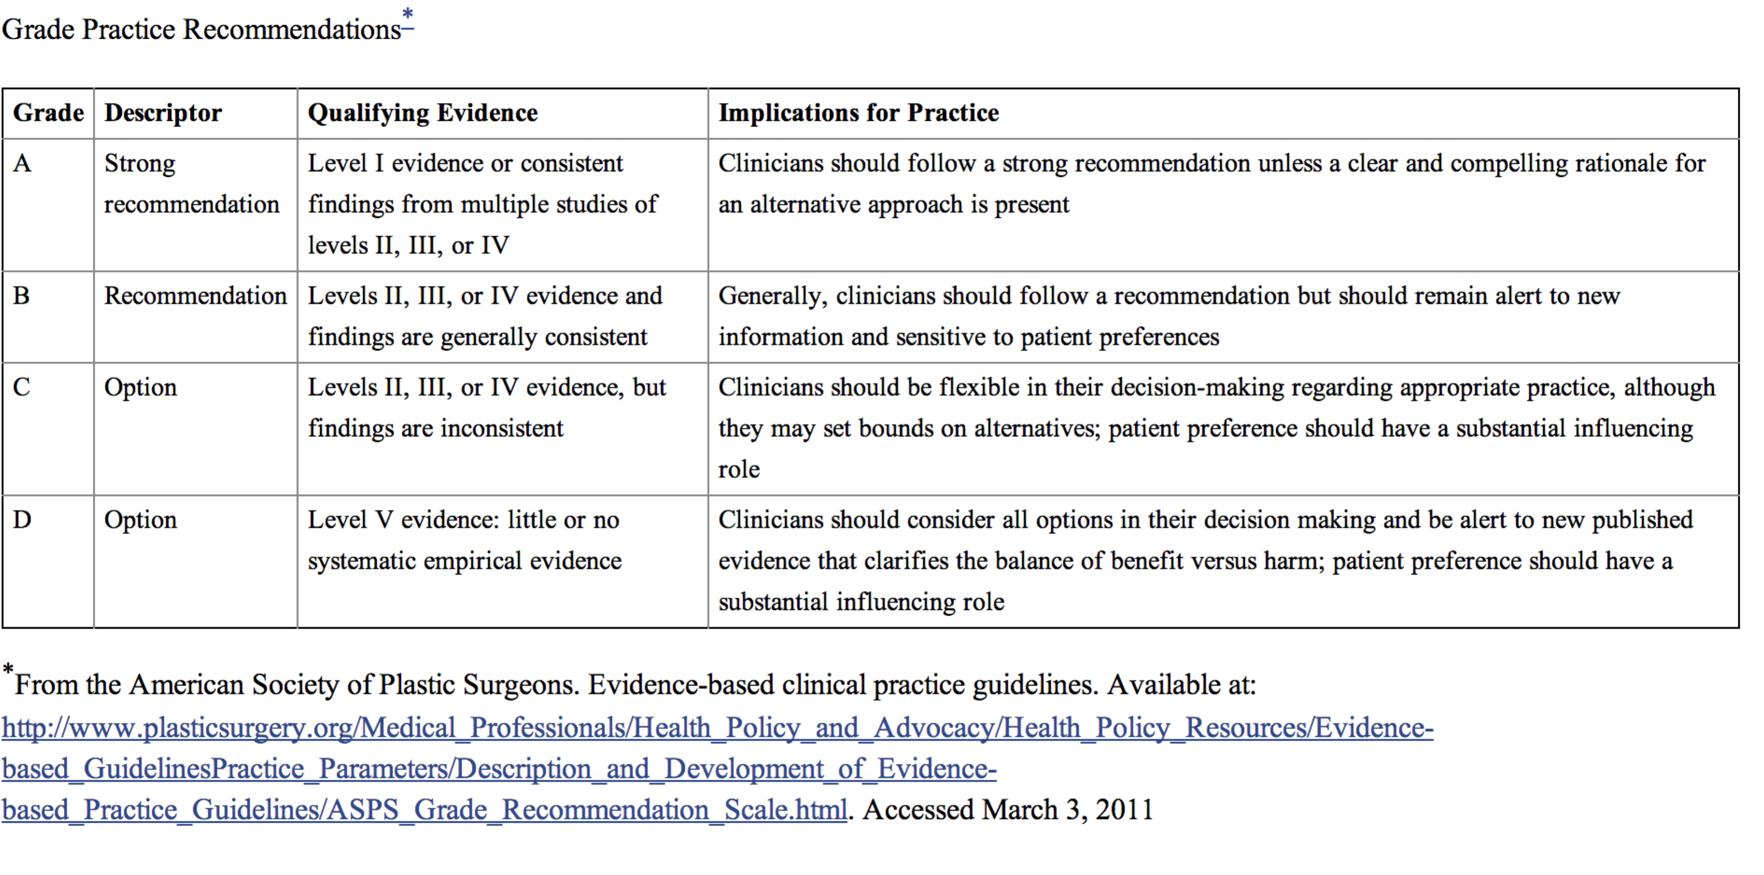
Grade PractiCe recommendations

Slide 40
Outcomes research
Study Design
Internal and External Validity
Confounding
Different types of bias in clinical research
Case-control vs. Observational Study
Levels of Evidence

Slide 41
Ch. 6: Interpreting Medical Data
Soroush Zaghi, MD. Sept 2014.

Slide 42
Objective
Understand the fundamental principles of data analysis and interpretation.
Types of Error
Sample Size Calculation
Clinical Significance vs. Statistical Significance
Standard Error vs. Standard Deviation
95% Confidence Intervals
Meta-Analysis
Parametric vs. Non-Parametric Data
Framework and References to Learn More

Slide 43
TypeS of error
If a study fails to find an association between an exposure and an outcome, even though one really does exist, this mistake is called:
Type I error
Type II error
Type III error
Type IV error

Slide 44
Type I/II Error
Type I error- occurs when the statistical tests show a positive result, but in reality the association is not true
The result is a product of chance and bias- not the “truth”
false positive.
α is the probability of a type I error,
Α is usually set at p=-0.05, 0.01, 0.001.
Type II error- occurs when the association is really true, but the statistical tests do not show a significant result.
false negative.
β (beta) is the rate of the type II error and is related to the power of a test (which equals 1−β).
A study with high power is less likely to miss a positive result.
Power may range from 80-99% in an appropriately designed study.

Slide 45
More on Type I error
What should I consider significant for my p-value?
P<0.05
P<0.01
P<0.001
➔ Depends on how much risk you are willing to accept with the possibility of having a false positive.

Slide 46

O.J. Simpson trial: Jury Decisions
O.J. is assumed innocent in the criminal trial, but guilty in the civil trial.
Evidence collected: size 12 Bruno Magli bloody footprint, bloody glove, blood spots on white Ford Bronco, the knock on the wall, DNA evidence from above, motive(?), etc…
What do you think: did he do it? Is he guilty?
A) Yes- definitely
B) Probably Yes
C) Probably No
B) No- absolutely not

Slide 47
O.J. Simpson trial: Jury Decisions
O.J. is assumed innocent in the criminal trial, but guilty in the civil trial.
There is at least some uncertainty as to whether or not he did it.
Let’s say: There’s a 90% chance he did it, but 10% chance he did not do it.
Criminal trials: “Beyond a reasonable doubt.” 12 of 12 jurors must unanimously vote guilty. Significance level α set at 0.01, for example.
Civil trials: “Preponderance of evidence.” 9 out of 12 jurors must vote guilty. Significance level α would be set at 0.25, in this example.
In criminal trial: The alpha is set at p=0.01 and the result is p=0.10. The evidence does not warrant rejecting the assumption of innocence. Behave as if O.J. is innocent.
In civil trial: The alpha is set a p=0.25 and p=0.10, evidence warrants rejecting the assumption of innocence. Behave as if O.J. is guilty.

Slide 48
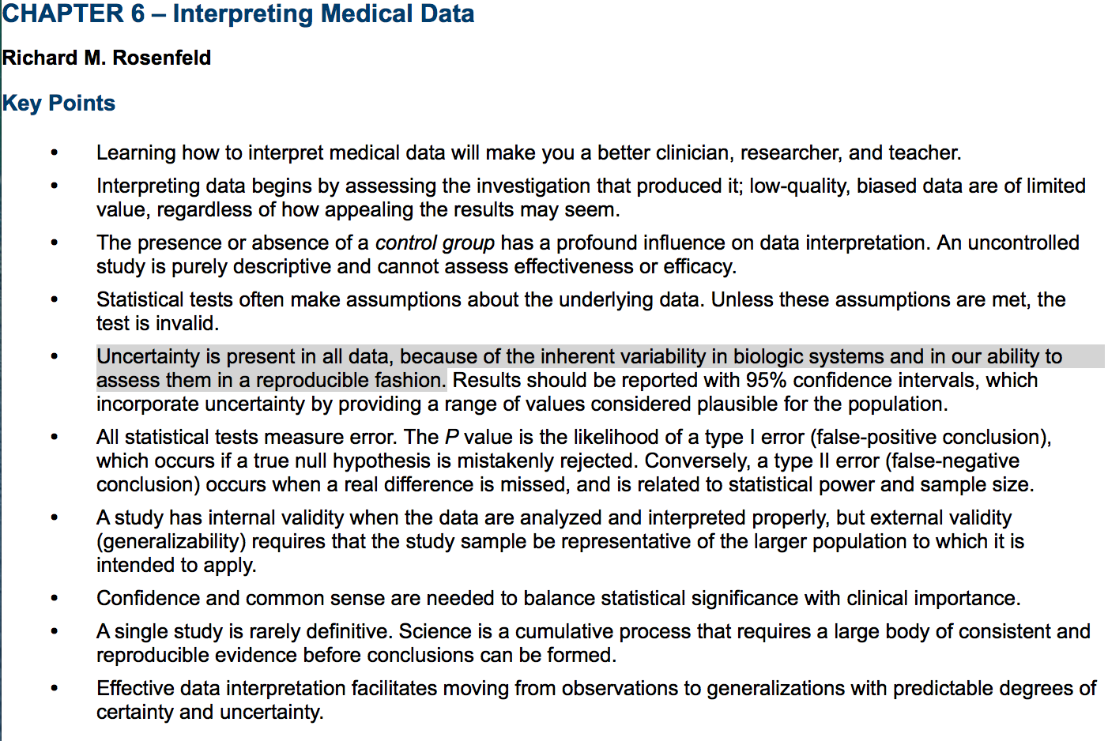
What about the truth?

Slide 49
Minimize chance of Type I error...
We can never know “The Truth”
But, we can develop some confidence in what might be the truth.
And, we can reduced our risk of being wrong…
… by making significance level α small.
Common values are α = 0.01, 0.05, or 0.10.
“How small” depends on seriousness of Type I error.
Decision is not a statistical one but a practical one.

Slide 50
Sample Size Calculation
Use pilot study to estimate the mean and standard deviation.
BP: 120/60 +/- 10 mm Hg
Anaplastic Thyroid Cancer Survival: 6 +/- 3 months
Decide what a meaningful difference would be between the mean in the control group and the mean in the experimental group.
BP: 15 mm Hg
Survival: 1 month, 3 months, 6 months, etc.
Specify α. Typically 0.001 to 0.05.
BP: p=0.001 (you want to be really sure before you recommend it)
Cancer: p= 0.05 (we are desperate, so we can be “sort of” sure and will accept the 5% chance that our result is a false positive)
Decide power: Typically 0.80 to 0.99, depends on how confident you want to be at the end of the study that you did not have a false negative- that you are not missing a meaningful difference.
Use software to determine sample size.

Slide 51
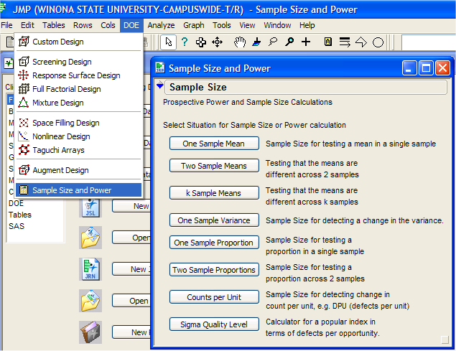
Using JMP to Determine Sample Size – DOE > Sample Size and Power

Slide 52
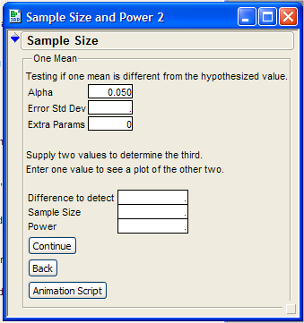
Using JMP to Determine Sample Size – One Sample Mean

Slide 53
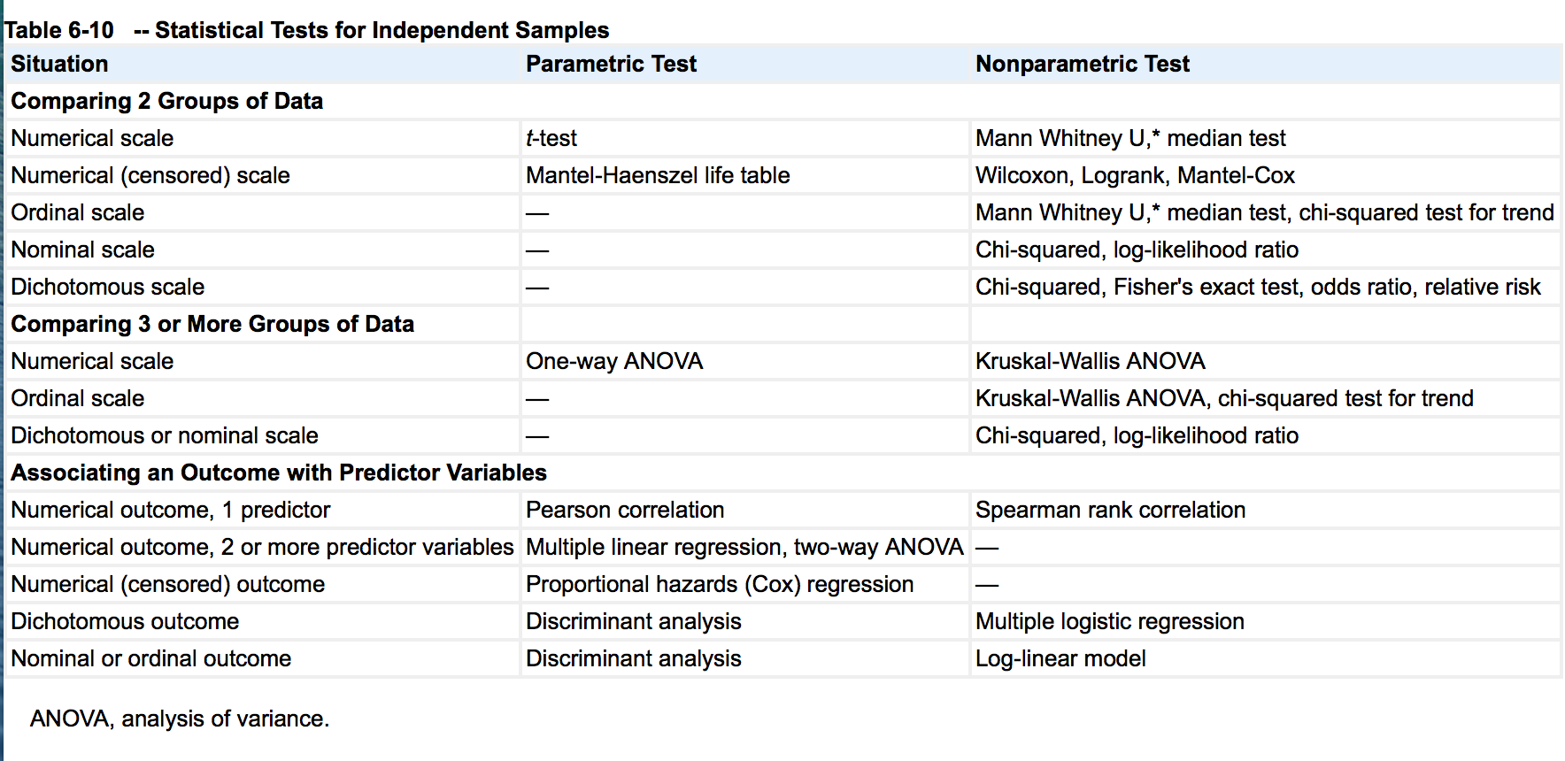

Slide 54


Slide 55


Slide 56
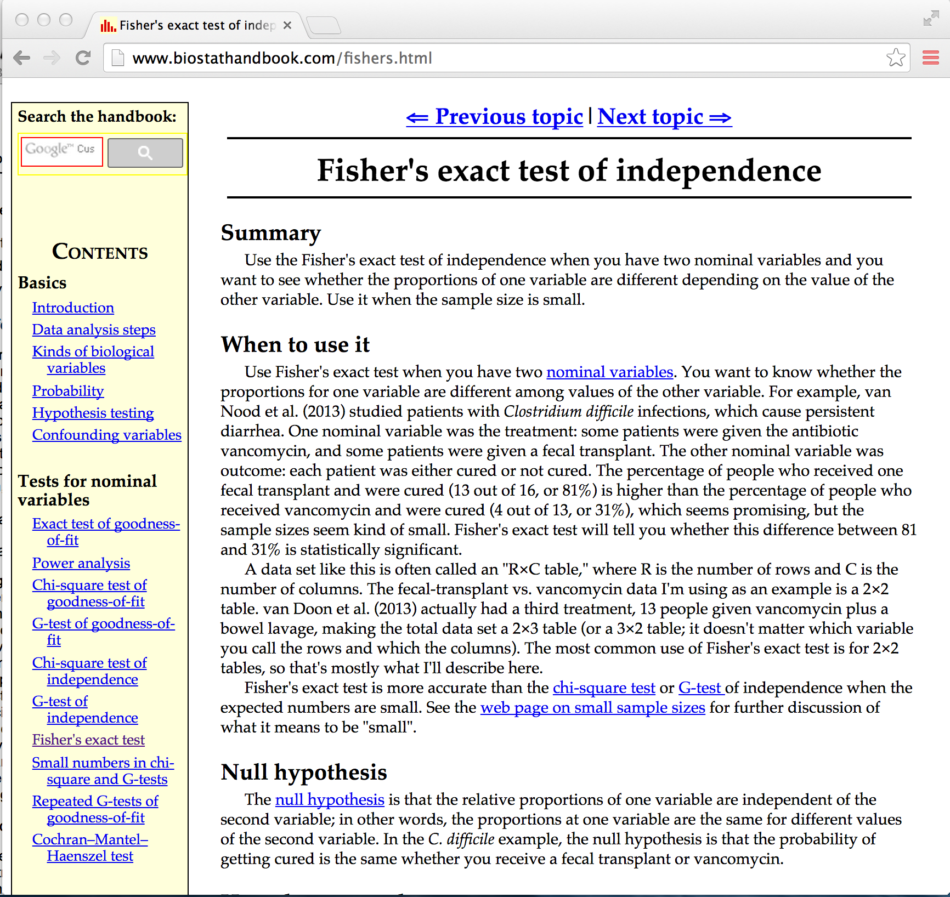

Slide 57
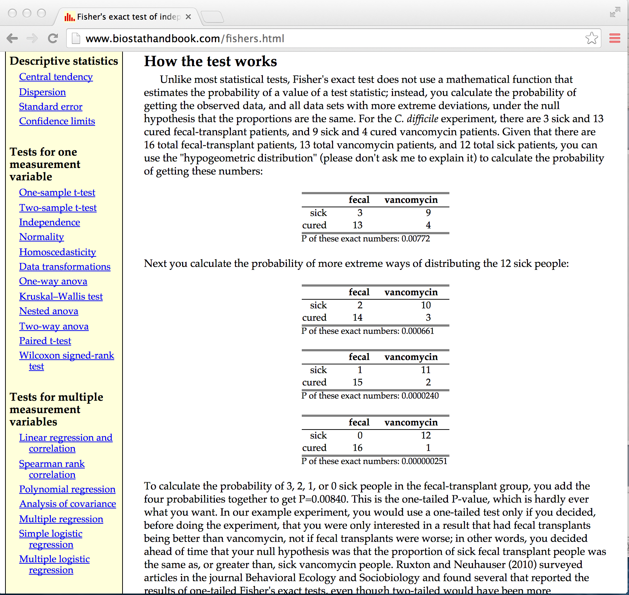

Slide 58
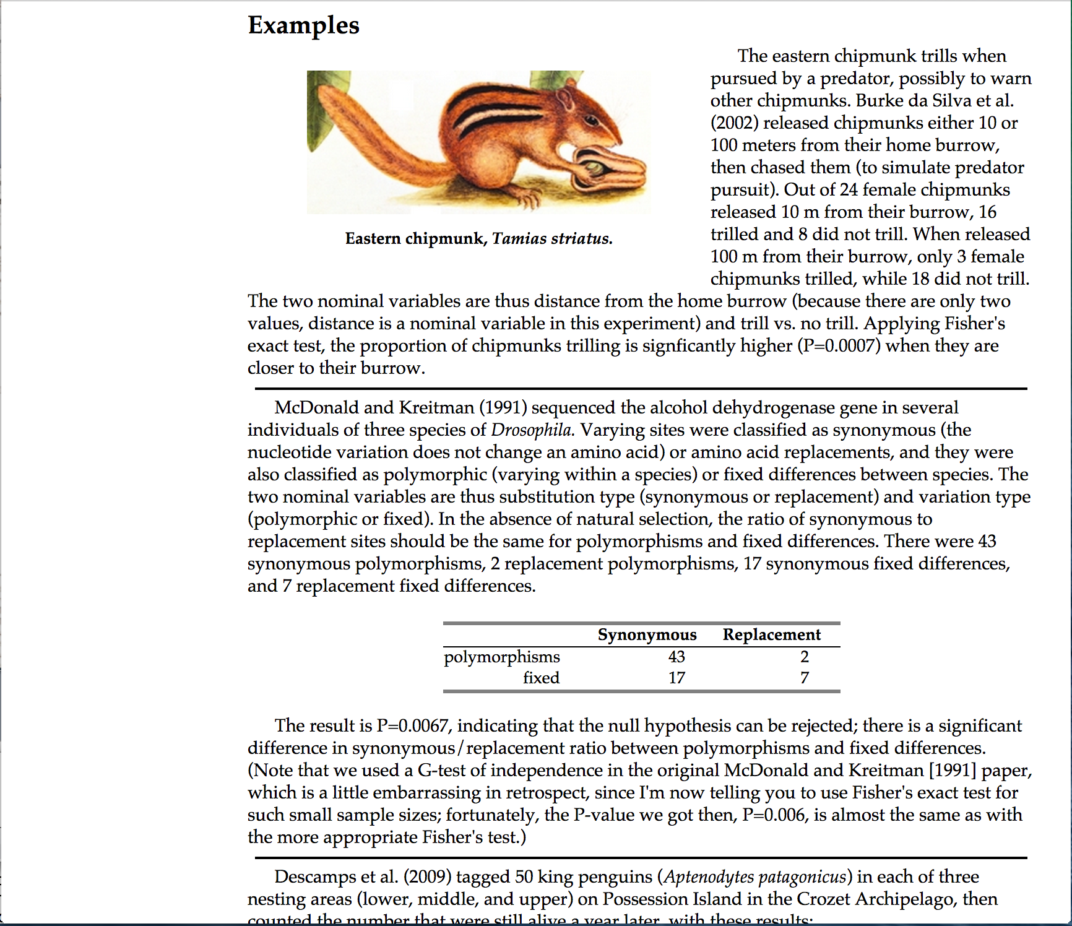

Slide 59
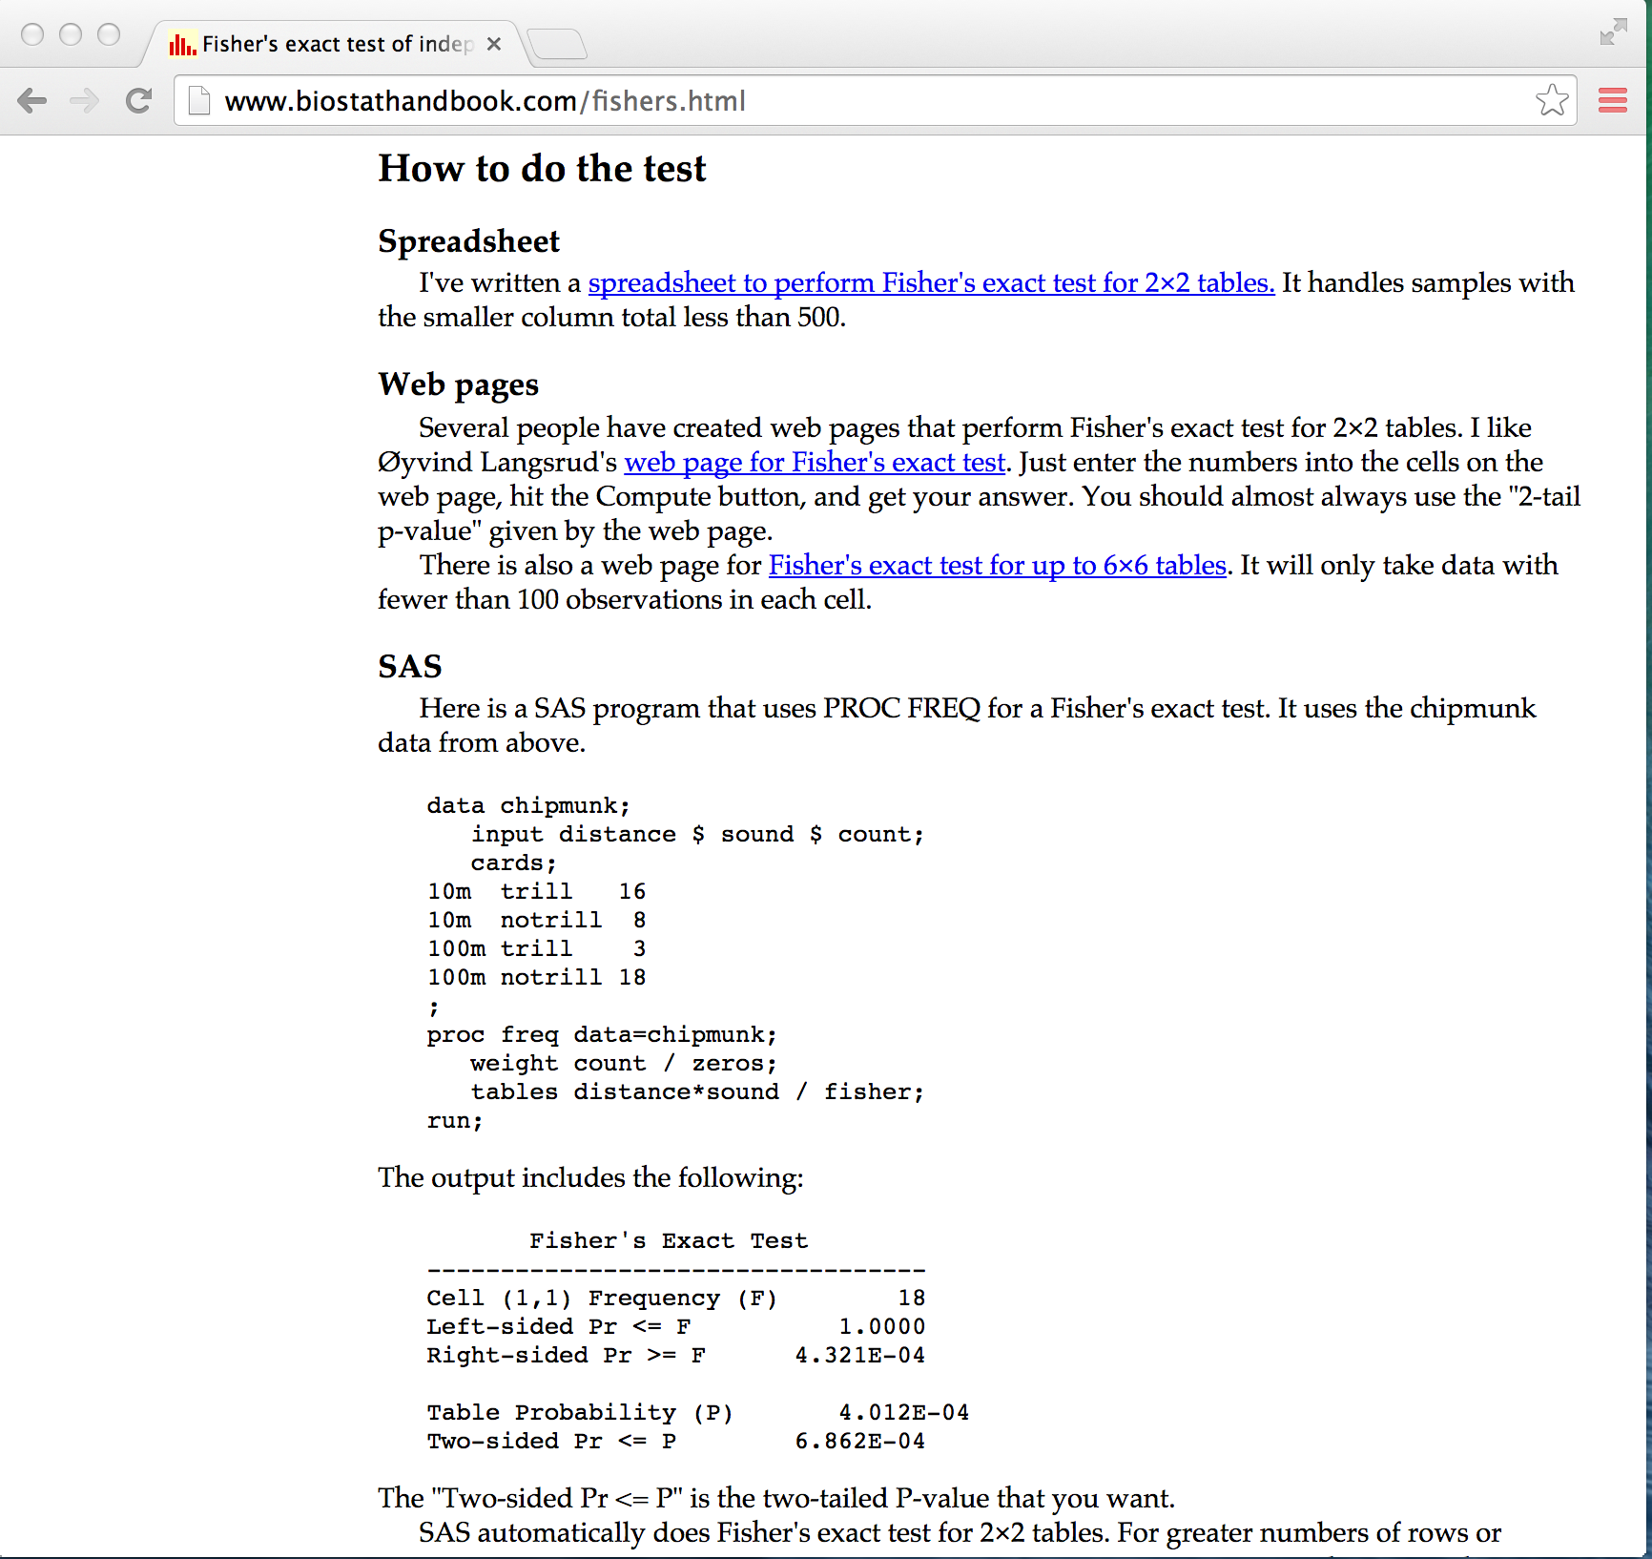

Slide 60

Clinical Importance Vs. Statistical significance

Slide 61
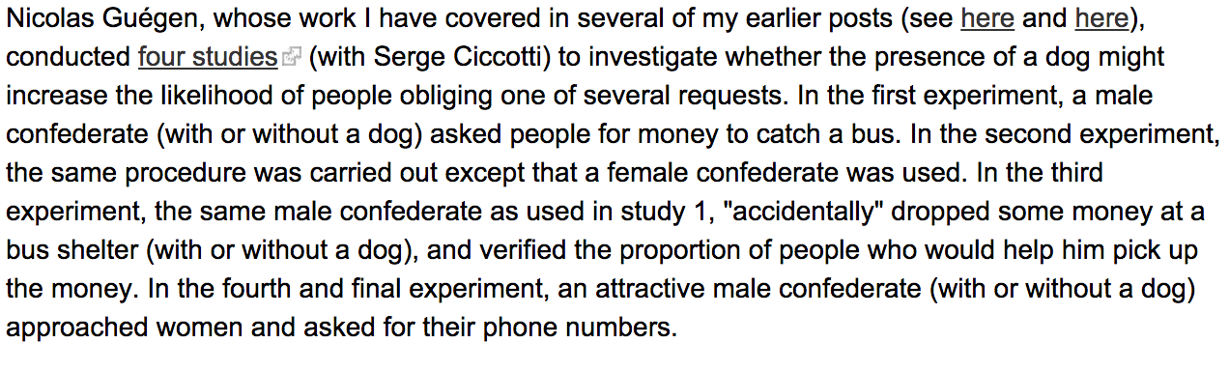
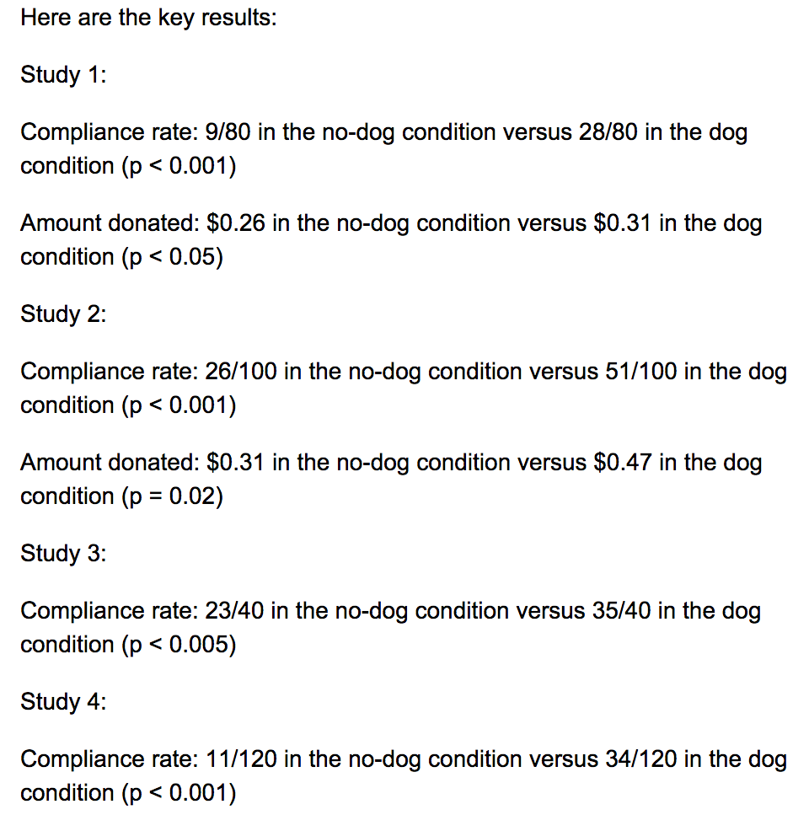


Slide 62
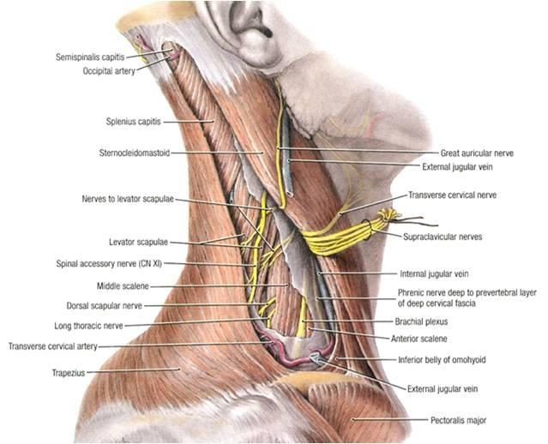
Standard error vs. Standard deviation
Spinal accessory nerve is located 1 cm posterior and superior to Erb’s point.
To understand the Normal Distribution of the location of CN XI, do you need to know:
Standard Error
Standard Deviation?

Slide 63
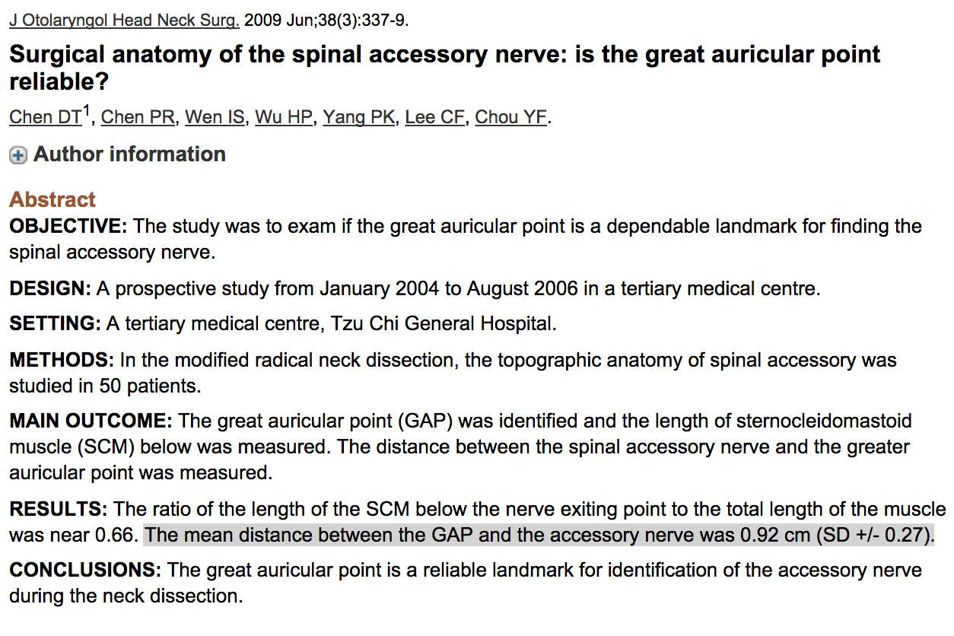
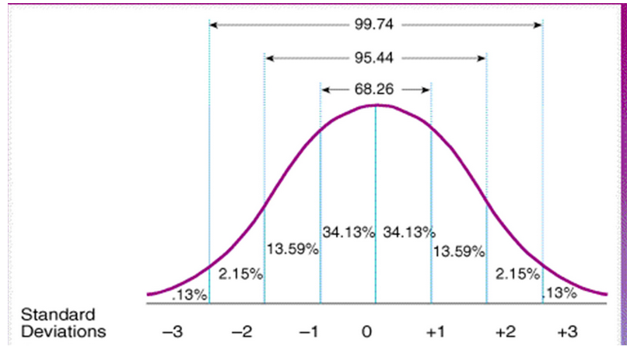
Mean 0.92 +/- SD 0.27 cm
68% CI: 0.65 to 1.19 [+/- 1 SD]
95% CI: 0. 38 to 1.46 [+/- 2 SD]
99% CI: 0.11 to 1.73 [+/- 3 SD]

Slide 64
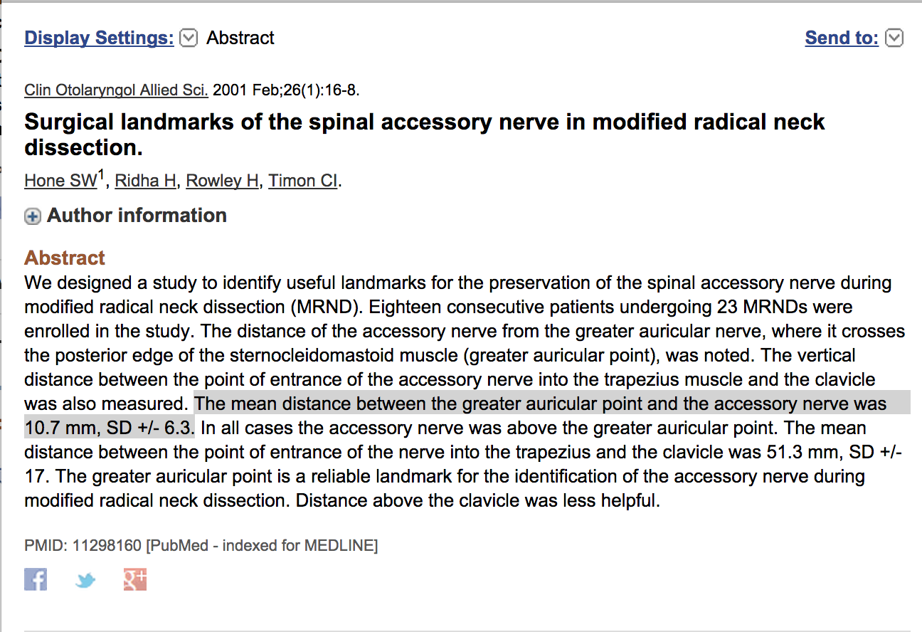
Mean 1.07 +/- SD 0.63 cm
68% CI: 0.65 to 1.7 [+/- 1 SD]
95% CI: 0. 44 to 2.33 [+/- 2 SD]
99% CI: 0 to 2.96 [+/- 3 SD]

Slide 65
Who should we believe?
Chen et al., 2009
Mean 0.92 +/- SD 0.27 cm
68% CI: 0.65 to 1.19 [+/- 1 SD]
95% CI: 0. 38 to 1.46 [+/- 2 SD]
99% CI: 0.11 to 1.73 [+/- 3 SD]
N= 50
Hone et al., 2001
Mean 1.07 +/- SD 0.63 cm
68% CI: 0.65 to 1.7 [+/- 1 SD]
95% CI: 0. 44 to 2.33 [+/- 2 SD]
99% CI: 0 to 2.96 [+/- 3 SD]
N= 23
Standard Error of the Mean: SD / (√ n) = 0.04
95% CI : mean= [0.84 – 1.0] 95% CI : SD= [ 0.19- .35]
Standard Error of the Mean: SD / (√ n) = 0.13
95% CI : mean= [0.81 – 1.33] 95% CI : SD= [ 0.37- .0.89]

Slide 66
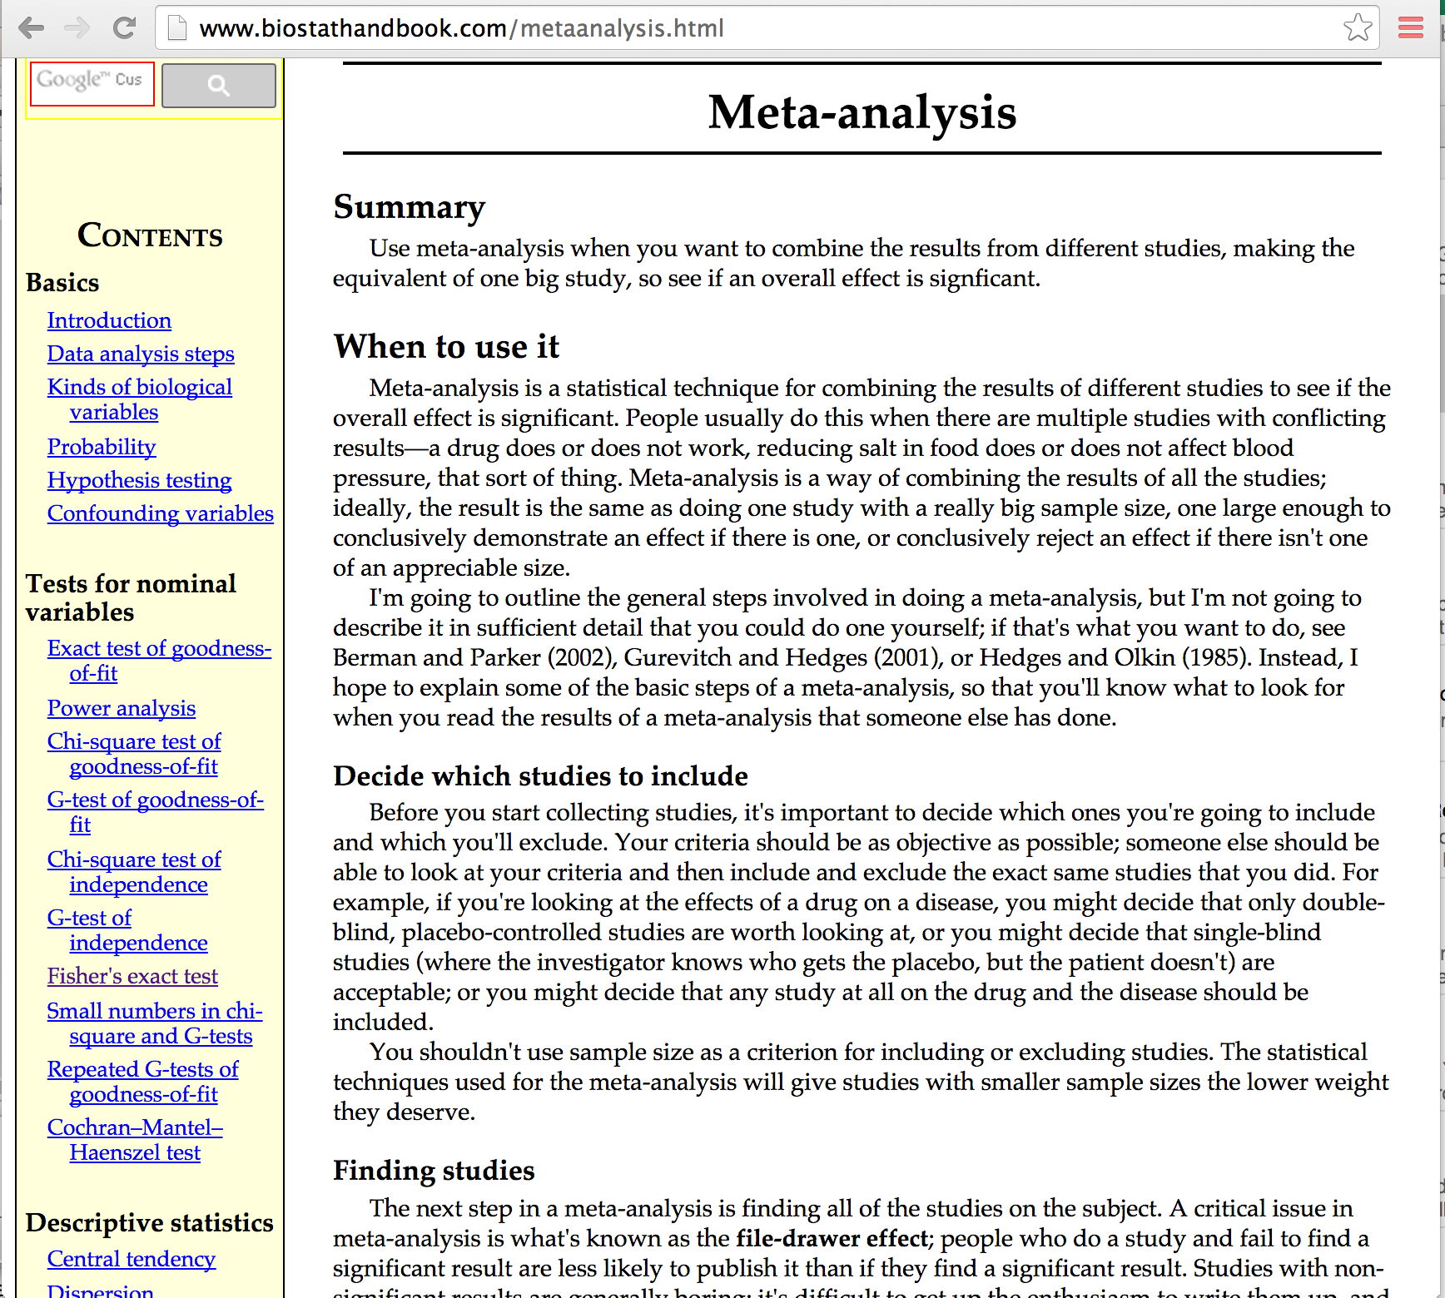

Slide 67
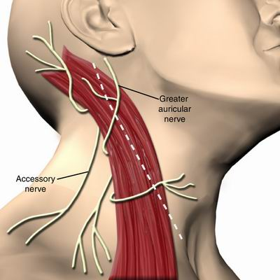
Spinal Accessory NErve
Weighted Mean: 0.98 cm
S.D. Combined from 2 studies: 0.136 cm
S.E.= 0.016
68% CI: 0.85 to 1.11 [+/- 1 SD]
95% CI: 0.72 to 1.24 [+/- 2 SD]
99% CI: 0.59 to 1.51 [+/- 3 SD]
Chen et al., 2009
Mean 0.92 +/- SD 0.27 cm
68% CI: 0.65 to 1.19 [+/- 1 SD]
95% CI: 0. 38 to 1.46 [+/- 2 SD]
99% CI: 0.11 to 1.73 [+/- 3 SD]
N= 50
Hone et al., 2001
Mean 1.07 +/- SD 0.63 cm
68% CI: 0.65 to 1.7 [+/- 1 SD]
95% CI: 0. 44 to 2.33 [+/- 2 SD]
99% CI: 0 to 2.96 [+/- 3 SD]
N= 23

Slide 68
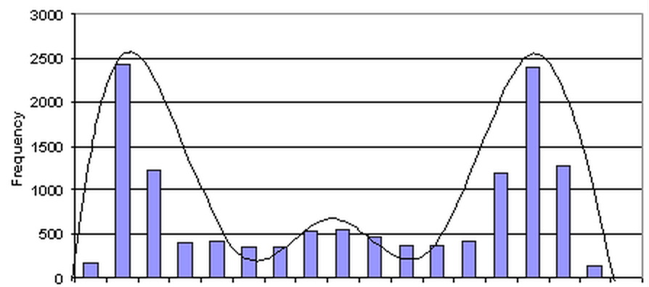
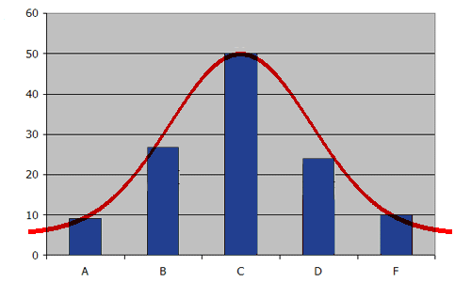
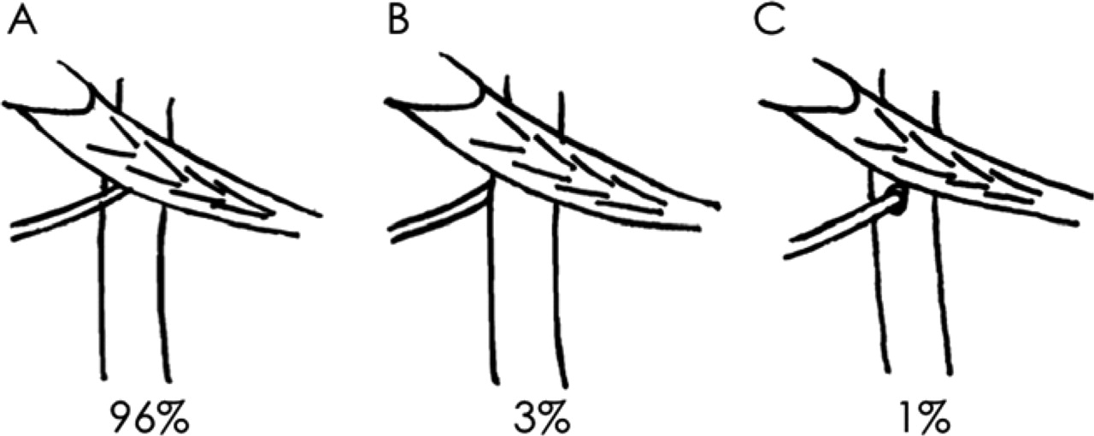
Parametric vs. Non-Parametric
The accessory nerve leaves the jugular fossa between the internal carotid artery and the internal jugular vein.
^{It then passes either:}
posterolateral to IJ: (54–80 per cent)
^{medial to IJ: (20–46 per cent)}
or, rarely, through IJ : (3 per cent)

Slide 69
Multiple P Value Phenomenon
When a journal article or data table is chock full of P values, realize that some “significant” P values (P < .05) are likely to occur by chance alone.
Consider, for example, that a researcher performs 20 individual hypothesis tests on a group of observations (e.g., calculates 20 P values).
Furthermore, the chance of there being one, two, or three significant P values is 38%, 19%, and 6%, respectively.
There is only a 36% chance that none of the P values will be significant!
What accounts for the multiple P value phenomenon? The problem arises because each test is based on a cutoff of P < .05 as a measure of significance; the effect of performing multiple tests is to inflate this 5% error level for the study as a whole.
When a single data set is being studied, multivariate analysis will eliminate the multiple P value problem induced by repeated univariate tests (e.g., t-test, chi-square).

Slide 70
Post- Hoc P Values
Post Hoc P Values
A fundamental assumption underlying all statistical tests is that the hypothesis under study was fully developed before the data were examined in any way.
When hypotheses are formulated post hoc—after even the briefest glance at the data—the basis for probability statements is invalidated.
Unfortunately, there is no way of knowing at which stage of the research process a hypothesis was developed. Therefore, unless the investigators state specifically that the test was planned a priori, one should infer with caution.
When the primary research purpose is to test an a priori hypothesis, the P value will aid in statistical inference.
When hypotheses are generated after the study, however, P values cannot be used to make inferences. Instead, they become a means of identifying promising associations that might form the new a priori hypotheses in a follow-up investigation.

Slide 71
Key Points
• All statistical tests measure error. The P value is the likelihood of a type I error (false-positive conclusion), which occurs if a true null hypothesis is mistakenly rejected. Conversely, a type II error (false-negative conclusion) occurs when a real difference is missed, and is related to statistical power and sample size.
• A study has internal validity when the data are analyzed and interpreted properly, but external validity (generalizability) requires that the study sample be representative of the larger population to which it is intended to apply.
• Confidence and common sense are needed to balance statistical significance with clinical importance.
• A single study is rarely definitive. Science is a cumulative process that requires a large body of consistent and reproducible evidence before conclusions can be formed.
• Effective data interpretation facilitates moving from observations to generalizations with predictable degrees of certainty and uncertainty.

Slide 72
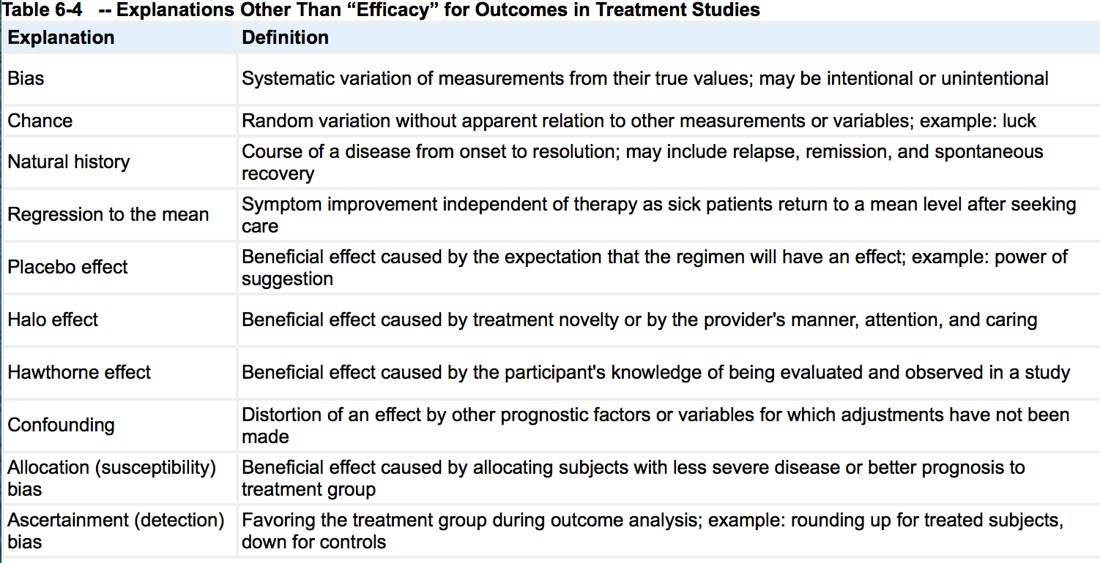

Slide 73
