Slide 1
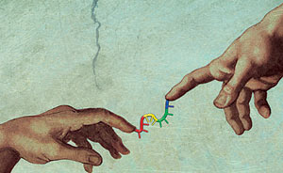


Odontogenic Infections,
Pharyngitis, Deep Neck Space Infections..
OH MY!
MAIE A. ST. JOHN, MD, PHD
Department of Head & Neck Surgery
David Geffen School of Medicine, UCLA
Jonsson Comprehensive Cancer Center

Slide 2
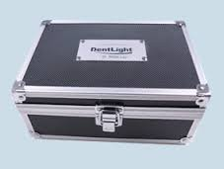

Slide 3
Do you like Turning Point as a teaching tool?
I love it
I can live with it
Not really
I never want to see it again

Slide 4
The most common bacteria isolated from head and neck odontogenic infections include all of the following except:
Peptostreptococcus
Staphylococci
Prevotella
Group D Streptococci

Slide 5
The most accurate clinical scenario that explains the progression of odontogenic infection is:
Invasive anaerobes allow the initial spread of infection through a necrotic dental pulp
Invasive aerobes allow the initial spread of infection through a necrotic dental pulp
Anaerobes release lytic enzymes to cause a spreading cellulitis
Aerobes predominate as the reduction-oxidation potential favors their growth

Slide 6
When you are capernoited, what are you:
Slightly afraid
Slightly drunk
Slightly embarrassed
Slightly out of tune

Slide 7
All of the following antibiotics are effective in treating odontogenic infections except:
cefoxitin
clindamycin
Third generation cephalosporin
penicillin

Slide 8
All of the following are true of bactericidal antibiotics except:
Less reliance of host resistance
Decreased flexibility with dosage intervals
Faster results
Direct killing of the bacteria

Slide 9
Once the bone has been perforated, which factor most affects the location of the soft tissue abscess?
Involvement of the canine
Involvement of the wisdom teeth
Local muscle attachments
The virulence of the organism

Slide 10
From the perspective of an otolaryngologist, infected teeth should be removed
Prior to incision and drainage of abscess
At the time of incision and drainage of abscess
The day after incision and drainage of abscess
Never

Slide 11
From the perspective of an OMFS resident, infected teeth should be removed
Prior to incision and drainage of abscess
At the time of incision and drainage of abscess
The day after incision and drainage of abscess
Never

Slide 12
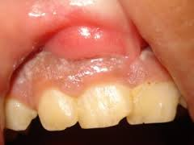
What is the most likely etiology of the lesion pictured below?
Pleomorphic adenoma
Vestibular abscess secondary to maxillary tooth infection
Vestibular abscess secondary to foreign body
Vestibular abscess secondary to sinonasal infection

Slide 13
The buccal space becomes involved when the infection of the maxillary molar teeth breaks out superior to the attachment of the:
Medial pterygoid
Lateral pterygoid
masseter
buccinator

Slide 14
The following are boundaries of the buccal space except:
Zygomatic arch
Buccinator muscle
Buccal fat
Inferior border of the mandible

Slide 15
A person who is a fysigunkus lacks what?
Humor
Wisdom
Curiosity
Temper

Slide 16
The primary mandibular spaces include all of the following except:
pterygomandibular
sublingual
submental
submandibular
Notes:
Primary spaces infection spreads directly form teeth to bone
Secondary: PM, temporal, masseteric

Slide 17
The factor that determines whether the sublingual or the submandibular space is involved is the location of the perforation relative to:
Geniohyoid muscle attachment
Mylohyoid muscle attachment
The cortical height of the bone
The tooth involved

Slide 18
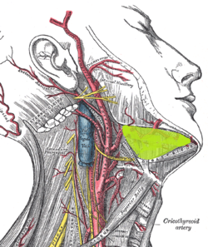
Which mandibular space is highlighted in the drawing below:
sublingual
submandibular
masseteric
submental

Slide 19
All of the following are true of Ludwig’s angina except:
It is bilateral
It involves all three primary mandibular spaces
It always extends into the pterygomandibular space
Was first described in 1836 by von Ludwig

Slide 20
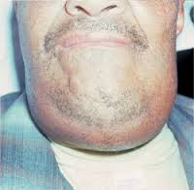
What is the next best step in management of the patient below
CT neck with IV contrast
Flexible endoscopy
I&D of his abscess transorally in the ED
I&D of his abscess transcervically in the ED

Slide 21
Which American city invented plastic vomit?
Los Angeles
Atlanta
New York
Chicago

Slide 22
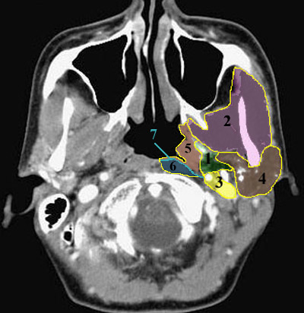
What is the name of the space labeled 1 in the image below?
masseteric
pterygomandibular
parapharyngeal
carotid
Notes:
Parapharyngeal
Masticator
Mucosal
4. carotid parotid
5. mucosal
6. perivertebral

Slide 23
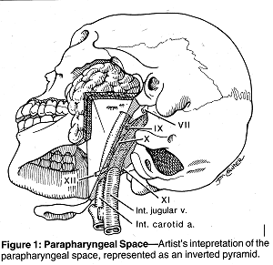
Parapharyngeal Space

Slide 24
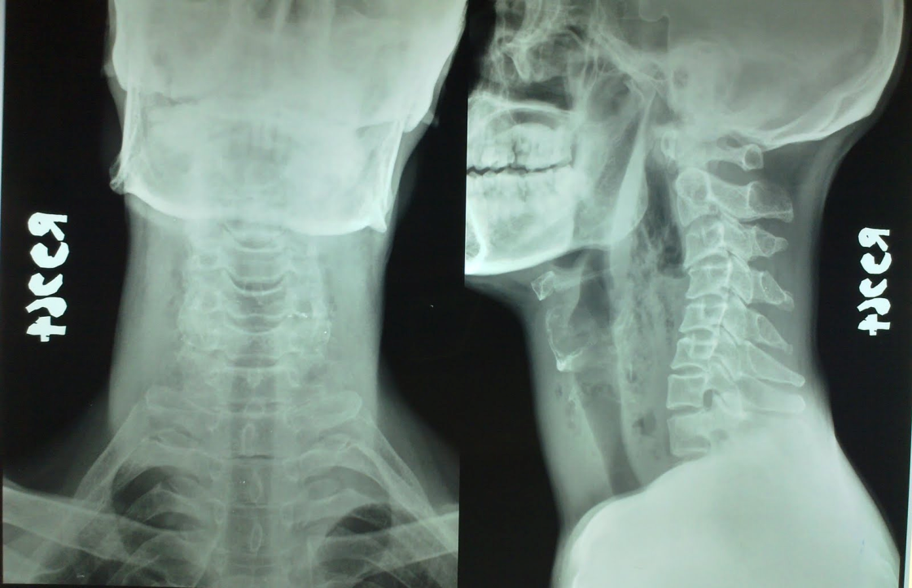
This young man presents with 2 days of increasing dysphagia and fever. He is an attorney and he really wants to avoid surgery if possible. The best course of action would include:
Clindamycin and steroids
Operative drainage of abscess
Image guided drainage of abscess
Admission to monitored bed with swallow evaluation

Slide 25
The pathogenic organism responsible for most cases of bacterial pharyngitis in adults is:
Group G strep
Group C Strep
GABHS
Group F strep

Slide 26
If antibiotics are prescribed within 24-48 hours of symptom onset in bacterial pharyngitis
The period of contagiousness is decreased to 24 hours after beginning tx
The period of contagiousness is decreased to 72 hours after beginning tx
The period of contagiousness is not affected but symptoms abate
Antibiotics should not be prescribed in this setting

Slide 27
Penicillin treatment failure in bacterial pharyngitis can be explained by all of the following except:
Lack of compliance
Recurrent exposure
Contaminated toothbrushes
Extracellular location of bacterium

Slide 28
What is the best way to stop crying while peeling onions?
Lick garlic
Chew lemon peel
Eat ginger
Chew gum

Slide 29
All of the following are true regarding Corynebacterium Diphtheriae infections except:
it is a motile gram positive bacillus
Patients may have a “bull neck” appearance
Sore throat usually develops 1-2 days before the pseudomembrane
Toxin effects at different sites can lead to acute tubular necrosis

Slide 30
The most common cause of pharyngitis in adults is
the RNA virus Rhinovirus
the DNA virus Rhinovirus
GABHS
HPV

Slide 31
The most commonly seen CT scan abnormality of patients with the common cold is:
Abnormalities of the ethmoid infundibulum
Abnormalities of the ethmoid sinus
Abnormalities of the maxillary sinus
Abnormalities of the frontal sinus

Slide 32
All the following statements are true concerning EBV except:
It is a single stranded DNA virus
The virus remains latent in B cells
80-90% of adults are seropositive
Initial infection occurs through the lymphoid tissues and pharyngeal epithelium

Slide 33
One human hair can support how many kilograms?
1 kg
9 kg
3 kg
5 kg

Slide 34
Which of the following is true re :the Danger Space?
It is a potential space that lies between the retropharyngeal and prevertebral spaces
The prevertebral layer forms its anterior border
The parasympathetic trunk courses through this space
This space extends from the larynx to the diaphragm

Slide 35
CT is essential in the evaluation of deep space neck infections as PE alone can misidentify the involved spaces 70% of the time.
True
False

Slide 36
Clindamycin is a fist line antibiotic choice for a community acquired deep neck infections
True
False

Slide 37
Failure to respond to 48 to 72 hours of empiric antibiotic therapy is an indication for surgery
True
False

Slide 38
Lemierre’s Syndrome is a thrombophlebitis of the IJ and carotid artery
True
False

Slide 39
A patient presents with fever, lethargy, orbital pain, reduced extraocular motility and a dilated pupil. He also reports having had dental work 1 week prior. These symptoms are concerning for
Carotid artery pseudoaneurysm
Gradenigo syndrome
Cavernous sinus thrombosis
Lemierre’s syndrome

Slide 40
Which animal sleeps for only 5 minutes a day?
Rat
Eagle
Beaver
Giraffe

Slide 41
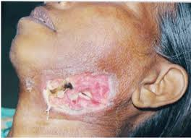
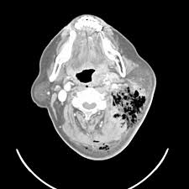
All of the following are true regarding the condition this patient has except:
Likely caused by an odontogenic infection
Neck CT shows tissue gas in 25% of cases
Involves mixed aerobic and anaerobic flora
Most often occurs in persons older than 60 yo

Slide 42


Conquer cancer and build a better future

