Slide 1
Aesthetic Facial Analysis
Irene Kim
10/22/14
Cummings
Chp. 19

Slide 2
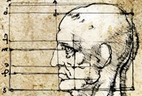
What is Beauty?
Plato and Aristotle
Symmetry
Harmony
Geometry
Leonardo da Vinci
Facial profile divided into equal thirds
Facial analysis
Soft tissue
Skeletal anatomic landmarks
Notes:
Facial analysis depends on soft tissue and skeletal anatomic landmarks.

Slide 3
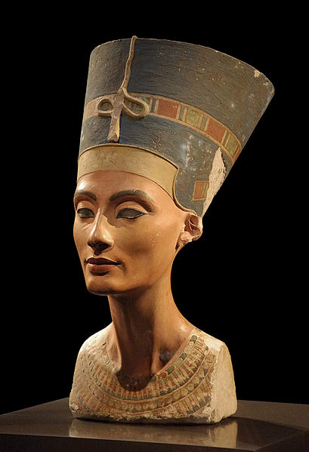
Notes:
Right: Nefertiti.
She was a famous queen of Egypt, likely second to Cleopatra. She was famed throughout the ancient world for her outstanding beauty.

Slide 4
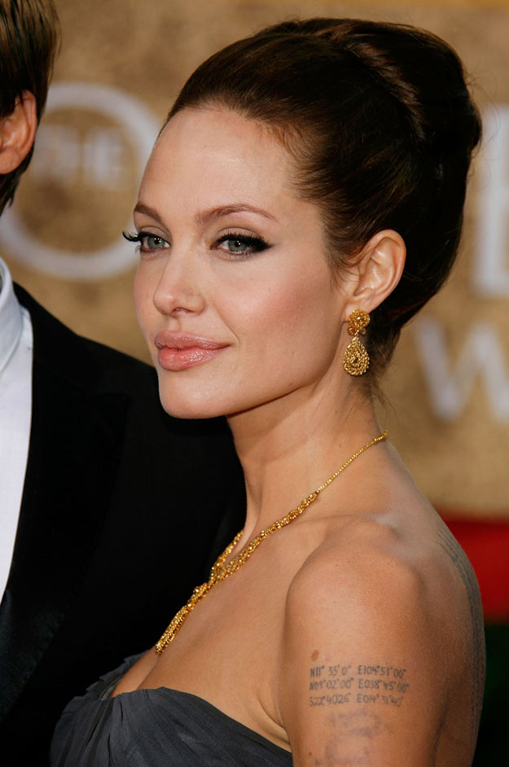

Slide 5
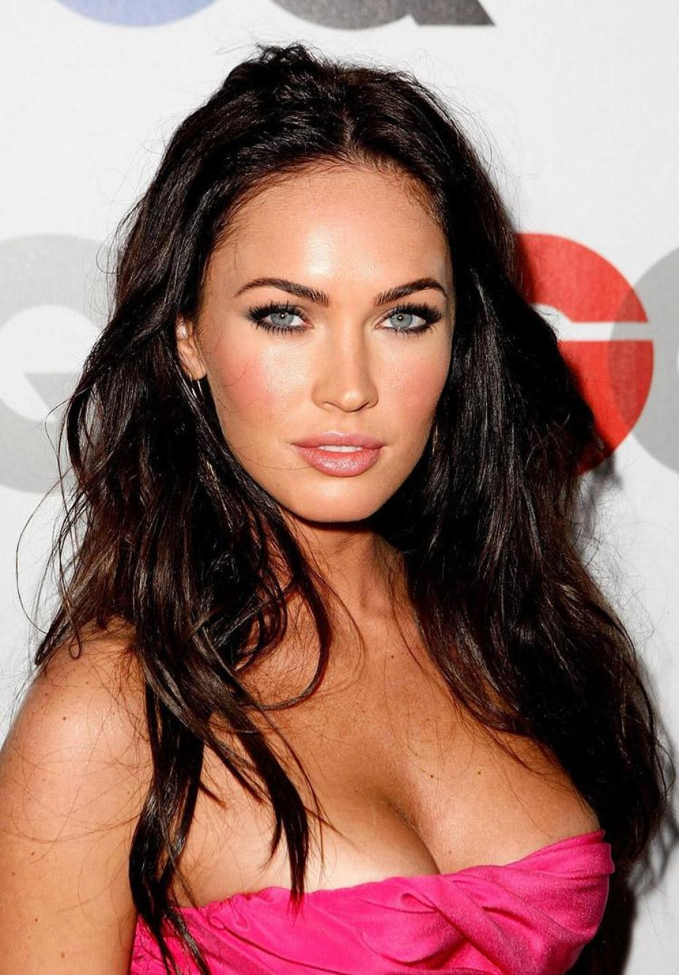

Slide 6
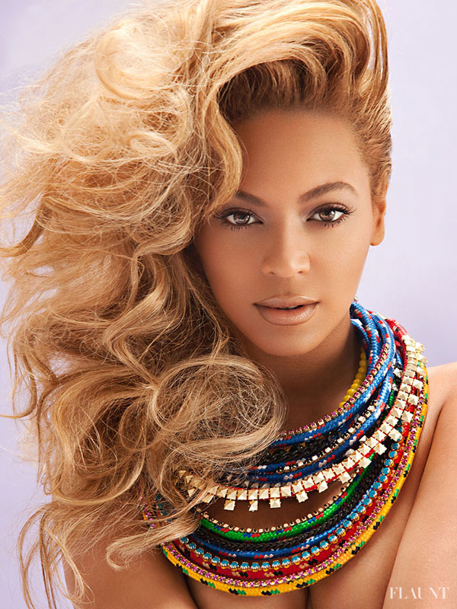

Slide 7
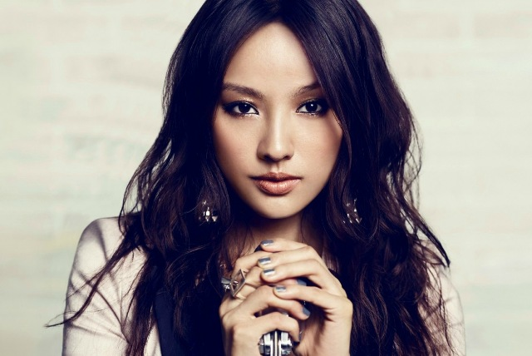

Slide 8


Slide 9
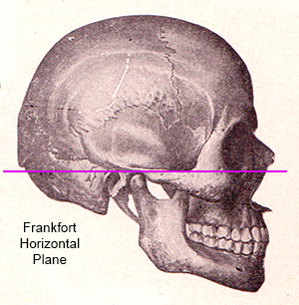
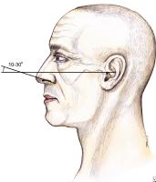
Frankfort Horizontal Plane
Notes:
This is the standard reference point for patient positioning in photographs and cephalometric radiographs. Line drawn from superior aspect of the external auditory canal to the inferior border of the infraorbital rim

Slide 10
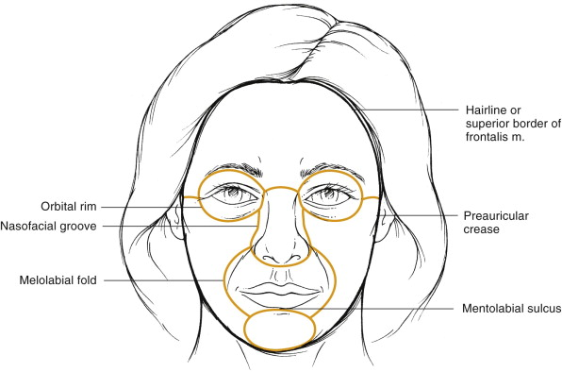
Facial Subunits
Aesthetic subunits
Forehead
Eyes
Nose
Lips
Chin
Ears
Neck

Slide 11
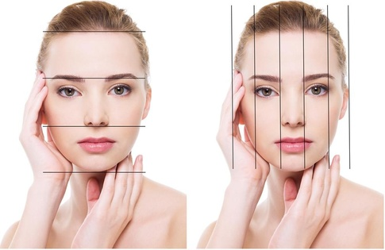
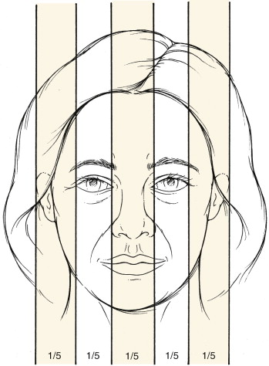
Facial Proportions
Symmetry: Facial WIDTH
Divide the face into equal fifths
Width of one eye = 1/5 of total facial width
Width of one eye = intercanthal distance
Width of one eye = nasal base width
www.quora.com

Slide 12
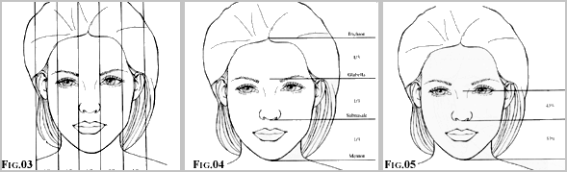
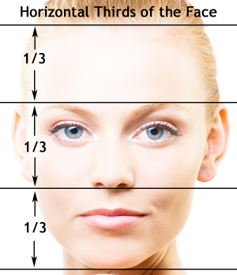
Facial Proportions
Symmetry: Facial HEIGHT
Method #1: Divide face into thirds
Method #2: Exclude upper third
of face
Midface is 43% of height
Lower face is 57% of height
Notes:
Method #1 was described by da Vinci. Measurements are made from the trichion to the glabella, from the glabella to the subnasale, and from the subnasale to the menton.
Glabella: most prominent point of the forehead on profile
Method #2: exclude upper third of the face because of variability of hairline position
Make measurements from nasion (as opposed to glabella) to subnasale, and from subnasale to menton
Nasion: the deepest depression at the root of the nose, typically corresponding with the nasofrontal suture

Slide 13

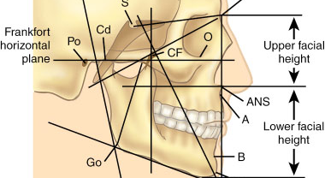

Slide 14
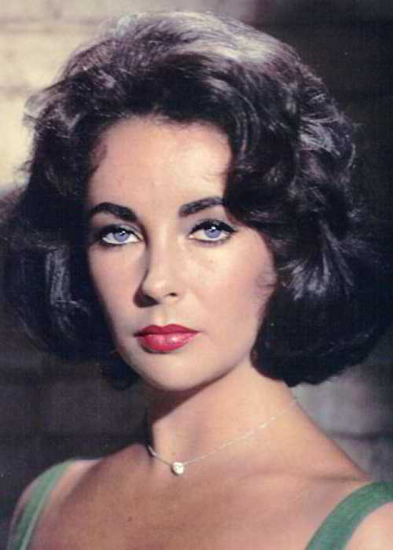
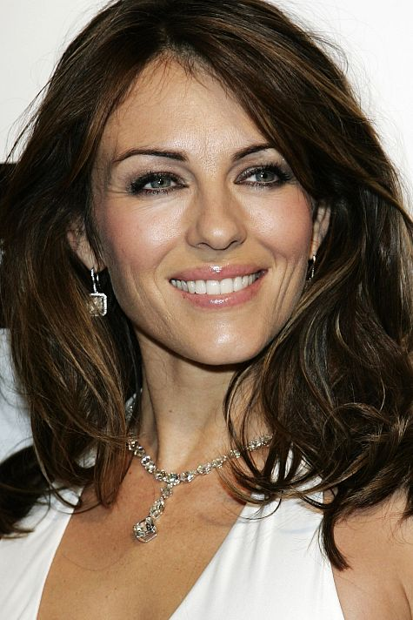
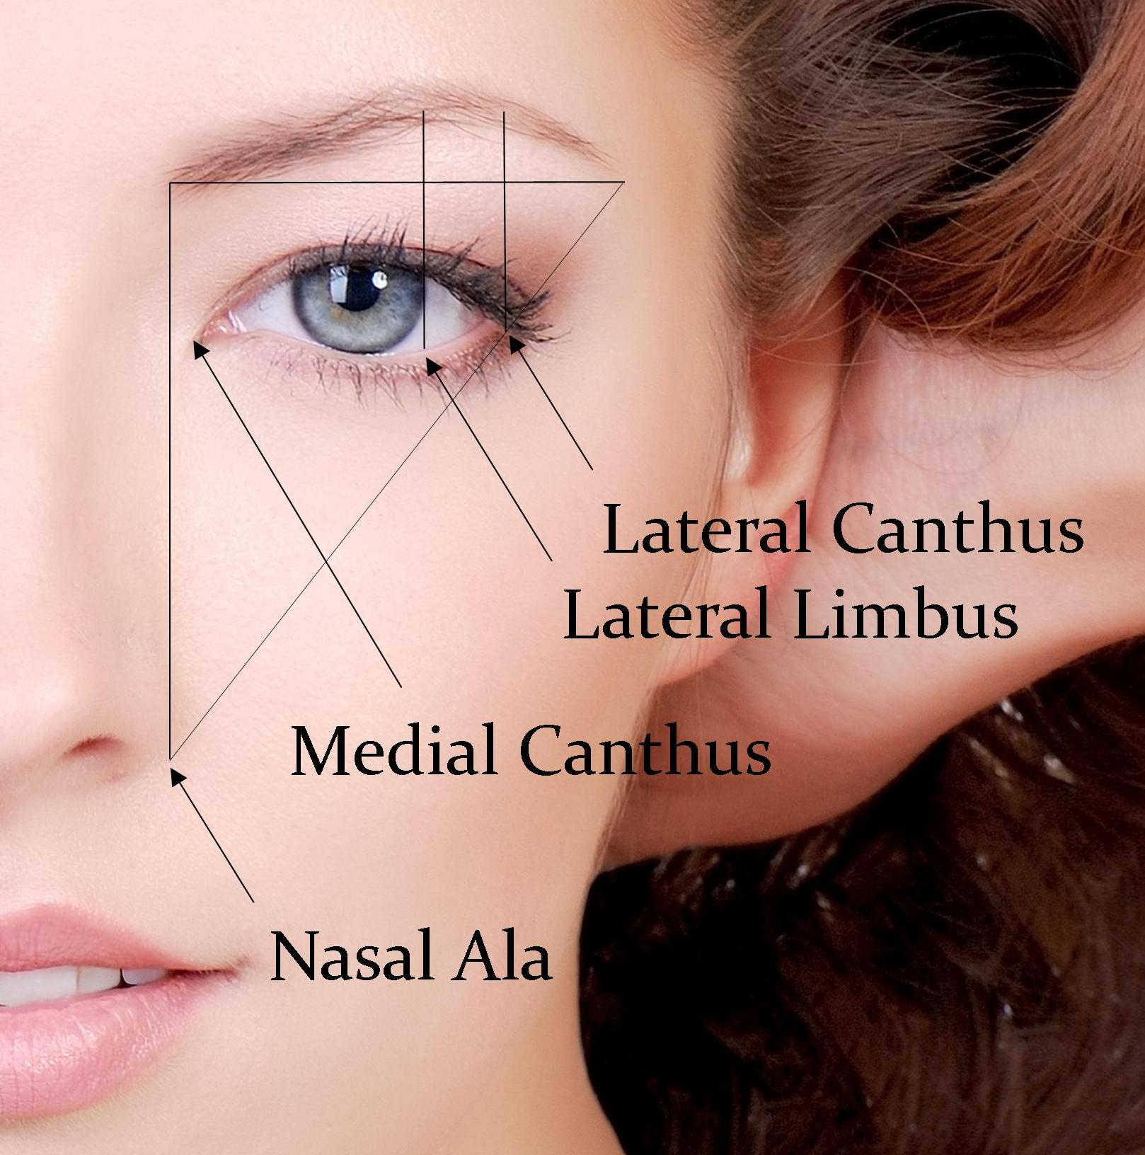
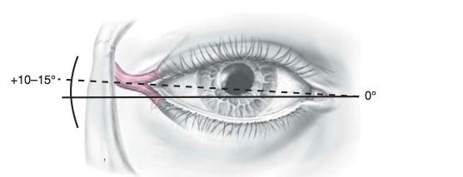
Eyebrow and Eye Position
Forehead
Eyebrow position
Eye
Lateral canthus 2-4 mm
slightly superior to medial canthus
Notes:
Ideal eyebrow position can vary
- Highest point can lie anywhere from lateral limbus to lateral canthus
- Sheen described the eyebrow as most pleasing when it extended as an unbroken line from brow down to lateral nasal tip

Slide 15
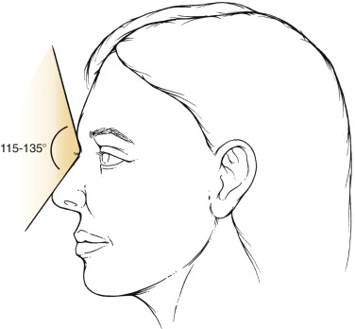
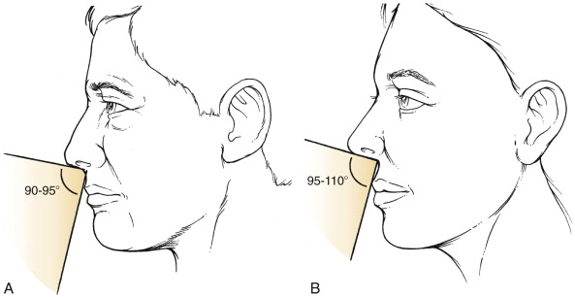
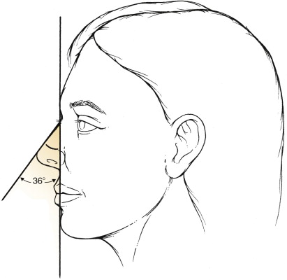
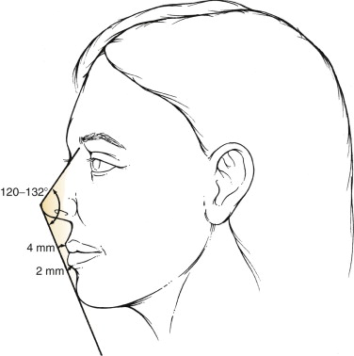
Facial Angles
Angles
Nasofrontal
Nasolabial
Women: 95-110°
Men: 90-95°
Nasofacial
36° (30-40°)
Nasomental
120-132°
Notes:
Nasofrontal angle: created by a line tangent to glabella through the nasion and INTERSECTING with a line tangent to the nasal dorsum
Nasolabial angle: angle of the columella as it meets the upper lip (95-110 in women, 90-95 in men)
Nasofacial angle: incline of nasal dorsum in relation to facial plane; is angle formed from a vertical line tangent from the glabella through pogonion intersecting a line from the nasion through the nasal tip
Nasomental angle: angle between tangent line from nasion to the nasal tip intersecting with a line from the tip to the pogonion

Slide 16
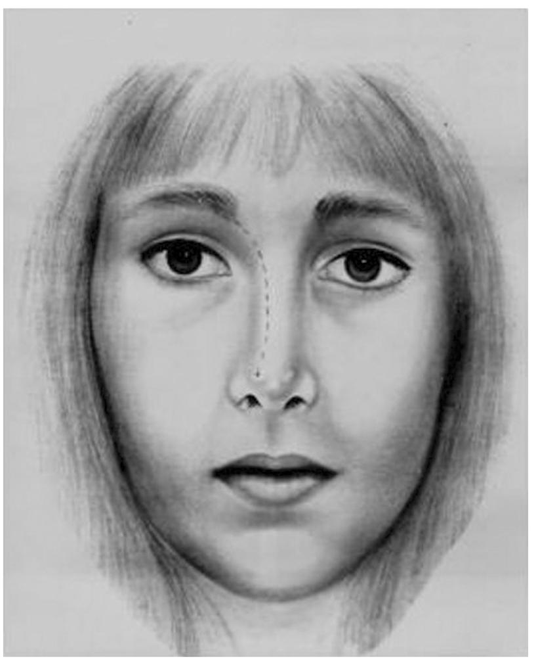
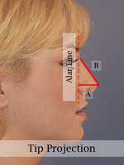
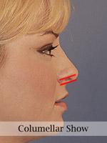
Nose
Goode’s Method
Ala-to-tip lobular complex ratio
Optimal 1:1
Columellar show
3-5 mm
www.davisrhinoplasty.com
www.drhilinski.com

Slide 17
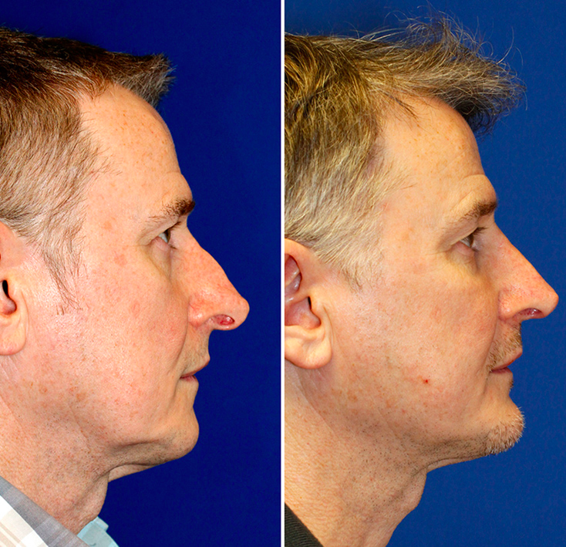

Slide 18
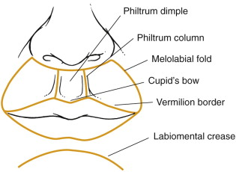
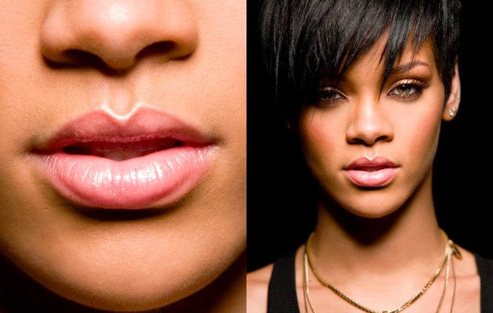
Lips
weheartit.com

Slide 19
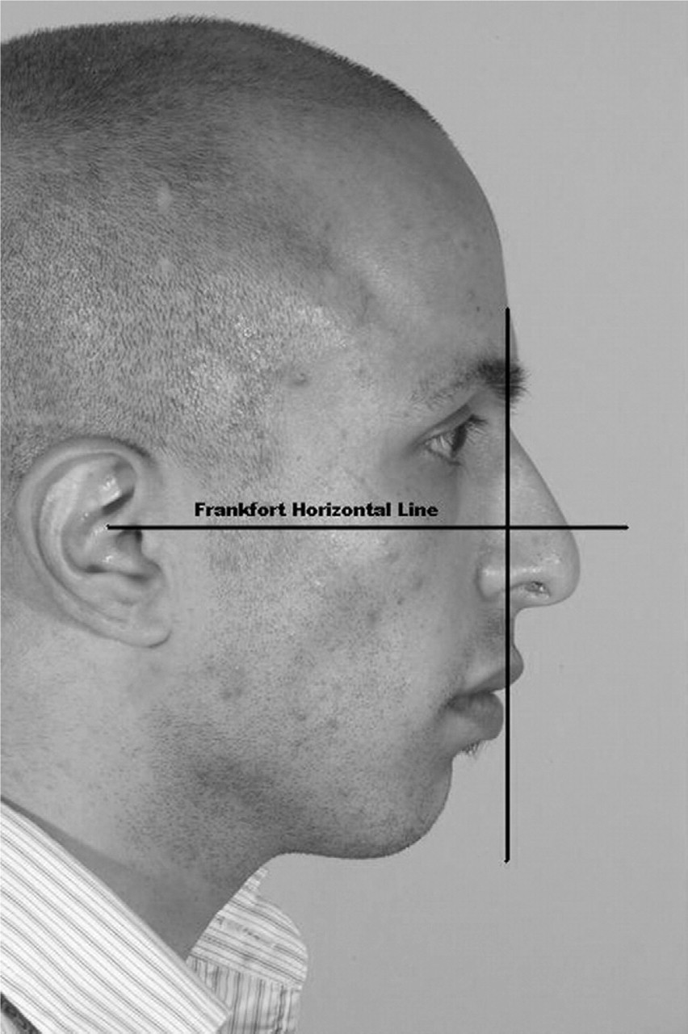
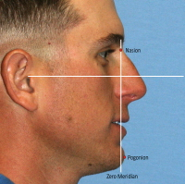
Chin Zero Meridian of Gonzalez-Ulloa
emedicine.medscape.com
oto.sagepub.com
Notes:
Chin is a pivotal facial unit when analyzing the nose or neck
Gonzalez-Ulloa described the ideal chin position by a tangential line through the nasion to the pogonion, which is almost perpendicular to the Frankfort horizontal plane.

Slide 20
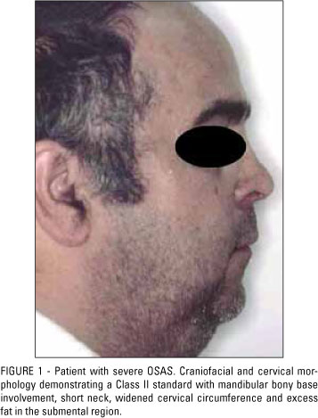
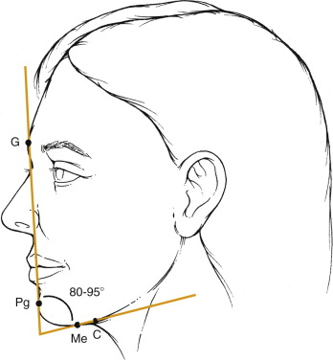
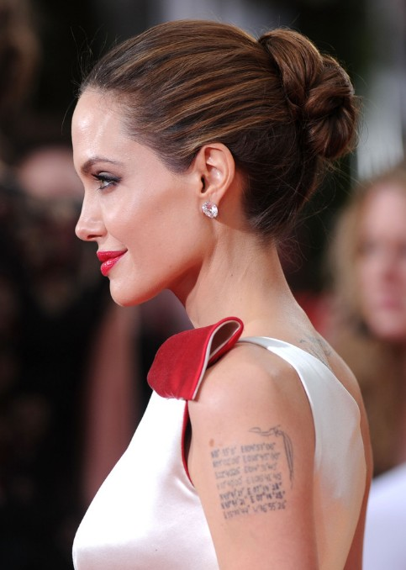
Neck
www.scielo.br
Notes:
-The neck should have an acute mentocervical angle
Angle is produced by drawing a line from the glabella to the pogonion and intersecting with a line tangent from the menton to the cervical point
Cervical point is the innermost point between the submentum and the neck

Slide 21
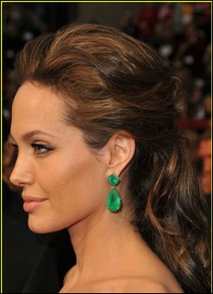
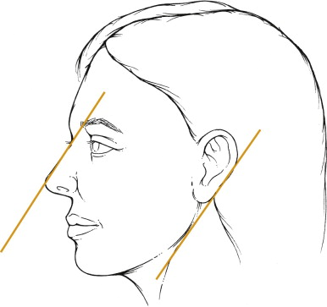
Ears
Long axis parallel to long axis of nasal dorsum
Posterior rotation of 15 degrees from vertical plane

Slide 22

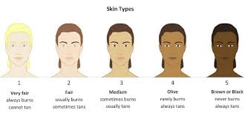
Fitzpatrick Classification
blog.evoderma.com
newserenityspa.com
Notes:
Fitzpatrick was a dermatologist at Harvard who came up with this skin classification.
It’s not entirely accurate, as brown and black skin does, in fact, burn.

Slide 23

Glogau Photoaging Classification
www.youbeauty.com
Notes:
Glogau Photaging classification shows four types of skin
No keratoses, few wrinkles, age 20-30, rarely wears makeup
Early lentigenes, wrinkles on animation, age 30-40, sometimes wears makeup
Advanced photoaging, wrinkles present at rest, age 50 to 60, always wears makeup
Severe photoaging, severe wrinkling, age 60-70, makeup has minimal benefit

Slide 24
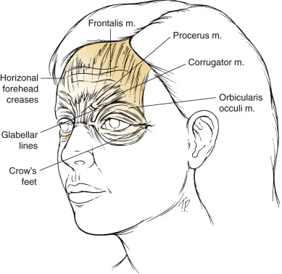
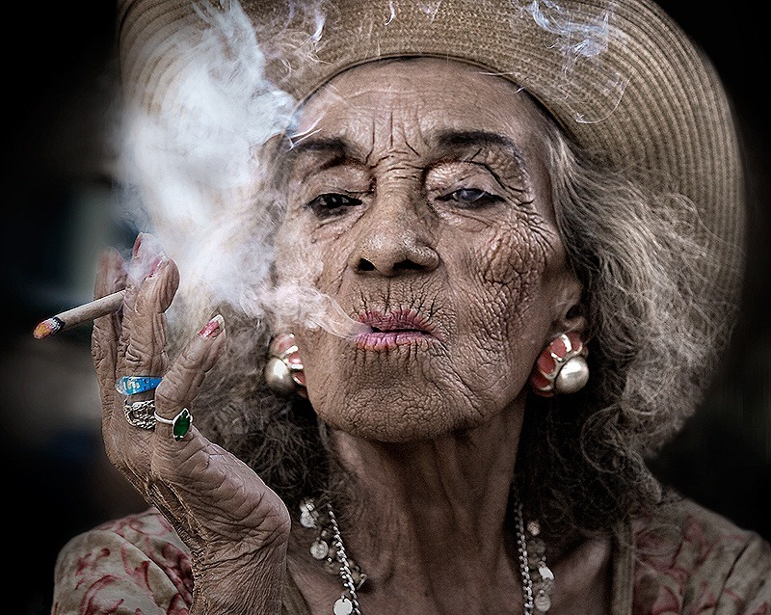
Skin
Hyperdynamic facial lines
Horizontal forehead creases
Crow’s feet
Glabellar lines
www.desireesdaydreams.com
Notes:
Hyperdynamic facial lines are caused by repeated underlying muscle contraction, and this is where Botox is helpful.
These lines should be distinguished from other facial lines like the melolabial fold, mentolabial sulcus, and fine crisscross wrinking found on the cheek and under the eyelids.

Slide 25
Recognition & Treatment of Skin Lesions
Irene Kim
Cummings
Chapter 20

Slide 26
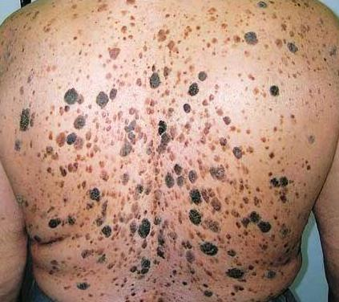
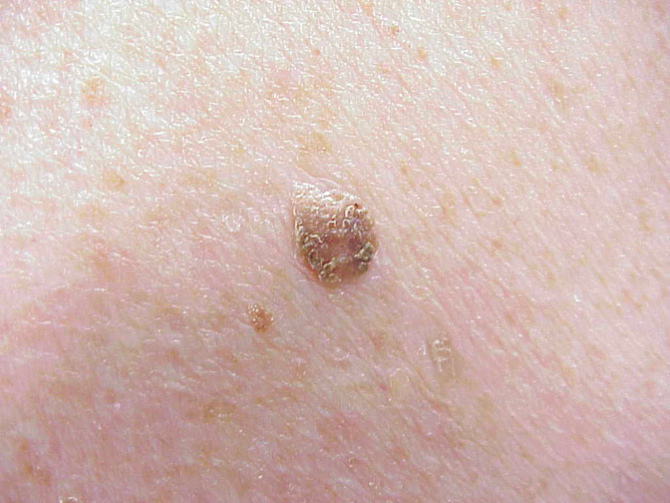
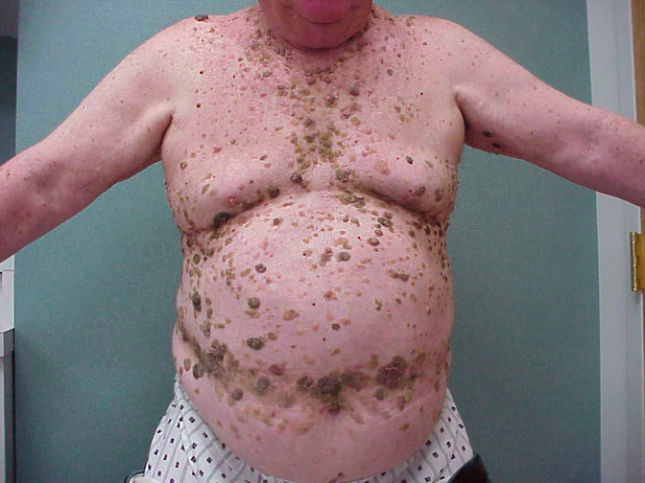
Seborrheic Keratoses
Single or multiple
Anywhere except for palms and soles
All show keratotic plugs
NO malignant potential
http://emedicine.medscape.com/article/1059477-clinical#a0217
Notes:
The picture on the right is an autosomal dominant form of multiple seborrheic keratoses. The man’s daughter is developing a similar distribution and quantity of seborrheic keratoses.
They are BENIGN with no malignant potential, but the appearance of hundred in rapid “showers” may be a sign of internal malignancy.
This is the much debated Leser-Trelat sign.

Slide 27
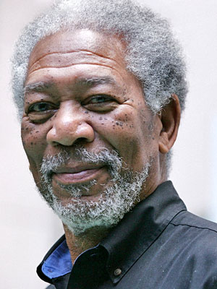
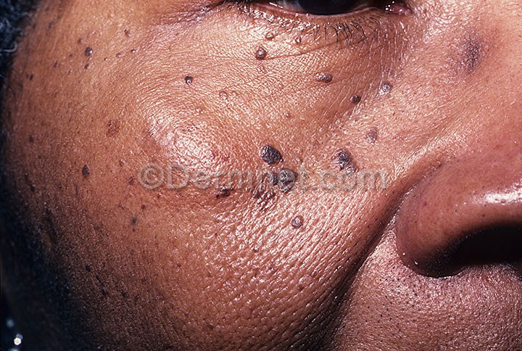
Dermatosis Papulosa Nigra
Notes:
Found in 35% of black adults
Consider them to be a variant of seborrheic keratoses
Treatment is difficult because of pigmentary problems that occur with the treatment of black skin
Options: fine-needle electrosurgery, shave excision, liquid nitrogen, dermabrasion

Slide 28
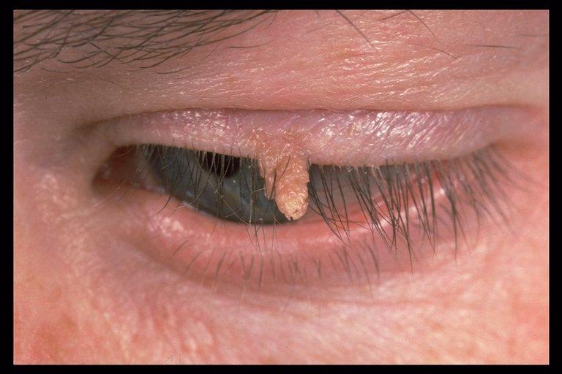
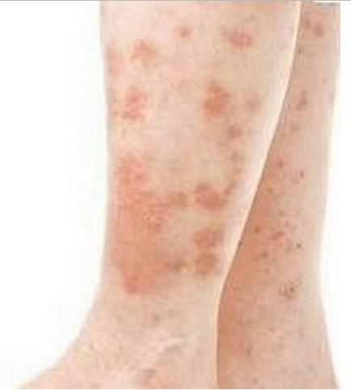
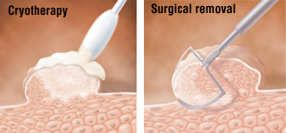
Warts (Verruca Vulgaris)
Caused by HPV
Most common facial warts
Common warts
Anywhere on face
Filiform
Flat warts
Younger patients, legs after shaving
Flat topped, hyperkeratotic
Eradication difficult
Cryotherapy, curettage, topical rx
healthfoxx.com
Notes:
Wars are classified by the clinical appearance and location.
The most common facial warts include common warts and flat warts.
Filiform warts are often pedunculated lesions occurring in isolation on the cheek, nasal tip or columella, or eyelid.
Flat warts usually occur in younger patients or on legs of women who regularly use a razor for shaving.
-The virus survives within cells at the base of the hyperplastic epithelium and within the adjacent normal-appearing skin, so eradication of warts can be DIFFICULT, and recurrences are common.
Various ways to treat– liquid nitrogen cryotherapy, scrape wart off with curette, anesthetize at base and excise w/ scissors

Slide 29
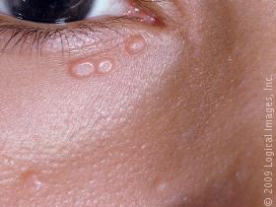
Molluscum Contagiosum
Skin-colored, dome-shaped papillomas
Umbilicated centers
WILL involute spontaneously
Treat with superficial cryotherapy or curettage
Topical therapy
www.skinsight.com
Notes:
Topical therapy include: imiquimod cream, liquid podophyllin, cantharidin, injectable candidal antigens

Slide 30
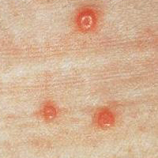
www.cdc.gov

Slide 31
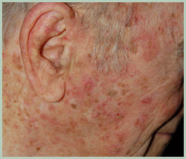
Actinic Keratoses or Solar Keratoses
Precancerous lesions
SCCA in one or more lesions in 5-20% of patients
Sun-exposed areas
Usually erythematous
Little or no infiltration
Can spread peripherally
REMOVE
www.rejuvadoc.com
Notes:
SCCA will develop in one or more lesions in 5% to 20% of persons with solar keratoses.
Best removed and not watched→ most common method is cryosurgery
In extensive disease, can treat with topical 5-fluorouracil, imiquimod, or retinoid creams

Slide 32
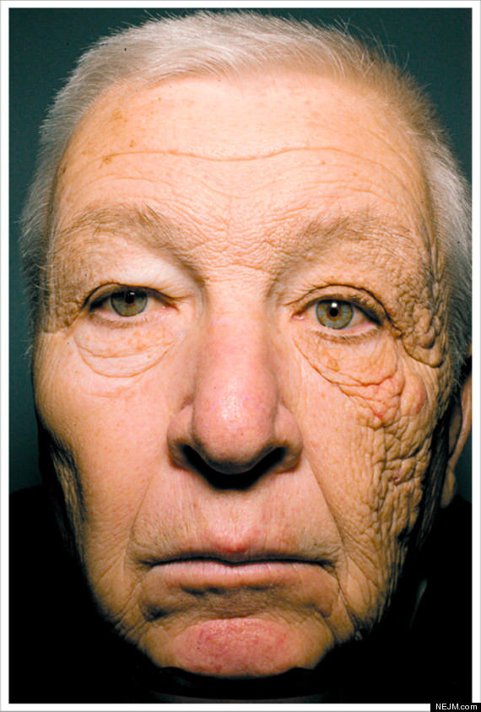
Basal Cell Carcinoma
Most common malignancy
Exposure to sunlight
Ultraviolet B rays
Nasal tip and nasal ala
Most common
LEFT side of body
http://www.huffingtonpost.ca/2012/06/06/bill-mcelligott-sun-damage_n_1573546.html
Notes:
Exposure to sunlight, esp rays in the UV B spectrum, is the primary risk factor for basal cell carcinoma.
Left side of the body is more common than the right
This is a picture of Bill McElligot who spent 28 years driving a truck, he has unilateral dermatoheliosis from the UV light transmitted through his window. His left side looks roughly 20 years older than the right.

Slide 33

Basal Cell Carcinomas
Nodular with smooth, raised, translucent or
“pearly” border with telangiectasia
Can ulcerate, crust
Pruritis
Extends peripherally; low rate of vertical invasion
Types
Nodular
Superficial
Morphea
Pigmented
Fibroepithelioma
Basosquamous
Notes:
Pruritis is a common early symptom
A. Actinic keratoses, B. Keratoacanthoma
C. Noduloulcerative basal cell carcinoma
D. Nodular basal cell carcinoma
E. Pigmented basal cell carcinoma
F. Morpheaform basal cell carcinoma→ this tumor extends subclinical, finger-like projections intradermally which makes complete excision difficult

Slide 34

Recurrent Basal Cell Carcinomas
Often nodular
Often with morpheaform or sclerotic histology in deeper portions
Histologic de-differentiation
Edge of skin graft, within scar, within suture line
Lesions in embryonic
fusion plates- “H zones”
more aggressive

Slide 35


Genetic Syndromes
Nevoid basal cell carcinoma syndrome
Autosomal dominant
Xeroderma pigmentosum
Autosomal recessive
Defect in DNA repair
Immunosuppression
Chemical carcinogens (arsenic)
Notes:
Nevoid basal cell carcinoma syndrome: AD condition→ basal cell carcinomas arise on any area of the body, esp toward sun-exposed sites beginning at an early age and continuing throughout life. They also have skeletal abnormalities like bifid ribs, jaw cysts, frontal bossing, calcified falx cerebri.
Xeroderma pigmentosum: AR condition caused by defect in DNA repair that leads to the development of basal cell carcinoma and other cutaneous malignancies in response to sun exposure and other carcinogens in childhood and early adulthood.

Slide 36

Squamous Cell Carcinoma
Second most common skin cancer
Account for majority of deaths due to skin cancer in adults > 85 yrs
Multifactorial
Fair skin, chronic cumulative skin exposure
Hx previous skin ca, age > 50 yrs, smoking
HPV infection, scarring skin lesions
Most important factor: UV exposure
Worst prognostic indicator: perineural invasion
TENDENCY for vertical invasion

Slide 37

www.bowesdermatology.com
Notes:
SCC can prevent clinically in several ways: thick, scaling, hyperkeratotic plaques (ear, lips, nose)
If crust is removed, base is often ulcerated and has a rolled margin.
Can present as a persistent ulcer
Vegetative nodular lesion
Can be pigmented

Slide 38

Keratoacanthoma
Rapidly growing, low grade tumor
Variant of SCCa
Exophytic dome-shaped nodule with central keratin
Rapid proliferative phase→ plateau→
involution (most)
REMOVE
Notes:
Surgical excision is the treatment of choice.
Because of the involution potential of keratoacanthomas, cytotoxic agents can be used to induced involution (methotrexate 12.5-25mg/mL)

Slide 39

What is this?
Notes:
Chondrodermatitis nodularis helicis.
It is an inflammatory disease of underlying helical cartilage that can mimic and be mistaken for basal cell carcinoma.
Usually results from chronic trauma. SURGERY is treatment of choice

Slide 40

Bowen’s Disease
Intraepithelial SCCa or carcinoma in situ
Well demarcated
Erythematous
Scaling
Thin plauqe
www.medscape.com
Notes:
If unrecognized and untreated, can progress to SCCa

Slide 41

What is the Diagnosis?
Cummings
Notes:
A- Actinic keratoses
B- Keratoacantoma
C- Noduloulcerative basal cell carcinoma
D- Nodular basal cell carcinoma
E- Pigmented basal cell carcinoma
F- Morpheaform basal cell carcinoma

Slide 42
Melanocytic Neoplasms
Most common
Nevocellular nevi (“moles”)
Melanoma

Slide 43

Nevi
Notes:
Lentigo maligna melanoma
Junctional nevus- melanocytes are located at the junction of the epidermis and dermis (dermoepidermoid junction); are usually benign but CAN develop into malignant melanoma
Intradermal nevus- often contain coarse hairs, reflecting depth within the dermis of the nevus cells. Rarely becomes malignant.
Blue nevus- dark blue or black hairless flat or raised lesion; treatment is excision or observation. Excision must be deep, because pigment often deeps into the subQ fat. These are highly aggressive, malignant transformation is rare.
Halo nevus- Usually found on the back; benign looking brown lesion in the center of a well-circumscribed pale white circle of depigmented skin. Reflects body’s rejection of the nevus cells
Nevus sebaceous

Slide 44

What kinds of moles does she have?
Notes:
Mole is best treated by shave excision when it is pedunculate and hairless. When it contains hair, it is necessary to excise the mole using either punch excision technique or routine excision to remove the complete depth of the hair follicles within the nevus

Slide 45
Congenital Nevi
Affects 1-6% of population
Potential psycosocial impact
Usually present at birth
Associated with risk of melanoma
Classified by size:
Small: < 1.5cm
Medium: 1.5 – 20 cm
Large: > 20 cm
Giant: > 50 cm
Notes:
When large or in conspicuous locations such as the face, can be a/w signficant psychosocial impact on pts and families

Slide 46

e-aps.org
Notes:
risk of transformation of large/ giant (1% – 42%) 6, 7 , medium (3-21%) 1, 8 and small CMN (8.1% – 14.9%) ...

Slide 47


www.jcasonline.com
ispub.com
Notes:
Risk for development of melanoma correlates with size.
GREATEST risk is associated with giant congenital nevi.
Pts with large congenital nevi are also at risk for developing neurocutaneous melanosis in which proliferation of leptomeningeal melanocytes may be associated with neurologic disease, structural malformations, and malignant degeneration.

Slide 48


Solar Lentigo or actinic lentigo
Keratinocytic pigmented macules
Referred to as lentigo senilis
Rarely occur 5th decade
Dorsa of hands, face
No malignant degeneration
Notes:
Lesions may resemble seborrheic keratoses in clinical appearance.
They are less hyperkeratotic than seborrheic keratoses and have no areas of follicular prominence.
IMPORTANT to distinguish solar lentigo from melanoma in situ, which can also present as dark brown macules on sun-damaged skin

Slide 49
Other Lesions

Slide 50


Cysts
True cyst: has epithelial lining
Epidermoid cyst
Pilar cyst
Dissect and remove entire cyst wall
Pseudocyst: lacks organized epithelium
Mucous cysts (mucoceles)
www.pcds.org.uk
Notes:
Pilar cysts = trichilemmal cysts are also true cysts. Lining of the cyst differentiates in a manner analogous to that of the outer root sheath of the hair follicle
It’s important to remove the entire cyst wall, because retained segments can lead to recurrent growth of the cyst
Mucoceles are result from traumatic rupture of ducts of minor salivary glands

Slide 51


What is this condition?
stjosephlitreview.blogspot.com
Notes:
Patient had colonic growths and many epidermal cysts.
If the cysts appear in large numbers, this may be an indication of Gardner’s syndrome, an AD condition that predisposes the patient to intestinal cancer.

Slide 52


Dermoid Cysts
Rare, at birth
Most common face
Lat eyebrow, orbit, nose
From inclusion of embryonic
epidermis within embryonal fusion plates
If over nasal root, DISTINGUISH from nasal glioma
dnbhelp.wordpress.com
Notes:
Can be differentiated from epidermal cysts by their attachment to adnexal structures which include hair, sebaceous glands, eccrine glands, and apocrine glands

Slide 53
Vascular Anomalies
Tumors
Infantile hemangioma
Tufted angioma
Pyogenic granuloma
Malformations
Capillary
Venous
Arteriovenous
Lymphatic

Slide 54

Infantile Hemangiomas
Most common benign soft tissue tumor of childhood (10% of children)
More in preemies
Rapid proliferation x 6 mo
Slow growth x 6 mo
Involution at 10% / year
What syndrome is associated with these?
Notes:
These are characterized by rapid proliferation during the first months of life followed by slow involution over several years.
Most are small are innocuous, but they can be associated with structural anomalies and neurocutaneous syndromes
Hemangiomas in the BEARD area may be associated with airway compromise

Slide 55


Segmental Hemangiomas &PHACES
Posterior fossa malformations
Hemangioma
Arterial anomalies
Coarctation of the aorta
Eye abnormalities
Sternal defects
www.gfmer.ch
www.medscape.com
Notes:
Hemangiomas greater than 5cm denote the possibility of PHACE. Intracranial Infantile Hemangiomas Associated With PHACE Syndrome

Slide 56



What are these?
www.cram.com
www.dermatalk.com

Slide 57

Salmon Patch
Most common vascular malformation
Represent persistent fetal circulation
Neck = “Stork bite”
Eyelid/glabella = “Angel’s Kiss”
Most spontaneously involute

Slide 58
Keloids vs Hypertrophic Scars
Both are uncontrolled proliferative responses to trauma by fibrous tissue of dermis
Keloid: growth EXTENDS beyond initial scar
Commonly seen in AA
Hypertrophic scars: does NOT extend beyond margins of injury
No racial predilection

Slide 59


Keloid

Slide 60


Hypertrophic Scar
www.scarformula.com

Slide 61



Neurofibromas
Derived from Schwann cells of cutaneous nerves
Nonencapsulated, loose, spindeloid tumors
Perhaps indicative of genetic neurofibromatosis syndrome
Look for café-au-lait spots, axillary freckling
www.utmb.edu
www.eyecalcs.com

Slide 62


Xanthelasma
Eyelids
Do not always signify elevated serum TG levels
Accumulation of xanthoma cells (lipid-laden histiocytes)
Rx: trichloroacetic acid, light cautery, excision
reference.medscape.com
www.hxbenefit.com

Slide 63
Treatment Methods
Excisional surgery
Electrosurgery
Cryosurgery
Chemical or abrasive surgery
Laser surgery

Slide 64
COCLIA
R2
2.2.2 What conditions predispose to cutaneous malignancy (xeroderma pigmentosa, basal cell nevus syndrome, actinic keratosis, nevus sebaceous to name a few!)? Tell us what patients are particularly at risk for developing cutaneous malignancies.
7.4.2 A young lady comes to see you in your office for consultation regarding chin augmentation. Methods of facial analysis?
R3
2.2.3 Discuss tumors that mimic SCCA (keratoacanthoma, and desmoplastic melanoma).
7.10.2 Describe the aesthetic units of the lip as described by Burget and Menick.
R4
2.2.7 List the different types of BCCA; microscopic and clinical distinctions?
7.12.2 What are the aesthetic subunits of the nose? How does this apply to nasal reconstruction?
R5
2.2.9 What are the treatment modalities for BCCA and SCCA? Discuss the importance of margins in surgery for each cell type and why.
7.14.12 Help us understand the anatomy of the nasal cartilages.

Slide 65
Thank You!

