Slide 2
Cummings 31
Liposuction
Jon Mallen-St. Clair MD, PhD
Department of Head and Neck Surgery, David Geffen School of Medicine at UCLA

Slide 3
Introduction
Distribution of body fat - genetics + hormones, diet, exercise, medications and patient age
Fat deposition occurs through enlargement as opposed to addition of new adipocytes
Liposuction removes adipocytes and therefore can have long lasting effects

Slide 4
Ideal Candidates
Subcutaneous fat pocket refractory to weight loss. Familial. Young skin. Submental, melolabial, submandibular, buccal areas

Slide 5
Pitfalls
Ptosis of facial skin may appear accentuated (older appearance)
Dependent of ability of skin to contract
skeletal insufficiency
muscular problems
ptotic SMG or enlarged parotid

Slide 6
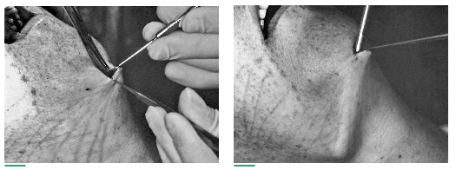
Technique

Slide 7
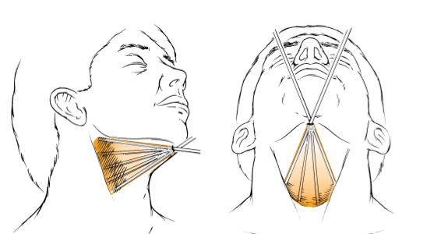

Slide 8
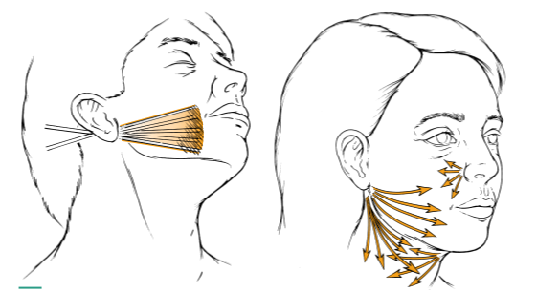

Slide 9
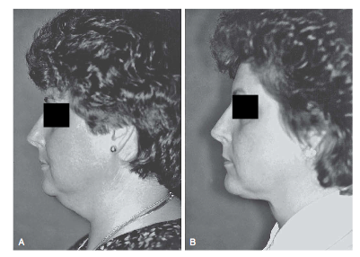
Outcomes

Slide 10
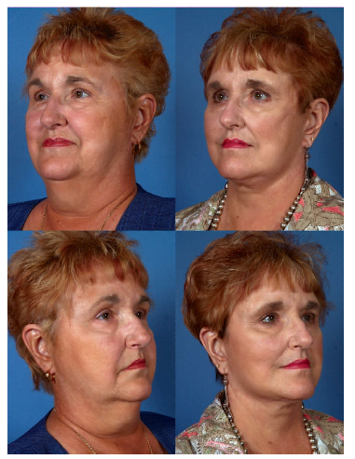
Outcomes

Slide 11
Conclusions
Good tool in combination with face lift/implants

Slide 12
Complications
Seroma/Hematoma
Skin slough/necrosis - smokers, avoid overaggressive lipo, maintain dermal/subdermal plexus
Cobra neck deformity - excess liposuction in anterior neck region

Slide 13
Cummings 32
Mentoplasty and Implants

Slide 14
Introduction
Chin prominence - unique human feature
Contributes to facial harmony - can impact appearance of lips, teeth, nose, neck
Alloplastic implants and Horizontal osteotomy

Slide 15
Alloplastic Implants
Useful for the correction of anteroposterior bony deficiency. Microgenia (horizontal defects)

Slide 16
Horizontal Osteotomy-Sliding Genioplasty
Versatile technique that allows:
horizontal advancement or reduction of the chin
Vertical lengthening or shortening of the chin
Correction of transverse deformities

Slide 17
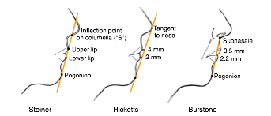
Aesthetic Analysis
Ideal relationship of the chin as it relates to the lips and lower facial structures

Slide 18
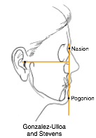
Aesthetic Analysis
Pogonion should be at or just posterior to zero meridian

Slide 19
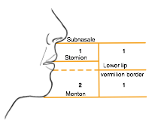
Aesthetic Analysis
Ideal relationship of the chin as it relates to the lips and lower facial structures

Slide 20
Chin Deformities
Microgenia-small chin (horizontal or vertical) normal bite
Micrognathia-mandibular hypoplasia, malocclusion

Slide 21
Chin Deformities
Retrogenia-retruded chin
Retrognathia-retruded mandible, malocclusion

Slide 22
Chin Deformities
Witch’s chin deformity
Soft tissue deformity - ptosis
Weakening of the muscular attachments of the mentalis and depressor labii inferioris
Soft tissue pad of chin falls below the mandible —> horizontal crease worsens with smile
Can be caused by failure to reapproximate mentalis

Slide 23
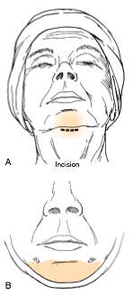
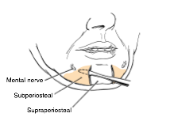
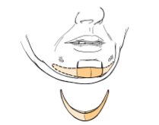
Technique - Alloplastic Implant

Slide 24
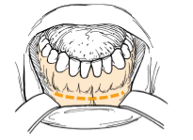
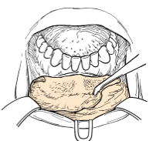
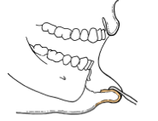
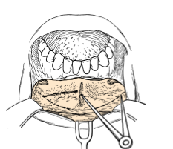
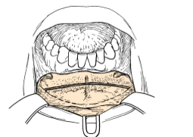
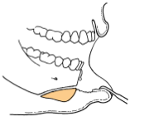
Technique - Sliding Genioplasty

Slide 25
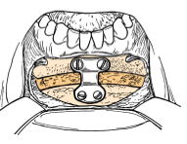
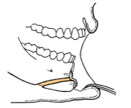
Technique

Slide 26
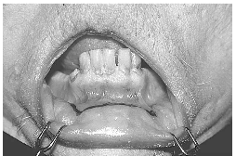
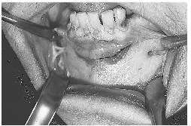
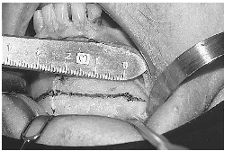
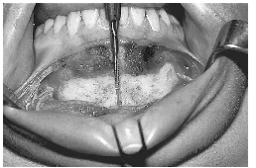
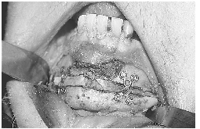
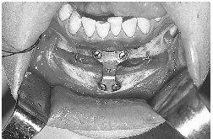
Technique

Slide 27


Slide 28
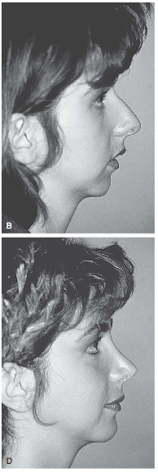

Slide 29


Slide 30
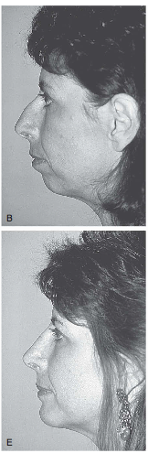

Slide 31
Complications
Mentoplasty
migration of implant, infection (rare)
Genioplasty
mental nerve trauma, malunion/non union

Slide 32
COCLIA QUESTIONS

Slide 33
7.4.1 Microgenia, micrognathia, retrogenia, retrognathia-what is the difference?

Slide 34


Slide 35
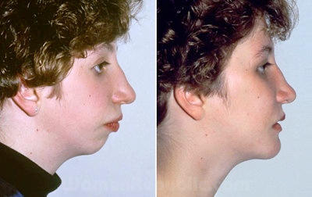
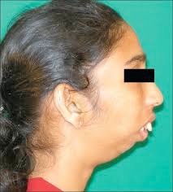
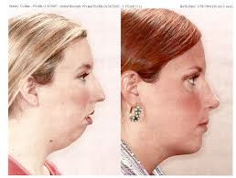

Slide 36
Microgenia/retrogenia
chin implant vs. sliding genioplasty
Micrognathia/retrognathia
sagittal split osteotomy

Slide 37
7.4.2 A young lady comes to see you in your office for consultation regarding chin augmentation. Methods of facial analysis?

Slide 38
Aesthetic Analysis
Pogonion should be at or just posterior to zero meridian

Slide 39
Aesthetic Analysis
Ideal relationship of the chin as it relates to the lips and lower facial structures

Slide 40
7.4.3 How do you determine if a patient needs a mentoplasty vs. sliding genioplasty?

Slide 41
Mentoplasty-chin implant
can gain up to 70% projection, good for horizontal defects
Sliding genioplasty
moves anterior part of mandible forward
versatile - can be used to correct vertical defects
more severe cases (retrognathia, hemifacial atrophy, failed implant)

Slide 42
7.4.4 Discuss the complications of mentoplasty vs. genioplasty.

Slide 43
Mentoplasty-complications
infection, displacement, extrusion, mental n. injury
Sliding genioplasty-complications
lip incompetence, tooth injury, mental n. injury, non union

Slide 44
7.4.5 What is a witch’s chin and how do you correct it?

Slide 45
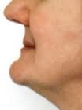
Witch’s Chin Deformity
Weakening of the muscular attachments of the mentalis and depressor labii inferioris
Soft tissue pad of chin falls below the mandible —> horizontal crease worsens with smile
Repair by removing ellipse of submental skin, creating soft tissue flap on chin and advancing/plicating inferiorly

Slide 46
7.4.6 Your fellow resident needs your advice. He has a patient scheduled for mentoplasty. He wants to know what alloplastic materials are available. How do you determine which size and shape to use? What approach should he use?

Slide 47
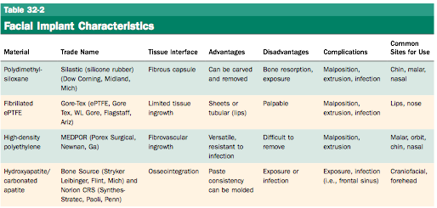

Slide 48
7.4.7 Your partner has referred a patient (he has a very busy and lucrative practice) to you for a genioplasty. He doesn’t feel comfortable performing this procedure. Can you describe the surgical technique to him?

Slide 49
Sliding GenioplastyTechnique

Slide 50
7.4.8 Pre-operative evaluation of a patient for chin surgery. When do you order radiographic studies?

Slide 51
Thank You!

