Slide 1

Ch 48 – Fungal Sinusitis
Sophie Shay, MD
UCLA Dept of Head and Neck Surgery
January 7, 2015

Slide 2
Fungal Sinusitis
Immunocompetent

Slide 3
Fungal Sinusitis

Slide 4

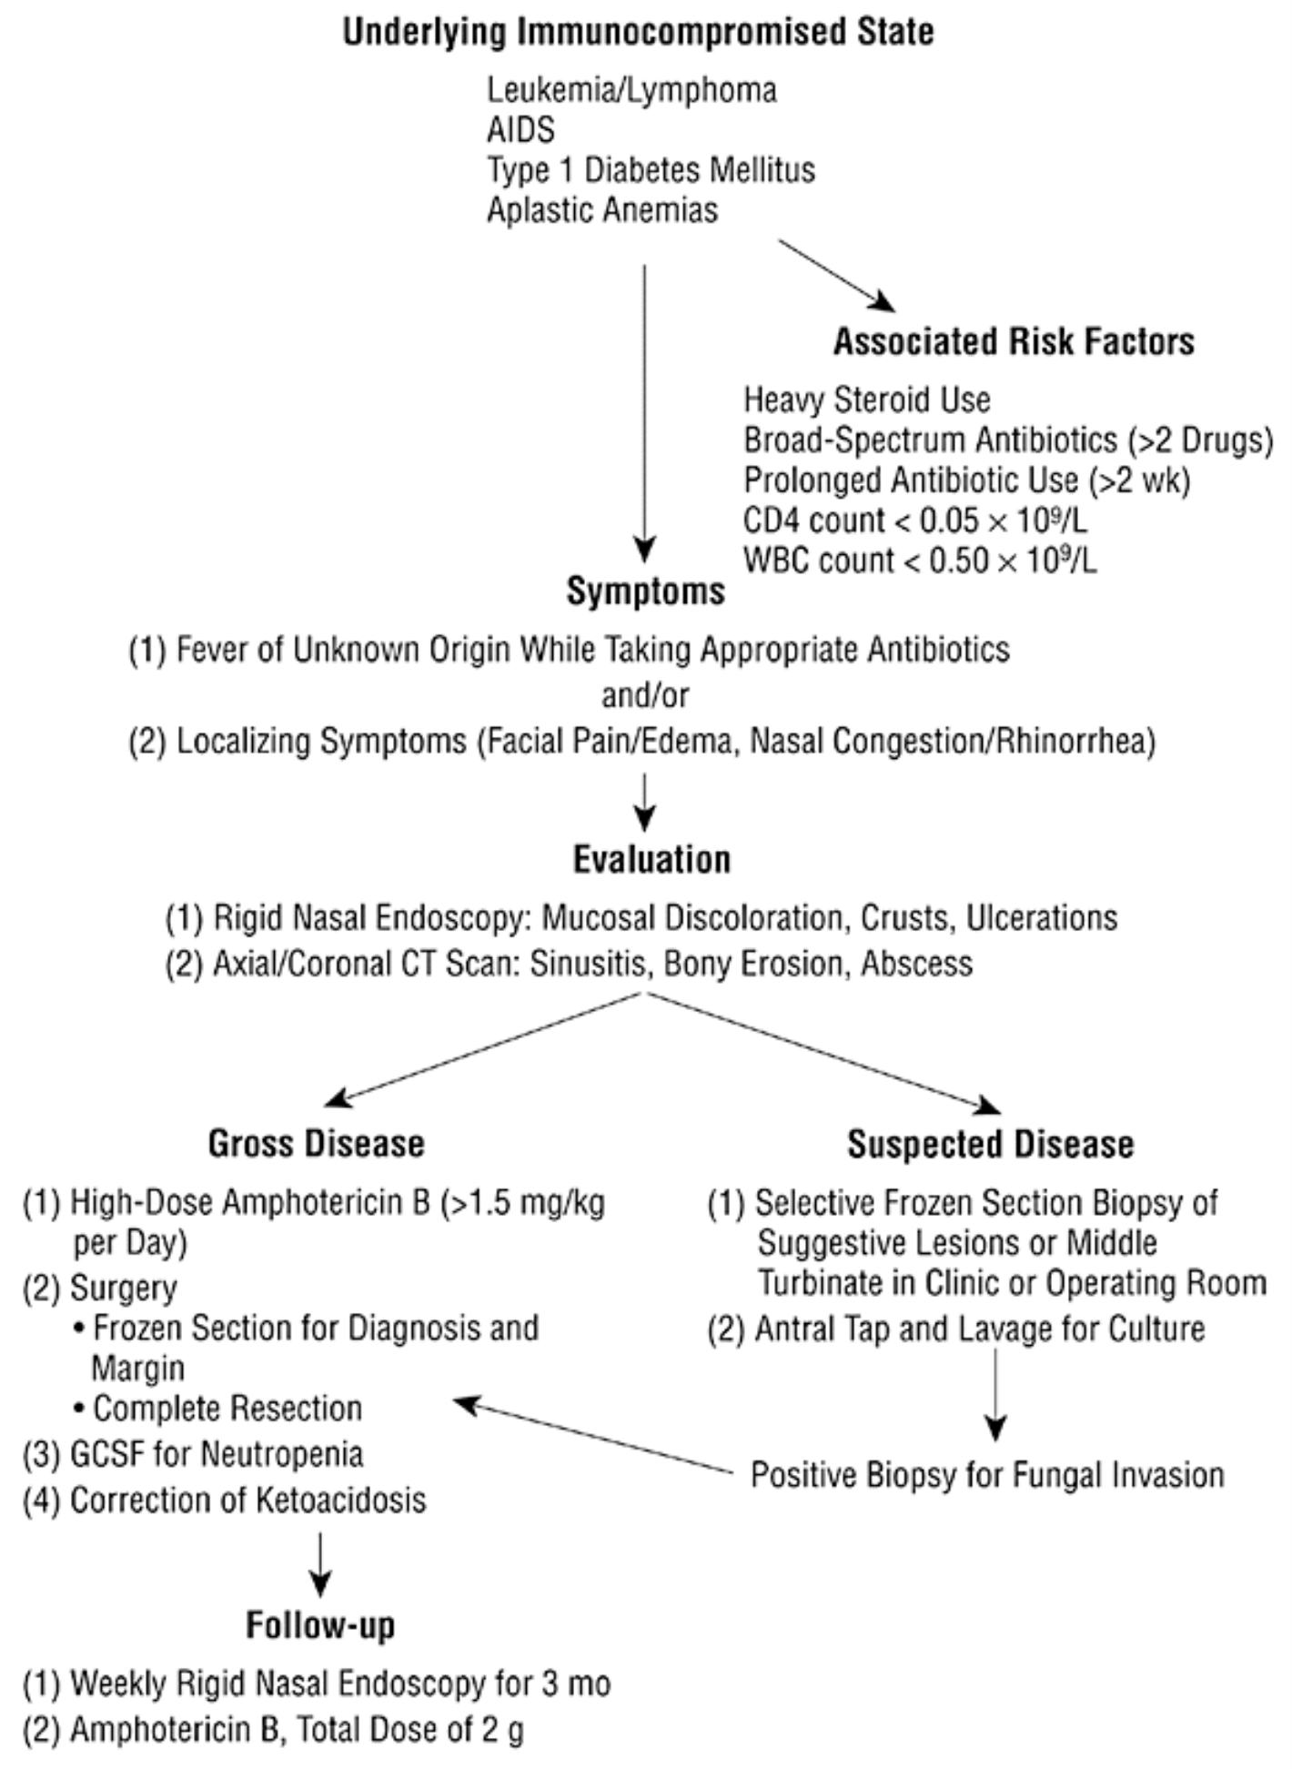
From: An Approach to Fulminant Invasive Fungal Rhinosinusitis in the Immunocompromised Host
Arch Otolaryngol Head Neck Surg. 1998;124(5):520-526. doi:10.1001/archotol.124.5.520
Figure Legend:
Algorithm for the diagnosis and management of invasive fungal rhinosinusitis. AIDS indicates acquired immunodeficiency syndrome; WBC, white blood cell; CT, computed tomographic; and GCSF, granulocyte colony–stimulating factor.
Date of download: 1/4/2015
Copyright © 2015 American Medical Association. All rights reserved.

Slide 5
Acute Invasive Fungal Sinusitis:
The immunocompromised patient
s/p transplant, leukemia, diabetic/DKA, AIDS
Mucor grows in acidotic conditions and with increased iron
DKA can enhance growth
  Diabetic patients have altered transferrin binding, therefore higher free iron
Dialysis patients on Deferoxamine
DKA is reversible, and prognosis is better – 80% survival (less than 50% survival in other immunosuppressed patients)

Slide 6
Acute Invasive Fungal Sinusitis: Initial Approach
    Symptoms: Fever, localization of symptoms to the nose or paranasal sinus area – orbital swelling, facial pain, nasal congestion
    Numbness of nasal mucosa or cheeks precedes necrosis
    Always check hard palate

Slide 7
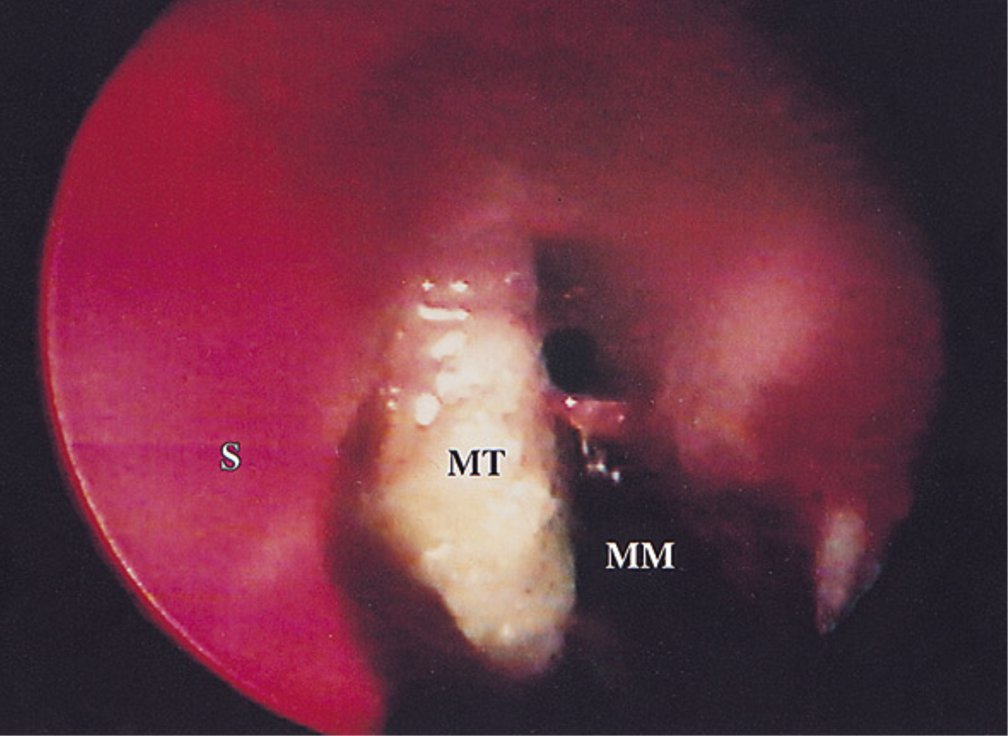
Acute Invasive Fungal Sinusitis: Physical Exam
Necrosis, or rarely fungal spores. Often nasal endoscopy can just show edema and changes similar to noninvasive sinusitis
From: An Approach to Fulminant Invasive Fungal Rhinosinusitis in the Immunocompromised Host
Arch Otolaryngol Head Neck Surg. 1998;124(5):520-526. doi:10.1001/archotol.124.5.520

Slide 8
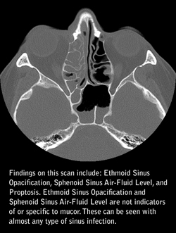
Acute Invasive Fungal Sinusitis:
Imaging
    CT sinus – often shows changes that are indistinguishable from other causes of sinusitis, though may show bony erosion or soft tissue invasion
http://www.surgery.wisc.edu/referring-physicians/newsletters/september-2011-otologic-head-neck-newsletter/targeted-review-fungal-sinus-infections/

Slide 9
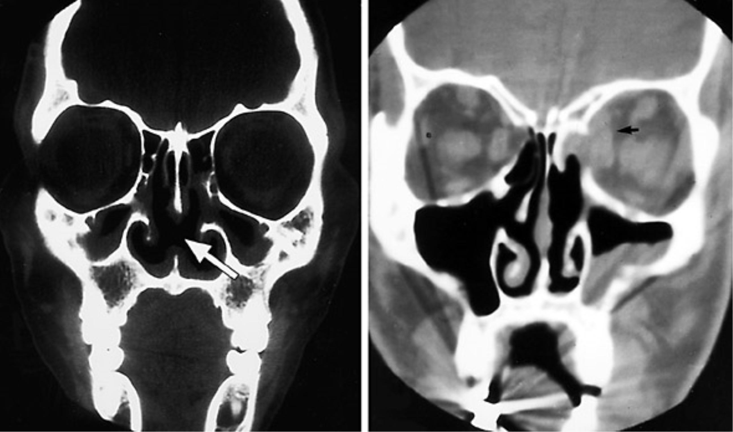
Acute Invasive Fungal Sinusitis:
More Imaging
Figure Legend:
Evidence of invasive disease was frequently seen on computed tomographic scans of the paranasal sinuses. Coronal computed tomographic scans demonstrating (left) septal perforation (arrow) and (right) left orbital abscess secondary to invasive fungal disease (arrow).
From: An Approach to Fulminant Invasive Fungal Rhinosinusitis in the Immunocompromised Host
Arch Otolaryngol Head Neck Surg. 1998;124(5):520-526. doi:10.1001/archotol.124.5.520

Slide 10
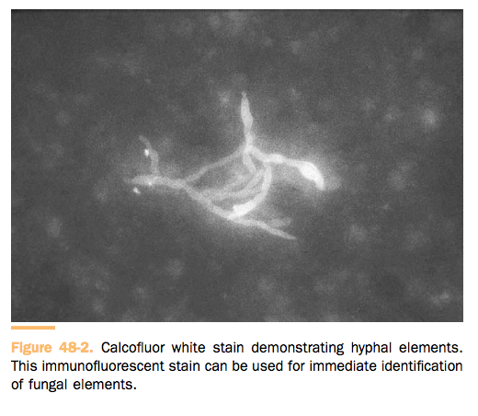
Acute Invasive Fungal Sinusitis:
Biopsy
Biopsy for pathology and culture
Histopathology – Hyphae within tissue
  Frozen section can be difficult to distinguish mucor and aspergillus
Calcofluor white stain

Slide 11
Acute Invasive Fungal Sinusitis:
Organisms
    Most commonly in both acute and chronici invasive fungal sinusitis is Aspergillus – Aspergillus fumigatus (more common) or Aspergillus flavus (Sudan, India)
    Scedosporium apiospermum or Pseudallescheria boydii, Fusarium, the Zygomycetes (which cause mucormycosis), and even, rarely, Basidiomycetes

Slide 12
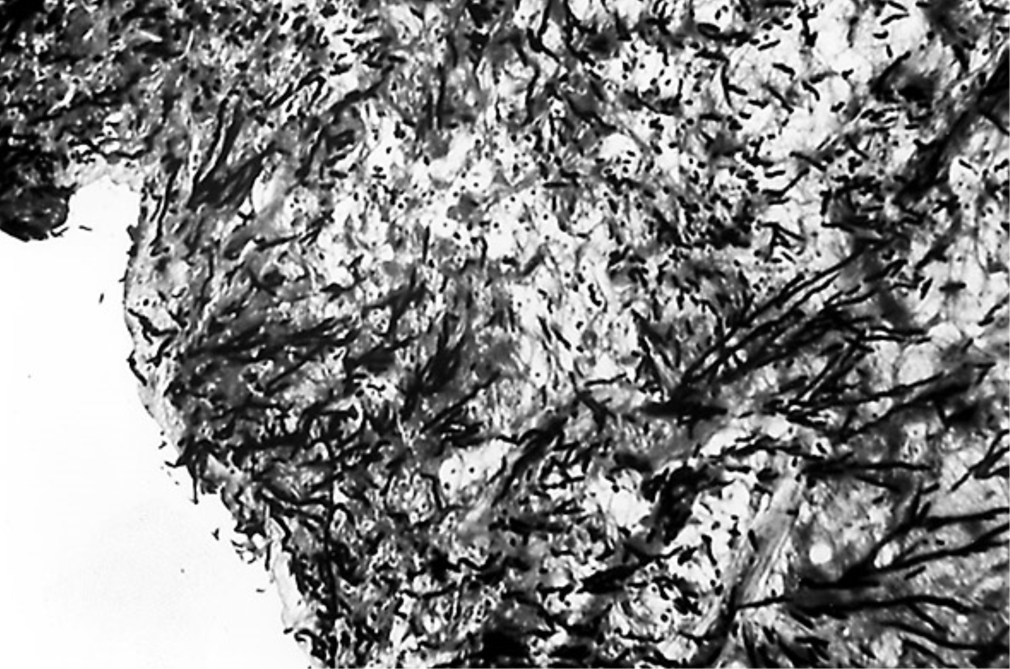
Acute Invasive Fungal Sinusitis:
Aspergillus
Can be angioinvasive, but does not have obliterative invasion
45 degree branching (Y-shaped)
Septated hyphae
Figure Legend:
Aspergillus invading the nasal submucosa (methenamine-silver, ×10).
From: An Approach to Fulminant Invasive Fungal Rhinosinusitis in the Immunocompromised Host
Arch Otolaryngol Head Neck Surg. 1998;124(5):520-526. doi:10.1001/archotol.124.5.520

Slide 13
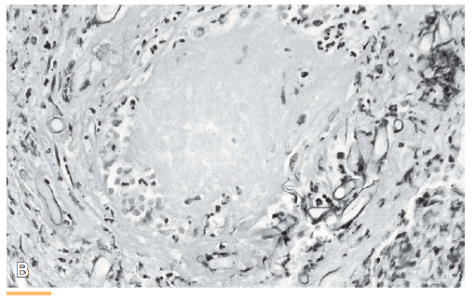
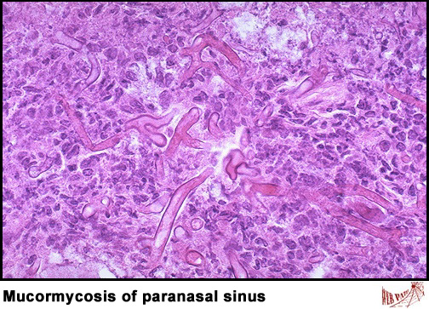
Acute Invasive Fungal Sinusitis:
Mucor
  Most virulent and common – Rhizopus oryzae
  Most acutely fatal fungal infection, rapidly growing
  Broad ribbon-like, irregular, 90 degree branching hyphae
  Rarely septated/nonseptated
  Vascular invasion and obliteration→ ischemia → necrosis (can consider HBOT)

Slide 14
Acute Invasive Fungal Sinusitis:
Treatment
Reversal of underlying immunosuppression
Wide/aggressive surgical debridement
Topical and systemic antifungal therapy
  Amphotericin B – 0.6-1mg/kg/day up to 3g
    Nephrotoxic – ABLC is less nephrotoxic (delivered through liposomes)
    20 ml of Amphotericin B nasal saline irrigation
  Posaconazole, Voriconazole

Slide 15
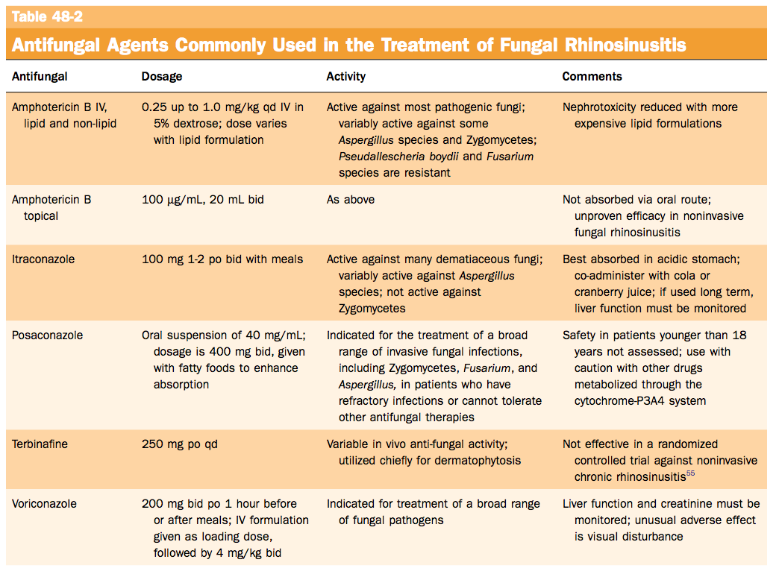
Antifungal therapy

Slide 16
Fungal Sinusitis

Slide 17
Chronic Invasive Fungal Sinusitis = Indolent Fungal Sinusitis
No or limited immunocompromise, but can be lethal
Slowly progressive (months, weeks)
Suspect this in patients with orbital extension or cranial neuropathy – immunocompetent patient with painless proptosis
Granulomas in which giant cells contain hyphae (more common in Africa and India) vs nongranulomatous type
Diagnosis and treatment is the same as acute
  Antifungal Therapy
  Surgical debridement

Slide 18
Fungal Sinusitis

Slide 19




Fungus Balls
  Mycetoma
  Affects ONE sinus
  Generally immunocompetent patient and indistinguishable from CRS
  Darkened crumbly mass with spores
  Aspergillus flavus, Aspergillus fumigatus, Mucor, Alternaria
  CT – metallic or calcified densities – 60% PPV

Slide 20
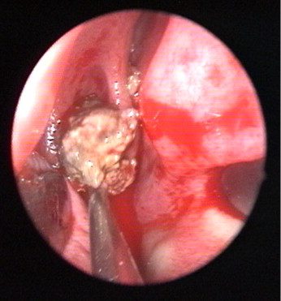
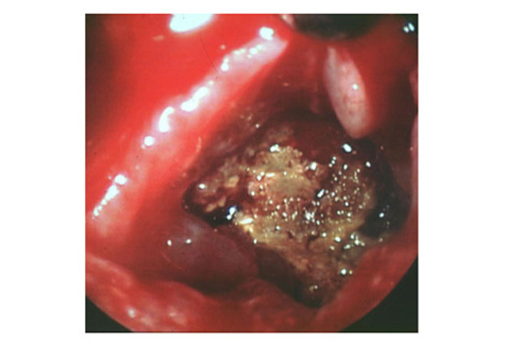
Fungus Balls: Endoscopy

Slide 21
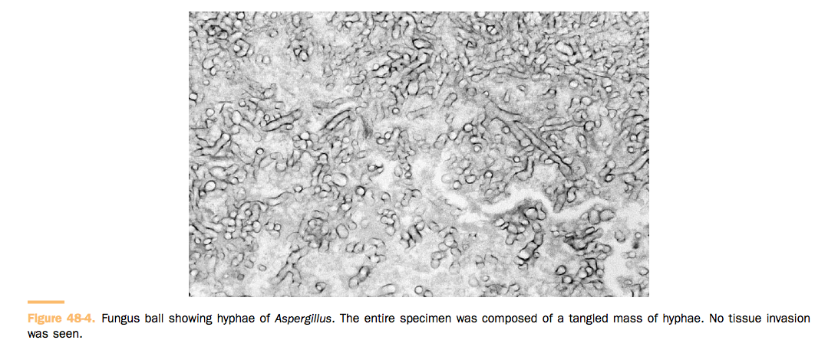
Fungus Balls: Histology
**NO TISSUE INVASION SEEN**

Slide 22
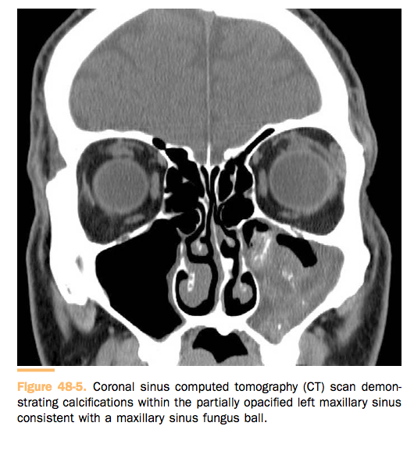
Fungus Balls: CT

Slide 23
Fungal Sinusitis

Slide 24
Allergic Fungal Rhinosinusitis (AFRS)
AFRS is the sinonasal form of allergic bronchopulmonary aspergillosis
  North American Organisms: Bipolaris, Exserohilum robustum, Curvularia lunata, and Alternaria.
  More common in humid regions (US along Mississippi River, southern US. Less common in cool regions (US pacific NW)
  Nasal polyps, allergies, atopy. 40% have asthma

Slide 25
AFRS: Pathogenesis
Germination

Slide 26
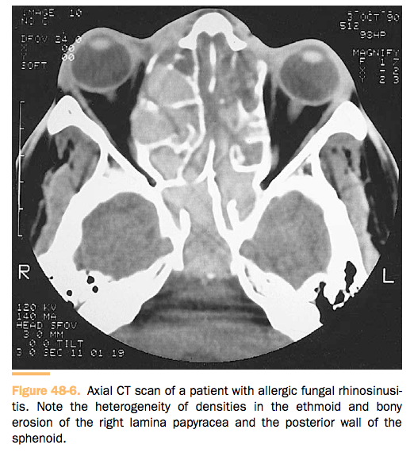
AFRS: Diagnosis
Allergic mucin characterized by necrotic inflammatory cells, eosinophils, and Charcot-Leyden crystals (from eosinophil degranulation). In this allergic mucin are hyphal elements usually best appreciated with fungal stains
Elevation of IgE antibodies on culture of eosinophilic mucin containing fungus and NO evidence of invasion
CT – bony erosion is common, heterogeneity of opacification

Slide 27
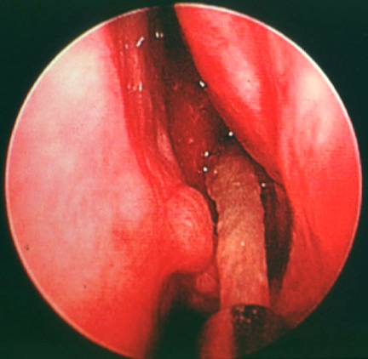
AFRS: Treatment
Nasal polypectomy, removal of mucin, conservative nonmutilating ESS
Prednisone 40-60mg Daily (taper over 2-4 weeks)
Preoperative steroids can resolve eosinophilic process leading to a misdiagnosis of a fungal ball
Maintenance – debridement, systemic and topical steroids, occasional antifungal therapy (no randomized controlled studies), irrigation

Slide 28
AFRS: Immunotherapy
No serious systemic complications other than local reactions
In the current literature, there are no double-blind, placebo-controlled studies comparing fungal desensitization in AFRS patients with a control group… More research is needed…

Slide 29
Fungal Sinusitis

Slide 30
Nonallergic Fungal Rhinosinusitis
  Controversial category of fungal sinusitis without eosinophilic mucin or IgE antibodies
  Fungus as a cause of CRS
  Can consider irrigation of amphotericin B
  However….
    Sacks et al (2011) – Cochrane review – 5 topical antifungals and 1 systemic antifungal – no evidence to support antifungal therapy in the management of CRS

Slide 31
Saprophytic Fungal Infection
Ubiquitous fungal spores land on mucous crusts
Treatment: remove crusts, nasal saline irrigation

Slide 32
Ch 49 – Benign Tumors of the Sinonasal Tract
Sophie Shay, MD
UCLA Dept of Head and Neck Surgery
January 7, 2015

Slide 33
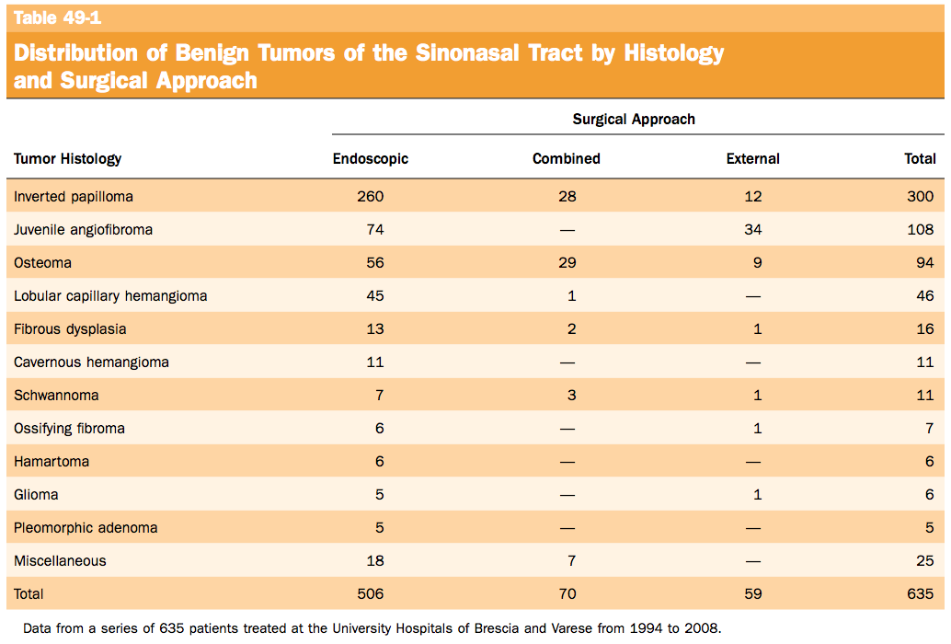

Slide 34
Overview
  Epithelial tumors (papillomas and salivary gland–type adenomas), soft tissue tumors (myxoma, leiomyoma, hemangioma, Schwannoma, neurofibroma, meningioma), and tumors of bone and cartilage (giant cell lesion, giant cell tumor, chondroma, osteoma, chondroblastoma, chondromyxoid fibroma, osteo- chondroma, osteoid osteoma, osteoblastoma, ameloblastoma, nasal chondromesenchymal hamartoma), JNA
  Presentation: Unilateral nasal obstruction
  Workup
    CT with contrast, MRI (differentiates tumor from retained secretions)
    Biopsy – don’t do it if you suspect a encephalomeningocele or angiofibroma

Slide 35
Inverted Papilloma (Schneiderian Papilloma)
  2nd most common benign tumor of the sinonasal tract
  Most common indication for surgery
  0.4% to 4.7% of all surgically removed sinonasal tumors, with an incidence ranging from 0.6 to 1.5 cases per 100,000 inhabitants per year.
  Men > Women
  5th and 6th decades of life
  3.4-9.7% of SCC prevalence, more often synchronous (Pasha – 10% malignant degeneration)
  Associated with HPV 6, 11, 16, 18 (16 and 18 with malignant transformation) and EBV

Slide 36
IP: Presentation
  Presentation: Unilateral nasal obstruction with watery rhinorrhea
  Epiphora, proptosis, diplopia, and headache if involving skull base of orbits

Slide 37
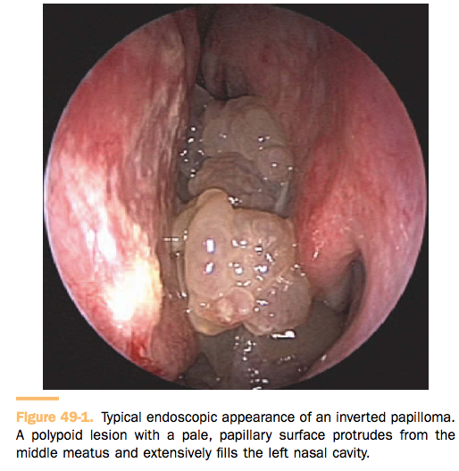
IP: Physical Exam
  Endoscopy: Pale polypoid mass with papilloma features in middle meatus
  Sites: lateral nasal wall, maxillary sinus. Rarely sphenoid or frontal sinuses

Slide 38
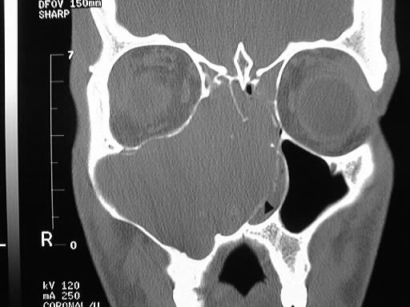
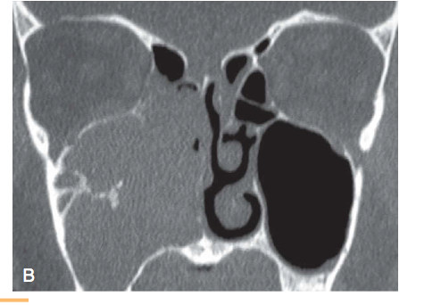
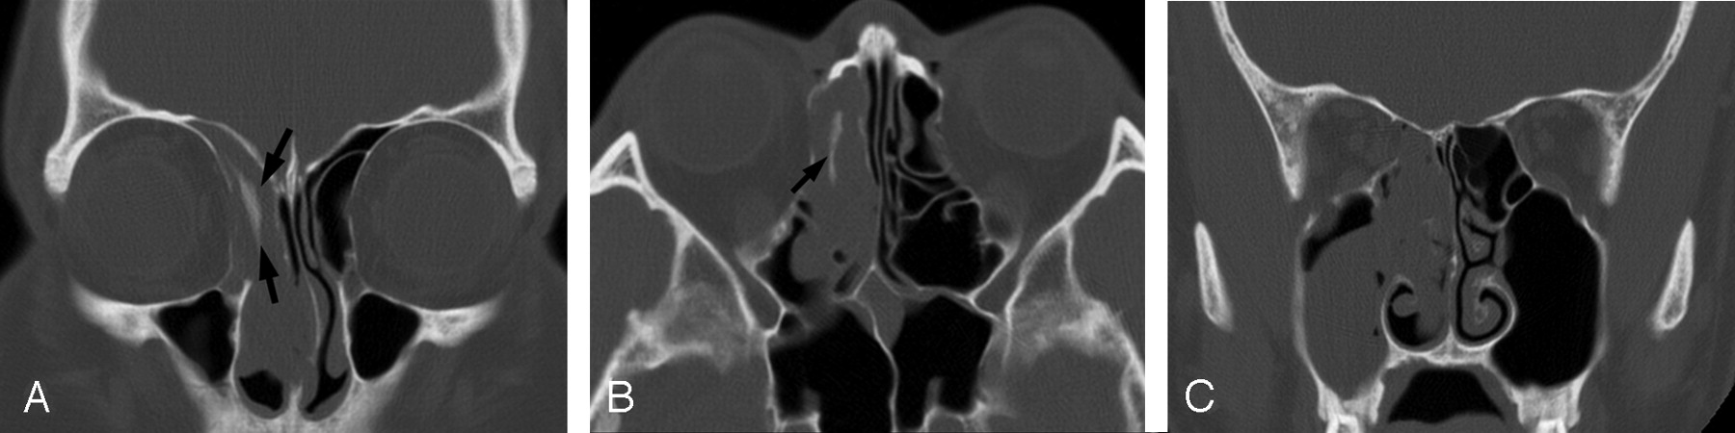
IP: Imaging - CT
Good for hyperostosis and osteic changes, looking for tumor origin

Slide 39
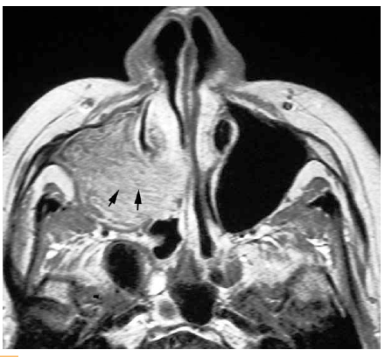
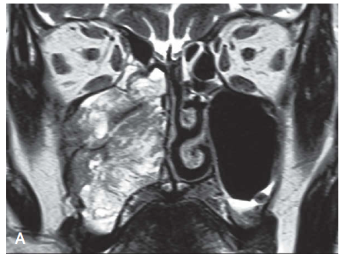
IP: Imaging - MRI
Differentiates tumor from inflammatory mucosal changes. Helpful in extensive tumor or recurrence
T1-weighted
T2-weighted

Slide 40
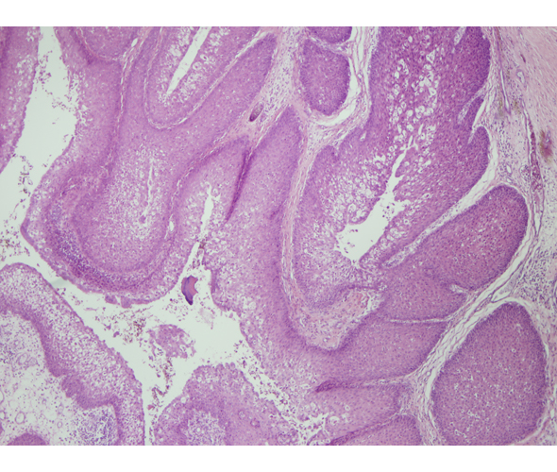
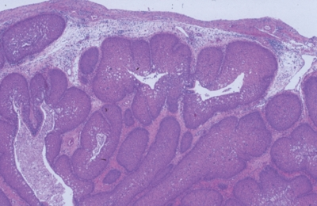
IP: Histology
Composed exclusively or almost exclusively of hyperplastic ribbons of basement membrane–endophytic growth of epithelium into the underlying stroma. The epithelium is multilayered and formed of squamous or ciliated columnar cells mixed with mucocytes.

Slide 41
IP: Treatment
  Open techniques – medial maxillectomy through lateral rhinotomy, midface degloving
  **Endoscopic removal**
  Contraindications: (1) massive involvement of the mucosa of the frontal sinus and/or of a supraorbital cell, (2) intradural extension or transorbital extension, (3) concomitant presence of a malignancy involving critical areas, and (4) presence of abundant scar tissue from previous surgery.
  GOAL: to dissect the involved mucosa along the subperiosteal plane and to drill the underlying bone, and to leave a marsupialized wide open cavity that makes endoscopic surveillance easy
  Post operative surveillance - imaging only if scarring has closed off a sinus from visibility

Slide 42
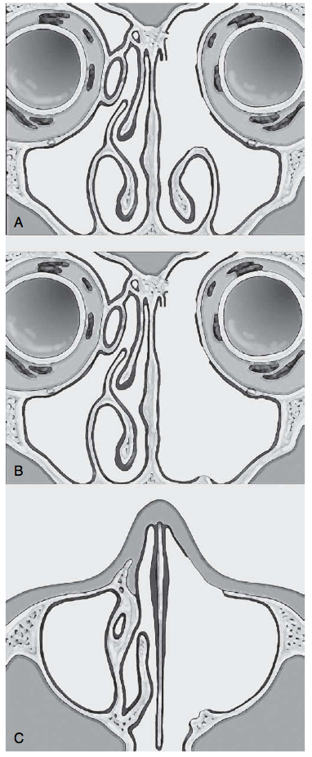
IP: Treatment, cont
Type I – Middle meatus, ethmoid, superior meatus, sphenoid
Type II – medial maxillectomy, takes entire medial wall of maxillary sinus and inferior turbinate – extending into maxillary sinus or involving mucosa of the maxillary sinus, primarily maxillary sinus lesions
Type III – resection of the medial portion of the anterior maxillary sinus wall to access all antrum walls

Slide 43
IP Frontal Sinus
Varies depending on tumor extent
Draf IIB, Draf III
Combination of external and endoscopic approaches (external sinusotomy, frontal osteoplastic flap, trephination)

Slide 44
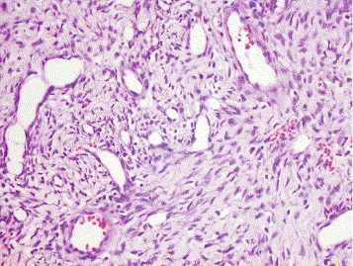
Juvenile Angiofibroma (JNA)
Vascular endothelium–lined spaces embedded in a fibrous stroma that typically affects adolescent males
Shick et al – postulates that JNAs may arise from a remnant brachial artery
Pathognomonic epicenter at the level of the pterygopalatine fossa

Slide 45
JNA: Extension
In its early phase, JNA extends through the sphenopalatine foramen into the nasopharynx and the nasal cavity and along the vidian nerve into the floor of the sphenoid sinus.
Lateral - infratemporal fossa
Anterior – posterior maxillary wall
Intracranial - through the orbit via the inferior and superior orbital fissure or along the maxillary nerve to the parasellar region.
Transdural growth is very rare

Slide 46
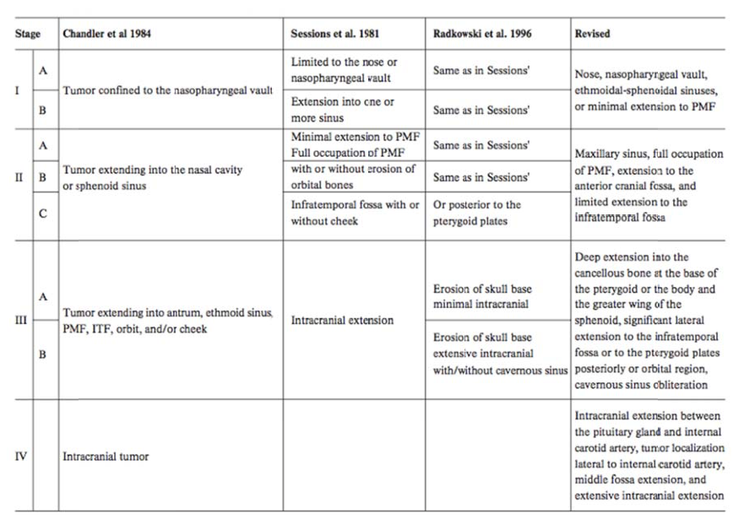
JNA: Classifications
Onerci M, Ogretmenoglu O, Yücel T. Juvenile nasopharyngeal angiofibroma: a revised staging system. Rhinology. 2006;44:39-45.

Slide 47
JNA: Fisch Classification (1983)
Limited to Nasal Cavity
Extends into PPF or sinuses with bony destruction
Invades infratemporal fossa, orbit, or parasellar region
Extends into cavernous sinus, optic chiasmal region, or pituitary fossa

Slide 48
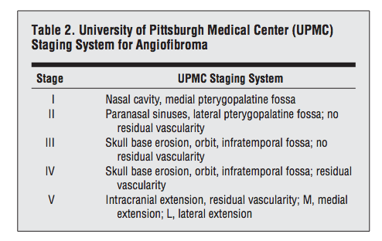
JNA: Pittsburgh Classification (2010)

Slide 49
JNA: Presentation
Unilateral nasal obstruction, epistaxis
In advanced lesions, swelling of the cheek, proptosis, or headache may be present, indicating an involvement of the infratemporal fossa, the orbit, or the cranial fossa, respectively

Slide 50
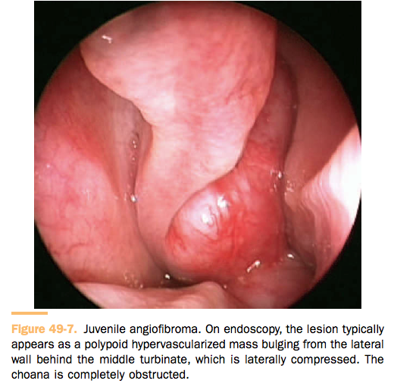
JNA: Endoscopy
  Smooth, hypervascularized lesion originating behind the middle turbinate, which is usually laterally displaced against the lateral wall
  DO NOT BIOPSY – high risk of hemorrhage

Slide 51
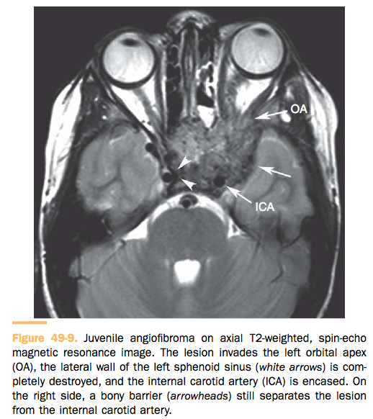
JNA: Imaging
  CT/MRI - origin at PPF
  MRI T1- and T2-weighted sequences with several signal voids (major intralesional vessels)

Slide 52
JNA: Treatment
    Risks – bleeding, incomplete resection
    Preoperative embolization (within 48hrs prior to surgery)
      Internal maxillary artery, ascending pharyngeal artery
      Branches of the internal carotid are still difficult (neuro complications)
    Endoscopic resection
    Open approaches – midface degloving, infratemporal fossa resection
    Consider a combination external/endoscopic approach for large tumors involving the cavernous sinus, encasing the internal carotid artery, large intracranial involvement
    Low dose radiation therapy 30-36 Gy

Slide 53
JNA: Post-op management
Most residual lesions grown submucosally – CT/MRI
MRI to assess growth – revision surgery when there is a clear increase in growth
Endoscopic surveillance
6.6-17% recurrence rate with endoscopic resection
Invasion of the sphenoid or pterygoid process, involvement of the infratemporal fossa, foramen lacerum, and/or cavernous sinus in more advanced lesions have a negative impact on local control

Slide 54
Osteoma
  Most common benign sinonasal tumor
  Benign slow growing osteoblastic tumor
  2nd to 5th decades of life
  Males slightly > females
  Frontal sinus (80%), Ethmoid, maxillary, sphenoid
  Gardner’s syndrome – multiple polyps of the colon associated with osteomas of skull and multiple soft tissue tumors
  Etiology: embryologic theory, traumatic, infective, slow growing osseous hamartoma
  Most commonly in the frontal or frontoethmoidal region
  Often incidentally found

Slide 55
Osteoma:
Fu and Perzin Classification
  Ivory or “eburnated” osteoma: lobulated, made of compact, dense bone, containing a minimal amount of fibrous tissue, and without evidence of haversian ducts.
  Mature osteoma or osteoma spongiosum: composed of spongy, mature bone in which the bony trabeculae are divided by a con- spicuous amount of fibrous tissue, containing fibroblasts in different stages of maturation, and a great number of collagen fibers. The connective tissue may often contain distended thin-walled vessels.
  Mixed osteoma, which features findings typical for both ivory and mature osteoma.

Slide 56
Osteoma: Presentation
  Frontal sinusitis
  Outer table of frontal sinus – cosmetic deformity
  Towards the orbit - orbital or lacrimal symptoms (i.e., proptosis, diplopia, orbital pain, epiphora, decreased visual acuity, and even transient blindness)
  Anterior cranial fossa extension - risk of cerebrospinal fluid leak, pneumocele, meningitis, and brain abscess
  Maxillary sinus – aesthetics, infraorbital nerve neuralgia
  Endoscopy is usually normal

Slide 57
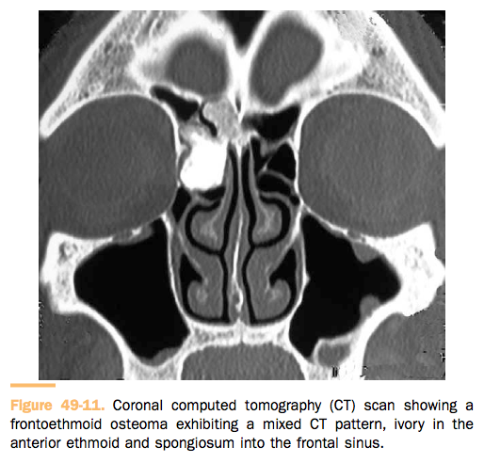
Osteoma: Imaging
CT without contrast
MRI may be needed to delineate soft tissue if concern for anterior cranial fossa or orbital extension

Slide 58
Osteoma: Treatment
  If asymptomatic – “wait and see” as long as there is no orbital or intracranial extension
  Surgery
    External approaches: Frontoethmoidectomy through a Lynch-Howarth incision, midfacial degloving, lateral rhinotomy, Caldwell-Luc procedure, and osteoplastic frontal sinusotomy via a coronal incision
    Endoscopic
  Recurrence is rare and surveillance with imaging is generally not indicated

Slide 59
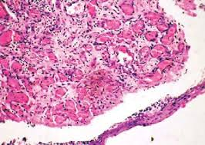
Lobular Capillary Hemangioma
(Pyogenic Granuloma)
Arranged in lobules and separated by a loose connective tissue stroma, often infiltrated by inflammatory cells.
Anterior ½ of nasal cavity – Little’s area, head of middle/inferior turbinate
Associated with trauma
Treatment: Endoscopic resection
Clinical Rhinology: An International Journal, September-December 2011;4(3):163-165
Anuja Santosh Kulkarni, Bachi T Hathiram

Slide 60
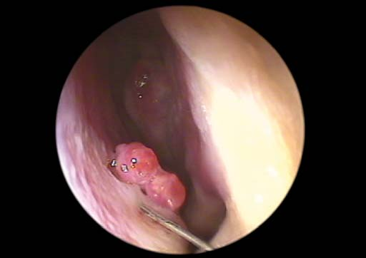
Lobular Capillary Hemangioma:
Endoscopy
Red to purple friable mass, not larger than 1cm, associated with epistaxis
Clinical Rhinology: An International Journal, September-December 2011;4(3):163-165
Anuja Santosh Kulkarni, Bachi T Hathiram

Slide 61
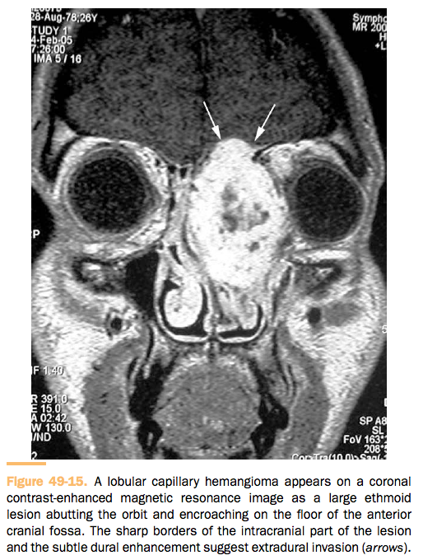
Lobular Capillary Hemangioma: Imaging
  CT, the lesion appears as a unilateral mass with soft tissue density
  MRI
    T2 hyperintensity
    Spontaneous T1 hypointensity
    T1 and T2 enchances with contrast

Slide 62
Ossifying Fibroma
  Benign osteoblastic lesion, encapsulated
  Third and fourth decades of life, preferentially in black women, whereas its psammomatoid variant typically affects men at a younger age and displays a more aggressive local behavior.
  Endoscopic radical resection – high recurrence rate, aggressive recurrences

Slide 63
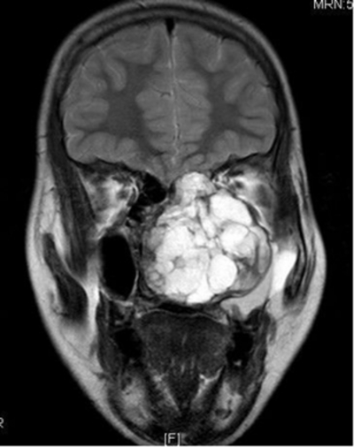
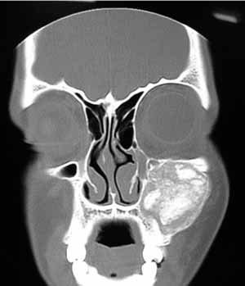
Ossifying Fibroma: Imaging
  CT - well-defined, multiloculated lesion, bordered by a peripheral eggshell-like dense rim.
  MRI
    T1 - signal is intermediately intense to hyperintense in the central part of the lesion and hypointense in the outer shell
    T2 - hyperintense
L Emerson., M Alexander, A Job. Juvenile Trabecular And Psammomatoid Variant Of Ossifying Fibroma Of The Maxilla With Secondary Aneurysmal Bone Cyst.. The Internet Journal of Otorhinolaryngology. 2012 Volume 14 Number 1.
Journal of Indian Academy of Oral Medicine and Radiology, October-December 2010;22(4):S53-57
Preeti Nair et al

Slide 64
Fibrous Dysplasia
  A genetically based developmental anomaly of the bone-forming mesenchyme with a defect in osteoblastic differentiation and maturation that leads to a replacement of normal bony tissue by fibrous tissue of variable cellularity and immature woven bone
  McCune-Albright Syndrome: (1) polyostotic fibrous dysplasia (PFD), (2) café-au-lait skin pigmentation, and (3) autonomous endocrine hyperfunction (eg, gonadotropin-independent precocious puberty)
  Treatment to relieve pressure on optic nerve or aesthetics
  No radiation therapy – risk of malignant transformation and effects on developing facial skeleton

Slide 65
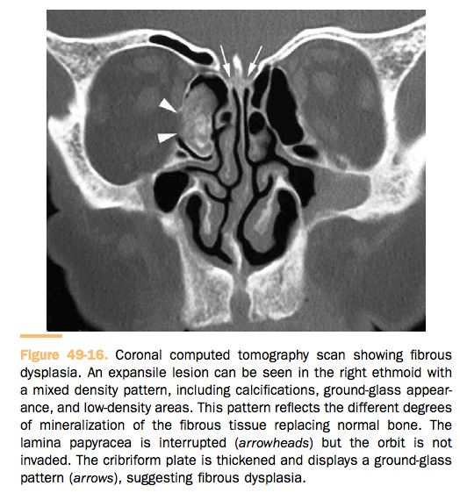
Fibrous Dysplasia

Slide 66
Schwannoma
  Arises from Schwann cells of myelinated nerves
  4% are sinonasal
  Ethmoid, maxillary sinus, nasal fossa, and sphenoid
  Arise more frequently from the ophthalmic and maxillary divisions of the trigeminal nerves, but they can also originate from sympathetic fibers of the carotid plexus or parasympathetic fibers of the pterygopalatine ganglion
  Differential Dx: neurofibroma, solitary fibrous tumor, leiomyoma, fibrous histiocytoma, and fibrosarcoma
  Endoscopic resection
  Strongly S-100 positive

Slide 67
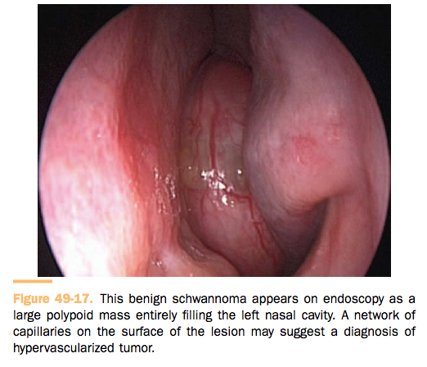
Schwannoma: Endoscopy
Well-delineated but non- encapsulated globular, firm to rubbery yellow-tan mass

Slide 68
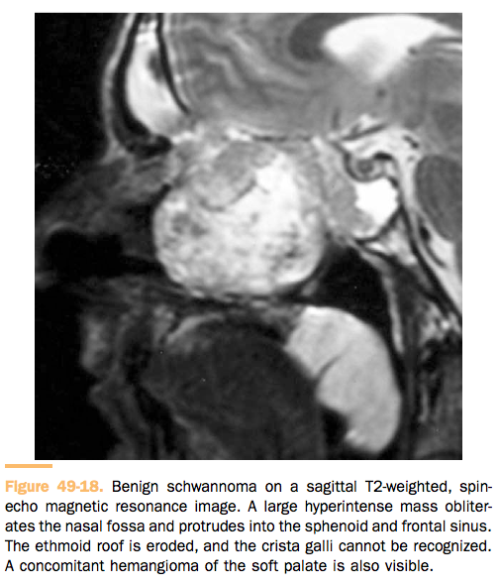
Schwannoma: MRI

Slide 69
COCLIA Questions

Slide 70
4.5.1
Describe the classification of fungal sinusitis. Discuss the Bent and Kuhn criteria for allergic fungal sinusitis (AFS). Is AFS distinct from Eosinophilic Mucin Rhinosinusitis (EMRS)?

Slide 71
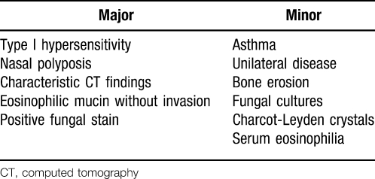
Bent and Kuhn Criteria

Slide 72
AFRS vs EMRS
Ferguson et al (2000) – “Significant clinical and immunological differences exist to distinguish AFS from EMRS. It is postulated that AFS is an allergic response to fungi in predisposed individuals, while EMRS occurs because of a systemic dysregulation of immunological controls. Because EMRS is a systemic disease, unilateral disease is not seen. In contrast, AFS, an allergic response to fungi, may occur unilaterally or bilaterally depending on the antigenic stimulation.”
Ferguson, B. J. (2000), Eosinophilic Mucin Rhinosinusitis: A Distinct Clinicopathological Entity . The Laryngoscope, 110: 799–813. doi: 10.1097/00005537-200005000-00010

Slide 73
4.5.2
What organisms are responsible for non-invasive and invasive fungal sinusitis?

Slide 74
    Invasive: Most commonly in both acute and chronic is Aspergillus – Aspergillus fumigatus (more common) or Aspergillus flavus (Sudan, India). Scedosporium apiospermum or Pseudallescheria boydii, Fusarium, the Zygomycetes (which cause mucormycosis), and even, rarely, Basidiomycetes
    Fungus Balls: Aspergillus flavus, Aspergillus fumigatus, Mucor, Alternaria
    AFRS: North American Organisms: Bipolaris, Exserohilum robustum, Curvularia lunata, and Alternaria.

Slide 75
4.5.3
Describe radiographic findings of invasive and non-invasive fungal sinusitis

Slide 76
    Invasive: CT sinus – often shows changes that are indistinguishable from other causes of sinusitis, though may show bony erosion or soft tissue invasion
    Noninvasive: bony erosion is common, heterogeneity of opacification

Slide 77
4.5.5
How is allergic fungal sinusitis treated? Is medical management effective? What is the role of antifungal therapy in chronic rhinosinusitis?

Slide 78
AFRS: Treatment
SURGERY - Nasal polypectomy, removal of mucin, conservative nonmutilating ESS
Prednisone 40-60mg Daily (taper over 2-4 weeks)
Preoperative steroids can resolve eosinophilic process leading to a misdiagnosis of a fungal ball
Maintenance – debridement, systemic and topical steroids, occasional antifungal therapy (no randomized controlled studies), irrigation

Slide 79
Role of antifungals in CRS
  Sacks et al (2011) – Cochrane review – 5 topical antifungals and 1 systemic antifungal – no evidence to support antifungal therapy in the management of CRS

Slide 80
4.5.6
Is there a role for immunotherapy in treating allergic fungal sinusitis?

Slide 81
AFRS: Immunotherapy
In the current literature, there are no double-blind, placebo-controlled studies comparing fungal desensitization in AFS patients with a control group, illustrating that there is a need for continued investigation and research for this confounding and fascinating disease.
No serious systemic complications other than local reactions

Slide 82
4.5.8
Discuss risk factors, clinical presentation and management of invasive fungal sinusitis?

Slide 83
Acute Invasive Fungal Sinusitis:
The immunocompromised patient
s/p transplant, leukemia, diabetic/DKA, AIDS
Mucor grows in acidotic conditions and with increased iron
DKA can enhance growth
  Diabetic patients have altered transferrin binding, therefore higher free iron
Dialysis patients on Deferoxamine
DKA is reversible, and prognosis is better – 80% survival (less than 50% survival in other immunosuppressed patients)

Slide 84
Acute Invasive Fungal Sinusitis: Initial Approach
    Symptoms: Fever, localization of symptoms to the nose or paranasal sinus area – orbital swelling, facial pain, nasal congestion
    Numbness of nasal mucosa or cheeks precedes necrosis
    Always check hard palate

Slide 85
Acute Invasive Fungal Sinusitis: Physical Exam
Necrosis, or rarely fungal spores. Often nasal endoscopy can just show edema and changes similar to noninvasive sinusitis
From: An Approach to Fulminant Invasive Fungal Rhinosinusitis in the Immunocompromised Host
Arch Otolaryngol Head Neck Surg. 1998;124(5):520-526. doi:10.1001/archotol.124.5.520

Slide 86
Acute Invasive Fungal Sinusitis:
Treatment
Reversal of underlying immunosuppression
Wide/aggressive surgical debridement
Topical and systemic antifungal therapy
  Amphotericin B – 0.6-1mg/kg/day up to 3g
    Nephrotoxic – ABLC is less nephrotoxic (delivered through liposomes)
    20 ml of Amphotericin B nasal saline irrigation
  Posaconazole, Voriconazole

Slide 87
4.5.9
You are called to the ICU to evaluate a neutropenic patient for invasive fungal sinusitis. Review a systematic approach to the diagnosis and management of this problem.

Slide 88
From: An Approach to Fulminant Invasive Fungal Rhinosinusitis in the Immunocompromised Host
Arch Otolaryngol Head Neck Surg. 1998;124(5):520-526. doi:10.1001/archotol.124.5.520
Figure Legend:
Algorithm for the diagnosis and management of invasive fungal rhinosinusitis. AIDS indicates acquired immunodeficiency syndrome; WBC, white blood cell; CT, computed tomographic; and GCSF, granulocyte colony–stimulating factor.
Date of download: 1/4/2015
Copyright © 2015 American Medical Association. All rights reserved.

Slide 89
4.5.10
Should frozen sections be routinely employed for early diagnosis of invasive fungal sinusitis?

Slide 90
Acute Invasive Fungal Sinusitis:
Biopsy
YES. – “Frozen-section biopsy is a useful tool for rapid and effective diagnosis in patients with suspected AIFRS. A positive frozen-section result is highly predictive of invasive disease and merits prompt surgical intervention.”
Biopsy for pathology and culture
Histopathology – Hyphae within tissue
  Frozen section can be difficult to distinguish mucor and aspergillus
Ghadiali MT, Deckard NA, et al. Frozen-section biopsy analysis for acute invasive fungal rhinosinusitis. Otolaryngol Head Neck Surg. 2007 May;136(5):714-9. PMID:17478203

Slide 91
4.8.1
Describe the clinical presentation and classification system for Juvenile Nasopharyngeal Angiofibroma (JNA).

Slide 92
JNA: Classifications
Onerci M, Ogretmenoglu O, Yücel T. Juvenile nasopharyngeal angiofibroma: a revised staging system. Rhinology. 2006;44:39-45.

Slide 93
JNA: Fisch Classification (1983)
Limited to Nasal Cavity
Extends into PPF or sinuses with bony destruction
Invades infratemporal fossa, orbit, or parasellar region
Extends into cavernous sinus, optic chiasmal region, or pituitary fossa

Slide 94
JNA: Pittsburgh Classification

Slide 95
JNA: Presentation
Unilateral nasal obstruction, epistaxis
In advanced lesions, swelling of the cheek, proptosis, or headache may be present, indicating an involvement of the infratemporal fossa, the orbit, or the cranial fossa, respectively

Slide 96
4.8.2
Describe the surgical approaches for excision of JNAs and compare the advantages and disadvantages of each approach. What is the role of embolization in the management of JNA?

Slide 97
JNA: Treatment
    Risks – bleeding, incomplete resection
    Preoperative embolization (within 48hrs prior to surgery)
    Internal maxillary artery, ascending pharyngeal artery
    Branches of the internal carotid are still difficult (neuro complications)
    Endoscopic resection
    Open approaches – midface degloving, infratemporal fossa resection
    Consider a combination external/endoscopic approach for large tumors involving the cavernous sinus, encasing the internal carotid artery, large intracranial involvement
    Low dose radiation therapy 30-36 Gy

Slide 98
4.8.3
What is the differential diagnosis of benign sinonasal tumors?

Slide 100
Overview
Epithelial tumors (papillomas and salivary gland–type adenomas), soft tissue tumors (myxoma, leiomyoma, hemangioma, Schwannoma, neurofibroma, meningioma), and tumors of bone and cartilage (giant cell lesion, giant cell tumor, chondroma, osteoma, chondroblastoma, chondromyxoid fibroma, osteo- chondroma, osteoid osteoma, osteoblastoma, ameloblastoma, nasal chondromesenchymal hamartoma), JNA
Presentation: Unilateral nasal obstruction
Workup
  CT with contrast, MRI (differentiates tumor from retained secretions)
  Biopsy – don’t do it if you suspect a encephalomeningocele or angiofibroma

Slide 101
4.8.4
Discuss the differential diagnosis, etiology and long term history of inverted papilloma.

Slide 102
Inverted Papilloma (Schneiderian Papilloma)
  2nd most common benign tumor of the sinonasal tract
  Most common indication for surgery
  0.4% to 4.7% of all surgically removed sinonasal tumors, with an incidence ranging from 0.6 to 1.5 cases per 100,000 inhabitants per year.
  Men > Women
  5th and 6th decades of life
  3.4-9.7% of SCC prevalence, more often synchronous
  Associated with HPV 6, 1, 16, 18 (16 and 18 with malignant transformation)

