Slide 1


Family Medicine Research Unit
Monthly Meeting
May 2023

Slide 2
Recently Processed Awards
PI | Award Title | Sponsor | Prime Sponsor | Action Type
Li, Michael Jonathan | Trajectories of Socially Regulated Gene Expression, Methamphetamine Use, and Viral Load Among HIV-positive Men Who Have Sex with Men (MSM) Receiving Contingency Management | NIH-NIDA National Institute on Drug Abuse | - | Continuation
Shoptaw, Steven J | Center for HIV Identification, Prevention and Treatment Services | NIH-NIMH National Institute of Mental Health | - | Continuation
Just announced: Dr. Lillian Gelberg and co-PI Dr. Marjan Javanbakht (Public Health, Dept. of Epidemiology) have been awarded a new, 2-year, $1.8M grant from the State of California’s Department of Cannabis Control entitled “Cannabis use for medicinal purposes among clinical populations in California: Population estimates of prevalence, frequency, quantity, and reasons for use.” It will focus on the epidemiology of medicinal cannabis use among clinical populations in California to describe the prevalence and patterns of medicinal cannabis use including detailed practices and behaviors related to medicinal cannabis use, elucidating sources, dosing, types of products, mode of use, patterns of use, perceived impact on symptoms/conditions, and self-reported adverse effects including disordered use.

Slide 3
Recently Submitted Proposals
PI | Title | Sponsor | Prime Sponsor | Type
Shoptaw, Steven J | Contingency management pilot program | Shine BC-LA | CONRAD HILTON FOUNDATION | New
Shoptaw, Steven J | Clinical Trials Network Big South/West Node – Yr19 Core | University of Texas-Southwestern Medical Center at Dallas | NIH-NIDA National Institute on Drug Abuse | Modification/ Amendment
Shoptaw, Steven J | Clinical Trials Network Big South/West Node – Yr19 CTN-0109 CURB-2 | University of Texas-Southwestern Medical Center at Dallas | NIH-NIDA National Institute on Drug Abuse | Modification/ Amendment
Shoptaw, Steven J | CTN-0110 MURB YR19 | University of Texas-Southwestern Medical Center at Dallas | NIH-NIDA National Institute on Drug Abuse | Modification/ Amendment

Slide 4

Upcoming Holidays
Monday, May 29

Slide 5
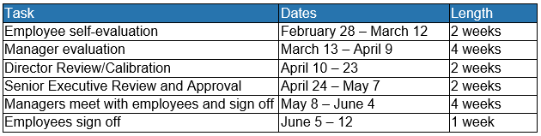
Performance Evaluations
For career staff in non-represented, non-academic positions
Managers should meet with employees to review starting next week

Slide 6
Career Tracks
New UC-wide job classification structure. Comprised of new job classification titles organized in a structure that is more closely aligned with current practices in the labor market.
Provides managers and employees at UCLA Health and the UC System with:
Better defined, market based job classification titles
More clearly defined career paths
Increased information for jobs across job families and functions
Salary ranges that reflect the local market for similar positions
Will support efforts to recruit, develop, and retain qualified employees.

Slide 7
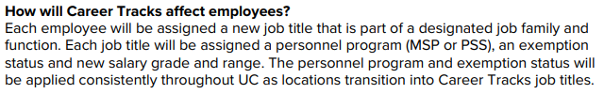
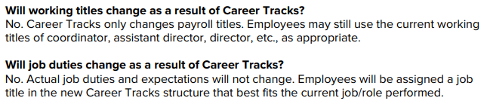
Career Tracks

Slide 8
Career Tracks
If your new classification is represented by the RX bargaining unit:
More information regarding your salary/payrate will be forthcoming.
Due to the step salary structure, employee rates will be moved to the step closest to (and not lower than) their current rate
The next increases bargained in the RX contract are:
      3.5% across the board increase effective July 1, 2023 (monthly) or July 9, 2023 (biweekly)
      Step increase for non-probationary career employees with satisfactory or better on latest evaluation, effective January 2024 (typically average ~2%)

Slide 9
Career Tracks
If you feel as though your position has been incorrectly mapped, please discuss your options for reconsideration with your supervisor.
For more information about roles and leveling, visit the UCLA Health Career Tracks Job Standards website at: https://hrsystems.mednet.ucla.edu/CareerTrk/list/.

Slide 10
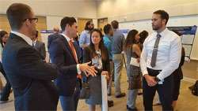
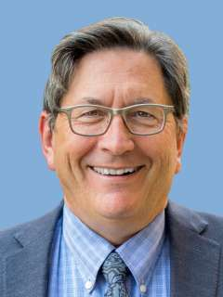
Research Day
2023 Meeting Information
In-person at the California Endowment (Center for Healthy Communities Los Angeles)
Wednesday, May 10, 2023
Keynote Speaker: Dr. Steve Shoptaw
RSVP deadline has passed – if you didn’t RSVP but want to attend, you must reach out to Laura

Slide 11
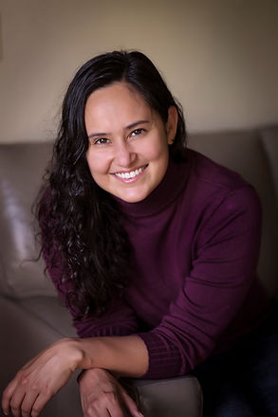
Grand Rounds
Fourth Friday of every month, from 12-1pm
Via Zoom (email Denise Acelar if you do not already have the invite)
Faculty, staff, and students are encouraged to attend
Next Grand Rounds: Friday, May 26, 2023
May Speaker: Dr. Alhelí Calderón-Villareal
May Grand Rounds Speaker: Alice Zhang, MD

Slide 12
Upcoming Faculty Meetings
Research Faculty Meeting: TBD, late May/early June
Meet-and-Greet with the Residents: Wednesday, June 21, from 8-11am
  Faculty are required to attend, or send proxy
  Opportunity to meet the residents, introduce yourself and your research foci
  Each faculty member will have approximately 10-15 mins; PowerPoint optional
  RSVP to Laura and let her know which time slot you prefer

Slide 13
Oppenheimer Building Updates
Effective TOMORROW, May 5, 2023:
All passenger elevators will be secured and will now require key card access 24/7
Access cards will be provided for employees who do not currently have one
Tenants must provide the Building Management Office their list of visitors for each day. Visitors requiring access to our floor/suite will be required to check in with Security at the Lobby and will only be given access if they are on the list provided. If the visitor is not on the list, the visitor must then contact their point of contact within our suite, who will need to come down to the lobby to escort the visitor to our suite.

Slide 14

Oppenheimer Building Updates
  Building Safety Training
  Time to renew/complete your Oppenheimer building training!
  Link for returning users
  Link for new users. If you are a new hire/user, please use this dept. specific registration code: 765229D
Nice:
Cristina B., Elena, Jenn, Cage, Laura, and Valencia
Naughty:
Everyone else!

Slide 15
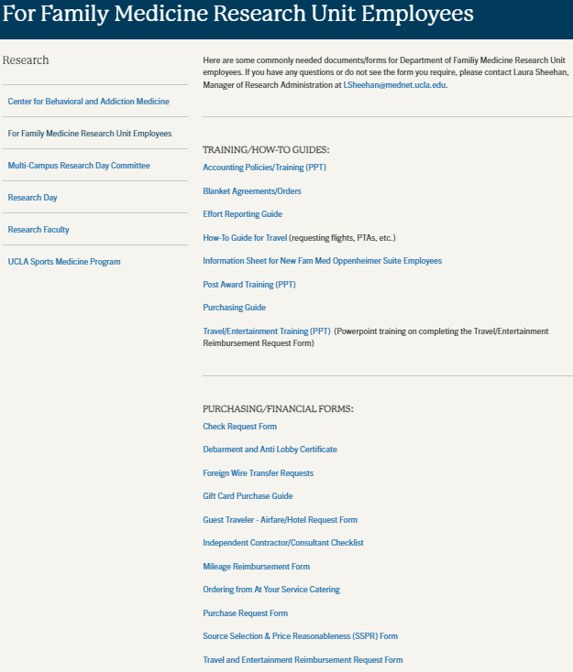
Travel

Slide 16
Travel

Slide 17
Travel
How-To Guide for Travel (requesting flights, PTAs, etc.)
Travel/Entertainment Training (PPT) (Powerpoint training on completing the Travel/ Entertainment Reimbursement Request Form)
Guest Traveler - Airfare/Hotel Request Form
Travel and Entertainment Reimbursement Request Form

Slide 18
PaymentWorks Vendor Onboarding
In support of UCLA’s ongoing effort to onboard existing UCLA vendors into PaymentWorks, unregistered vendors have been assigned to one of seven priority tiers. Tier 1 consists of critical vendors with high spend and a high PO volume while tier 7 captures the vendors with low spend and a low PO volume. The project team is primarily focusing on onboarding vendor tiers 1 through 5.
If a vendor you are working with is having difficulty registering with PaymentWorks:
Please review the PaymentWorks roster to determine if your vendors have already registered.
If your vendor is not listed:
Email vendors@finance.ucla.edu and
Provide the vendor name, contact name, email address, and/or phone number.

Slide 19


Ascend 2.0
Object Codes
Expenditure Types

Slide 20
Ascend 2.0
Expenditure Types
Goal is to eliminate underused Object Codes, combine Object Codes where possible, and add more descriptive detail with the aim of streamlining the list of Expenditure Types

Slide 21
Ascend 2.0
A draft of the new Expenditure Type List is available; Ascend is seeking feedback by May 15
Expenditure: 190 types (vs ~850 object codes)
Laura may reach out to you for input, please check your email
If you want to be included, please email her directly

Slide 22
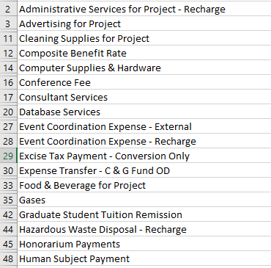
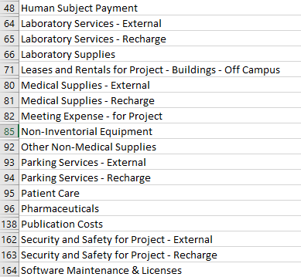
Ascend 2.0

Slide 23
NIH Updates
Updates to Funding Opportunity Terminology (NOT-OD-23-109) Effective immediately, NIH will use the term notice of funding opportunity (NOFO) to refer to formal announcements of the availability of Federal funding through a financial assistance program. Previously, such announcements were referred to as funding opportunity announcements (FOAs). See the NIH Grants & Funding Glossary for the full definition. https://grants.nih.gov/grants/guide/notice-files/NOT-OD-23-109.html

Slide 24
Internal Deadlines for Outgoing Proposals
Proposals where we are the submitting department
Type of Proposal |  | Date you should submit for Internal Review/Approval
 | Proposal has at least one of the following: Multiple PI’s One or more subawards Complicated/unusual sponsor guidelines | Proposal Intake Form should be submitted at least 15 business days prior to the sponsor due date
 | All other proposals | Proposal Intake Form should be submitted at least 10 business days prior to the sponsor due date

Slide 25
Internal Deadlines for Outgoing Proposals
Proposals being submitted by another department
Type of Proposal |  | Date you should submit for Internal Review/Approval
 | You are a Co-PI or MPI | Your portion of the budget must be discussed with Laura before it is incorporated into the submitting department’s budget. Salary, CBR rates, TIF, Rent, and effort must be approved by Laura’s office before the submitting department finalizes their budget. If you are over-funded, Dr. Moreno’s approval may be needed to proceed. After internal approval is received, the EPASS must be submitted for Dr. Moreno’s signature at least 8 business days prior to the sponsor due date. He will not sign off on EPASS’s that have not been internally approved.
 | You are a Co-Investigator or other collaborator | Your portion of the budget must be discussed with Laura before it is incorporated into the submitting department’s budget. Salary, CBR rates, TIF, rent, and effort must be approved by Laura’s office before the submitting department finalizes their budget. If you are over-funded, Dr. Moreno’s approval may be needed to proceed.

Slide 26
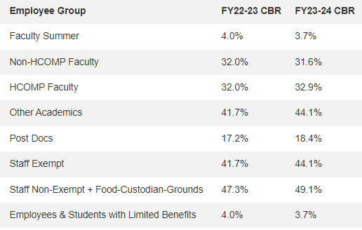
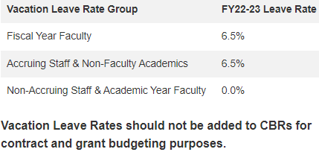
CBR/Fringe Benefit Rates

Slide 27
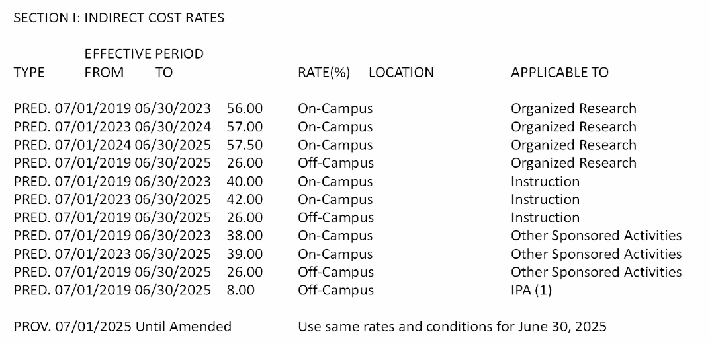
New F&A Rate Agreement

Slide 28
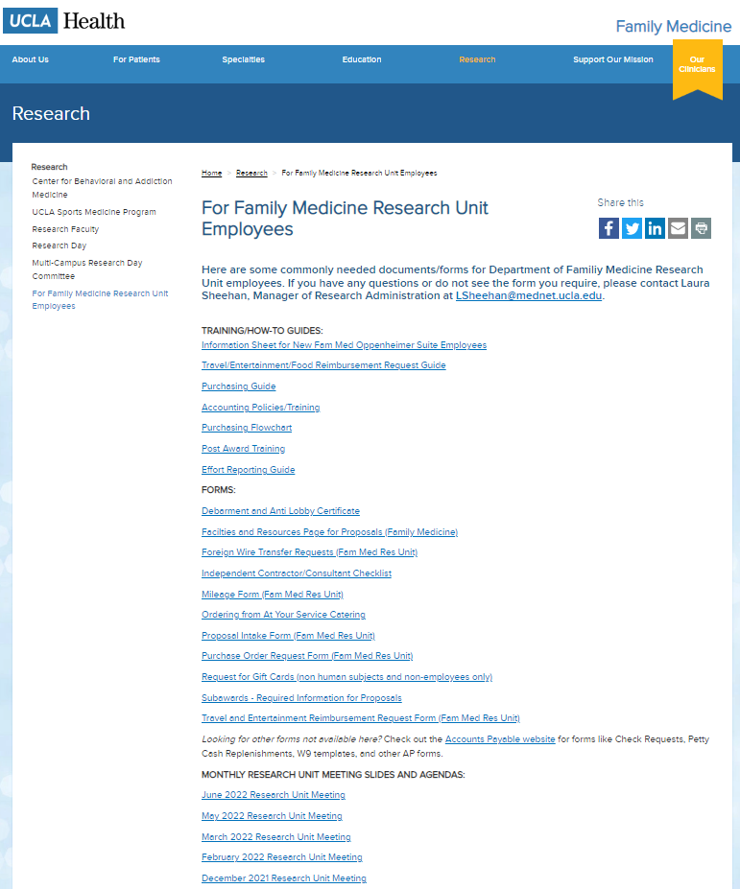
Upcoming Meetings/Events
  Next Research Unit Meeting: June 1
  Next Grand Rounds: Friday, May 26
Research Day: May 10, 2023 at the California Endowment (downtown)
Prior monthly meeting agendas/slides are available on the website

