Slide 1
Management of Alopecia
Ashley Balaker, MD
March 21, 2012

Slide 2
Causes of Alopecia
Burns
Traction
Dermatitis
Autoimmune disease
Neoplasm
Radiation
Chemotherapy
Androgenic alopecia – most common in men and women

Slide 3
Androgenic Alopecia
Affects scalp follicles
Genetically susceptible to androgen inhibition
Terminal hairs → vellus hairs
Frontotemporal and crown regions

Slide 4
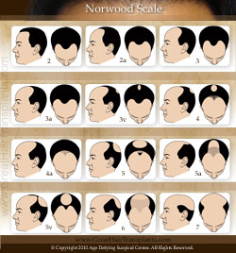
Norwood Classification

Slide 5
Medical Therapy
Finasteride (Propecia) 1mg/day
  Competitive and specific inhibitor of coversion of testosterone to DHT
  Sexual side effects (loss of libido and potency)
Minoxidil (Rogaine), 2 or 5%
  Initially found to have side effect of hypertrichosis
  K+ channel opener and vasodilator
  Unknown mechanism for hair growth

Slide 6
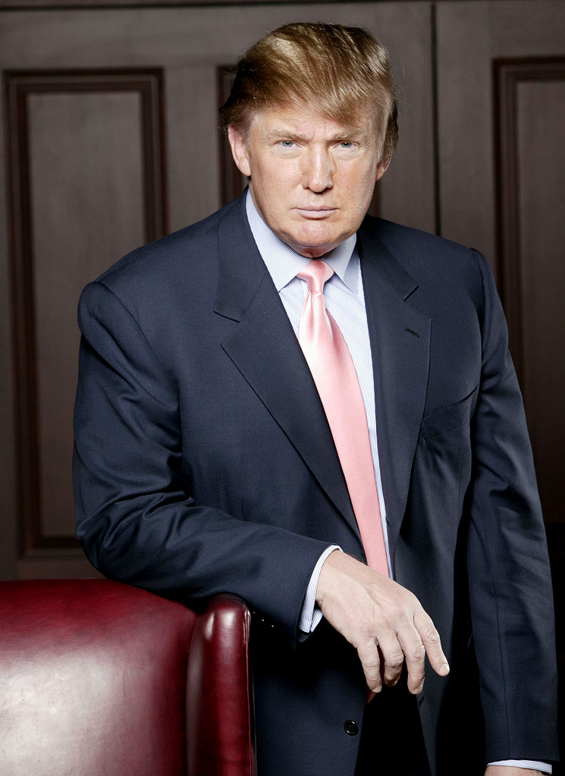
Surgical Management
Restore natural frontotemporal hairline
Avoid designs that require unnatural hairstyles →

Slide 7
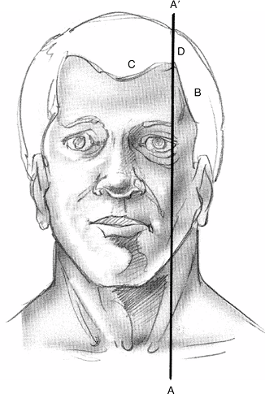
Natural frontotemporal hairline

Slide 8
Patient Evaluation
History and physical
Expectations
Age – may need to delay until older if unsure about future balding in donor areas
Donor area hair density (>8 hairs in 4mm circle)
Hair type and skin color

Slide 9
Women
Rarely have Norwood type pattern
Hair may be thinned
Hormonal and autoimmune causes more prevalent
Minoxidil 2% 1st line tx, Finasteride not shown to be of benefit in women

Slide 10
Anesthesia
Local vs. general
Sedative then local (1% Lido w/ epi)
  Regional frontal, occipital and temporal nerve blocks
  Then wide field circumferential scalp block

Slide 11
History of hair autografts
Okuda – 1st to describe use of full thickness hair bearing autografts
Orentreich 1959 – punch grafts in U.S.

Slide 12
Donor harvesting
Donor area
  Anterior limit: vertical line through EAC
  Superior limit: horizontal line at superior attachement of auricle
Multiblade knife to remove parallel strips of scalp (1.5 -3mm width)
Max total width of 1cm to prevent tension on closure of donor site

Slide 13
Donor harvesting
If multidirectional hair growth, then harvest single 1cm strip w/ scalpel
Trim hair to 3mm, infiltrate scalp with saline to tense scalp skin
Cut parallel to hair follicles
Close with 4-0 nylon suture, minimize tension

Slide 14
Preparing follicular units
Trim excess subQ fat, leave 2mm below follicle
Trim to create teardrop shaped graft

Slide 15
Recipient site
2-4 transplant sessions
Holes made with trephine punch or scalpel
Holes made at angle to mimick original hair growth pattern
  Anteriorly at frontal hairline
  Inferiorly along sides

Slide 16
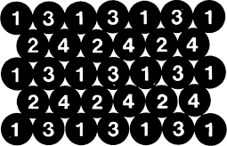
Spacing of grafts

Slide 17
Postop
Crusts form and hair sheds 1-2 wks postop
Telogen effluvium 2-6 weeks
Hair regrowth at 10 – 16 weeks
Space transplant sessions out by 4 months

Slide 18
Complications
Minimal postop pain
Forehead edema: temporary, tx w/ Medrol dosepak
Scarring/keloids – usually at donor site
Infection (<1%)
Necrosis at donor site (due to tension)
Cobblestoning due to poor graft trimming

Slide 19
Scalp Reduction
Excise bald scalp skin
Best in pts with laxity in scalp
Best results when treating crown area Norwood class IV to VI
Multiple designs
  Sagittal midline: easiest, slot like deformity in occipital scalp
  Y pattern
  C, J, S and lateral crescent shapes: technically difficult, central scalp hypesthesia

Slide 20
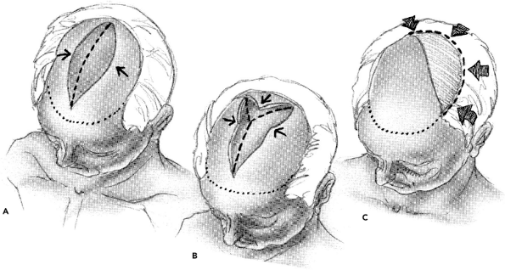
Types of Scalp Reduction

Slide 21
Technique
Local anesthesia/MAC
Incision down through galea, bevel incision to parallel follicles
Subgaleal dissection to auricles and neck
Excise overlapping scalp
Close in 2 layers

Slide 22
Extensive Scalp Reduction
Brandy – described bilateral occipitoparietal (BOP) flap and bitemporal (BT) flap
Treats baldness at crown and vertex in Norwood IV to VI, does not create frontal hairline
Allows excision of up to 7cm transverse bald skin
Most pts need 2 to 3 procedures
  BOP first, then BT flap 2-3 months later

Slide 23
Extensive Scalp Reduction
Staged ligation of occipital vessels 2-6 wks prior to procedure via 1cm vertical incision over nuchal ridge
Decreases risk of scalp necrosis

Slide 24
Extensive Scalp Reduction
Both types require identification of STAs
Extensive undermining onto mastoids and trapezius
Postop telogen more common due to altered blood supply to large flaps

Slide 25
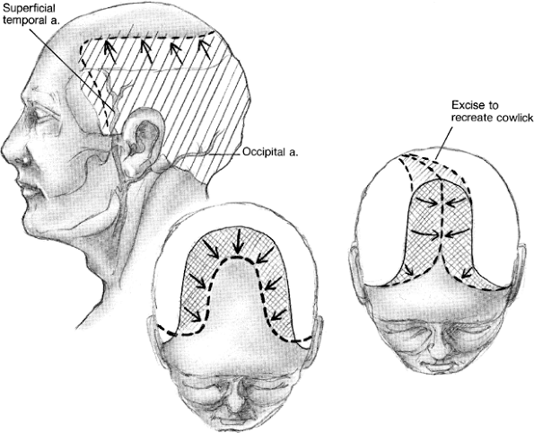
Extensive Scalp Reduction

Slide 26
Tissue expanders
Tissue expanders can also be used prior to scalp reduction when pt has taught scalp skin
Requires repeated filling and temporary cosmetic deformity

Slide 27
Juri Flap
Restores frontal hairline
Can be combined with scalp resection
Based on STA, can do both sides sequentially
4 stages
  Make donor incisions (1 week)
  Elevate donor flap (1 week)
  Transpose flap (6 weeks)
  Revise dog ear

Slide 28
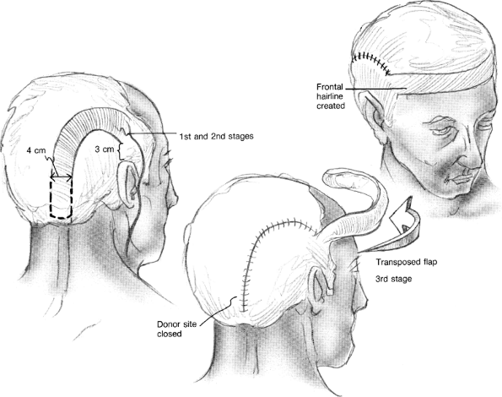
Juri Flap

Slide 29
Conclusion
Patient selection is critical for good results
Modern follicular unit transplants offer the most natural looking results
Flap and scalp excisions while once popular, now are seldom used due to difficult technique and unnatural appearing results

