Slide 1
Medialization Thyroplasty
Jennifer Bergeron
April 11, 2012

Slide 2
Introduction
Payr in 1915 first described medialzing paralyzed vocal fold by inward displacement of overlying thyroid cartilage with cartilage wedge
Isshiki in 1974 first described the 4 types of thyroplasty we recognize today on a canine model
1990’s: Medialization Thyroplasty was a well-accepted commonly-performed operation

Slide 3
Isshiki’s Thyroplasty
Was a true THYROPLASTY
  Cutting and reshaping thyroid cartilage in various ways
4 Types
  Type I: Medialization
  Type II: Lateralization
  Type III: Shortening, relaxation (lower pitch)
  Type IV: Lengthening, tension (raise pitch)

Slide 4
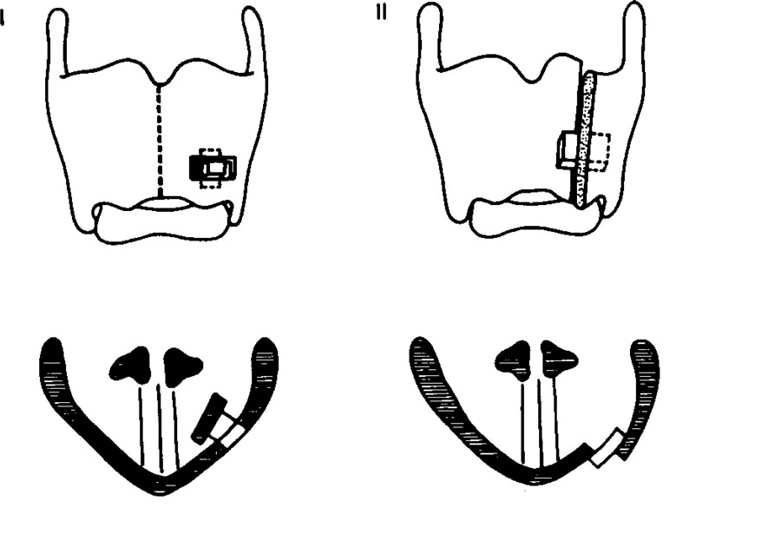
Isshiki N. Mechanical and Dynamic Aspects of Voice Production as Related to Voice Therapy and Phonosurgery. Otolaryngol Head Neck Surg. 2000; 122(6):782-793.

Slide 5
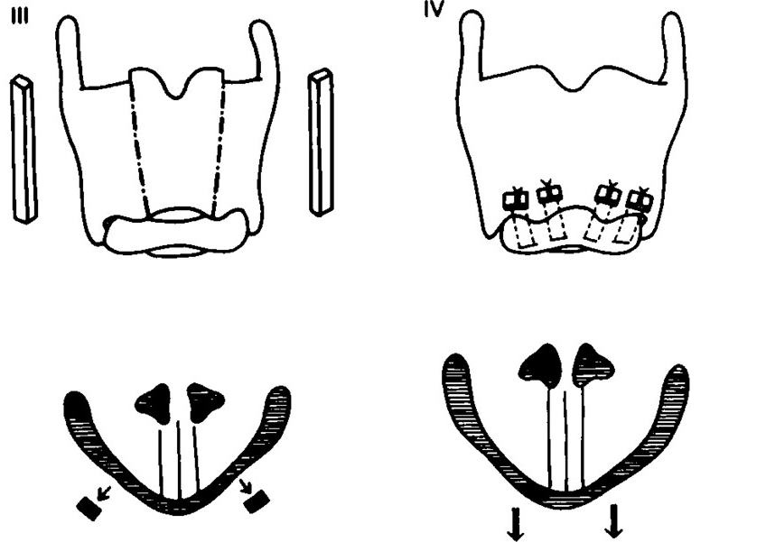
Isshiki N. “Mechanical and Dynamic Aspects of Voice Production as Related to Voice Therapy and Phonosurgery. Otolaryngol Head Neck Surg. 2000; 122(6):782-793

Slide 6
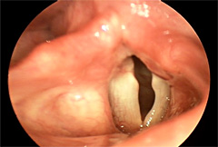
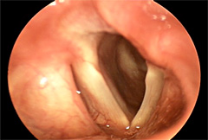
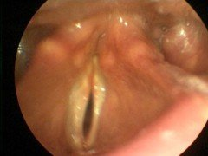
Type I Thyroplasty: Indications
Dysphonia or aspiration due to Vocal Fold Paralysis/Paresis
Dysphonia due to
Vocal Fold Atrophy
http://www.voicemedicine.com/unilateral.htm
http://www.gbmc.org/home_voicecenter.cfm?id=1563

Slide 7
Type I Thyroplasty: Theory
In paralyzed or atrophic vocal fold the medial bulge from the Thyroarytenoid (TA) muscle contraction is inadequate.
The thyroplasty implant medializes the midmembranous vocal fold to mimic the activity of the TA muscle.
Goals: to improve voice quality and prevent aspiration.

Slide 8
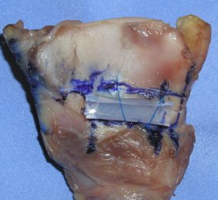
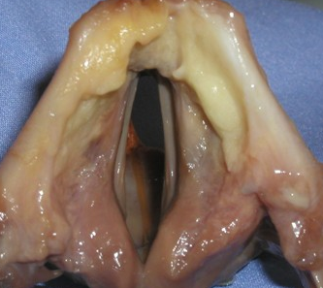
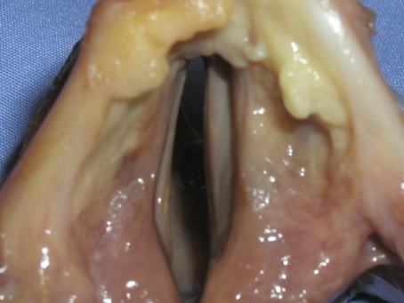

Slide 9
Before you start
Talk to your anesthesiologist
  Surgery done with patient AWAKE with MAC
    You need the patient to phonate
  Give pre-op ABX and Decadron
Local:
  Use 1% lido with Epi 1:100,000 with an amp of bicarb
    Bicarb makes it hurt less
  Inject broadly EVERYWHERE you are going to dissect! (down onto the outer perichondrium)

Slide 10
Before you start
Positioning: shoulder roll with neck extended
Flexible scope: (Dr. Berke does not do this, Dr. Chhetri and many others do):
  Once patient is positioned place flex so that you get a clear view of the true vocal folds.
  Then (here’s the tricky part) fix the scope to something (anything, Dr. Chhetri uses the ortho bar, many people use a jimmy-rigged IV pole. Whatever works to hold the scope in place)

Slide 11
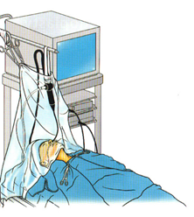
Set-up
Rosen CA, Simpson CB. Silastic Medialization Laryngoplasty for Unilateral Vocal Fold Paralysis. In: Operative Techniques in Laryngology. Berlin, Germany: Springer-Verlag; 2008:242-251.

Slide 12
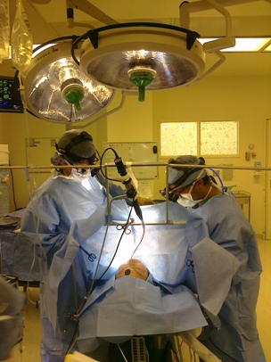
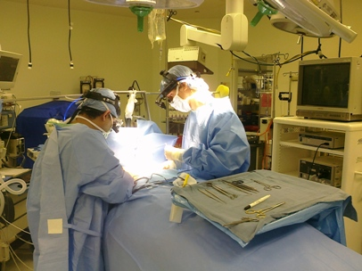
Set-up

Slide 13
Starting the operation
Horizontal incision over thyroid cartilage
Subplatysmal flaps
Separate midline raphe
Expose lateral thyroid ala to notch superiorly, and inferior border past tubercle
Oblique line: need to remove some of these muscular attachments to expose the inferior border

Slide 14
Type I Thyroplasty: Window
Outline before cutting
Goal: window at the level of the TVF, so you will medialize only the TVF
If carving your own implant, or using Gore-Tex can free-hand
If using pre-formed implant (i.e. Montgomery or titanium) must use window sizer to mark window
Perichondrium: Dr. Berke and Dr. Chhetri leave the perichondrium intact.

Slide 15
Type I Thyroplasty: Window
Superior edge of window most important (bc if too high will medialize false VF)
Half way between the thyroid notch and the inferior border of the thyroid cartilage, parallel to the inferior border

Slide 16
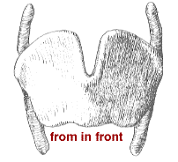
Type I Thyroplasty: Window
Level of notch
Level of superior edge of Window
Level of Inferior border

Slide 17
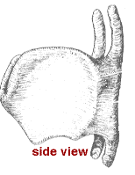
Type I Thyroplasty: Window
Superior edge of window parallel to inferior border
Level of notch
Level of Superior edge of Window
Level of Inferior border
Inferior border

Slide 18
Type I Thyroplasty: Window
The size of the window is dependent on the size of the larynx, men > women
Dr. Berke and Dr. Chhetri eyeball this:
  Anterior border should be about 5-7mm posterior to midline
  Posterior border should be just anterior to the oblique line (width usually about 10-13mm)
  Inferior border should be about 2-3 mm superior to the inferior border to prevent fracturing (height usually 4-6mm)

Slide 19
Type I Thyroplasty: Window
Inferior edge about 2-3mm from inferior border
Level of superior edge of Window
Inferior border

Slide 20
Type I Thyroplasty: Window
Inferior edge about 2-3mm from inferior border
Level of superior edge of Window
Inferior border

Slide 21
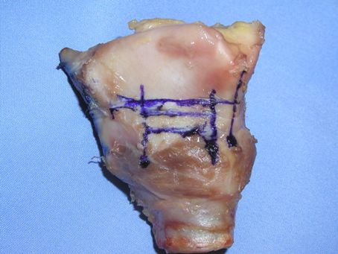

Slide 22
Type I Thyroplasty: Window
Cutting the window
  If cartilage is soft use #15 blade
  If calcified:
    Dr. Berke and Dr. Chhetri use oscillating saw
    Others use otologic drill 2mm burr to outline window and then a Kerrison to remove remaining cartilage
Inner perichondrium

Slide 23
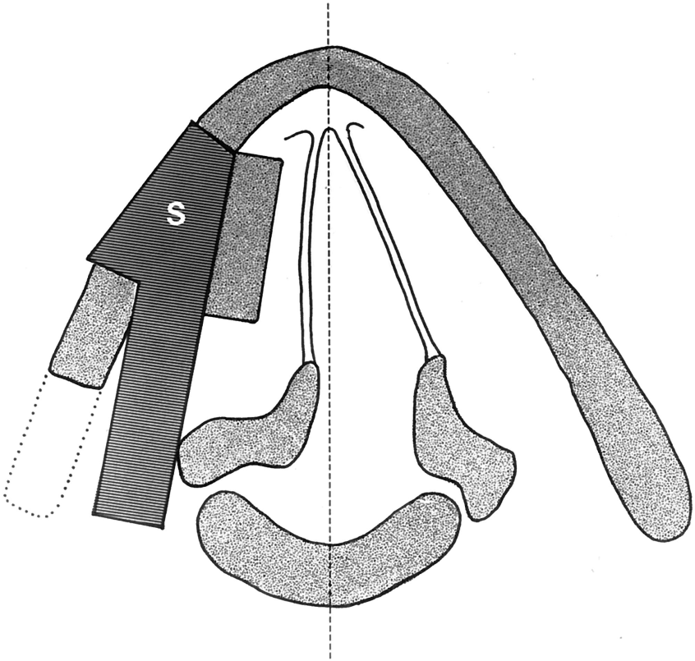
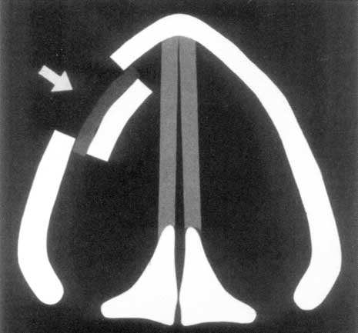
Type I Thyroplasty: Implant
Fun fact: Originally, after the window was cut, the cartilage of the window was pushed in by a cartilage shim or later an implant.
Isshiki N, Mechanical and Dynamic Aspects of Voice Production as Related to Voice Therapy and Phonosurgery. Otolaryngol Head Neck Surg. 2000;122:782-793.
Hong KH, Kim JH, Kim HK. Anterior and Posterior Medialization (APM) Thyroplasty. Laryngoscope. 2001; 111:1406-1412

Slide 24
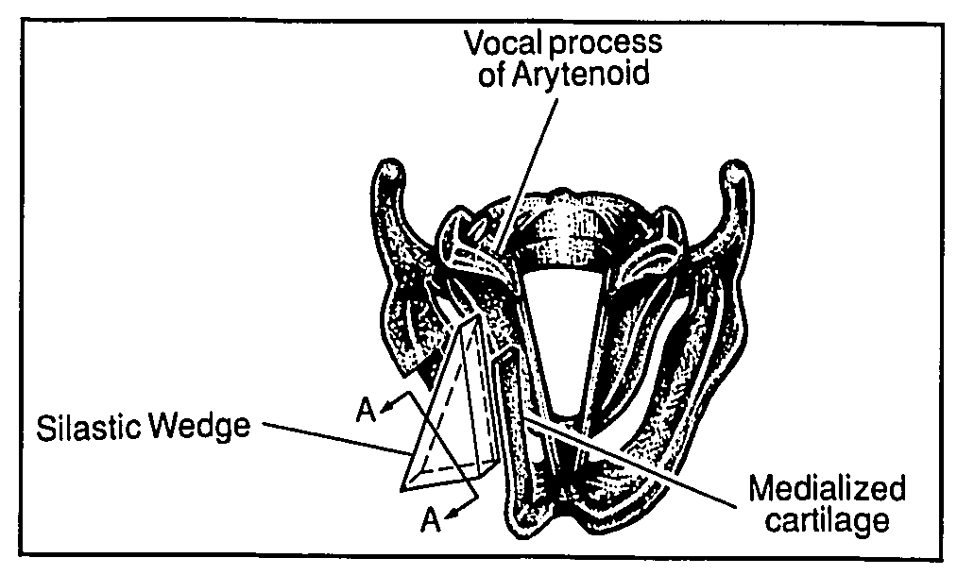
Type I Thyroplasty: Implant
It was later found that the cartilage migrated over time. Dr. Berke and Dr. Bielamowicz suggested a trap door technique to prevent migration.
Bielamowicz S, Berke G. “An Improved Method of Medialization Laryngoplasty Using a Three-sided Thyroplasty Window.” Laryngoscope. 1995: 105:537-539.

Slide 25
Type I Thyroplasty: Implant
It was eventually discovered that over time the medialized cartilage degraded (this was shown histologically) causing the voice to worsen as it got smaller.
Now, we remove the cartilage before placing an implant.

Slide 26
Type I Thyroplasty: Implant
Implants come in many materials shapes and sizes and little has been shown to prove the superiority of one method over another.
They can be pre-formed (Montgomery, Titanium, or Calcium Hydroxylapatite), hand carved silicone, or layered Gore-Tex.

Slide 27

Type I Thyroplasty: Implant
Montgomery
  Set window size for men and women, 5 implants sizes for each window.
  Use an implant sizer to decide which implant to use
  Has inner and outer phalanges securing in place.
http://www.bosmed.com/thyroplasty.html

Slide 28
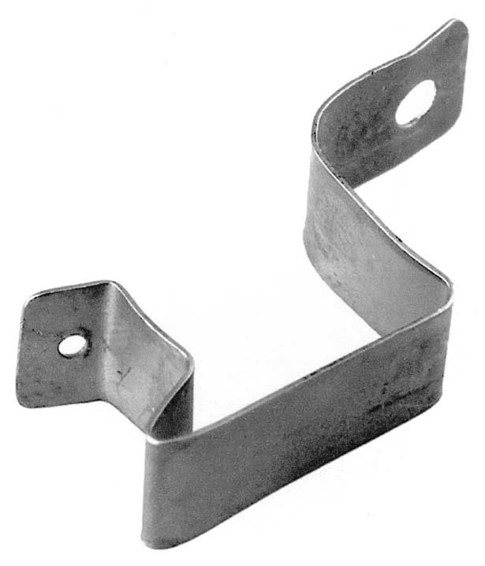
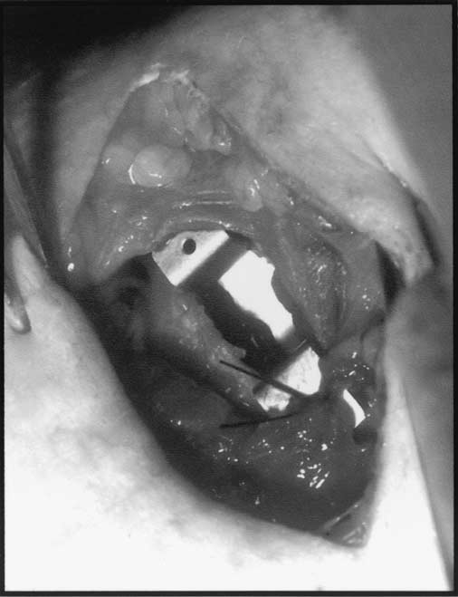
Type I Thyroplasty: Implant
Titanium VF medialization Implant
  Secured in place at varying depths depending on voice with titanium screw system.
Schneider B, Denik DM, Bigenahn W. Acoustic assessment of the voice quality before and after medialization thyroplasty using the titanium vocal fold medialization implant (TVFMI). Otolaryngol Head Neck Surg. 2003; 128:815-822.

Slide 29
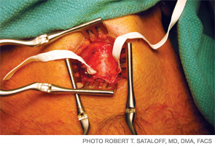
Type I Thyroplasty: Implant
Free-form: Gore-Tex (ePTFE)
  Pre-made strip or create a strip from vascular patch
  Layer it into window to medialize vocal fold
Valeo T. The Voice Lift: Should vocal fold surgery be considered a cosmetic procedure? ENT today. April 2010.

Slide 30
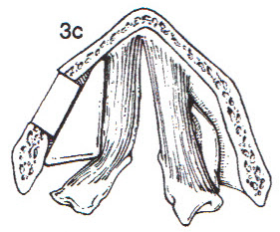
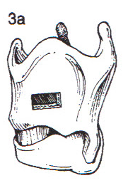
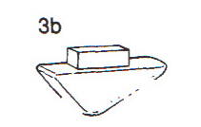
Type I Thyroplasty: Implant
Hand-carved: Silastic: Firm silicone block
  carved by the surgeon during
  operation to appropriate shape
Kraus DH, Ali MK, Gainsberg RJ, et al. Vocal cord medialization for unilateral paralysis associated with intrathoracic malignancies. J Thoracic Cardiovasc Surg. 1996;111(2):334-341.

Slide 31
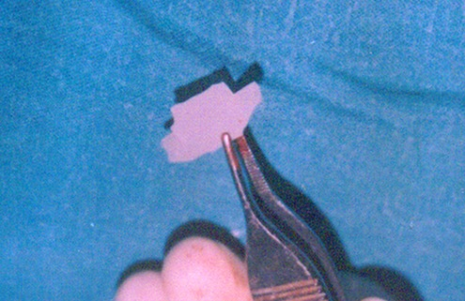
Type I Thyroplasty: Implant
Hand-carved: one technique with inner phalanges
S.P. Singh Yadav, J. Singh Gulia, K. Singh, S. Singh: Medialization Thyroplasty Using Silastic Implant. The Internet Journal of Head and Neck Surgery. 2007 Volume 1 Number 1.

Slide 32
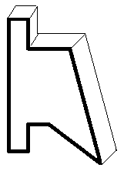
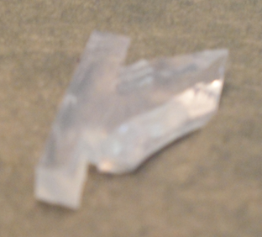
Type I Thyroplasty: Implant
Hand-Carved: technique used by Dr. Berke and Dr. Chhetri with outer phalanges
  Carved based on window size, and amount of medialization needed
  Bevel medial surface to be divergent.

Slide 33
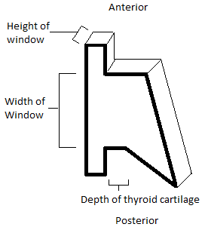
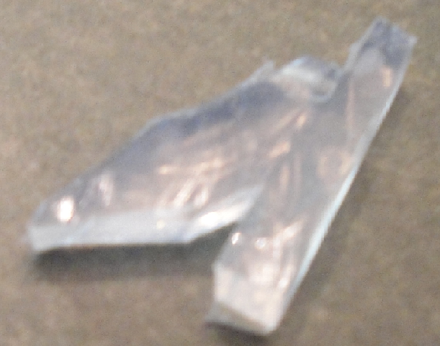
Type I Thyroplasty: Implant

Slide 34
Type I Thyroplasty: finishing up
Secure the implant
  Suture vs. no suture: it depends on the implant
Drain vs. no drain
  Dr. Berke yes, Dr. Chhetri usually no.
Outpatient vs. overnight observation
  Both Dr. Berke and Dr. Chhetri do this surgery outpatient, but there are many institutions where they prefer to keep patients for observation overnight.

Slide 36
Type I Thyroplasty: Complications
Airway obstruction
  Higher risk if thyroplasty done with AA
Implant extrusion
  Can become displaced and even extrude into the airway, more commonly described with Gore-Tex and with implants without outer phalanges

Slide 37
Type I Thyroplasty: Pitfalls
Window is too high
  Then implant is too high, false VF is medialized and voice is poor (can see this on flex exam)
Implant is too big or too small
  Makes voice either pressed or breathy
Voice is still poor after Procedure because of posterior glottal chink (patient may need arytenoid adduction to correct this)

Slide 38
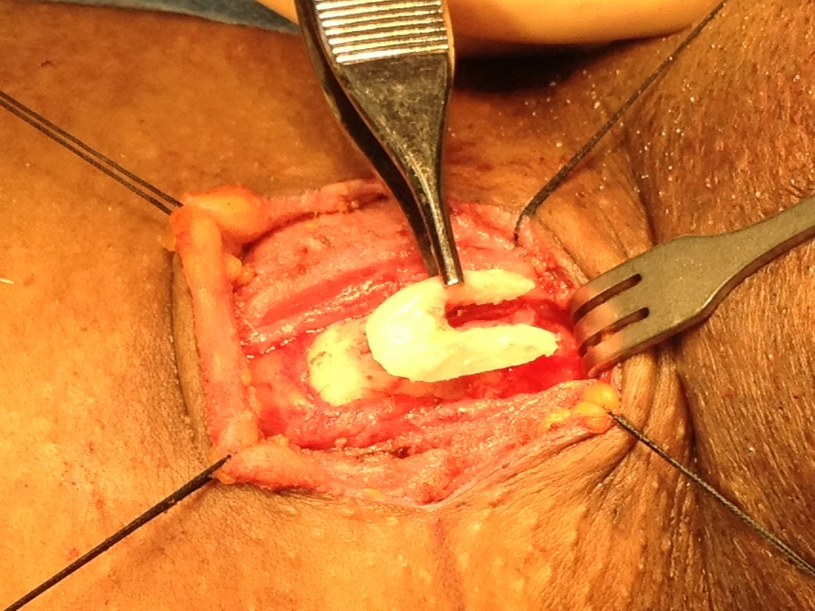
Thyroid Cartilage Shave

Slide 39
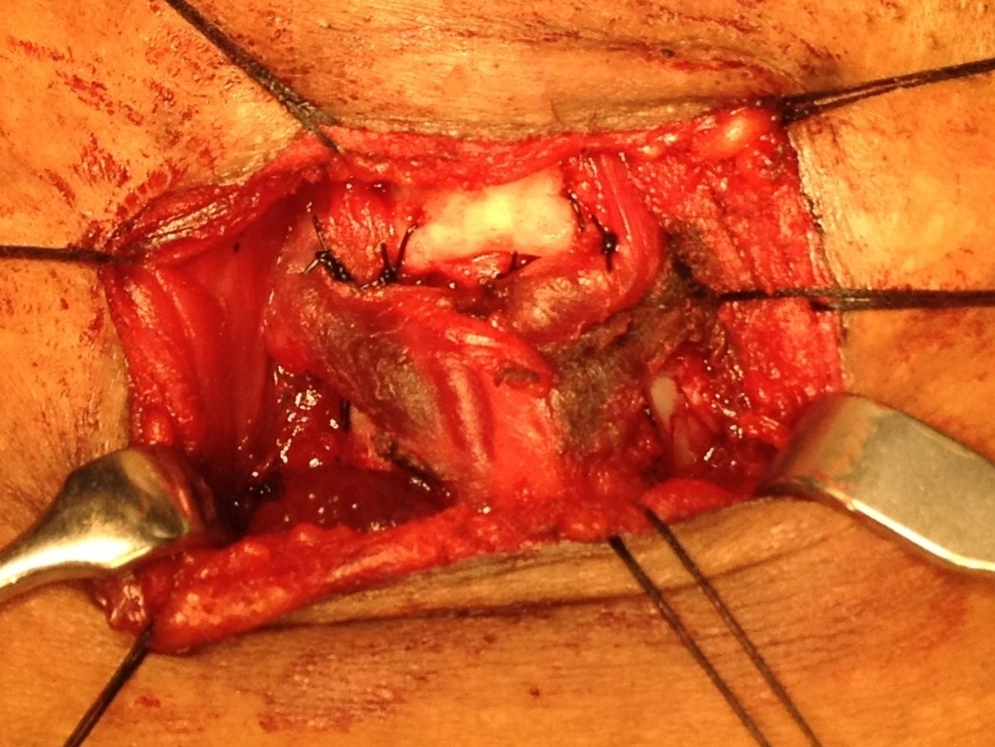
Type IV Thyroplasty
Cricothyroidopexy sutures
Inferior Thyroid cartilage
Cricoid cartilage

Slide 40
References
Isshiki N. Mechanical and Dynamic Aspects of Voice Production as Related to Voice Therapy and Phonosurgery. Otolaryngol Head Neck Surg. 2000; 122(6):782-793.
http://www.voicemedicine.com/unilateral.htm
http://www.gbmc.org/home_voicecenter.cfm?id=1563
Rosen CA, Simpson CB. Silastic Medialization Laryngoplasty for Unilateral Vocal Fold Paralysis. In: Operative Techniques in Laryngology. Berlin, Germany: Springer-Verlag; 2008:242-251.
Isshiki N, Mechanical and Dynamic Aspects of Voice Production as Related to Voice Therapy and Phonosurgery. Otolaryngol Head Neck Surg. 2000;122:782-793.
Hong KH, Kim JH, Kim HK. Anterior and Posterior Medialization (APM) Thyroplasty. Laryngoscope. 2001; 111:1406-1412
Bielamowicz S, Berke G. “An Improved Method of Medialization Laryngoplasty Using a Three-sided Thyroplasty Window.” Laryngoscope. 1995: 105:537-539.
http://www.bosmed.com/thyroplasty.html
Schneider B, Denik DM, Bigenahn W. Acoustic assessment of the voice quality before and after medialization thyroplasty using the titanium vocal fold medialization implant (TVFMI). Otolaryngol Head Neck Surg. 2003; 128:815-822.
Valeo T. The Voice Lift: Should vocal fold surgery be considered a cosmetic procedure? ENT today. April 2010.
Kraus DH, Ali MK, Gainsberg RJ, et al. Vocal cord medialization for unilateral paralysis associated with intrathoracic malignancies. J Thoracic Cardiovasc Surg. 1996;111(2):334-341.
S.P. Singh Yadav, J. Singh Gulia, K. Singh, S. Singh: Medialization Thyroplasty Using Silastic Implant. The Internet Journal of Head and Neck Surgery. 2007 Volume 1 Number 1.

