Slide 1
Cummings Chapters 92-94
Sameer Ahmed
4/24/2013

Slide 2
Ch 92: Oral Manifestations of Systemic Diseases

Slide 3
Cardiac
Association between heart disease and periodontal disease
Calcium channel blockers → gingival enlargement
Disturbance in taste → ACE, Ca Channel blockers
Cyclosporine → gingival enlargement

Slide 4
Pulmonary
Chronic use of corticosteroids suppresses hypothalamic-pituitary-adrenal axis
Result in acute adrenal insufficiency during stress
Therefore steroid replacement therapy is sometimes required for extensive dental and surgical procedures
The classic oral mucosal lesion of TB is a painful, deep, irregular ulcer on the dorsum of the tongue

Slide 5
Endocrine
Diabetes
Association between severe periodontitis and an increased risk of poor glycemic control.
Adrenal
Addison's disease, caused by primary adrenal insufficiency or hypoadrenalism, include diffuse, cutaneous pigmentation of the skin and mucous membranes
With hyperadrenalism or Cushing's disease, present with moon shaped face and muscle weakness

Slide 6
Endocrine
Thyroid
Macroglossia is the primary oral manifestation of hypothyroidism
Parathyroid
Hyper PTH: Bone demineralization from excessive osteoclast function (indirect effect of PTH, RANKL)
Subsequent fibrous-tissue replacement can produce well-defined cystic radiographic radiolucencies (Brown tumor)

Slide 7
Autoimmune
Sjogren's
Primary SS → salivary and lacrimal gland disorders
Secondary SS → the disorder occurs with other autoimmune diseases such as RA
Focal, periductal, mononuclear cell infiltrates (mainly T cells) in exocrine tissues and autoantibodies (particularly anti-Ro/SSA, anti-La/SSB, and rheumatoid factor)
44-fold increase in B-cell lymphoma risk

Slide 8
Autoimmune
SLE
Approximately one quarter of SLE patients have oral lesions
Usually superficial ulcers with surrounding erythema
Dermatomyositis/Polymositis
Can involve tongue and UPPER esophagus (upper third, involving UES)

Slide 9
Bacteria
Porphyromonas gingivalis and Treponema denticola → periodontal disease
Staphylococcus aureus and Streptococcus viridans → salivary gland infections
Streptococcus mutans and Lactobacillus sp →new and recurrent dental caries.

Slide 10
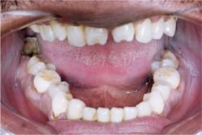
Syphillis
Congenital syphilis
Hutchinson's incisors (notched incisors)
Mulberry molars (multiple rounded rudimentary enamel cusps on the permanent first molars).

Slide 11
Lichen Planus
Lichen planus is a chronic, mucocutaneous, autoimmune disorder
Some evidence suggests that lichen planus lesions are predisposed to malignant transformation

Slide 12
Pemphigus Vulgaris
Pemphigus vulgaris is an autoimmune disease caused by antibodies created against desmoglein 3
Disassociation of the epithelium at the suprabasal layer with acantholysis
+Nikolsky's sign

Slide 13
Vitamin Deficiencies
Vitamins A and B2 (riboflavin) → angular chelitis
Vitamin B12 → aphthous ulcer, angular chelitis, loss of tongue papillae
Niacin → swollen tongue, pellagra

Slide 14
Neurologic
In myotonic muscular dystrophy, why does the tongue get large?
Enlargement of the tongue caused by fatty deposits.

Slide 15
Renal
Heparin is administered during dialysis to prevent blood coagulation
dental procedures should be performed on alternate days of dialysis

Slide 16
Liver
Oral microbial infections and impaired wound healing
Most common oral complications of patients with cirrhosis
Result of alcohol-induced immunosuppression

Slide 17
Heme
Von Willebrand's disease
Most common hereditary bleeding disorder
Deficiency of secondary factor VIII (vWF)
Resulting in poor platelet adhesion
Wiskott-Aldrich syndrome
X-linked recessive inherited disease,
Recurrent infections, eczema, and chronic thrombocytopenia (in OC mucosa, manifests with petechiae and ecchymoses)

Slide 18
Inherited Disorders
Cowden's disease
Autosomal dominant
Warty/hamartomatous papules on the face, arms, and mucous membrane of the mouth
Melkersson-Rosenthal syndrome
Unilateral facial paralysis
Edema of the periorbital skin
Fissured tongue with papillary projections

Slide 19
Ch 93: Odontogenesis, Odontogenic Cysts, and Odontogenic Tumors

Slide 20
Background
Odontogenic tumors: mix of epithelium and mesenchyme, hard to analyze histologically
All odontogenic tumors/cysts related to the stomodeum in some way.

Slide 21
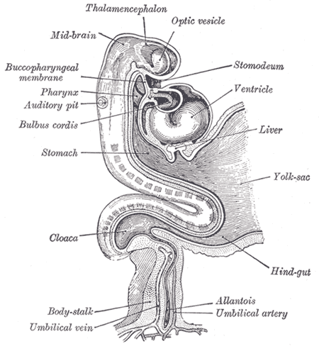
Embryology
The stomodeum: depression between the brain and the pericardium in an embryo, and is the precursor of the mouth and the anterior lobe of the pituitary gland.

Slide 22
Epithelial Odontogenesis
The four main stages of epithelial odontegenesis are (1) dental lamina, (2) enamel organ, (3) reduced enamel epithelium, and (4) Hertwig's epithelial root sheath.

Slide 23
The enamel organ is generally divided into the bud stage, cap stage, and bell stage.
Epithelial bands → dental lamina –> 20 tooth buds
Reduced enamel epithelium
Consists of inner enamel epithelium (ameloblast cells) and outer enamel epithelium (cuboidal cells from dental lamina).
As the cells of the reduced enamel epithelium degenerate, the tooth is revealed progressively with its eruption into the mouth.

Slide 24
Hertwig's rooth sheath: a layer of cells that separate away from the reduced enamel epithelium, as they move towards the tooth root.
On their way, they leave behind rests of Malassez
small islands of epithelial tissue that are formed during tooth root development, they are located in the region of the periodontal ligament

Slide 25
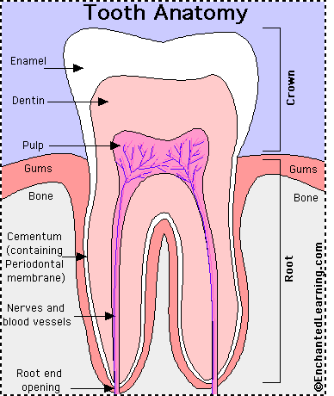
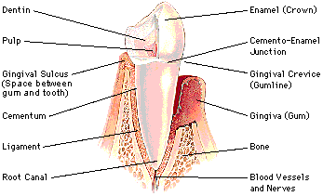

Slide 26
Cysts
Periapical/Radicular cyst The periapical cyst must be associated with a nonvital tooth, located at the tooth apex.
Tx: Most of these cysts adequately resolved with endodontic therapy.
If a radiolucency persists longer than 6 months following endodontic therapy, enucleation and histopathologic review are necessary.[

Slide 27
Cysts
Dentigerous cysts
Form when fluid accumulates between reduced enamel epithelium and tooth crown of an unerupted tooth (near the cementoenamel junction) .
Usually occurs in impacted teeth (3rd molars, maxillary canines)
Some malignant potential (SCCa, mucoep, ameloblastoma)
Tx: Dentigerous cysts are usually easily enucleated at the time of tooth extraction.

Slide 28
Cysts
Lateral Periodntal Cyst: unilocular cyst, from dental lamina, on the lateral surface of a vital tooth
Tx: enucleation
Botryoid Odontogenic Cyst: multilocular cyst, from dental lamina, on the lateral surface of a vital tooth
Tx: enucleation + curettage

Slide 29

Keratinizing odontegenic cyst is NOT the same as an odontegenic keratocyst (OKC, more recently named as an keratocystic odontogenic tumor)

Slide 30
Cysts
OKC
OKCs are most common in the mandibular third molar area, but can be in the maxilla or mandible
2nd to 3rd decade most common age group
swelling, pain, trismus, sensory deficits, and infection being the most common complaints
But can be an incidental finding on xray also
Unilocular vs multilocular; multiple vs single cysts
With multiple cysts, think about working up basal cell nevus syndrome

Slide 31
OKC
Tx: Debatabe.
Author says dont use aggressive approach on everyone (e.g.: for large lesions, try decompression and then curettage as opposed to excision and tooth extraction).
1st occurrence: excise the entire lesion, especially the inner cyst lining, limited bone curettage
Recurrences: be more aggressive (except in basal cell nevus syndrome patients as recurrences are probably new lesions)

Slide 32
Cysts
Calcifying Odontogenic Cyst
It can fall into 2 categories: cystic or neoplastic
Cystic → from early dental lamina, anterior mandible most common.
On path → ghost cells seen (but not pathognomonic).
Tx: enucleation for simple, unilocular; enculeation and curettage for multilocular
Neoplastic; ghost cell tumor → The epithelial odontogenic ghost cell tumor is an unusual jaw lesion that consists of solid, tumor-like mass, though a cystic area is usually present as well.

Slide 33
Malignant transformation of cysts → it's rare but can happen in any cyst (when we do hear about it, it's usually a dentigerous cyst or OKC). Often happen in residual cysts left in an edentulous area.

Slide 34
Odontogenic Tumors
Ameloblastoma (intraosseus, solid, multicystic)
Neoplasm of enamel; comes from the lining of odontegenic cyst, reduced enamel epithelium, or odontogenic rests of tissue.
80% in the mandible
Radiology: “soap bubble” or honeycomb appearance
Path: histologic subtypes include follicular, plexiform, granular cell, acanthomatous, desmoplastic, basal cell, and keratinizing
Tx: at least 1 cm margins in mandible (proximal and distal directions), 1-2 cm margins in maxilla
However, Tx not well defined (enuclation alone is def not a good option)

Slide 35
Odontogenic Tumors
Unicystic ameloblastoma
Posterior mandible most common
Asymptomatic
Radiology: Single radioloucent, unilocular, well-demarcated lesion, <2cm
No extension into connective tissue (no plexiform or follicular variants)
Tx: enucleation only; generally no recurrence

Slide 36
Odontogenic Tumors
Peripheral Amelobastoma (Extraosseus)
Peripheral ameloblastomas present as mucosal masses and arise from the gingiva or alveolar mucosa.
If any bone is involved, it is not a peripheral amelobastoma
Tx: excision; generally no recurrence

Slide 37
Malignant Ameloblastomas
Benign histopathologic features of amelobastoma but metastasize to distant locations
Lung is most common
Ameloblastic Carcinoma
Cytopathologic features associated with malginangy; +/- metastasize

Slide 38
Ameloblastic Fibroma
Benign odontogenic neoplasm characterized by proliferation of immature mesenchymal and ameloblastic cells (found in developing teeth)
Posterior mandible
Well-defined radiolucency
Tx: Unilocular → conservative enucleation; Multilocular –> segmental rsxn if jaw integrity is messed up

Slide 39
Calcifying Epithelial Odontogenic Tumor (Pindborg Tumor)
Mandible > Maxilla
Molar and pre-molar region
Well-circumscribed, multilocular > unilocular, mixed radiolucent-radiopaque
Tx: conservative surgical removal (usually enucleation and curettage)
However, tumors with clear cell changes may be more aggressive
Segmental rsxn reserved for those tumors which have messed up the jaw already

Slide 40
Adenomatoid Odontogenic Tumor
Most innocuous odontogenic tumor
Comes from the enamel or from the dental lamina
2/3 female, 2/3 in maxilla
Mixed radiolucent-radiopaque
Tx: Enucleation, low recurrence rate

Slide 41
Ch 94: TMJ Disorders

Slide 42
Temporomandibular disorders:
Intracapsular disorders, or true abnormalities of the temporomandibular joint (TMJ), and muscular disorders, or myofascial pain
Symptoms: facial pain, earache, and headache.

Slide 43
Anatomy
TMJ → Synovial joint
Articulating surfaces: glenoid fossa and condylar process
Articular disk is between these 2 surfaces
Articular disk separates the joint space into 2 compartments
The inferior compartment: anterior and posterior rotational The superior compartment: translational movement between the disk and the glenoid fossa

Slide 44
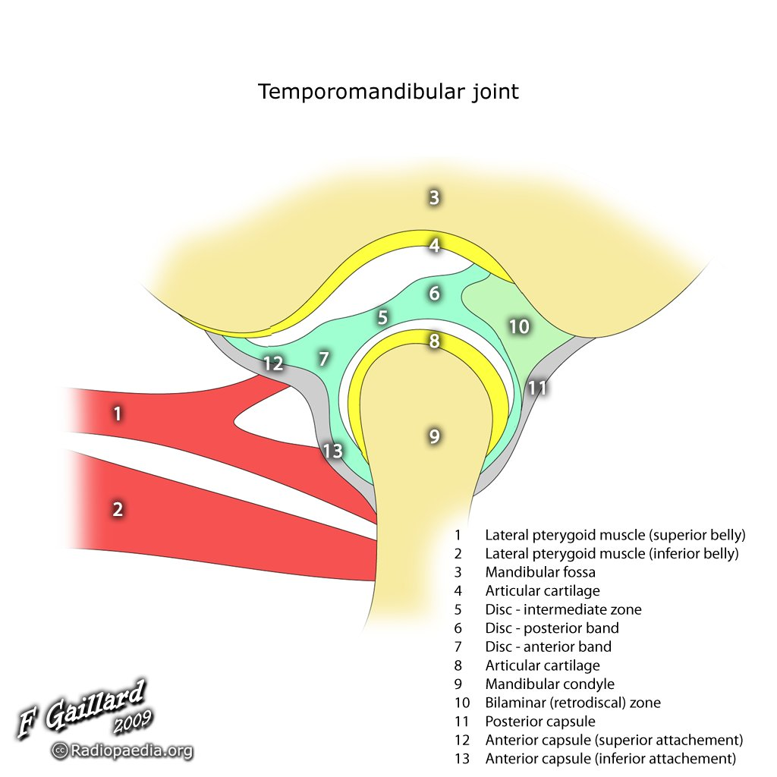

Slide 45
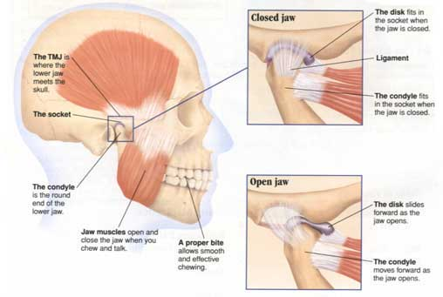

Slide 46
Fractures
Condylar or subcondylar fractures
preauricular pain and tenderness, difficulty in opening the mouth, and malocclusion
Unilateral fracturejaw deviation to the affected side on attempted mouth opening
Bilateral fractures frequently produce an anterior open (loss of support in ascending ramus)

Slide 47
Dislocation
Acute dislocation
Condyle translates anterior to the articular eminence and becomes locked in that position.
Tx: apply downward pressure on the posterior mandible while placing upward and backward pressure on the chin.
Restrict mandibular opening for 2 to 4 weeks
NSAIDs

Slide 48
Dislocation
Chronic Dislocation
Tx: inject sclerosing agent into the TMJ capsule to produce scarring of the stretched tissues

Slide 49
Neoplasms
Rare to have tumor originating in TMJ
Often, these tumors are not radiosensitive so you need to operate

Slide 50
Intracapsular Disorders
Anterior disk displacement with reduction
Mouth opening →Clicking, popping sound
Normal range of mandibular motion
Treatment of these painful joints consists of soft diet, self-limitation of opening, NSAIDS, splint therapy, and physical therapy

Slide 51
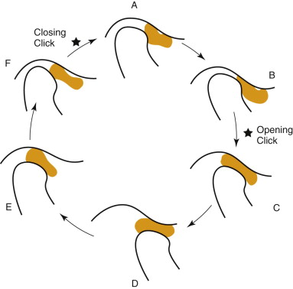
Anterior displacement of the intra-articular disk with reduction

Slide 52
Intracapsular Disorders
2) Anterior Disk Displacement w/o Reduction
Closed lock
The maximum interincisal opening (MIO) is generally only 25 to 30 mm
Mandible deviates toward the affected joint
Tx:
Acutely displaced disks→manual reduction
Chronic: stabilization splint

Slide 53
Intracapsular Disorders
3) Degenerative Joint Disease
Most frequent abnormal condition affecting the TMJ
Tx:
NSAIDs, soft diet, limited jaw movement, and use of a stabilizing bite splint to help reduce the effects of chronic clenching or bruxis
When nonsurgical management fails and when there are bony change on the articular surface of the condyle → can opt for surgery

Slide 54
Ankylosis
Ankylosis = stiffness of a joint due to abnormal adhesion and rigidity of the bones of the joint
2 most common causes:
rheumatoid arthritis and traumatic injuries

Slide 55
TMJ Surgery
Absolute indications
Treatment of neoplasms
Growth abnormalities
Ankylosis of the joint
1) Arthrocentesis
Simplest
2) Arthroscopy
Minimally invasive
3) Arthrotomy (open joint surgery)
E.g. debridement or disk repositioning

