Slide 1
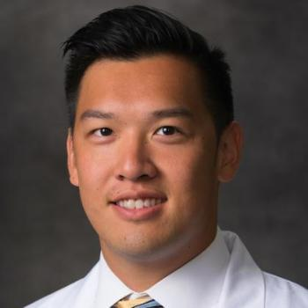


Advancing Artificial Intelligence and Machine Learning in Primary Care
Timothy Tsai DO MMCi
Clinical Assistant Professor, Medicine
Data Lead, Stanford Asynchronous Virtual Co-PCP
Associate Medical Director, Stanford Healthcare AI Applied Research Team
Division of Primary Care and Population Health
Stanford University School of Medicine

Slide 2





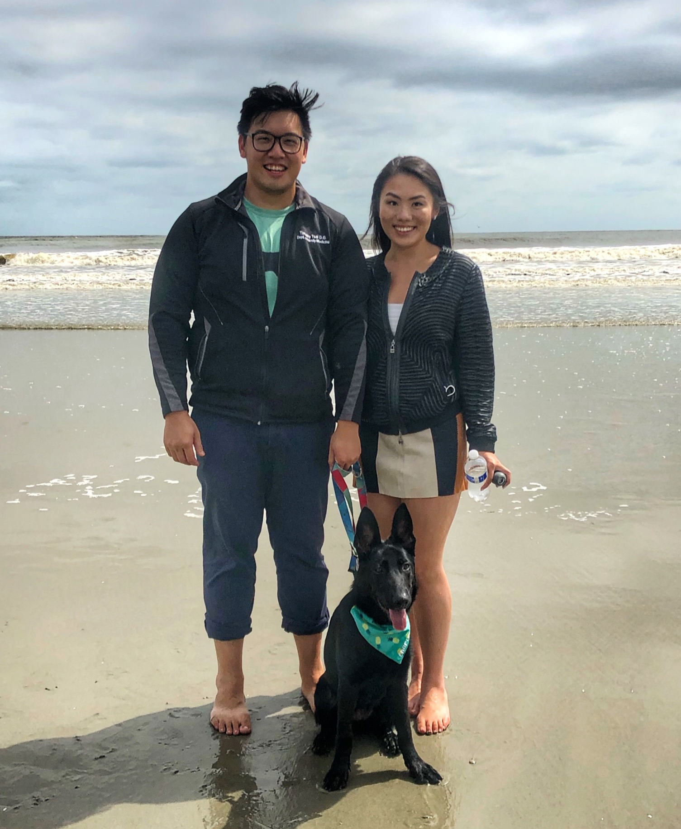





Slide 3
What is Missing in Healthcare AI/ML Today?
Only 3% of FDA approved AI/ML tools is intended for primary care, and 1% of AI/ML research funding goes to primary care
90% of AI/ML models never make it to production, and 97% of FDA approved AI/ML tools never undergo prospective evaluation
AI/ML activity is concentrated in a short list of affluent academic centers, and community engagement is little to non-existent
Not enough attention to primary care
Not enough attention to implementation
Not enough attention to
DEI

Slide 4
How can a Research Team Address These Gaps?
Not enough attention to implementation
Partner in AI/ML policy and health equity work
Not enough attention to primary care
Engage in the implementation science of AI/ML
Not enough attention to
DEI
Develop effective cross-sectoral collaborations

Slide 5



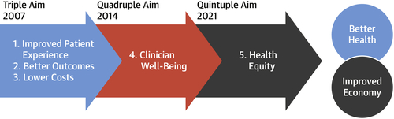
Mission
To bring leading edge AI technologies from “code to bedside” in support of the Quintuple Aim.
Vision
To be a national leader in the study and implementation of AI technologies to solve specific, practical problems in healthcare.
Core Competencies
Translational AI research study design and AI implementation
Clinical integration workflow design and simulation
Quality improvement and design thinking methodology
Notes:
First I'd like to briefly introduce our team.
Margaret Smith is our Director of Operations and co-developed this slide deck. Grace Hong, Shreya Shah, Steven Lin
At HEA3RT our mission is to bring leading edge AI technologies from code to bedside in support of the quintuple aim and we leverage a unique combination of methods rooted in quality improvement methodology to guide our research projects.

Slide 6













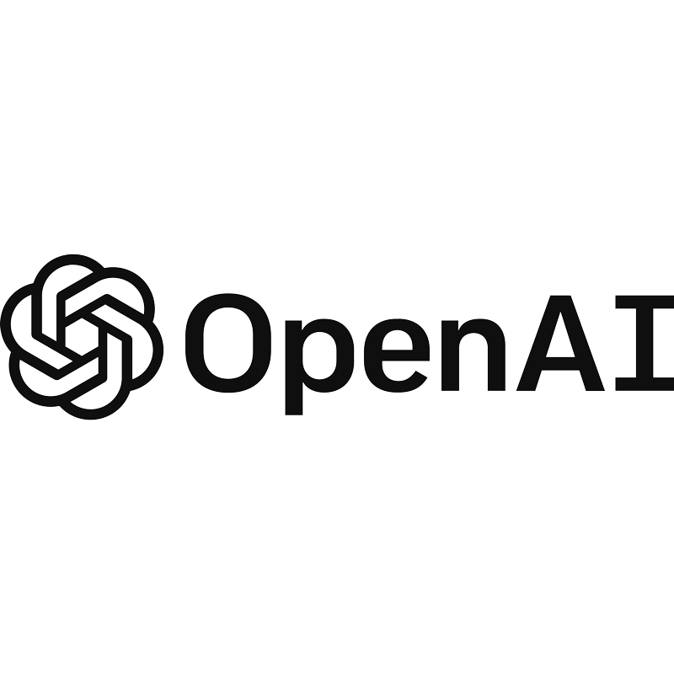







Clinical Decision Making
Dermatology in Primary Care
Autoimmune Disease
Behavioral Health
Population Health Management
Remote Patient Monitoring
Hypertension & Heart Failure
Stress Sensing
Value Based Care
Predicting ED/Hospitalizations
Digital Care Coordinator
Care Gap Voice Assistant
Transitions of Care
Predicting Clinical Deterioration in Hospitals
Advance Care Planning
Care Team Burnout
Automating Clinical Documentation
Message Categorization
Message Auto Reply
Health Policy, Education and Development
Equity & Governance
Advocacy & Education
Research Capacity Building

Slide 7
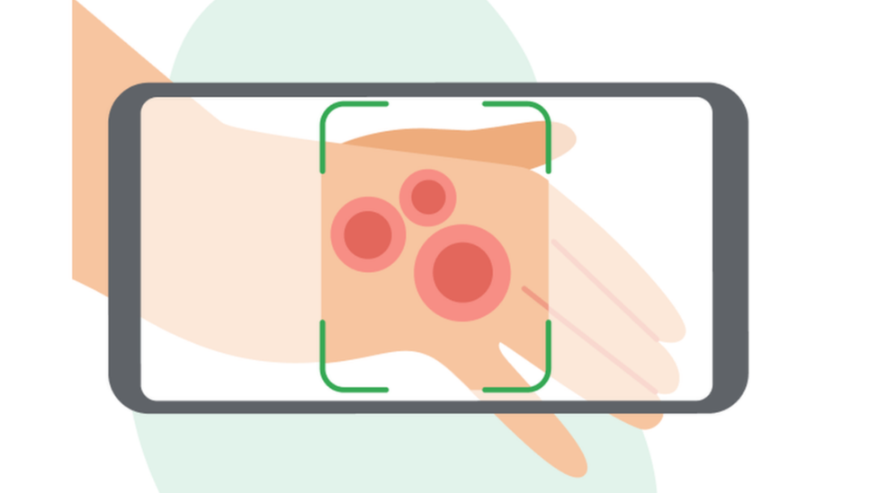
Improving Access to Skin Disease Diagnosis
Problem: Primary care providers manage 70% of skin cases, and access to dermatology is lacking in many community settings
What’s been done: AI is non-inferior to dermatologists, and can improve PCP diagnoses
What we’re doing: Testing the AI’s feasibility, acceptability, and performance in the community

Slide 8
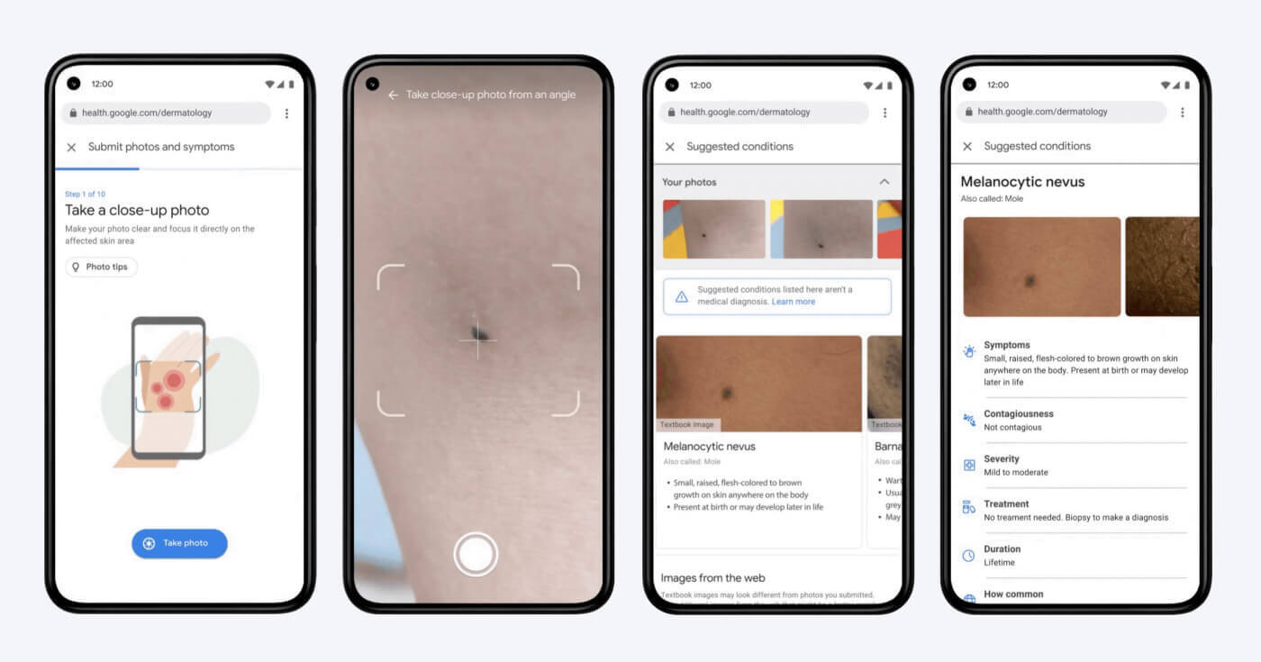
AI built using 16K cases can distinguish between 419 skin conditions, and is non-inferior to dermatologists and superior to PCPs on 963 validation cases
AI was associated with improved PCP diagnoses for 1 in every 8-10 validation cases

Slide 9



Enrolled 110 diverse community participants across 4 health fairs
73% of participants were extremely or very satisfied with the app
Clinicians: app was concordant with their own assessments in 86% of cases

Slide 10
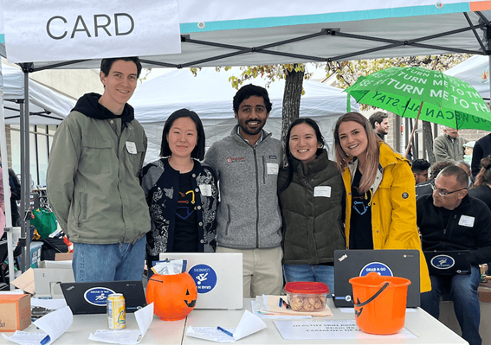

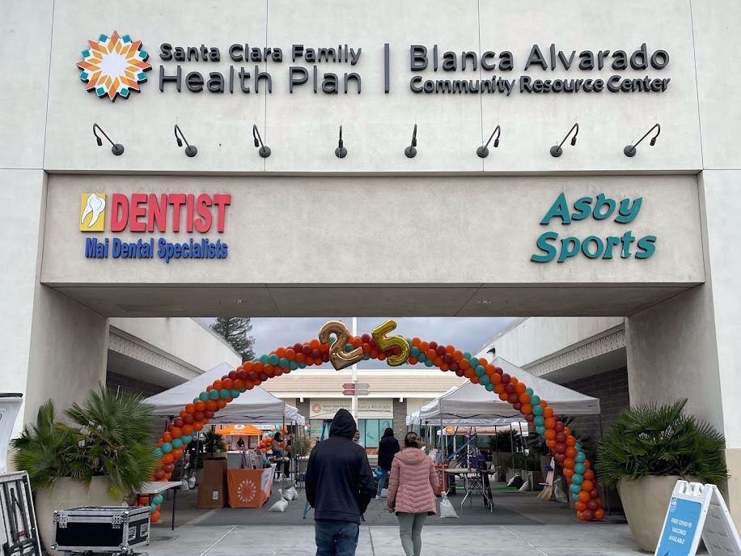
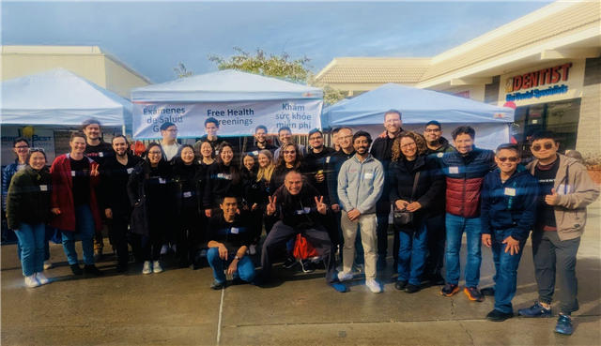
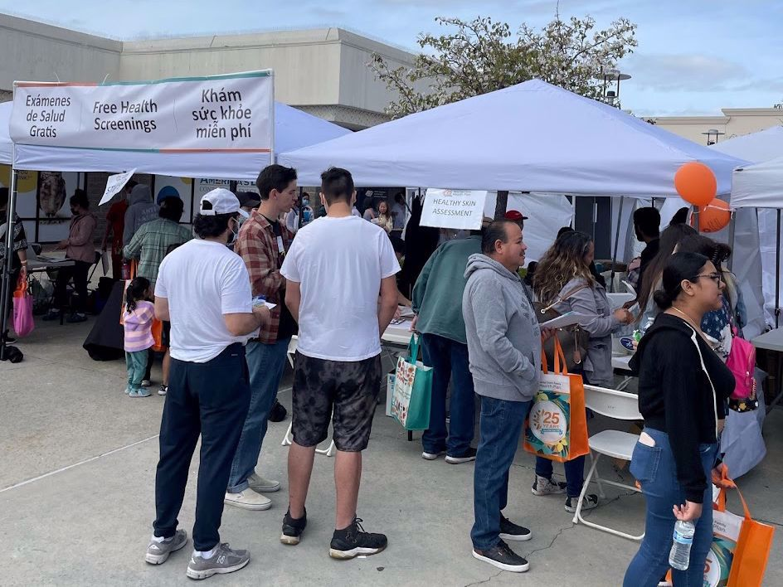
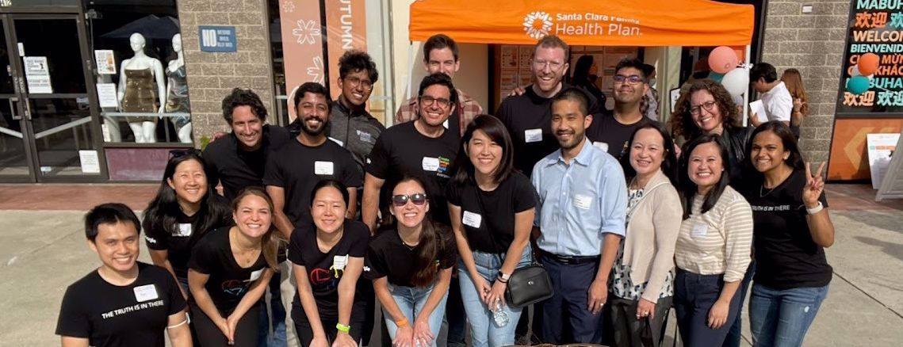
Merging research, product development and community service into a single pursuit may help bridge the gap between academia, industry and community in AI/ML science, innovation and equity

Slide 11
Clinical Decision Making
Dermatology in Primary Care
Autoimmune Disease
Behavioral Health
Population Health Management
Remote Patient Monitoring
Hypertension & Heart Failure
Stress Sensing
Value Based Care
Predicting ED/Hospitalizations
Digital Care Coordinator
Care Gap Voice Assistant
Transitions of Care
Predicting Clinical Deterioration in Hospitals
Advance Care Planning
Care Team Burnout
Automating Clinical Documentation
Message Categorization
Message Auto Reply
Health Policy, Education and Development
Equity & Governance
Advocacy & Education
Research Capacity Building

Slide 12

Improving Chronic Care With Remote Monitoring
Problem: Episodic visits are not sufficient for controlling chronic diseases at the population level
What’s been done: AI-assisted RPM is promising, but evidence is inadequate and RPM vendors operate outside health systems
What we’re doing: Testing an AI-assisted RPM program vs usual care for HTN in a pragmatic RCT

Slide 13

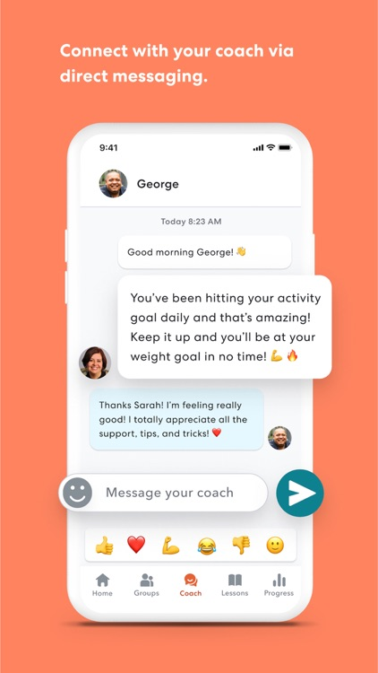

Slide 14



Reached out to 11,000+ patients
via patient portal and text messages
Collected and entered 1,500+ BP readings into EHR for pop health
Enrolled 300 patients in fully remote fashion

Slide 15
Clinical Decision Making
Dermatology in Primary Care
Autoimmune Disease
Behavioral Health
Population Health Management
Remote Patient Monitoring
Hypertension & Heart Failure
Stress Sensing
Value Based Care
Predicting ED/Hospitalizations
Digital Care Coordinator
Care Gap Voice Assistant
Transitions of Care
Predicting Clinical Deterioration in Hospitals
Advance Care Planning
Care Team Burnout
Automating Clinical Documentation
Message Categorization
Message Auto Reply
Health Policy, Education and Development
Equity & Governance
Advocacy & Education
Research Capacity Building

Slide 16

Using AI to Draft Replies to Patient Messages
Problem: COVID-19 hastened the adoption of virtual care resulting in 1.6-fold increase in electronic patient messages
What’s been done: AI chatbots can draft replies to messages with human-quality text
What we’re doing: Testing a ChatGPT-powered Epic “draft auto-reply” feature with PCPs

Slide 17
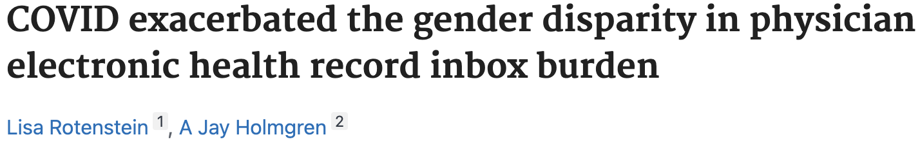
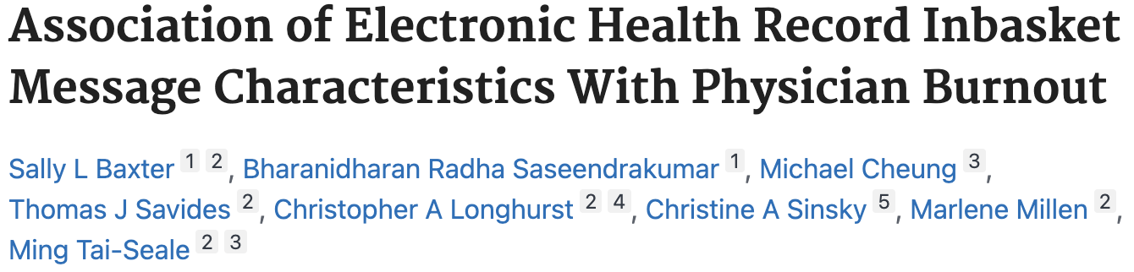
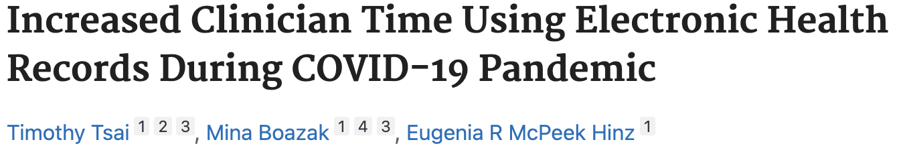

In Basket Burden
Stanford Medicine Data, 2021.
Notes:
As we all know, patient message volumes have skyrocketed over the last several years.
Patient messages represent a new part of care delivery that is here to stay post-pandemic

Slide 18

In Basket Burden
How did we get here?
HITEC Act and meaningful use
  Adoption of EHR-based patient portals
21st Century Cures Act
COVID 19 pandemic
  Telehealth
  Remote Care
Assessing the impact of the COVID-19 pandemic on clinician ambulatory electronic health record use, JAMIA, 2022,
The Electronic Inbox—Benefits, Questions, and Solutions for the Road Ahead. JAMA. 2023
Notes:
How did we get here?
As we all know, patient message volumes have skyrocketed over the last several years.
Patient messages represent a new part of care delivery that is here to stay post-pandemic
Several factors that have contributed to this including …

Slide 19



In Basket Burden
Electronic messaging within electronic health records (EHRs) has emerged as a leading cause of clinician burnout
% Patient Messages vs In-person Visits
570%
106%
2017
2018
2019
2020
2021
Stanford Medicine Data, 2021.
Notes:
As we all know, patient message volumes have skyrocketed over the last several years.
Patient messages represent a new part of care delivery that is here to stay post-pandemic

Slide 20
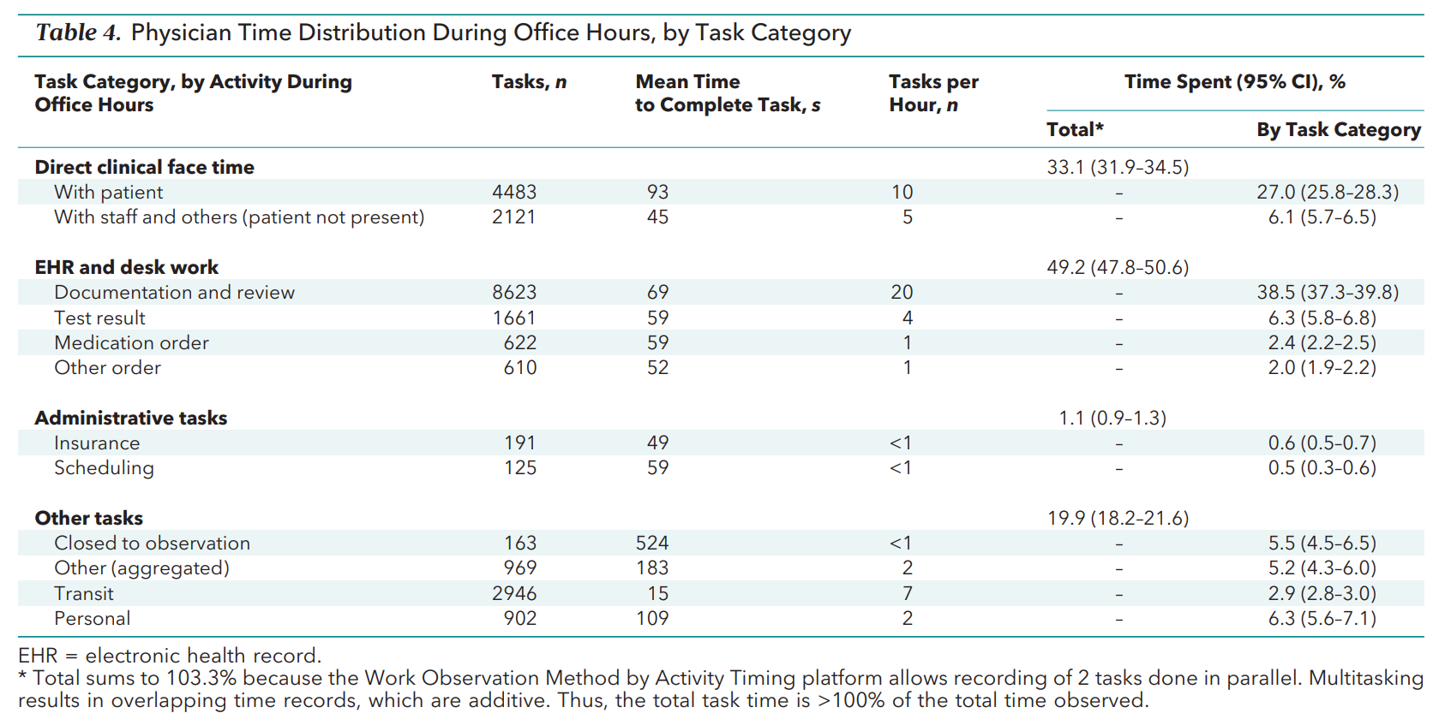
In Basket Burden
Loss of the therapeutic relationship
Clinician burnout
Exacerbation of inequalities from the Digital Divide
Allocation of Physician Time in Ambulatory Practice: A Time and Motion Study in 4 Specialties, Annals of Internal Medicine, 2016

Slide 21

Strategies to Address In Basket Burden
Billing for patient messages
Automated message categorization and triage
Multidisciplinary teams to address message pools
AI-generated draft patient messages
Annals of Family Medicine, 2017 (https://www.annfammed.org/content/15/5/419); JAMIA, 2021 (https://academic.oup.com/jamia/article-abstract/28/5/923/5924604)
Notes:
Current solutions like billing for patient messages haven't been scalable or effective.
And operational solutions like pool optimization work but are slow and variable in their effect.
AI-generated draft replies have the potential to reduce the time and cognitive burden of responding to patient messages

Slide 22
Beta testing with GPT 3.5
Launch of ChatGPT
November 2022
Technical Build in Production
April 2023
Beta testing initiated
May 2023
Model Update to GPT4
June 2023
Pilot
July to August 2023
Notes:
ChatGPT launched in November of 2022, and in May 2023 Stanford was live with AI generated draft responses
This effort was championed with full support by hospital leadership - interested in being early adopters and shaping generative AI in healthcare
The tool was beta tested with a small pool of multidisciplinary ambulatory clinician beta users and the model was then updated to GPT4 before we went live with our pilot in July 2023

Slide 23
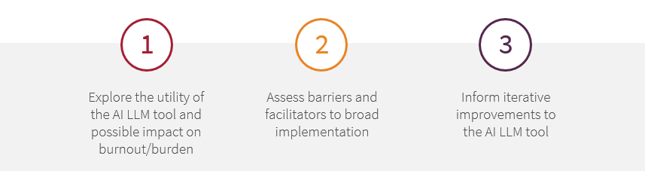
LLM Draft Replies Pilot Study: A developmental assessment for quality improvement (QI) purposes leveraging the RE-AIM evaluation framework for AI (GPT4) generated draft replies for patient messages
Enrolled 206 users in Primary Care and GI including frontline providers (MDs/APPs), RNs, and clinical pharmacists
Pre and Post Surveys
(NASA TLX, Burnout, Usability)
Reporting
(Clarity, Signal)
Pilot Feedback Channels
(Point of message feedback in Epic, ad hoc emails)
Analysis performed on 80 providers for whom we have both pre- and post- surveys

Slide 24
Clinical Decision Making
Population Health Management
Value Based Care
Transitions of Care
Care Team Burnout
Health Policy, Education and Development
Not enough attention to implementation
Partner in AI/ML policy and health equity work
Not enough attention to primary care
Engage in the implementation science of AI/ML
Not enough attention to
DEI
Develop effective cross-sectoral collaborations

Slide 25
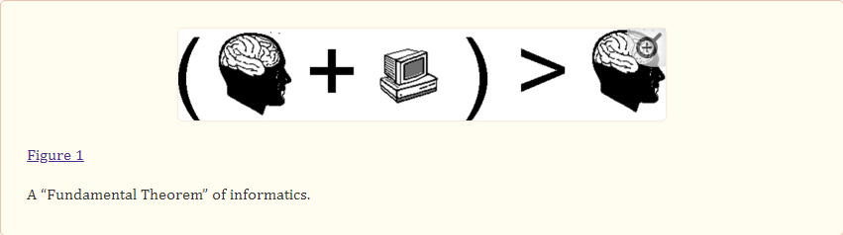
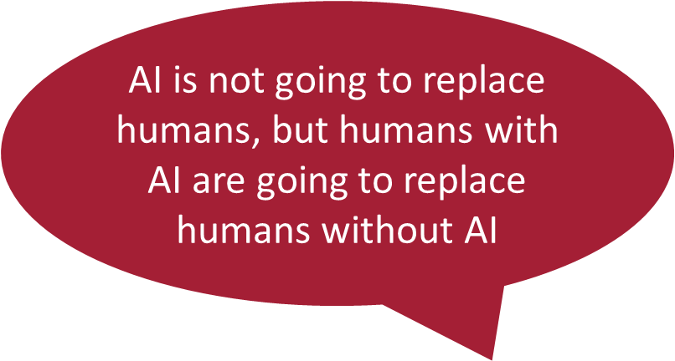

The Future
Charles Friedman, 2009
-A "fundamental theorem" of biomedical informatics. J Am Med Inform Assoc. 2009 Mar-Apr;16(2):169-70.
Erik Brynjolfsson, Professor, Director Stanford Digital Economy Lab
https://digitaleconomy.stanford.edu/news/the-turing-trap-the-promise-peril-of-human-like-artificial-intelligence/

Slide 26
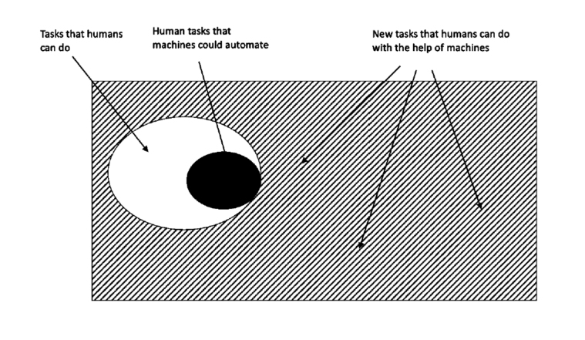
The Future
Erik Brynjolfsson, Professor, Director Stanford Digital Economy Lab
https://digitaleconomy.stanford.edu/news/the-turing-trap-the-promise-peril-of-human-like-artificial-intelligence/
Erik Brynjolfsson, Professor, Director Stanford Digital Economy Lab
https://digitaleconomy.stanford.edu/news/the-turing-trap-the-promise-peril-of-human-like-artificial-intelligence/

Slide 27


Thank you! Questions?
https://med.stanford.edu/healthcare-ai.html
Email
timothy.tsai@stanford.edu
LinkedIn
www.linkedin.com/in/timothytsai1

