Slide 1

Primary Care:
The essential, not basic, foundation of Health Systems
Andrew Bazemore MD MPH
May 24th, 2023

Slide 2
Formative experiences shaped my understanding of what primary care could & should be…
“Primary care is essential health care based on practical, scientifically sound and socially acceptable methods and technology made universally accessible to individual and families in the community through their full participation and at a cost that the community and country can afford…
It forms an integral part of both the country’s health system, of which it is the central function and main focus, and overall social economic development of the community
-Declaration of Alma Ata, WHA, 1978

Slide 3
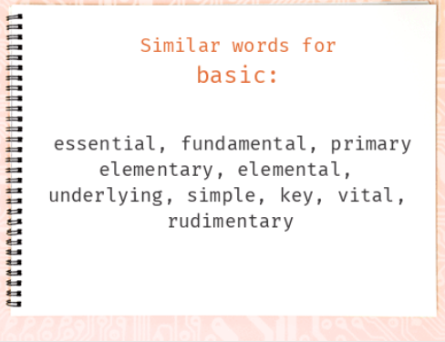
Primary Care as Essential, not Basic
Basic = simple, uncomplicated, or at a low level of skill.
Essential = something that is necessary, and without which a thing cannot exist or is impossible.
  Example: “Freedom of the press is essential to a healthy democracy.”

Slide 4
In the U.S., primary care is in no way central, and the outcomes show it

Slide 5
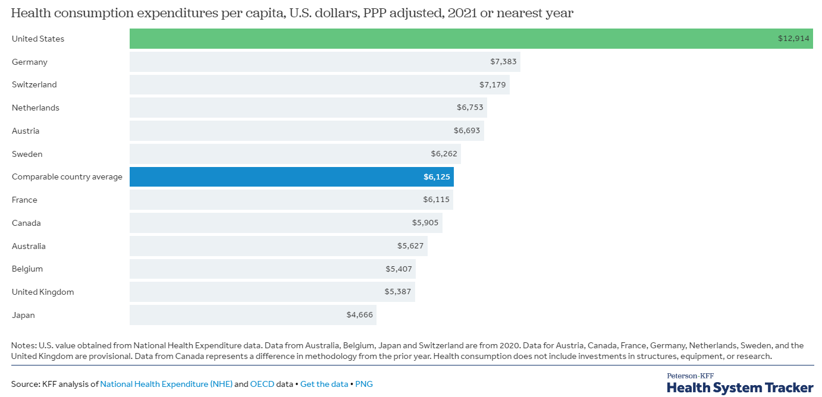
But the reality is, through a health care lens, our differences couldn’t be any more stark
Despite double the per capita health spending of peer nations…

Slide 6
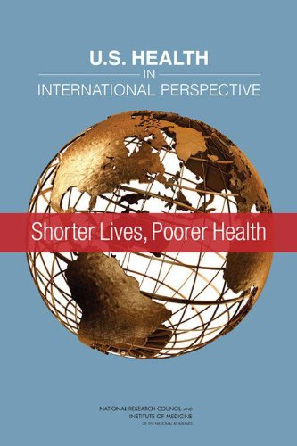
The U.S. suffers worse health outcomes, whether measured in quality… or longevity

Slide 7
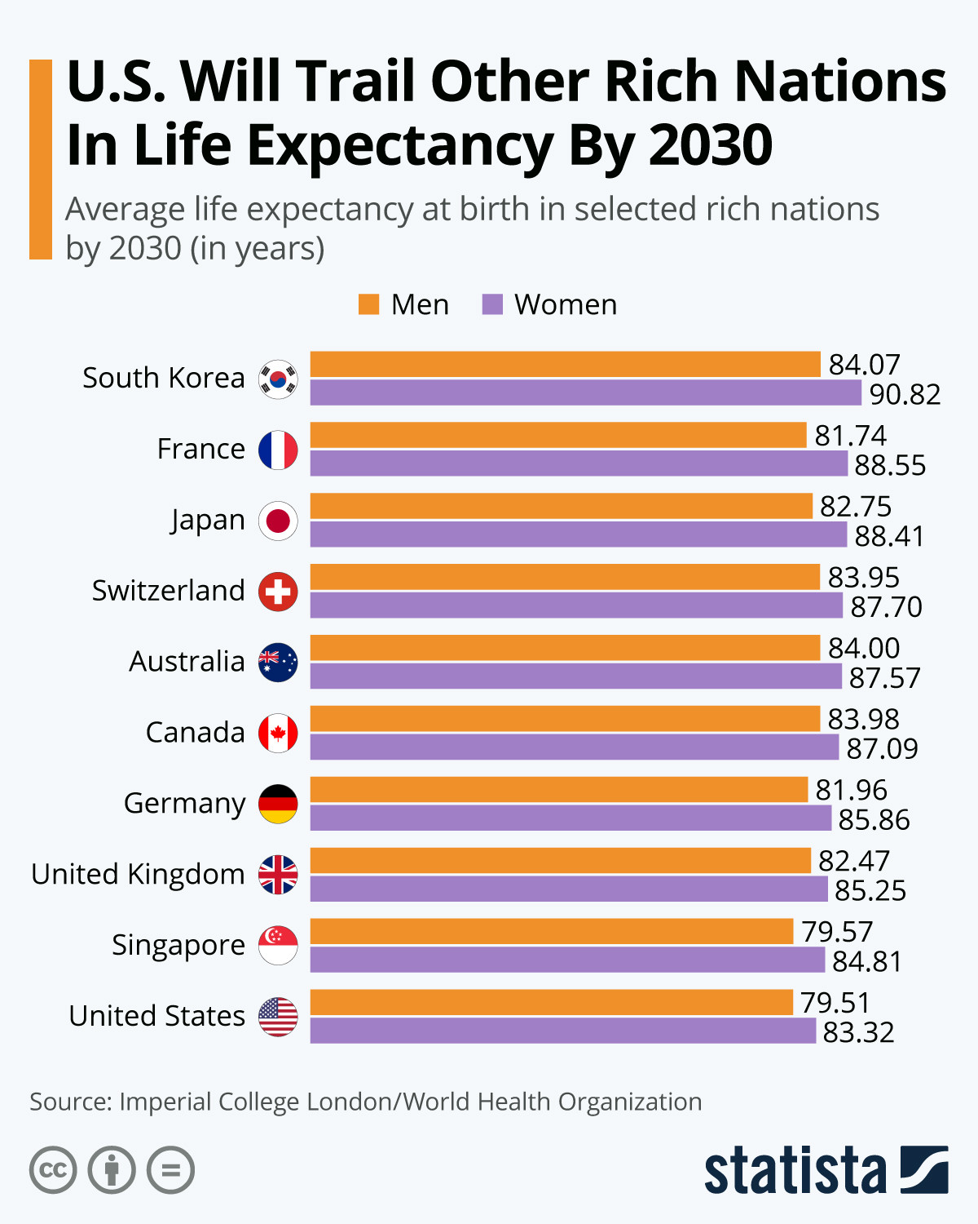
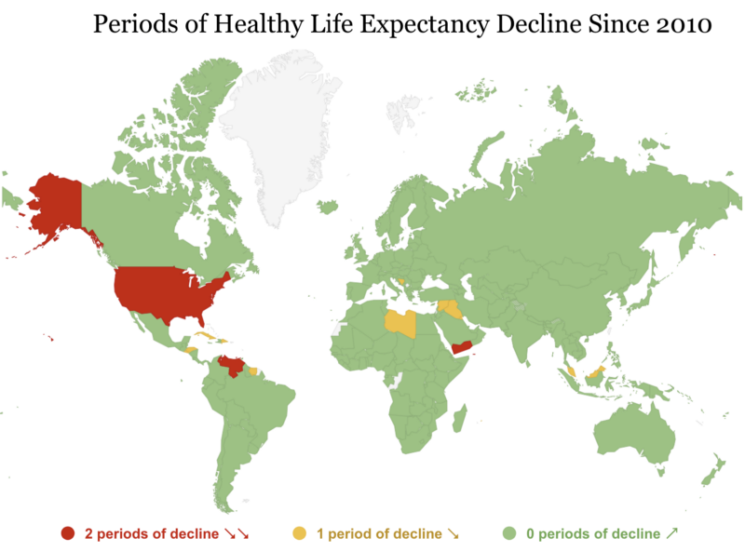

Slide 8


Slide 9
Instead of this
“Primary care is essential health care based on practical, scientifically sound and socially acceptable methods and technology made universally accessible to individual and families in the community through their full participation and at a cost that the community and country can afford…
It forms an integral part of both the country’s health system, of which it is the central function and main focus, and overall social economic development of the community
-Declaration of Alma Ata, WHA, 1978

Slide 10
The U.S. does this:
Adapted with permission from Starfield B. Policy relevant determinants of health: an international perspective. Health Policy 2002;60:201-21.

Slide 11
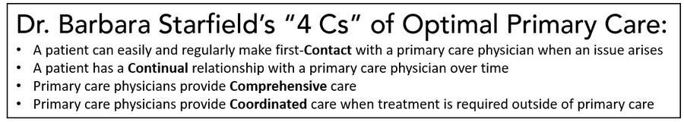
Explaining Primary Care’s salutary effects

Slide 12

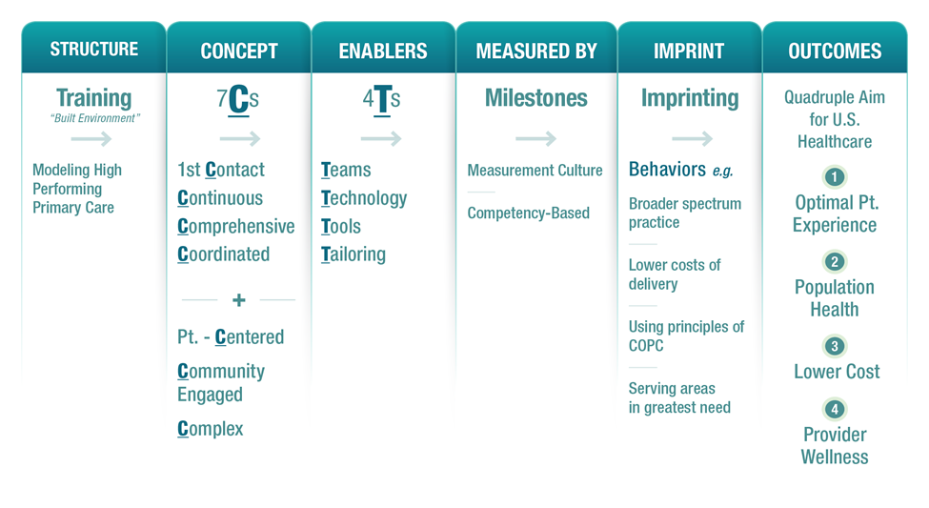




Contemporized?

Slide 13
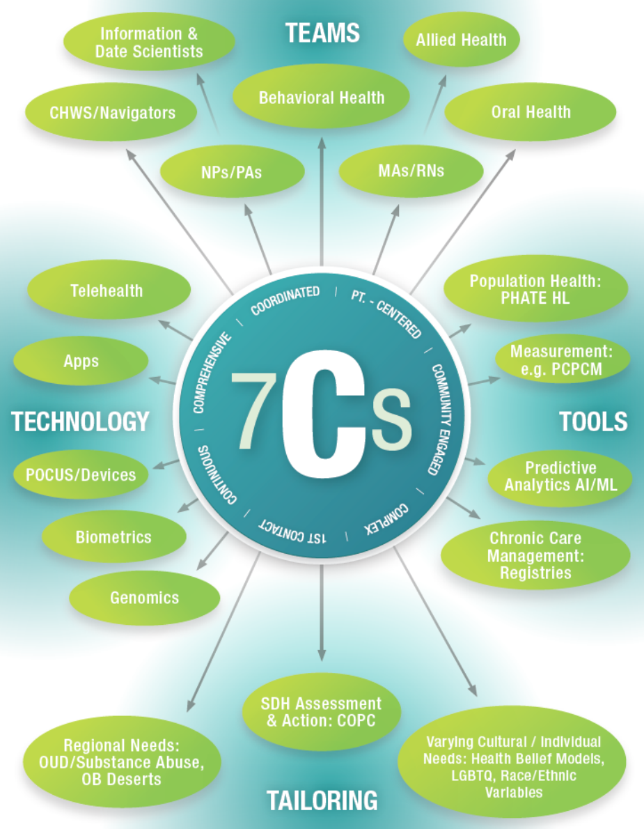
And 4Ts that facilitate these 7Cs?

Slide 14
To achieve optimal, essential Primary Health Care delivering on these 4 or 7Cs, we need
People-centered & primary care friendly Payment
Measures that Matter to Primary Care
Effective & integrated Teams

Slide 15
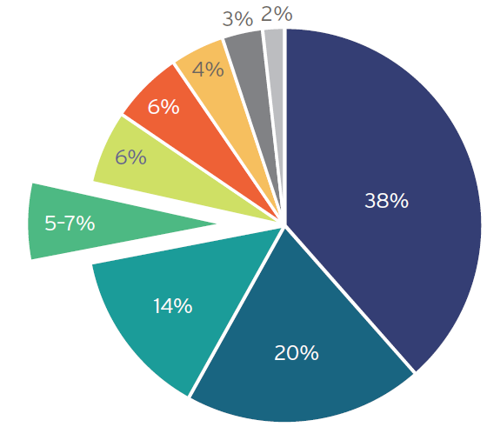
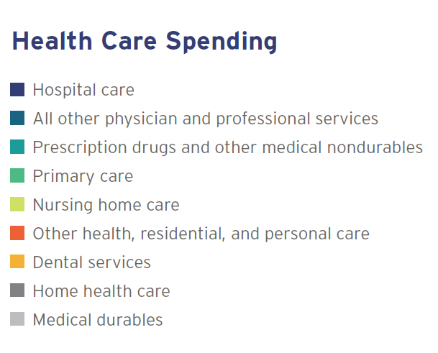
In the U.S., primary care suffers chronic anemia
Patient-Centered Primary Care Collaborative. 2019 Executive Report

Slide 16
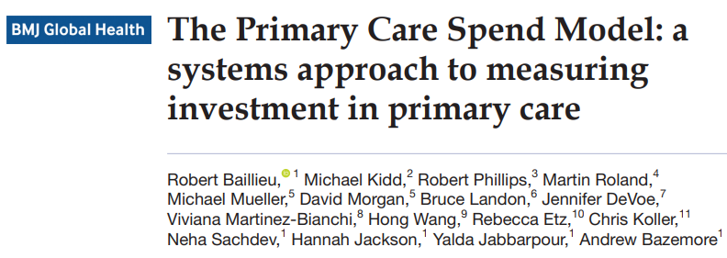
Solutions? Measuring, Benchmarking, & targeting increases in “PC Spend”

Slide 17
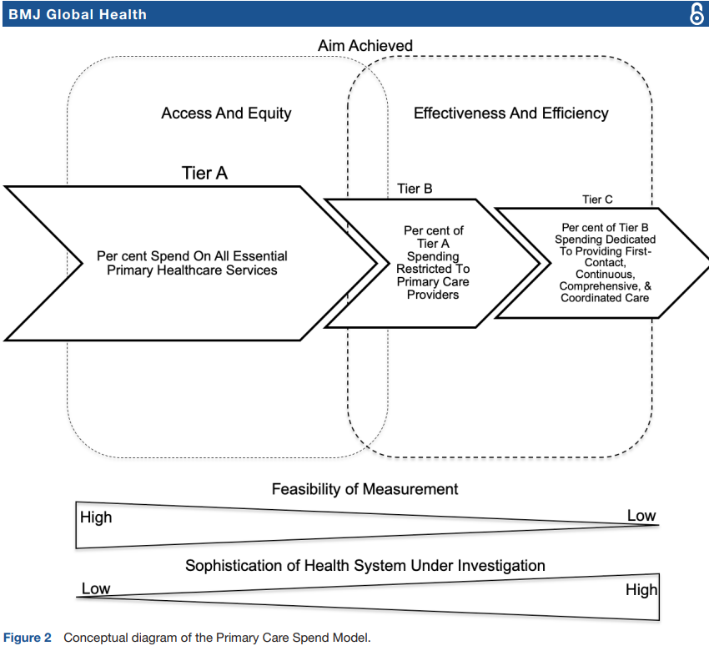
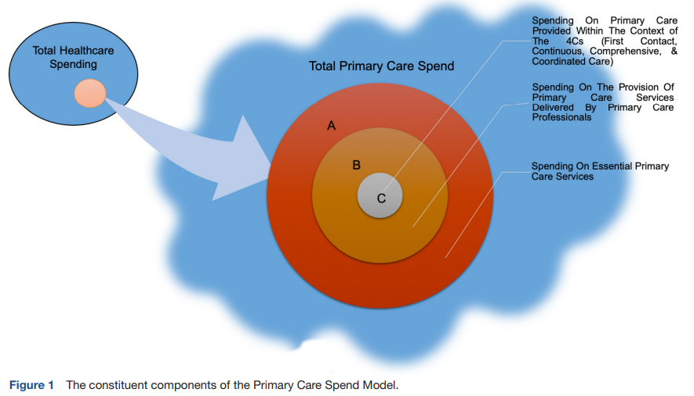

Slide 18
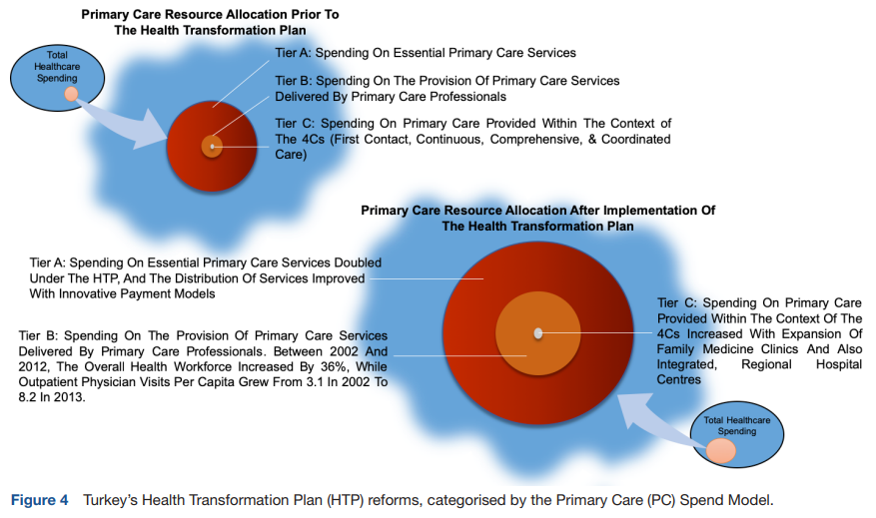
Turkey
& targeted Increases in PC Spend

Slide 19
Rhode Island, Oregon
& targeted Increases in PC Spend
California Health Care Foundation. 2022

Slide 20

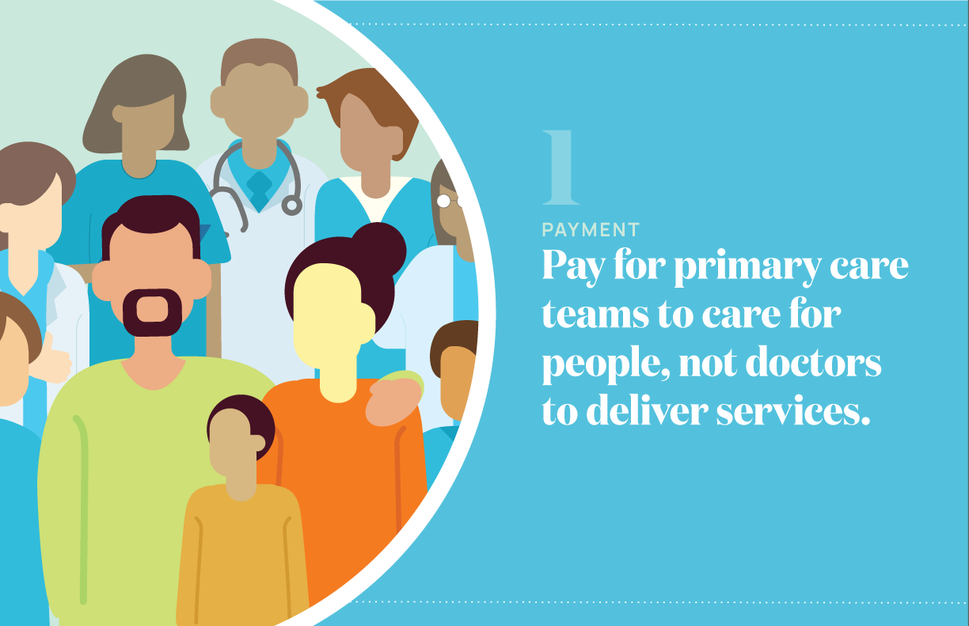

Implementing High Quality Primary Care: A Review of the recent NAM report
Fulbright Specialist Visit – Singapore
Andrew Bazemore, MD MPH
Nationalacademies.org/primarycare
primarycare@nas.edu

Slide 21
Action 1.1: Payers should evaluate and disseminate payment models based on their ability to promote the delivery of high-quality primary care, not short-term cost savings.
Action 1.2: Payers using fee-for-service models for primary care should shift toward hybrid reimbursement models, making them the default over time. For risk-bearing contracts, payers should ensure that sufficient resources and incentives flow to primary care.

Slide 22
Pay for primary care teams to care for people, not doctors to deliver services
Payers: Hybrid payment models, don’t focus on short-term savings
CMS: Increase overall spend on primary care
States: Facilitate multi-payer collaboration on increased overall spend on primary care

Slide 23
Measurement matters in payment design for optimized, essential PHC

Slide 24

Behavioral Economics: Harnessing Nudge
There is considerable evidence from outside medicine to suggest that we can design incentives and settings to extrinsically nudge behavior that is aligned with intrinsic, professional behavior–to make professional behavior the default and easy choice

Slide 25
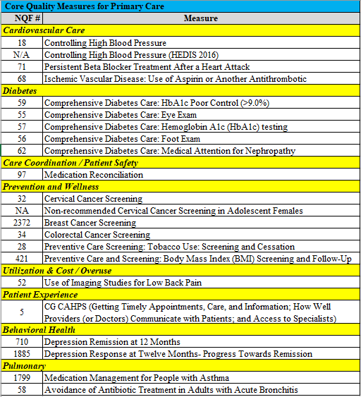
Problem with current measures in Primary Care
Too many measures, too burdensome
Focused on disease care and don’t recognize the higher level integrating, personalizing prioritizing functions
Not aligned with the foundations of primary care or the needs of patients, communities, systems

Slide 26
New Measures of Primary Care
Starting over
  Begin by “crowd sourcing” - asking what is important about good care--Patients, Clinicians, Employers/Payers
  “Measurizing” the 4 C’s
  Translate Total Cost of Care into Low Value measures

Slide 27
ABFM Quality Measure Development
Measuring What Matters In Primary Care
Person Centered Primary Care Performance Measure
Rebecca S. Etz, PhD, Stephen J. Zyzanski, PhD, Martha M. Gonzalez, Sarah R. Reves, MSN, FNP-C, Jonathan P. O’Neal, Kurt C. Stange, MD, PhD,A New Comprehensive Measure of High-Value Aspects of Primary Care, Ann Fam Med 2019;17:221-230. https://doi.org/10.1370/afm.2393.
Continuity of Care Performance Measure
Andrew Bazemore, MD, MPH, Stephen Petterson, PhD, Lars E. Peterson, MD, PhD, Richard Bruno, MD, MPH, Yoonkyung Chung, PhD, Robert L. Phillips Jr, MD, MSPH, Higher Primary Care Physician Continuity is Associated With Lower Costs and Hospitalizations, Ann Fam Med 2018;16:492-497. https://doi.org/10.1370/afm.2308.
Low-Value Care Performance Measure
Tyler W. Barreto, Yoonkyung Chung, Peter Wingrove, Richard A. Young, Stephen Petterson, Andrew Bazemore and Winston Liaw, Primary Care Physician Characteristics Associated with Low Value Care Spending, JABFM March 2019, 32 (2) 218-225; DOI: https://doi.org/10.3122/jabfm.2019.02.180111
Comprehensiveness Performance Measure
Bazemore A, Petterson S, Peterson LE, Phillips RL. More comprehensive care among family physicians is associated with lower costs and fewer hospitalizations. The Ann Fam Med. 2015; 13(3):206-213. http://www.annfammed.org/content/13/3/206.full
Crowd-sourcing & 2016 “Starfield Summit” revealed:
•Clinicians and patients think that a lot of the same things are important
•Patients want more personalized attention
•Clinicians don’t feel that what they do that is important is recognized or supported
•Employers/payers focus on cost & employee experience
•A large portion of what clinicians & patients think is important is missing from current measures
•All groups consider systemic support & integration important

Slide 28
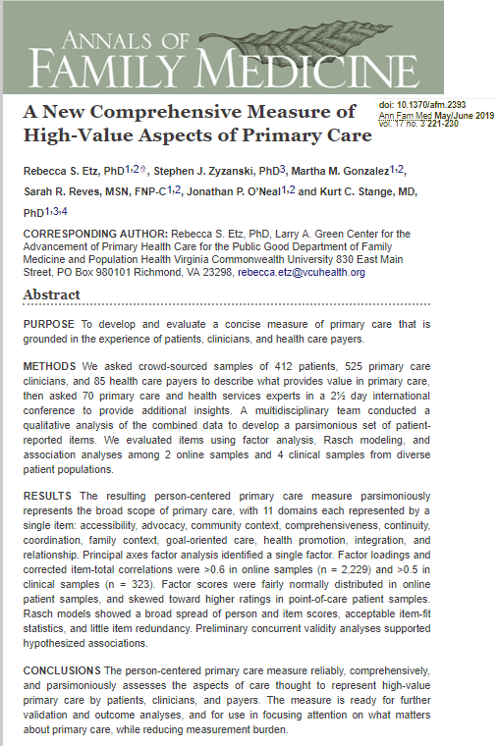
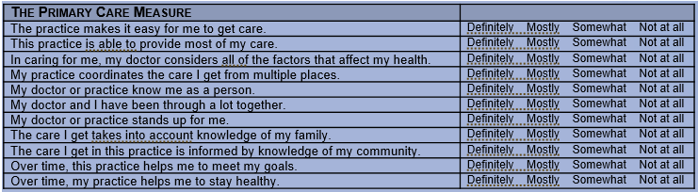
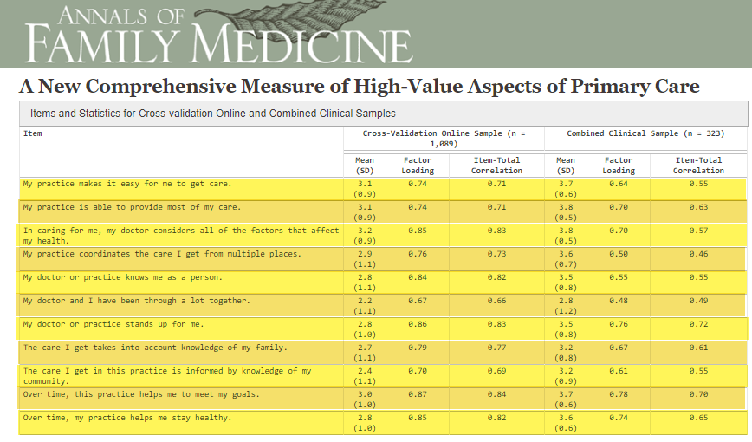
Person-Centered Primary Care Performance Measure

Slide 29
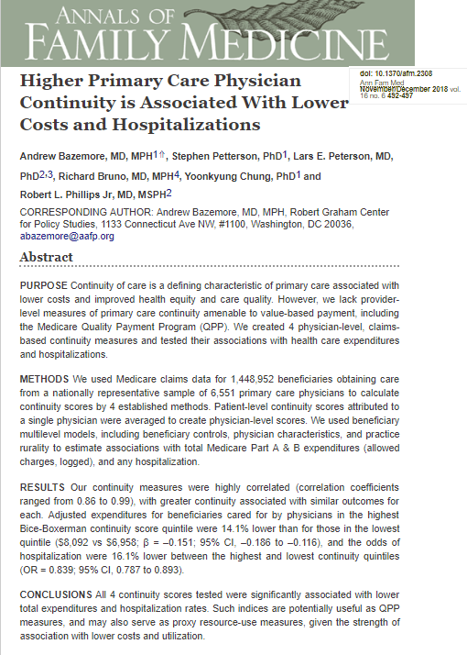
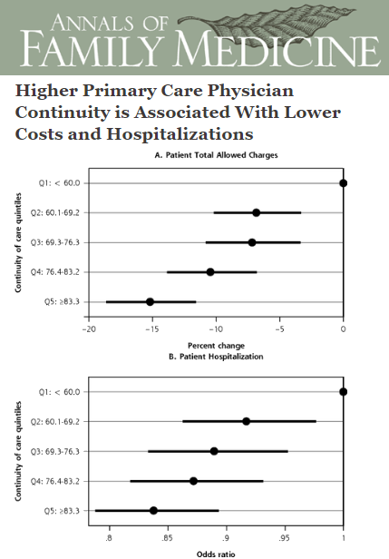
Measuring the Value-Functions of Primary Care: Provider Level Continuity Measure
15% Cost
25% Odds hospitalization
See also: BMJ 2017;356:j84
http://dx.doi.org/10.1136/bmj.j84

Slide 30
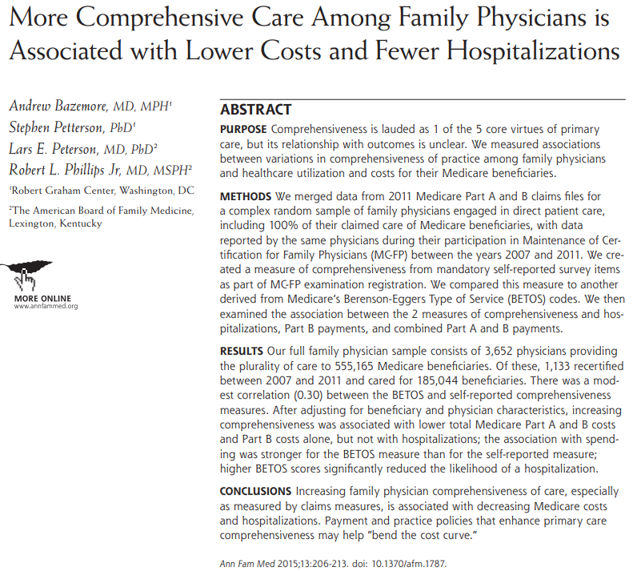
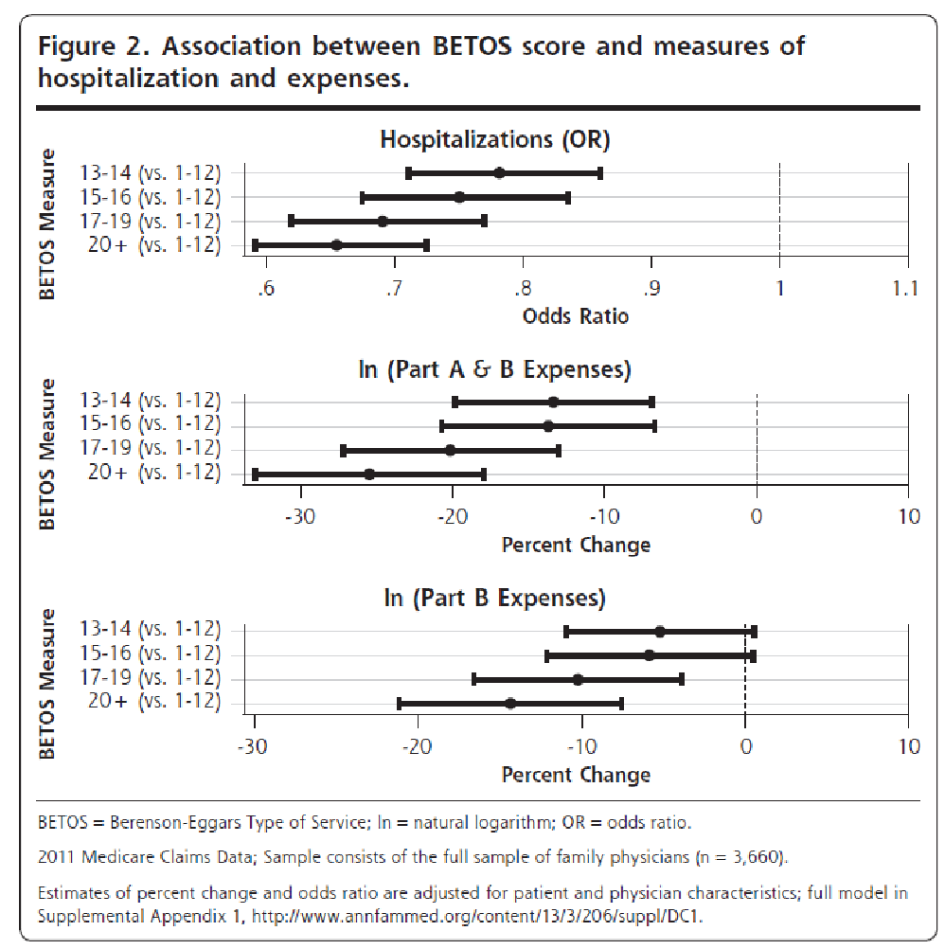
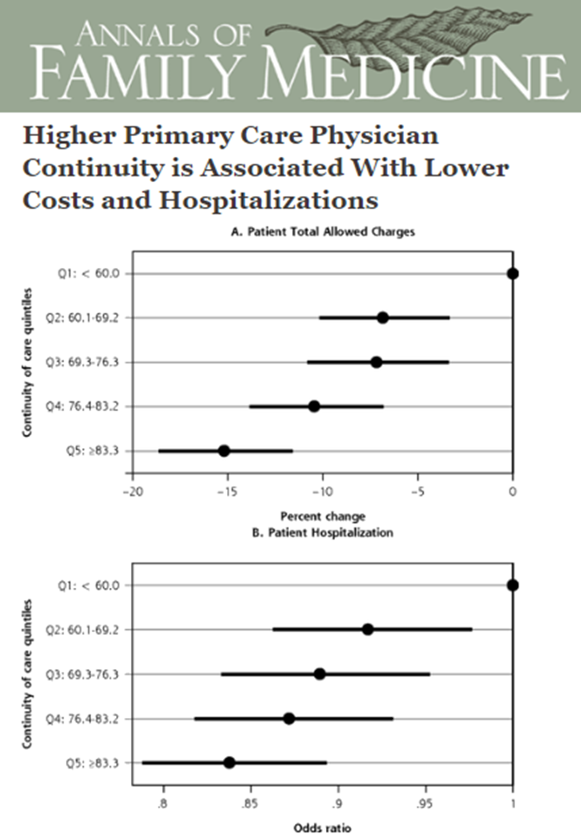
Measuring the Value-Functions of Primary Care: Provider Level Comprehensiveness Measure
15% Cost
35% Odds hospitalization

Slide 31
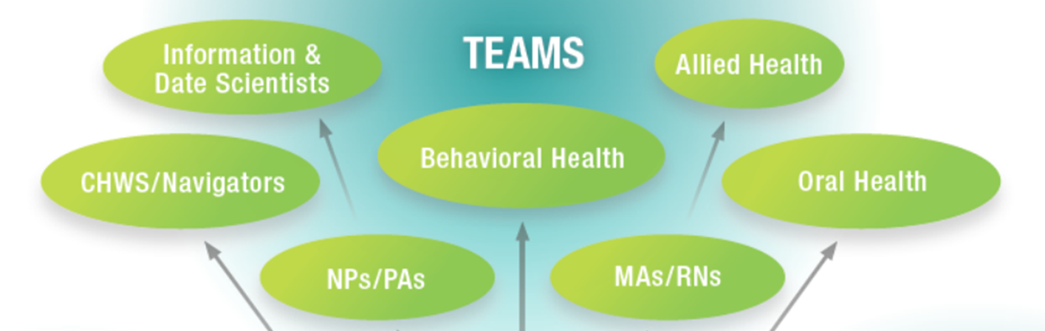
7Cs Primary Care requires robust & effective teams

Slide 32
Bodenheimer: Teams & “Teamlets” the cornerstone among 10 building blocks of High Performing PC

Slide 33
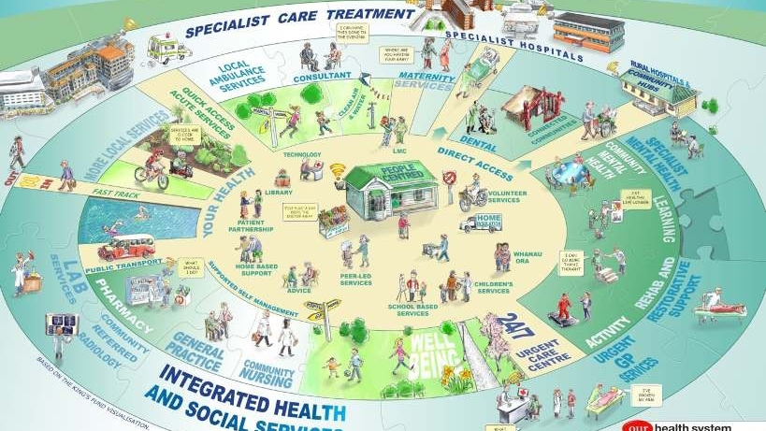
Person-Centered, Team-Based, Integrated Primary Care delivery:
Canterbury Health Pathways
Multisectoral strategy provides resources and permission for general practice to do ‘whatever it takes’ supported by a rapid-response community nursing team to provide services in the community for patients who would otherwise require an emergency department (ED) attendance or acute admission
-30% less hospitalizations versus NZ baseline over 7 years
(Gullery and Hamilton, 2015)

Slide 34
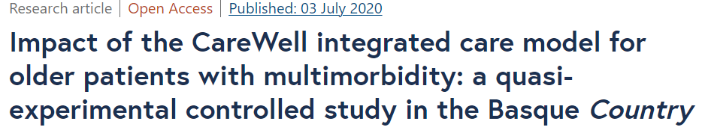
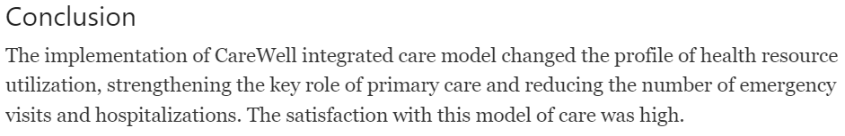
Integrated Primary Health Care in Spain

Slide 35
7Cs requires Teams enabled by Tools & Technology to Tailor care to individual & population needs

Slide 36
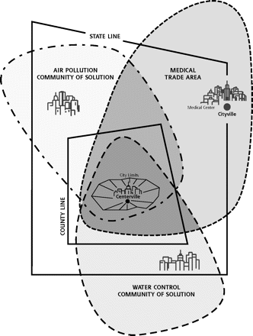
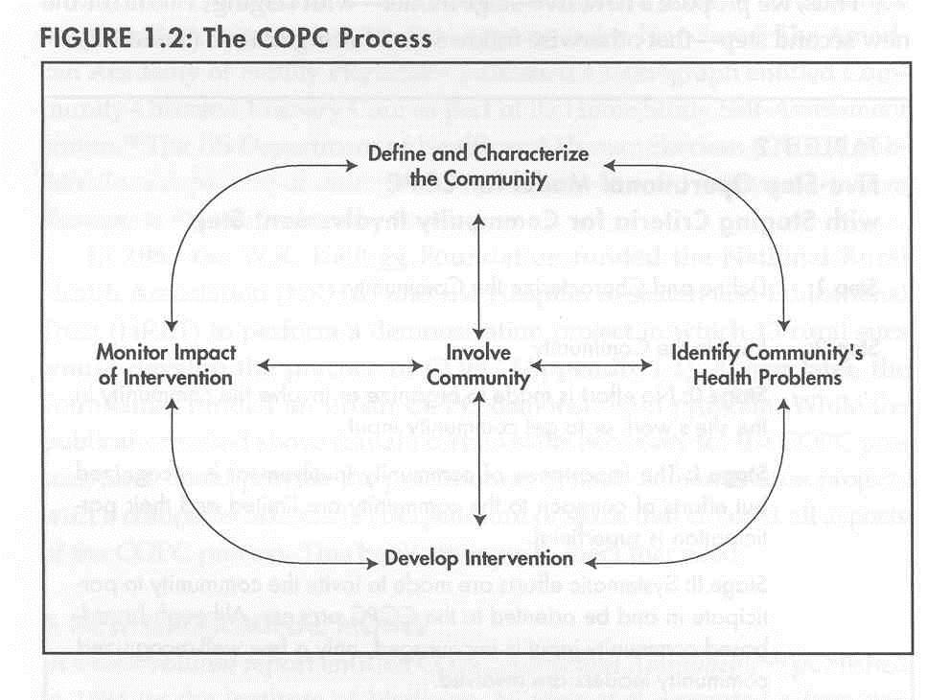
Revisiting old concepts in a new age of Tailoring: PC teams using COPC to identify ‘problemsheds & create “Communities of Solution”

Slide 37
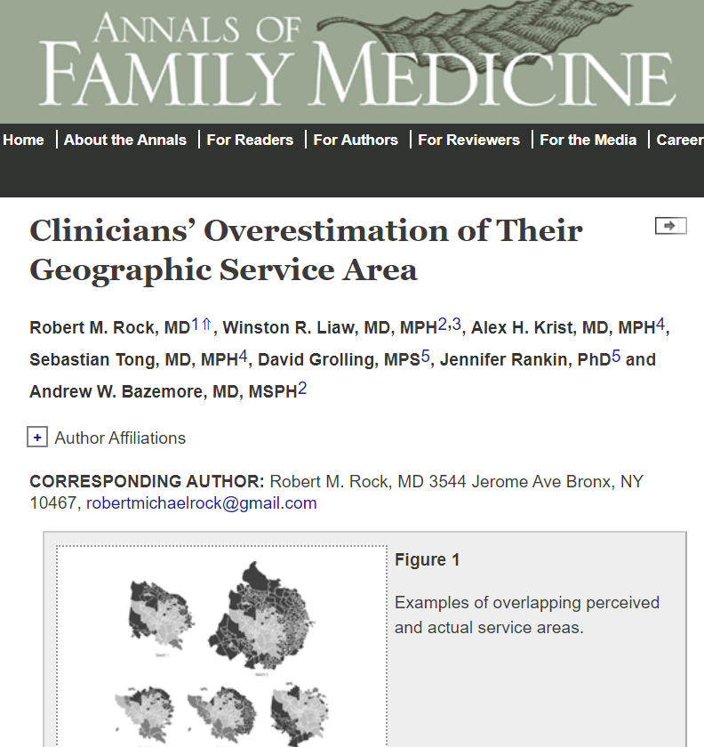
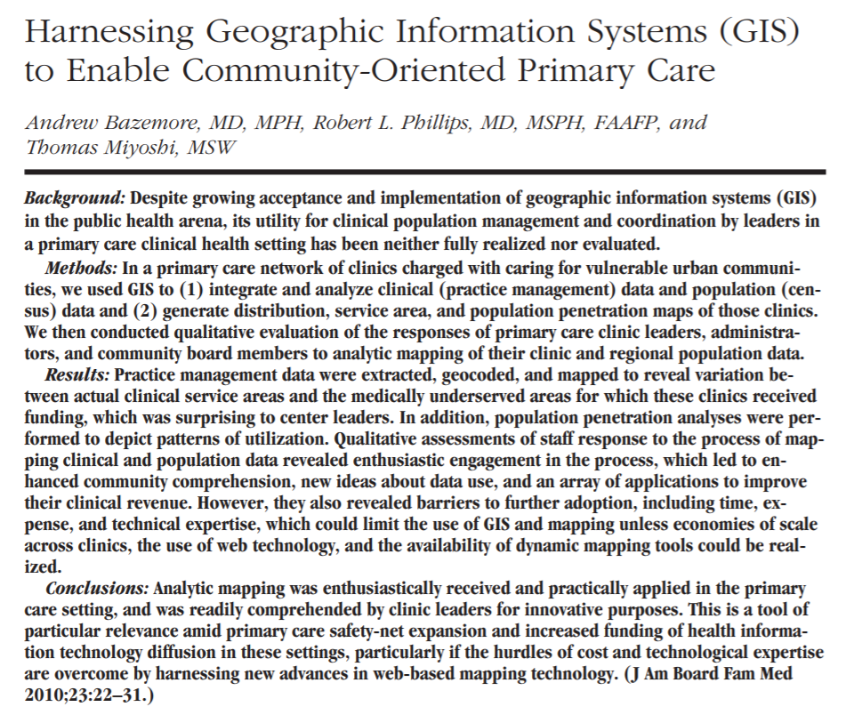

Slide 38
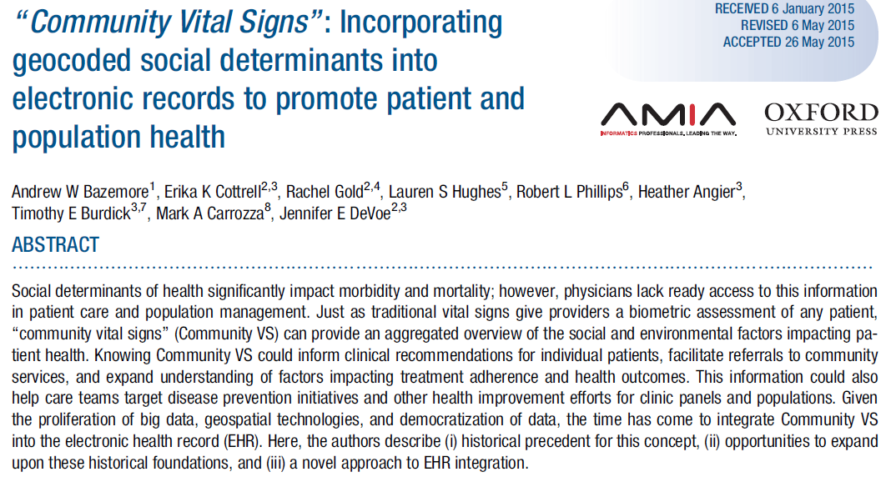
Integrating clinical & population data into Primary Care patient, population & panel management

Slide 39
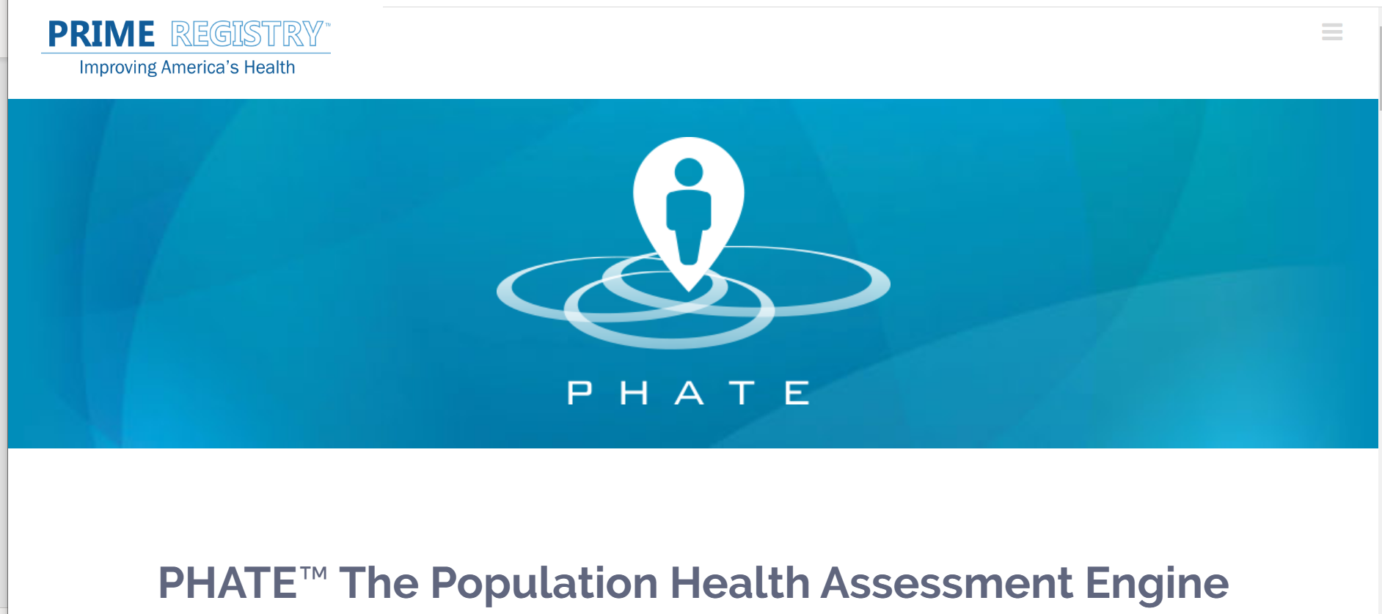
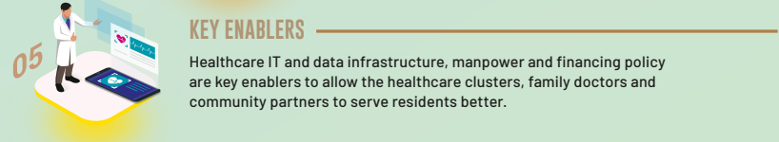
PRIME & PHATE

Slide 40
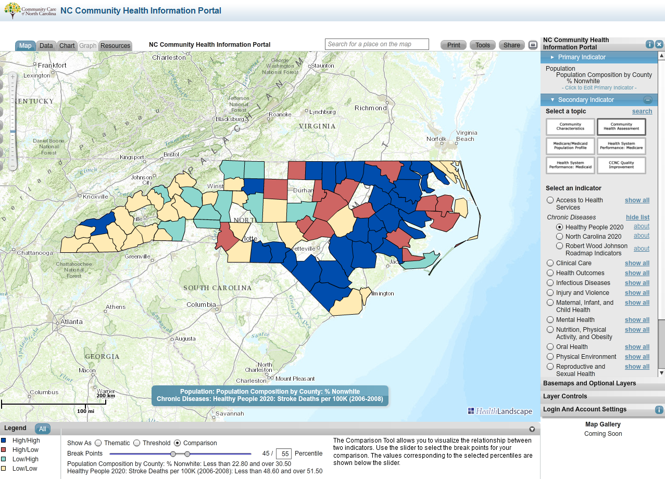
Data Support, ‘Detailing’, & tools to recognize and address Hotspots, and ‘Coldspots’

Slide 41
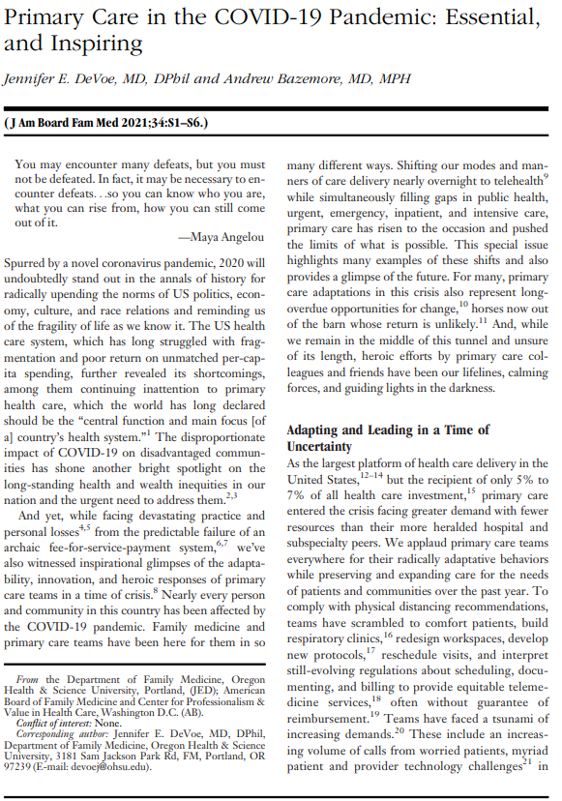
Post pandemic :
Unique opportunity to implement 7Cs PHC

Slide 42

Thoughts, Comments & Questions welcomed

