Slide 1
Cummings Ch 115: Penetrating and Blunt Trauma to the Neck
Kimanh Nguyen
May 29, 2013

Slide 2
Vital Structures
Air passages
Trachea, larynx, pharynx, lungs
Vascular
Carotid, jugular, subclavian, innominate, aortic arch
Gastrointestinal
Pharynx, esophagus
Neurologic
Spinal cord, brachial plexus, peripheral nerves, cranial nerves

Slide 3
Kinetic Energy
Kinetic energy affects magnitude of injury:
KE = ½ M (V₁ – V₂)²

Slide 4
Handguns
Projectile type
Speed
Handguns/pistols are low velocity (90-600 m/s)
Caliber
.44-caliber magnum is comparable to a rifle
Yaw
Tumbling bullet causes injury in a wider path

Slide 5
Rifles
Military bullets
Jacket creates smoother flight, clean hole, through-and-through wound
High velocity (760 m/s) transmits energy waves to surrounding tissue
Hunting rifles with expanding bullets
Soft-tips expand, create large wound cavity, may not exit, may fragment
High mortality

Slide 6
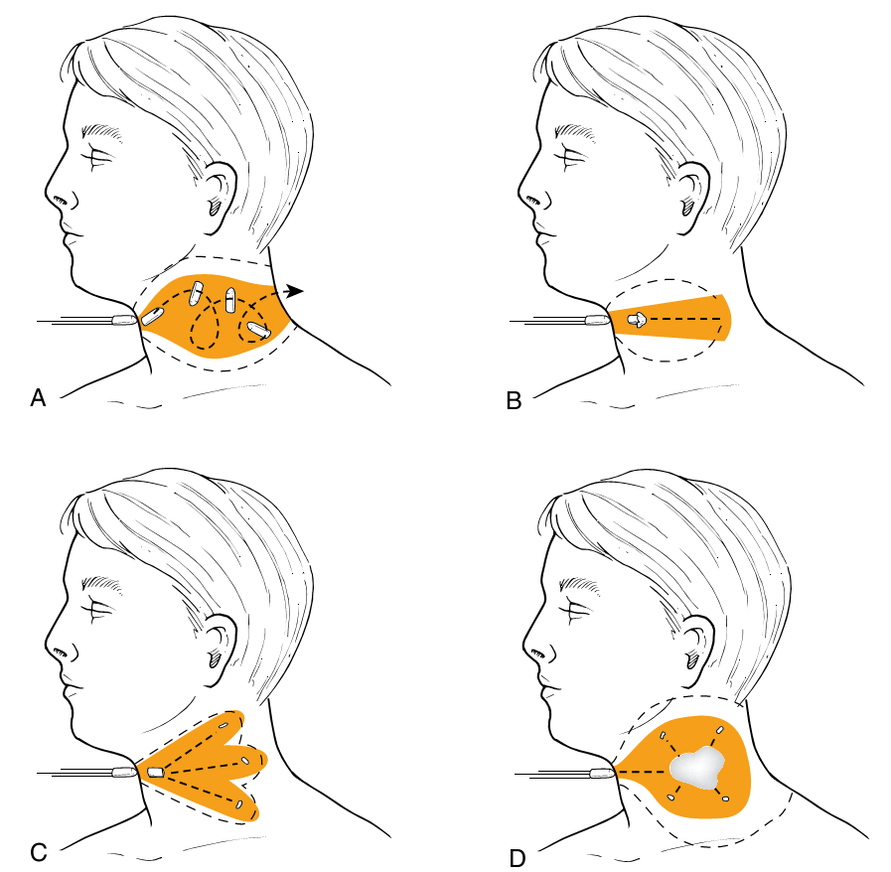
Different Missiles

Slide 7
Shotguns
Velocity ~ 300 m/s
Distance
Pellets scatter at longer distances
Type of weapon
Sawed-off shotgun sprays the shot earlier
Size of projectile (shot)
Birdshots (< 3.5 mm, 12m range)
Buckshots (> 3.5 mm, 150m range). Comparable to handgun bullet wounds
Wadding

Slide 8
Stab Injuries
Single-entry vs multiple stab wounds
Higher incidence of subclavian vessel laceration due to downward direction
Lower incidence of spinal injuries

Slide 9
Immediate surgical exploration
Massive bleeding
Expanding hematoma
Nonexpanding hematoma with hemodynamic instability
Hemomediastinum
Hemothorax
Hypovolemic shock

Slide 10
Management
“For the stable patient, the choice of management remains controversial: either mandatory exploration for all penetrating neck wounds or selective exploration with observation [and monitoring]”

Slide 11
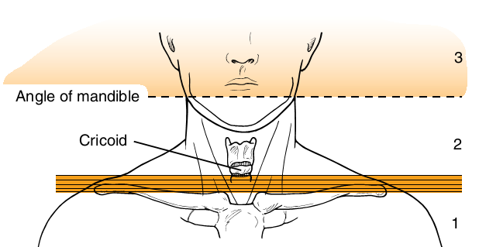
Neck Zones

Slide 12
Zone I
Vascular structures are in close proximity to thorax
Protection by bony thorax and clavicle
Difficult to explore
Median sternotomy for R injuries
Left anterior thoracotomy for L injuries
High mortality rate: 12%
Management:
Angiography if stable
Mandatory exploration usually not recommended
May consider barium swallow

Slide 13
Zone III
Protected by skeletal structures
Difficult to explore; may need craniotomy for high carotid injury
CN injuries may indicate great vessel injury
Management
Angiography if abnormal neurologic exam in stable patient
Frequent intraoral examination for edema/hematoma

Slide 14
Zone II
Most common region injured (60-75%)
Isolated venous and pharyngoesophageal injuries are most commonly missed
Management
Admit for observation
Radiology and endoscopy if stable and no signs of major injury

Slide 15
Initial Management
Airway establishment
Intubation
Cricothyroidotomy
Tracheostomy
Blood perfusion maintenance
Large-bore IV
Clarification and classification of wound severity
Do not probe wound
Routine AP/lat neck and chest films
Notes:
In the emergency department, satisfactory control of the airway is established by intubation, cricothyroidotomy, or tracheostomy. Direct transcervical tracheal intubation is safer than oral or nasal intubation when the oral cavity, pharynx, or larynx are
traumatized and filled with blood. In the setting of a gunshot wound, it may be difficult to fully evaluate the cervical spine until the airway is controlled. Multiple blind intubation attempts will risk enlarging a lacerated piriform sinus wound and extending it iatrogenically into the mediastinum. Similarly, a tracheal tear may be exacerbated by extend-ing the neck, which distracts the proximal and distal segments

Slide 16
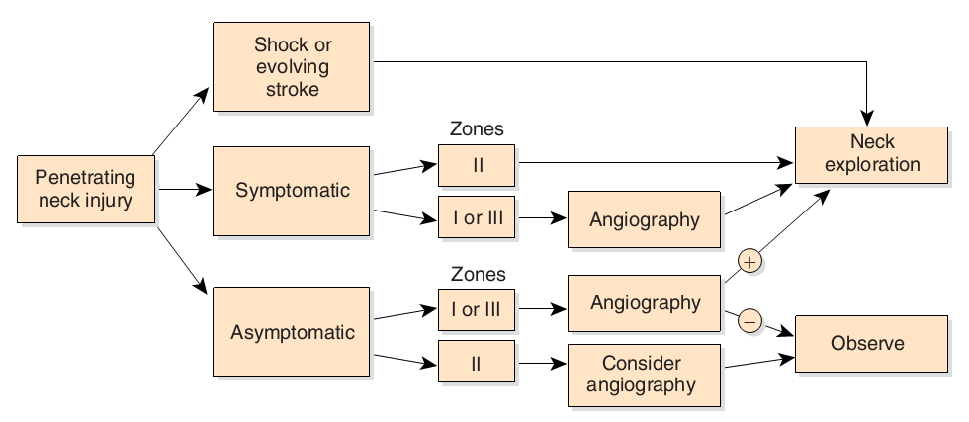
Management of Penetrating Neck Injury
Notes:
In the conscious patient a full neurologic examination should be done and a chest radiograph taken. The radiograph should be examined to rule out hemothorax, pneumothorax, or pneumomediastinum. The latter would suggest a punctured viscus and demands further evaluation. Subclavian vessel injury may be first recognized by an abnormal chest radiograph. All patients should be managed assuming potential cervical spine fractures until they undergo radiographic evaluation. On radio-graphs, all cutaneous wounds can be marked with radiopaque objects to aid in evaluating the site of the injury.
A positive angiogram may mandate an immediate trip to the operating room, but evaluation of the upper digestive tract in the radiology suite may be useful if time and the patient’s condition permit. Zone I and zone III injuries usually require routine preoperative arteriography on stable patients because their surgical approach is more difficult than zone II injuries.
In addition, when wounds involve both sides of the neck with zone I and zone III injuries, four-vessel angiography (bilateral carotid and vertebral arteries) should be considered in stable but symptomatic patients.
Approximately 30% of patients with carotid artery injury present with a neurologic deficit. Arterial injury or propagation of a thrombus into the skull can lead to cerebral ischemia. One third of the population cannot tolerate complete unilateral carotid occlusion

Slide 17
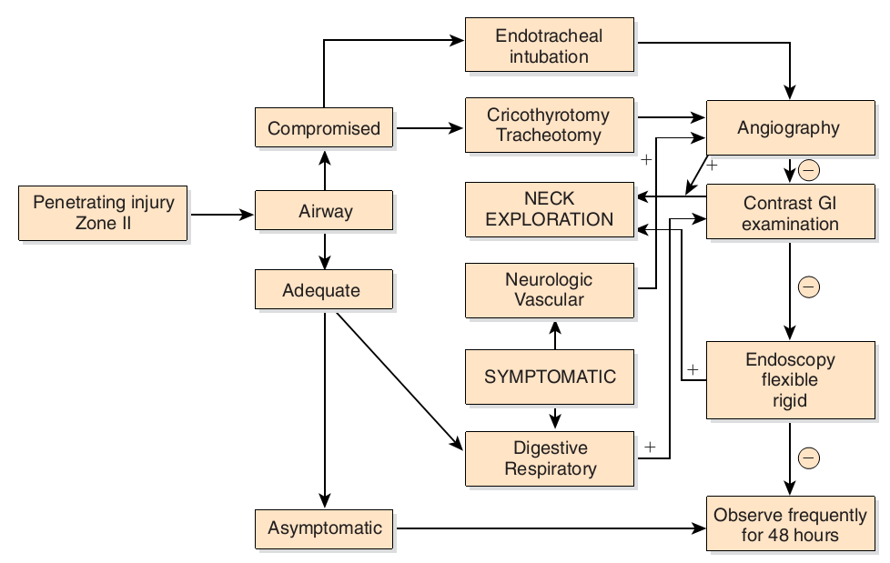
Management of Penetrating Zone II Injury
Notes:
Certain indications for an angiogram in zone II injuries include a stable patient who has persistent hemorrhage or
neurologic deficits compatible with adjacent vascular structure damage. An example of this is a Horner’s syndrome indicative of
sympathetic nerve plexus injury or hoarseness indicating a recurrent laryngeal nerve injury. This neurologic picture suggests that the carotid sheath has been violated, and vascular integrity needs confirmation by angiography, as well as frequent close observation to detect for a lacer-ated carotid artery, intimal tear, or pseudoaneurysm

Slide 18
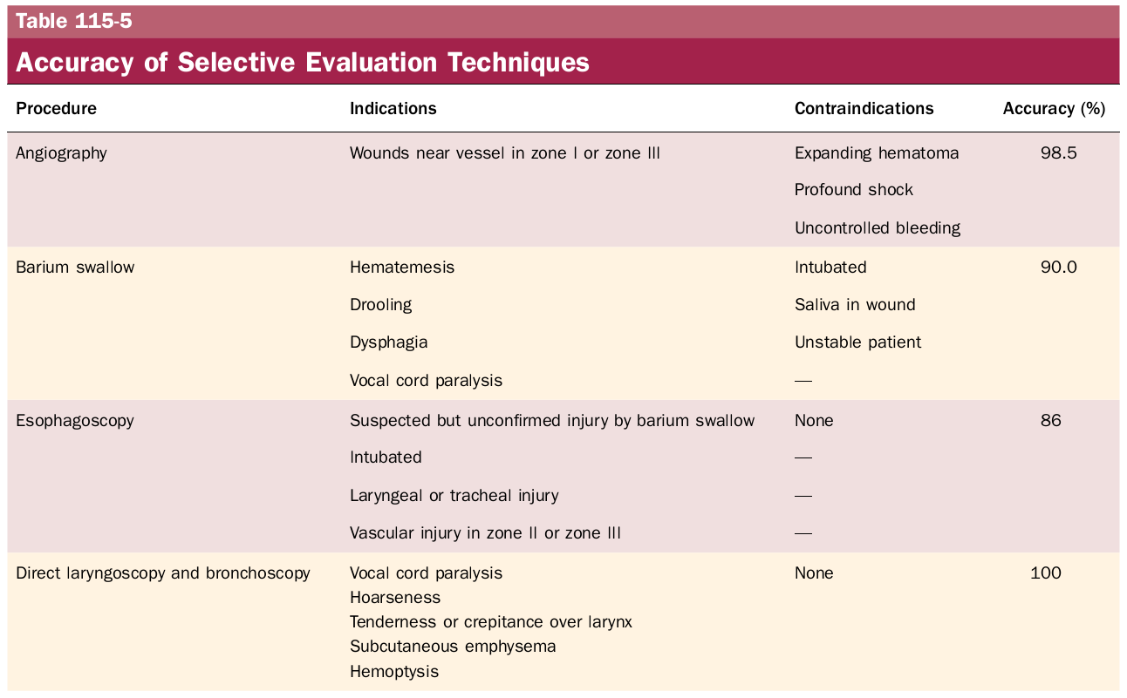

Slide 19
Vascular Penetration
Zone I
Thoracic surgery
Zone III
Temporary pressure or carotid arterial bypass
No. 4 Fogarty catheter
Jugular
Ligation
Carotid
Ligation of ECA
Lateral arteriorhaphy, end-to-end anastomosis, autogenous grafting
IR transcatheter arterial embolization

Slide 20
Digestive Tract Injury
Gastrograffin swallow
Barium swallow
Flexible esophagoscopy (risk of missing perforations near CP and hypopharynx)
Rigid esophagoscopy
Neck exploration for subQ emphysema or mediastinitis; localization with methylene blue
Management of esophageal injury
2-layer closure with wound irrigation, debridement, drainage, possible muscle flap
Lateral cervical esophagostomy, later definitive repair
Notes:
Many studies report the use of flexible esophagoscopy to circum-vent the need for general anesthesia during rigid endoscopy. However, several authors have reported a missed perforation near the cricopha-ryngeus, as well as the hypopharynx, where flexible endoscopy is least satisfactory due to mucosa redundancy. Missed esophageal tears represent most of the delayed injuries and, when they progress to mediastinitis, morbidity and mortality are considerable

Slide 21
Laryngotracheal Injury
Repair mucosal lacerations within 24 hours
Soft laryngeal stent for badly macerated mucosa
6-week trach below or through the injury for significant injuries that detach a tracheal ring or encroach on the airway
Notes:
Scarring can affect airway and voice

Slide 22
Blunt Neck Injury
Occult cervical spine injury
Delayed onset of signs and symptoms
Careful observation
Thrombosis, intimal tears, dissection, pseudoaneurysm

Slide 23
Cummings Ch 116: Differential Diagnosis of Neck Masses

Slide 24
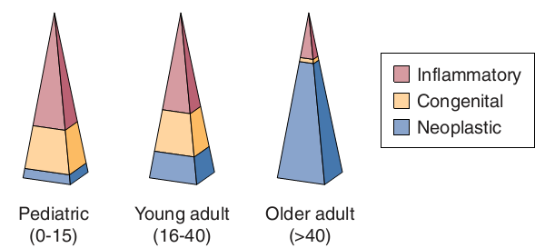
Neck Masses
History (time course, risk factors, symptoms)
Physical exam (full head and neck exam, flexible laryngoscopy)
Imaging

Slide 25
Imaging of Neck Masses
Modality | Basic Indications
Ultrasound | Good for pediatric neck masses, thyroid masses. Differentiates cystic versus solid.
Computed tomography | Workhorse imaging modality for adult neck masses. Provides 3D relationships, excellent detail of mucosal disease and involvement of adjacent bone.
Magnetic resonance imaging | Superior soft tissue delineation. Good for lesions of the salivary glands and tongue (where dental amalgam may obscure the view on a CT). Modality of choice for determining nerve enhancement. Consider for thyroid imaging in cases necessitating radioiodine.
Radionuclide scanning | Useful for midline lesions in children—differentiates functioning from nonfunctioning tissue.
PET | Useful for staging of head and neck malignancies. Can be used in cases of unknown primary malignant neck masses or treated neck disease.
Angiography | Useful for lesions encasing the carotid and vascular lesions. Conventional angiography should be considered for preoperative assessment in cases of potential carotid artery sacrifice or where embolization is required.

Slide 26
Initial workup
Antibiotic trial
Further investigation for concerning signs/symptoms
Unilateral, enlarging, asymmetric, supraclavicular fossae, not associated with infections
Imaging
Biopsy
FNA (gold standard), repeat FNA, core needle biopsy, open biopsy, neck dissection (SCCA)

Slide 27
Inflammatory Neck Masses
Lymphadenopathy/lymphadenitis
Staph, Strep, HIV, lymphoma
Granulomatous disease
TB, MAI, actinomycosis, cat-scratch, syphilis
Sialadenitis/sialolithiasis
Purulent material expressed from ducts
Notes:
Diffuse lymphadenopathy is common in patients with human immunodeficiency virus, but a growing or domi-nant mass should raise suspicion for lymphoma

Slide 28
Congenital Neck Masses
Rule out malignancy in adults
Thyroglossal duct cyst
Midline neck mass that elevates with tongue protrusion or swallowing
Rule out median ectopic thyroid
Sistrunk procedure
Branchial cleft anomalies
Cyst, sinus, or fistula
1st arch (1%), 2nd arch (95%), 3rd and 4th arch (rare)
Complete excision of the tract

Slide 29
Congenital Neck Masses
Dermoid cyst
Trapped rests of epithelial elements
Ectoderm and endoderm
Teratomas
Ectoderm, mesoderm, endoderm
Lymphangiomas
Soft, compressible, 50% present at birth
Hemangiomas
Soft, compressible, bluish-purple, thrill/bruit, 50% regress by age 5

Slide 30
Primary Neoplasms of the Neck
Lymphoma
Most common H&N malignancy in children
80% of HL have cervical disease
33% of NHL have cervical disease (90% B-cell)
Thyroid neoplasms
90% of thyroid nodules are benign
Salivary gland neoplasms
80% parotid, 15% SMG
Notes:
Schwannomas can occur in the cranial nerves, sympathetic trunk, or spinal nerve roots. These
lesions are best imaged by CT or MRI; they are enhancing and will often demonstrate areas of cystic degeneration.
When located in the carotid sheath, schwannomas will displace the internal and external carotid arteries anteriorly, a feature distinguishing them from carotid body tumors. These lesions can be difficult to diagnose by FNA because FNAs typically reveal bland spindle cell cytology and can be confused with other soft tissue tumors.
Schwannomas can manifest as cranial nerve deficits of the involved nerves and are typically painful on
attempts at FNA biopsy
Neurofibromas should be considered in their association with von Recklinghausen’s disease (NF-1). Most patients with NF-1 present with diffuse or plexiform neurofibromas. There is a 2% to 6% incidence of malignant degenera-tion into or de novo generation of malignant peripheral nerve tumors for patients with neurofibromas associated with NF-1.
Paraganglia are collections of cells of neuroectoderm origin that secrete catecholamines. They have an important functional role during embry-ogenesis, when they serve as the major source of catecholamines. After birth, most paraganglia rests disappear, with the exception of the adrenal medulla and the sites around the autonomic nervous system.
In the adult the function of the paraganglia is to help the autonomic nervous system respond to stressors such as hypercapnia, hypoxia, or decreasing pH

Slide 31
Primary Neoplasms of the Neck
Neurogenic neoplasms
Schwannoma (most common), neurofibromas, malignant peripheral nerve sheath tumors, neuromas
Paragangliomas
Neuroectoderm origin, secrete catecholamines
Carotid body, jugulotympanic region, vagus nerve
10% autosomal dominant/syndromic, 10% multicentric, <10% malignant
Salt and pepper appearance on T1-MRI
Lipomas
Mostly in posterior neck

Slide 32
Unknown Primary SCCA
Thorough physical exam
Imaging of the head, neck, and chest
Panendoscopy and biopsies (BOT, tonsils, NP, HP)
Notes:
The ipsilateral tonsil has been found to harbor the occult primary in 20% to 40% of cases of unknown primary squamous cell carcinoma of the neck as reported in several series in the literature. The next most common subsite is the base of tongue

