Slide 1



A Novel Modular Polymer Platform
for the Treatment of
Oral and Head And Neck Carcinoma
MAIE A. ST. JOHN, MD, PHD
Department of Head & Neck Surgery
David Geffen School of Medicine, UCLA
Jonsson Comprehensive Cancer Center

Slide 2

The Preschool Years

Slide 3

The Incredible Egg . . .

Slide 4
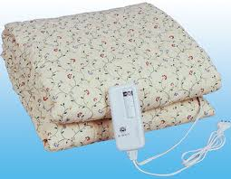
+
=

Slide 5


Slide 6

However . . .

Slide 7

The Oreo . . .

Slide 8


+
+
=

Slide 9


Slide 10


Slide 11
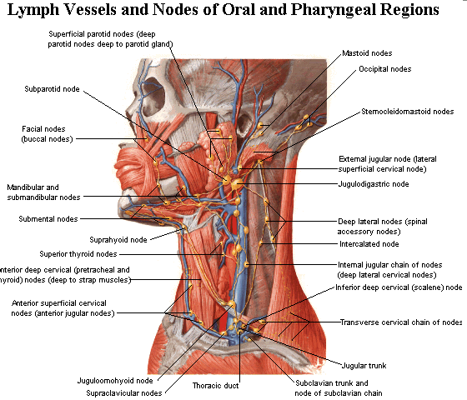
Why Oral and Head and Neck Cancer?
PhD years
surgery and cancer
anatomy intricate and personal

Slide 12
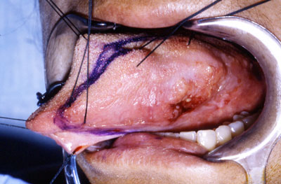
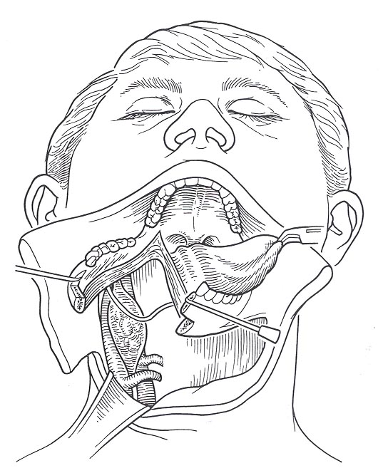
OSCC
Aggressive surgical resection cornerstone of treatment
Disfiguring
Quality of Life

Slide 13


Surgery Can Be Disfiguring

Slide 14
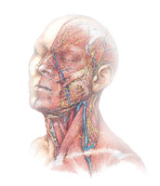
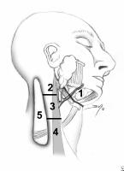
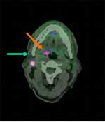
OSCC
Despite advances in surgical techniques and chemoradiation:
Past 30 years, 5 year survival rate with advanced SCC poor (20-30%)
50% of patients fail primary management
Recur at primary site or lymphatics
Presence of metastatic SCCA in LNs: correlates with 50% decrease in survival

Slide 15
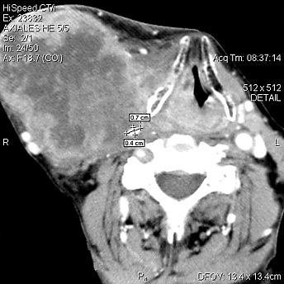
OSCC
Standard of care: Surgical Salvage
Resectability
Proximity to vital structures (ICA, skull base)

Slide 16
Recurrent Oral and Head & Neck SCCA
Palliation:
Radiation Therapy:
Many patients receive RT as definitive or adjuvant therapy
Retreatment a challenge
Chemotherapy:
Systemic Toxicity
Efficacy
Poor quality of life
New advances needed for effective treatment

Slide 17
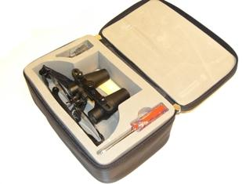
?

Slide 18
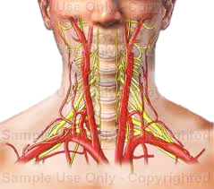
The Polymer Platform
The Clinical Problem:
patients with advanced or recurrent OSCC:
tumor is fixed to the underlying vital structures
surgery becomes cytoreductive rather than ablative and curative.
Polymer Platform:
most oral and head and neck cancers and their cervical metastatic nodes are clinically accessible
local treatment with a polymer matrix will have significant clinical applications.
treat recurrent tumors refractory to multimodality therapy, or as a concurrent treatment with radiotherapy to augment its response.

Slide 19
The Polymer Platform
Polymer technology for Drug Delivery evolved since 1990:
Tx: neoplasms, brain disorders, infections
Harness the power of the polymer system further
Beyond its capacity as a drug delivery system

Slide 20
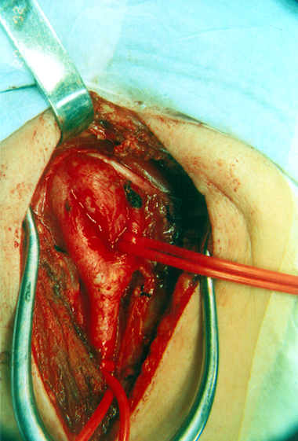
Goals
The polymer system as a modular platform
Facile application
Serve as a mechanical barrier to early metastasis and angiogenesis
Incorporate a radiosensitizer
Incorporate a radioopaque tracer (tantalum)
Evaluate recurrence by volume averaging on CT scan
Function as a platform to deliver immunomodulators

Slide 21
Polymer Platform Design
First week
After 4-6 weeks
Cisplatin
Cisplatin
CCL-21
Impermeable Backing Film Non-porous, radiopaque, > 4-6 wks degradation
Initial Release
Micro-porous gel, <2 wks degradation
Intermediate Release
Macro-porous matrix, 4-6 wk degradation
Degradation of the Impermeable Backing Film

Slide 22
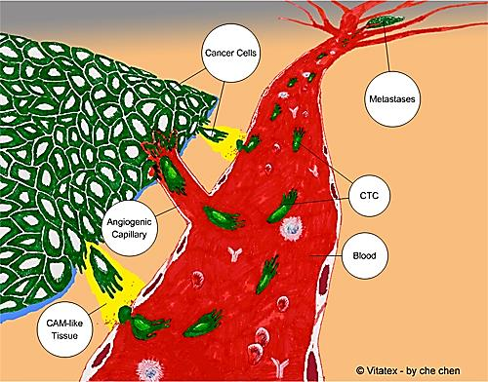
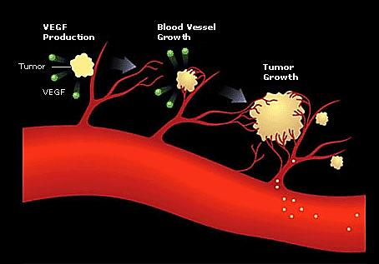
The Polymer Platform as a Mechanical Barrier
Prevent initial metastasis while cells are fragile
Prevent ingrowth of vasculature (angiogenesis)

Slide 23
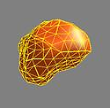
The Polymer Platform in Monitoring Tumor Recurrence
Tantalum
Volume averaging

Slide 24
The Polymer Platform as a Radiosensitizer
Delivery of a lethal dose of RT to a tumor while sparing nearby tissues
Chemotherapeutic agents as radiosensitizers (Cisplatin)
Enhanced tumor cell killing without increased normal tissue toxicity
Maximizing drug concentration in tumor microenvironment and minimizing systemic drug distribution

Slide 25
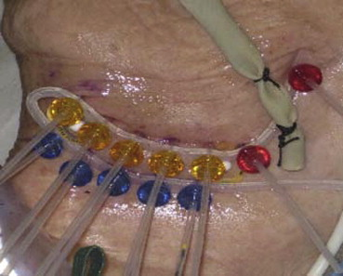
The Polymer Platform as a Radiosensitizer
Advantages of polymer over Brachytherapy
Eliminates radioprotection issues for patient and their family
Psychosocial: daily activities not limited

Slide 26
The Polymer Platform in Immunomodulator Delivery
Increase the efficiency of tumor cell killing by the host’s immune system
Combinations of immunomodulators and drugs
identify ideal synergistic combinations
dissect the mechanisms of interrelated pathways

Slide 27
Immunomodulators
HNSCC patients:
Documented local immunosuppression: T cells and NK cells
Gene therapy: largely remains limited
Major limitation for clinical use of cytokines:
Lack of an effective protocol for local and sustained release.

Slide 28
CCL21
CCL21 (secondary lymphoid chemokine, SLC):
recruit DC, T, NK and NKT cells
distinctly advantageous because of its capacity to elicit a type I cytokine response in vivo
Our group demonstrated previously that CCL21 administered intratumorally elicits potent antitumor responses in murine cancer models
substantiated by other groups in lung and colon cancer models
In addition to its immunotherapeutic potential, CCL21: potent angiostatic effects
additional support for its use in cancer therapy.

Slide 29
Import of the polymer system as a modular system
Modular platform can serve to limit the recurrence of OSCC by attacking the cancer cells in several ways.
a chemotherapeutic agent: effectively kill tumor cells in the proximity of the polymer application
platform to deliver immunomodulators
Elegant approach to future dosing modifications and device improvements
Incorporate changes into one layer without altering the chemical-physical properties of the other layer
Robust design
Enable dissection of underlying mechanisms of immune activation and expansion,
design additional strategies to block the inactivation and death of the cytotoxic effectors

Slide 30
The Problem in a Nutshell
How do we make the future better?

Slide 31
Hypotheses
The local delivery of chemotherapeutic agents will enhance tumor reduction
The local delivery of immunomodulators will increase the efficiency of tumor cell killing by the host’s immune system
The modular nature of our polymer platform will allow us to customize it for individual patient tumors

Slide 32
Specific Aims
Specific Aim 1. Determine the efficacy of the polymer as a platform for chemotherapeutic delivery in combination with Radiation Therapy
Specific Aim 2. Determine the efficacy of the polymer as a platform for immunomodulator delivery in the presence of Radiation Therapy
Specific Aim 3. Customize the Polymer for Individual Patient Tumors

Slide 33
Specific Aims
Specific Aim 1. Determine the efficacy of the polymer as a platform for chemotherapeutic delivery in combination with Radiation Therapy
Specific Aim 1a. Determine the release kinetics of cisplatin under the influence of ionizing radiation.
Specific Aim 1b. Assess the in vivo efficacy of the Chemotherapeutic Layer of the polymer, in combination with radiation treatment
Cisplatin

Slide 34
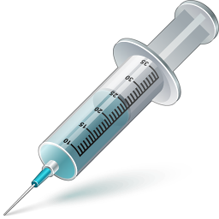
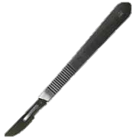

Experimental Model
Day 0
tumor cell injection
Day 7-10
(tumor 1 cm²)
debulk surgery / polymer
monitoring

Slide 35
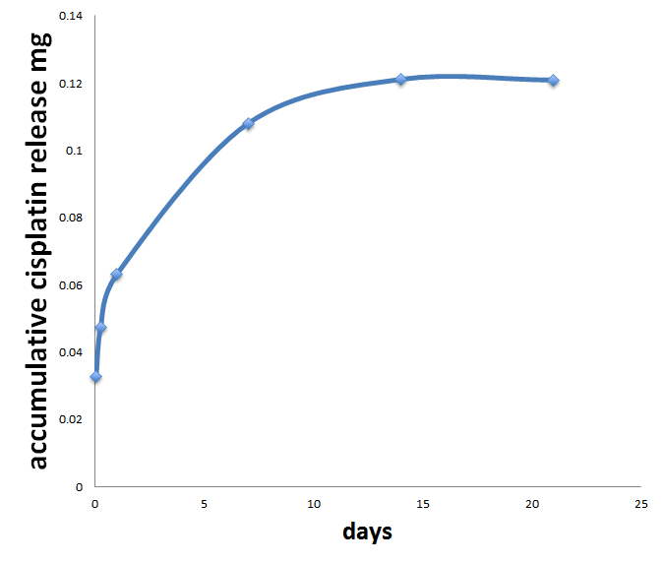
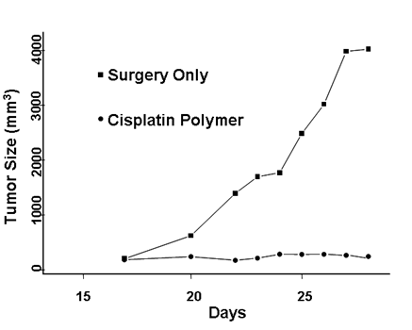
Cisplatin Polymer Effectively Reduces the Growth OSCC in Mouse Model
(Hu, 2012)

Slide 36
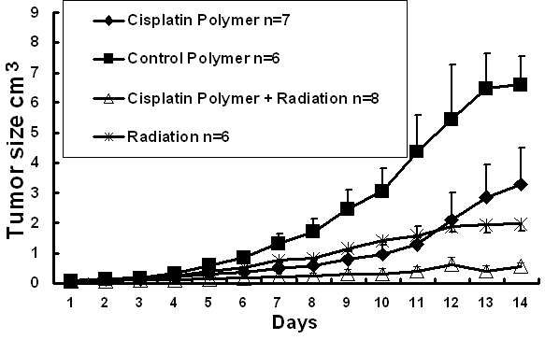
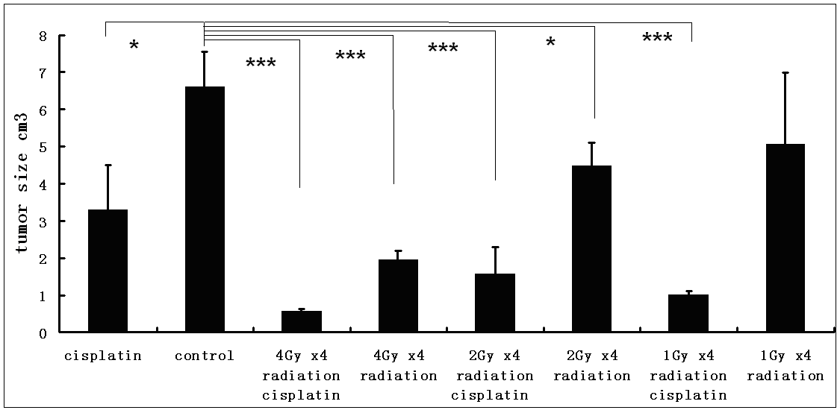
Cisplatin Secreting Polymer Enhances the Efficacy of Radiation Therapy
A
B

Slide 37
Decreased RT is required in the presence of Cisplatin Polymer
2
8
6
1
4
5,7
3

Slide 38
Specific Aims
Specific Aim 2. Determine the efficacy of the polymer as a platform for immunomodulator delivery in the presence of Radiation Therapy
Specific Aim 2a. Determine the release kinetics of the immunomodulators (CCL21) under the influence of ionizing radiation.
Specific Aim 2b. Assess the in vivo efficacy of the bilayer polymer (Chemotherapeutic and Immunomodulator layers), in combination with radiation treatment.

Slide 39
DC-CCL21 Polymer
Tumor
Dendritic Cells

Slide 40
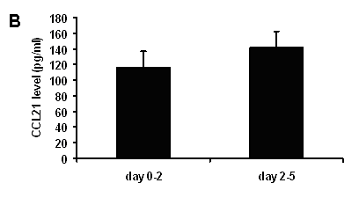
DC-CCL21 cultured in the polymer is capable to producing CCL21 in vitro
Time dependent continuous release of CCL21 from DC-CCL21 in polymer

Slide 41
CCL21 release kinetics from polymer

Slide 42
Polymer-based DC-CCL21 treatment inhibits tumor growth

Slide 43
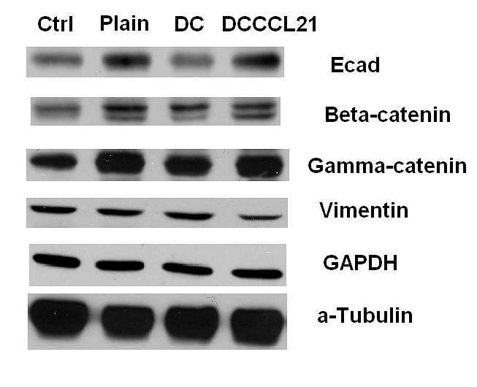
DC-CCL21 treatment inhibits EMT in squamous cell tumors

Slide 44
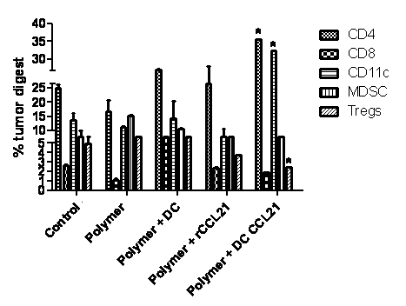
DC-CCL21 Decreases Tregs in tumors
Animals receiving DC-CCL21 polymer therapy exhibited a significant increase in the frequency of CD4+ T cell and CD11c+ dendritic cells, as well as a marked decrease in CD4+CD25+ regulatory T cells infiltrating the tumor site.

Slide 45
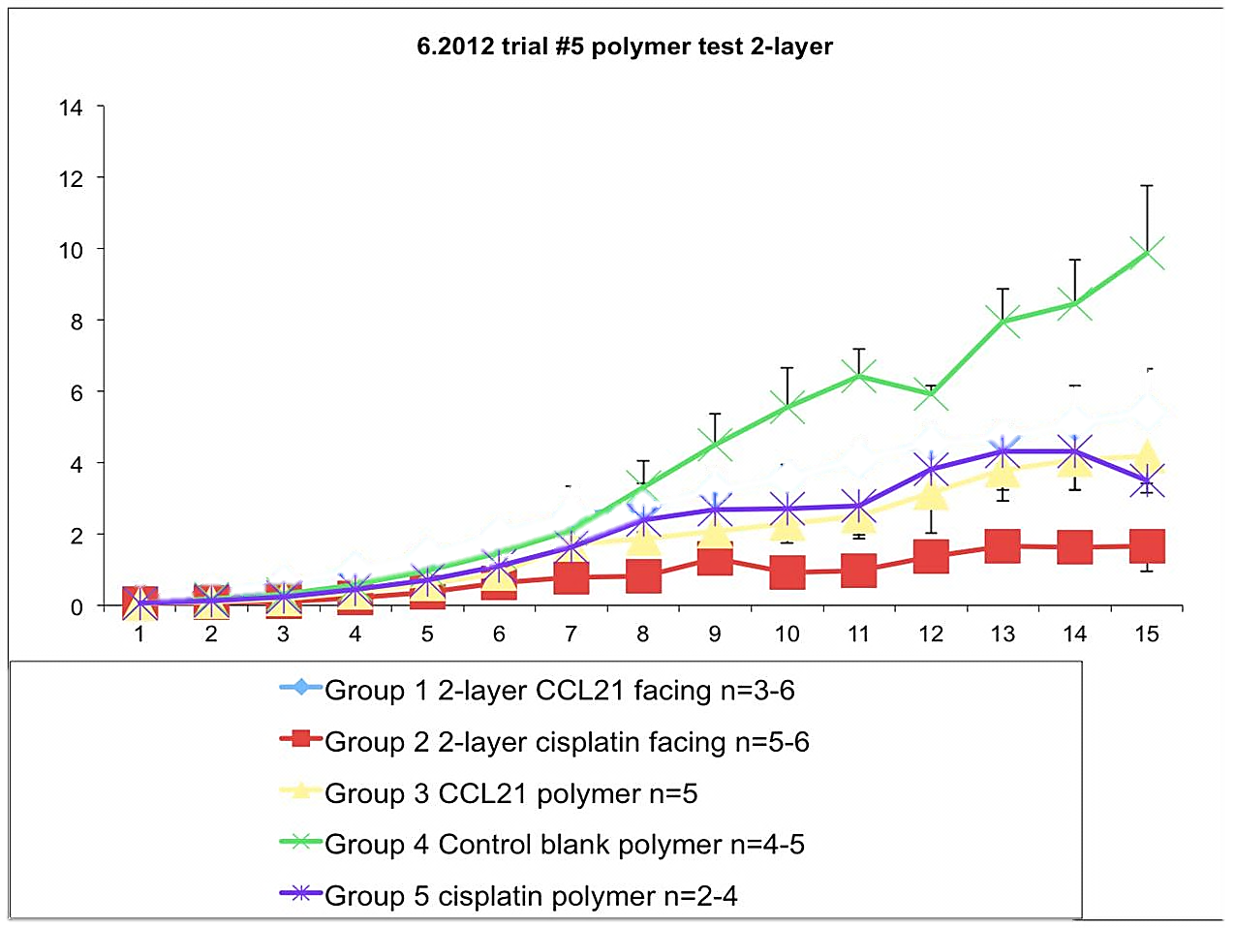

Concomitant CCL21 and cisplatin secreting polymer further reduced tumor burden
Blank polymer
CCl21 polymer
Cisplatin polymer
Cisplatin / CCL21 polymer

Slide 46
Summary of Findings
The local delivery of Cisplatin significantly reduces tumor burden and decreases the dosage of RT required.
The local delivery of CCL21 significantly reduces tumor burden by increase the efficiency of tumor cell killing by the host’s immune system
Polymers with a combination of Cisplatin and CCL21 further reduce tumor burden.
The modular nature of our polymer platform will allow us to customize it for individual patient tumors

Slide 47
Specific Aims Future Directions
Specific Aim 3. Customize the Polymer for Individual Patient Tumors
Modular polymer platform
We will use the DCTD (Division of Cancer Treatment and Diagnosis) approved oncology drugs to screen against a panel of established and primary (obtained from our patients) human oral cancer cell lines.
Tumor

Slide 48
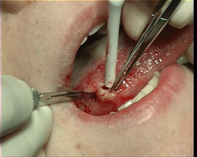
Custom Made Polymers
Patient has biopsy done and tumor screened for its drug sensitivity profile
Immune boosting agents and specific drugs that work against that patient’s specific tumor are layered onto the polymer
The polymer is applied at the time of surgery

Slide 49

Clinical Trial
optimized and validated our cisplatin polymer in mouse model
plan a prospective trial in patients with unresectable SCC
10-15 patients with end stage unresectable oral or head and neck cancer.
debulking surgery
polymer application
low dose of RT
GMP grade polymers that are identical from batch to batch.
modular nature of this polymer platform
incorporate changes into one layer without altering the chemical-physical properties of the other layer.
intervention that warrants larger scale research efforts or multi-site clinical trials.

Slide 50
“My husband, Rick, says I’m in the business of putting myself out of business. If that happens in my lifetime, I would be thrilled!”

Slide 51


Conquer cancer and build a better future

Slide 52
Acknowledgements
Steven Dubinett, MD
Mariam Dohadwala, PhD
Jie Luo
Guanyu Wang MD, PhD
Ontario Lau
David Hu
Yuan Lin, PhD
Chi Lai, MD
Miranda Dennis
Elliot Abemayor MD, PhD
David Elashoff, PhD
Cun-Yu Wang, DDS, PhD
Benjamin Wu, DDS, PhD
J. Silvio Gutkind, PhD
James Economou. MD, PhD
Sherven Sharma, PhD
Gerald S. Berke, MD
The Patients
Rick, Zane, Jude & Adam St. John

