Slide 1


Family Medicine Research Unit
Monthly Meeting
December 2022
Laura Sheehan
Manager of Research Administration, Dept. of Family Medicine

Slide 2
Recently Processed Awards
PI | Award Title | Sponsor | Prime Sponsor | Action Type
Gelberg, Lillian | Disparities in Rates & Impact of Tobacco and Marijuana in UCLA Primary Care | UC TOBACCO-RELATED DISEASE RESEARCH PROGRAM | - | Continuation
Donohoe, Thomas J | Pacific AIDS Education & Training Center | UNIVERSITY OF CALIFORNIA, SAN FRANCISCO | DHHS-HRSA | Continuation
Shoptaw, Steven J | Screen, Treat and Retain Meth-Using Opioid Drug Users at Methadone Clinics (STAR-OM) | Hanoi Medical University (Vietnam) | NIH-NIDA | Continuation
Clark, Jesse Lawton | Mirtazapine for Methamphetamine Use Disorder: Drug-Drug Interaction Study | HELUNA HEALTH Formerly PUBLIC HEALTH FOUNDATION ENTERPRISES, INC. | NIH-NIDA | No Cost Extension
Tarn, Derjung | The MUM Study: MUltimorbidity and Medications: The Unheard Perspective of Older Adults | UNIVERSITY OF CALIFORNIA, SAN FRANCISCO | DHHS-FDA | Continuation
Shoptaw, Steven J | Center for HIV Identification, Prevention and Treatment Services | NIH-NIMH National Institute of Mental Health | - | Modification/Amendment
Kalmin, Mariah Mattera | Phenotyping Substance Use Disorder | UNIVERSITY OF ROCHESTER | - | New
Moreno, Gerardo | Path to Health Pilot Project (Phase 2) | County Medical Services Program | - | New
Shoptaw, Steven J | CTN-0110 Randomized, Double-Blind, Placebo-Controlled Trial of Monthly Injectable Buprenorphine (BUP) for Methamphetamine (MA) Use Disorder (MURB) | University of Texas-Southwestern Medical Center at Dallas | NIH-NIDA | New

Slide 3
Recently Submitted Proposals
PI | Sponsor | Prime Sponsor | Proposal Type
Uskup, Dilara | UC TOBACCO-RELATED DISEASE RESEARCH PROGRAM | - | New
Gelberg, Lillian | UC TOBACCO-RELATED DISEASE RESEARCH PROGRAM | - | Resubmission - New
Gelberg, Lillian | UNIVERSITY OF CALIFORNIA, SAN FRANCISCO | UC TOBACCO-RELATED DISEASE RESEARCH PROGRAM | New

Slide 4
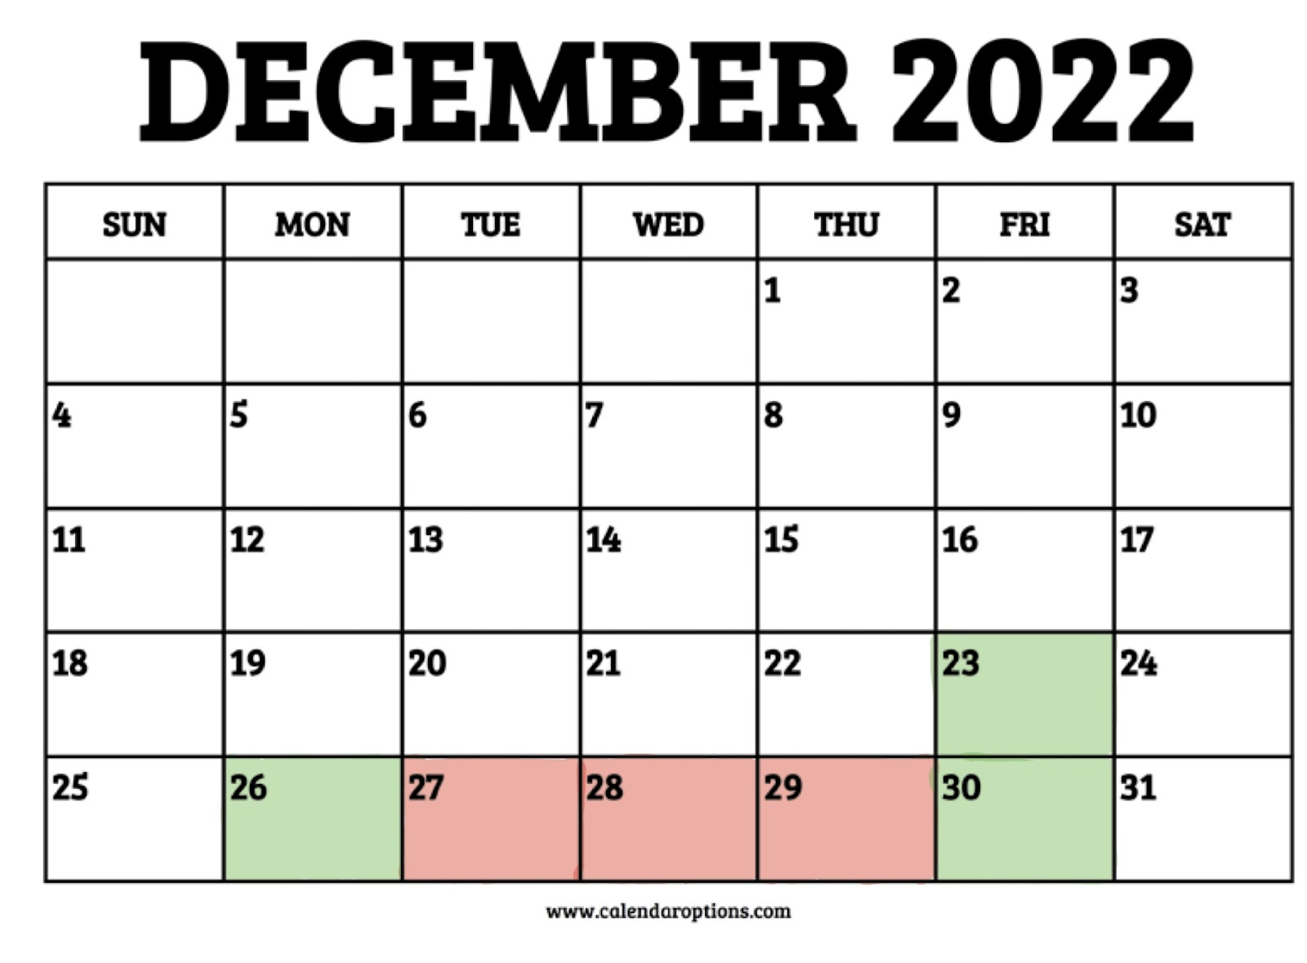
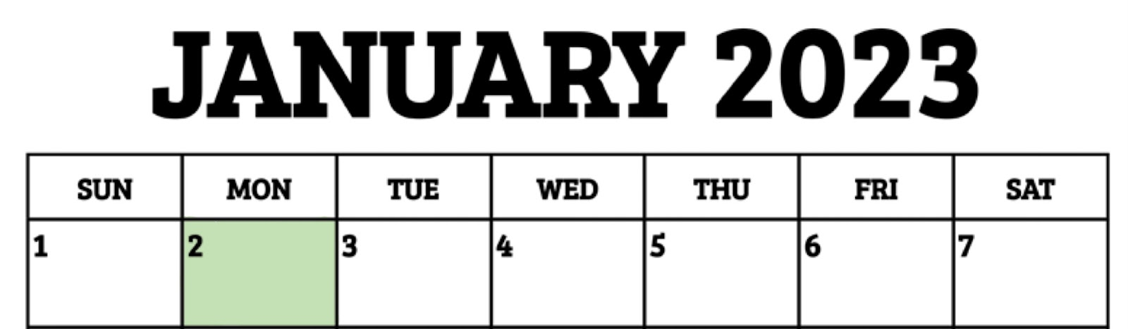
Winter Closure
CLOSED Dec. 23, 2022 through Monday, Jan. 2, 2023
Reopens on Tuesday, Jan. 3, 2023
Staff should use vacation hours for Dec. 27-29
Dec 23, 26, 30, and Jan 2 are paid holidays

Slide 5
Updated COVID Guidance for Supervisors
If your employee tests positive for COVID:
o Please have them call the COVID Call Center at (310)267-3300
o Employee must follow the guidance provided by the Call Center
o Emergency paid sick leave: up to 80 hrs for COVID diagnoses. COVID Leave of Absence Notification (COVID LOAN) can be requested at: https://hshr.mednet.ucla.edu/s/loanote/request/
o After any required isolation/time off, employees should complete the Daily Survey before returning to work
For more information, please visit the COVID home page or reach out to Monica Bolanos in Staff HR.

Slide 6

Password Compliance
1. **REQUIRED** Check compliance status: https://changepassword.mednet.ucla.edu/
2. Change your password if it does not pass
3. If you need to change your password, your new password/passphrase must:
Be at least 14 characters in length.
Be rated Strong/Very Strong and not considered compromised.
Contain 3 of the following:
  Number (0-9)
  Lower case letter (a-z)
  Upper case letter (A-Z)
  Special characters (e.g. !#$%^&*)

Slide 7

Continued
Important: In order to avoid lockouts after changing your password/passphrase, update credentials anywhere it may have been saved (e.g., browsers, mobile devices, wireless networks, apps, mac keychain).
If your password is not compliant with the new requirements, you will be scheduled for a forced reset in early 2023.

Slide 8
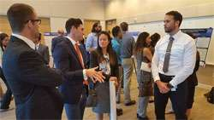
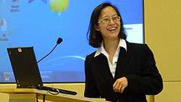
Research Day Updates
2023 Meeting Information
In-person at the California Endowment (Center for Healthy Communities Los Angeles): 1000 North Alameda Street, Los Angeles, CA 90012
Wednesday, May 10, 2023
Morning Faculty Development Session (invitation only)
Main Research Day activities will be held in the afternoon
Abstract Submission
Abstracts will be due April 7, 2023.
More details to be announced after winter break

Slide 9
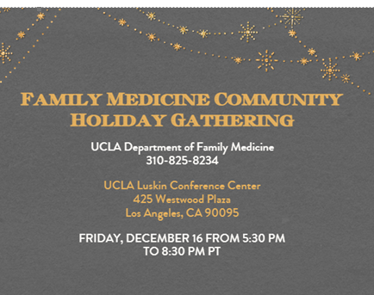
Holiday Gathering
Friday, December 16th from 5:30-8:30pm
UCLA Luskin Conference Center
RSVP by Friday, December 9: http://evite.me/kNBFdYXCCa (include your first and last name and email address when you respond)

Slide 10

Monthly Research Unit Meetings
Starting in February 2023, we ask that Research Unit employees start attending the monthly meeting in person
This allows us to work in the office together at least once a month
Refreshments will be provided
Zoom/Call-in will still be available, but
should not be your primary mode of
participation

Slide 11
Family Medicine Grand Rounds
Monthly on the 4th Friday of the month
12:00pm – 1:00pm
Starting January 2023
Everyone invited, including affiliated residencies, research unit, clinical personnel, etc.
Email with further information will be forthcoming

Slide 12
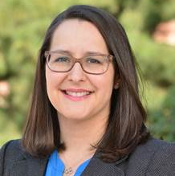
Justice, Equity, Diversity, and Inclusion
Dr. Yelba Castellon-Lopez
Director of JEDI
Department of Family Medicine

Slide 13
Increase in Meal Rates
Travel Meals
The Meal and Incidental Expenses (M&IE) Reimbursement Cap is the maximum amount authorized for the daily meal and incidental expenses established by the University.
Applies to any business travel of less than 30 days in the continental United States
The maximum M&IE rate for the Fiscal Year 2022-2023 is $79.00 and is based on the highest per diem rate available for all UC locations as published by US General Services Administration for Fiscal 2023.

Slide 14
Increase in Meal Rates
Entertainment Meals
The maximum meal rates for entertainment and business meeting meals have been increased in response to soaring food prices.
The new rates are as follows:
Breakfast $31
Lunch $54
Dinner $94
Light Refreshments $22
As a reminder, these amounts include the cost of food and beverages, labor, sales tax, service, and delivery charges

Slide 15

Travel Reimbursements
Concur/Travel Express
New system was supposed to make it easier for travelers to create their own reimbursement reports

Slide 16
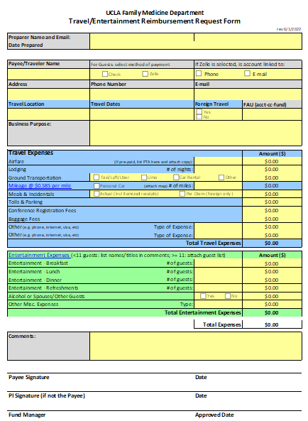
Travel Reimbursements
Submit Form Like the Old Days
Save your receipts
Complete Travel Reimbursement Form
Obtain PI or Approver approval
Submit to Fund Manager
Valencia will submit via Concur/Travel Express, will contact you when done
TRAVELLER MUST THEN “SUBMIT” REPORT IN CONCUR
NOTE: Guests do not need to register for PaymentWorks

Slide 17
POLL – BEST HOLIDAY MOVIE

Slide 18
New NIH Data Management and Sharing Policy
To encourage the management and sharing of scientific data produced by NIH-funded or carried out research
Effective Date is January 25, 2023 for all submitted proposals
Requires submission of a plan outlining how scientific data and any accompanying metadata will be managed and shared, taking into account any potential restrictions or limitations.
The NIH may request additional information to be included within the Plan in order to meet expectations for data management and data sharing
We have to include such a plan on all proposals and we have to comply with the plan once it is approved and awarded

Slide 19
New NIH Forms H
Due for applications due on/after Jan 25, 2023
Requires Data Management and Sharing Plan (next slide)
Budget: must include DMSP costs as an individual line item with justification

Slide 20
Upcoming NIH Virtual Courses (free)
December 6-7, 2022 12:00PM - 4:00PM
Human Subjects Research: Policies, Clinical Trials, & Inclusion
What are the basic HHS and NIH policies that apply to research involving human subjects, including clinical trials? How do you prepare a research proposal for review that addresses the regulatory requirements? What are some strategies for developing realistic and scientifically acceptable inclusion plans? Answers to these questions are just a few of the valuable take-aways you’ll gain from this event. HHS and NIH experts will share policies, resources, guidance, and case studies in this informative and engaging event.

Slide 21

Upcoming Guidance
Transcription purchases
Software purchases

Slide 22
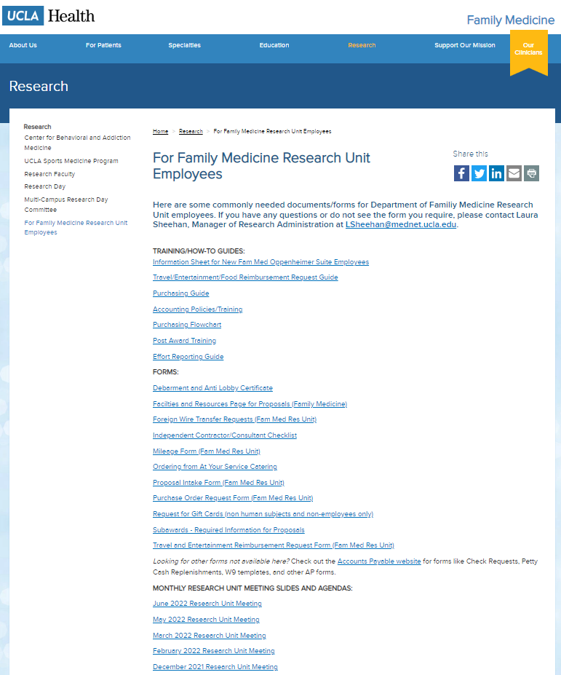
Meetings/Events
Staring in 2023: in person
January Meeting cancelled
Next Monthly Research Unit Meeting: Feb 2 IN PERSON
Prior monthly meeting agendas/slides will be available on the website

