Slide 1

New Research Faculty Onboarding
Laura Sheehan
Manager of Research Administration
Department of Family Medicine

Slide 2


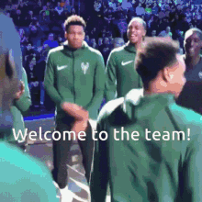




Slide 3
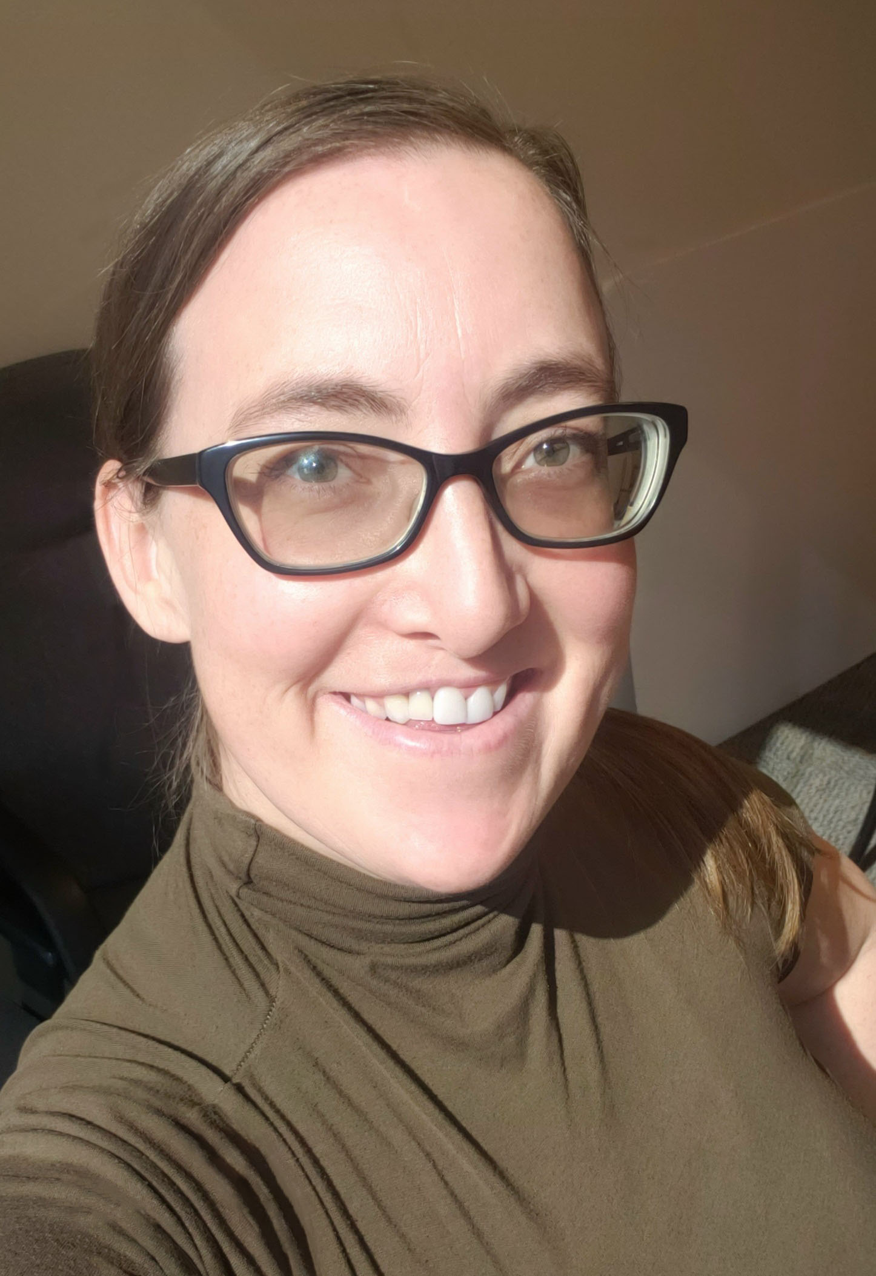
Laura Sheehan
Manager of Research Administration, Department of Family Medicine, David Geffen School of Medicine at UCLA
25 years in academic research administration
  3 years in Civil/Environmental Engineering research administration at University of Southern California (USC)
  10 years in Pediatric Infectious Diseases research and fellowship administration, and divisional financial management at UCLA
  12 years in Family Medicine research administration and financial management at UCLA
Management of approximately $10M in contract and grant funding annually
Department consistently ranks in top 10 nationwide for federal funding among all Family Medicine Departments

Slide 4

National Ranking
UCLA Department of Family Medicine ranked #4 nationwide among all Fam Med departments for federal research funding (Blue Ridge Rankings)
Year | Rank | Amount
2024 | 5 | $4,207,964
2023 | 4 | $5,044,646
2022 | 7 | $3,855,041
2021 | 7 | $3,470,049
2020 | 8 | $3,018,776
2019 | 8 | $2,849,051
2018 | 2 | $4,775,715
2017 | 3 | $4,878,450
2016 | 4 | $3,351,473
2015 | 10 | $1,797,066
2014 | 12 | $1,402,593

Slide 5
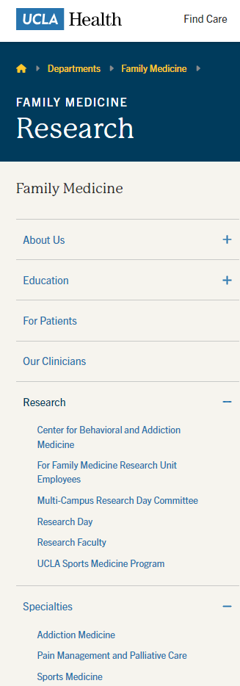
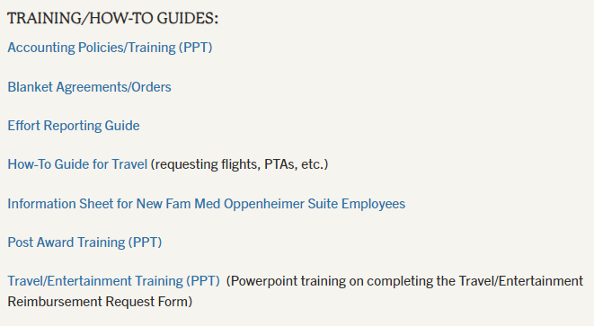
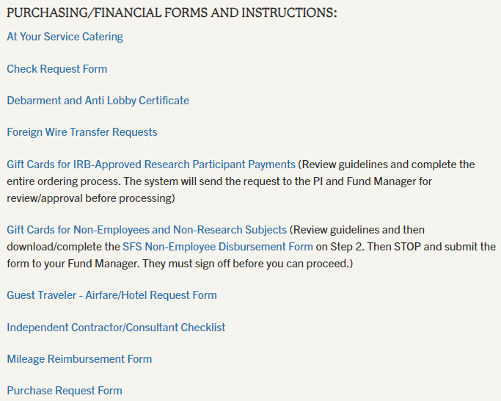
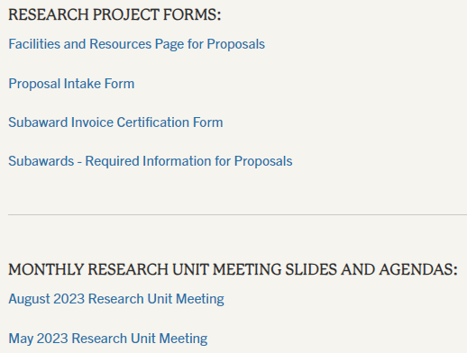
Website
https://www.uclahealth.org/departments/family-medicine/research

Slide 6
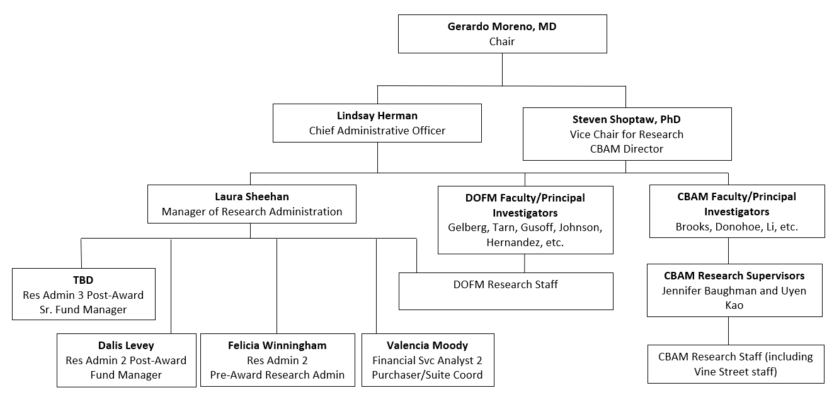
Research Unit Org Chart

Slide 7
What does the Research Unit Admin Team Do?
We provide administrative assistance to anyone who wants to conduct research in our department. Primarily that is research faculty, but it could also include students, residents, fellows, non-research faculty, and more.
Liaison with central offices or connect department personnel with the correct central office connections (e.g. OCGA, EFM, Purchasing, AP, etc.)
Pre-Award assistance (finding funding opportunities, creating proposals, navigating approvals/internal processes, crafting budgets, submission, etc.)
Post-Award assistance (allocating funds, approving purchases, running monthly internal financial reports, setting up subawards, financial reporting to sponsor, close-outs, etc.)
Training for anyone interested in conducting research
Manage various research-related activities (including monthly Grand Rounds, medical student Discovery Year, and resident Research Day)

Slide 8

Fam Med Research Unit Admin Team
Laura Sheehan: Oversees pre- and post-award management, finances and purchasing, training of faculty and staff, etc.
Felicia Winningham: Handles pre-award for all research personnel
Dalis Levey: Fund Manager responsible for post-award financial issues for our less complex contract & grant funds
Sr. Fund Mngr (TBD): Will serve as Sr. Fund Manager and will handle post-award financial issues for our more complex C&G funds and will provide guidance to the Fund Manager.
Valencia Moody: Oppenheimer Suite Coordinator and our main Fam Med Purchaser on the blended Peds/Fam Med Purchasing Team. Handles most FM purchasing, buying, and reimbursement issues.

Slide 9
ORCA
Office of the Vice Chancellor for Research & Creative Activities
ORA
Office of Research Administration
TDG
Technology Development Group
REO
Research Enhancement Office
RPC
Research Policy & Compliance
Manages most of the alphabet soup:
OCGA, EFM, OHRPP, ORIS, ORDM, and OBFS
Manages Industry (for profit) sponsored research, MTAs, patents, inventions, royalties, etc.
Limited submissions, funding opportunities newsletters and resources, UCLA Grand Challenges, etc.
Animal Research, Conflicts of Interest, Biosafety, Dual Use Review, Export Control, etc.

Slide 10
Pre-Award (non-industry sponsors)
OHRPP
Office of Human Research Protection Programs
OCGA
Office of Contract and Grant Administration
ORA
Office of Research Administration
EFM
Extramural Fund Management
ORIS
Office of Research Information Systems
Post-Award
ORDM
Office of Research Data Management
OBFS
Office of Business and Financial Services
Notes:
There is also the Clinical Trials Contracts and Strategic Relations Office

Slide 11
Pre-Award

Slide 12
Research Project Process
Idea
Find Funding
Develop Proposal
Route Proposal for Internal Approval
Authorized Official Submits Proposal
Award Processed
Initiate and Manage Project
Close-Out

Slide 13
Pre-Award PI Responsibilities:
Identifies research funding opportunity and READS THE SPONSOR GUIDELINES
Submitting Proposal Intake Form to Fam Med Pre-Award Administrator well in advance of the 5-business day deadline
Create budget and justification
Create all other proposal documents, including cover letter, abstract, research plan, specific aims, human subjects research plan, etc. in accordance with opportunity/sponsor guidance
Signs conflict of interest forms, EPASS, and any other necessary internal forms
Pre-Award Administrator assists with all items in yellow. Will also assist with creating the budget and budget justifications, coordinating subaward documentation, and will handle all internal forms and submission to the appropriate Central Office.
Central Office is responsible for reviewing for compliance, signing off as Authorized Official and submitting to sponsor (or giving us permission to submit).

Slide 14
Which central office handles proposals?
It depends on who the sponsor is and the type of proposal. It will be one of these three offices:
Sponsor | Project Type | Responsible Central Office
Non-Profit (e.g. govt) | All | Office of Contract and Grant Administration (OCGA)
For Profit / Industry | Non-Clinical Trial Contracts and Grants | Technology Development Group (TDG)
For Profit / Industry | Clinical Trials | Clinical Trials Contracts & Strategic Relations (CTC&SR)

Slide 15


Can I submit a proposal myself, without going through Fam Med or a central office like OCGA?
Nope. Don’t even think about it.

Slide 16
PI works with Pre-Award Admin to create proposal
Pre-Award Admin Submits to Central Office
Central Office reviews and replies to Dept with corrections (if needed)
Pre-Award Admin works with PI to respond
Central Office completes final review and AO signs off
Central Office obtains final PI approval to submit, or will tell Dept to submit
Proposal Process

Slide 17
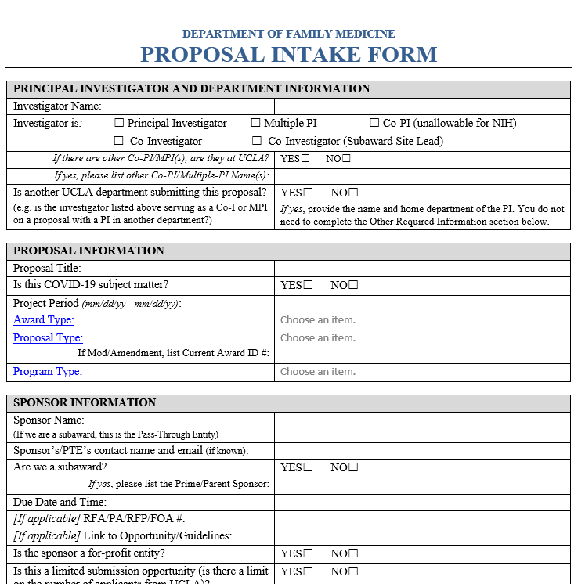
Internal forms
Proposal Intake Form
  Due to Pre-Award Admin at the start of pre-proposal process, the sooner the better
  Gathers basic data for planning purposes and for EPASS completion
EPASS (Extramural Proposal Approval and Submission Summary)
  Created by Pre-Award Admin and then submitted to Central Office, gathers info to ensure proper approvals/certifications are in place
  Used for institution-wide tracking and record-keeping
  Requires sign-off by PI and Chair/Dean

Slide 18
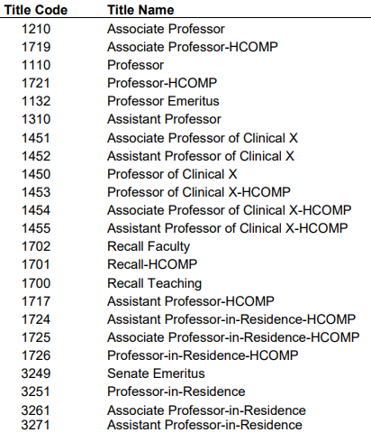
Internal forms
PI Exception Form
Faculty can serve as PI if they are members of the Academic Senate. Titles with Academic Senate Membership are in the table to the right.
Pre-Award Admin will submit the form if it is required, but since it requires signature from the Chair and Dean, the sooner the Intake Form is submitted, the better.
Conflict of Interest Forms (signed by all UCLA Key Personnel)
  Pre-Award Admin will let you know which one(s) are required:
  Federal PHS Sponsor/Prime: eDGE
  Federal non-PHS, CIRM, or UC RGPO/UCOP Sponsor/Prime: 740 and Suppl 740 Form
  Non-Government Sponsor/Prime: 700U and 700u Addendum
  (Exemptions: non-profit, tax-exempt educational institutions and Exempt Organizations)

Slide 19
Proposal Documents/Attachments
Budgets
Pre-Award Administrator can assist with creation of budget
We have Excel templates for most sponsors already, and can create new ones as needed
Budget Justifications
Pre-Award Administrator can assist with creating a skeleton justification, including standard language for common items
PI will need to provide detail for personnel (responsibilities on project) and less-common costs
Facilities and Resources Page:
Standard template is available on our website, can be customized as needed
Biosketches
PI/research staff are responsible for creating Biosketches, but Pre-Award Admin will review for compliance and formatting

Slide 20
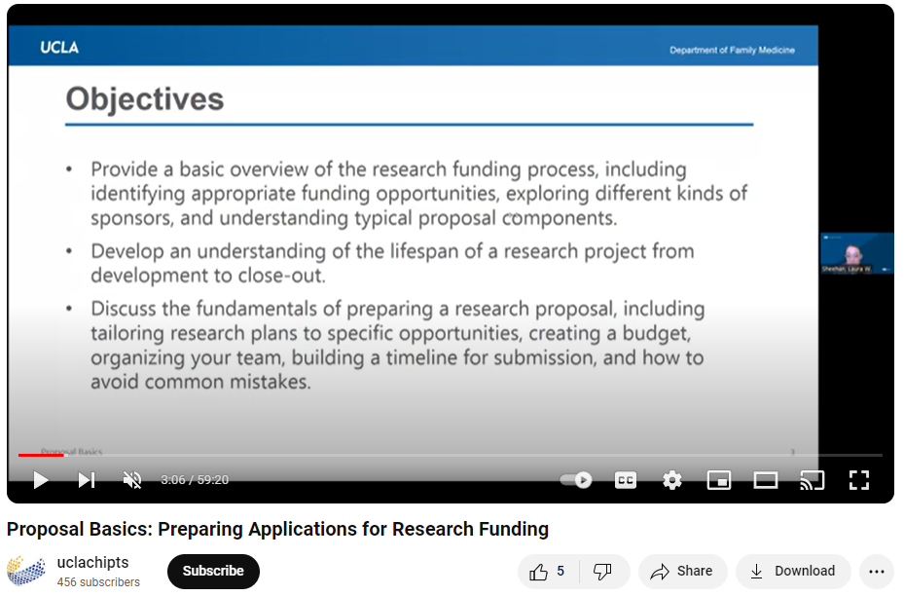
Interested in learning more about submitting proposals and building budgets?
  Proposal Basics: Preparing Applications for Research Funding – 60-minute video presentation providing basic overview of proposal process and basics.
  Building a Budget: Financial Basics for Research Proposals – 90-minute video presentation providing a more in-depth look into how to create a proposal budget.

Slide 21
Pre-Award Key Takeaways
Reach out to the Pre-Award Research Administrator as far in advance as possible.
Do NOT sign anything yourself unless you have been advised to do so by your Pre-Award Administrator or Central Office. No one in our department or even within DGSOM is an Authorized Official (AO) for our submissions.
When in doubt, reach out to the Research Unit Admin Team if you have questions.

Slide 22
Post-Award

Slide 23
How does the award get processed?
Sponsor sends Notice of Award (NOA) and Terms & Conditions to OCGA
OCGA reviews, redlines as needed, both parties eventually fully execute (FE) agreement
OCGA instructs ORDM to create fund number
You should not begin work until the fund number has been created
If you need to start work prior to the FE agreement, we can submit a Request for Advanced Spending (RAS)

Slide 24

How does the award get processed?
Sponsor sends Notice of Award (NOA) and Terms & Conditions to OCGA
OCGA reviews, redlines as needed, both parties eventually fully execute (FE) agreement
OCGA instructs ORDM to create fund number
You should not begin work until the fund number has been created
What exactly is a fund number?
If you need to start work prior to the FE agreement, we can submit a Request for Advanced Spending (RAS)

Slide 25
FAUs (Full Accounting Units): Accounts, Cost Centers, and Fund Numbers
Three components often referred to as the “FAU”:
  Account: Groups transactions of major activities within Fam Med. First two digits represent the function. Most common are 40- for Instruction, 44- for Research, 62- for Public Service. Remaining digits are almost always -1435 for Fam Med.
  Cost Center – Typically the PI’s initials. However, if you receive supplemental funding, have a split payment basis, or have any other special circumstance, you may have multiple cc’s for the same fund number.
  Fund Number – Discrete monetary source for a particular programmatic or contractual objective. In other words: each grant gets its own fund number. Same number across departments if you transfer funds for the same award.
  Example: 441435-JB-12345

Slide 26

Why do I need to know this?

Slide 27

Procurement Basics
What are you procuring?
From whom? (vendor)
Why? (justification)
How much does it cost? (get a quote)
Where are you paying this from? (FAU)
You’ll need this information to submit the proper paperwork to initiate purchases

Slide 28
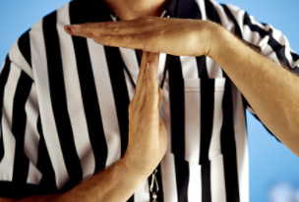
No services should be rendered and no products should be ordered until the vendor has received a PO #.

Slide 29

Yes, what about travel, though?
OK, smarty-pants, that’s the one exception. Put a pin in that, we’ll get to Travel in a few slides.

Slide 30
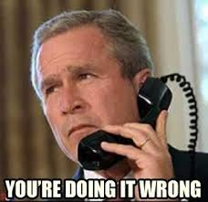
If a vendor generates an invoice and you don’t have a PO # yet, or
If you are buying something with your own cash or credit card (and it isn’t a travel expense), or
If you are signing Terms & Conditions to reserve an event space, or
If you worked with a vendor to provide a service and they are now asking to be paid for that service and you just now realized that you haven’t submitted any paperwork to your fund manager…

Slide 31

Every transaction that requires payment, must be pre-approved and signed off by someone with authorization to spend. That applies to ordering supplies, hiring a consultant, purchasing flights, utilizing parking services on campus, securing a venue for an event, paying a guest lecturer, utilizing a campus lab, etc.

Slide 32
Requester
(you or your staff)
Authorizer
(PI, aka YOU)
Approver
(Fund Manager, AKA ME atm)
Fam Med Purchaser
(Valencia or her team)
Campus Dept
(UC Travel, AP, etc.)
Vendor
(recipient of funds)
Typical Procurement Process

Slide 33

Checks and Balances
Good accounting practices incorporate a system of checks and balances to ensure that no one person has control over all parts of a financial transaction.
This means the person requesting the financial transaction must be different from the person who approves it and that person is different from the one who processes it.
Why is this important?
UCLA is a state agency, funded in large part by tax dollars. In addition, many of our research projects are federally funded. These factors mean there is an extra layer of scrutiny over how we spend money and it’s important that we have systems in place to prevent fraud and abuse.

Slide 34

What happens if I buy something without going through the appropriate process?

Slide 35
If services are rendered or products are ordered without a PO # already in place, we will be forced to submit an After the Fact request, which MAY NOT BE APPROVED.
These forms require several layers of approval: the Department CAO, the DGSOM Controller, the DGSOM Sr. Associate Dean, and UCLA’s Chief Procurement Officer.
This can take upwards of a month.
The PO will not be created while we wait for these approvals. Only if all aforementioned parties approve it, will the PO then be created, at which point the vendor can be paid.

Slide 36

Understood. So what form do I need to submit to make sure I buy things in the correct way?

Slide 37
Website
https://www.uclahealth.org/departments/family-medicine/research

Slide 38
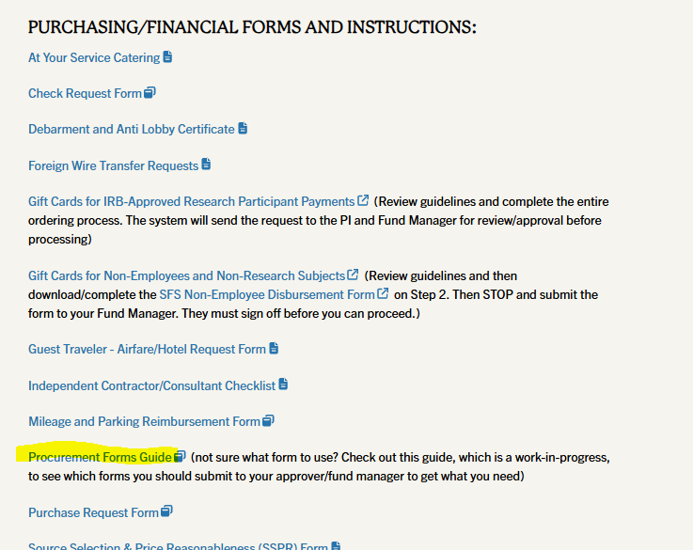

Slide 39
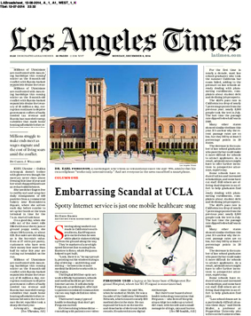
LA Times Rule
FAKE
FAKE
If the newspaper were to publish details regarding the expense, would you or the University look bad? If yes, do not proceed with the expense.
Business justifications should be detailed, comprehensive, accurate, and always included in your expense documentation/purchase requests.

Slide 40

Travel
In general:
It is preferable for us to pay for flight and registration directly from grant/funding sources, rather than travelers purchase out of pocket and seek reimbursement
The only expenses the traveler should incur directly are the following: hotel, ground transportation (taxi/Lyft/Uber), and food

Slide 41
Airfare
Create a draft itinerary for your by either going to the SAP Concur website or by calling UC Travel at 310-206-2639 and having a Travel Agent create the itinerary for you (the latter is what I prefer). If you are working with a Travel Agent, let them know you will be paying via Concur Request ID (AKA Direct Pay or PTA). Tell them if it will be paid from a FEDERAL FUNDING SOURCE.
Once you have spoken with a Travel Agent, a draft itinerary will be emailed to you. If you are booking using the self-service SAP Concur website, you will create the itinerary yourself. You will need your itinerary for the next step.
To request a Concur Request ID/PTA, you will need to email the following information to Laura Sheehan:
• FAU
• Business Justification for the travel (please avoid jargon and use language that can be copied and pasted directly into the system. E.g. don’t say “I wanna pay for my trip to SD conference next month,” but rather: “Roundtrip airfare for Dr. Josephine Bruin to Washington DC to attend the Scientific Development conference October 2-5, 2025.”)
• Attach the Travel Itinerary you received from UC Travel Agent or the Concur Website
Laura will approve and forward to our Fam Med Purchasing Team, who will create the Concur Request ID. If you used a Travel Agent, we can submit the Concur Request ID directly to the travel system for processing. If you did it yourself on the Concur website, you might need to log back in and enter it there.
The traveler will then receive confirmation of the finalized itinerary via email.
Save the itinerary and Concur Request ID for later, as you will need it when you submit your reimbursement request. Even though you aren’t paying out of pocket, we need to provide proof that it was paid and what method was used.

Slide 42
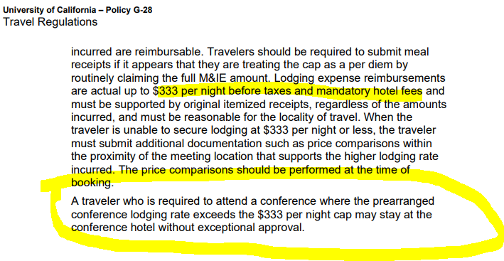
Hotel
Work directly with the hotel to book your room (don’t use package deals like Travelocity, etc. as you will be required to provide an itemized receipt, which sometimes those agencies cannot provide).
Exceptions for hotel maximum may be allowed IF RECEIVED IN ADVANCE.

Slide 43

Ground Transportation
Please do not rent a car unless you need to make multiple trips during your stay. If you do need to rent a car, this should be done via UC Travel
The reason for this is that UCLA has its own insurance and will not reimburse you for insurance that you pay directly to a rental car company, they also get discounts, and if you pay more that what we could have paid, they won’t reimburse you for that either. There also may be restrictions on which company you can use, etc., so it’s better go to through UC Travel.
Mostly you will be using taxi/lyft/uber/public transit, so the main thing you need to know is: save your receipts.
And don’t use Uber Black or limo’s.

Slide 44

Food
Please refer to https://travel.ucla.edu/policy-resources/meals-lodging-expenses and https://travel.ucla.edu/policy-resources/reimbursement-allowances-mileage-mealsfor the latest guidelines regarding maximums for both lodging and meals, etc.
We do not reimburse per diem for food or lodging unless it is FOREIGN Travel. So domestic travel will be reimbursed based on actual costs incurred, up to the maximum allowed daily.
SAVE YOUR RECEIPTS.

Slide 45
General
When you return from the trip, you should complete the Travel Reimbursement Request Form and attach all relevant receipts.
Submit the Travel Reimbursement Request Form and receipts to Laura immediately upon return, but certainly no later than 30 days after travel.
Reimbursements that are not fully processed (by Travel Accounting) by the 45 day mark will require additional justification and may be registered as income on your W2.
Laura will review and submit to the purchasing team for processing. There will be more steps after that, but they will be in touch regarding how to view the final reimbursement and approve online.
The most important thing to remember for hotel, meals, and ground transport is SAVE YOUR RECEIPTS.

Slide 46
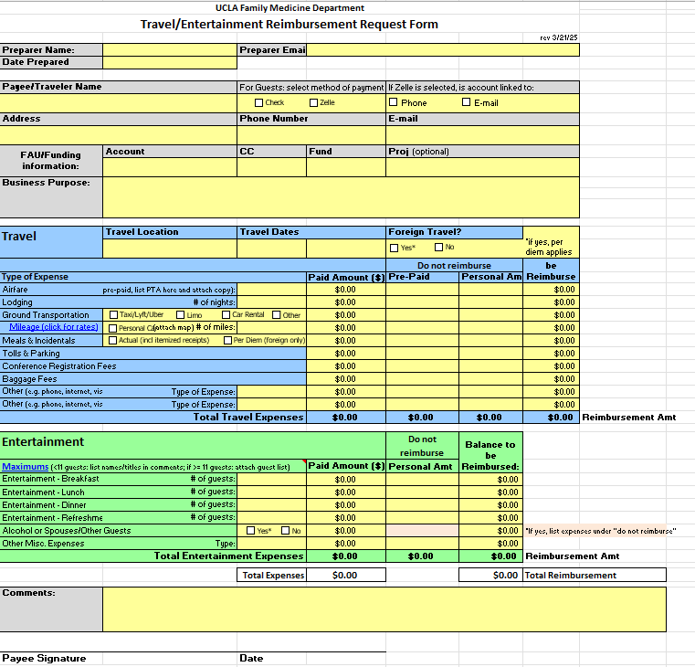

Slide 47
Post-Award PI Responsibilities:
Ethical and safe conduct of research
Acquisition of appropriate approvals (e.g. IRB, human/animal subjects, biohazardous materials, etc.) and licenses, and ensuring all study personnel receive appropriate training
Technical/scientific record keeping and reporting (financial reporting = fund manager)
Understand and comply with all guidelines, restrictions, terms, and conditions, including following appropriate financial processes for purchases.
Fiscal management of the project, including review and approval of financial transactions and reports.
Meeting monthly with your fund manager
Fund Manager assists with all items in gold
More information: https://ora.research.ucla.edu/OHRPP/Documents/Policy/2/PI_Responsibilities.pdf

Slide 48

Monthly Meetings with Fund Manager
Are they actually required?
YES!

Slide 49
Monthly Meetings with Fund Manager
First meeting
  Review budget
  Review Snapshot
  Discuss any discrepancies and any planned changes
  Discuss timing of anticipated expenses
  Approve/initiate transfers and subaward set-ups, etc.

Slide 50
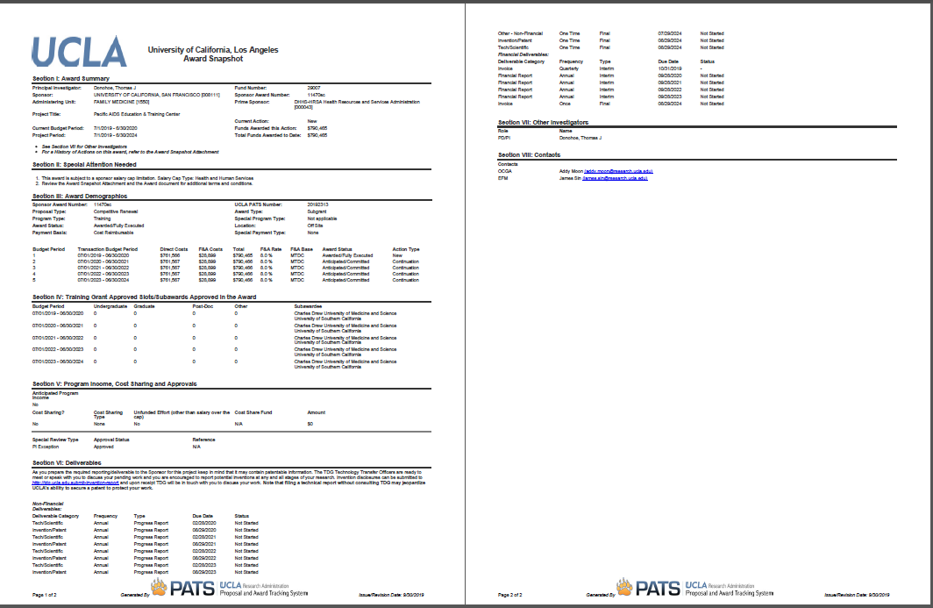
Award Snapshot
Two-page snapshot generated by UCLA OCGA to summarize sponsor’s Notice of Award (NOA)
Full NOA will also be included (starting on pg 3)
Notes:
Can be downloaded from ORA Portal, but only Laura, Daphne, and Andrew have access. Can be requested from us. Good to review at first monthly review mtg with fund manager.

Slide 51
Reading the Award Snapshot and NOA
Review the Award Snapshot and NOA with your fund manager at your first monthly meeting
Fund number
Budget/project period
Special Attention items and Alerts
Amount awarded
Deliverables (technical reports, financial reports, etc.)
Compliance requirements
Payment basis
Contacts
Notes:
Special attention items: salary caps, restrictions/holds, prior approvals. ACCURACY.

Slide 52
Monthly Meetings with Fund Manager
Regular Monthly Meetings
  Review financial reports (aka FR’s, GL)
  Ensure that all recorded expenses are allowable, applicable, complete
  Determine if adjustments need to be made
  Review encumbered items
  Monitor spending rate
Are sister depts/subawards performing as expected? Is personnel effort accurate? Is that charge applicable? Are there any applicable charges missing? Why is that item still encumbered?

Slide 53
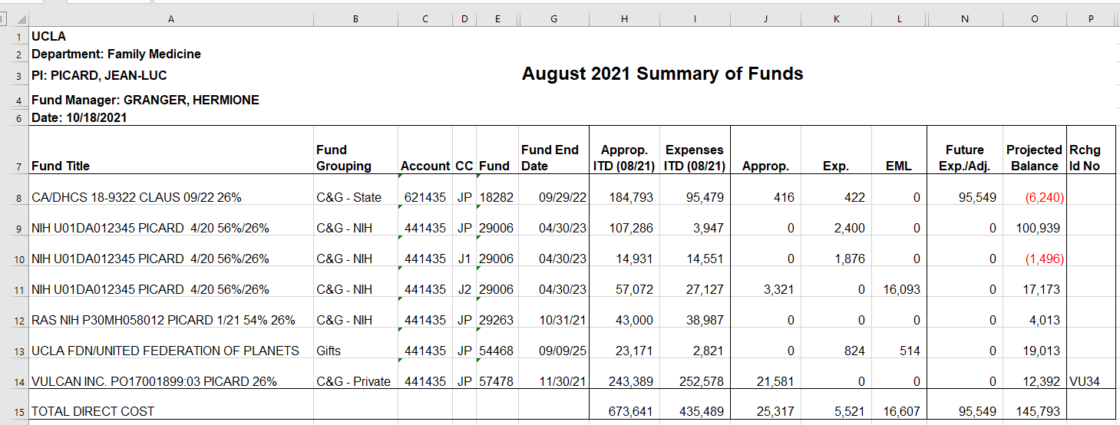
Financial Reports
Sum of Funds

Slide 54
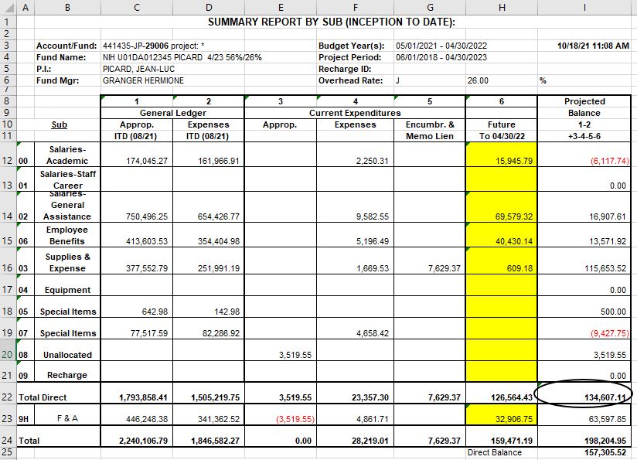
Financial Reports
Summary by Sub

Slide 55
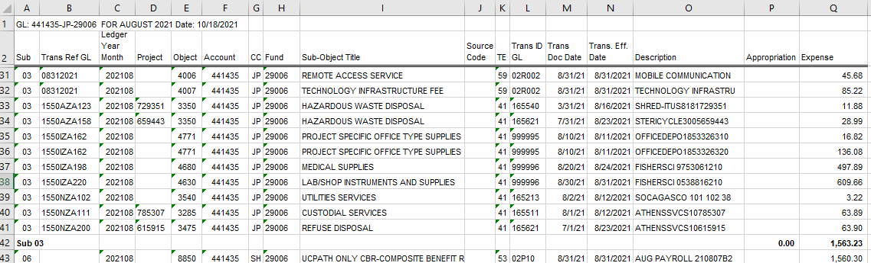
Financial Reports
Closed Expenses

Slide 56
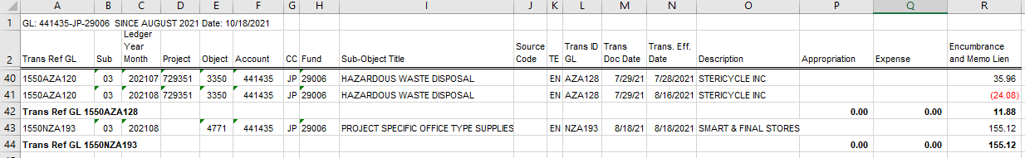
Financial Reports
Open Expenses

Slide 57
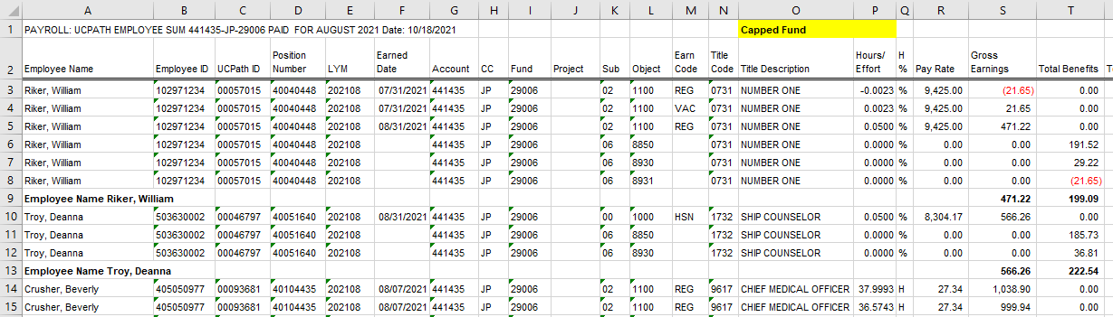
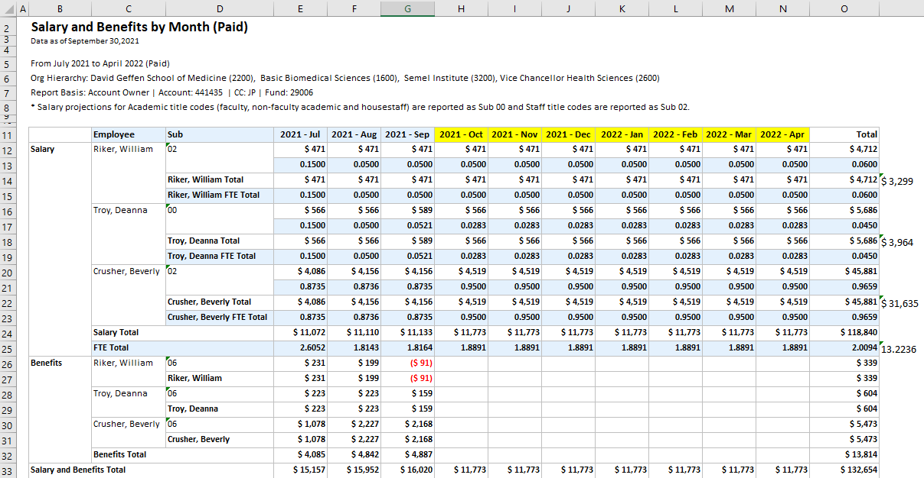
Financial Reports
Salary

Slide 58


Monthly Meetings with Fund Manager
Look
Back
Look
Ahead

Slide 59


Notices from ORA Reports (portal@research.ucla.edu)
Sent automatically at 90-, 60-, and 30-day mark prior to budget period end date
If you’ve been meeting monthly with your Fund Manager
If you have NOT been meeting monthly with your Fund Manager

Slide 60
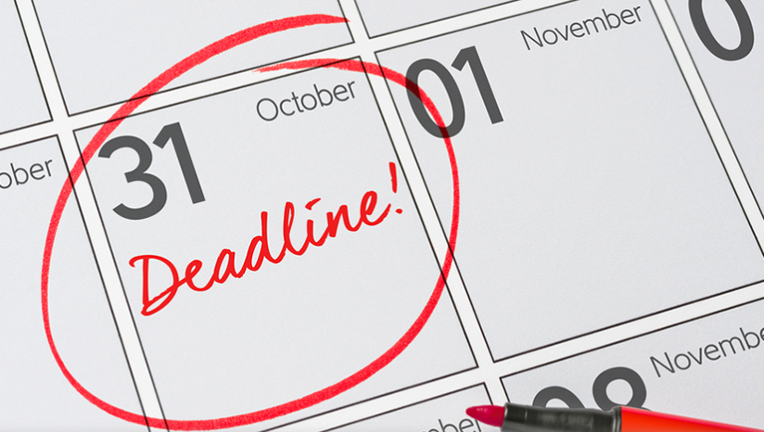
Approaching End Dates
Budget Period End Date
Are you projecting a balance? How big? Is carryforward allowed?
Are you on target in regard to milestones/aims?
Make personnel adjustments (forward and back)
Make applicable purchases, pay applicable invoices
Technical/Scientific Progress Reports
Financial Progress Reports

Slide 61
Approaching End Dates
Project Period End Date
Are you projecting a balance? How big? Is NCE allowed?
Are you on target in regard to milestones/aims?
Make personnel adjustments (forward and back)
Make applicable purchases, pay applicable invoices
Technical/Scientific Final Reports
Financial Final Reports
Is Policy 913 applicable?

Slide 62
Financial Progress Reports & Final Financial Reports (FFRs)
Fund Manager will create
May be combined with Technical/Scientific Reports
If you have massively underspent
  You will likely need to provide a justification, list the remaining balance, and explain how you plan to spend down the funds
  You may be required to return unspent funds
  Subsequent incoming funding may be cut

Slide 63
Effort Reporting
Required for federal funding only
Confirms that amount paid matches actual work performed
Must be certified by PI or person familiar with project/effort
Often comes months after work is performed

Slide 64
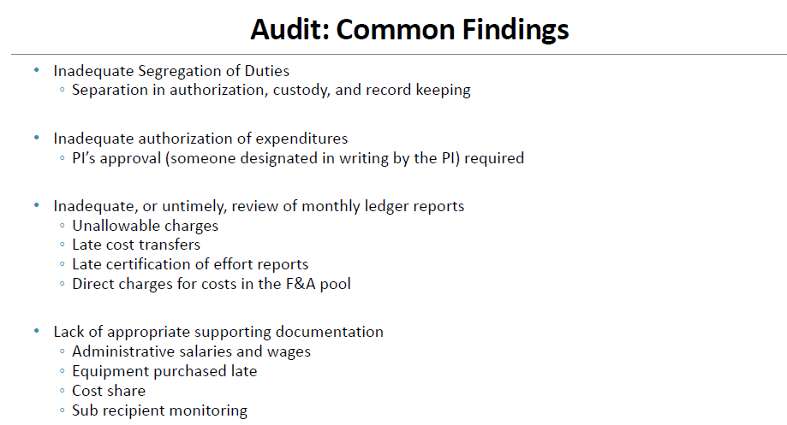

Slide 65
Monthly Meetings with Fund Manager
Look
Back
Look
Ahead

Slide 66
Post-Award Key Takeaways
PI’s are responsible for ethical conduct of research and obtaining all applicable approvals (IRB, HRPP training, etc.)
Do NOT purchase things without following appropriate purchasing procedures.
Set up a recurring monthly meeting with your fund manager as soon as you receive an award.
When in doubt, reach out to the Research Unit Admin Team if you have questions.

Slide 67
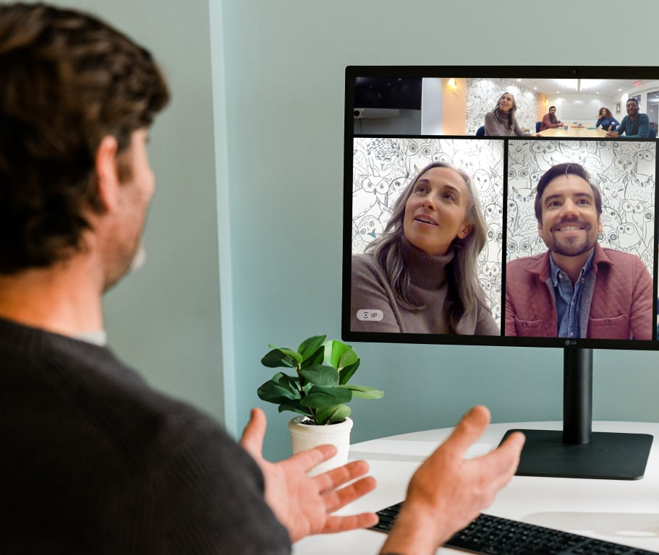
Monthly Research Unit Meeting
First Thursday of the month from 11am-12pm, via Zoom
Email Laura at Lsheehan@mednet.ucla.edu if you’d like to receive the calendar invite
If you receive research funding, are interested in obtaining research funding, or want to hear more about the kind of research our department is doing, you should attend
https://uclahs.zoom.us/j/319497060 Password: Research

Slide 68
Thank You

