Slide 1
Family Medicine Research Unit
Monthly Meeting
August 2023

Slide 2
New Awards Received (since May)
PI | Award Title | Sponsor | Prime Sponsor | Project Period Begin Date | Project Period End Date
Tarn, Derjung | Nasal Steroids, Nasal Irrigation, Oral antibiotics and Subgroup Targeting for Effective Management of Sinusitis (NOSES) | GEORGETOWN UNIVERSITY | PCORI | 04/01/2023 | 09/30/2024
Sur, Denise Kc | HCAI Song-Brown Grant Primary Care Residency (2023-2026) | CA-Department of Health Care Access and Information | - | 06/30/2023 | 08/31/2026
Sur, Denise Kc | CalMedForce 2022-2025 | Physicians for a Healthy California | UC/OFFICE OF THE PRESIDENT | 07/01/2023 | 09/30/2026
Tarn, Derjung | Los Angeles Maternal Mental Health Access (LAMMHA) – Phase 2 | UNIVERSITY OF WASHINGTON | CALIFORNIA HEALTHCARE FOUNDATION | 02/01/2023 | 01/31/2027
Gelberg, Lillian | Cannabis Use for Medicinal Purposes Among Clinical Populations in California: Population Estimates of Prevalence, Frequency, Quantity and Reasons for Use | CA-Department of Cannabis Control | - | 06/15/2023 | 06/14/2025
Li, Michael Jonathan | Midwest Integration of the National HIV Curriculum (MINHC) Grant | UNIVERSITY OF ILLINOIS | DHHS-HRSA | 03/01/2023 | 08/31/2026

Slide 3
Recently Submitted Proposals (since May)
PI | Title | Sponsor | Prime Sponsor | Type
Brooks, Ronald Andrew | Developing Implementation Strategies to Enhance Delivery of LAI PrEP to Black and Latino MSM | UC CALIFORNIA HIV/AIDS RESEARCH PROGRAM (CHRP) | - | New
Gelberg, Lillian | Effectiveness of the Diabetes Homeless Medication Support (D-HOMES) program on diabetes management | Hennepin Healthcare Research Institute | NIH | New
Shoptaw, Steven | HIV Prevention Trials Leadership Group: 094 Protocol Chair | FHI 360 (Family Health International) | NIH-NIAID | Modification/ Amendment
Shoptaw, Steven | CTN-0109: Randomized, placebo-controlled trial of injectable naltrexone and monthly injectable buprenorphine for cocaine use (CURB-2) | University of Texas-Southwestern Medical Center at Dallas | NIH | Supplement
Shoptaw, Steven | CTN-0110 MURB Non-HEAL YR19 | University of Texas-Southwestern Medical Center at Dallas | NIH | Supplement

Slide 4
Labor Day Holiday
Monday, September 4th

Slide 5
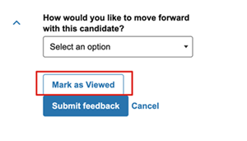
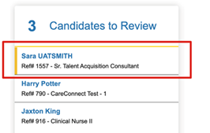
Hiring Updates
Career Tracks
Asst. CRCs and CRCs – completed
Sr. CRCs and many other titles: Delayed
Avature
Do not download or email resumes, reviewers must log into Avature to review resumes
Office Hours: Fridays from 11:30a-1p https://uclahs.zoom.us/j/97522351115
“Mark as Viewed” feature

Slide 6
Employee Relations – Office Hours
Employee Relations Office Hours for Managers and Supervisors
Meet with Vera Moubayed, Employee Relations Manager
Every Other Thursday at 1pm; Next: August 10
Zoom Meeting ID: 946 9752 5571 https://uclahs.zoom.us/j/94697525571
This is an opportunity for supervisors to stop in for a quick consultation on any Employee Relations issue or question, or to benefit from the discussion on topics and questions raised by other colleagues. Additional Employee and Labor Relations updates and discussions will occasionally be provided as necessary, in addition to general day-to-day ER subject matter, such as probationary periods, performance management, unauthorized leave, handling claims of discrimination/harassment, etc.

Slide 7
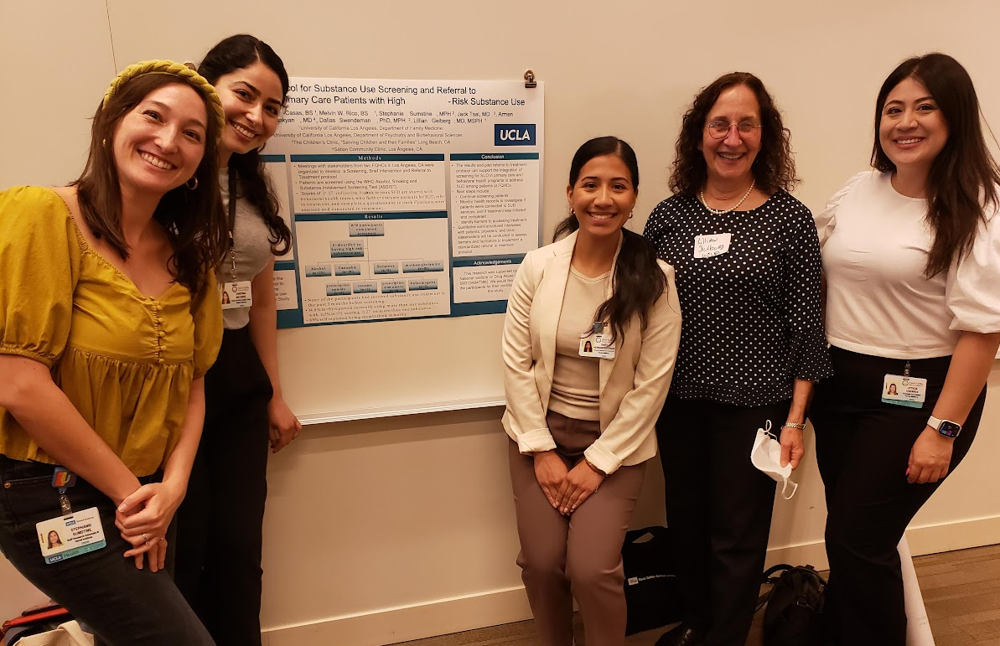
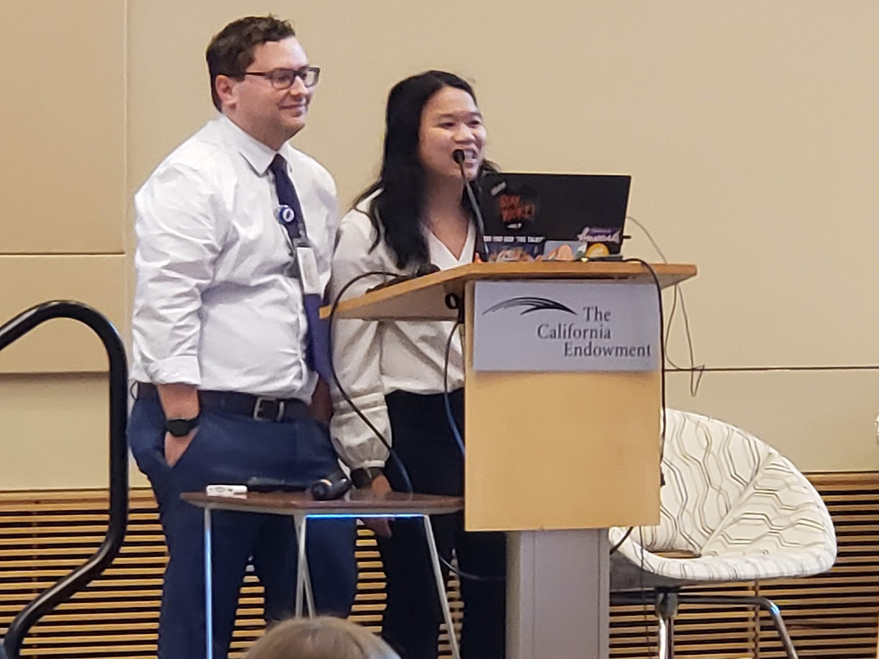
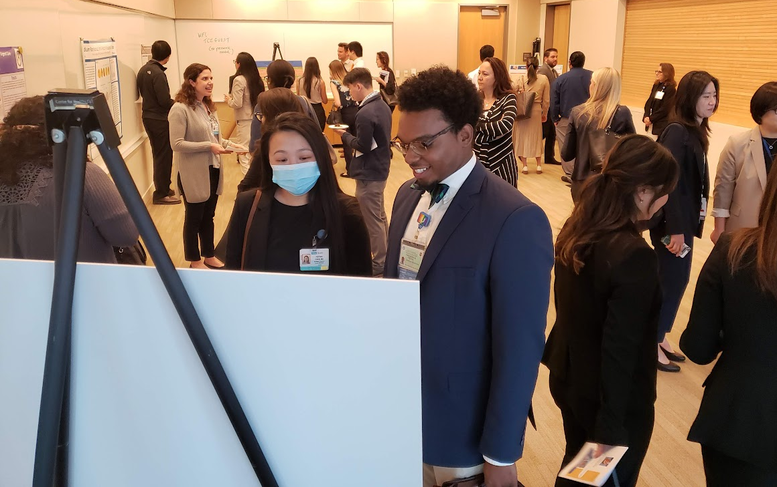
Research Day Save the Date: May 22, 2024

Slide 8
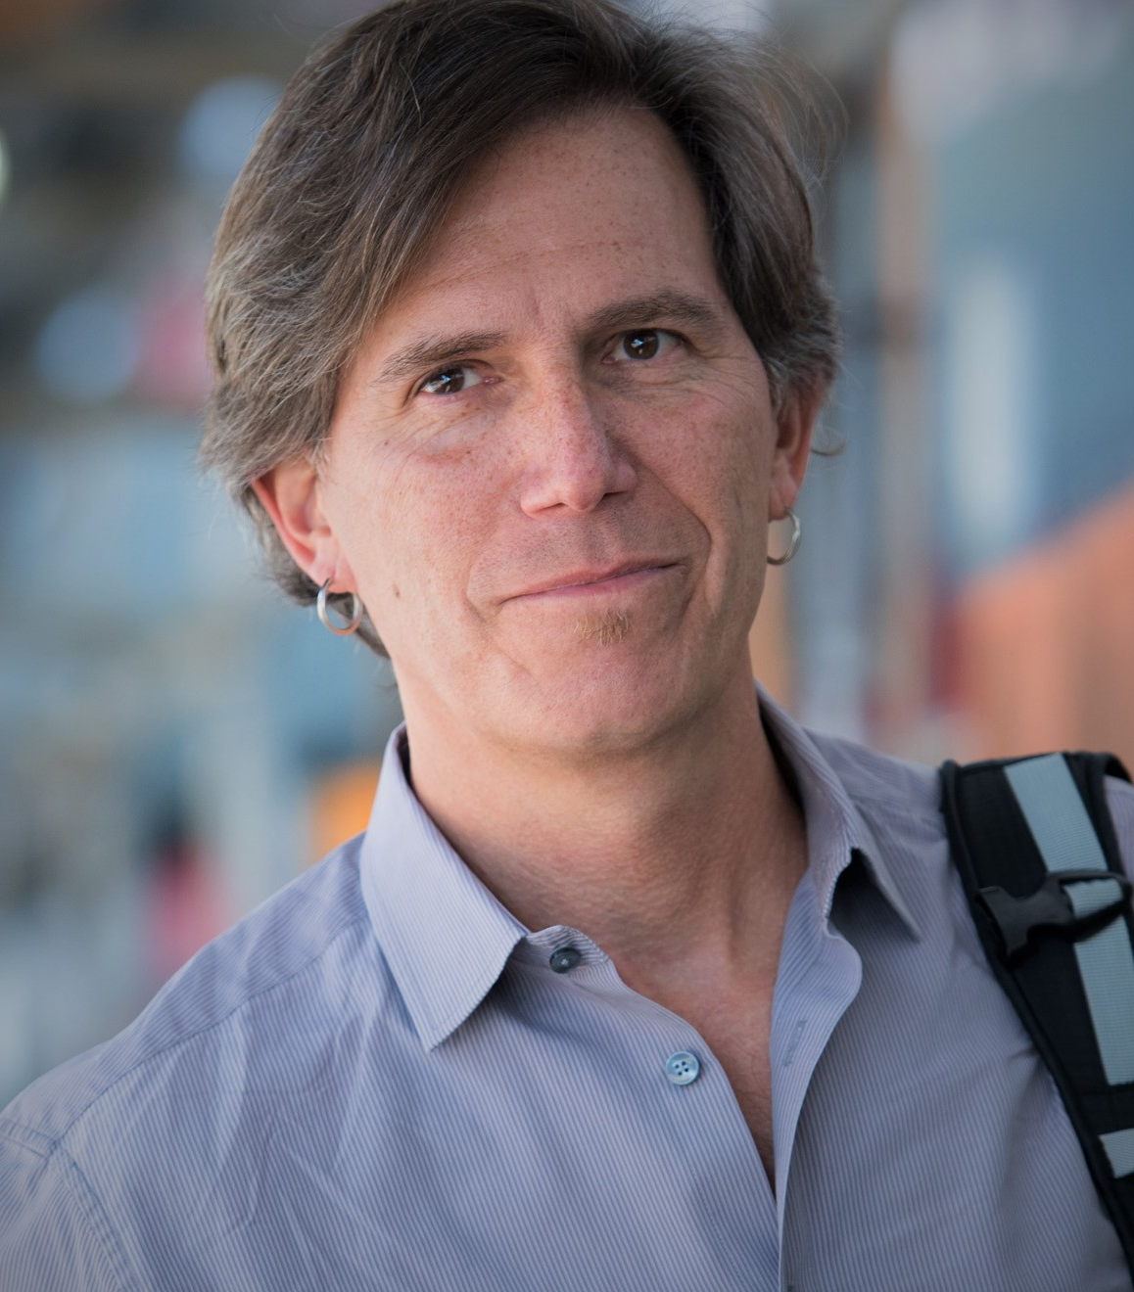
Grand Rounds
September Grand Rounds
Friday, August 25, 2023
12:00pm-1:00pm
Dr. Daniel Ciccarone
Professor in Addiction Medicine
UCSF

Slide 9
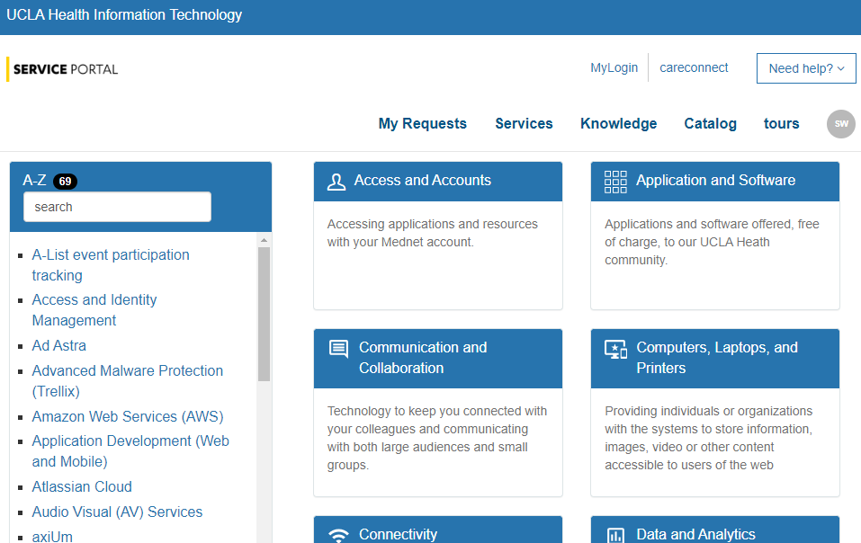
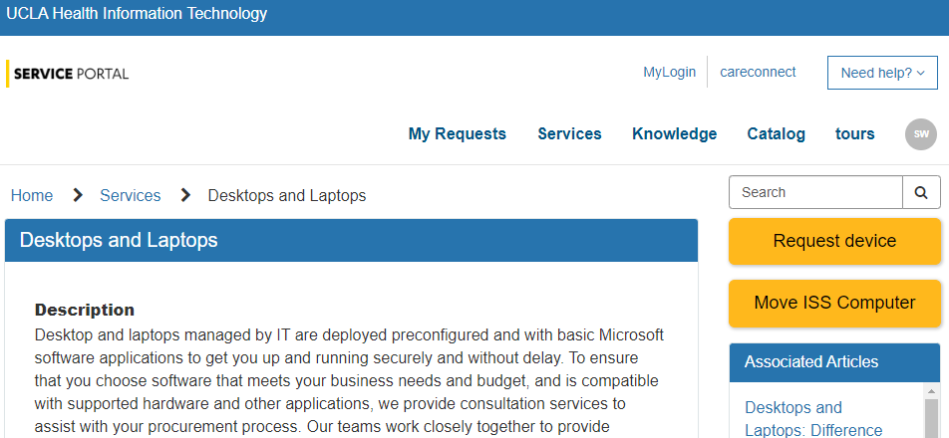
Ordering Computers
Step 1
Request a quote
Log into UCLA Health IT Service Portal
Click on “Services”
Select “Computers, Laptops, and
Printers”
Click on “Request Device”
Complete the form and submit

Slide 10
Ordering Computers
Step 2
Complete and Submit Purchase Request Form
ServiceNow will send you an email with the quote attached (save the email, you will need it later)
Complete a Purchase Request Form and submit it and the quote to your Authorizer
After Authorizer approves, submit the Purchase Request and quote to Fund Manager
Fund Manager will approve and submit to Purchaser to create PO#

Slide 11
Ordering Computers
Step 3
Reply to Original Email and Attach PO
Purchaser will send the PO to the Requester with instructions to:
REPLY to the original quote email
Attach both PO and quote
Send to Customer Care and UCLA Computer Store
Do not alter the subject line

Slide 12
Ordering Computers
Step 4
DGIT/ISS will Receive and Prepare Laptop for Pick-up
Computer will be delivered to DGIT/ISS
They will encrypt it and add any requested software, as per the order
They will contact you via email when the device is ready for pick-up

Slide 13
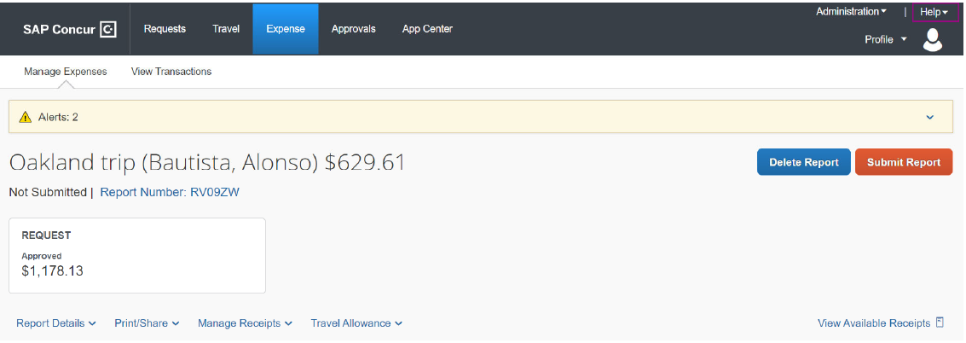
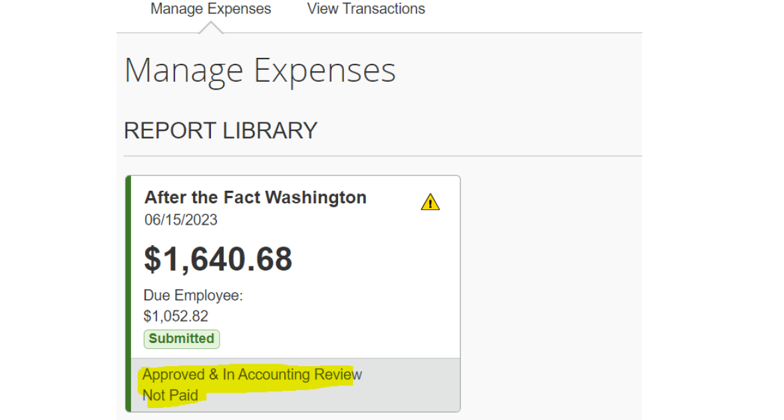
How to Submit Travel Expense Report in Concur

Slide 14
Non Travel/Entertainment Reimbursements

Slide 15
Non Travel/Entertainment Reimbursements

Slide 16
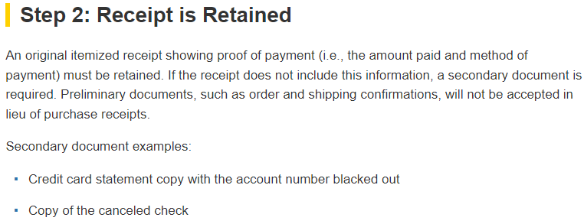
Non Travel/Entertainment Reimbursements

Slide 17
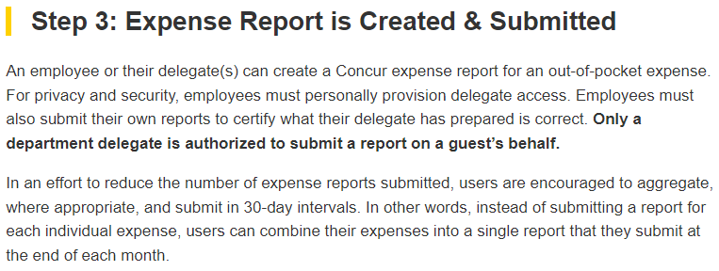
Non Travel/Entertainment Reimbursements
Partial Reimbursements are not allowed!
You must submit within 60 days of the date the expense was incurred!

Slide 18
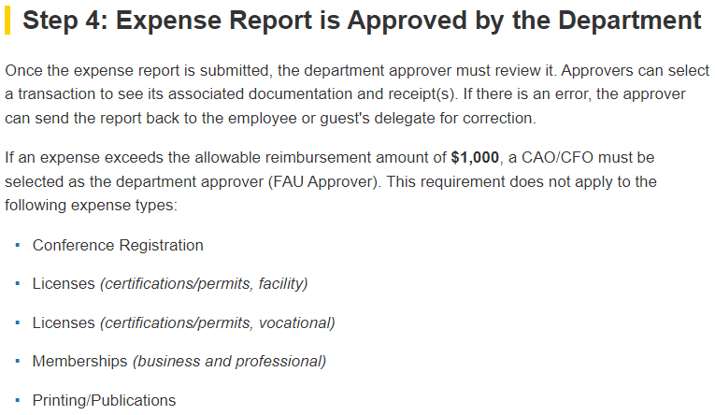
Non Travel/Entertainment Reimbursements

Slide 19
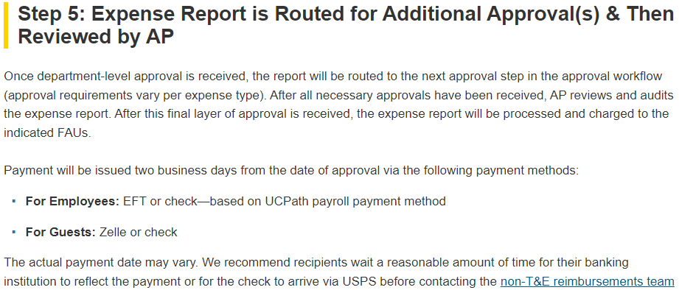
Non Travel/Entertainment Reimbursements

Slide 20
Small Business First (SBF) Program
Helps UC invest in and enrich our local communities with jobs and economic stability
UC procurements between $10,000 and $250,000 must be awarded to a certified small business (SB) whenever practicable

Slide 21
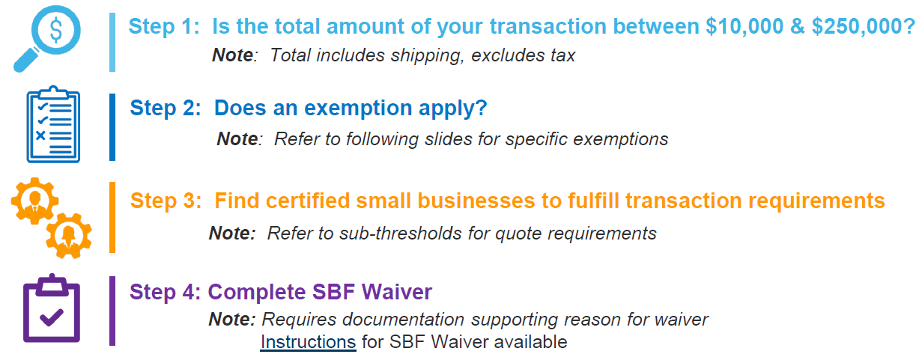
Small Business First (SBF) Program

Slide 22
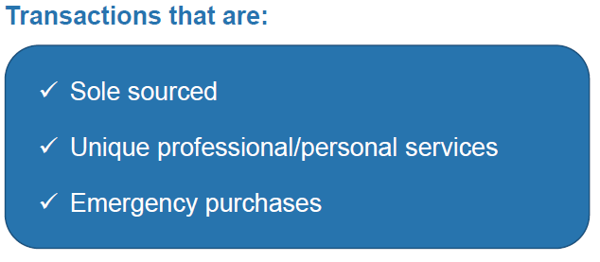
SBF Exemptions

Slide 23
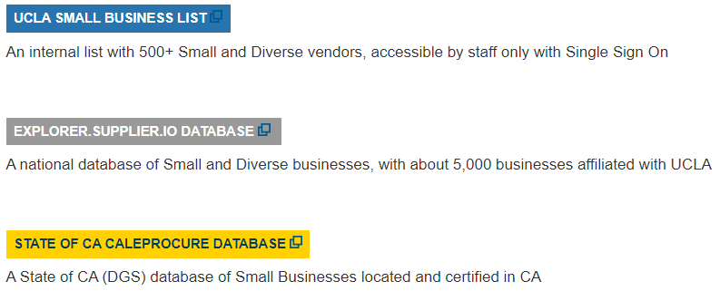
Finding a Certified Small Business
Go to: https://purchasing.ucla.edu/small-business-databases
If you are not able to find a Certified Small Business you must complete a SBF Waiver and attach the Waiver to your requisition.

Slide 24
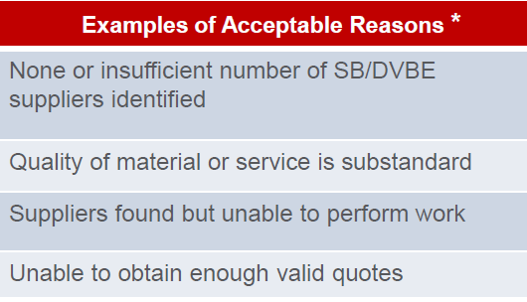
Paying a Certified Small Business
Complete the Purchase Request Form as usual
Attach the following:
Quote
Screenshot from database showing certification for chosen SB
If you were unable to utilize a Small Business, you must attach:
Waiver
Supporting documents

Slide 25
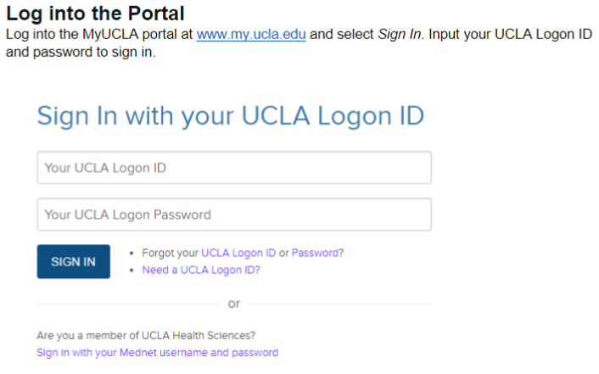
Research Participant Payment (Incentive) Requests
https://www.finance.ucla.edu/business-finance-services/payment-solutions-and-compliance/how-to-submit-research-payment-request
IRB Approved Research Payment Requests are completed through a combination of the Research Payment Portal on MyUCLA and the MyUCLA Message Center. You can track the status of your request on the Research Payment Portal.

Slide 26
Research Participant Payment (Incentive) Requests

Slide 27
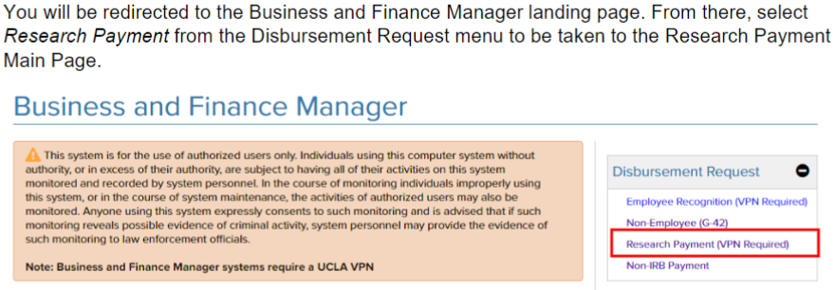
Research Participant Payment (Incentive) Requests

Slide 28
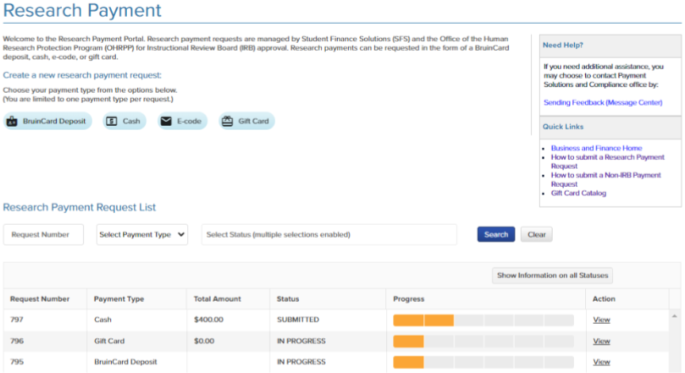
Research Participant Payment (Incentive) Requests

Slide 29
Research Participant Payment (Incentive) Requests
Provide contact info for authorized personnel, fund manager, PI’s etc.
Select delivery method (for physical cards) or authorized recipient (for e-codes)
3) Provide Order Information (Select “Add New” and enter vendor, amount, quantity, etc.)
4) Provide FAU, IRB Approval Number, IRB Expiration Date
5) Finalize Request by acknowledging policies and procedures and clicking “submit”
6) Both Fund Manager and PI will then receive automatic email to review and approve the request
7) Once both have approved, it will be processed

Slide 30
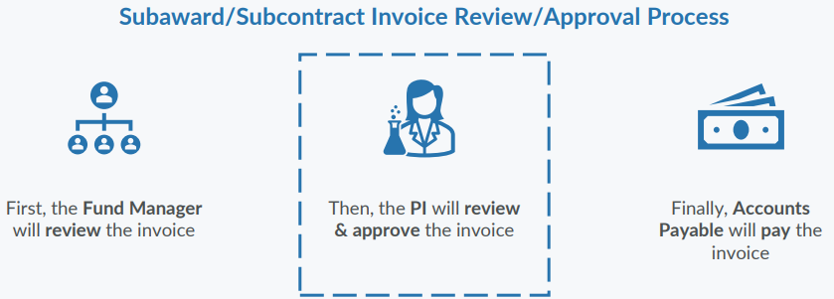
BruinBuy Plus and Subaward Invoices
Starting this fall Principal Investigators will be required to approve subaward/subcontract invoices in the BruinBuy Plus system. This is a change from current state, where PI approval is obtained outside the system

Slide 31
Goodbye One-Time Payees
Everyone needs to register with PaymentWorks; send payee contact info to Valencia to initiate registration process
Do not gather W2’s, payees will need to upload their own
After registration, when you submit the check request form you must include a DETAILED justification, including date of service

Slide 32
Other Support Pages
The Other Support page asks for the Year (YYYY), but my project starts in one calendar year and ends in another. Which year do I list on the OS page?

Slide 33
Other Support Pages
If you are reporting person-months that span two calendar years, you should enter the latter year. For example, if the budget period runs from Aug 2023 through July 2024, you should enter “2024” for the year and include the corresponding person months.

Slide 34
Other Support Pages
The Other Support page asks for the dollar amounts for each study. Do I list direct or total costs? Do I list annual costs or PoP costs? What if we’re a subaward?

Slide 35
Other Support Pages
Other Support pages should provide the total award amount, direct and indirect, for the entire project period, not just the annual budget period.
For subprojects, recipients should provide the project number and PD/PI name for the overall project, but all other information, including total award amount and person months, for the subproject only.

Slide 36
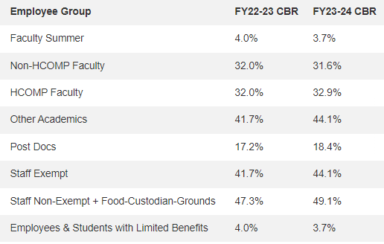
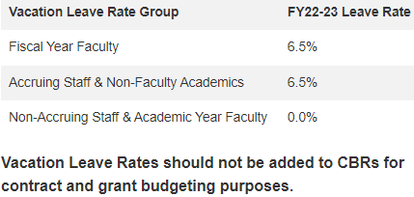
CBR/Fringe Benefit Rates

Slide 37
Data Management and Sharing Costs
Current NIH guidelines state that costs to support activities described in the DMS plan, including personnel costs, can only be noted on the R&R Budget Form as a single line item titled “Data Management and Sharing Costs.” These instructions will be rescinded effective October for due dates on or after October 5, 2023.
Effective for applications submitted for due dates on or after October 5, 2023, NIH will no longer require the use of the single DMS cost line item. NIH recognizes that DMS costs may be requested in many cost categories. Therefore, DMS costs must be requested in the appropriate cost category, e.g., personnel, equipment, supplies, and other expenses, following the instructions for the R&R Budget Form or PHS 398 Modular Budget Form, as applicable. While the single cost line item is no longer required, NIH will require applicants to specify estimated DMS cost details within the budget justification.

Slide 38
Data Management and Sharing Costs
The NIH Data Management and Sharing Policy requires all NIH-funded researchers to create, implement, and report a Data Management and Sharing Plan to ensure research is made publicly available.
Findable
Accessible
Interoperable
Reusable

Slide 39
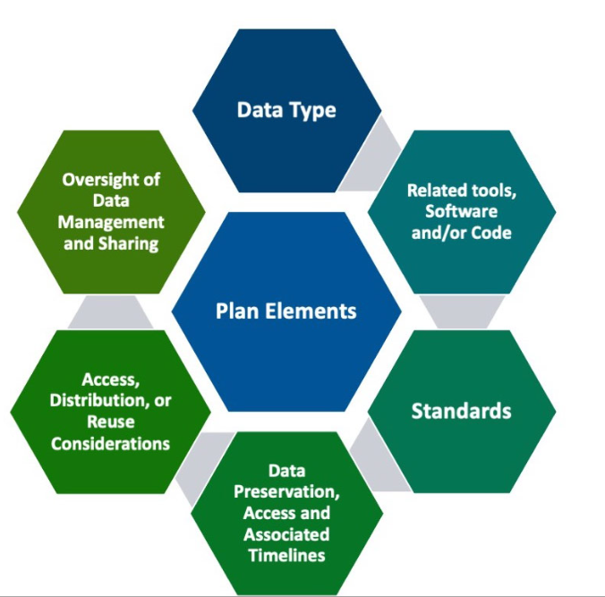
Data Management and Sharing Costs
“At the heart of the new policy, it is really about trying to convey the value of why data sharing is important… If you are going to properly data share, you must effectively manage your data. The two are intricately linked because data management happens throughout the research lifecycle. The DMS Plan aids researchers in thinking about data management and data sharing issues up front before they conduct a study.”
- Stephanie Holmgren, program manager at NIEHS Office of Data Science

Slide 40
In the News
Science funding agencies say no to using AI for peer review (Science)
Neuroscientist Greg Siegle was at a conference in early April when he heard something he found "very scary." Another scientist was gushing that ChatGPT, the artificial intelligence (AI) tool released in November 2022, had quickly become indispensable for drafting critiques of the thick research proposals he had to wade through as a peer reviewer for the National Institutes of Health (NIH). … NIH and other funding agencies, however, are putting the kibosh on the approach. On 23 June, NIH banned the use of online generative AI tools like ChatGPT "for analyzing and formulating peer-review critiques"..
https://www.science.org/content/article/science-funding-agencies-say-no-using-ai-peer-review

Slide 41
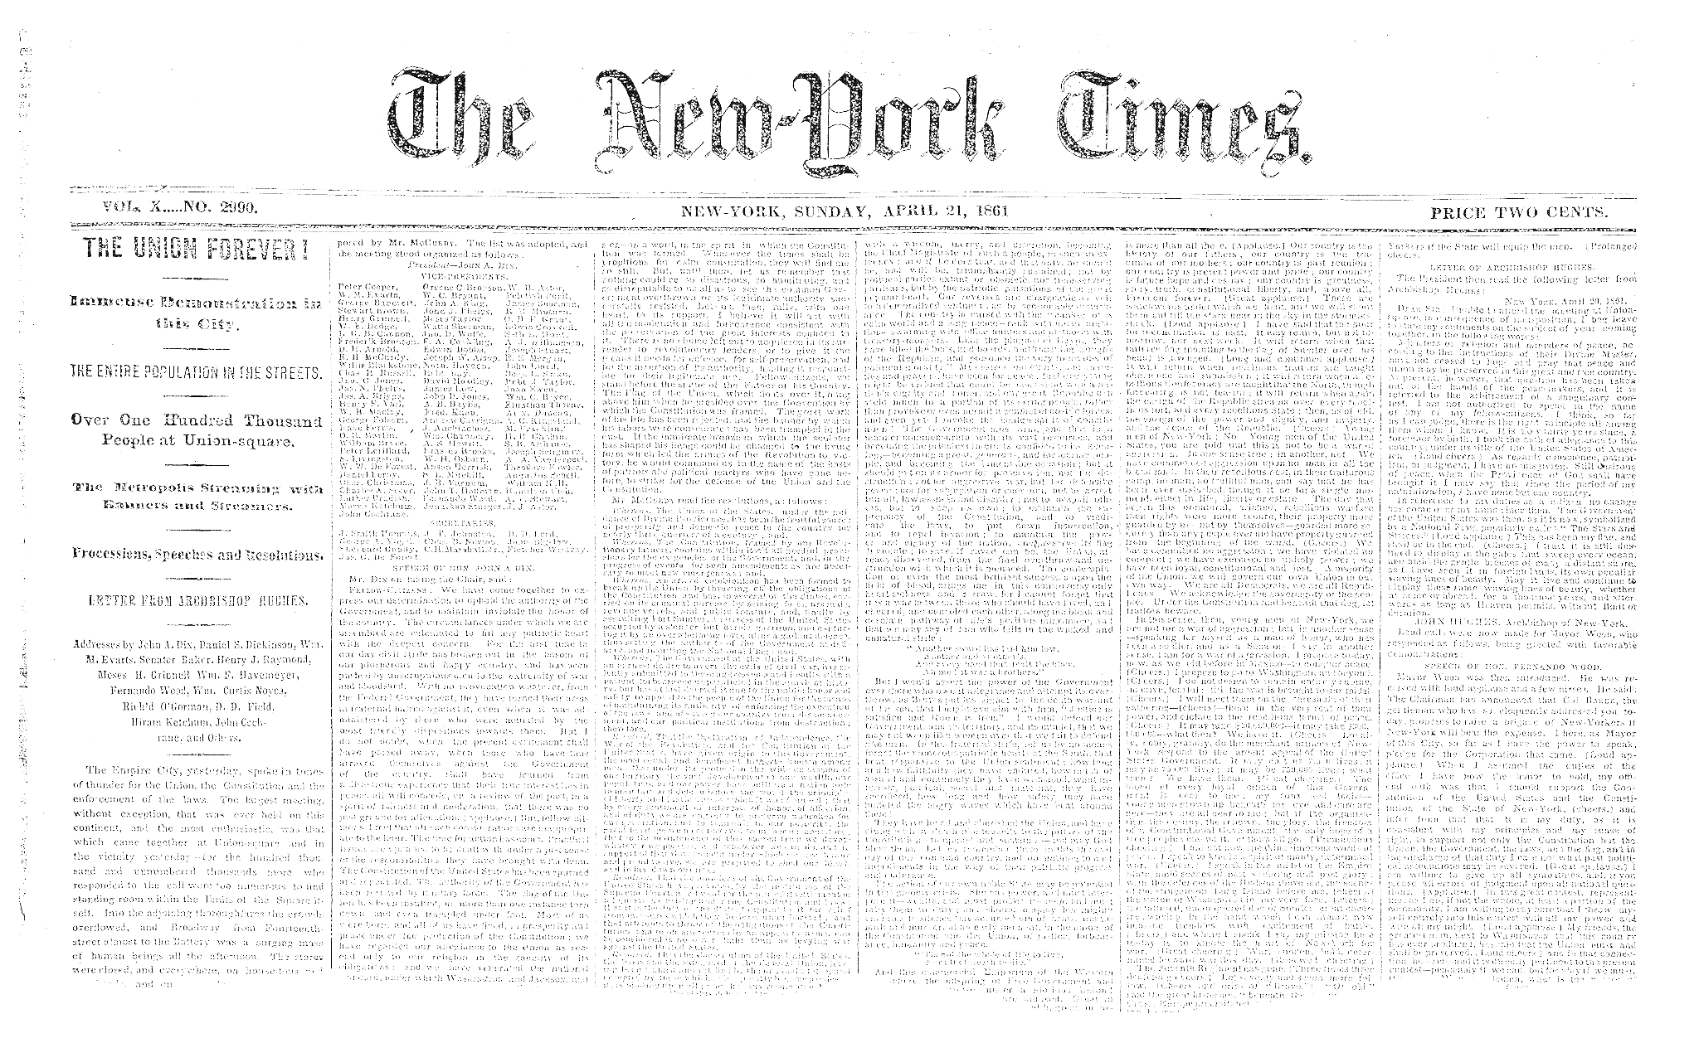
In the News
NIH Will Require Review Integrity and Bias Awareness Training for Reviewers in 2024
The agency has developed reviewer training modules covering review integrity and bias awareness mitigation. Effective May 2024, completion of the modules will be required for all reviewers. Each training takes about 30 minutes and must be completed every three years. READ MORE
Thousands of early-career NIH researchers forming union for first time (Nature)
The mobilization at the NIH comes amid a wave of academic workers forming unions across the United States while citing pay and working conditions that have failed to keep up with the rising cost of living. "These are issues that science needs to come to grips with," says Rick McGee, associate dean of professional development at the Northwestern University Feinberg School of Medicine in Chicago. https://www.nature.com/articles/d41586-023-01845-w

Slide 42
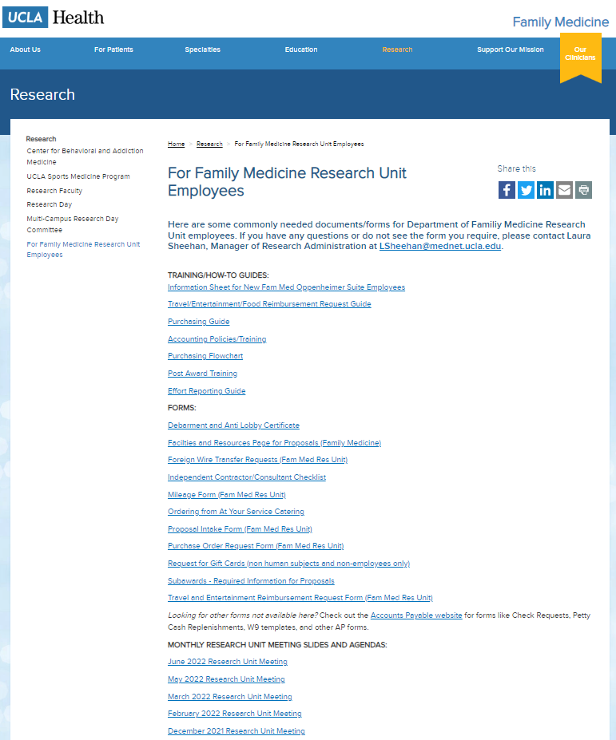
Upcoming Meetings/Events
Next Research Unit Meeting: Thu Sep 7
Next Grand Rounds: Friday, Aug 25
Prior monthly meeting agendas/slides are available on the website

