Slide 1
Laryngology Journal Club
Nausheen Jamal, MD
Dept of Head & Neck Surgery
University of California, Los Angeles
August 8, 2012

Slide 2
Laryngology Journal Club
A nomenclature paradigm for benign midmembranous vocal fold lesions
Rosen, et al.
Utility of voice therapy in the management of vocal fold polyps and cysts
Cohen & Garrett
Vocal process granuloma and glottal insufficiency: an overlooked etiology?
Rosen, et al.

Slide 3
VHI-10
Voice Handicap Index originally described in 1997 by Jacobson and Johnson
30 items
Three sections: Functional, Physical, Emotional
Scale of 0-4
Higher score means higher handicap
Rosen, et al. picked 10 “most robust”
VHI of 100 dysphonic and 159 control patients
VHI then administered to >800 patients
Analyzed VHI and VHI-10 scores pre- and post-treatment
VHI-10 not only correlated very well with VHI, but showed more of a difference between pre- and post-treatment scores

Slide 4
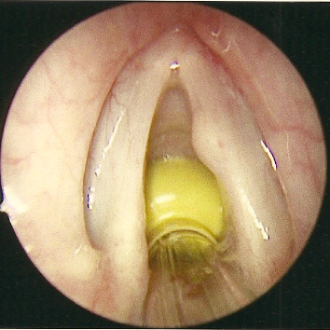
What is the pathology?

Slide 5
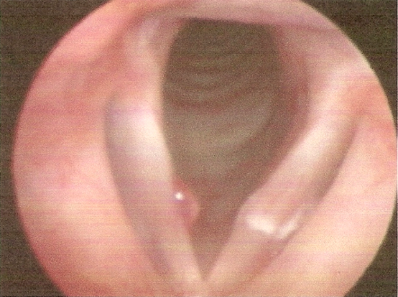
What is the pathology?

Slide 6
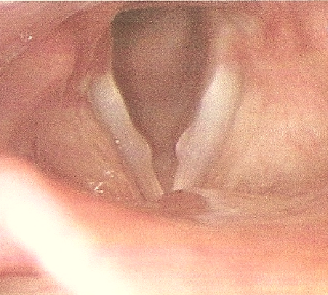
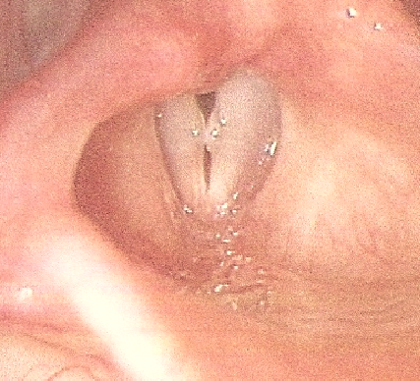
What is the pathology?

Slide 7
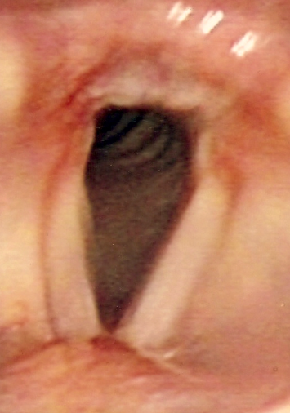
What is the pathology?

Slide 8
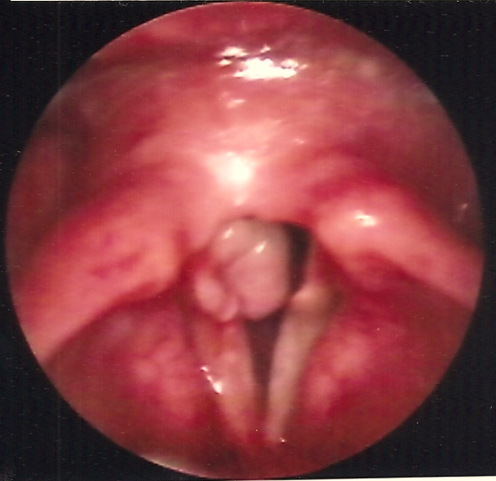
What is the pathology?

Slide 9
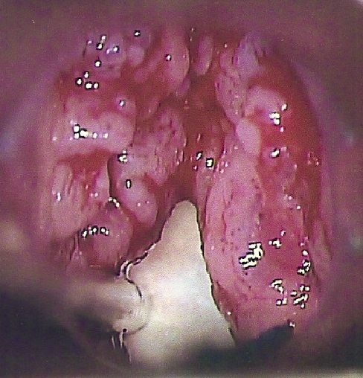
What is the pathology?

Slide 10
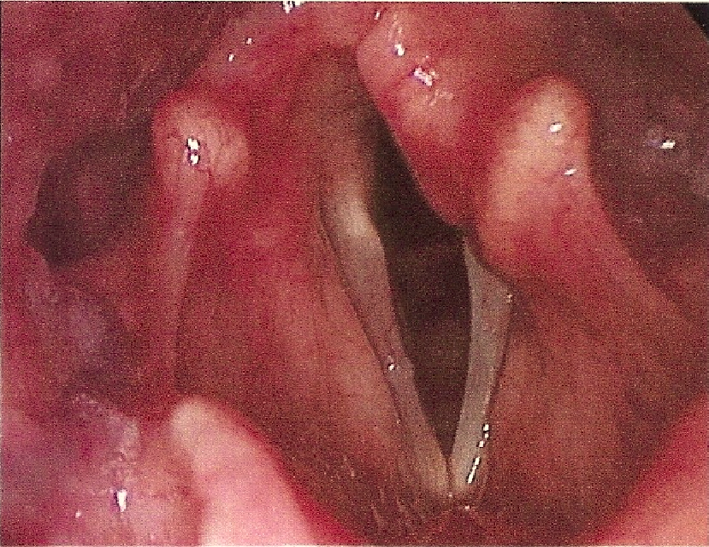
What is the pathology?

Slide 11
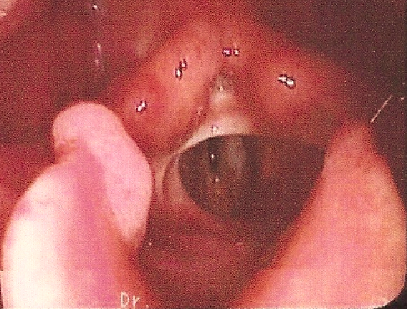
What is the pathology?

Slide 12
RSI (Reflux Symptom Index)
Specifically for LPR (not GERD)
Self-administered, nine item survey
Scale of 0-5
Higher score correlates with more severe symptoms
Score >13 abnormal
Tested on 25 LPR patients (confirmed with 24-hour, double-probe pH monitoring)
Diet and BID PPI
Gender- and age-matched controls
Significant improvement in therapeutic group

Slide 13
Case Presentation
53 y/o man with a h/o vocal fold mass
Excised by outside otolaryngologist in January 2011
Mass recurred
Re-excised by same surgeon in July 2011
Sent to you for subsequent managment

Slide 14
Case Presentation
What is your differential diagnosis?

Slide 15
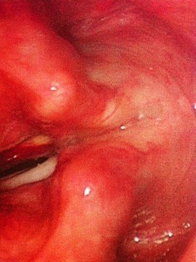
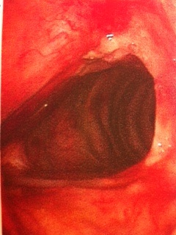
Case Presentation

Slide 16
Case Presentation
What pathology or pathologies do you see?
What are your therapeutic options?

Slide 17
Case Presentation
4 units of Botox injected into each vocal fold
Anti-reflux regimen
Referral for voice therapy
Modified voice rest regimen
Comes back to see you after 2½ months

Slide 18
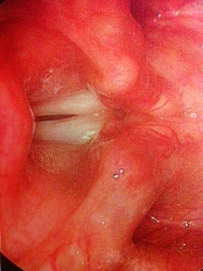
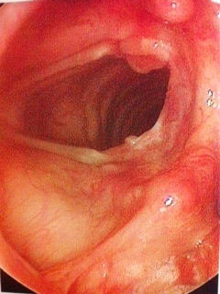
Case Presentation

Slide 19
Case Presentation
Stopped using his PPI because “it isn’t helping”
Begins voice therapy
Comes back after 3 months

Slide 20
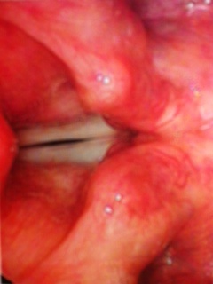
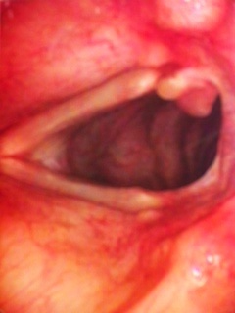
Case Presentation

Slide 21
Case Presentation
What is your next step in treatment?

Slide 22
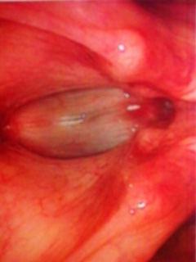
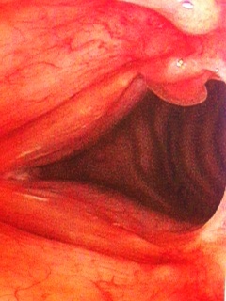
Case Presentation
Two weeks after thyroplasty:

Slide 23
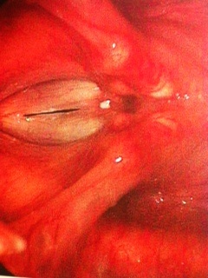
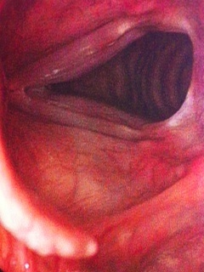
Case Presentation
Four months after thyroplasty:

Slide 24
Case Presentation
You cured the patient!

