Slide 1
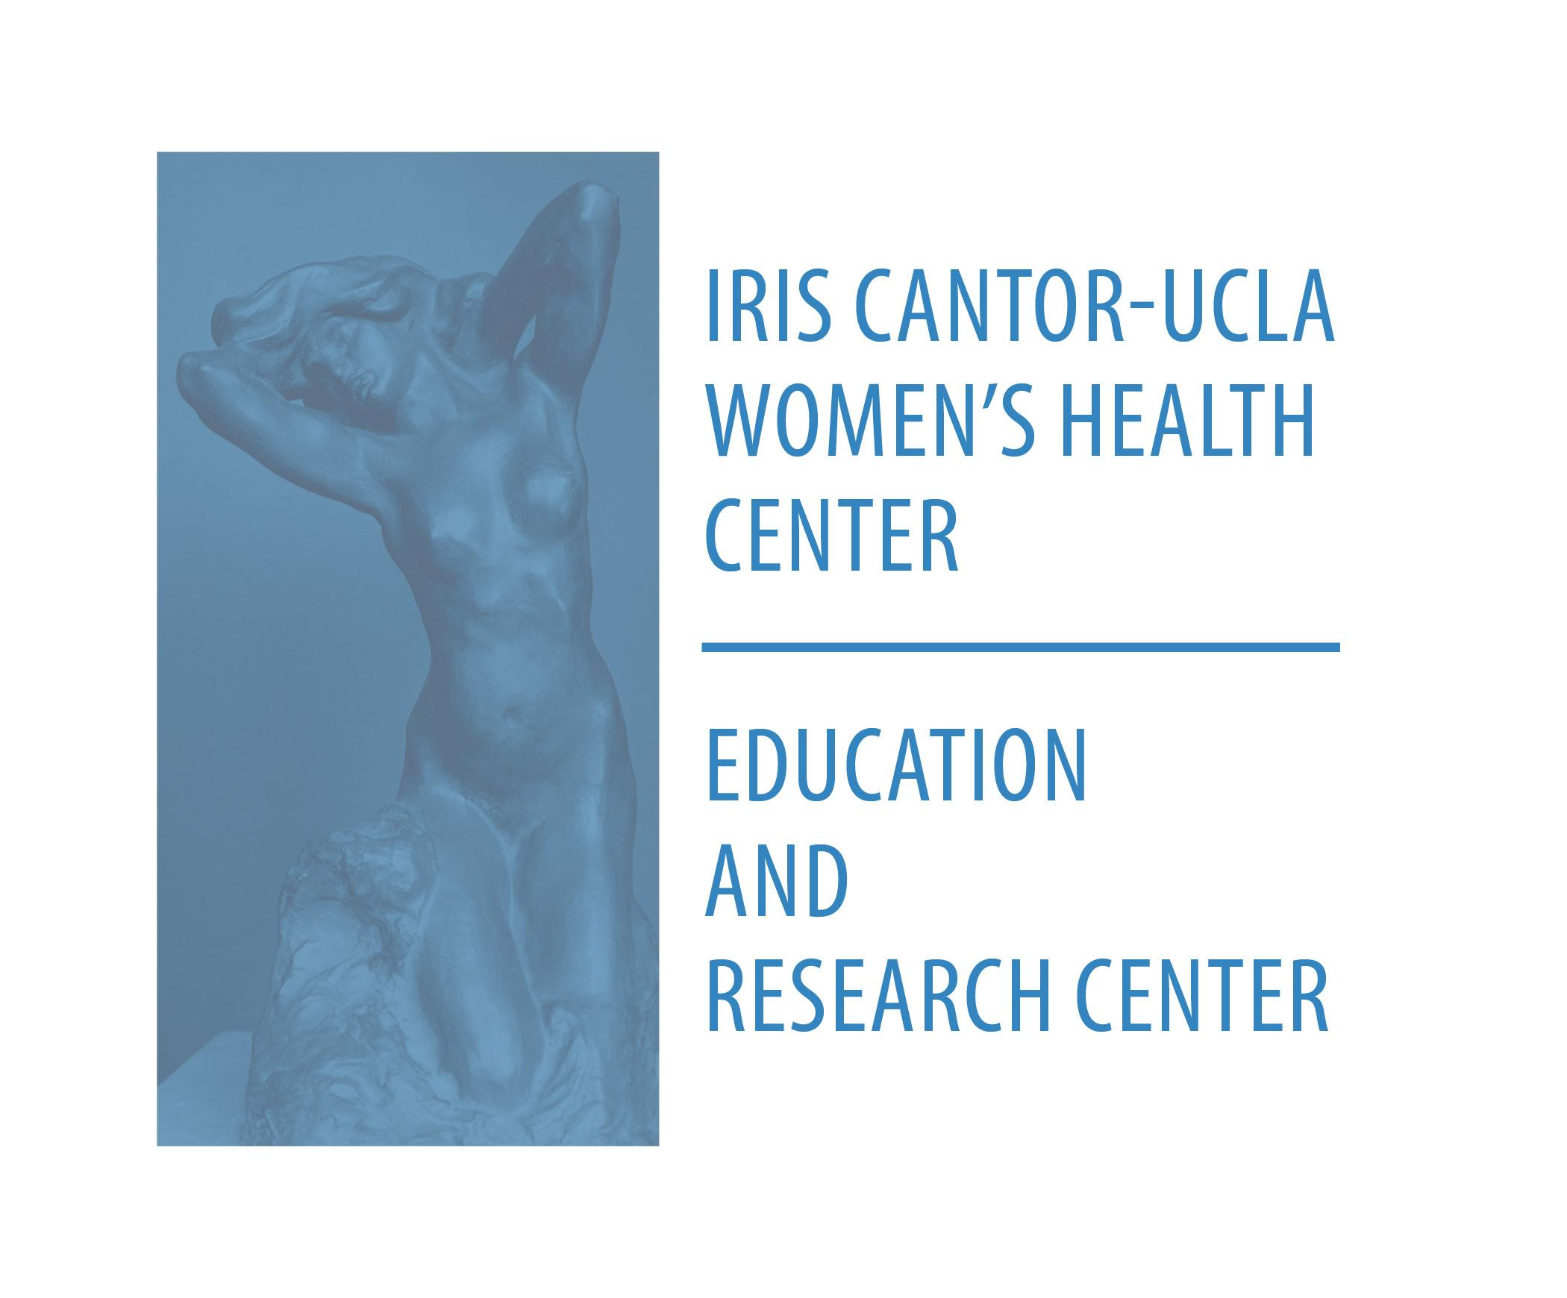
November 2019
Notes:
Introduction:
· Planning for a Healthy Home, Body, and Baby (PHHBB) is a community advocacy and education project. The aim of PHHBB is to reduce damaging exposure from hidden environmental hazards among women of childbearing age.
Target audience:
· PHHBB focuses on educating low-income women of color on how to avoid and/or minimize exposure to toxins, as these women are most at risk for reproductive harm.
· Lower income women of color are more likely to live in the most polluted neighborhoods, be exposed to environmental toxins, and are less likely to have access to preconception education and counseling.
· The program focuses on these women to address the inequitable distribution of both risk and resources.
Program components:
· A curriculum that can be implemented by staff and volunteers from community-based organizations (CBOs) serving the target audience in Los Angeles County that includes a PowerPoint presentation, wallet cards, and other materials.
How to use the facilitator guide:
· The purpose of this facilitator guide is to provide the information you need to be able to present PHHBB workshops to clients or community members served through your organization.
· It includes key talking points that you can cover when conducting it, as well as additional background information to enhance your understanding of the subject matter.
· Given the fact that exposure to environmental toxins is ubiquitous and can create a feeling of overwhelm, it’s suggested that you focus on immediate actions women can take to reduce environmental exposures.
· For this reason, it is not recommended that you include the background information in presentations, unless relevant questions arise.
· That information is there to enhance your knowledge. Having said that, you are encouraged to tailor the information to the needs of your specific audience(s).
· We encourage you to implement it in whatever way is best for your clients or community members. It can be conducted in group health education classes, community workshops, and even offered in individual client sessions, whether they take place within your facility or through home visits. Feel free to adapt the content to fit any of these different settings.
· We’ve also included additional resources with more information for you and/or the community you serve.
For more information, please contact:
Julie Friedman, MPH, CHES
Director
Iris Cantor-UCLA Women’s Health Education & Research Center
1100 Glendon Ave. Ste 800
Los Angeles, CA 90024
jafriedman@mednet.ucla.edu
310-794-8062
http://womenshealth.ucla.edu

Slide 2
November 2019
Notes:
Talking Points
We live in an increasingly toxic world. There are more than 85,000 chemicals in use in the U.S. and more are added each year.
The vast majority of them have not been tested to determine the risks they pose to human health or the environment.
This makes it important to have the information we need to make healthier choices and be smart consumers.
Empowering ourselves with this information and making small changes can help us protect ourselves, our families, the community, and the environment.
Background Information and Resources
The precautionary principle states that when an activity raises threats of harm to humans or the environment, precautionary measures should be taken even if some cause and effect relationships are not fully established scientifically and that the proponent of an activity, not the public, should bear the burden of proof.
In the U.S., the precautionary principle has not been applied to the regulation of chemicals.

Slide 3
You often cannot see, smell, or taste chemicals
Notes:
Talking Points
Chemicals are all around us, yet we usually cannot see, smell, or taste them.
They may be in the food we eat, the water we drink, the products we use, and the air we breathe.
We’re in contact with them daily and they are accumulating in our bodies.
This exposure may not make us sick right away. With some chemicals, it can take time for health conditions to develop and we may not receive any early warning signs.
Or if we do, we may not realize the cause until it’s too late.
Chemicals are linked to many health issues? What are a few of the health conditions that can develop from exposure to toxins?
(Cancer, thyroid disease, infertility, low birth weight, birth defects, learning disabilities, behavioral problems in children like ADHD, digestive issues, asthma/allergies, neurologic disease like Parkinson’s and Alzheimer’s, heart disease, weight gain, diabetes)
This makes it extremely important for us to take a preventative approach and do what we can to minimize our exposure to the chemicals that we know can cause harm.

Slide 4
Neighborhoods and workplaces affect health
Notes:
Talking Points
Chemicals are everywhere in the environment, including places where we spend a lot of time like our neighborhoods and workplaces.
Some neighborhoods are more polluted than others and some workplaces pose more of a risk depending on the type of job.
Why are some neighborhoods more polluted than others?
What types of jobs put workers more at risk of exposure to toxins?
(Jobs with increased risk of chemical exposure include: assembly plants, farm workers, nail salon workers/cosmetologists, housekeeping, construction, oil refinery, auto repair, battery manufacturing/recycling, welding)

Slide 5
Impact of Hidden Environmental Hazards on Communities
African-American and Latino communities are especially exposed to toxins
Notes:
Talking Points
Environmental toxins are a reproductive justice issue because lower income communities, particularly those of color, are more likely to be exposed to harmful substances compared to their higher income counterparts.
Particularly those of color, are more likely to be exposed to harmful substances compared to their higher income counterparts.
Suggested Question: What are some examples of how communities of color are more contaminated?
Background Information and Resources
Reproductive justice is the human right to maintain personal bodily autonomy, have or not have children, and parent the children we do have in safe and sustainable communities.
Low-income communities of color tend to have more freeways, industrial facilities, diesel polluted ports, and hazardous waste.
Housing in low-income areas also tends to be less well maintained by landlords.

Slide 6
Harmful chemicals are toxic
Everybody absorbs harmful chemicals from their environments
These chemicals may cause problems during pregnancy
Notes:
Talking Points
While chemical exposure can harm anyone, women and children are particularly vulnerable. Women are more vulnerable due to their reproductive capacity. There are particular risks during pregnancy since the toxins in a woman’s body can be transferred to the fetus and to the baby through breastmilk.
Research has proven that breast milk is still healthier than formula.
Women can also be more at risk since they tend to be exposed more through cosmetics, personal care products, and household cleaners.
Children are particularly vulnerable to all toxic chemical exposures because their organs, nervous systems, and immune systems are still developing. This increases their susceptibility to chemical exposure
Background Information and Resources
Breast milk is the ideal food for babies since it provides optimal nutrition in a form that is more readily digested and absorbed, which results in fewer digestive conditions. Breast milk contains antibodies that reduce the risk of ear, urinary tract, and respiratory infections.
Breastfeeding also reduces the risk of SIDS, childhood cancer, type 1 and 2 diabetes, allergies, and asthma. Breastfeeding enhances bonding between woman and baby.
Benefits for women include faster postpartum recovery, faster weight loss, and decreased risk of ovarian and breast cancer.

Slide 7
Health Concerns
Problems for parents:
Trouble getting pregnant
Difficulties during pregnancy
Miscarriage
Asthma
Cancer
Notes:
Talking Points
It’s important to reduce exposure to toxins because they can affect maternal and child health. Such as:
Toxins can affect fertility in women and men. Many chemicals are endocrine disruptors, which are substances that interfere with the normal function of hormones in the body.
Increase the risk of miscarriage and complications during pregnancy, such as premature birth.
Maternal exposure to harmful chemicals can impact children’s health years after birth.
Other effects on children may not be seen until they are older, such as learning problems or even cancer.
Background Information and Resources
Endocrine disruptors are chemicals that interfere with the hormonal system and can have harmful effects on reproduction, development, the nervous system, and immunity.
Endocrine disruptors can mimic naturally occurring hormones in the body, including estrogen, testosterone, and thyroid hormones.
Endocrine disruptors include: Pesticides, lead, phthalates, cadmium, PCBs, dioxins, BPA, parabens, triclosan, and perfluorochemicals in nonstick cookware.
Effects can include: Neurological and behavioral changes, obesity, type 2 diabetes, thyroid function, reduced fertility, low birthweight, lowered immunity, cancer (especially breast and prostate

Slide 8
Health Concerns
Problems for children:
Premature birth
Birth defects
Developmental delays
Asthma
Cancer

Slide 9
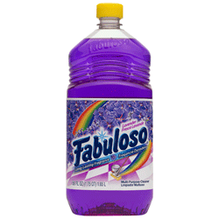
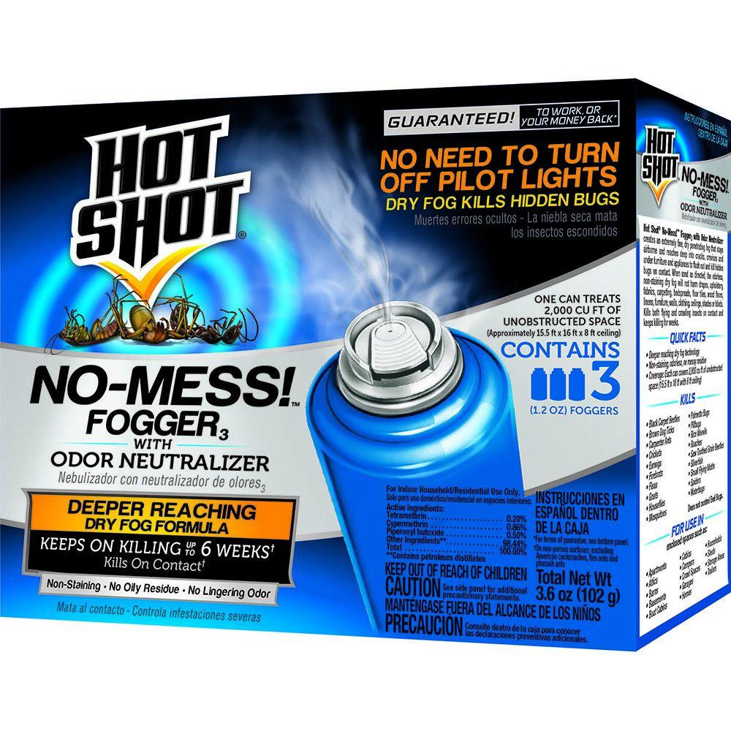
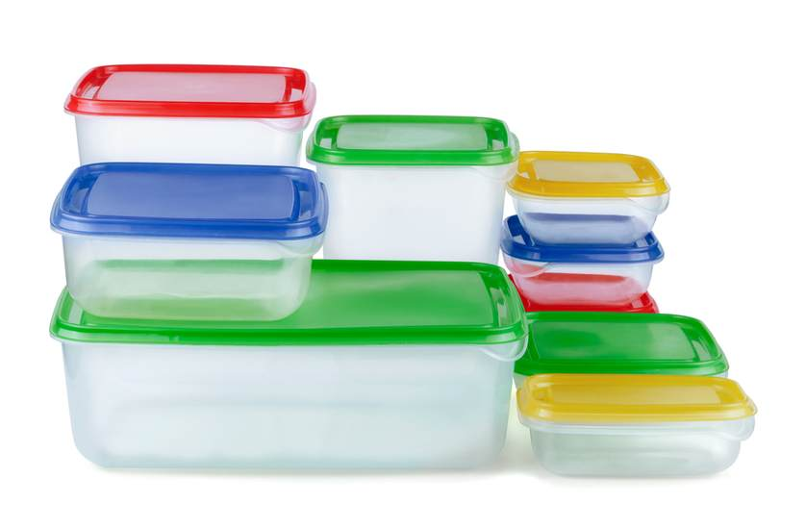
Harmful chemicals can be found in:
Cribs, furniture, and seat belts
Pesticides
Cleaning products
Some metals and plastics
Notes:
Talking Points
Chemicals are all around us, including many of the products and items we use on a regular basis.
We will take a closer look at how each of these poses a risk.

Slide 10
What YOU Can Do!
How to avoid harmful chemicals at home
Notes:
Talking Points
Focus on practical action steps that you can easily take to reduce your exposure and that of your family.

Slide 11
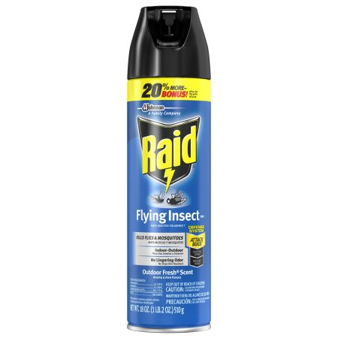
Avoid Pesticides
Bug sprays
Bug bombs
Notes:
Talking Points
Pesticides are toxic chemicals that kills or repel insects, rodents, weeds, bacteria, and mold. They are harmful to human health as well.
Try to avoid bug sprays, bug bombs, and garden pesticides.
Background Information and Resources
Pesticides are endocrine disruptors that can have developmental and reproductive effects, and are linked with cancer, kidney, and liver damage.

Slide 12
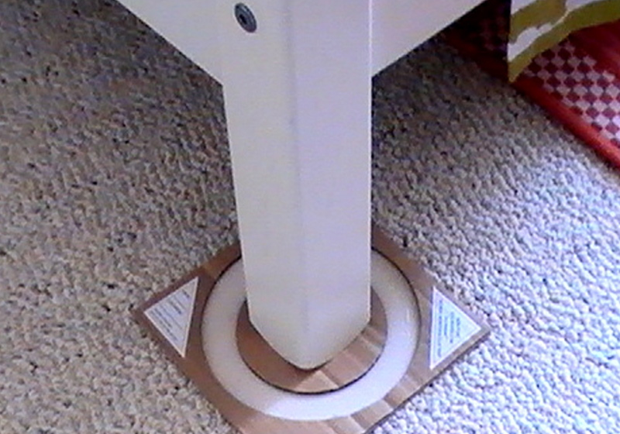
Keeping bugs away
Seal cracks
Clean up crumbs
Use bug traps
Notes:
Talking Points
A safer approach is to prevent bugs from getting into your house in the first place, by:
Sealing cracks
Cleaning up crumbs
Repairing any leaks
If you do have pests, bug traps are a better option.
Background Information and Resources
Boric acid can work to kill roaches by sprinkling it on areas where roaches may hide.
Roaches can also be repelled by mixing two parts water with one part vinegar and 10 drops of peppermint essential oil in a spray bottle.

Slide 13
Avoid Lead Exposure
Peeling paint
Dust
Soil
Lead-soldered pipes
Glazed plates and pottery
Plated jewelry
Old or imported toys
Notes:
Talking Points
Lead is a heavy metal that for many years was added to paint and gasoline. While it was banned from these products in 1978, homes, buildings, and products made before then still may contain lead.
Lead can be found in various places, such as:
Old peeling paint, Old plumbing, Some jewelry, Some glazed plates and pottery, Some candy imported from Mexico or Asia, Some herbal remedies
The biggest risk is lead in dust from peeling or chipping paint in homes built before 1978.
Although exposure can harm anyone, young children are particularly vulnerable because they tend to put hands and objects into their mouth and their bodies and brains are still developing. In children, even low levels can cause learning disabilities and behavioral problems, such as hyperactivity.
Background Information and Resources
Lead is a neurotoxin, which means it can affect the brain and nervous system. Exposure during pregnancy can increase the risk of low birth weight and birth defects.
In adults, lead can cause memory problems, high blood pressure, reproductive problems, depression, sleep issues, headaches, personality changes, fatigue, anemia, and muscle weakness. At high levels, it can cause seizures, coma, and death.
Foods rich in calcium, vitamin C, and iron can reduce the among of lead the body absorbs.

Slide 14
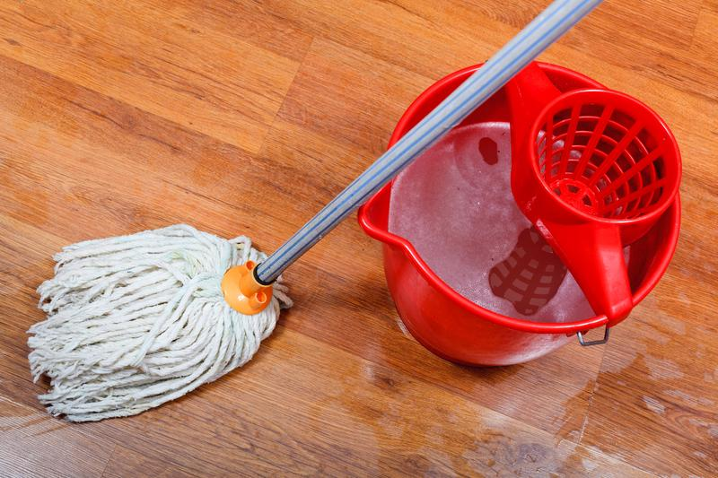
Steer Clear of Lead
USE:
Water-based paints and glues
High Efficiency Particulate Arresting (HEPA) filter vacuums
Wet mops
Notes:
Talking Points
Avoid exposure to lead by using water-based paints and glues.
If possible, use a vacuum with a HEPA filter and/or clean frequently by using a wet cloth/mop.
It’s important to have your children tested for lead at 12 and 24 months. Blood tests can check for lead levels. Older children should also be tested if they weren’t tested earlier.
Background Information and Resources
Lead testing should be done through well child exams and is free to children covered by MediCal or the CHDP program (Child Health Disability Prevention).
Currently, the CDC considers 5 micrograms per deciliter of lead in blood a concern (it used to be 10). Chelation therapy is recommended at 45 micrograms.
When children are tested, it’s important for parents to be given the actual numerical results rather than just being told “it’s negative” or “normal” since no amount of lead in the blood is safe.

Slide 15
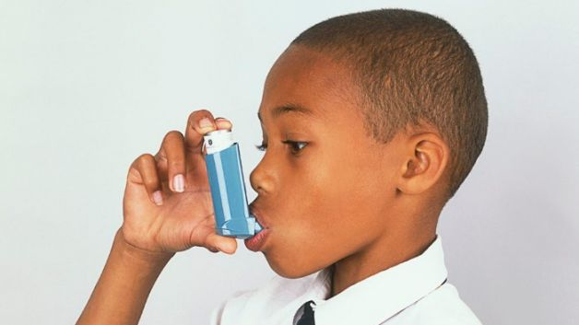
Get rid of dust
Wet mops and vacuums with HEPA filters help remove dust
Dust can trigger asthma
Notes:
Talking Points
Dust can also trigger asthma symptoms. Wet cleaning and using a vacuum with a HEPA filter is important for controlling asthma too.

Slide 16
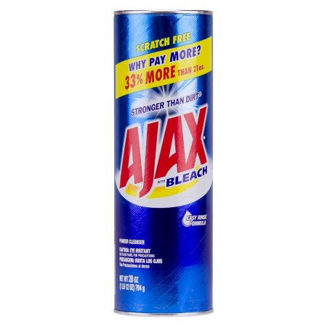
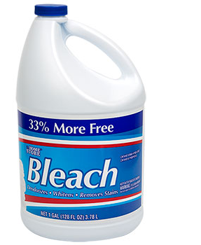
Avoid Strongly Scented Cleaners
PRODUCTS LIKE:
Bleach
Fabuloso and Pinesol
Ajax and Comet
It doesn’t have to smell strong to be clean!
Notes:
Talking Points
The chemicals in these products have been linked with respiratory issues like:
Asthma and allergies
Skin irritations
Damage to eyes and nasal passageways
They are also harmful to the environment by contaminating water
Products that contain ammonia, bleach, or triclosan should be avoided.
Background Information and Resources
Bleach has been linked with asthma and allergies and can cause damage to skin and eyes. It can create toxic fumes if combined with other cleaning products.
Ammonia is an irritant that can be harmful to the eyes, mouth, throat, lungs, skin, and can trigger asthma symptoms.

Slide 17
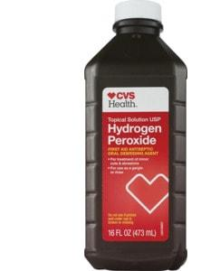
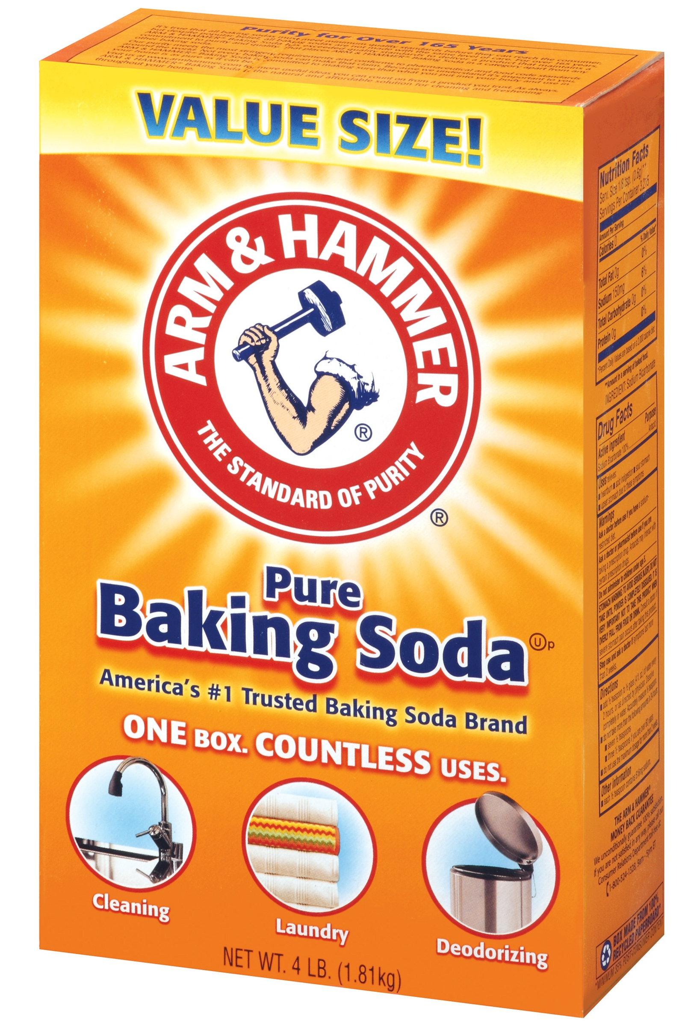
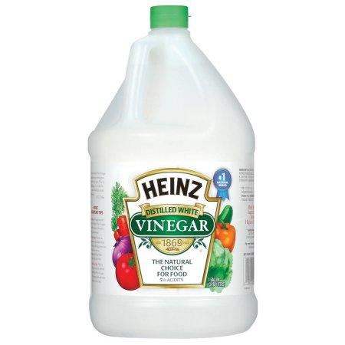
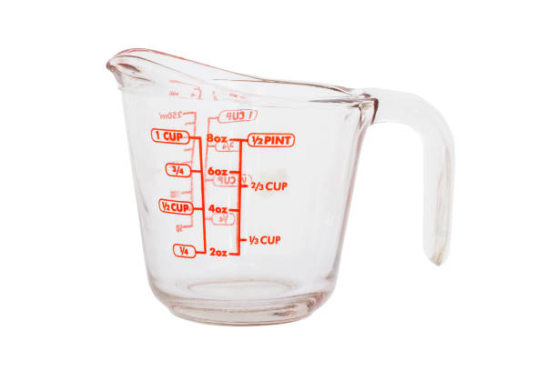
Use Non-toxic cleaners
Vinegar
Sodium bicarbonate (baking soda)
Hydrogen peroxide
Chemical free cleaning solution:
1 cup water + 1 cup vinegar
Notes:
Talking Points
The home does not need to be as sterile as an operating room. It’s unnecessary to disinfect your home to the degree that advertisers and product manufacturers would have you believe.
Non-toxic cleaners are easy to make and can save you money.
A solution of 1 cup water + 1 cup white vinegar can clean and disinfect effectively.
Baking soda can be used for scrubbing sinks, tubs, and toilets.
Lemon can be added for a nice scent and it helps disinfect.
Glass cleaner can be made with 1 cup alcohol, 1 cup water, and 1 tbsp white vinegar.
Background Information and Resources
Hydrogen peroxide, borax, or white vinegar can be added to laundry to help whiten clothing instead of bleach.

Slide 18
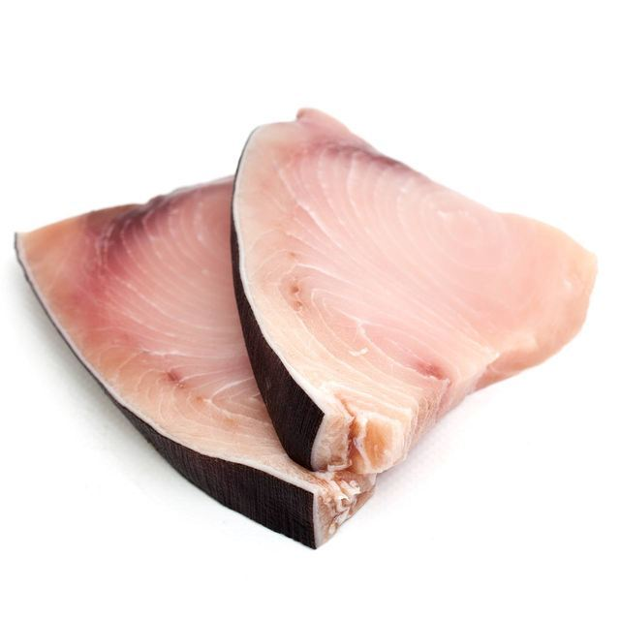
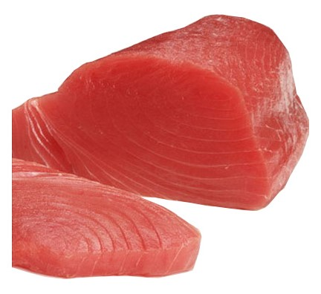
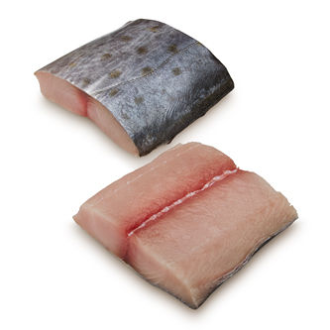
Avoid Big Fish High in Mercury
Shark
Swordfish
King mackerel
Tilefish
Albacore and yellowfin tuna
Notes:
Talking Points
Fish is an important source of Omega-3 fatty acids, which are important for brain and heart health.
Mercury is a heavy metal that can damage the developing brain and nervous system in infants.
We need to choose the right type of fish to avoid excess mercury.
Larger, predatory fish are more contaminated because they eat smaller fish, which leads to higher levels of mercury.
Background Information and Resources
Industrial activities like coal-fired power plants release mercury into bodies of water, which contaminates fish.
Mercury can harm the brain, kidneys, liver, heart, and nervous system.
Mercury exposure during pregnancy can impair development of the baby’s brain and nervous system.

Slide 19
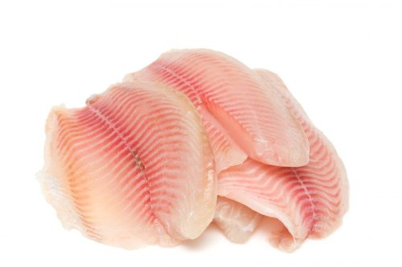
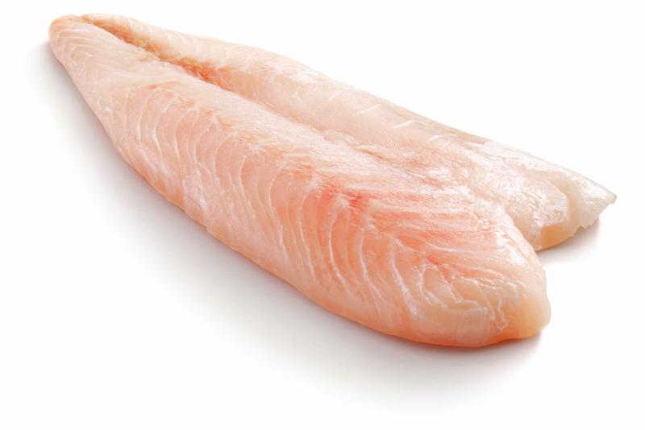
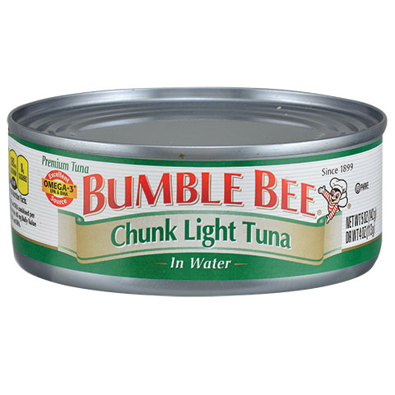
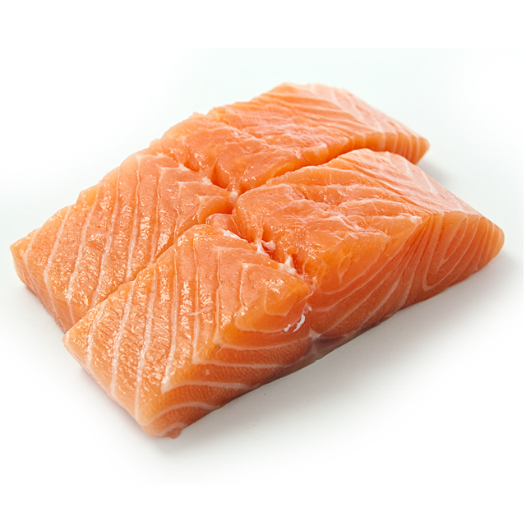
Eat fish with LOW mercury
Wild Salmon
Tilapia
Catfish
Shrimp
Skipjack tuna (light)
Notes:
Talking Points
Safer fish include wild salmon, tilapia, catfish, shrimp, and skipjack or light tuna.
Background Information and Resources
Farmed salmon is high in PCBs.
Other fish that are high in Omega-3 fats and low in mercury include: Sardines, pollock/imitation crab, king crab, mussels, rainbow trout, Atlantic mackerel, oysters, anchovies, and herring.
Marlin, tuna steaks (sushi), and Orange Roughy are also high in mercury.

Slide 20
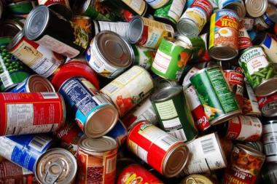
Eat Less…
Canned foods
Food with animal fat
Notes:
Talking Points
Most cans have BPA in the lining, which can leach out and contaminate foods, so it’s best to limit the amount of canned food eaten.
Meats with a lot of fat should be avoided since fat is where the chemicals are stored.
Background Information and Resources
BPA or bisphenol A is an industrial chemical used to make plastics that are used in food and beverage containers and is added to the lining of most food and beverage cans.

Slide 21
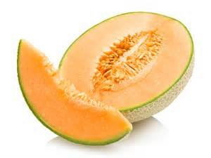
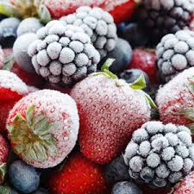
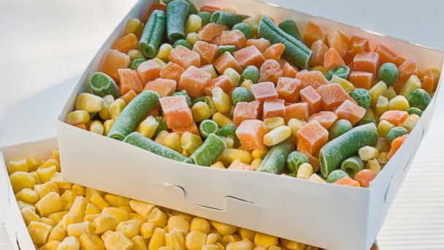
Eat More Fresh or Frozen Produce
Fresh fruits and veggies
Frozen fruits and veggies
Fruits and veggies with thick skins that can be peeled
Notes:
Talking Points
Buy organic produce to avoid pesticides.
A safe and cheaper option is to buy fruits and vegetables with thick skins that can be peeled, like bananas, melons, avocados, and oranges.
Background Information and Resources
Pesticides can contribute to brain and nervous system toxicity, cancer, and hormone disruption.

Slide 22
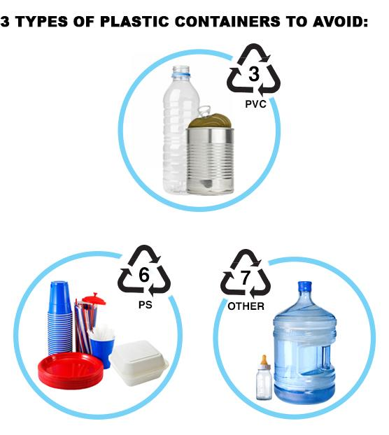
Avoid plastic containers 3, 6, and 7
3
Canned foods
Disposable water bottles
6
Disposable cups and plates
Plastic straws
7
Some baby bottles
Notes:
Talking Points
Plastic contains various toxins, such as BPA, that can leach into whatever it comes in contact with.
Those that are labeled with the numbers 3, 6, and 7 should especially be avoided.
Background Information and Resources
BPA is a plasticizer that is used to make plastics hard and rigid. It was originally developed as a synthetic form of estrogen so it is also an endocrine disruptor that can disrupt normal hormone levels.
BPA is linked with hyperactivity, early puberty, prostate issues, and obesity.

Slide 23
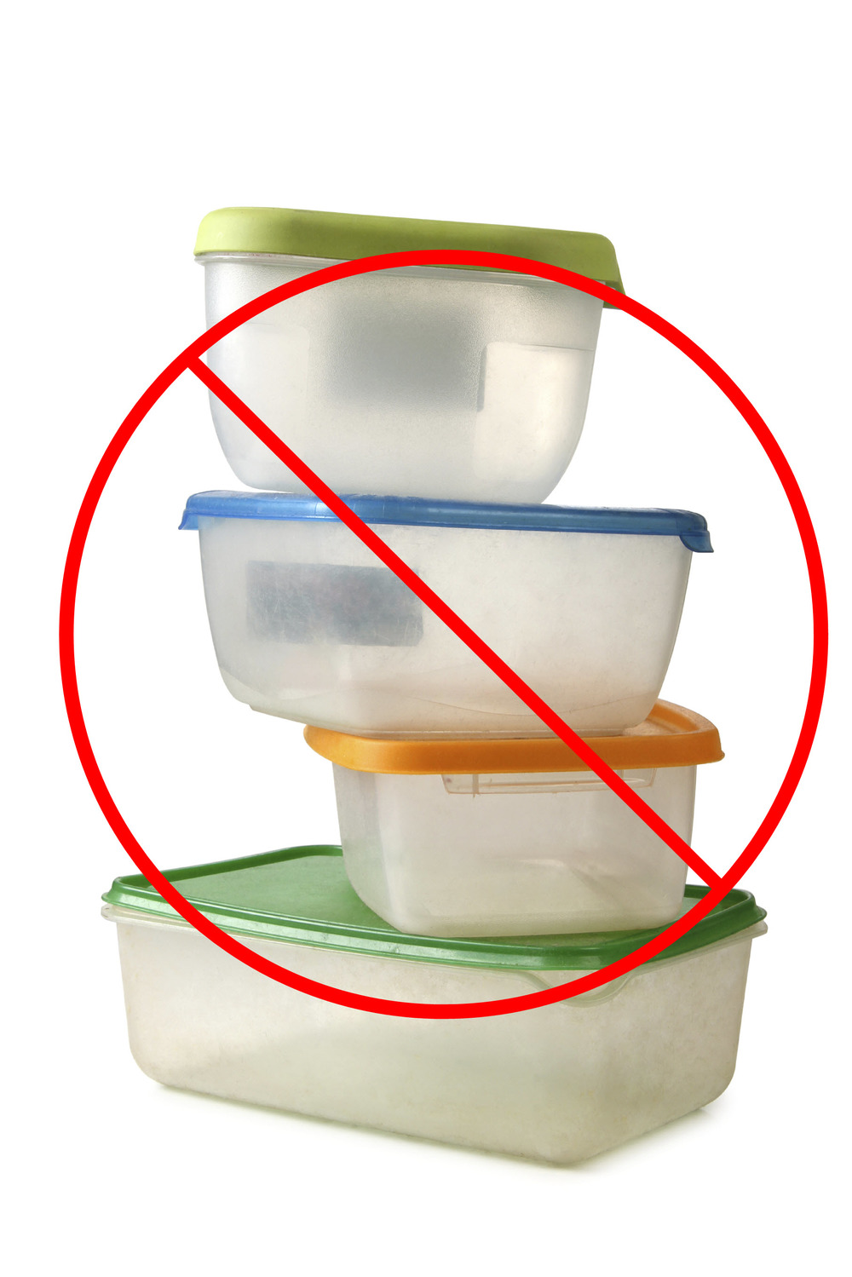
Avoid refrigerating and microwaving plastics
Refrigerating and microwaving plastic can release chemicals into your food
Notes:
Talking Points
Refrigerating and microwaving plastic containers can release chemicals into your food and liquids.

Slide 24
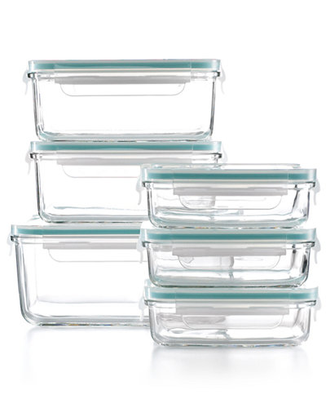
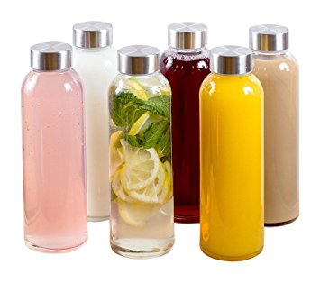
Use glass and Stainless Steel containers
These are safe and reusable
Notes:
Talking Points
Instead of plastic, store food in glass or ceramic containers.
Drink water from glass or stainless steel reusable bottles.
Plastic bottles that are BPA-free are not safe.
Background Information and Resources
Manufacturers replaced BPA in some products, like water bottles and baby bottles with BPS, BPF, or BPAf, which are not much different than BPA.

Slide 25
Water Quality
Water has naturally occurring
and added chemicals, nutrients, and minerals
The quality of drinking water can vary depending on where it comes from and where you live
Public water suppliers are required to routinely test their water and reduce impurity levels
Notes:
Talking Points
The federal government regulates tap water for impurities.
Tap water is more regulated than bottled water.
The quality can vary depending on where you live.
Background Information and Resources
The Environmental Protection Agency (EPA) regulates tap water by setting limits on the level of contaminants that are allowed in drinking water by local utilities.
The FDA uses similar standards to regulate the safety of bottled water, but tap water is tested more frequently.

Slide 26
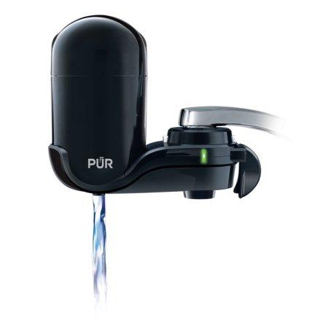
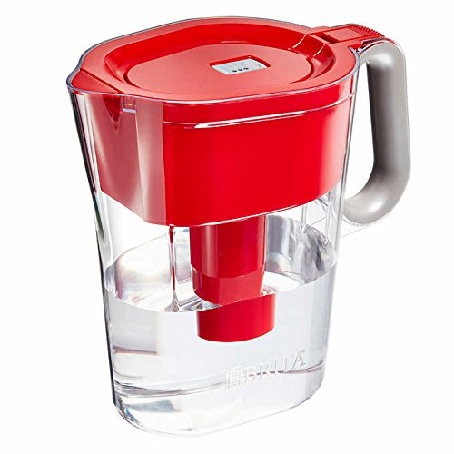
Drink Filtered
Tap Water
Bottled water is NOT better than tap water!
Reusing disposable water bottles is harmful
If concerned about lead in your pipes, flush your tap with cold water for 1-2 minutes
Fluoride in tap water prevents tooth decay in children and adults
Notes:
Talking Points
Bottled water can be contaminated from the chemicals in plastic, so it’s best to drink filtered tap water in most cases.
Plastic from bottled water is harmful for the environment.
Those who are unsure of the condition or age of the pipes in their home should run the cold water for 1-2 minutes before using it.
Background Information and Resources
It takes three times the water to manufacture a water bottle than the water it takes to fill it.
17 million barrels of oil are used each year to make water bottles.
It’s estimated that most water bottles are not recycled.
The fragments the water bottles break into pollute the water and soil.

Slide 27
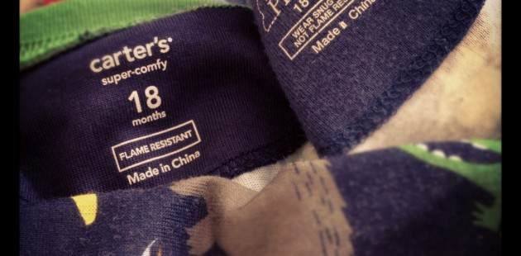
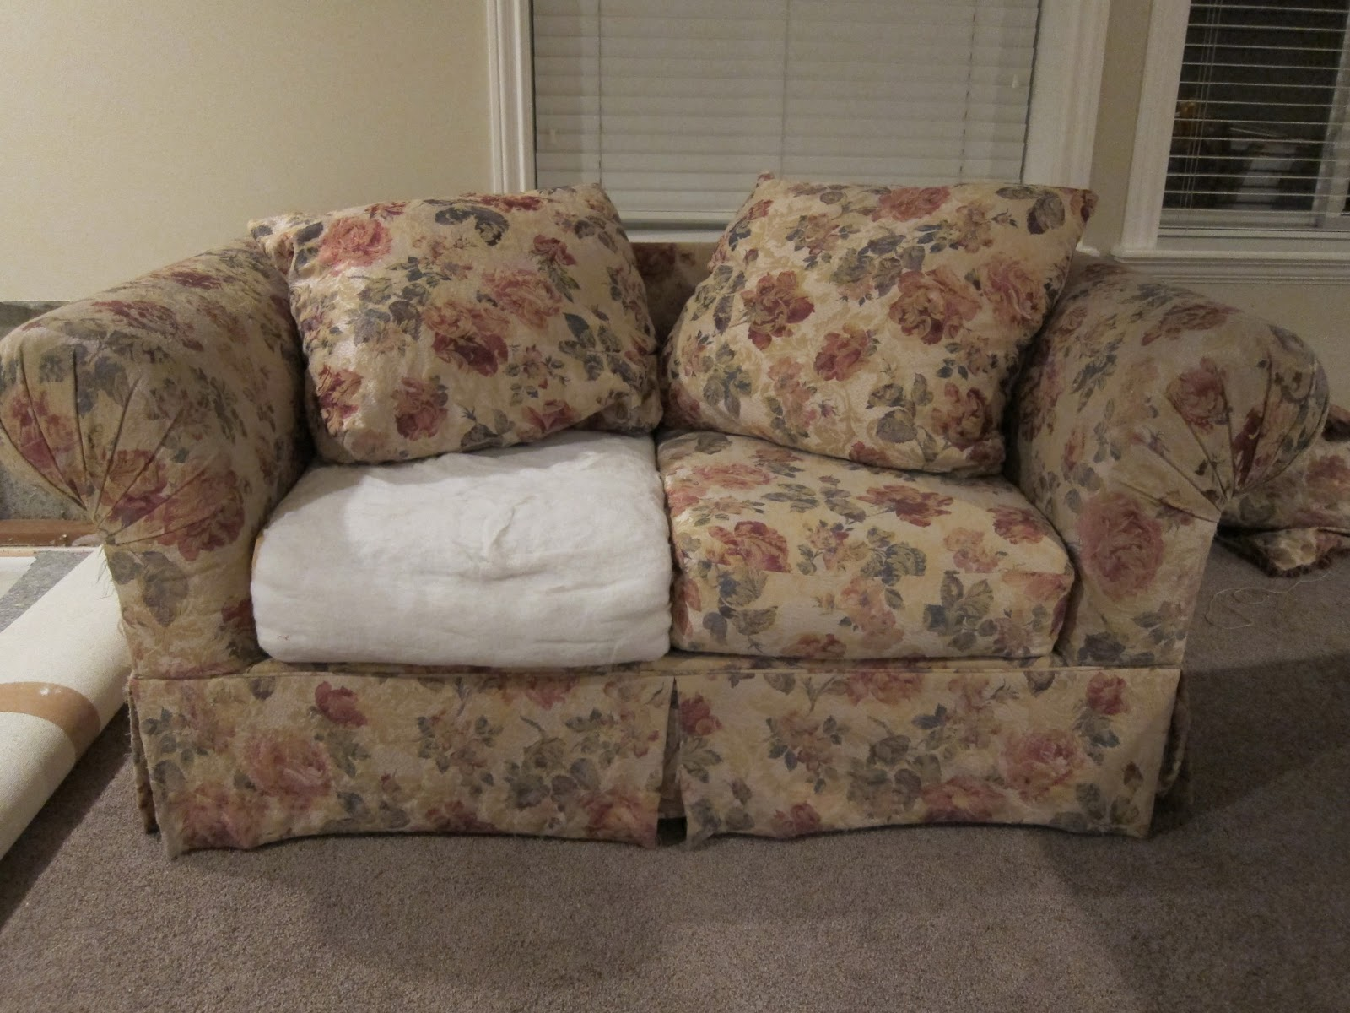
Avoid flame retardants
CAN BE FOUND IN SOME:
Foam baby items
Baby clothes
Furniture upholstery
Carpet
Notes:
Talking Points
Products containing flame-retardants have PBDEs that can be harmful, especially since these types of products, like sofas, baby clothing, etc. come in close contact to our bodies on a frequent basis.
Background Information and Resources
PBDEs or polybrominated Diphenyl Ethers are chemical flame retardants that were added to polyurethane foam products and electronics made before 2005. Although they are no longer in use, they are persistent chemicals that remain in the environment.
PBDEs are endocrine disruptors and can affects a child’s development.

Slide 28
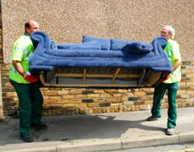
Avoid flame retardants
Buy products labeled “flame retardant free”
Wash hands before eating
Dispose of damaged cushioning
Notes:
Talking Points
Avoid crib mattresses, nap mats, and other upholstered products with flame retardants by looking for labels that state “flame retardant free.”
Washing your hands and your children’s hands before eating can also help.
Background Information and Resources
Since the chemicals can be found in household dust, wet cleaning is also recommended for minimizing exposure to flame retardants.

Slide 29
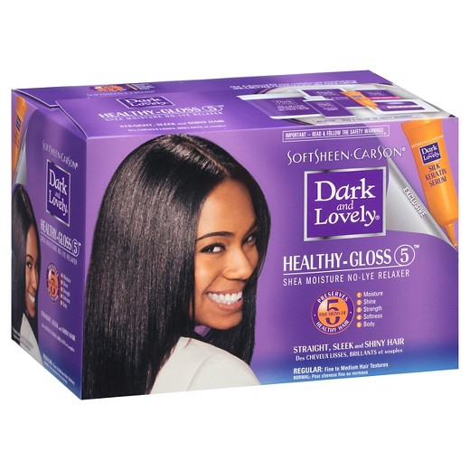
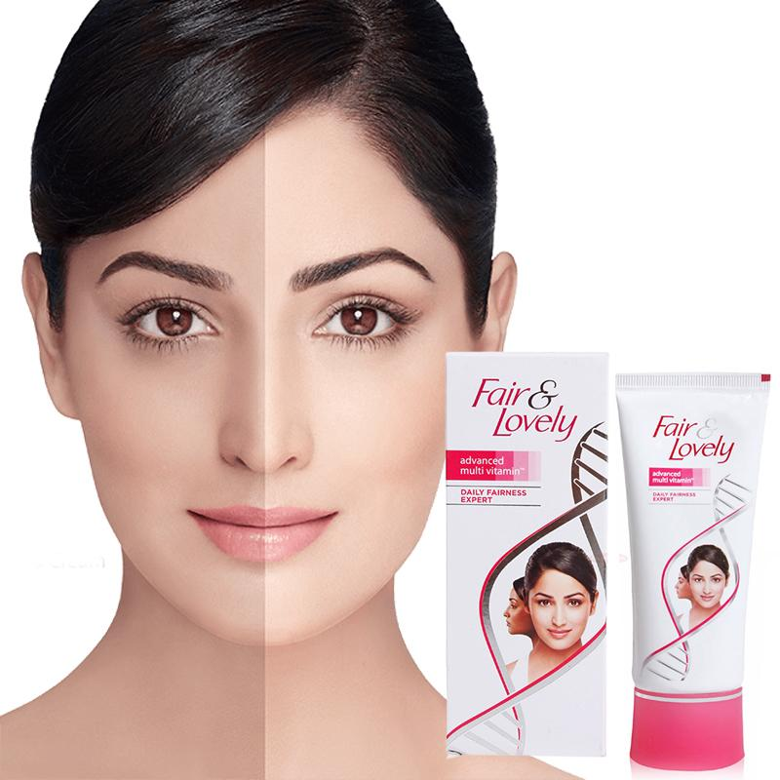
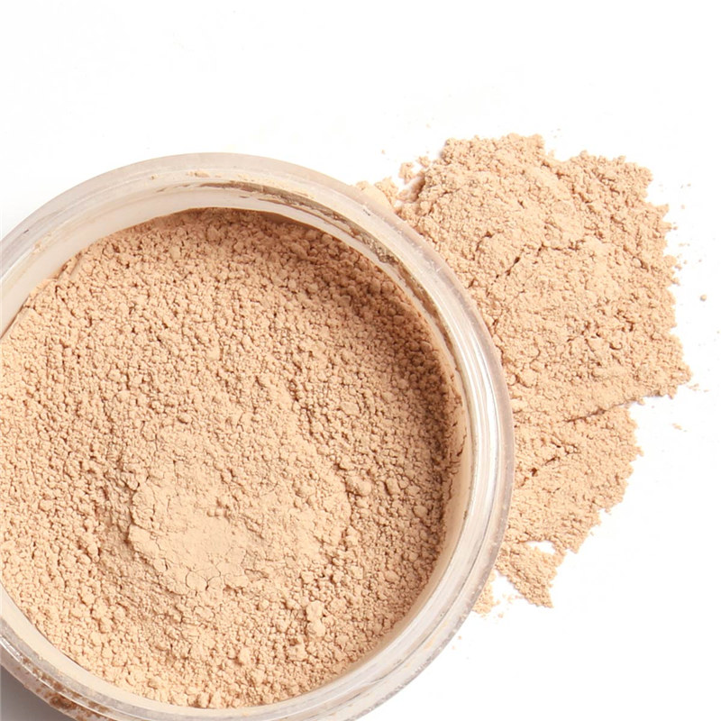
Avoid harmful beauty products
Hair straighteners
Skin lighteners
Benzyl Salicylate
Hydroquinone
Perfumes
Hair dyes
Loose powder
Lead
Propylparaben
Fragrance
Notes:
Talking Points
Personal care products used on a daily basis often contain many chemicals which may be harmful to health.
While a single product may contain a small amount of toxins, women often use many different products, increasing the level of chemicals they are exposed to.
It’s best to limit exposure of non-essential personal care products or choose those without harmful chemicals.
Background Information and Resources
Synthetic fragrances and other personal care products have phthalates, which are endocrine disruptors and are linked to abdominal obesity and insulin resistance, as well as other hormonal alterations.
Hair straighteners contain formaldehyde, which is a carcinogen. They can also cause allergy or irritation.
Hair dyes pose risk of allergy and darker, permanent dyes pose cancer risk.
Loose powders pose risk of inhalation and some contain parabens, which increase breast cancer risk.
Skin lighteners can cause irritation and some contain mercury.

Slide 30
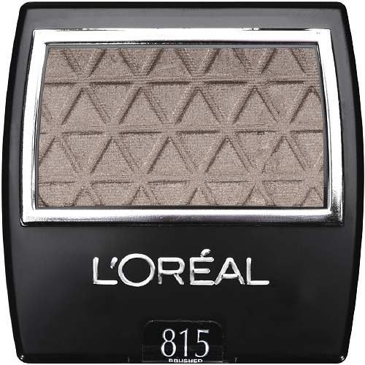
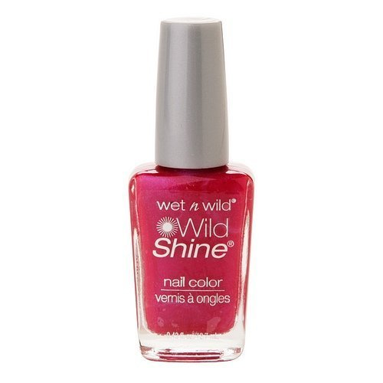
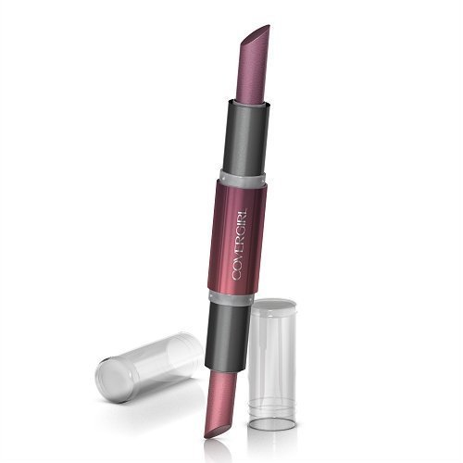
Read Labels
Minimize using products with:
Toluene
Nail polish and treatments
Dibutyl Phthalate (DBP)
Nail polish and treatments
Formaldehyde
Nail polish and treatments
Eyelash glue
Triclosan
Soap, body wash
Toothpaste
Parabens
Makeup: foundation, lipstick, eye shadow, eye liner, mascara, powder, lip gloss, etc.
Notes:
Talking Points
Read product labels and look out for the most harmful chemicals listed here: Toulene, Dibutyl Phthalate (DBP), formaldehyde, triclosan, and parabens.
Background Information and Resources
Toulene is linked with reproductive and respiratory harm.
DBP is a reproductive and developmental toxin and can be an ingredient in some soft plastics, like shower curtains, raincoats, food wraps, and bowls.
Formaldehyde is a carcinogen.
Triclosan is an ingredient in some liquid hand and dishwashing soaps and other personal care products like toothpaste. It is an endocrine disruptor that can affect thyroid hormones.
Parabens are linked with reproductive harm (decreased sperm, early puberty) and breast cancer.

Slide 31
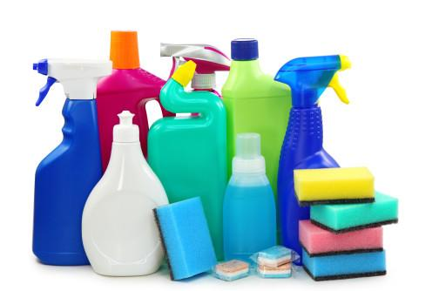
No label? Don’t buy!
Saving up for a few good products is better than many cheap and dangerous products.
Better to be safe than sorry!
Notes:
Talking Points
If a product label does not contain an ingredient list, don’t buy it no matter how cheap it is, as it’s better to be safe than sorry.

Slide 32
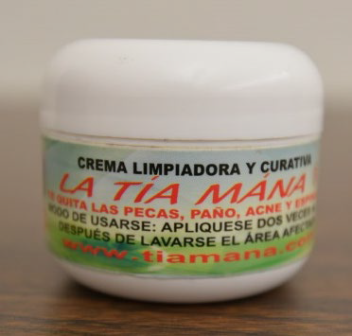
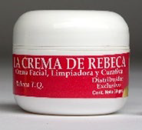
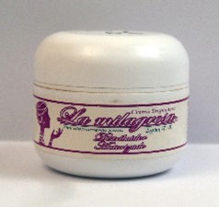
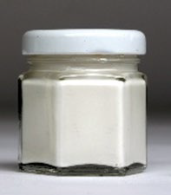
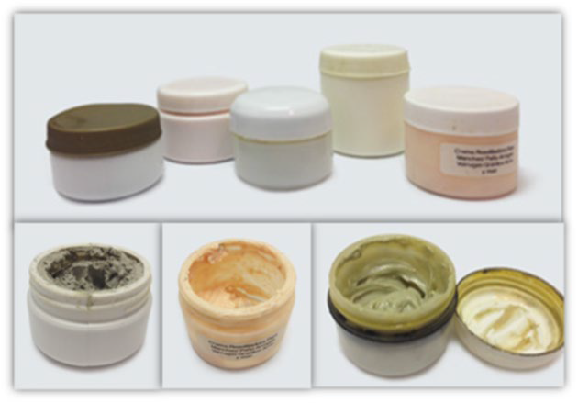
Mercury in Face Creams
Imported or unlabeled face creams used to lighten age spots or get rid of wrinkles, freckles, acne, or other blemishes can have mercury in them
Mercury is a poison. Its symptoms can be hard to see or feel.
Mercury from creams has sent children, teens, and women to the hospital
If you use these creams, see your doctor and ask for a urine test for mercury
For more information, visit http://bit.ly/MercuryinCream,call (510) 981-4354 or email AskEHIB@cdph.ca.gov

Slide 33
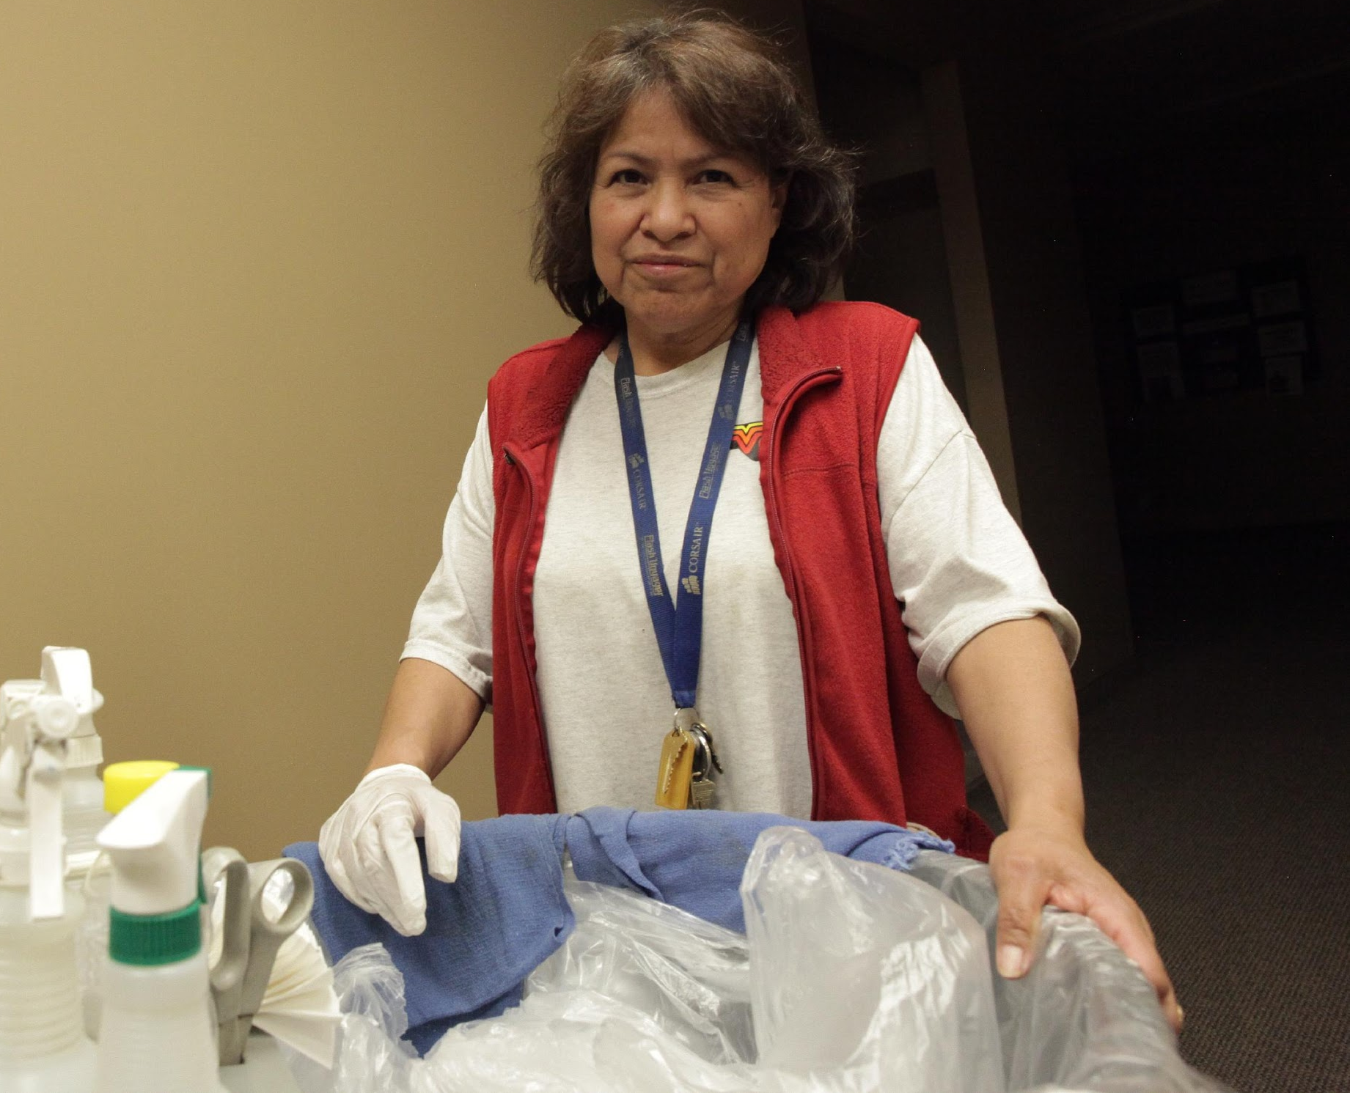
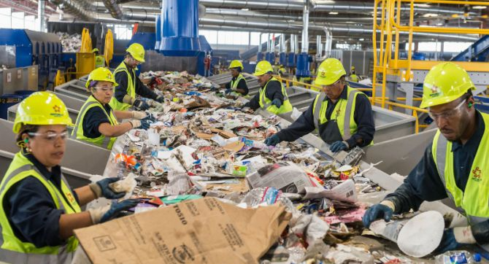
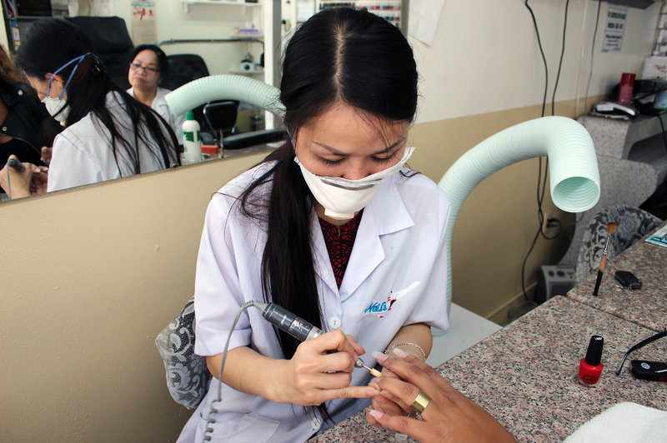
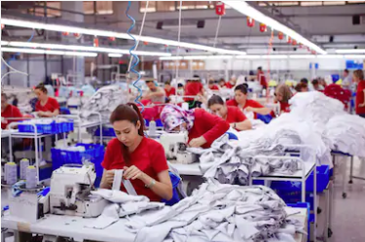
Minimizing Exposure From Work
Notes:
Talking Points
Workers in certain industries are more likely to routinely come into contact with toxins.
Background Information and Resources
https://www.osha.gov/workers/

Slide 34
Limit contact with chemicals
Frequently wash your hands
Use gloves
Use protective gear
Notes:
Talking Points
It’s important to limit exposure to toxins by following workplace safety procedures, such as frequent hand washing, wearing gloves, and using other protective gear that is provided.
Background Information and Resources
Workers can inform themselves about the chemicals in use at their workplace by reading the Material Safety Data Sheets (MSDS) and checking labels.
Guidelines for ventilation, preventing spills, and minimizing release of chemicals into the air should also be followed by both the employee and employer.

Slide 35
Workplace advocacy
Workplace wellness programs promoted by employers are a cost effective way of improving your health!
Notes:
Talking Points
Some companies have workplace wellness programs that can be a cost-effective way of supporting employees to improve their health.

Slide 36
Separate clothing worn at work from those worn at home
Change clothes before going home
Shower immediately when returning home
Wash your work clothes separately
Leave shoes at the door
Notes:
Talking Points
Those who work at jobs with chemicals should take precautions to avoid exposing other family members in the home by changing their clothes before going home, washing their clothes separately and leaving shoes at the door.

Slide 37
Community Advocacy
Community Organizing
Legal Advocacy
Tenants’ Rights
Workers’ Rights
Notes:
Talking Points
In addition to taking action steps to protect ourselves, there are organizations that engage in collaborative work, such as community organizing, legal advocacy, research, and tenant’s rights in order to protect communities that are most at risk.

Slide 38
Tenant Rights
Right to a lead-free, mold-free, safe and healthy home
Protected by an implied warranty of habitability, which includes complying with state and local building and health codes
All residences must comply with state and local building health codes
Notes:
Talking Points
Tenants have the right to live in a lead-free, mold-free, and safe home that meets the state and city building codes.
Unfortunately, in low-income areas, landlords don’t always comply with these laws.

Slide 39
Reporting Housing Hazards
LA Housing and Community Investment Department (HCID)
1-866-557-RENT (7368)
http://hcidapp.lacity.org/ReportViolation/Pages/ReportViolation
*Responds in 24-72 hours
LA County Environmental Health Services
1-888-700-9995
Notes:
Talking Points
There are city and county departments that will investigate complaints from tenants about housing violations.

Slide 40
Healthy Homes
Community education
Home visits by Promotoras de Salud
Hazard assessment of indoor/outdoor environment
Prevent lead poisoning and asthma triggers from injuring families
Notes:
Talking Points
There are also community based organizations that advocate for tenant’s rights and some work in collaboration, such as the Healthy Homes Collaborative, to support families who may be exposed to lead or asthma triggers.
Background Information and Resources
http://www.esperanzacommunityhousing.org
https://www.wellchild.org
https://www.saje.net

Slide 41
Environmental Working Group’s
Databases
ewg.org
Notes:
Talking Points and Background Information and Resources
EWG is a helpful resource for information on environmental toxins.
Each year they test all produce to determine the level of contamination from pesticides and develop a list of the most contamination (Dirty Dozen) and the least contaminated (Clean 15).
https://www.ewg.org/foodnews
2019 Dirty Dozen: Strawberries, spinach, kale, nectarines, apples, grapes, peaches, cherries, pears, tomatoes, celery, potatoes.
2019 Clean 15: Honeydew melon, mushrooms, broccoli, cantaloupe, cauliflower, cabbage, kiwi, asparagus, eggplant, papayas, onions, peas, pineapple, corn, avocados.
EWG also has a database where you can enter your zip code to find out if the water in your area meets federal water quality standard, what contaminants are in it, and what to look for in a water filter.
https://www.ewg.org/tapwater
EWG’s Skin Deep Cosmetics Database is a great resource that provides ratings for a wide range of personal care products and ingredients.
https://www.ewg.org/skindeep
EWG also has a “Healthy Living” app that allows you to scan a product to review its rating so you can choose safer food and personal care products.

Slide 42
Developed by:
The Iris Cantor-UCLA Women’s Health Education & Research Center
1100 Glendon Ave, Suite 800
Los Angeles, CA 90024
www.womenshealth.ucla.edu
Julie Friedman, MPH, CHES
Director
jafriedman@mednet.ucla.edu
310-794-8062
Contact:
Notes:
Talking Points
What action steps will you commit to taking to reduce your chemical exposure or the exposure of your family?
Thank you!

Slide 43
Access this presentation at: http://womenshealth.ucla.edu/phhbb or http://phhbb.shutterfly.com

