Slide 1


Family Medicine Research Unit
Monthly Meeting
March 2025

Slide 2
Recently Submitted Proposals (since last meeting)
PI | Title | Sponsor | Prime Sponsor | Program Type | Overall Proposal Type | Project Begin Date | Project End Date
Shoptaw, Steven J | Promoting PrEP Uptake in Methadone Maintenance Treatment in Vietnam | Hanoi Medical University (Vietnam) | NIH | Clinical Research | New | 12/1/2025 | 11/30/2028
Shoptaw, Steven J | Family-Supported Screening, Treatment and Retention of Youth Who Use Methamphetamine (Family-STAR) | Hennepin Healthcare Research Institute | NIH | Clinical Research | New | 12/1/2025 | 11/30/2030
Gelberg, Lillian | Effect of an Adapted Community-Based Biofeedback Program on Mental Health among People Experiencing Homelessness | UNIVERSITY OF CALIFORNIA, IRVINE | NIH | Clinical Research | Resubmission - New | 12/1/2025 | 11/30/2030

Slide 3
Recently Processed Awards (since last meeting)
PI | Award Title | Sponsor | Prime Sponsor | Action Type | Project Period Begin Date | Project Period End Date
Gelberg, Lillian | mHealth to Enhance & Sustain Drug Use Reduction of the QUIT BI in Primary Care | NIH-NIDA | - | No Cost Extension | 06/01/2020 | 03/31/2026
Gelberg, Lillian | Effectiveness of the Diabetes Homeless Medication Support (D-HOMES) Project on Diabetes Management | Hennepin Healthcare Research Institute | NIH-NIDDK | New | 01/01/2025 | 11/30/2029
Shoptaw, Steven J | NIDA Clinical Trials Network: Big South/West Node | UT Southwestern Med Center at Dallas | NIH | New | 03/01/2025 | 09/01/2025
Shoptaw, Steven J | Nguyen, Birch Diep: 2024 National Institute on Drug Abuse (NIDA) International Visiting Scientists and Technical Exchange Program (INVEST) Clinical Trials Network Drug Use and Addiction Research Fellowship | IQ Solutions, Inc. | NIH-NIDA | No Cost Extension | 04/30/2024 | 07/31/2025
Butler, Derrick | Pacific AIDS Education and Training Center (PAETC) (2024-2029) | UCSF | DHHS-HRSA | New | 07/01/2024 | 06/30/2029

Slide 4
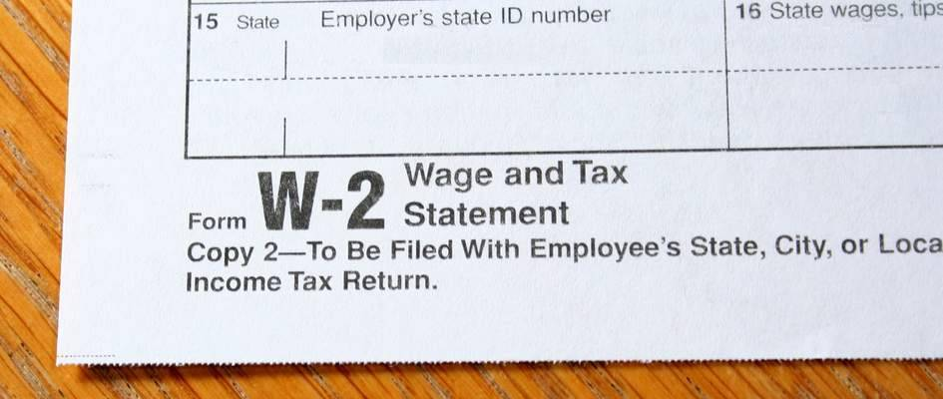
W2’s
If you signed up to receive your W2 electronically, you should have received an email letting you know it is available for download in UCPath.
UCLA will never email or text
you your W2.
If you did not sign up to receive
it electronically, it will be
mailed.

Slide 5
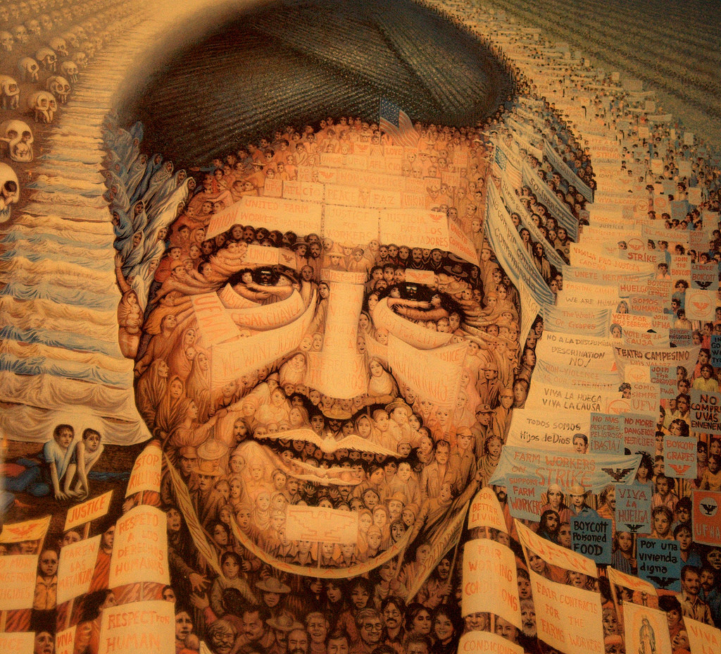
Upcoming Holidays
March 28, 2025
Cesar Chavez Day

Slide 6
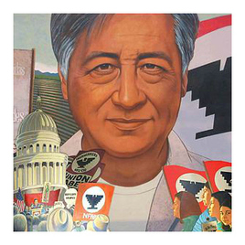
Grand Rounds
No Grand Rounds
For March 2025
Join us in April!

Slide 7
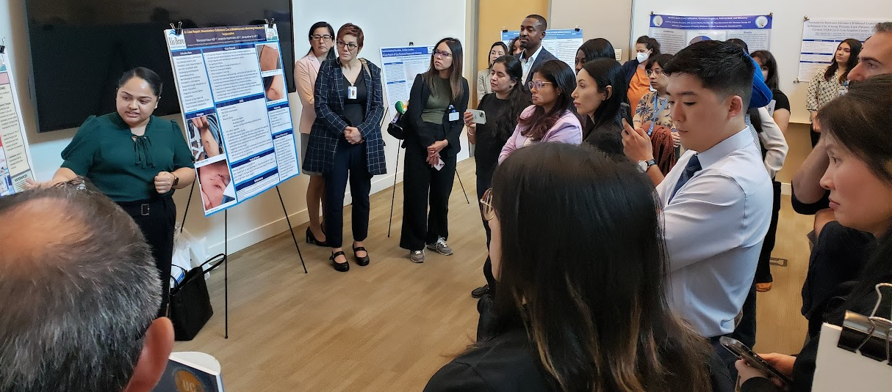

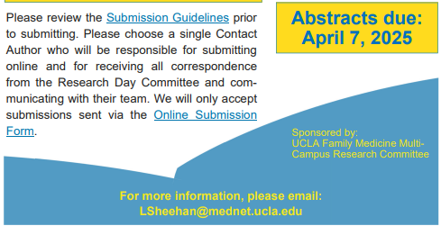
Research Day

Slide 8
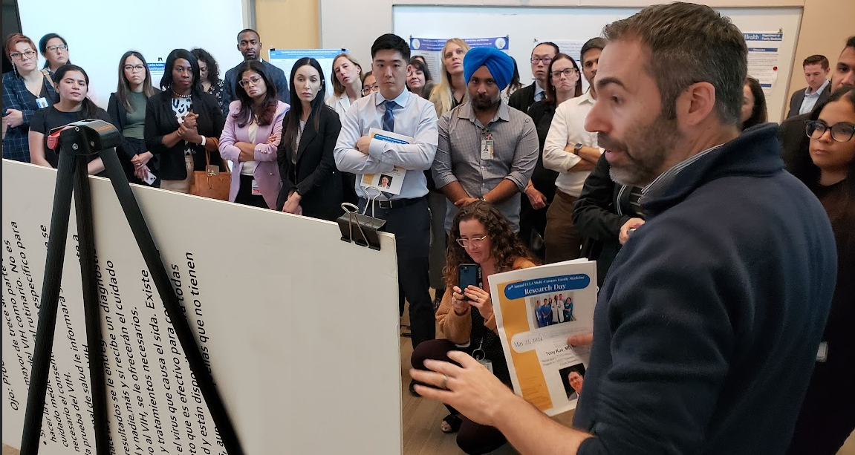
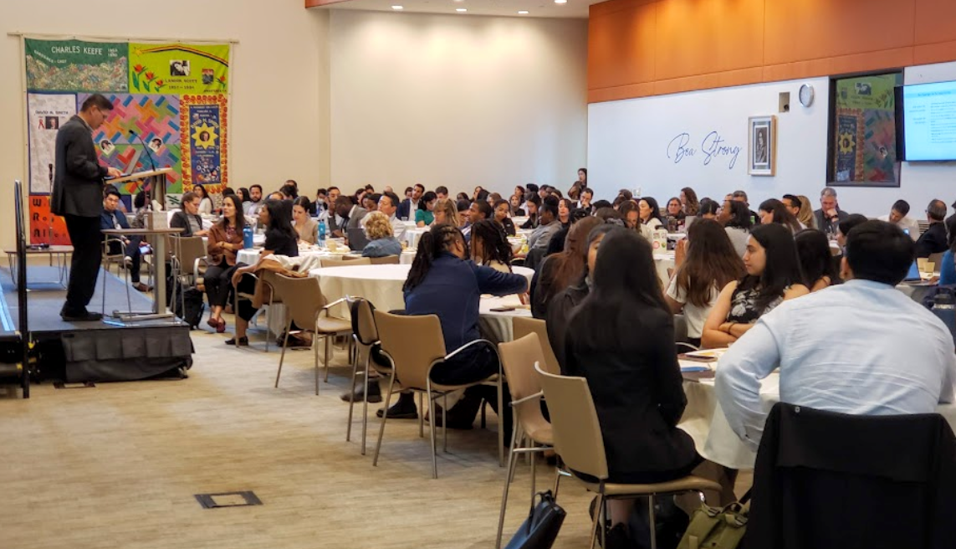
Research Day
2025 Meeting Information
In-person at the California Endowment downtown
Wednesday, May 14, 2025
Keynote Speaker: Dr. Mohsen Bazargan
Abstract Submissions
Submission Guidelines and other info can be found on our website
Abstracts must be submitted via the Submission Portal by April 7, 2025

Slide 9
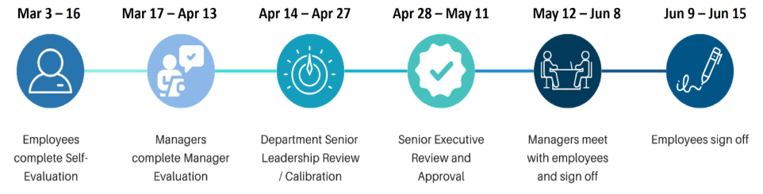
Performance Evaluations
For UCLA Health career staff in non-academic positions across the health system and the David Geffen School of Medicine hired on or before January 4, 2025
The self-evaluation period runs from March 3 -16.

Slide 10
Performance Evaluations
For Union-represented, non-academic positions: employees should have received an email with a PDF of the evaluation form to initiate self-evaluations.
For non-bargaining unit, non-academic positions: employees should have received a notification to log into Cornerstone to initiate self-evaluations.

Slide 11
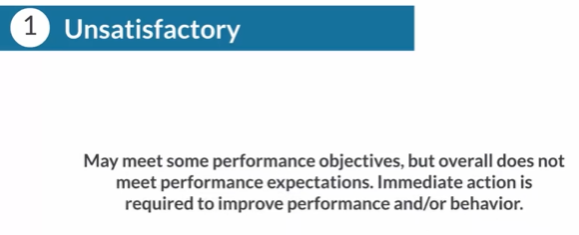
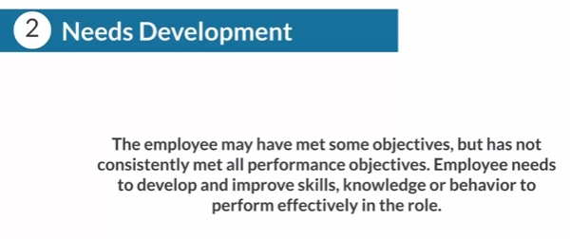
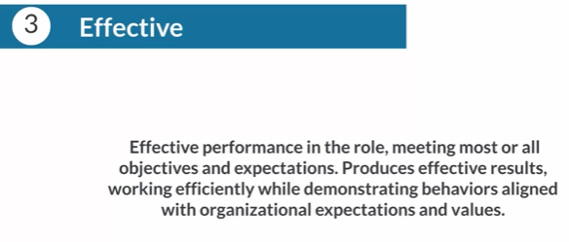
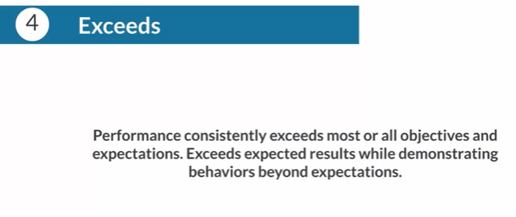
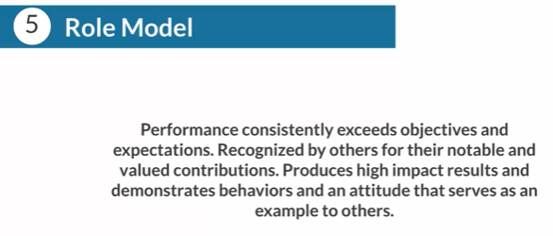
Performance Evaluations
Five-point rating system
Any “1” or “5” rating must be accompanied with comments. “5” or “Role Model” rating should only be used after the employee has consistently exceeded expectations in previous reviews.

Slide 12
Research Unit Administrative Team
Laura Sheehan
Manager of Research Administration (Fam Med)
Dalis Levey
Fund Manager
Felicia Winningham
Pre-Award Administrator
Valencia Moody
Fam Med Purchaser
Knarik Piloyan
Pediatric Purchasing Team Supervisor
Mark Kimura
CFO (Peds)

Slide 13

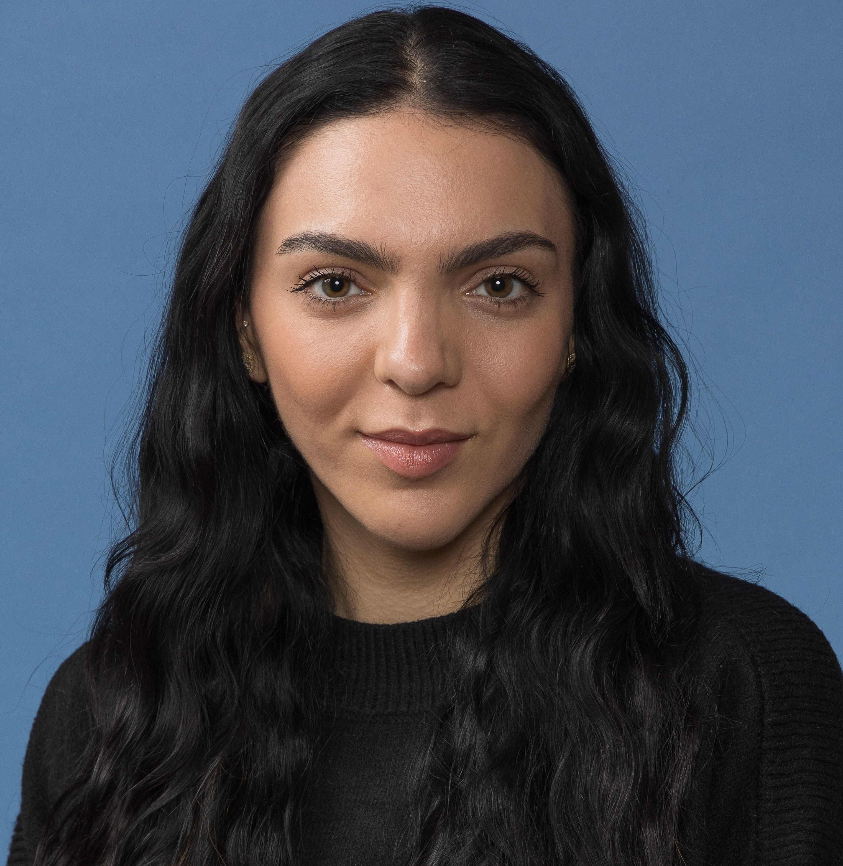

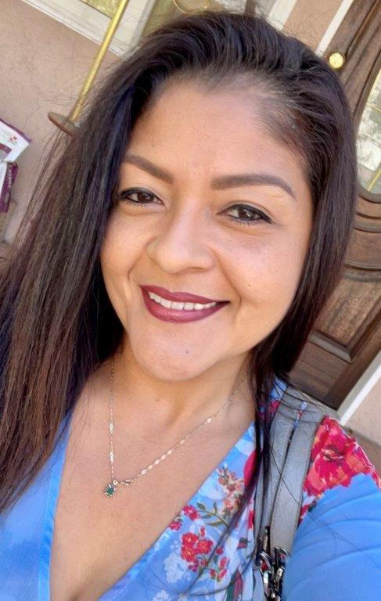
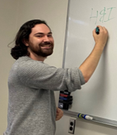
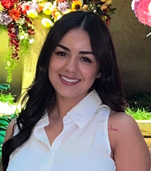
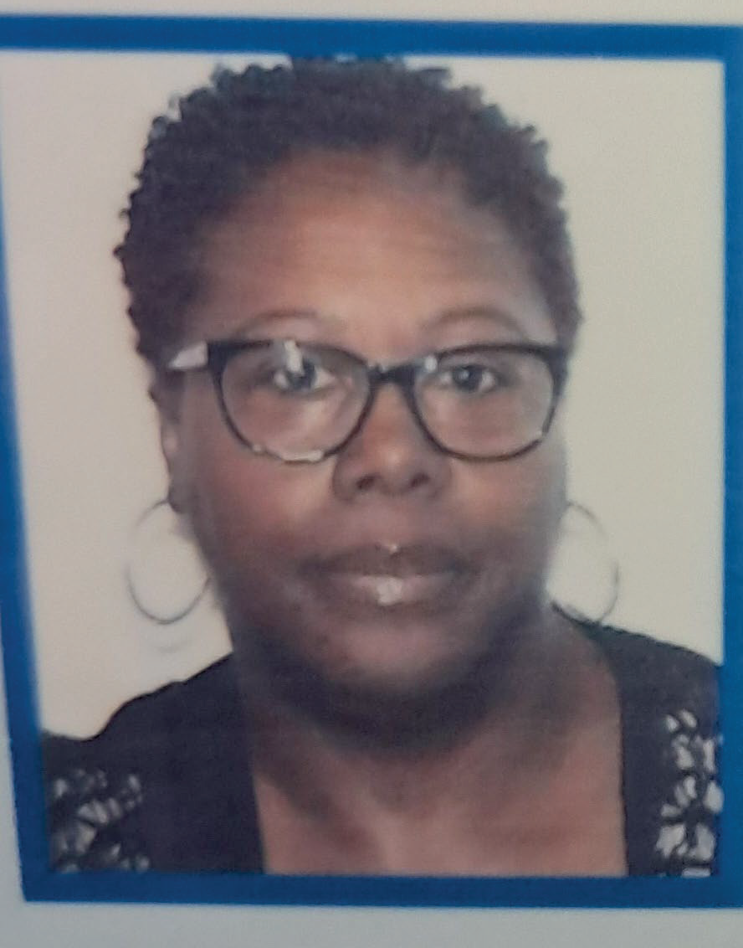
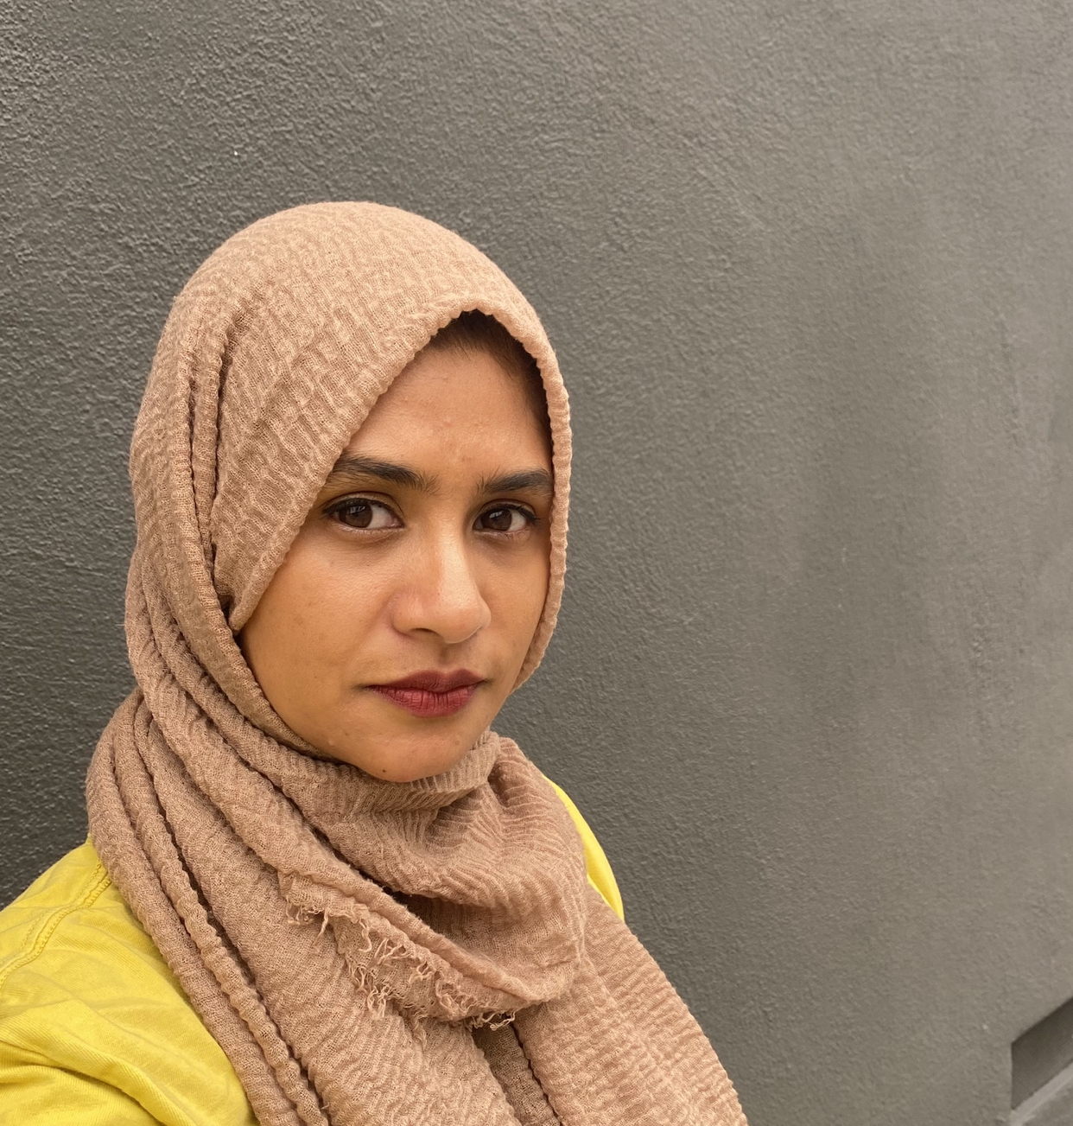
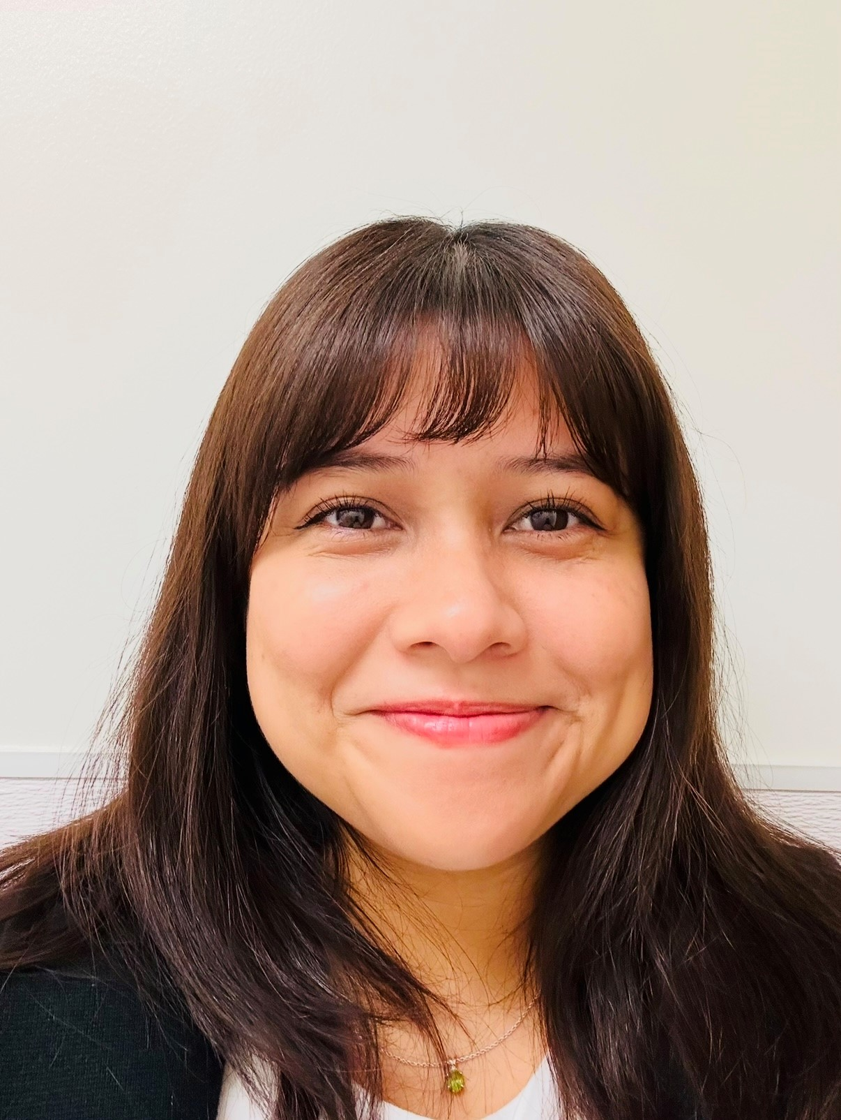
Pediatrics & Family Medicine Purchasing Team
Team Supervisor
Knarik Piloyan
Purchasers
Veronica Garcia
Hernandez
Alex
Keveney
Candice
Lopez
Valencia
Moody Burns
Gahliema
Martin
Bre
Navarro

Slide 14
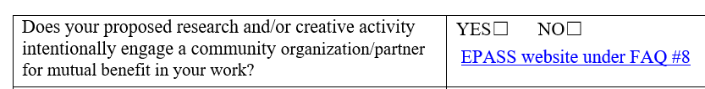
Outgoing Proposals
Felicia Winningham is your point of contact for all proposals
You must provide us with a Proposal Intake Form
We need to submit to OCGA by COB on the 6th business day prior to deadline
If you are the lead investigator, proposal must be submitted through Fam Med
SIX is the new FIVE
(business days)

Slide 15

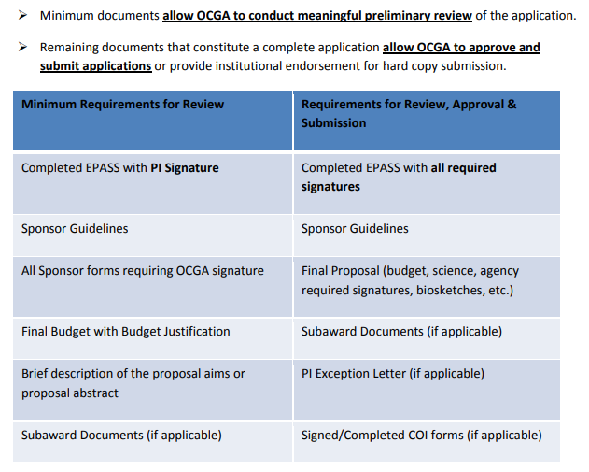

Aim to submit a complete proposal, not just minimum documents required

Slide 16

Monthly Meetings with Fund Manager
Are they actually required?
YES!

Slide 17
Monthly Meetings between PI and Fund Manager
First meeting after award is received
  Review budget and NOA with PI
  Discuss any changes/discrepancies
  Discuss timing of anticipated expenses
  Obtain permission to initiate transfers, payroll distribution corrections, subaward set-ups, etc. from PI

Slide 18
Monthly Meetings between PI and Fund Manager
Regular Monthly Meetings
  Review financial reports (aka FR’s, GL)
  Ensure that all recorded expenses are allowable, applicable, complete
  Determine if adjustments need to be made
  Review encumbered items
  Monitor spending rate
Are sister departments/subawards performing as expected? Are they spending down/invoicing? Is the project making progress as expected? If not, is carryforward/NCE necessary/allowed? Is the effort being charged for personnel accurate? Does it need to change in the upcoming months? Is that charge applicable? Are there any applicable charges missing? Why is that item still encumbered?

Slide 19


Monthly Meetings between PI and Fund Manager
Look
Back
Look
Ahead

Slide 20

NIH Updates – New Salary Cap
New NIH Salary Cap, effective Jan 1, 2025: $225,700
“For active awards, including awards that have been issued in FY 2025 (continuation and new) that were restricted to Executive Level II, if adequate funds are available, and if the salary cap increase is consistent with the institutional base salary, recipients may rebudget funds to accommodate the current Executive Level II salary level.”
“The salary limitation also applies to all subawards and subcontracts.”

Slide 21
NIH Updates
NIH released guide notice NOT-OD-24-084, which provides an overview of changes effective in 2025 to help the community contextualize them. Details will be released in the next few months.
    Simplified review criteria for most research project grants
    Revisions to the fellowship application and review process
    Updates to reference letter guidance
    Release of “Forms-I” grant application forms and instructions
    Common Forms for biographical sketch and current and pending (other) support
  The announcement of changes to their peer review framework for most Research Project (RPG) applications to address the complexity of the process, reduce reviewer burden, and mitigate bias. Read more: https://grants.nih.gov/policy/peer/simplifying-review/framework.htm

Slide 22
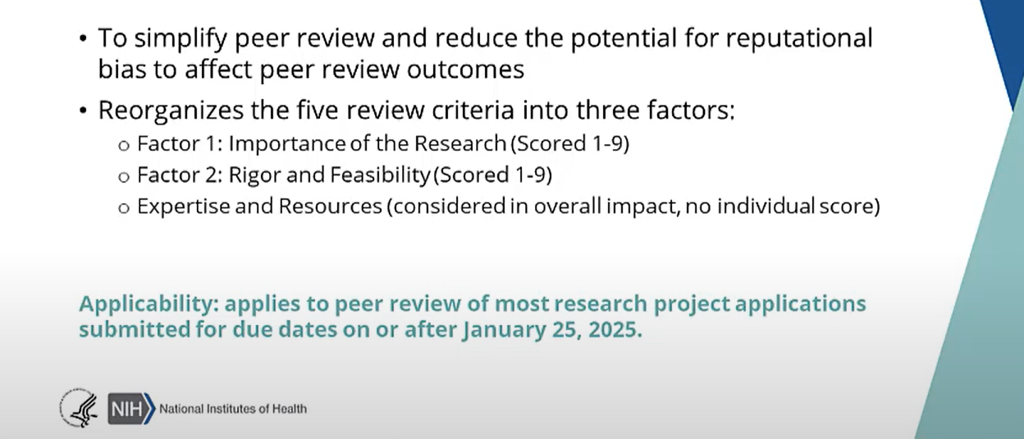
Overview of Simplified Review of Most Grant Applications

Slide 23
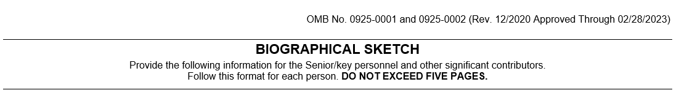
Biosketch reminders

Slide 24
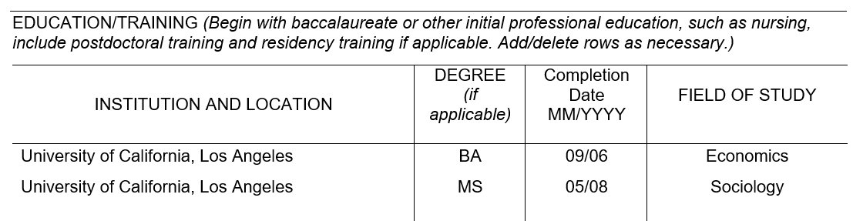
Biosketch reminders

Slide 25
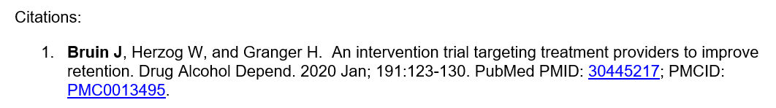
Biosketch reminders

Slide 26
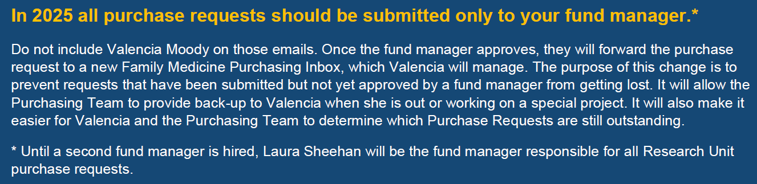
Purchasing and Fund Management
Per December 2024 Newsletter

Slide 27
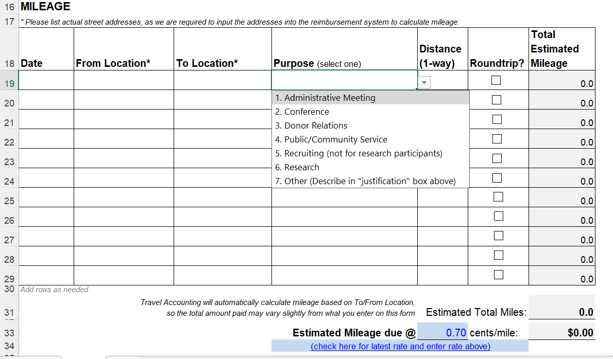
New Mileage Reimbursement Form

Slide 28
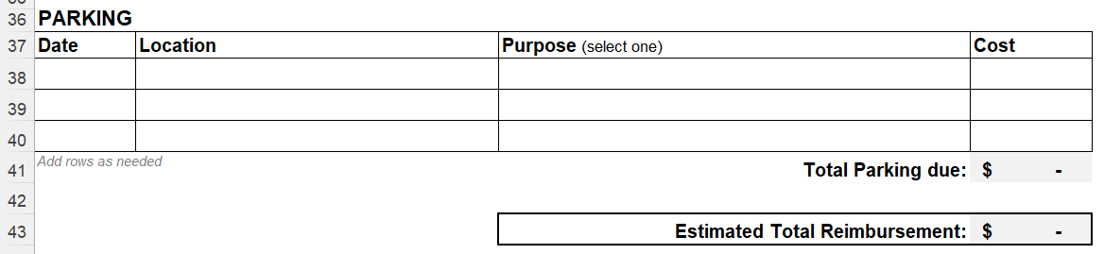
New Mileage Reimbursement Form

Slide 29

Stay Tuned
New Purchase Request Form

Slide 30


Consultant Costs
Don’t include travel when creating a consulting agreement; consultants should not include travel costs on their invoices
If the consultant needs to travel, it is better to:
  Not seek reimbursement
  Process their travel as a guest, rather than having them invoice us for travel as part of their consulting agreement

Slide 31
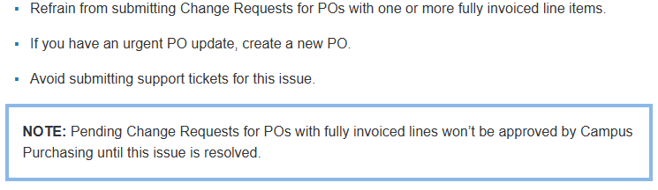
Change Requests
Problem:
If a Change Request is issued against a PO with one or more fully invoiced lines, the fully invoiced lines duplicate on the revised PO. This occurs even if the lines weren’t edited in the Change Request submission.
(Previous) Solution:

Slide 32
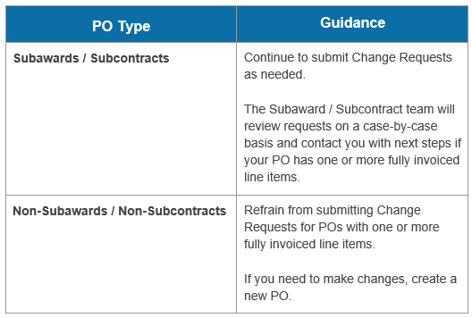
Change Requests
New Solution:

Slide 33


Paying for Food/catering/entertainment:
Preferred:
Not preferred:
Set-up a Purchase Order in advance
Pay with your personal credit card and get reimbursed after-the-fact
This is for external catering only (not internal UCLA catering, which uses recharge)

Slide 34
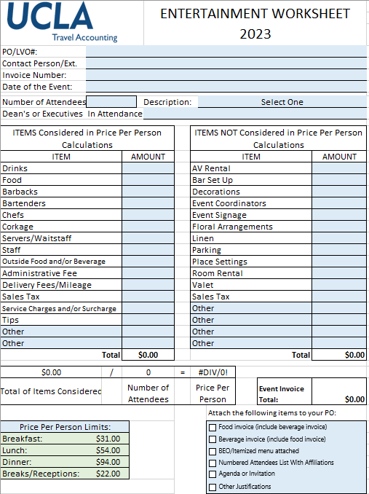
Purchase Order for Catering/Entertainment
Reach out to the vendor of your choice
  Ensure they will accept PO’s and are registered w/ UCLA PaymentWorks
  Discuss your event needs and obtain a quote
  Find out what email to send the Purchase Order to
Complete the Entertainment Worksheet
  Leave “Purchase Order” blank
  Invoice # can be a reservation number or Quote #
Email your fund manager. In the body of the email, we need the following:
    FAU
    Business Justification
    Is this a federal funding source? Yes/No
    Email to send the PO to
  Attach the agenda or invitation (required for large events)
  Attach the quote (required)

Slide 35
Purchase Order for Catering/Entertainment
Fund Manager will approve and will send to Fam Med Purchasing/Valencia
Fam Med Purchasing/Valencia will then input into BruinBuy Plus
Travel Accounting reviews, and then UCLA Purchasing creates the PO and will email it directly to the vendor
  The PO automatically goes to the email on file for the vendor
  HOWEVER, if you provided a different email, Valencia can add them as a recipient
We recommend you start this process as early as possible.

Slide 36
Purchase Order for Catering/Entertainment
AFTER THE EVENT TAKES PLACE:
The vendor needs to send the invoice either to you or directly to the invoice submission portal (noreply@invoices.ucla.edu)
If they send it to you, please forward it to your fund manager for submission to the invoice submission portal
You will also need to send the sign-in sheet/RSVP list to your fund manager after the event has taken place
Valencia/Fam Med Purchasing will upload to BB+
Once the invoice has been submitted and matched in BB+, and the sign-in-sheet has been uploaded, Travel will review for compliance and then approve for payment
UCLA Purchasing will then issue payment on the invoice (method of payment is determined by the vendor when they registered with PaymentWorks)

Slide 37
Paying with Personal Credit Card
If you choose this method, please ensure that all guidelines are met and that you do not exceed per person maximums. You will NOT be reimbursed for amounts over the allowable limit.
Complete the Travel/Entertainment Reimbursement form
Email the form to your fund manager for processing
You must also attach all receipts, the sign-in/guest list, and a breakdown of per-person costs
Valencia/Fam Med Purchasing will submit via Concur
You will be notified when you need to log in to Concur to approve/submit
Travel will review/approve, and you will be reimbursed in the same manner that you currently receive your paycheck (e.g. if you are signed up for direct deposit, you will receive reimbursement as a direct deposit)

Slide 38
Entertainment / Catering Important Links
Entertainment Worksheet Sponsorship/Contribution Guidelines and Worksheet | https://travel.ucla.edu/forms
BUS-79 Expenditures for Business Meetings, Entertainment, and Other Occasions | https://policy.ucop.edu/doc/3420364/BFB-BUS-79
G-28 Travel Regulations | https://policy.ucop.edu/doc/3420365/BFB-G-28
UCLA Travel & Entertainment Expense Guidelines | https://ucla.app.box.com/v/travel-ent-exp-guidelines
Logo Approval for Sponsorships | https://www.adminvc.ucla.edu/marks
Travel Allowances for Mileage & Meals | https://travel.ucla.edu/policy-resources/reimbursement-allowances-mileage-meals

Slide 39
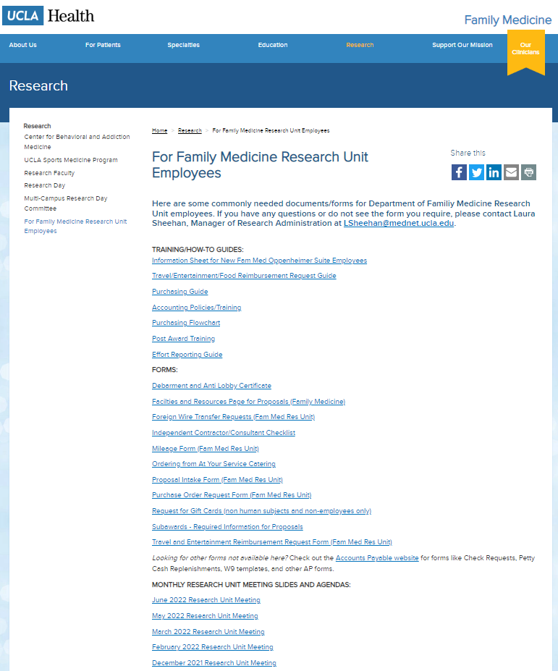
Upcoming Meetings/Events
  Next Research Unit Meeting: April 3
Next Grand Rounds: April 25, 2025
Research Day: May 14, 2025
Prior monthly meeting agendas/slides are available on the website

