Slide 1
Family Medicine Research Unit
Monthly Meeting
February 2024

Slide 2
Recently Submitted Proposals (since December)
PI | Title | Sponsor | Prime Sponsor | Type
Brooks, Ronald Andrew | Developing Implementation Strategies to Enhance Delivery of LAI PrEP to Black and Latino MSM | NIH - National Institutes of Health | - | New
Gelberg, Lillian | Medical Respite Programs for Persons Experiencing Homelessness | UNIVERSITY OF NORTH CAROLINA | NIH | New
Shoptaw, Steven J | Clinical Trials Network Big South/West Node – Yr20 Core | University of Texas-Southwestern Medical Center at Dallas | NIH-NIDA | Modification/ Amendment
Shoptaw, Steven J | Clinical Trials Network Big South/West Node – Yr19 Core | University of Texas-Southwestern Medical Center at Dallas | NIH-NIDA | Modification/ Amendment

Slide 3
Recently Processed Awards (since December)
PI | Award Title | Sponsor | Prime Sponsor | Action Type | Project Period Begin Date | Project Period End Date
Shoptaw, Steven J | HIV Prevention Trials Leadership Group: 094 Protocol Chair | FHI 360 | NIH-NIAID | 12/01/2020 | 11/30/2024 | Modification/ Amendment
Bholat, Michelle Anne | UCLA International Medical Graduate Program (2021-2022) | UNIHEALTH FOUNDATION | - | 02/01/2022 | 09/30/2023 | No Cost Extension
Moreno, Gerardo | UCLA Underrepresented in Medicine - Center of Excellence | DHHS-HRSA | - | 07/01/2022 | 06/30/2027 | Continuation
Tarn, Derjung | Increasing the Feasibility, Impact, and Equity of the Medicare Annual Wellness Visit | NIH-NIA | - | 08/01/2023 | 04/30/2028 | Modification/ Amendment
Shoptaw, Steven J | CTN-0110 Randomized, Double-Blind, Placebo-Controlled Trial of Monthly Injectable Buprenorphine (BUP) for Methamphetamine (MA) Use Disorder (MURB) | Univ of Texas-Southwest Med Cntr | NIH-NIDA | 03/01/2022 | 02/28/2025 | Modification/ Amendment

Slide 4
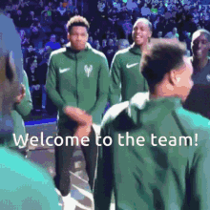

Slide 5
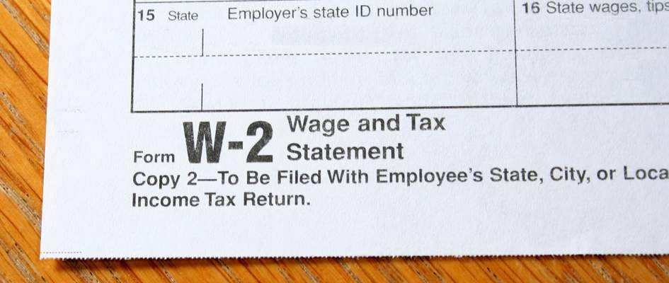
W2’s
If you signed up to receive your W2 electronically, you will receive an email letting you know when it is available for download in UCPath.
UCLA will never email or text
you your W2.
If you did not sign up to receive
it electronically, it will be
mailed.

Slide 6
Upcoming Holidays
February 19, 2024 – President’s Day
This Photo by Unknown Author is licensed under CC BY-SA-NC

Slide 7
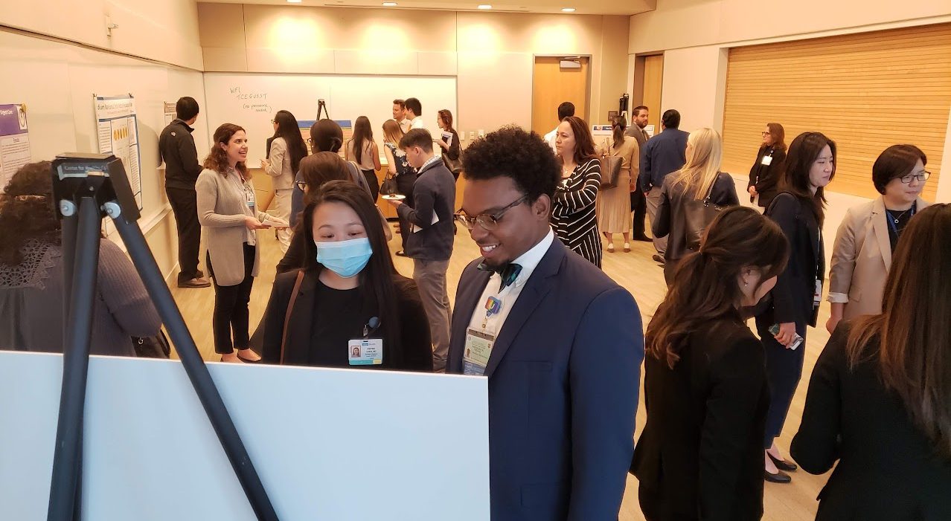
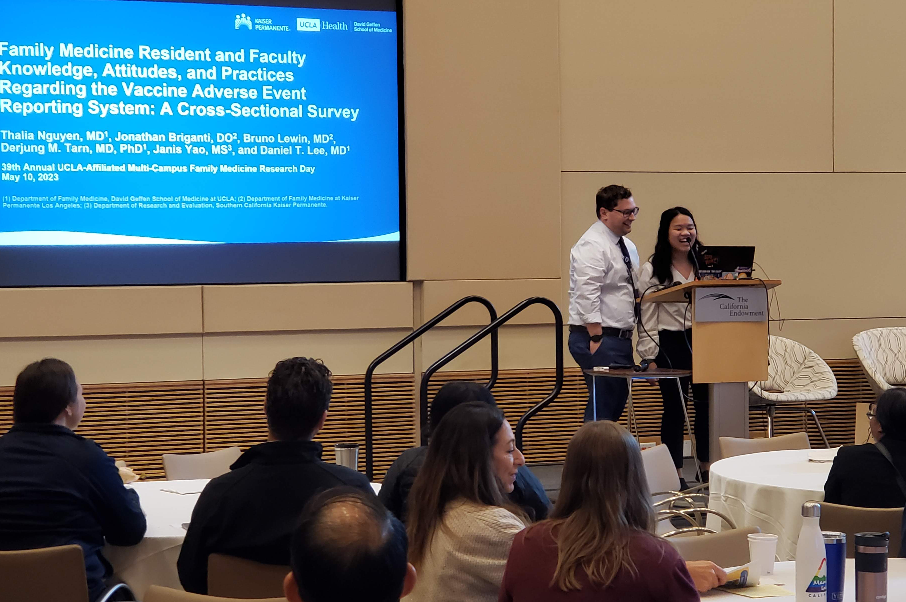
Research Day
2024 Meeting Information
In-person at the California Endowment downtown
Wednesday, May 22, 2024
Keynote Speaker: Dr. Tony Kuo
Abstract Submissions
Submission Guidelines and other info can be found on our website
Abstracts must be submitted via the Submission Portal by April 15, 2024

Slide 8
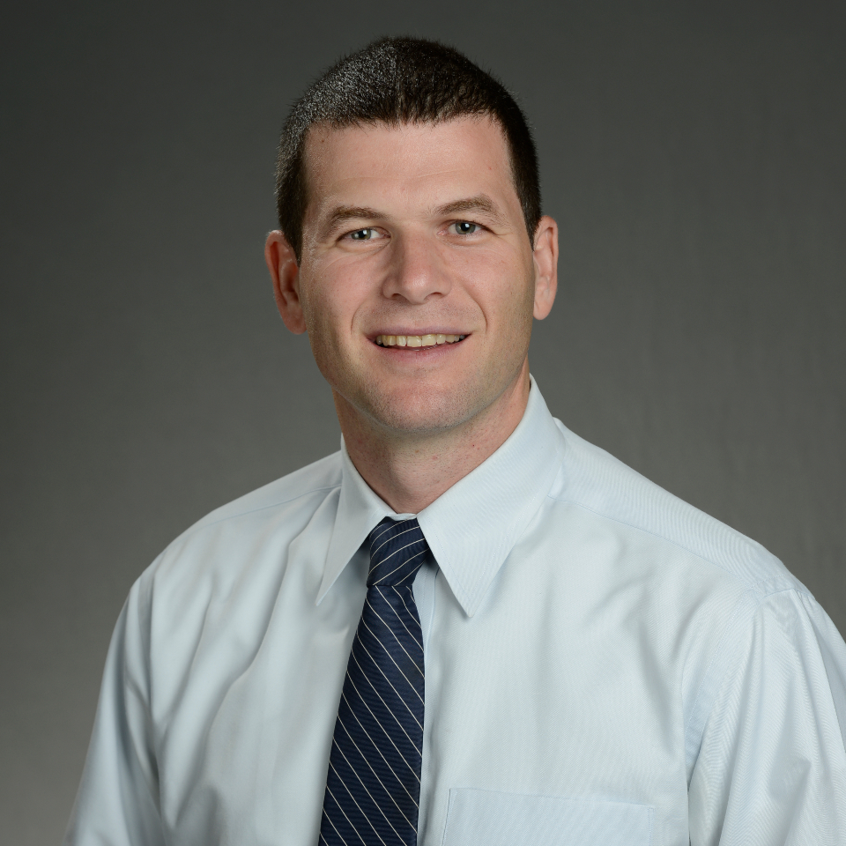
Grand Rounds
February Grand Rounds
Friday, February 23, 2024
12:00pm-1:00pm
Dr. Bruno Lewin
Global Health is Local Health – Latent TB, Hepatitis B and Chagas Disease

Slide 9
Outgoing Proposals
Chris Ashikyan is your point of contact for all outgoing proposals
You must include a Proposal Intake Form when you contact Chris
Plan to submit to OCGA by COB on the 6th business day prior to deadline
Aim to submit a complete proposal, not just minimum documents required
If you are the lead investigator, proposal must be submitted through Fam Med
SIX is the new FIVE
(business days)

Slide 10
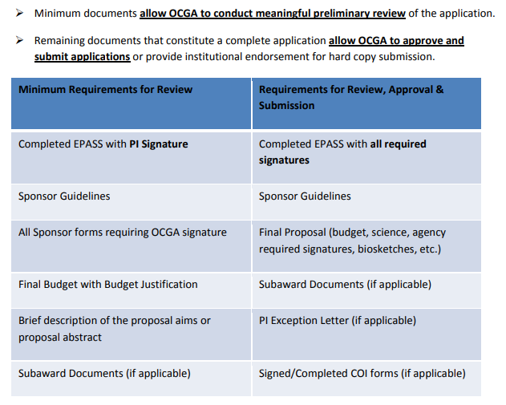

Slide 11
https://brimr.org/
Authoritative annual rankings of NIH funding to individual researchers and academic institutions
BRIMR has now posted a modified version of the newly-released NIH data file, which they will use as the basis of all their 2023 rankings. They invite users to access their new draft file here and to provide them with any feedback, corrections, or suggestions via email to rrj@brimr.org, following the instructions for submitting corrections.
All proposed corrections must be received by BRIMR before 6:00 PM EST on Friday February 2, 2024.

Slide 12
2023 BRIMR Data for Rankings
PROJECT NUMBER | FUNDING MECHANISM | PI NAME | PROJECT TITLE | FUNDING | AWARD NOTICE DATE | OPPORTUNITY NUMBER
5K23DK129828-02 | Other Research-Related | CASTELLON-LOPEZ, YELBA | Understanding Barriers to Engagement in the Diabetes Prevention Program among Low-Income Latino Patients: Design and Implementation of an Intervention in Community Health Centers | $204,393 | 2/27/2023 | PA-20-206
5R01DA047386-04 | RPGs - Non SBIR/STTR | GELBERG, LILLIAN | mHealth to Enhance & Sustain Drug Use Reduction of the QUIT BI in Primary Care | $841,444 | 4/18/2023 | PA-19-055
3P30MH058107-27S1 | Research Centers | SHOPTAW, STEVEN J | Addressing intimate partner violence, mental health burdens, and other syndemic factors to support engagement in HIV prevention services in a trans community center | $217,256 | 8/18/2023 | PA-20-272
3P30MH058107-27S2 | Research Centers | SHOPTAW, STEVEN J | UCLA Rapid, Relevant, Rigorous Implementation Science Hub | $421,007 | 8/25/2023 | PA-20-272
3P30MH058107-27S3 | Research Centers | SHOPTAW, STEVEN J | Preparing for Implementation of the ATN CARES Evidence-Based Intervention Package for PrEP Uptake and Syndemic Factors among Youth | $235,232 | 8/28/2023 | PA-20-272
5P30MH058107-27 | Research Centers | SHOPTAW, STEVEN J | Center for HIV Identification, Prevention and Treatment Services | $1,981,042 | 12/16/2022 | PAR-20-308
1R01AG081996-01 | RPGs - Non SBIR/STTR | TARN, DERJUNG M | Increasing the Feasibility, Impact, and Equity of the Medicare Annual Wellness Visit (AWV) | $650,000 | 7/27/2023 | PA-20-183
5R33AG068946-04 | RPGs - Non SBIR/STTR | TARN, DERJUNG M | Medicare Annual Wellness Visit Practice Redesign Toolkit: A Tailored Intervention to Improve Preventive Health Service Use | $494,272 | 7/26/2023 | RFA-AG-20-045

Slide 13
BRIMR Historical Rankings
Year | Rank | Name | Amount
2009 | 13 | UCLA Family Medicine | $1,368,878
2010 | 5 | UCLA Family Medicine | $2,807,817
2011 | 6 | UCLA Family Medicine | $2,686,515
2013 | 9 | UCLA Family Medicine | $1,796,551
2014 | 12 | UCLA Family Medicine | $1,402,593
2015 | 10 | UCLA Family Medicine | $1,797,066
2016 | 4 | UCLA Family Medicine | $3,351,473
2017 | 3 | UCLA Family Medicine | $4,878,450
2018 | 2 | UCLA Family Medicine | $4,775,715
2019 | 8 | UCLA Family Medicine | $2,849,051
2020 | 8 | UCLA Family Medicine | $3,018,776
2021 | 7 | UCLA Family Medicine | $3,470,049
2022 | 7 | UCLA Family Medicine | $3,855,041
2023 | TBD | UCLA Family Medicine | $5,044,646 | tentative; not yet released

Slide 19
Potential Federal Government Shutdown
Just a day before the previous extension expired on 1/19/24, the federal government signed off on another continuing resolution to keep the government open and running, but still without a budget for the fiscal year that began Oct. 1, 2023.
Congress now has until March 8 to negotiate/pass/approve a budget to fund the federal government's agencies, including the NIH.
However, there is opposition in the Republican Speaker's party on this stopgap measure. The bill passed the House by a 318-108 vote, with 106 Republicans opposed. The C.R. passed the Senate, 77-18.

Slide 23
Revised NIH Salary Cap
The NIH has issued a NOT (NOT-OD-24-057) confirming that, effective January 1, 2024, the 2024 salary cap for NIH grants and cooperative agreements is $221,900 (Executive Level II).
The NOT states:
For active awards, including awards that have been issued in FY 2024 (continuation and new) that were restricted to Executive Level II, if adequate funds are available, and if the salary cap increase is consistent with the institutional base salary, recipients may rebudget funds to accommodate the current Executive Level II salary level.

Slide 24
Funding Opportunities
NIAID SBIR Phase II Clinical Trial Implementation Cooperative Agreement (U44 Clinical Trial Required) (PAR-24-099) National Institute of Allergy and Infectious Diseases
NIAID Clinical Trial Implementation Cooperative Agreement (U01 Clinical Trial Required) (PAR-24-100) National Institute of Allergy and Infectious Diseases
Mechanistic Studies on Social Behavior in Substance Use Disorder (R01 Clinical Trial Optional) (RFA-DA-25-032); (R01 Basic Experimental Studies with Humans (BESH) Required) (RFA-DA-25-033); (R01 Clinical Trials Not Allowed) (RFA-DA-25-034) National Institute on Drug Abuse
Risk and Protective Factors of Family Health and Family Level Interventions (R01 - Clinical Trial Optional) (PAR-21-358) National Institutes of Health/DHHS
RFA-OD-23-014 -- Understanding Chronic Conditions Understudied Among Women (R01 Clinical Trial Optional) (RFA-OD-23-014) National Institutes of Health/DHHS

Slide 25
BruinBuy Plus
There have been a number of pain points, including:
We were told after launch that we cannot do change orders on migrated POs
Inability to see certain migrated classes of orders (P, S, G etc)
Receiving required for items where receiving was not requested.
Vendor agreements not loaded into the system
Expense form needed upfront for Business & Entertainment (formerly T-class)
Must indicate if funds are federal or not with every order.
Confusion over what forms to use for a particular transaction.
FAU validation issues
For Pos that did not migrate, invoices need to be paid by the end of February. After that old POs in BruinBuy legacy will be closed and a new PO would have to be generated.
Support requests go through a ticketing system and responses are delayed.
Difficult to tell when/if invoices have been paid. There is no current service standard. A/P did not process invoices from 12/15/24-01/02/24
Fund managers/PIs not getting notifications to approve subaward invoices.

Slide 26
BruinBuy Plus
Please be patient with us while we navigate through this.
Submit far in advance and expect delays.

Slide 27
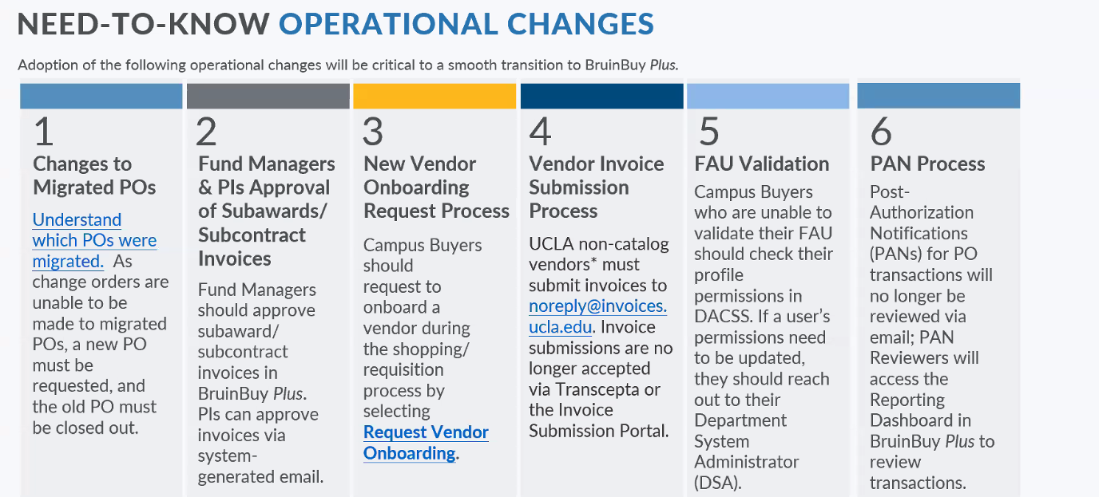
BruinBuy Plus

Slide 28
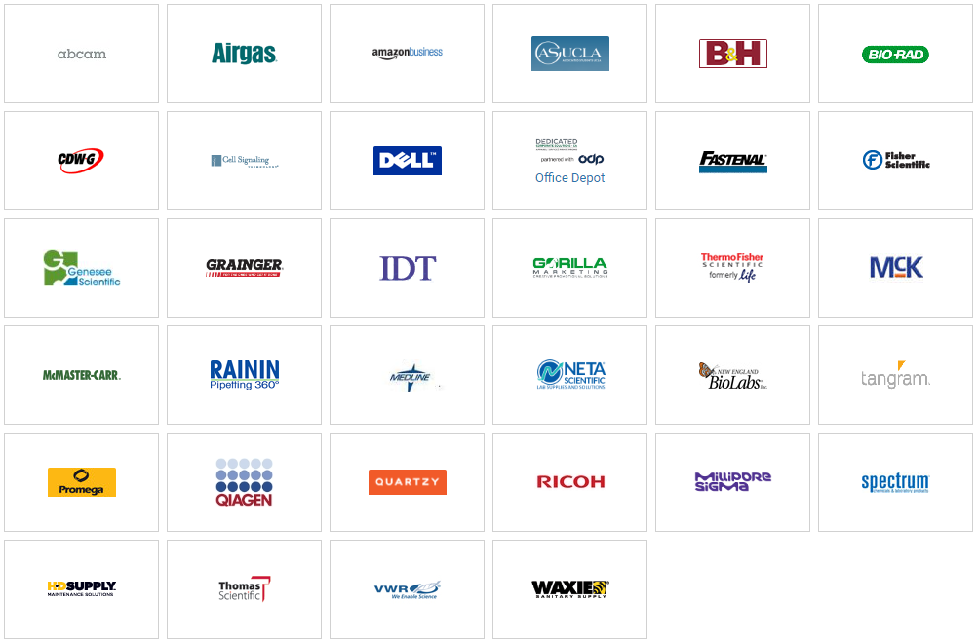
Vendor Catalogs

Slide 29
Purchasing and Payment Forms

Slide 30
There are two ways to pay for food/catering:
Set-up a Purchase Order in advance
Pay with your personal credit card and get reimbursed after-the-fact
This is for external catering only (not internal UCLA catering, which uses recharge)

Slide 31
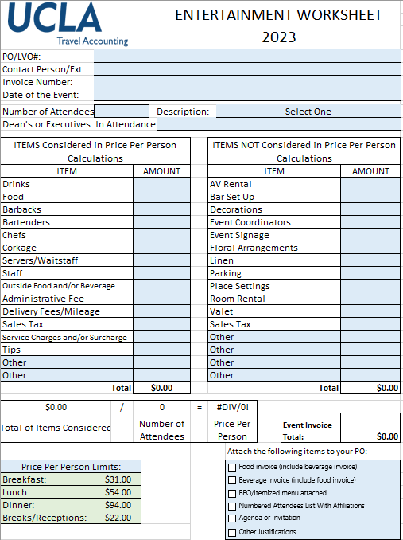
Purchase Order for Catering/Entertainment
Reach out to the vendor of your choice
Ensure they will accept PO’s and are registered w/ UCLA PaymentWorks
Discuss your event needs and obtain a quote
Find out what email to send the Purchase Order to
Complete the Entertainment Worksheet
Leave “Purchase Order” blank
Invoice # can be a reservation number or Quote #
Email your fund manager and Valencia
In the body of the email, we need the following:
FAU
Business Justification
Is this a federal funding source? Yes/No
Email to send the PO to
Attach the agenda or invitation (required)
Attach the quote (required)

Slide 32
Purchase Order for Catering/Entertainment
Fund Manager will approve
Valencia will then input into BruinBuy Plus
Travel Accounting reviews, and then Purchasing creates the PO and will email it directly to the vendor
The PO automatically goes to the email on file for the vendor
HOWEVER, if you provided a different email, Valencia can add them as a recipient
PO’s do NOT automatically go to Valencia (or you, or anyone else in the department)
We recommend you start this process as early as possible. We don’t have a good estimate of how long this process takes yet.
Until BB+ sorts out the kinks, we recommend you follow-up with Valencia and/or the vendor to ensure it was processed in time for your event.

Slide 33
Purchase Order for Catering/Entertainment
AFTER THE EVENT TAKES PLACE:
The vendor needs to send the invoice either to you or directly to the invoice submission email (noreply@invoices.ucla.edu)
If they send it to you, please forward it to Valencia and she will submit to the invoice submission email
You will also need to send the sign-in sheet/RSVP list to Valencia after the event has taken place
Valencia will upload to BB+
Once the invoice has been submitted and matched in BB+, and the sign-in-sheet has been uploaded, Travel will review for compliance and then approve for payment
Purchasing will then issue payment on the invoice (method of payment is determined by the vendor when they registered with PaymentWorks)

Slide 34
Paying with Personal Credit Card
If you choose this method, please ensure that all guidelines are met and that you do not exceed per person maximums. You will NOT be reimbursed for amounts over the allowable limit.
Complete the Travel/Entertainment Reimbursement form, as we have done in the past
Email the form to your fund manager and Valencia for processing
You must also attach all receipts, the sign-in/guest list, and a breakdown of per-person costs
Valencia will submit via Concur
You will be notified when you need to log in to Concur to approve/submit
Travel will review/approve, and you will be reimbursed in the same manner that you currently receive your paycheck (e.g. if you are signed up for direct deposit, you will receive reimbursement as a direct deposit)

Slide 35
Entertainment / Catering Important Links
Entertainment Worksheet Sponsorship/Contribution Guidelines and Worksheet | https://travel.ucla.edu/forms
BUS-79 Expenditures for Business Meetings, Entertainment, and Other Occasions | https://policy.ucop.edu/doc/3420364/BFB-BUS-79
G-28 Travel Regulations | https://policy.ucop.edu/doc/3420365/BFB-G-28
UCLA Travel & Entertainment Expense Guidelines | https://ucla.app.box.com/v/travel-ent-exp-guidelines
Logo Approval for Sponsorships | https://www.adminvc.ucla.edu/marks
Travel Allowances for Mileage & Meals | https://travel.ucla.edu/policy-resources/reimbursement-allowances-mileage-meals

Slide 36
Purchasing and Payment Forms

Slide 37
Direct Pay Form
This is only for invoices that do not require a purchase order, including:
Awards (Recognition of past activities) - Non-Employees only
Fellowships and Scholarships
Honorarium
Human Subject Payments
Memberships
Non-Matriculated Student Payments
Prizes (Competition) - Non-Employees only
Refunds (Entities only)
Royalty Payments
Subscriptions (non-software)
Transient Occupancy Tax Payments
Utility payments

Slide 38
Direct Pay Procedure
Send an email to your fund manager and Valencia
Attach the invoice/explanation of item
In the body of the email, list the following:
FAU
Object Code
Business justification
Is this being paid from a federal funding source? Yes/No
Fund Manager will approve
Valencia will then complete the Direct Pay Form on BruinBuy Plus and will upload the invoice directly into the form
Note: Recipients MUST be registered in PaymentWorks. If they are not, Valencia can instigate the registration process when the invoice is received. However, if you know about the expense in advance (e.g. guest speakers), we highly encourage you to reach out to Valencia prior to the expense being incurred so that she can instigate the registration process in advance.
Laura is working on a new form to gather this information, but for now, an email will suffice…

Slide 39
Utility Object Codes (Direct Pay)
Cellular Phone | 3540, 4001, or 5285
Electricity | 5210
Water & Sewer | 5220
Natural Gas | 5230
Satellite/Cable TV | 5285
Propane/Butane | 5260
Recycling | 3474
Refuse Disposal | 3475
Storage | 3005
Security/Alarm Monitoring Services | 3495

Slide 40
Invoice Submissions – For PO’s only
All invoices for PO’s must be submitted to noreply@invoices.ucla.edu. If a vendor sends you an invoice directly, you can forward it to this address yourself, or forward it to Valencia to submit.
Do not submit to this email address for Direct Pay.
Invoices MUST have the PO # on them in order to get paid. Do not forward invoices to the invoice email if they don’t have a PO # on them.
Invoices must be in PDF format and must be 8.5 x 11 in in order to be properly matched.
Vendors received this information via email.

Slide 41
BruinBuy Plus Training
https://purchasing.ucla.edu/bruinbuy-plus-hub

Slide 42
Fund Manger Updates
We are in the process of hiring a new fund manager.
Current Fund Manager Assignments:
Bholat, Sur, and all Sports Med Faculty: Andrew Titus.
Moreno and Tarn: Christine Ashikyan.
Shoptaw: Mindy Huynh and introducing Thao Nguyen.
All other faculty: Monica Gonzalez.
For those of you working with Christine Ashikyan and/or Andrew Titus as your temporary fund managers, please continue to work with them as you have been.

Slide 43
Fund Manger Updates
For those working with Monica or Mindy (which is everyone who isn’t working with Andrew or Christine A.), please read the following for some important changes:
Moving forward, until we have a new Fund Manager in place, please send the following requests to Laura and Valencia, instead of Valencia and Mindy/Monica/Thao:
PTAs/Concur Request IDs/flights approvals and approvals on travel reimbursements
Purchase Orders, Direct Pay Requests (e.g. buying supplies, paying invoices, independent contractors/consultants, etc.)
For the following items, please send these requests directly to Laura, instead of Mindy/Monica/Thao:
Transfers of Funds (TOFs)
NPEARs

Slide 44
Fund Manger Updates
For faculty other than Shoptaw, Monica will remain the points of contact for the following, but please cc Laura:
Subaward set-ups
Financial Reports (monthly reports, sponsor progress or final Financial Reports)
Close-Outs
Salary distributions changes/UCPath/PAFs
For Shoptaw, Thao will be taking over the following and Mindy will focus only on CHIPTS close-out:
Subaward set-ups
Financial Reports (monthly reports, sponsor progress or final Financial Reports)
Close-Outs for any project other than CHIPTS/29080
Salary distributions changes/UCPath/PAFs

Slide 45
Fund Manger Updates
Laura will continue to be your point of contact for the following fund manager responsibilities until a new FM is hired:
Meeting monthly with the PI’s/Project Coordinators to review financial reports
RAS’s (Requests for Advanced Spending)
NCEs (No Cost Extensions)
Carry-forward requests, re-budgeting or other items requiring prior approval
H&I issues
Effort Reporting
Changes to rent
Questions about BB+ or financial policies
General C&G management, etc.

Slide 46
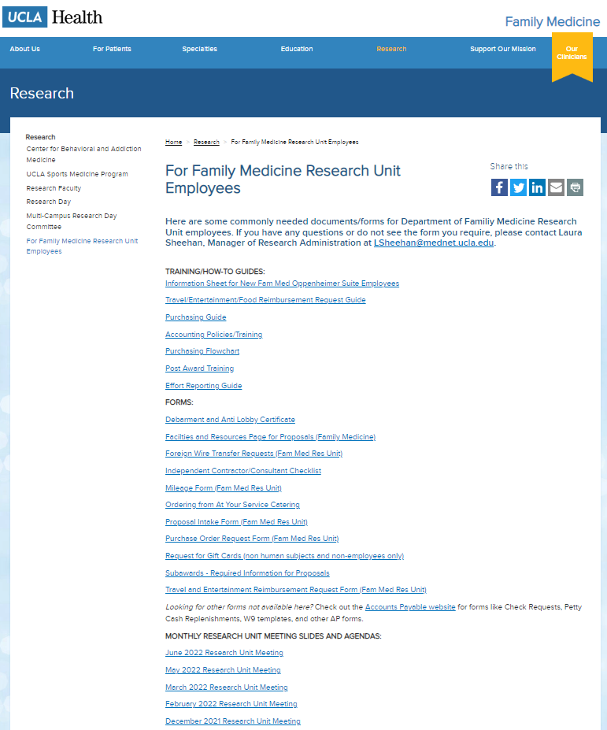
Upcoming Meetings/Events
Next Research Unit Meeting: March 7
Next Grand Rounds: February 23, 2024
Prior monthly meeting agendas/slides are available on the website

