Slide 1


Family Medicine Research Unit
Monthly Meeting
February 2023

Slide 2
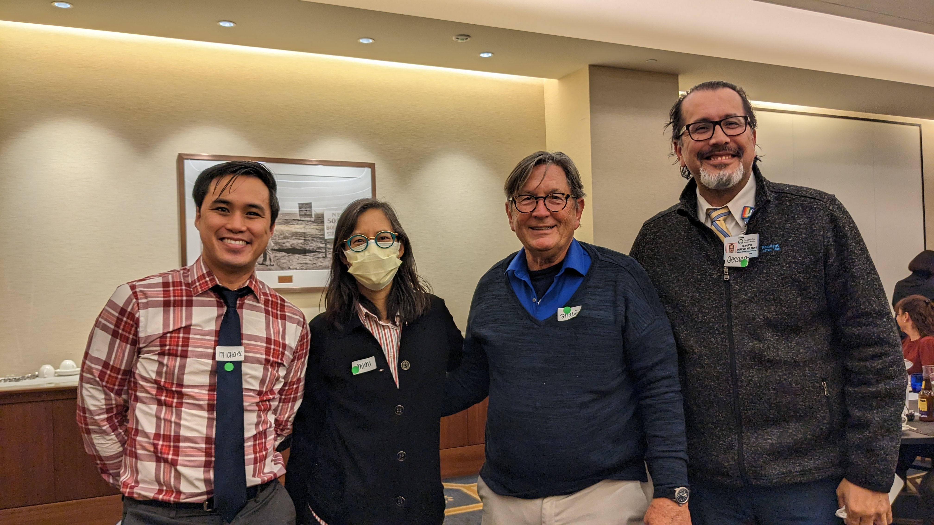
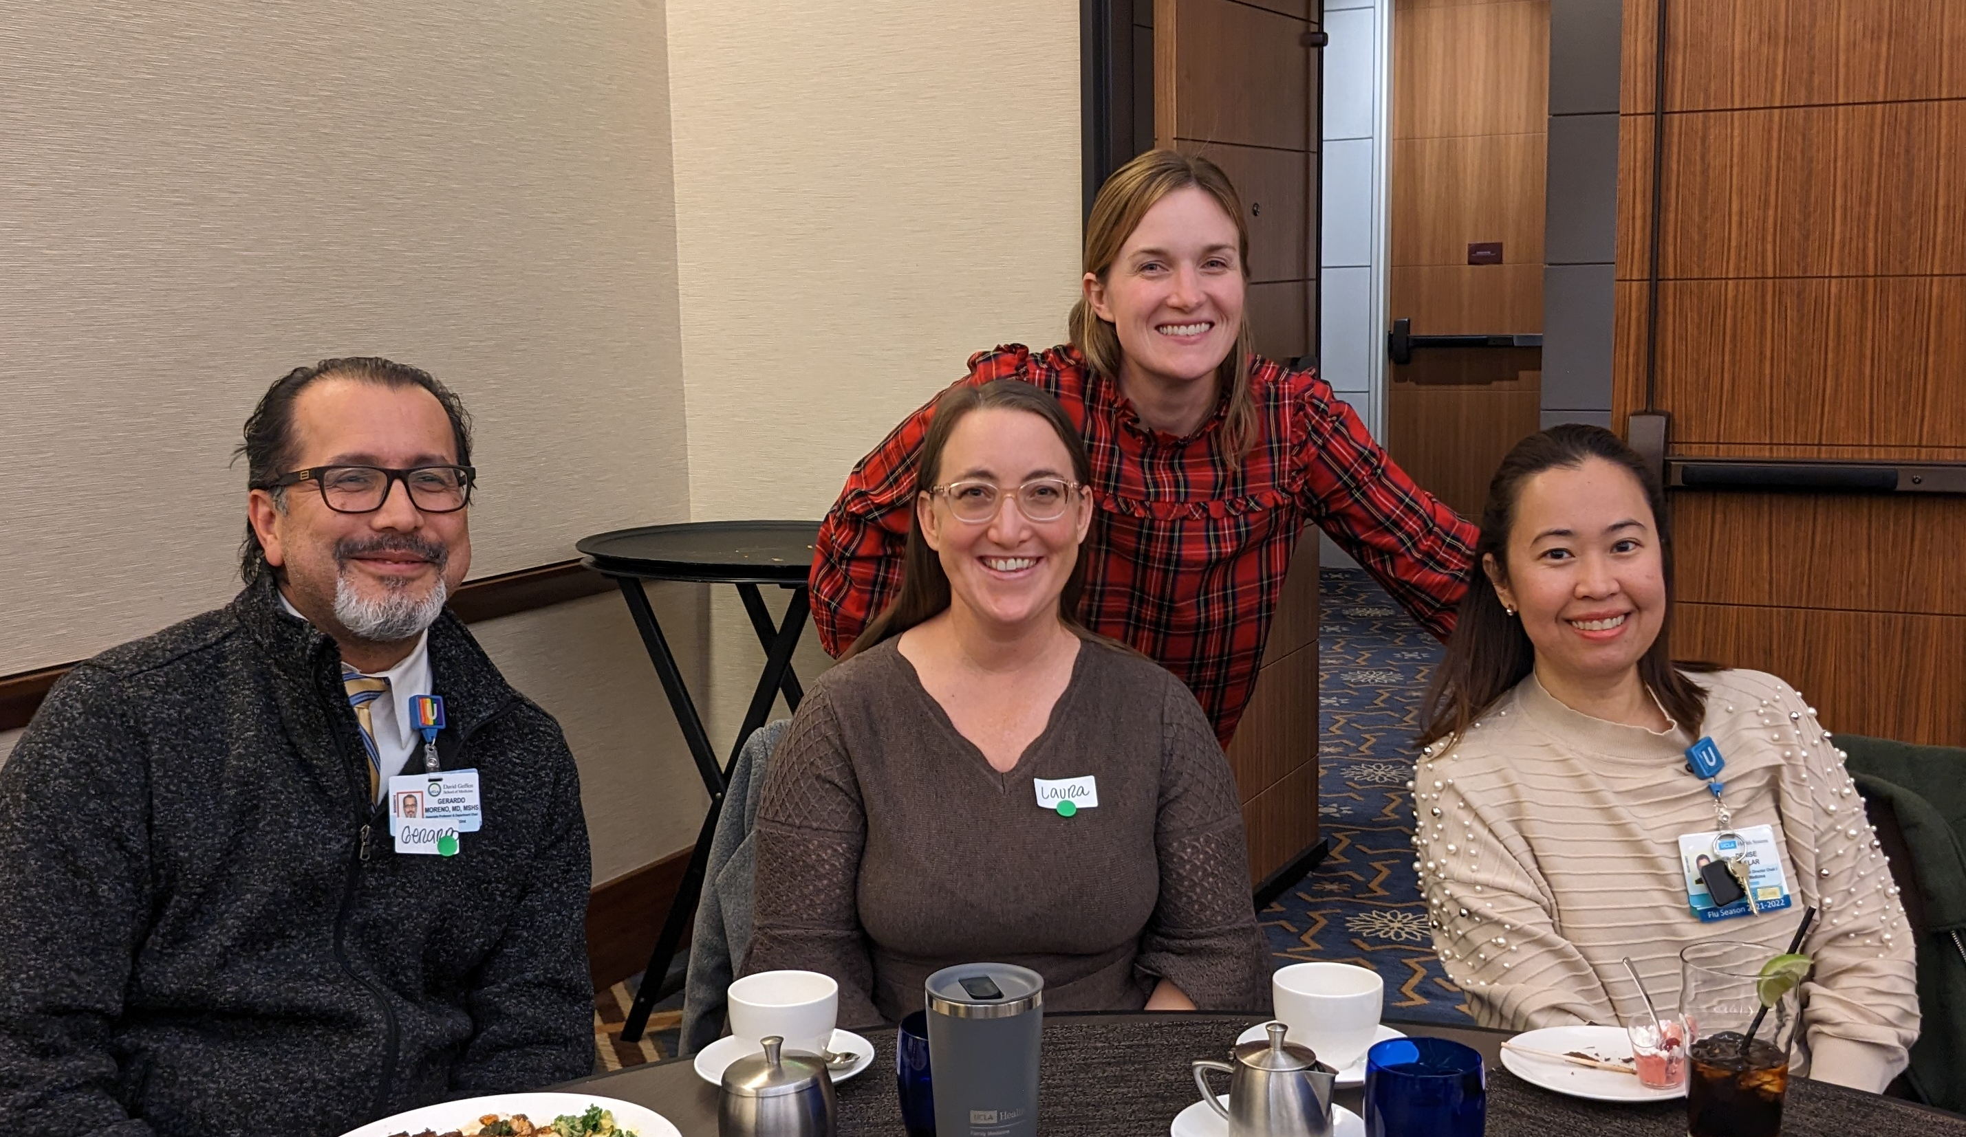
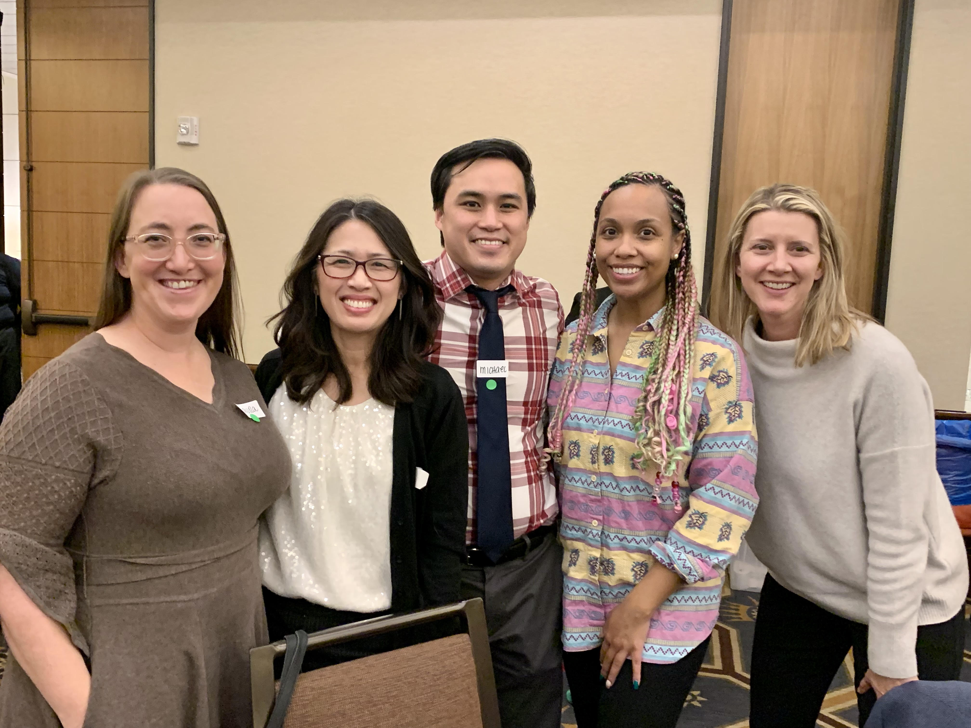
Winter Holiday Party 2022

Slide 3
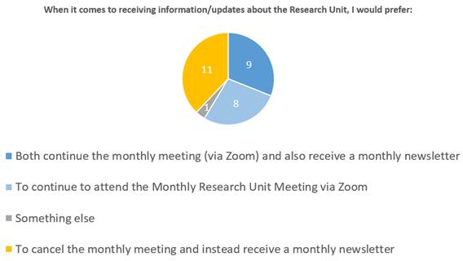
Monthly Research Unit Meetings
Poll results:

Slide 4
Recently Processed Awards
PI | Award Title | Sponsor | Prime Sponsor | Action Type
Shoptaw, Steven J | HIV Prevention Trials Leadership Group: 094 Protocol Chair | FHI 360 (Family Health International) | NIH-NIAID | Modification/Amendment
Shoptaw, Steven J | Clinical Trials Network - The Big South/West Node | University of Texas-Southwestern Medical Center at Dallas | NIH-NIDA | Continuation
Tarn, Derjung | Medicare Annual Wellness Visit Practice Redesign Toolkit: A Tailored Intervention to Improve Preventive Health Service Use | NIH-NIA National Institute on Aging | - | Modification/Amendment
Shoptaw, Steven J | HPTN 094 Integra | FHI 360 (Family Health International) | NIH-NIAID | Modification/Amendment
Kalmin, Mariah Mattera | CA Bridge Research | PUBLIC HEALTH INSTITUTE (FORMERLY CA PUBLIC HEALTH FDN) | Battery Foundation | No Cost Extension
Shoptaw, Steven J | Clinical Trials Network Big South/West Node – Yr18 Remove Restrictions Request: CTN-0109 CURB-2 | University of Texas-Southwestern Medical Center at Dallas | NIH-NIDA | New
Shoptaw, Steven J | HIV Prevention Trials Leadership Group: 094 Protocol Chair | FHI 360 (Family Health International) | NIH-NIAID | Modification/Amendment

Slide 5
Recently Submitted Proposals
PI | Title | Sponsor | Prime Sponsor | Type
Gelberg, Lillian | Cannabis use for medicinal purposes among clinical populations in California: Population estimates of prevalence, frequency, quantity and reasons for use | CA-California Department of Cannabis Control | - | New
Uskup, Dilara | Assessing Forces Anti-Competitive to Social Equity Cannabis Business Licensees in California | CA-California Department of Cannabis Control | - | New
Uskup, Dilara | A Culturally Competent Digital Cannabis Education Program: Interventions and Best Practices for California Policymakers & Retail Industry | CA-California Department of Cannabis Control | - | New
Uskup, Dilara | Understanding Investment, Operating Pressures, and Anti-Competitive Characteristics in the Cannabis Industry | UNIVERSITY OF CALIFORNIA, BERKELEY | CA-California Department of Cannabis Control | New
Li, Michael Jonathan | Digital contingency management for methamphetamine-using men who have sex with men who are living with HIV | NIH-NIDA National Institute on Drug Abuse | - | New
Gelberg, Lillian | Subthreshold Opioid Use Disorder Prevention (STOP) Trial (Year 6) | NEW YORK UNIVERSITY | NIH-NIDA | Modification/Amendment

Slide 6
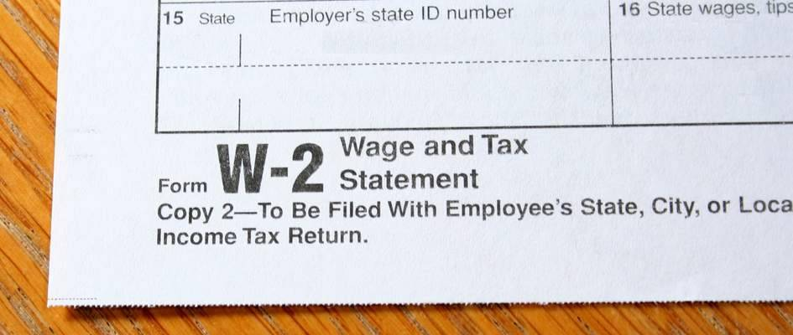
W2’s
If you signed up before Jan 13, 2023 to receive your W2 electronically, you will receive an email letting you know when it is available for download in UCPath.
UCLA will never email or text
you your W2.
If you did not sign up to receive
it electronically, it will be
mailed.

Slide 7

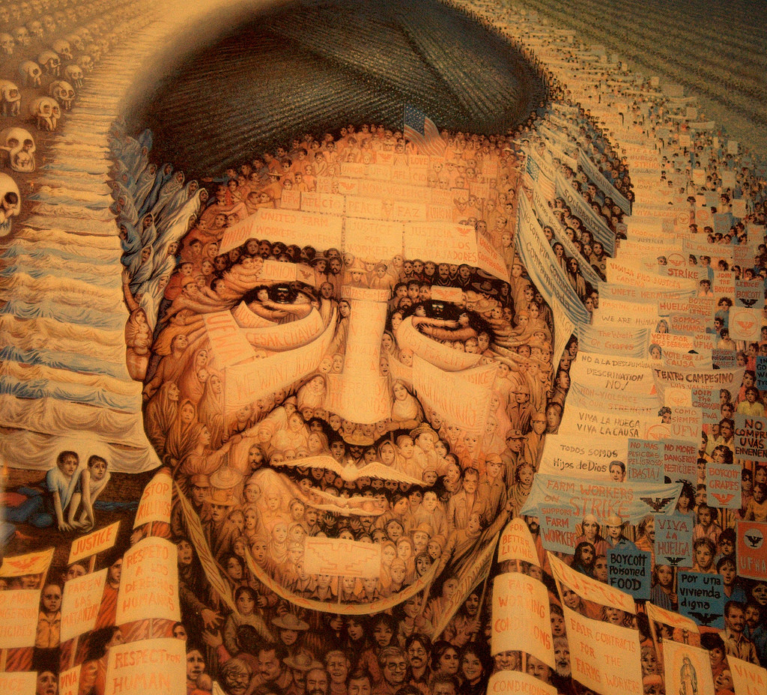
Upcoming Holidays
February 20, 2023 – President’s Day
March 31, 2023 – Cesar Chavez Day

Slide 8
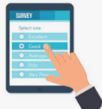
Employee Engagement Survey
The survey closes tomorrow, so please respond asap!
Purpose is to gather valuable insights from each of us to help elevate the employee experience at UCLA Health.
You can access the Employee Engagement Survey website for any questions or email umattersurvey@mednet.ucla.edu.

Slide 9
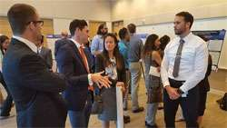
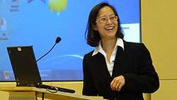
Research Day Updates
2023 Meeting Information
In-person at the California Endowment (Center for Healthy Communities Los Angeles)
Wednesday, May 10, 2023
Keynote Speaker: Dr. Steve Shoptaw
Abstract Submissions
Submission Guidelines and other info can be found on our website
Abstracts must be submitted via the Submission Portal by April 7, 2023.

Slide 10

Grand Rounds
Fourth Friday of every month, from 12-1pm
First event: Friday, February 24th
Via Zoom (email Denise Acelar if you do not already have the invite)
Everyone invited, including affiliated residencies, research unit, clinical personnel, etc.
We are soliciting topics and speaker
suggestions for 2023

Slide 11

Emergency Preparation
Visit the UCLA Health Emergency Preparedness website for important safety tips
Hybrid employees should renew/complete their Oppenheimer building training: Link for returning users. Link for new users. If you are a new hire/user, please use this dept. specific registration code: 765229D
Update Laura and HR with any changes to your emergency contact information

Slide 12

Emergency Preparation
1. In the event of an emergency or drill, Oppenheimer employees may have to evacuate the building. Where is the safe refuge/rendezvous for our suite?
ANSWER: The parking lot behind CVS, near Glendon and Wellworth
2. How many emergency kits do we have in Oppenheimer Suite 1800, and where are they located?
ANSWER: Two, one in Laura’s office and one in the Supply/Copy Room
3. In the event of an active shooter, what is the three-word phrase to help you remember what to do?
ANSWER: Run, Hide, Fight

Slide 13
Ordering Furniture
*(or anything remotely resembling furniture)
UCLA policy restricts the purchase of furniture*, limiting what we are allowed to purchase to specific vendors, and sometimes, specific items.
The following items MUST be purchased from Steelcase, Inc. (Tangram), we cannot use any other vendor for these items:
Filing cabinets
Free-standing steel and laminate desks
Steel bookcases
Paneled office systems
Task chairs and side chairs
You can use vendors other than Steelcase when buying furniture such as lounge pieces and bookcases. For wood furniture, UC has established agreements with Haworth, Kimball and Steelcase.
For any other furniture* purchase, you must use one of the vendors on Purchasing’s Vendor Agreements List that has a negotiated agreement with UCLA.

Slide 14

Ordering Furniture (cont.)
Below are the 3 main line furniture manufacturers to the UC system. These are the preferred manufacturers for UCLA and the associated aligned dealership. Furniture sales is similar to automotive sales in that it uses a dealership model with the largest manufacturers requiring dealer alignment. IE. A Ford dealer can't sell Toyotas in the same way Tangram can't sell Miller-Knoll.
UC CONTRACTED FURNITURE SUPPLIERS
Tangram Interiors; Main Furniture Line: Steelcase
  Sales Rep: Rhonda Law, rlaw@tangraminteriors.com (Health)
M3 Office; Main Furniture Line: Miller-Knoll
  Sales Rep: Manny Gomez, manny@m3office.com
CPM One Source; Main Furniture Line: Kimball
  Sales Rep: Ignacio Negrete Jr, ignacio@cpmonesource.com

Slide 15
Ordering “Furniture”
Per Purchasing: Office furniture generally includes task chairs, guest chairs, desks, and storage.
However: some other items are being classified as furniture, e.g. desk additions that convert a regular desk to a standing desk.
What about mail carts and safes?
These items can be purchased from either office furniture or office supply vendors. Office Depot would be a good match for a reasonably priced locking pedestal or a file cart. Grainger is also another place to find more commercial/industrial items such as mail carts or safes. Grainger and Office Depot are both contract UC suppliers and have supplier sites in BruinBuy.

Slide 16

Gift Cards
New form available with guidelines on how to order gift cards
Relevant for both human subject payments AND non-employee/non-IRB gift cards
THE PROCESS HAS RECENTLY CHANGED
Response time is slow, allow for extra time when ordering

Slide 17
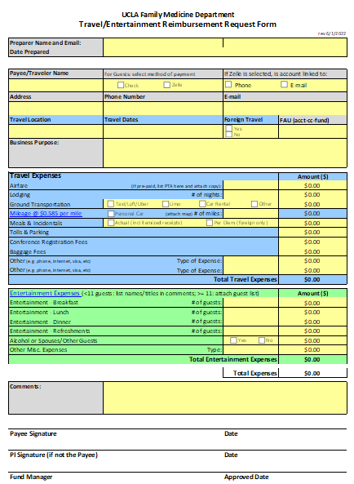

Travel Reimbursements

Slide 18
Travel Reimbursements
Self-service system (Travel Express/Concur)
  Requires training
  Traveler must download app and upload receipts into system
  Traveler responsible for submitting accurate, comprehensive, and compliant report
  https://www.finance.ucla.edu/express/general-user for training
Complete Travel/Entertainment Reimbursement Request Form
  Review presentation on the website
  Save receipts and submit to Fund Manager with Reimbursement Request Form
  Fund Manager and Purchaser will review for accuracy/compliance
  Guests must use this option
Note: PTA is recommended for either option for purchase of airfare

Slide 19
Guest Travel
New form available for gathering information from Guest Travelers (with gratitude to Dami, Uyen, and the CHIPTS team for letting us hijack and revise their template)

Slide 20
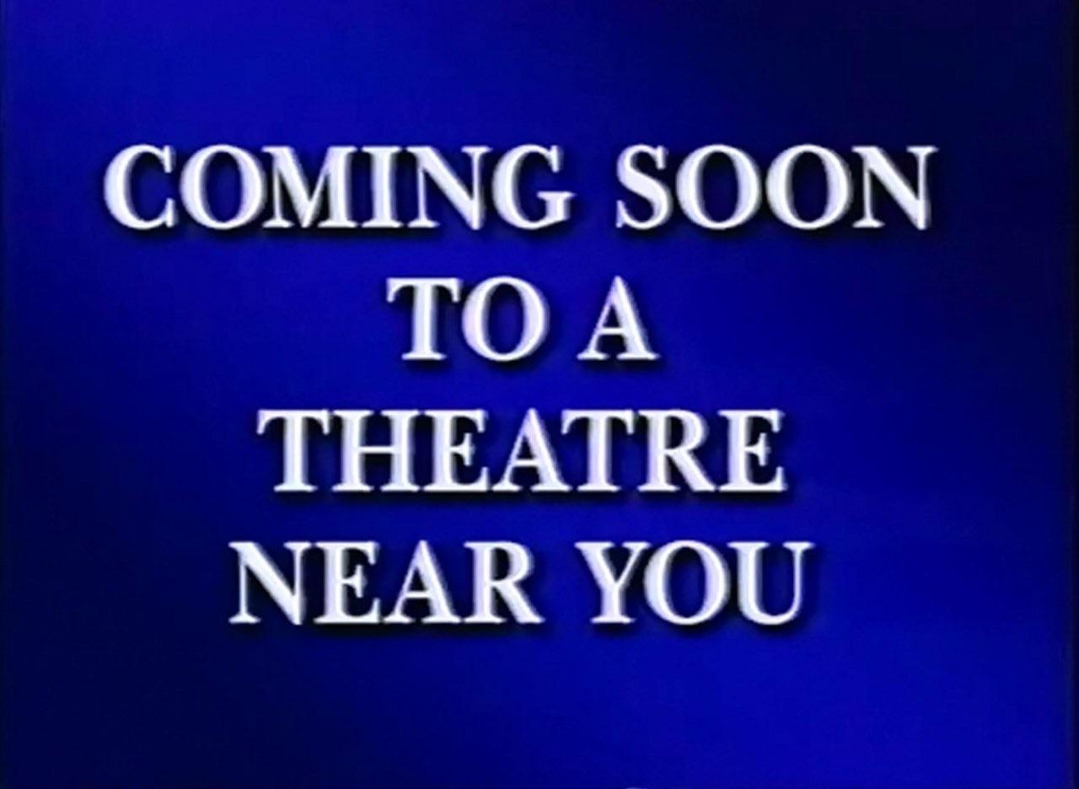
Upcoming Guidance
Software purchases

Slide 21
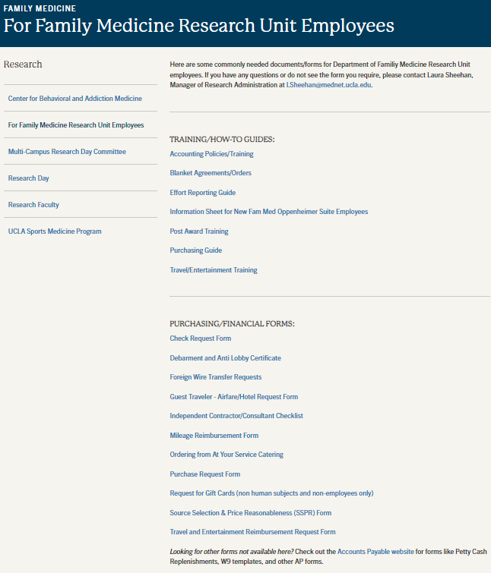
Website Updates
Faculty: provide Laura with your research information ASAP
Updated how-to guides and financial forms are now available on the “For Fam Med Research Unit Employees” page

Slide 22

NIH Updates
New NIH Salary Cap, effective Jan 1, 2023: $212,100
NIH is allowed to adjust Funding Opportunity Announcements (FOA’s) up to 30 days prior to the deadline. Review FOA at that time to ensure no changes have been made that would affect your in-progress applications.
NIH Human Subject Research Policies, Clinical Trials, and Inclusion Webinars are now available online

Slide 23
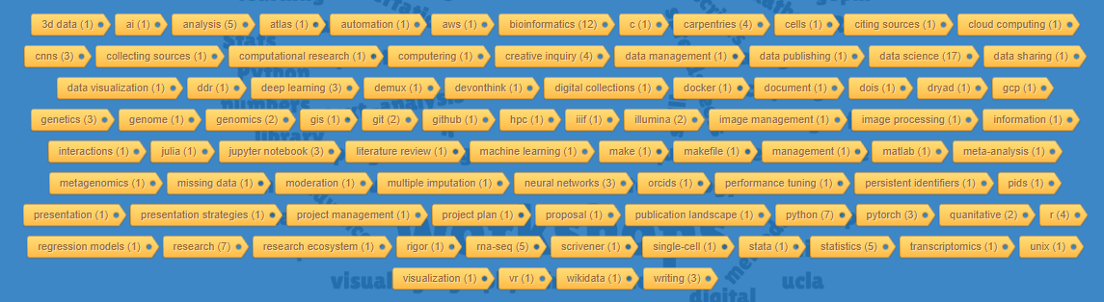
UCLA Workshops
Both live and recorded workshops available online

Slide 24
Budget Justifications – Required Language
Our F&A Rate Agreement has expired, therefore we need to include specific language in our proposal budget justifications until a new agreement has been issued:
Fringe Benefits: “Fringe benefit rates used have been proposed to DHHS for FY22/23.”
F&A/IDC: “These negotiated rates are established through June 30, 2019 and are provisional as of July 1, 2019 and beyond. Awards using provisional rates must be adjusted once a new F&A rate agreement is negotiated and approved by the cognizant agency for indirect costs.”

Slide 25

IRB
The IRB Meeting Calendars for 2023 have been announced and are available on the HRPP Website

Slide 26
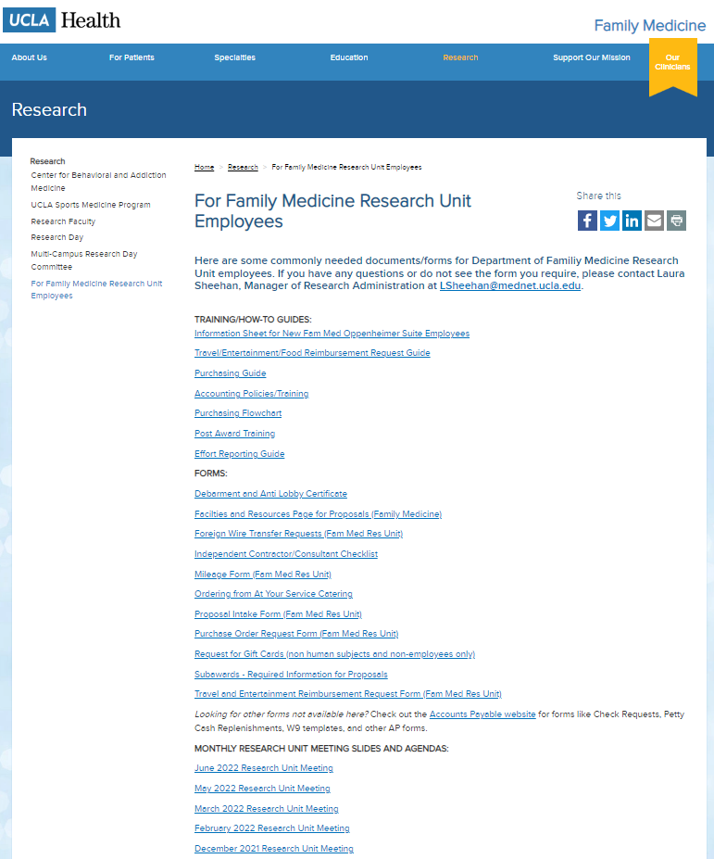
Meetings/Events
CHIPTS-hosted webinar in March (date TBD): Building a Budget
Next Monthly Research Unit Meeting: March 2nd, 2023
Prior monthly meeting agendas/slides are available on the website

