Slide 1
SOS-Stomp out Sepsis!
A Clinical Nurse Specialist mentored initiative to improve mortality rates
Mary Lawanson-Nichols RN, MSN, NP, CNS, CCRN
Clinical Nurse Specialist Critical Care & Intermediate Care Units
UCLA -Santa Monica Medical Center
Notes:
Stacie

Slide 2
Disclosure
Nothing to disclose, no outside influences
Notes:
Stacie

Slide 3
Objectives
At the conclusion of this session, the participants will be able to:
Identify mentoring skills by the Clinical Nurse Specialist
Describe interventions to assist staff nurses to become leaders in their unit
Examine staff influences to decrease mortality in Severe Sepsis/ Septic Shock patients
Notes:
Vicky

Slide 4


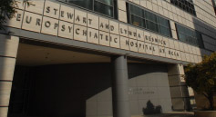
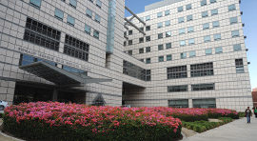
UCLA Health
Hospitals:
  Ronald Reagan UCLA Medical Center
  UCLA Medical Center, Santa Monica
  UCLA Mattel Children’s Hospital
  Stewart and Lynda Resnick Neuropsychiatric Hospital
  California Rehabilitation Institute
Notes:
Stacie

Slide 5

UCLA Medical Center, Santa Monica
  A 260 bed facility
  Magnet Designated in 2016
  Provides a broad range of academic
  medical services in a convenient, accessible community setting
  Top Geriatrics services on the west coast
  Internationally known Rape Treatment Center and its Stuart House facility for child victims
  Solid Oncology services
  Orthopedic/spine surgery
Notes:
Catherine

Slide 6
Clinical Issue
1.5 million people per year are diagnosed with sepsis. 1/3 to 2/3 of sepsis patients nationwide will lose their life to this diagnosis (2, 5)
Sepsis is the #1 cause of death among the hospital inpatients and the #1 reason for admission to the ICU (5)
At UCLA- Santa Monica Medical Center, Severe Sepsis mortality in 2016 was at 13% and Septic Shock mortality was at 49% per inpatient ICD codes
Notes:
Stacie

Slide 7
Spheres of Influence
Patient sphere of influence: which is the critical focus of CNS practice, is clinical expertise directed toward managing patient outcomes to improve quality and provide cost-effective care
Nurse sphere of influence: The nurses/nursing practice sphere reflects how the CNS influences nursing activities and actions to improve patient outcomes. These activities can be achieved through education, policy development, and evidence-based practice
Organization/system sphere of influence: The organization/system sphere refers to hospital- or organization-wide changes brought about by the CNS that result in improved patient outcomes and cost-effectiveness (8)

Slide 8
Literature Review
Mentoring nurses in developing practical leadership skills to lead quality improvement efforts helps with project sustainability (5, 6)
The use of Evidence Based Practice in nursing is a long-term dynamic process that requires material resources and leadership support. The support fosters expertise and integration into daily practice (1)

Slide 9
Literature Review
MEWS tools stratify patients by applying a numerical score to quantify physiologic ﬁndings. This aids in early detection in a patient deteriorating in acutely ill or septic patients. (7)
As such, Medical Emergency Response Teams (MERTs) are arranged around specific medical diagnoses such as cardiac arrest (CODE), injury (Trauma), stroke, ST elevation MI (STEMI), and increasingly prevalent, and can be used in treating sepsis (3, 4)

Slide 10
Team Members
Mary Lawanson-Nichols, RN, MSN, CNS
Danielle Park, RN, BSN, CNII- Sepsis RN
Mackenzie Roesti, RN, MSN, CNII- Sepsis RN
Susan Abrams, RN-BC- CNII- Sepsis RN
Unit Champions from 11 units within the facility
Sepsis Project Manager
Unit Leadership (Unit Director, Assistant Unit Directors and Educators)
Notes:
Catherine

Slide 11
Plan & Implementation- Sepsis RN
Clinical Nurse Specialist (CNS) supported pilot with a dedicated Sepsis RN (February, 2017- April, 2018) for early sepsis recognition by the use of the Modified Early Warning Score (MUSE) monitoring system. Daily logs recorded by nurses with a log at the end of the week with review of activities
Sepsis RNs assisted colleagues with sepsis lab interventions ( nurse driven protocol), collection of 2-sets of blood cultures and lactate. Physician notification could be assisted by the Sepsis RN

Slide 12
Plan & Implementation- Sepsis RN
Sepsis RN to send follow up email to staff and unit leadership discussing conversation with fellow colleagues during one on one mentoring sessions. The CNS mentored Sepsis RN with presentations at staff meetings and interdisciplanary meetings on Sepsis recognition. CNS reviewed all documentation & presentations prior to release

Slide 13
Plan Implementation- Sepsis Champions
Clinical Nurse Specialist (CNS) supported bedside Nurse Sepsis Champions (July, 2016- ongoing). The goal was to empower bedside staff to educate colleagues. Meeting held monthly for one hour then extended to two hours to review data and to conduct unit education & surveillance
CNS reviewed all sepsis fallout cases presented at the champion meeting
https://www.uclahealth.org/sepsis/
CNS coordinated champion rounds thru the hospital during sepsis week 2018. Staff educated over 300 RNs and interdisciplinary colleagues on Sepsis & sepsis recoginition

Slide 14
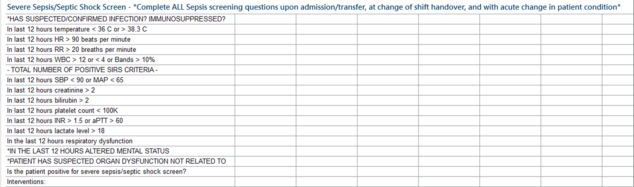
Plan Implementation- Sepsis Champions- Staff Education

Slide 15
Effects of Improvement
Sepsis RN’s reviewed 3,100 charts and had 1,100 nurse encounters. They attended 66 code blues & rapid responses to facilitate lab draws and fluid boluses. They also presented at 12 staff meetings including interdisciplinary colleagues of respiratory therapists and lab services.
Sepsis RNs created a fun interactive game to help understand Sepsis (sepsis Jepardody https://www.uclahealth.org/sepsis/)

Slide 16
Effects of Improvement
The CNS mentored nurse champions were instrumental in educating their colleagues in instituting a new sepsis screening tool. Champions presented fall out cases at the monthly meeting. Took part in unit staff meeting and rounds to encourage peer to peer education.

Slide 17
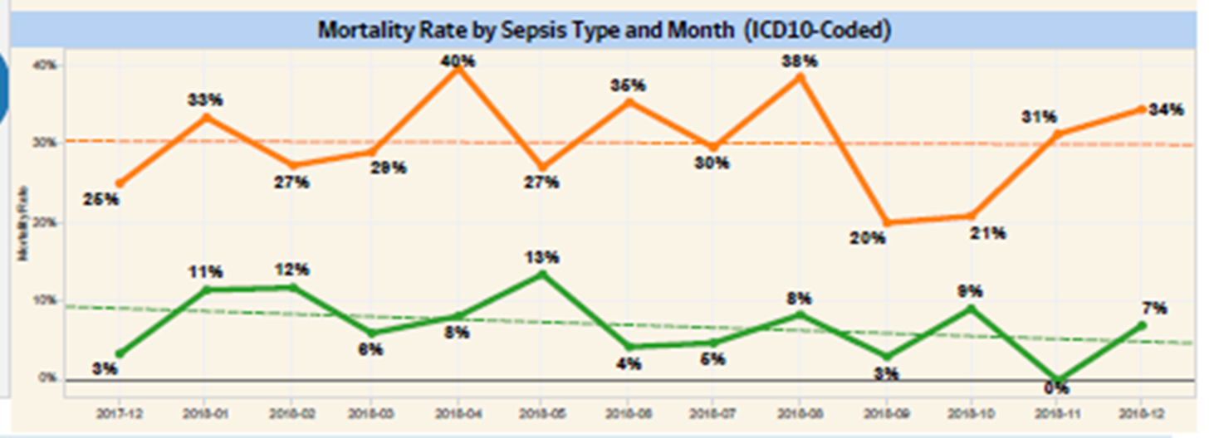
Effects of Improvement
With the assistance of the unit champions & Sepsis RNs, mortality from Severe Sepsis was reduced to zero at on point, 2018. Septic Shock mortality decreased down to 20% in the same year. ( Orange- Septic Shock) ( Green- Severe Sepsis)

Slide 18
Future Efforts
We no longer have a Sepsis RN but are coordinating a Code Sepsis. The team would include : Physician, Critical Care RN, Respiratory Therapist, Pharmacist (to deliver 1st Antibiotics) and lab on stand by
Go live date around April 2019

Slide 19
Conclusion
CNSs take part in an organization projects which have implications on system projects that focus on patient outcomes
As clinicians we do small projects like my presentation on a daily basis
My mentorship is assisting with sustainability in reducing mortality
Thank you☺

Slide 20
Contact Information
Mary Lawanson-Nichols RN, MSN, NP, CNS, CCRN
Clinical Nurse Specialist, Critical Care & Intermediate Care
UCLA- Santa Monica Medical Center
Office- 424-259-8281
Email: Mlawanson@mednet.ucla.edu

Slide 21



Any Questions

Slide 22
References
1.Breckenridge Sproat, S. T., Throop, M. D., Raju, D., Murphy, et. al.,(2015). Building a Unit-Level Mentored Program to Sustain a Culture of Inquiry for Evidence-Based Practice. Clinical Nurse Specialist, 29(6), 329-337
2.Dellinger RP et al. (2016), Surviving Sepsis Campaign: International Guidelines for management of severe sepsis and septic shock: 2012-2016. Critical Care Medicine. 41(2):580-637
3.Fernandez Moure, J., Pascual, J. L., Martin, N. R., Rodgers, H., & Kaplan, L. J. (2018). Emergency Response Teams In and Outside of Medicine - Structurally Crafted To Be Worlds Apart. Journal of Trauma and Acute Care Surgery, doi: 10.1097/TA.0000000000002073. [Epub ahead of print]
4. Gauer, (2013) Early Recognition and Management of Sepsis in Adults: The First Six Hours. American Family Physician. 88(1):44-53

Slide 23
References
5. Jones, S. L., Ashton, C. M., Kiehne, L., et. al.,. (2015). Reductions in Sepsis Mortality and Costs After Design and Implementation of a Nurse-Based Early Recognition and Response Program. The joint commission journal on quality and patient safety, 41(11), 483-491
6. Kliger, J., Singer, S. J., Hoffman, F. H. (2015). Using the integrated nurse leadership program to reduce sepsis mortality. The Joint Commission Journal on Quality and Patient Safety, 41(6), 264-272
7. Roney, J. K., Whitley, B. E., Maples, J. C., Futrell, L. S., Stunkard, K. A., & Long, J. D. (2015). Modified early warning scoring (MEWS): evaluating the evidence for tool inclusion of sepsis screening criteria and impact on mortality and failure to rescue. Journal of Clinical Nursing, 24(23-24), 3343-3354
8. Delp,S., Ward,C., Altice, N.,(2016). “Spheres of influence, Clinical nurse specialists Sparking economic impact, innovative practice”, Nursing management, 47(6)p.30-37

Slide 24
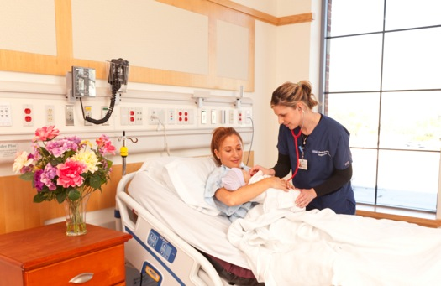

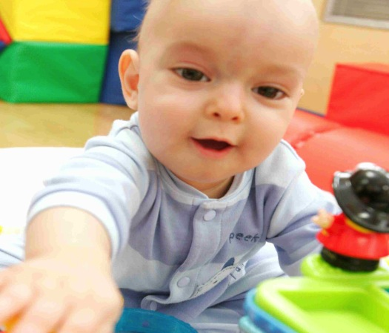
UCLA Medical Center, Santa Monica
  The BirthPlace, Santa Monica
    Comprehensive maternity services to help expectant parents be ready for their new arrivals.
    Comfortable, home-like LDR rooms
    Laborist Program
    16-bassinet Neonatal Intensive Care Unit
  Expanded pediatric services
    25-bed Pediatric Unit — the only inpatient pediatric unit in Santa Monica
    Operates as a unit of Mattel Children’s Hospital UCLA
    Teen Cancer Center

