Slide 1
Natural Experiment Methods and COVID-19 Research
Bernie Black
2020.09
Next-D2 Stakeholder Virtual Meeting (Sept. 2020)

Slide 2
Underlying goal in any observational study
Observe only treated outcome y₁ for treated units
Observe only control outcome y₀ for control units
Use control units to predict missing potential outcome for treated units
  Compute ATT (average treatment effect for the treated)
    y₁ (observed) – y₀ (if had been control), for the treated
  Sometimes also study ATE (average effect for everyone)
Goal: Approximate a randomized experiment
  Then can use control mean to predict missing mean potential outcome for treated:
    E[y₀|treated] (unobserved) = E[y₀|control] (observed)
  Try to acheive: Random assignment to treatment, conditional on x
    Different names: Unconfounded assignment, strongly ignorable assignment, SOO, CIA
  E[y₀|treated, x] (unobserved) = E[y₀|control, x] (observed)
If goal achieved: Randomized block experiment [block on x]

Slide 3
Exogenous Shock
“Natural experiment” provides an exogenous shock
Hopefully: divides sample into treated vs. control units in as-if-random manner. Several possible designs, in different settings:
  Difference-in-differences (DiD)
  Shock-based instrumental variables (shock-IV)
  Regression discontinuity (RD)
  Combined methods
Sometimes (if shock is large and clearly exogenous):
  Before vs. after the shock: Interrupted time series (ITS)
  COVID-19 is a large shock, so ITS can be credible
    ITS with fast onset of treatment effect → RD, which can be highly credible

Slide 4
To move closer to as-if-random assignment
Can use balancing methods to improve balance between treated and control, For example:
  Matching (on propensity score, covariates, or both)
  Inverse propensity weighting (IPW)
  Exact balancing approaches

Slide 5
On to some examples
Effect of Masks and Social Distancing (Lyu Wehby, Health Affairs 2020)
  DiD design (with dynamic treatment effects)

Slide 6
Always ask: What are possible confounders?
Leads-and-lags graph (dynamic treatment effects) is convincing
  Parallel pre-treatment trends
  Effect grows over time, which is plausible
  Counties weighted by population (effects more likely in urban areas)
  Control for other state policies; various robustness checks
What else could be done?
  Better: Balancing treated vs. control counties
  ATT weights: based on propensity to have a mask order
    Based on everything about the county except the state it is located in.

Slide 7
Transmission on public transport
Shen et al. (JAMA IM 2020): Two Chinese buses
  Both full (60 and 68 passengers; 88% women)
  Same destination (worship event); 50 minutes each way
  Who was assigned a seat on which bus = apparently random
  Tested all passengers on both buses
    plus 172 people who arrived at the event in another way
One infected passenger on bus A: apparently a “superspreader”
Afterwards: 23/67 infections on Bus A; 0/60 on Bus B
  And 7/172 other attendees
Sitting near index patient on bus: mildly higher risk (not signif.)
Implies: transmission of aerosols through bus ventilation system

Slide 8
Here is the bus!
Green = asymptomatic
Yellow = mild case
Red = moderate case
Dark red = index case

Slide 9
Effect of Health Homes and Telehealth
Mt. Sinai extension of Next-D2 project
Effect of health home during COVID pandemic
DiD design: Study combined effect of COVID pandemic and access to telehealth (separate shocks, but hit at same time in NYC)
  Treated: diabetic patients with other comorbidities in health homes
  Versus similar (matched) controls not in health homes
Outcomes:
  access to health care and social services
  COVID-19 and non-COVID-19 clinical outcomes
  racial/ethnic disparities in these outcomes

Slide 10
Mt. Sinai Design Advantages
Panel data on treated (in health homes) versus control (not in health homes) patients
  Multiyear effort to obtain data, as part of Next-D2
  Medicaid data, IRB approvals already in hand
  Long pre-treatment period: Confirm parallel pre-treatment trends
Match treated persons to similar controls
  already implemented
  Careful trajectory balancing methods
Study evolution of treatment effects over time, during the COVID period
  See Lyu Wehby example above

Slide 11
ED Avoidance
Did people stop coming to EDs with heart attacks?
  News reports and several published studies say yes.
    Solomon et al. (NEJM 2020) report a 40% drop in AMI hospitalizations for Kaiser Permanente Northern California, but do not distinguish between STEMI and nSTEMI.
    Garcia et al. (JACC 2020) obtain data from 9 high-volume cardiac catheterization laboratories and report a 38% drop in lab activations for STEMI.
    Bhatt et al. (JACC 2020) report a sharp decline in hospital admissions for acute cardiovascular conditions, but do not distinguish between AMI, stroke, and heart failure.
    Kansagra et al. (NEJM 2020) report a sharp drop in queries to the RAPID stroke evaluation software platform.
We beg to differ . . .

Slide 12
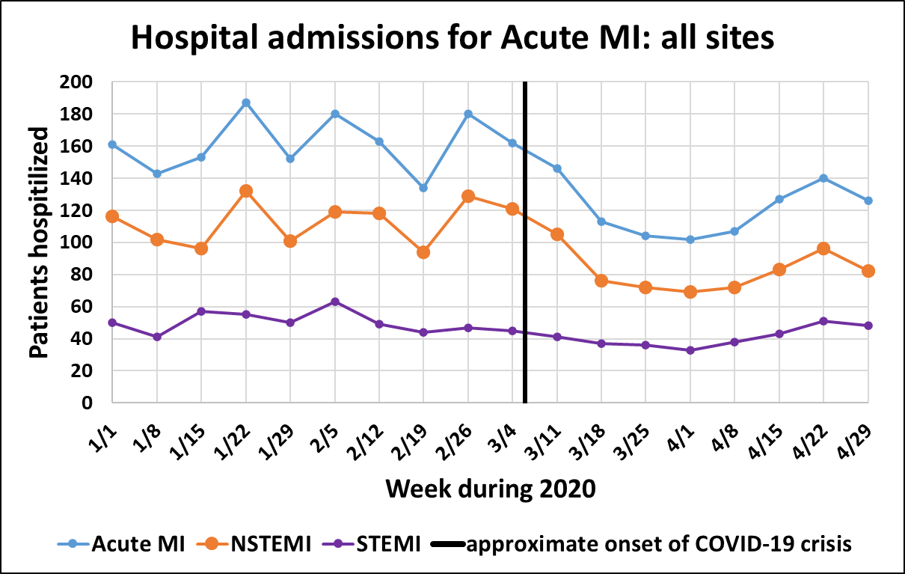
Data from 4 major academic health systems
Northwestern (Chicago), Indiana (whole state, health insurance exchange), MCW (Milwaukee), U Missouri.
  Data collection possible because network in place for Next-D2

Slide 13
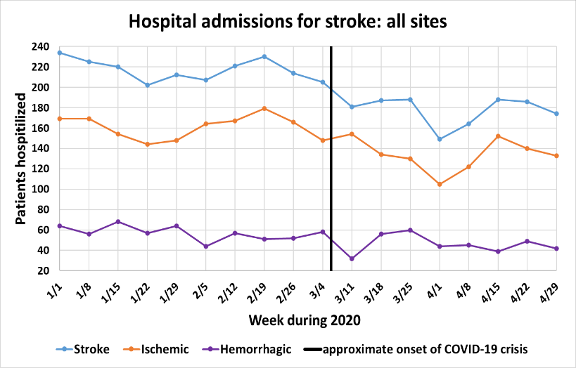
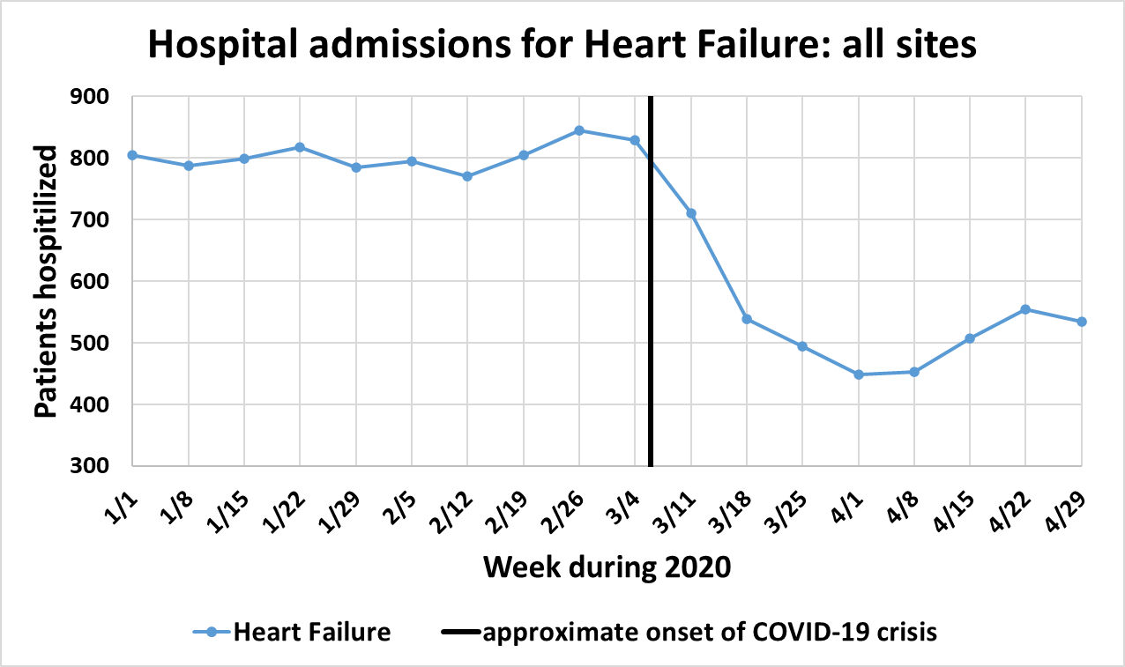
How about Stroke and Heart Failure

Slide 14
The message for natural experiment research is . . .
Details matter
  HF admissions fell. Maybe appropriately. Many can be managed remotely.
  If you study all “acute cardiovascular conditions” (Bhatt) your results will be driven by HF (the most common condition)
  Study all AMI hospitalizations (Solomon) combines STEMI with nSTEMI.
  Catheter lab activations for potential STEMI (Garcia) ≠ Actual STEMI
Don’t rely too heavily on a single study . . .

Slide 15
Will we have a COVID/flu twindemic?
Anecdotal evidence: virtually no flu season in Southern Hemisphere countries
  The social distancing measures aimed at COVID are knocking out flu
    Which is typically much less infectious
Can we do better than anecdote with US data? Maybe
ITS design: ratio: 2020 ED visits/same period in 2019

Slide 16
ITS design with control for seasonality
Data from national ED staffing company, on pediatric ED visits
Ratio of 1 → no change

Slide 17
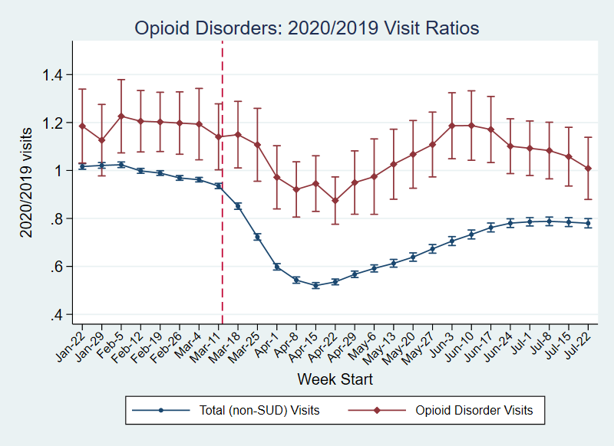
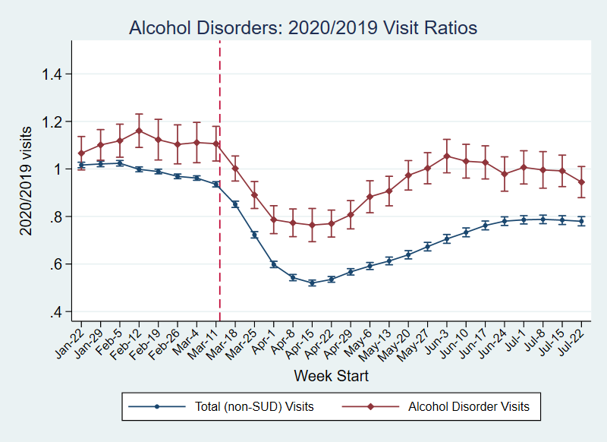
Substance abuse: ED visit trends
Data from national ED staffing company
News stories: Opioid epidemic is getting worse during COVID period
We find: Yes, in some states, but rates falling in other states.
Overall 17% drop (versus 33% for all non-COVID visits)
Maybe, news stories come from places where rates would be rising anyway.

Slide 18
Summary: Natural Experiment Research on COVID
Natural experiments start with exogenous shocks
Good news (for research): COVID-19 is a big one
Challenge: It’s mostly a national shock
  ED visit declines similar in hard-hit versus less-hit areas
But with creativity, credible approaches can sometimes be found

