Slide 1

Lessons Learned from NEXT-D and NEXT-D2
Dennis Ross-Degnan, ScD
Harvard Medical School and Harvard Pilgrim Health Care Institute

Slide 2
Chronic Care Model: Framework for Improving Chronic Illness Care
Community
Resources and Policies
Health Systems
Organization of Health Care
Self-Management
Support
Delivery
System
Design
Decision
Support
Clinical
Information
System
Informed, Activated Patient
Prepared, Proactive Practice Team
Productive
Interactions
Improved Outcomes

Slide 3
NEXT-D: 1: KP Northern CA; 2: Mt Sinai St. Luke’s; 3: UCLA; 4. Harvard; 5. NW
Public policies and programs
State innovation funds
State Medicaid expansion
IRS insurance regulation
Public Policy
Community Resources
Legislation &
Regulations
Environmental &
Social Context
Commercial insurance
High deductibles
Drug cost sharing reductions
Diabetes Health Plan
G
5
F
Religious
Institutions
SUPPLIERS
Health
Agencies
E
Pharmaceuticals
Purchasers
Employers
D
B
C
Social
Networks
Health System
Health Plans
F
G
Providers & Hospitals
4
Devices
Public Insurers
A
1
H
2
3
A
4
BEHAVIORS & PREVENTIVE SERVICES
Detection
Counseling
Lifestyle choices
Utilization Patterns
Medication adherence
Clinical Care Quality
Patients
B
IMPACTS
Diabetes Incidence
Diabetes Progression
Patient-centered outcomes
Patient & System Costs
Unintended outcomes
Disparities
Delivery system
Screening and outreach
Health IT
Quality improvement
Community-based DPP
B
C
F
H
Public insurance
Medicare coverage policies
Medicaid Health Homes
Medicaid managed care
NEXT-D2: A: Harvard B: UCLA C. Penn St D. NW E. Oregon F. Tulane G. UC Berkeley H. Mt Sinai

Slide 4
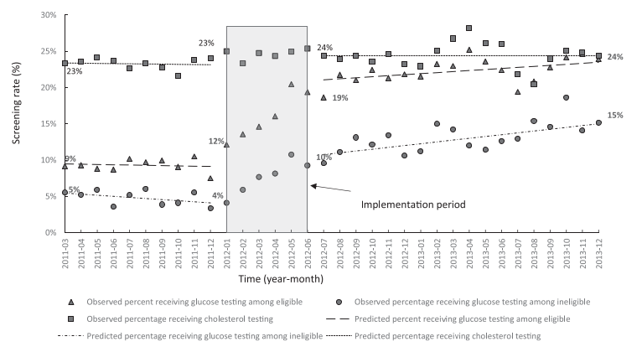
Delivery System Change – Glucose Testing
Enhanced glucose screening (Mt Sinai)
  Only one-fifth of patients eligible by ADA or USPSTF guidelines received test
  EMR decision-support increased screening among eligible patients by 11%, but also among non-eligible patients by 5%
Outreach to promote glucose testing (Kaiser)
  Employees with HTN >age 45 and BMI>25 without test in 5 years in selected employers
  Outreach (mail, email, message) results in nearly 3 times greater rate of testing within 6 months than employees of control employers
Practice or health plan strategies can increase appropriate screening, but long-term impact on glucose control unknown
Rates of Glucose Screening
Cholesterol (control test)
Glucose (eligible)
Glucose (ineligible)

Slide 5
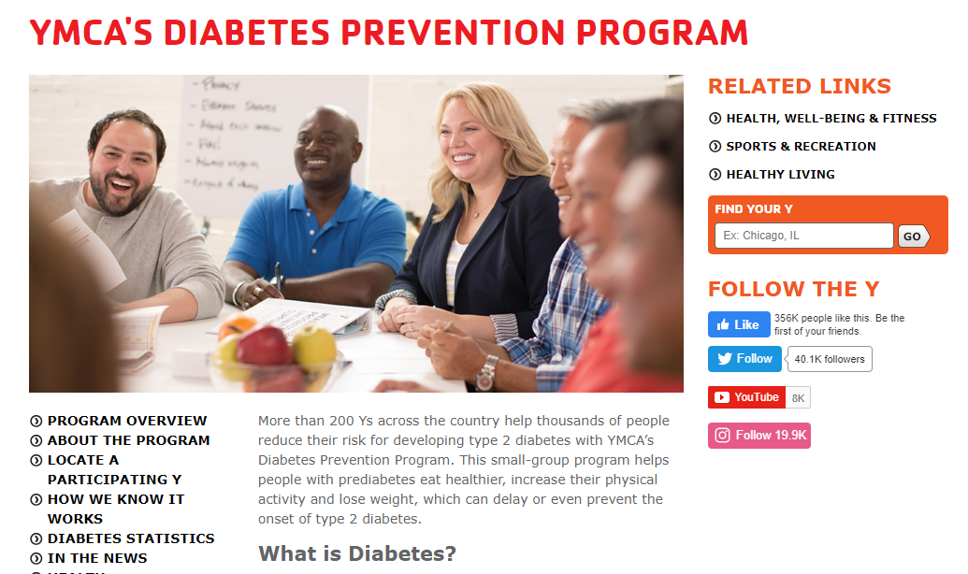
Delivery System Change – Prevention Programs
Low intensity health promotion (Kaiser)
  Patients in practices that documented exercise as a vital sign had higher rates of lifestyle referrals, slightly greater weight loss, and lower HbA1c
  Brief telephonic wellness coaching associated with greater weight loss and higher rates of quitting smoking
YMCA DPP implementation (N’western)
  Full DPP implemented in YMCAs for employees referred with diabetes or prediabetes
  Less than 10% of potentially eligible employees completed a test to verify risk status
  40% with documented prediabetes completed one session, 29% completed 9 core sessions, and 12% lost ≥5% of body weight
Engagement in wellness activities is a key barrier, especially in intensive community-based programs

Slide 6
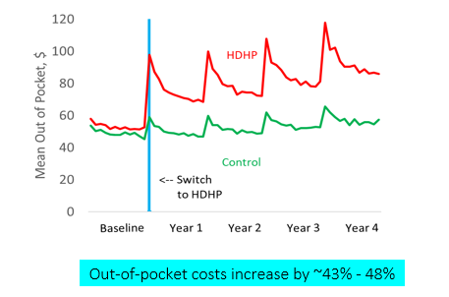
Commercial Insurance – Cost Sharing
High deductible health plans (Harvard)
  More than half of commercially insured individuals now have HDHPs
  Large out-of-pocket cost increases with HDHPs for all patients, especially those with HSA-linked plans
  Change in rates of specific services after switch to HDHPs related to OOP increase
  Low income patients delay important outpatient visits to treat acute diabetes complications, with increased ED and hospital care for these problems

Slide 7
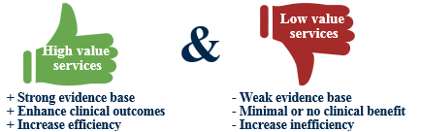
Commercial Insurance – Value-based Insurance
Diabetes Health Plan (UCLA)
  United VBID plan offered to employers
  Greater adherence to Metformin/ACEI/statins
  Fewer transitions from prediabetes to diabetes
  Reduced ER use, hospitalization, cost
Preventive Drug Lists (Harvard)
  Free or reduced cost medicines for DM, HTN, lipids, asthma, and other key chronic conditions
  Increased medication use among all members, but much larger effects among low income members
  Reduced ER and outpatient visits for acute diabetes complications
Reduced cost sharing for VBID services can improve appropriate use, improve outcomes, and potentially reduce disparities

Slide 8
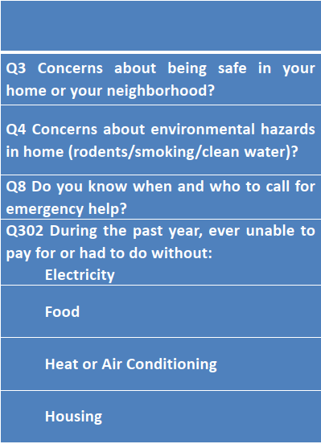
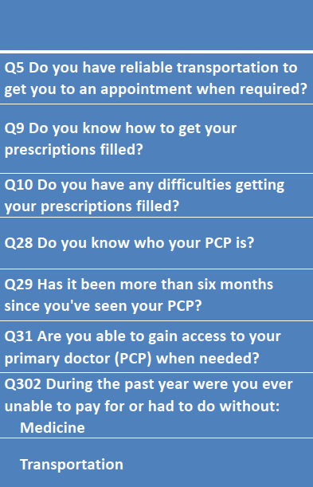


Public Insurance – Medicaid Managed Care
Health Homes (Mt Sinai)
  Challenges of privacy protecting data linkage
  Impact analyses ongoing, but qualitative work indicates improved access to care, social risks, and social support
Care Coordination Program (UCLA)
  Integrated medical, behavioral, and social support for high-need beneficiaries targeting social determinants
  Reduced utilization among SSI and Medicaid expansion patients with DM but not other groups
  Greater uptake would have increased impact
Complex social and health care needs make it challenging to engage patients
Need for more nuanced measures of social need
Impact on non-health outcomes may not be captured by typical health utilization measures

Slide 9
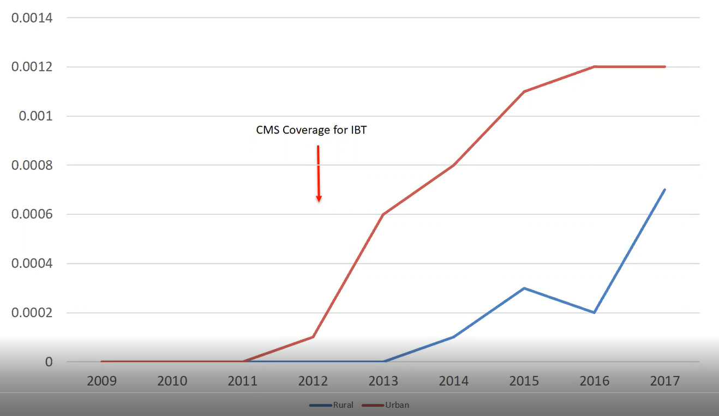
Public Insurance – Medicare Coverage Additions
Non-face-to-face chronic care management (Tulane)
  FGDs highlight financial (copay) and logistic (time) barriers to uptake, with some systems contracting outside vendors
  Evidence of increases in outpatient care, and small reductions in ER and inpatient care
Intensive behavioral therapy for obesity (Penn St)
  Up to 20 visits, mostly no patient cost sharing
  Low uptake in most health systems (<1%), but greater age <65, women, non-white, and urban
  Strong stakeholder engagement enhances understanding of barriers
Systems vary widely in rates of uptake, so impacts may not be generalizable
Population benefits small due to low uptake
Uptake of IBT
Urban
Rural

Slide 10
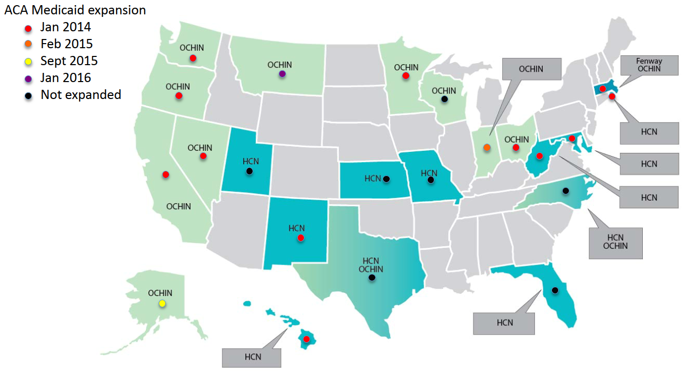

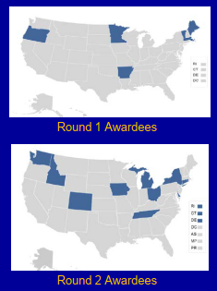
Public Policies and Programs
Medicaid expansion
State Medicaid expansion (OHSU, N’western)
  Expected increased DM diagnoses and service use
  CHCs: Better access to insurance and DM diagnosis, better HbA1c control among newly diagnosed
  Academic health centers: Small nonsignificant effects on visits, DM diagnosis, access to medicines
State Innovation Models (Berkeley)
  Stakeholder invaluable in understanding implementation
  Higher hospitalization rates for patients with DM in “food swamps” (especially rural areas)
  Increased DM diagnosis and use of social risk codes
  No evidence of reduced 30-day readmissions, increased adoption of HIT or care management
Challenge to find appropriate comparators given selection, timing, and contextual differences

Slide 11

Some Methodological Insights
Value of conceptual models of causal pathways to understand reasons for success/failure
Value of mixed methods for understanding results
Thoughtful matching
  Identifying appropriate comparators
  Dealing adequately with selection
  Balancing baseline trajectories in outcomes
Need for more complete data
  Insurance status at each patient encounter
  Better measures of SES and social risk
  More efficient linkage

Slide 12




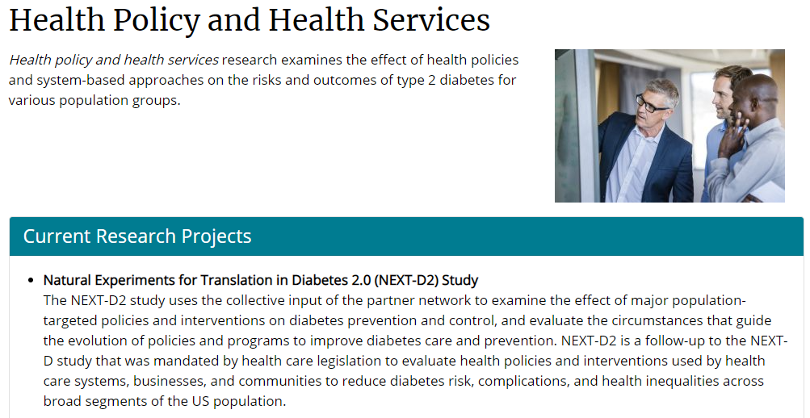
Some Benefits of NEXT-D Consortium
Shared solutions to common methodological challenges
  Operational definitions
  Optimal study design, sample selection, matching
  Stronger analysis approaches
Accountability structure
Constructive input on presentation and interpretation of results
Evolving insights about natural experiments that improve diabetes prevention and control

Slide 13
Thank You!
Dennis Ross-Degnan
dennis_ross-degnan@hms.harvard.edu

