Slide 1

Emerging Design and Analysis Approaches:
NEXT-D Lessons for COVID-19 Research
Dennis Ross-Degnan, ScD
Harvard Medical School and Harvard Pilgrim Health Care Institute

Slide 2
Overview
NEXT-D2 interventions and COVID-19 research
Study design and approaches
Bias reduction and balancing
Attention to denominators
Measurement and metrics
Data linkages
Value of long-term research consortia like NEXT-D
NEXT-D COVID-19 Enhancement Grants

Slide 3
NEXT-D2 Interventions, Comparators, and Relevance to COVID-19 Research
Practice-level and system-level differences
  Medicare coverage expansion: Practices/systems that bill service vs. not (Penn State, Tulane)
  Medicaid expansion: High vs. low performing CHCs (OHSU)
  Adoption of HIT and care management (Berkeley)
Insurance coverage
  Medicaid Care Coordination Organizations: Qualifying acceptors vs. non-acceptors (UCLA)
  Medicaid Health Homes: Outreached/enrolled vs. outreached/not enrolled vs. not outreached (Mt Sinai)
  Medicare coverage expansion: Exposed vs. not (Tulane, Penn St)
  Employer adoption of reduced cost sharing: full replacement vs. not (Harvard)
State-level policy differences
  Medicaid expansion vs. not (OHSU, N’western)
  Receiving innovation funds vs. not (Berkeley)
Determinants of practice and system differences in patient care and outcomes
Effects of COVID-related policies (e.g., furloughs) or programs (e.g., patient outreach)
Differential impacts of prior coverage policies on COVID utilization and outcomes
Effects of reimbursement policies (e.g., coverage of telephonic visits)
Impact of job loss on coverage and outcomes
Differential impact of COVID within risk groupsor insurance groups
Effects of state policies (e.g., shelter in place) or community differences (e.g., masking)

Slide 4

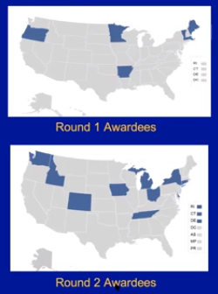
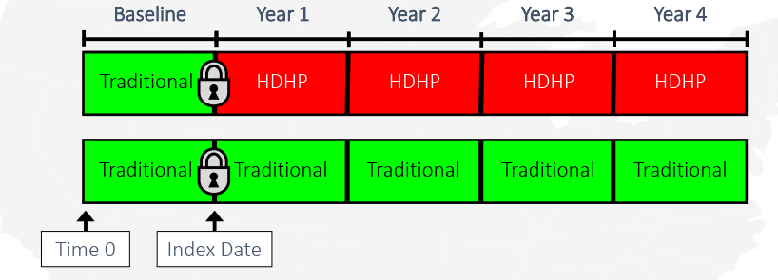
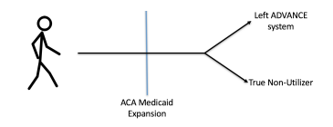




Design Issues in Observational Studies
Baseline comparability of comparison groups
  Differential likelihood of receiving intervention
  Imbalance on observable factors
  Non-parallel trends in covariates or outcomes
Post-intervention differences due to selection
  Differential regression to the mean
  Divergent trends due to unrelated interventions
Post-intervention changes in population
  Insurance or program churning
  Health system entries or exits

Slide 5
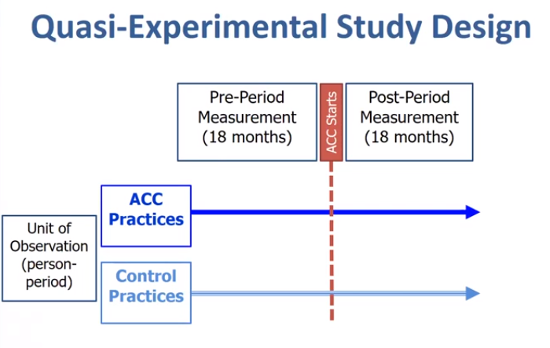
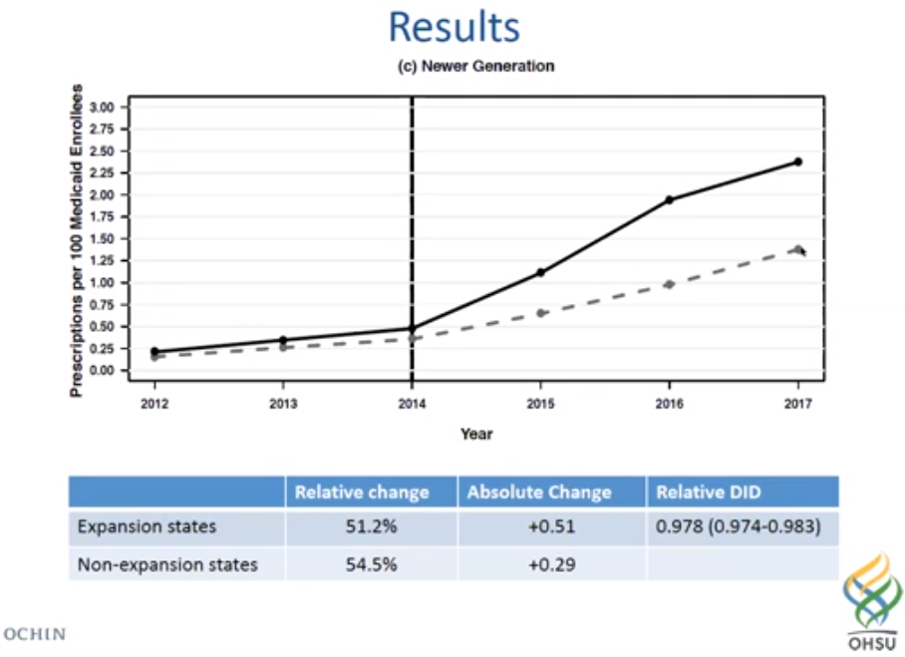
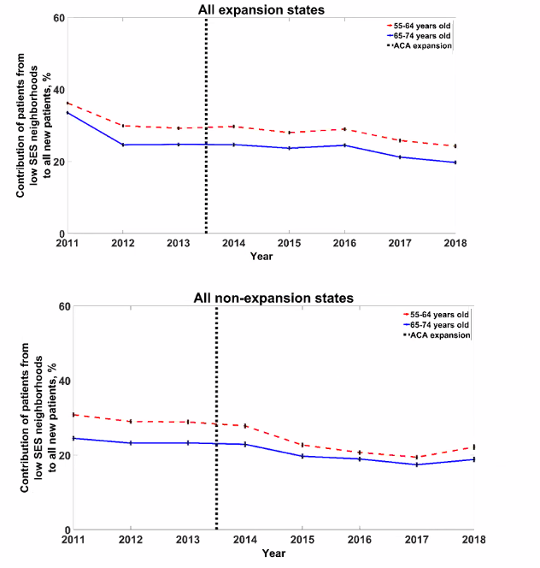
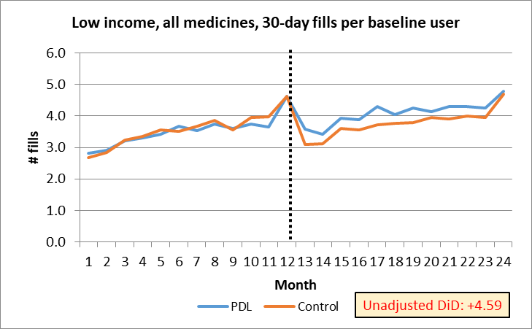
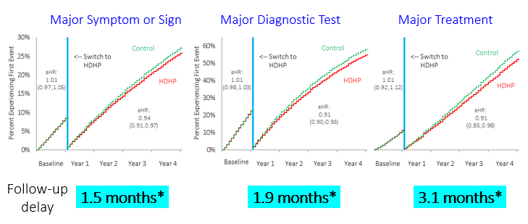
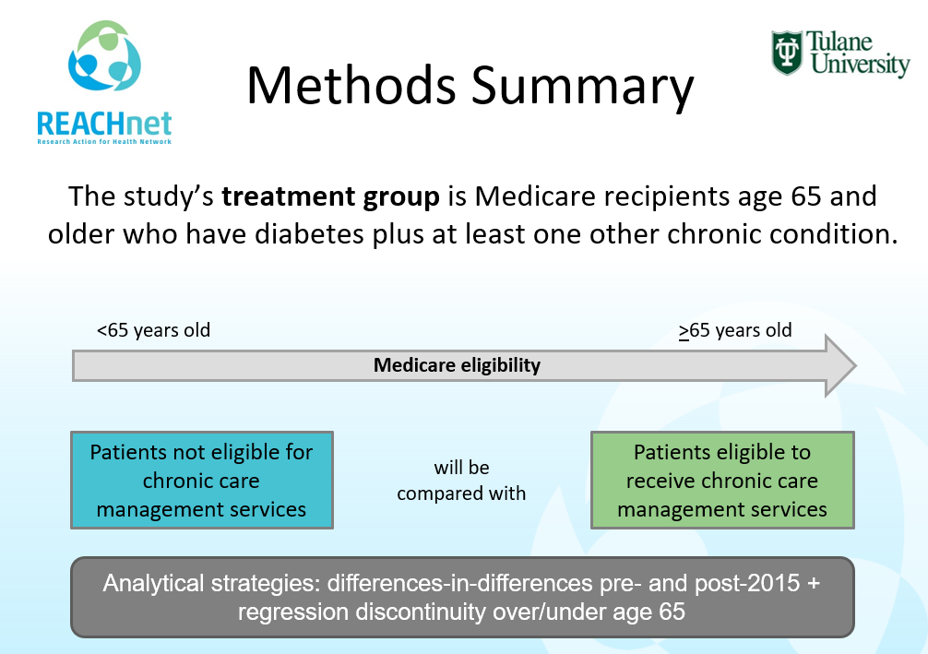


Study Design and Analysis Approaches
Difference in difference
  With stratification
  With matching/weighting
  Dynamic effects
Interrupted time series
Survival/segmented survival
Regression discontinuity

Slide 6
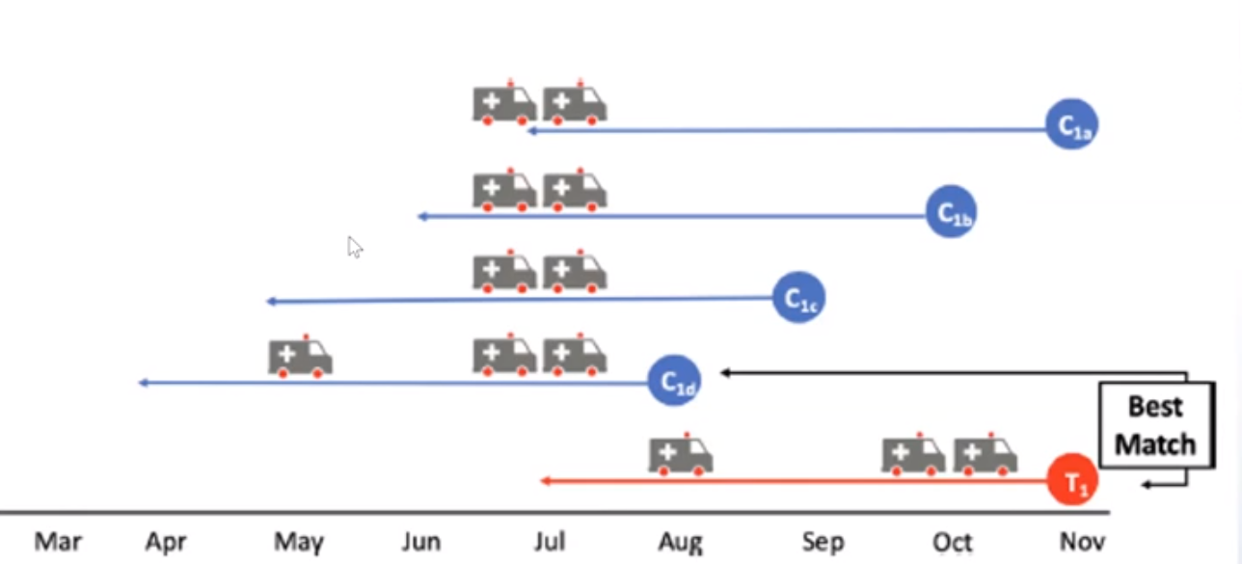
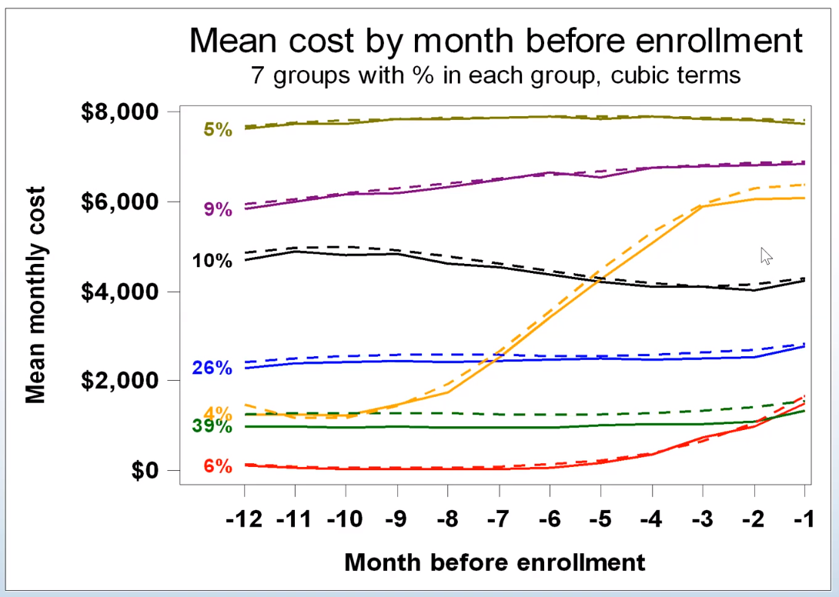

Bias Reduction and Balancing
Group- and individual-level selection
  Employer interventions (Harvard)
  State interventions (Berkeley, N’western)
Balancing comparison groups
  Longitudinal matching and trajectory balancing (Harvard, Mt Sinai, Tulane, Penn St)
  Combining coarsened exact & propensity matching (Harvard)
  Comparing multiple balancing weights (Mt. Sinai, N’western)

Slide 7
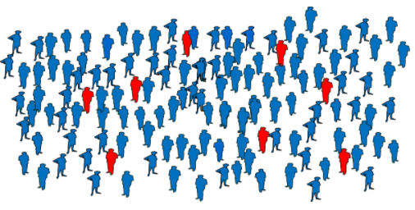
Attention to Denominators: Importance for NEXT-D and for COVID-19 Research on Diabetes Care
Defining exposed population
  Timing of exposure
  Selection bias
Key analysis issues
  Differential uptake and impacts
  Continuity in system
  Out-of-system care
Analysis approaches
  Doubly robust estimation
  Multiple analysis methods
  Dose response / implementation “depth”
  Heterogeneous treatment effects

Slide 8
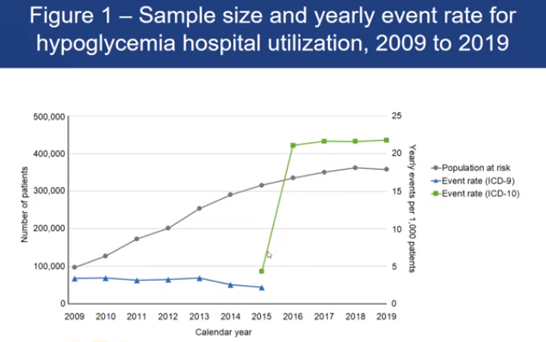
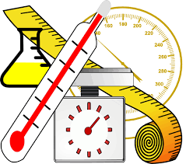
NEXT-D2 Measurement and Metrics Issues Relevant to COVID-19 Research
ICD-9/10 discontinuities (Harvard, Penn St)
Measure of acute diabetes complications (Harvard)
Continuity and coordination of care (Mt. Sinai, OHSU, Tulane, N’western, Harvard)
Race/ethnicity/income/social determinants (all groups)
Modeling dynamic effects (N’western, UCLA, Berkeley, Harvard, Mt Sinai)
Telemedicine impacts (Penn St, Mt. Sinai, Tulane)

Slide 9
Value of Long-term Diabetes Research Consortia like NEXT-D in the Era of COVID-19
Flexibility to pivot
  Changes in natural experiment interventions
  New study questions (e.g., COVID-19 impacts)
  Changes in data availability
Shorten time needed for data assembly, linking, validation
Strengthen and extend efforts at data coordination and integration (e.g., PaTH Network, REACHnet,)
Interdisciplinary perspectives (clinicians, epidemiologists, economists, methodologists, social scientists)
  Input on questions and methods
Ongoing stakeholder engagement in research process

Slide 10
Summary
Collaborative work on study design, balancing, and analysis methods has strengthened NEXT-D studies of diabetes-related natural experiments
Many methodological lessons from NEXT-D translate directly into strengthening the design and analysis of research on the impacts of COVID-19
  Risk factors for COVID-19 and clinical impacts
  Effects of health system disruptions due to COVID-19 and of health system adaptations to address these disruptions

Slide 11
Thank you!

