Slide 1


High-deductible Health Plans:
Effects on Health Care Use and Outcomes in Diabetes
Frank Wharam MD MPH, Fang Zhang PhD, Jamie Wallace MPH, Stephanie Argetsinger MPH, Emma Eggleston MD, Laura Garabedian PhD,, Matt Callahan MS, Xin Xu MS, Christine Y. Lu PhD, Stephen Soumerai ScD, Joseph Newhouse PhD, Dennis Ross-Degnan ScD
Department of Population Medicine, Harvard Medical School & Harvard Pilgrim Health Care Institute
Funded by the CDC/NIDDK (U58DP02719, U18DP006122) NEXT-D & NEXT-D2 and NIDDK (R01DK100304)

Slide 2
Background
Out-of-pocket cost increases for high-value care after HDHP switch
Preservation of low out-of-pocket costs for high-value care after HDHP switch
Out-of-pocket cost decreases for high-value care
Discussion
Outline

Slide 3
High-deductible health plan (HDHP)* growth
High-deductible Health Plans: Overview and Design
Source: Kaiser Family Foundation 2019 Employer Health Benefits Survey; *HDHP: >=$1000 / year

Slide 4



Low OOP for high-value care
High OOP for high-value care
High-deductible Health Plans: Overview and Design
Low
High
High OOP for low-value care
Low
$1000 ← High → $7000

Slide 5
Low OOP for high-value care
Value-based Health Insurance Design (VBID)
Low
High
High OOP for low-value care
Low
$1000 ← High → $7000

Slide 6
Increasing prevalence of plans with select $0 meds (preventive drug lists)
Value-based Health Insurance Design (VBID)
Source: Authors’ preliminary analysis of Optum data; please do not distribute.

Slide 7
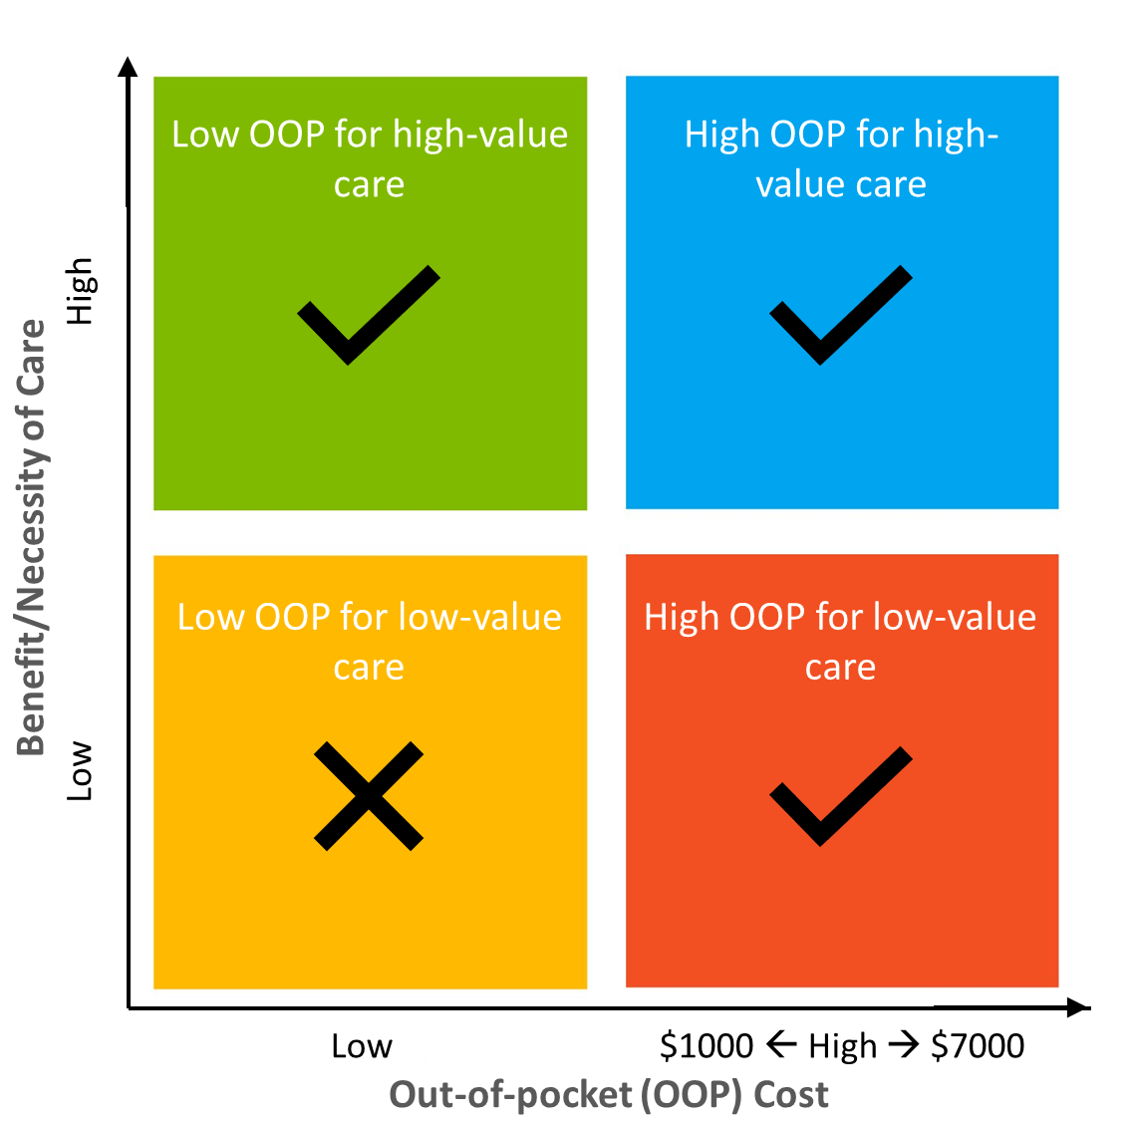

Modern HDHPs allow insights about OOP/value combinations and impacts
High-deductible Health Plans: Framework for Research
VBID Features
Anti-VBID Features
Health care utilization
Health outcomes
VBID Features
HDHPs

Slide 8


Outline
Background
Out-of-pocket cost increases for high-value care after HDHP switch
Preservation of low out-of-pocket costs for high-value care after HDHP switch
Out-of-pocket cost decreases for high-value care
Discussion

Slide 9
Outpatient visits for acute complications (eg, pneumonia, dehydration, angina)
Macrovascular disease testing and treatment
Diabetes Measures: Services
Low
High
Low
$1000 ← High → $7000

Slide 10
ED visits for acute complications & high-severity Dxs (eg, kidney stones)
Hosp days for high-severity conditions
Diabetes Measures: Health Outcomes
Low
High
Low
$1000 ← High → $7000

Slide 11
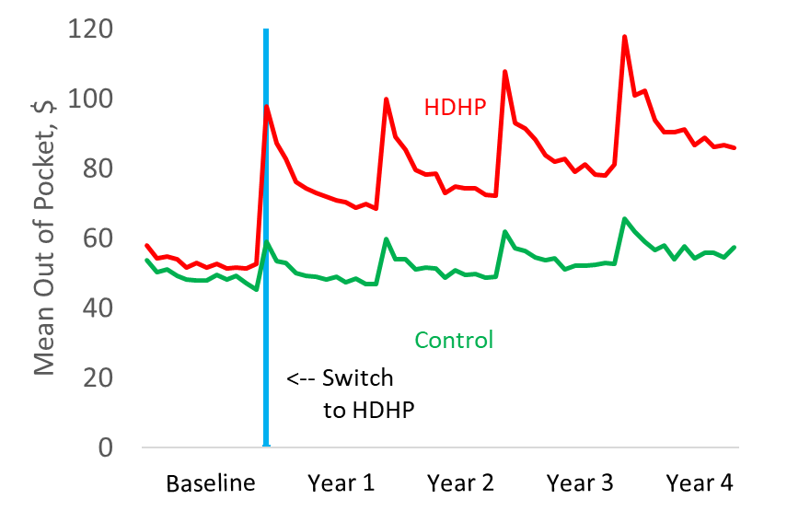
What is the effect of high OOP costs on high-value care?
Out-of-pocket costs increase by ~45%

Slide 12
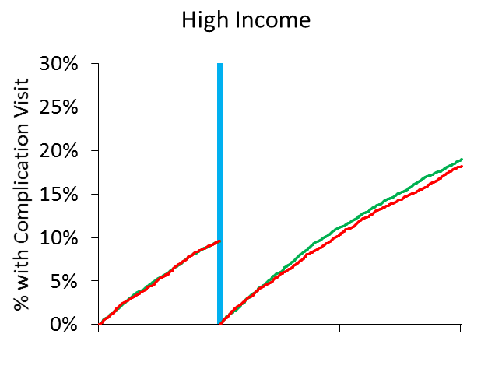
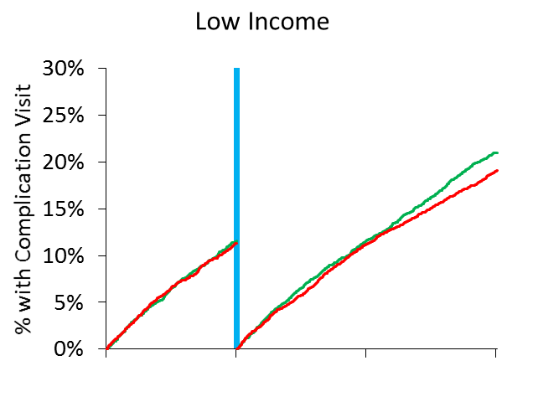
Low-income (but not high-income) diabetes patients delay outpatient complication visits …
High Income¹
Low Income¹ (1/3 population)
← Switch to HDHP
Control
HDHP
Baseline
Year 1
Year 2
Baseline
Year 1
Year 2
aHR:
1.00
0.95
0.98
0.89*
Wharam JF, Zhang F, Eggleston EM, Lu CY, Soumerai S, Ross-Degnan D. JAMA-IM. 2017. *p < 0.05. ¹High vs low income categorization based on residence in census block group with < or > 10% of households below the federal poverty level.

Slide 13
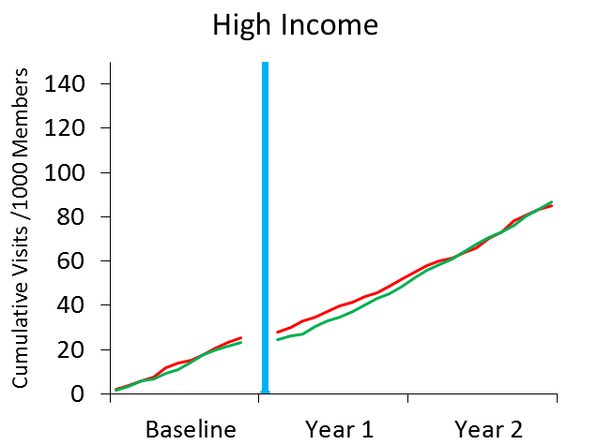
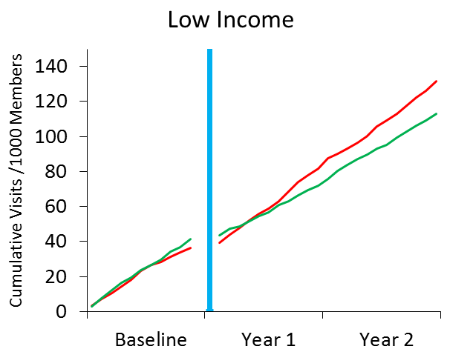
… experience increased complications at the emergency department, …
High Income¹
Low Income¹
← Switch to HDHP
Control
HDHP
Baseline
Year 1
Year 2
Baseline
Year 1
Year 2
Relative Annual ∆:
-7%*
22%*
Wharam JF, Zhang F, Eggleston EM, Lu CY, Soumerai S, Ross-Degnan D. JAMA-IM. 2017. *p < 0.05. ¹High vs low income categorization based on residence in census block group with < or > 10% of households below the federal poverty level.

Slide 14
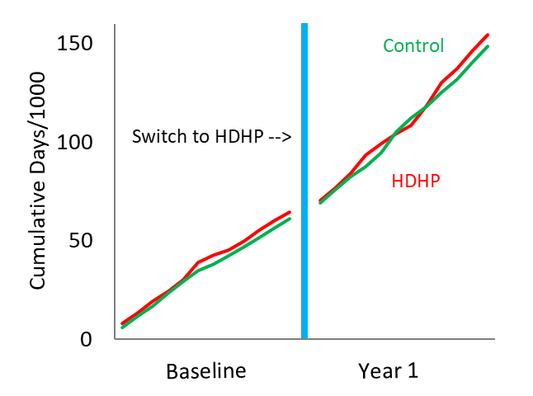
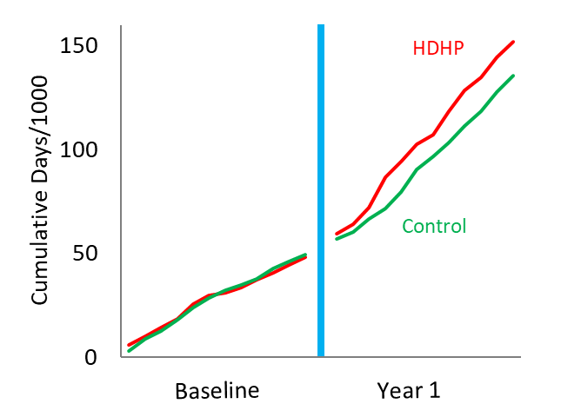
… and more high-severity hospitalization days.
Overall
Low Income¹
Baseline
Year 1
Baseline
Year 1
Relative Annual ∆:
4%
27%*
Wharam JF, Zhang F, Eggleston EM, Lu CY, Soumerai SB, Ross-Degnan D. Diabetes Care. 2018. *p < 0.05. ¹High vs low income categorization based on residence in census block group with < or > 10% of households below the federal poverty level.

Slide 15
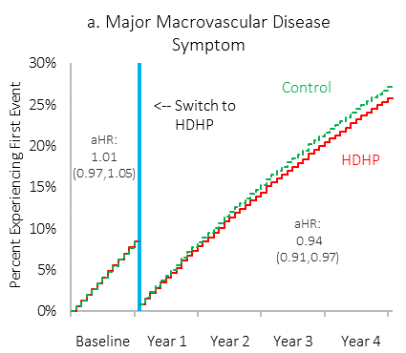
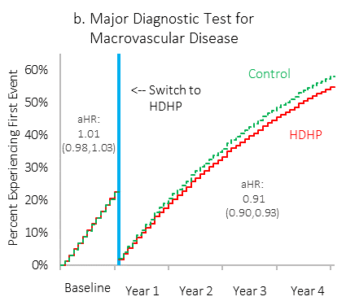
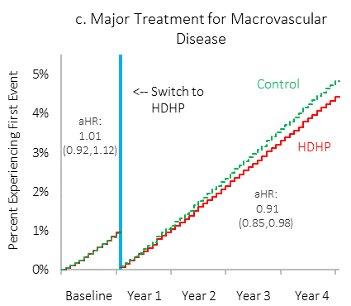
And the overall HDHP diabetes population delays cardiovascular disease care.
Major Symptom or Sign
Major Diagnostic Test
Major Treatment
Follow-up delay
1.5 months*
1.9 months*
3.1 months*
Wharam JF, Lu CY, Zhang F, Callahan M, Xu X, Wallace J, Ross-Degnan D, Newhouse J. Ann Intern Med. 2018. *p < 0.05

Slide 16
Outline
Background
Out-of-pocket cost increases for high-value care after HDHP switch
Preservation of low out-of-pocket costs for high-value care after HDHP switch
Out-of-pocket cost decreases for high-value care
Discussion

Slide 17
Secondary preventive tests
Antidiabetic and cardioprotective medication use
Diabetes Measures: Services
Low
High
Low
$1000 ← High → $7000

Slide 18
Major adverse cardiovascular events
Diabetes Measures: Health Outcomes
Low
High
Low
$1000 ← High → $7000

Slide 19
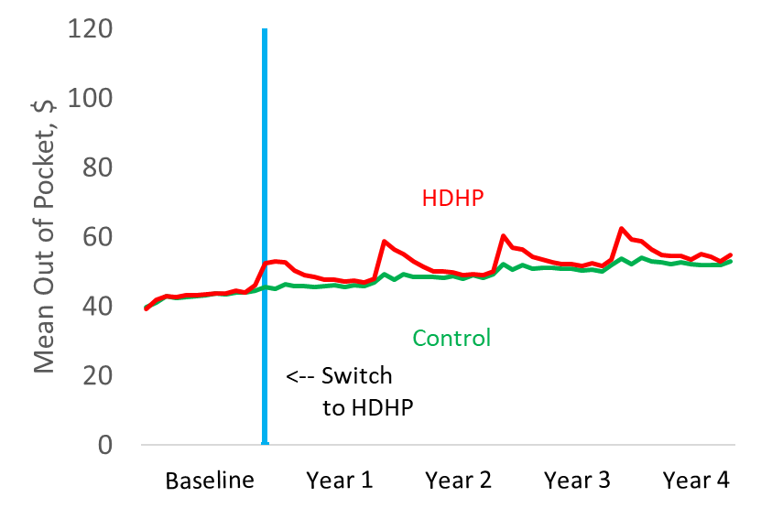
What is the effect of maintaining low OOP costs on high-value care?
Mean OOP for Meds, $
Notes:
Most other care high OOP, but these carved out

Slide 20
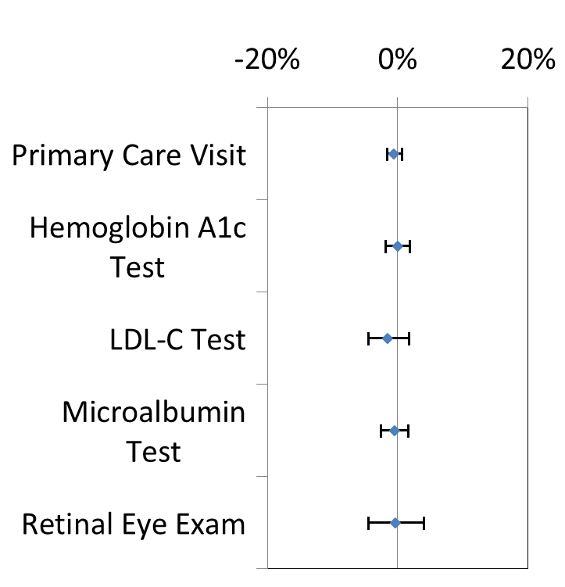
Disease monitoring is unchanged, …
Pre-to-Post Change among HDHP vs Control Members
Wharam JF, Zhang F, Eggleston EM, Lu CY, Soumerai S, Ross-Degnan D. JAMA-IM. 2017.

Slide 21
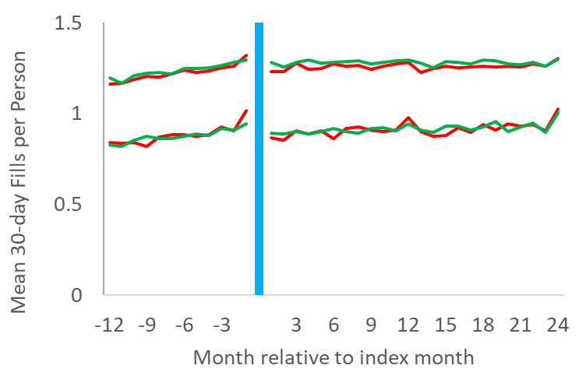
… medication use is essentially unchanged, …
Oral anti-diabetic meds
Insulin
← Switch to HDHP

Slide 22
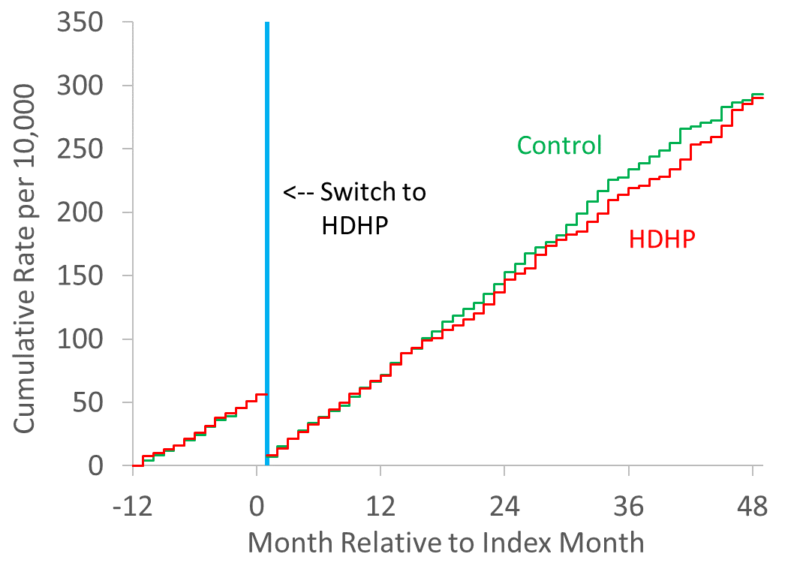
… and major adverse macrovascular disease events¹ are unchanged.
aHR:
0.98 (0.80, 1.19)
Wharam JF, Wallace J, Zhang F Xu X, Lu CY, Hernandez A, Ross-Degnan D, Newhouse JP. JNO.2020; ¹MI, stroke, and extremity amputation

Slide 23
Outline
Background
Out-of-pocket cost increases for high-value care after HDHP switch
Preservation of low out-of-pocket costs for high-value care after HDHP switch
Out-of-pocket cost decreases for high-value care
Discussion

Slide 24
Antidiabetic and cardioprotective medication use (preventive drug lists. PDLs)
Diabetes Measures: Services
Low
High
Low
$1000 ← High → $7000

Slide 25
ED visits for acute diabetes complications
Diabetes Measures: Health Outcomes
Low
High
Low
$1000 ← High → $7000

Slide 26
What is the effect of reducing OOP costs through PDLs on use/outcomes?
Switch to PDL→
Relative change:
-62%*
-49%*
Ross-Degnan D, Zhang F, Lu CY, Wallace J, Soumerai SB, Wharam JF. Med Care. 2020. n = 1372 PDL and 2599 Control members; *p < 0.05

Slide 27
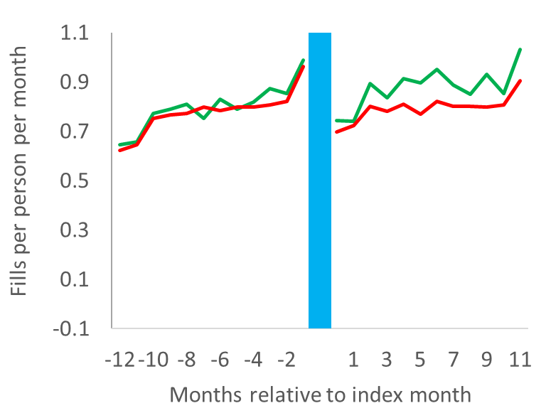
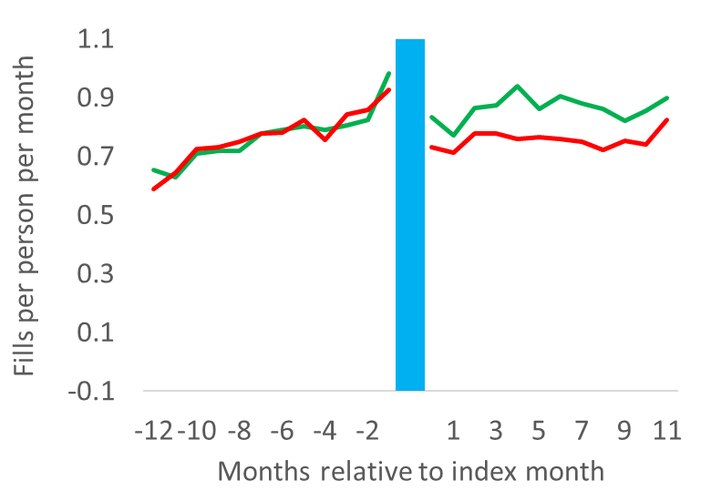
Oral antidiabetic and other diabetes-related medication use increases…
High Income¹
Low Income¹
HSA-HDHP with PDL
HSA-HDHP with PDL
HSA-HDHP
HSA-HDHP
← Switch to PDL
Relative Annual ∆:
5%
17%*
Ross-Degnan D, et al. Med Care. 2020. HSA-HDHP, Health Savings Account HDHP; PDL, preventive drug list; *p < 0.001. ¹High vs low income categorization based on residence in census tract with < or > 10% of households below the federal poverty level.

Slide 28
… and ED acute diabetes complication visits decrease.
Comparison group
Switch to PDL →
Drug cost-sharing reduction group
Relative change:
-12%*
Source: authors’ preliminary analyses; please do not distribute. *p < 0.05.

Slide 29
Background
Out-of-pocket cost increases for high-value care after HDHP switch
Preservation of low out-of-pocket costs for high-value care after HDHP switch
Out-of-pocket cost decreases for high-value care
Discussion
Outline

Slide 30
Summary: impact of high OOP costs on high-value care in diabetes
Delayed diabetes complication visits, macrovascular disease care
Increased short-term adverse outcomes among low-income diabetes patients
No detectable adverse effects on high-income diabetes patients
(1) Wharam JF et al. JAMA-IM. 2017. (2) Wharam JF et al. Diabetes Care. 2019. (3) Wharam JF et al. Ann Int Med. 2018.

Slide 31
Summary: impact of VBID features on high-value care in diabetes
Preserved disease monitoring
Increases in diabetes medication use when out-of-pocket costs decrease
Lower emergency department visits for acute diabetes complications
Unchanged major cardiovascular outcomes
Wharam et al. NEJM. 2013.
(1) Wharam JF et al. JAMA-IM. 2017. (2) Ross-Degnan D et al. Med Care. 2020.

Slide 32
Policy opportunity
VBID works, but higher-income patients might be unaffected / might not need it
When resources are tight, VBID should be preferentially given to low-income or other vulnerable populations
“Population-tailored health insurance designs”
  e.g., Preferentially fund the health savings accounts of low-income workers to protect their health
Discussion
Wharam et al. NEJM. 2013.
Wharam JF, Ross-Degnan D, Rosenthal M. NEJM. 2013.

Slide 33
Thank you to:
CDC / NIDDK / NEXT-D
  Ed Gregg, PhD
  Mo Ali, MD
  Pamela Thornton, PhD
  Theresa Jones, MD
UnitedHealth
  Sam Ho, MD
  Bob Luchs
  Dave Steinfeld
  Donna O’Shea, MD
OptumInsight
  Ben Klein
  Dawn Albright
HMS Dept of Population Medicine
  Stephanie Argetsinger, MPH
  Matt Callahan, MS
  Laura Garabedian, PhD
  Robert LeCates, MA
  Chris Lu, PhD
  Dennis Ross-Degnan, ScD
  Steve Soumerai, ScD
  Jamie Wallace, MPH
  Xin Xu, MS
  Fang Zhang, PhD
HMS Dept of Health Care Policy
  Joseph Newhouse, PhD
West Virginia University
  Emma Eggleston, MD
jwharam@post.harvard.edu

