Slide 1



What are Natural Experiments and Why Should we Study Them?
Frank Wharam MD MPH
Division of Health Policy and Insurance Research (HPI), Harvard Medical School & Harvard Pilgrim Health Care Institute
Boston, Massachusetts

Slide 2
Outline
Definition of natural experiments and quasi-experiments
How to find natural experiments that affect people with diabetes
Reasons for analyzing health reform natural experiments

Slide 3
Outline
Definition of natural experiments and quasi-experiments
How to find natural experiments that affect people with diabetes
Reasons for analyzing health reform natural experiments

Slide 4
Natural Experiments
Definition:
  Occur when populations are exposed to experimental and control conditions by factors outside the control of investigators and outside the control of most people in the populations
  (Typically no randomized assignment to experimental and control arm)
Some also distinguish “quasi-experiments:”
  Investigators have some control over assigning the intervention group, but assignment is not randomized

Slide 5
Classifying Experimental Type
Degree of investigator control over “intervention” assignment
Occurred naturally or not influenced by investigators
Assigned by investigators
Intervention is endogenous (self-selected)
Observational study
Intervention is exogenous
Quasi-experiment
Intervention is randomized
Randomized controlled experiment
Intervention is exogenous
Natural experiment

Slide 6
Natural Experiment

Slide 7
Natural Experiment
COVID-19

Slide 8
Natural Experiment
COVID-19
Before intervention

Slide 9
Natural Experiment
COVID-19
Before intervention
After intervention

Slide 10
Natural Experiment
COVID-19
Before intervention
After intervention
Intervention Group

Slide 11
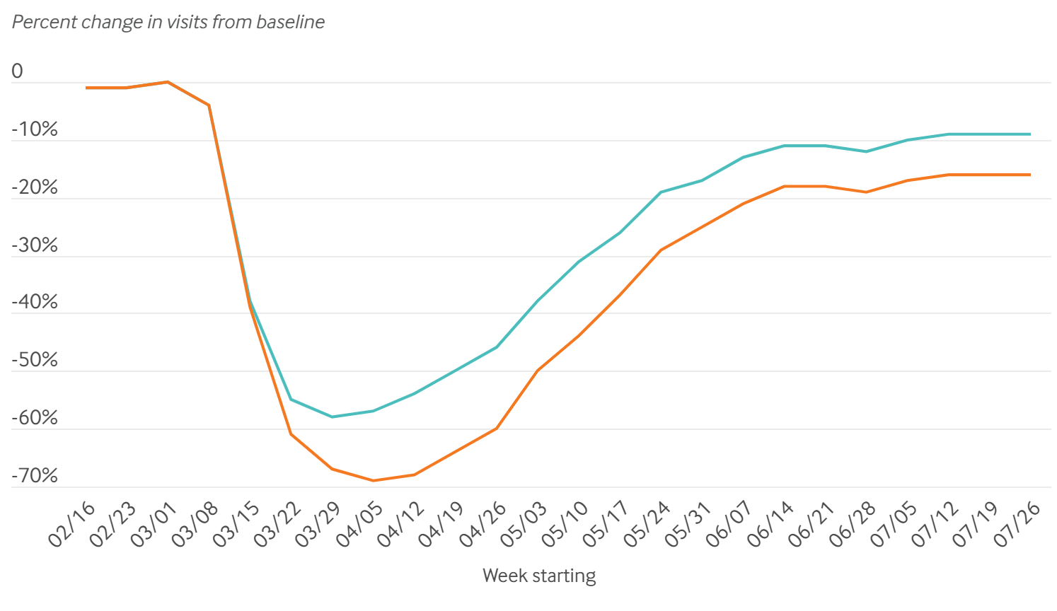
Impact of the COVID-19 Pandemic on Outpatient Visits
All types of visits
← Mid-March 2020 COVID onset
In-person visits only
Mehrotra A et al. https://www.commonwealthfund.org/publications/2020/aug/impact-covid-19-pandemic-outpatient-visits-changing-patterns-care-newest

Slide 12
Natural Experiment with Control Group
Free Meds
Before intervention
After intervention
Intervention Group

Slide 13
Natural Experiment with Control Group
Free Meds
Before intervention
After intervention
Intervention Group
Control Group

Slide 14
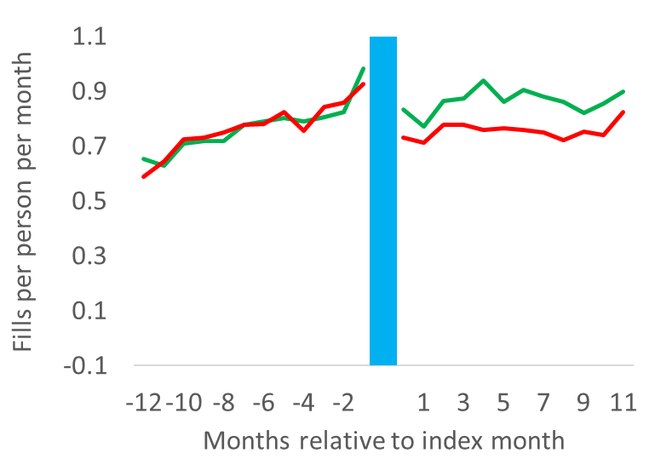
Oral Antidiabetic Medication Use after Removing Out-of-pocket Costs
Intervention group (out-of-pocket $ for meds removed)
Control group (continued expensive meds)
← Out-of-pocket $ for meds removed for intervention group
Baseline
Year 1
Year 2

Slide 15
Key Features of Natural Experiments
Manner in which “intervention” carried out allows understanding about whether intervention caused an outcome (i.e., “causal inference”)
External validity (real-world generalizability) typically better than RCTs, but causal inference usually not better
Researchers can use a variety of study designs to study effects of intervention on outcome measures
  Cross-sectional
  Pre-post with comparison group
  Interrupted time series with control series
Shadish WR, Cook TD, Campbell DT. Experimental and quasi-experimental designs for generalized causal inference. 2001.

Slide 16
Examples of Healthcare Natural Experiments
COVID-19
A state changes legislation affecting price of insulin
A leading expert organization changes guidelines for cancer screening
A health system changes from a paper to electronic health records
An employer switches workers to a new health insurance benefit

Slide 17
Outline
Definition of natural experiments and quasi-experiments
How to find natural experiments that affect people with diabetes
Reasons for analyzing health reform natural experiments

Slide 18
How to Find Natural Experiments that Affect People with Diabetes
Preliminary questions to ask:
  What are the hypothesized intended and unintended effects of a population-level intervention or disruption?
  Do those effects change mediators of diabetes health outcomes?
Factors affecting people with diabetes
Population-level disruptions
Diabetes health outcomes

Slide 19
Example Conceptual Model
Access to antidiabetic drugs
Use of antidiabetic drugs
Acute complications
COVID-19
Population-level disruption/policy
Factors affecting people with diabetes
Diabetes health outcomes

Slide 20
Outline
Definition of natural experiments and quasi-experiments
How to find natural experiments that affect people with diabetes
Reasons for analyzing health reform natural experiments

Slide 21
Reasons for Analyzing Health Care Natural Experiments
To answer high-impact, real-world clinical and policy questions
Because scientific rigor / internal validity can be high, and methods are improving
Because results can be communicated in an intuitive manner to clinical, policymaking, and lay audiences in order to inform evidence-based improvements

Slide 22
Reasons for Analyzing Health Care Natural Experiments
To answer high-impact, real-world clinical and policy questions
Because scientific rigor / internal validity can be high, and methods are improving
Because results can be communicated in an intuitive manner to clinical, policymaking, and lay audiences in order to inform evidence-based improvements

Slide 23
Natural EXperiments for Translation in Diabetes (NEXT-D1 & NEXT-D2)

Slide 24
NEXT-D: 1: KP Northern CA; 2: Mt Sinai St. Luke’s; 3: UCLA; 4. Harvard; 5. NW
G
Public Policy
Community Resources
Legislation &
Regulations
Environmental &
Social Context
F
5
E
Religious
Institutions
SUPPLIERS
Health
Agencies
D
Pharmaceuticals
Purchasers
Employers
Health System
3
Social
Networks
A
B
Health Plans
Providers & Hospitals
4
1
Public Insurers
Devices
4
C
H
2
A
BEHAVIORS & PREVENTIVE SERVICES
Detection
Counseling
Lifestyle choices
Utilization Patterns
Medication adherence
Clinical Care Quality
Patients
IMPACTS
Diabetes Incidence
Diabetes Progression
Patient-centered outcomes
Patient & System Costs
Unintended outcomes
Disparities
G
F
NEXT-D2: A: Harvard B: UCLA C. UC Berkeley D. NW E. Oregon F. Tulane G. PSU H. Mt Sinai

Slide 25
Example Health Reform Natural Experiments that Might Affect People with Diabetes
Affordable Care Act of 2010:
  Some states expanded Medicaid eligibility
  Allowed states to establish Medicaid Health Homes for chronically ill patients
Centers for Medicare & Medicaid Services:
  Began $0 coverage for intensive behavioral therapy for obesity in 2012
  Introduced billing code for non-face-to-face chronic care management services in 2015
COVID-19
  Direct and indirect effects

Slide 26
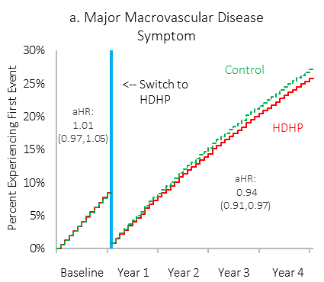
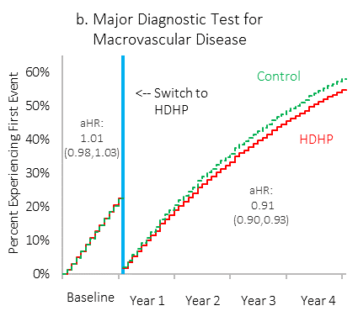
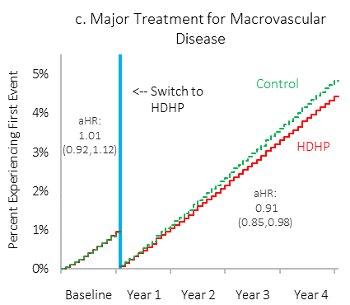
High-deductible Health Plan (HDHP) Members with Diabetes Delayed Cardiovascular Disease Care
Major Symptom or Sign
Major Diagnostic Test
Major Treatment
Follow-up delay
1.5 months*
1.9 months*
3.1 months*
Wharam JF, Lu CY, Zhang F, Callahan M, Xu X, Wallace J, Ross-Degnan D, Newhouse J. Ann Intern Med. 2018. *p<0.05

Slide 27
Reasons for Analyzing Health Care Natural Experiments
To answer high-impact, real-world clinical and policy questions
Because scientific rigor / internal validity can be high, and methods are improving
Because results can be communicated in an intuitive manner to clinical, policymaking, and lay audiences in order to inform evidence-based improvements

Slide 28
Investigators Have Options for Optimizing the Rigor of Research Results
Studying inherently strong quasi-experiments or natural experiments
Overlaying study designs that are high on the hierarchy of study design rigor
Matching intervention and control groups
Flexibility to find additional evidence in data to support research conclusions

Slide 29
A. Studying inherently strong quasi-experiments or natural experiments
Degree of investigator control over “intervention” assignment
Occurred naturally or not influenced by investigators
Assigned by investigators
Intervention is endogenous (self-selected)
Observational study
Intervention is exogenous
Strong quasi-experiment
Intervention is randomized
Randomized controlled experiment
Intervention is exogenous
Strong natural experiment

Slide 30
B. Overlaying study designs that are high on the hierarchy of study design rigor
Weak Designs |  | Intermediate Designs |  | Strong Designs
 |  |  |  |  |  | Multiple randomized controlled trials
 |  |  |  |  | Randomized controlled trials
 |  |  |  | ITS with control group (+/- matched)
 |  |  | Interrupted time series (ITS) without control group
 |  | Before-after with control group
 | Before-after without control group (pre–post)
Cross-sectional designs
Assuming exogenous intervention
Weaker
Stronger

Slide 31
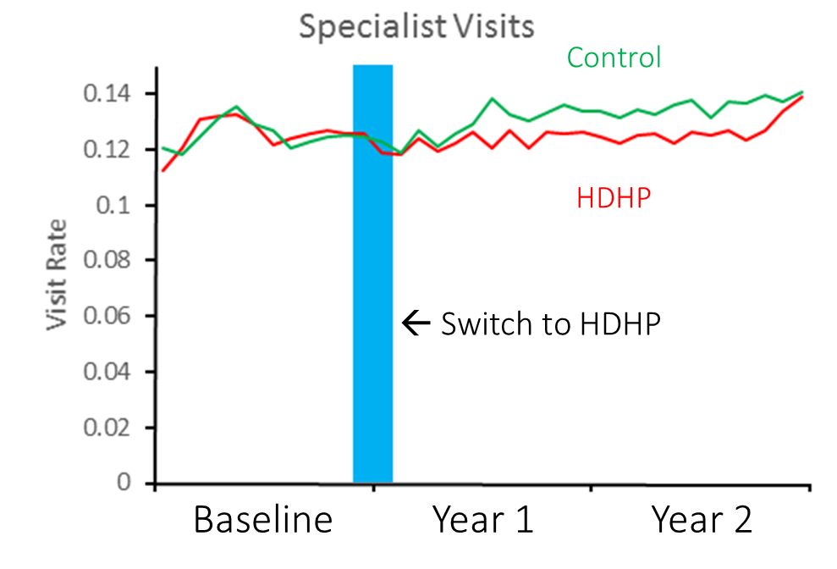
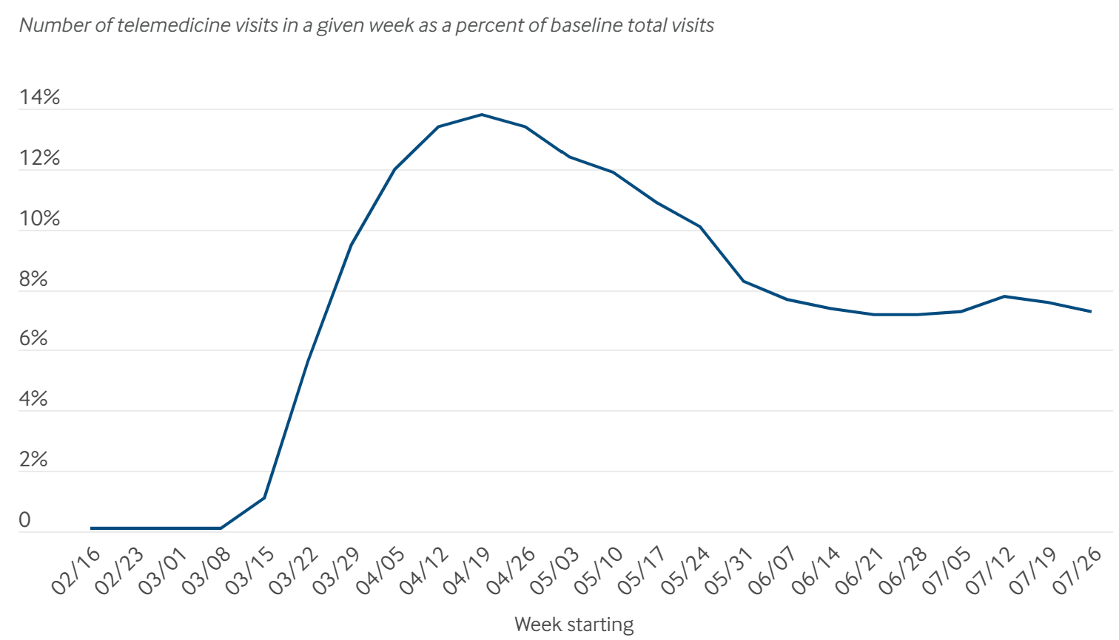
Interrupted Time Series Designs
Without Control Group
With Control Series Group
Telehealth Visits
← Mid-March 2020 COVID onset
(1) Wharam JF, Zhang F, Eggleston EM, Lu CY, Soumerai S, Ross-Degnan D. JAMA-IM. 2017. (2) Mehrotra A et al. https://www.commonwealthfund.org/publications/2020/aug/impact-covid-19-pandemic-outpatient-visits-changing-patterns-care-newest

Slide 32
C. Matching intervention and control groups
Can enhance comparability of the study groups
Matching approaches are evolving and improving
Iacus SM, King G, Porro G. J Am Stat Assoc. 2011 Iacus S, King G, Porro G. Coarsened Exact Matching Software. https://gking.harvard.edu/cem.

Slide 33
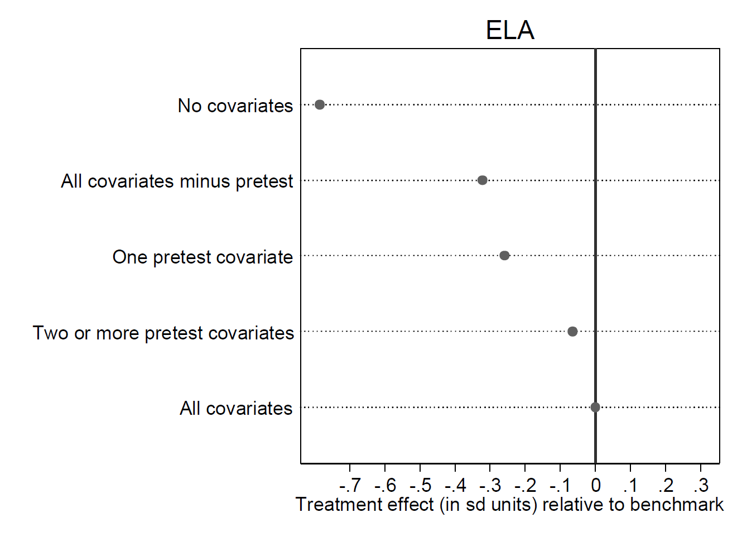
Bias Reduction: Matching on Covariates +/- Baseline Outcomes
RCT result
Hallberg K. and Cook TD. https://arc.uchicago.edu/sites/default/files/Cook_NSF%20ARC%20Presentation_10.28.13-1.pdf

Slide 34
D. Flexibility to find additional evidence in data to support research conclusions
Examine unaffected outcomes or less affected subpopulations
Falsification tests (e.g., move index date back 1 year)
Other context-specific approaches

Slide 35
Reasons for Analyzing Health Care Natural Experiments
To answer high-impact, real-world clinical and policy questions
Because scientific rigor / internal validity can be high, and methods are improving
Because results can be communicated in an intuitive manner to clinical, policymaking, and lay audiences in order to inform evidence-based improvements

Slide 36
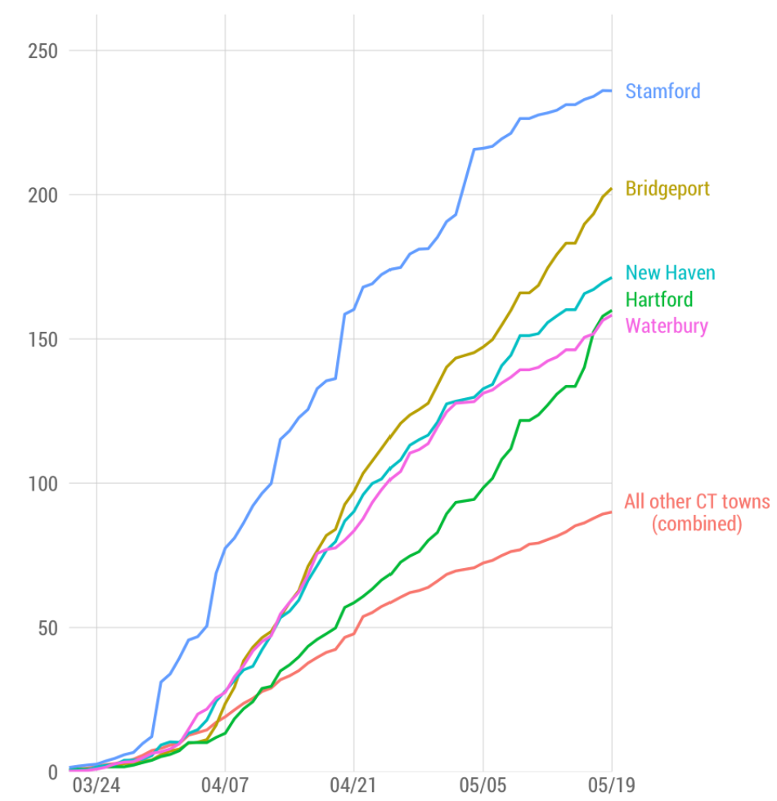
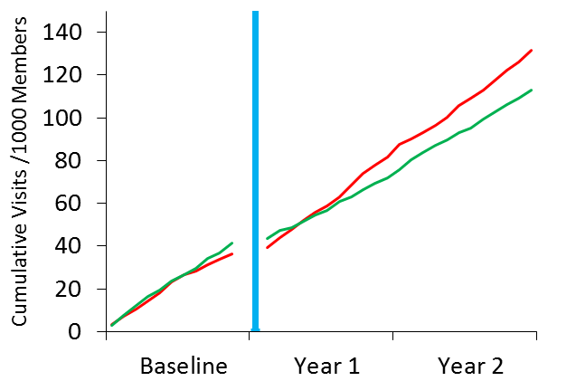
People at Risk for COVID-19; Patients at risk for Acute Diabetes Complications
Detected COVID-19 Cases by Connecticut City
Complications among low-income HDHP vs Control Diabetes Patients
HDHP
Control
Baseline
Year 1
Year 2
(1) https://www.ctdatahaven.org/blog/datahaven-analysis-despite-statewide-improvements-covid-19-cases-remain-high-five-largest (2) Wharam JF, Zhang F, Eggleston EM, Lu CY, Soumerai S, Ross-Degnan D. JAMA-IM. 2017. *p < 0.05

Slide 37
Summary
Healthcare natural experiments occur when populations are exposed to a new policy, system, disruption, guideline, etc. that affects health
People with diabetes are commonly exposed to natural experiments with both beneficial and detrimental effects
Carefully selecting and studying natural experiments provides the opportunity to:
  Rigorously assess effects of major societal phenomena on important, real-world diabetes outcomes
  Inform evidence-based policymaking

Slide 38
Thank you!
jwharam@post.harvard.edu

