Slide 1

Family Medicine Research Unit
Monthly Meeting - June 2022
Laura Sheehan
Manager of Research Administration, Dept. of Family Medicine

Slide 2
Survey Results
We received 29 responses, mostly from people who attend fairly regularly
15 respondents were faculty or PIs, 7 research staff, and 7 administrative staff
The majority of people preferred to keep the meeting on Thursday morning or midday
Mostly positive feedback:
  Agenda items were mostly useful
  Format (e.g. faculty and staff combined) is working
  Managed well
Lots of great suggestions:
  Include games/interactive activities
  Make Zooms more visually interesting
  Have clear mission

Slide 3
Mission
To bring members of the research unit closer together by providing a forum where current and potential research ideas are shared, and where both faculty and staff are informed of the latest updates in research administration.

Slide 4
Recently Processed Research Funding
PI | Award Title | Sponsor | Prime Sponsor | Action Type
Gelberg, Lillian | Development of a Community-based HCV Treatment Completion Intervention Among HCV Positive Homeless Adults | UNIVERSITY OF CALIFORNIA, IRVINE | NIH-NIMHD National Institute on Minority Health and Health Disparities | No Cost Extension
Gelberg, Lillian | Subthreshold Opioid Use Disorder Prevention (STOP) Trial | NEW YORK UNIVERSITY | NIH-NIDA National Institute on Drug Abuse | Modification/ Amendment
Shoptaw, Steven | HIV Prevention Trials Leadership Group: 094 Protocol Chair | FHI 360 (Family Health International) | NIH-NIAID National Institute of Allergy and Infectious Diseases | Modification/ Amendment
Donohoe, Thomas | Rapid Antiretroviral Therapy (ART) Start in the Ryan White HIV/AIDS Program - Dissemination Assistance Provider (DAP) | Cicatelli Associates | DHHS-HRSA Health Resources and Services Administration | Modification/ Amendment
Sur, Denise | SBPCR-1000756: UCLA Family Medicine Residency Program (Song-Brown 2021) | CA-Department of Health Care Access and Information | - | New

Slide 5
Recently Submitted Outgoing Proposals
PI | Title | Sponsor | Prime Sponsor | Proposal Type
Tarn, Derjung Mimi | The MUM study: MUltimorbidity and Medications: the unheard perspective of older adults | UNIVERSITY OF CALIFORNIA, SAN FRANCISCO | DHHS-FDA Food and Drug Administration | Modification/ Amendment
Tarn, Derjung Mimi | Concentrations of ApixabAn, Bleeding, Embolic Events, and cognition in Atrial Fibrillation – CAPABLE-AF | UNIVERSITY OF CALIFORNIA, SAN FRANCISCO | NIH - National Institutes of Health | New
Tarn, Derjung Mimi | Increasing the Feasibility, Impact, and Equity of the Medicare Annual Wellness Visit | NIH-NIA |  | New
Gelberg, Lillian | Individual and Place Effects Influencing the Experience of Homelessness and Exiting Homelessness | UNIVERSITY OF NORTH CAROLINA | NIH | New

Slide 6
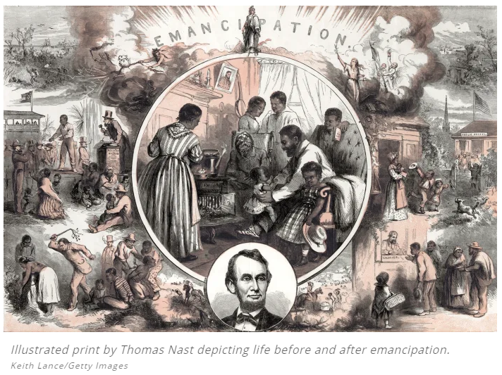
Human Resources/Personnel
Friday, June 10th is Commencement Day
Campus closed on Monday, June 20th in honor of Juneteenth
Juneteenth (short for “June 19th”) marks the day when federal troops arrived in Galveston, Texas in 1865 to take control of the state and ensure that all enslaved people be freed. The troops’ arrival came a full two and a half years after the signing of the Emancipation Proclamation. Juneteenth honors the end to slavery in the United States and is considered the longest-running African American holiday.

Slide 7
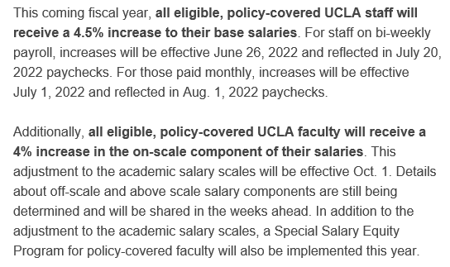
Human Resources/Personnel
Salary Increases Announced for Policy-Covered Employees

Slide 8
Human Resources/Personnel
This applies to policy-covered non-probationary staff in career, partial-year career, and eligible contract appointments.
Student employees in casual-restricted positions and staff holding limited appointments are not included, nor are employees covered by a collective bargaining agreement.
You must have been on payroll before January 1, 2022 to be eligible
This does not apply to staff members whose most recent performance rating was “Unsatisfactory” or “Does Not Meet Expectations” or who have been subject to corrective/disciplinary action during the review period

Slide 9
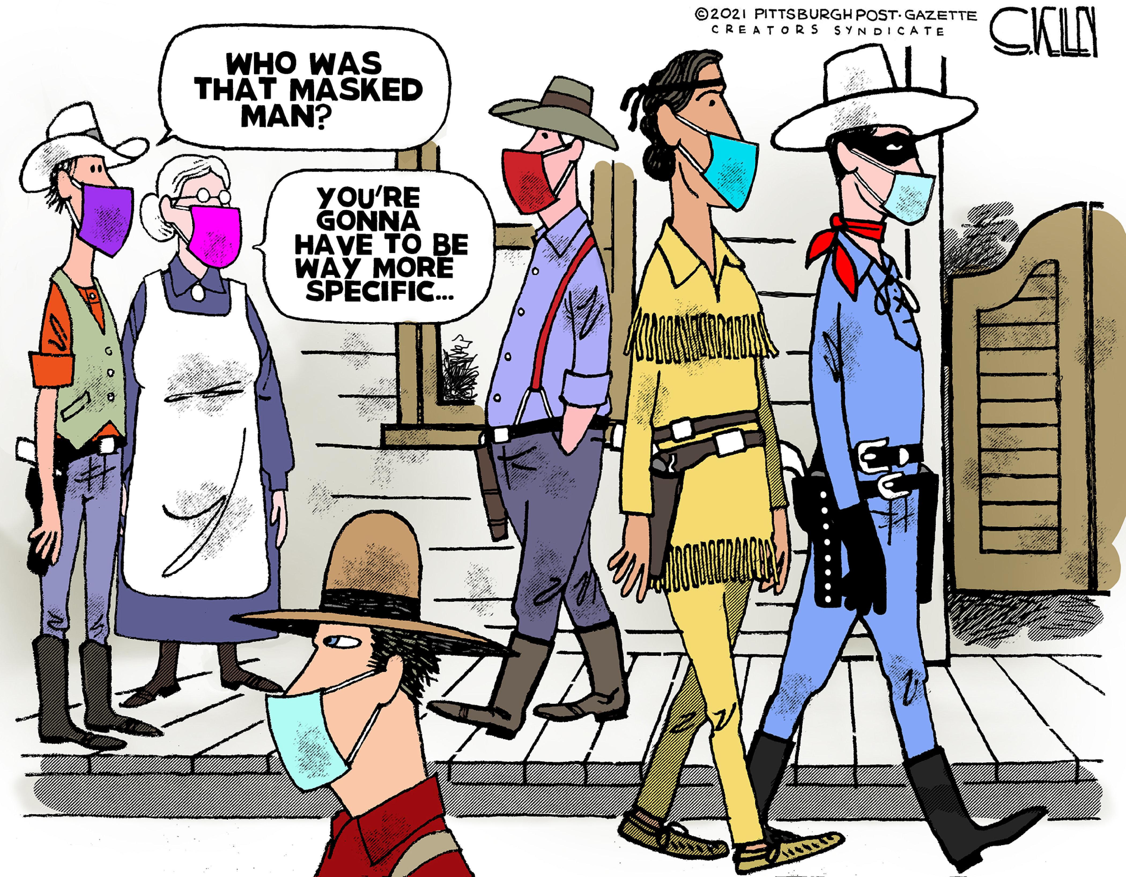
COVID Updates
As of May 27, masks are again required indoors at Oppy

Slide 10
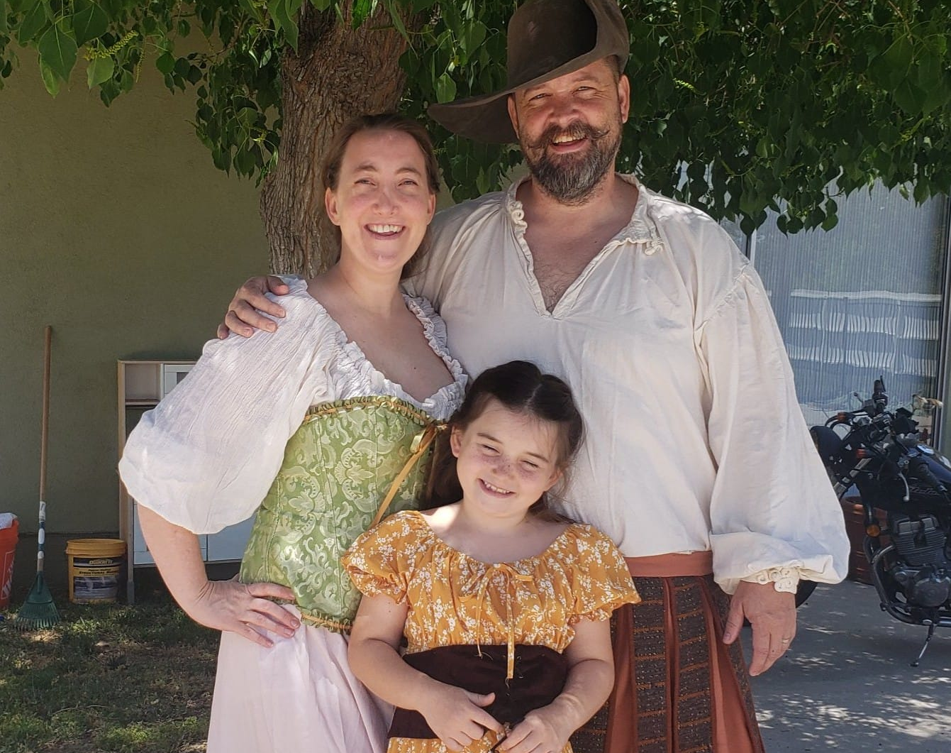
Get to Know Your Co-workers
This month’s spotlight: ME!
5 jobs, 1 is a lie:
Dancing Berenstain Bear at a mall
Singing telegram performer
Steamy romance novelist
Quick change captain for a show starring Kristen Bell
D&D miniature painter
Years at UCLA: 18
Hometown: Las Vegas, NV
Hobbies: Softball, dancing, writing
Favorite smells: Freshly-cut grass, pools, coffee, campfires
I’d love to visit: Scotland, Sweden, Greece, Puerto Rico

Slide 11
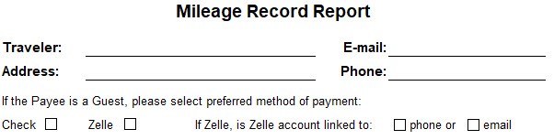
Financial
New Mileage Form available on our website
  Gathers required information for reimbursement, including address, phone number, email and method of payment for guests (check vs. Zelle)
New Travel and Entertainment Reimbursement form available on our website

Slide 12
Financial
End of Fiscal Year is approaching
  Work with your vendors and subawards to obtain invoices ASAP.
  Place orders ASAP for Office Depot, ASUCLA, VWR, Fisher, etc. Any requests received after the first week of June should be purchased in July, if at all possible, to avoid additional paperwork.
  If you had any travel during this fiscal year, submit reimbursement immediately.
  The only exceptions should be for expenses incurred in June

Slide 13
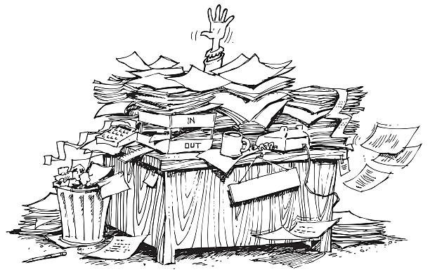
Actual footage of what will happen to Christine if we don’t do our part

Slide 14

Financial
Receiving services from people/vendors
  Accounts Payable will reject any invoice that is or appears to be “consulting” (unless a requisition/P-class is already in place)
  Any service that could be considered consulting should be set up BEFORE THE FACT as a Requisition (meaning we will need the consultant/contractor packet)

Slide 15
Proposals and Contracts/Grants
OCGA Contacts
  Round-robin assignment of analysts due to fiscal close
Effort Reporting
  Due by July
  Check out the Effort Reporting Guide on our website
Facilities and Resources Page
  Standard Facilities page for our department is now available on our website
  Includes remote work resources
  May need further specification for your purposes

Slide 16
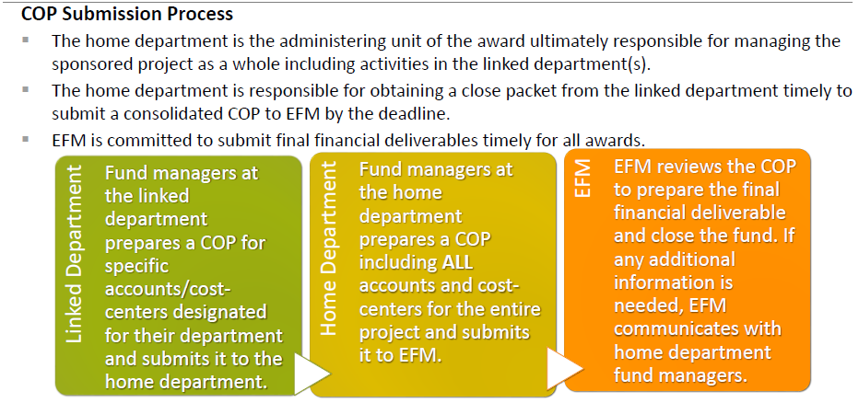
Proposals and Contracts/Grants
Close-out Packets (COPs)
  Strict deadlines, NO MORE GRACE PERIODS

Slide 17

Monthly Meetings with Fund Manager
Are they actually required?
YES!

Slide 18
Monthly Meetings with Fund Manager
First meeting
  Review proposed budget
  Review Award Snapshot
  Discuss any changes
  Discuss timing of anticipated expenses
  Approve/initiate transfers and subaward set-ups, etc.

Slide 19
Monthly Meetings with Fund Manager
Regular Monthly Meetings
  Review financial reports (aka FR’s, GL)
  Ensure that all recorded expenses are allowable, applicable, complete
  Determine if adjustments need to be made
  Review encumbered items
  Monitor spending rate

Slide 20

Questions You Should be Asking
Are sister departments/subawards performing as expected? Are they spending down/invoicing?
Is the project making progress as expected? If not, is carryforward/NCE necessary/allowed?
Is the effort being charged for personnel accurate? Does it need to change in the upcoming months?
Is that charge applicable?
Are there any applicable charges missing?
Why is that item still encumbered?

Slide 21


Notices from ORA Reports (portal@research.ucla.edu)
Sent automatically at 90-, 60-, and 30-day mark prior to budget period end date
If you’ve been meeting monthly with your Fund Manager
If you have NOT been meeting monthly with your Fund Manager

Slide 22
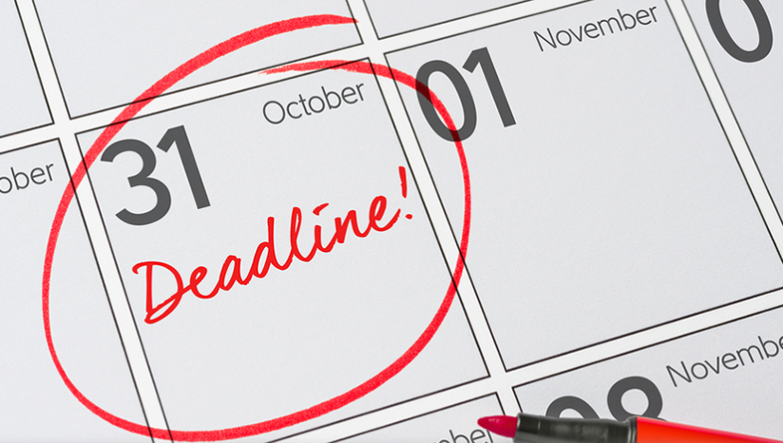
Approaching End Dates
Budget Period End Date
Are you projecting a balance? How big? Is carryforward allowed?
Are you on target in regard to milestones/aims?
Make personnel adjustments (forward and back)
Make applicable purchases, pay applicable invoices
Technical/Scientific Progress Reports
Financial Progress Reports

Slide 23
Approaching End Dates
Project Period End Date
Are you projecting a balance? How big? Is NCE allowed?
Are you on target in regard to milestones/aims?
Make personnel adjustments (forward and back)
Make applicable purchases, pay applicable invoices
Technical/Scientific Final Reports
Financial Final Reports
Is Policy 913 applicable?

Slide 24
Upcoming Meetings
REQUIRED FOR FACULTY: Meet and Greet with the Residents
  Wednesday, June 22 from 8a-11a
  Via Zoom
  Dr. Ryba will send out call-in information
  Please RSVP by June 10
  Send a representative from your team or slides if you can’t make it

Slide 25
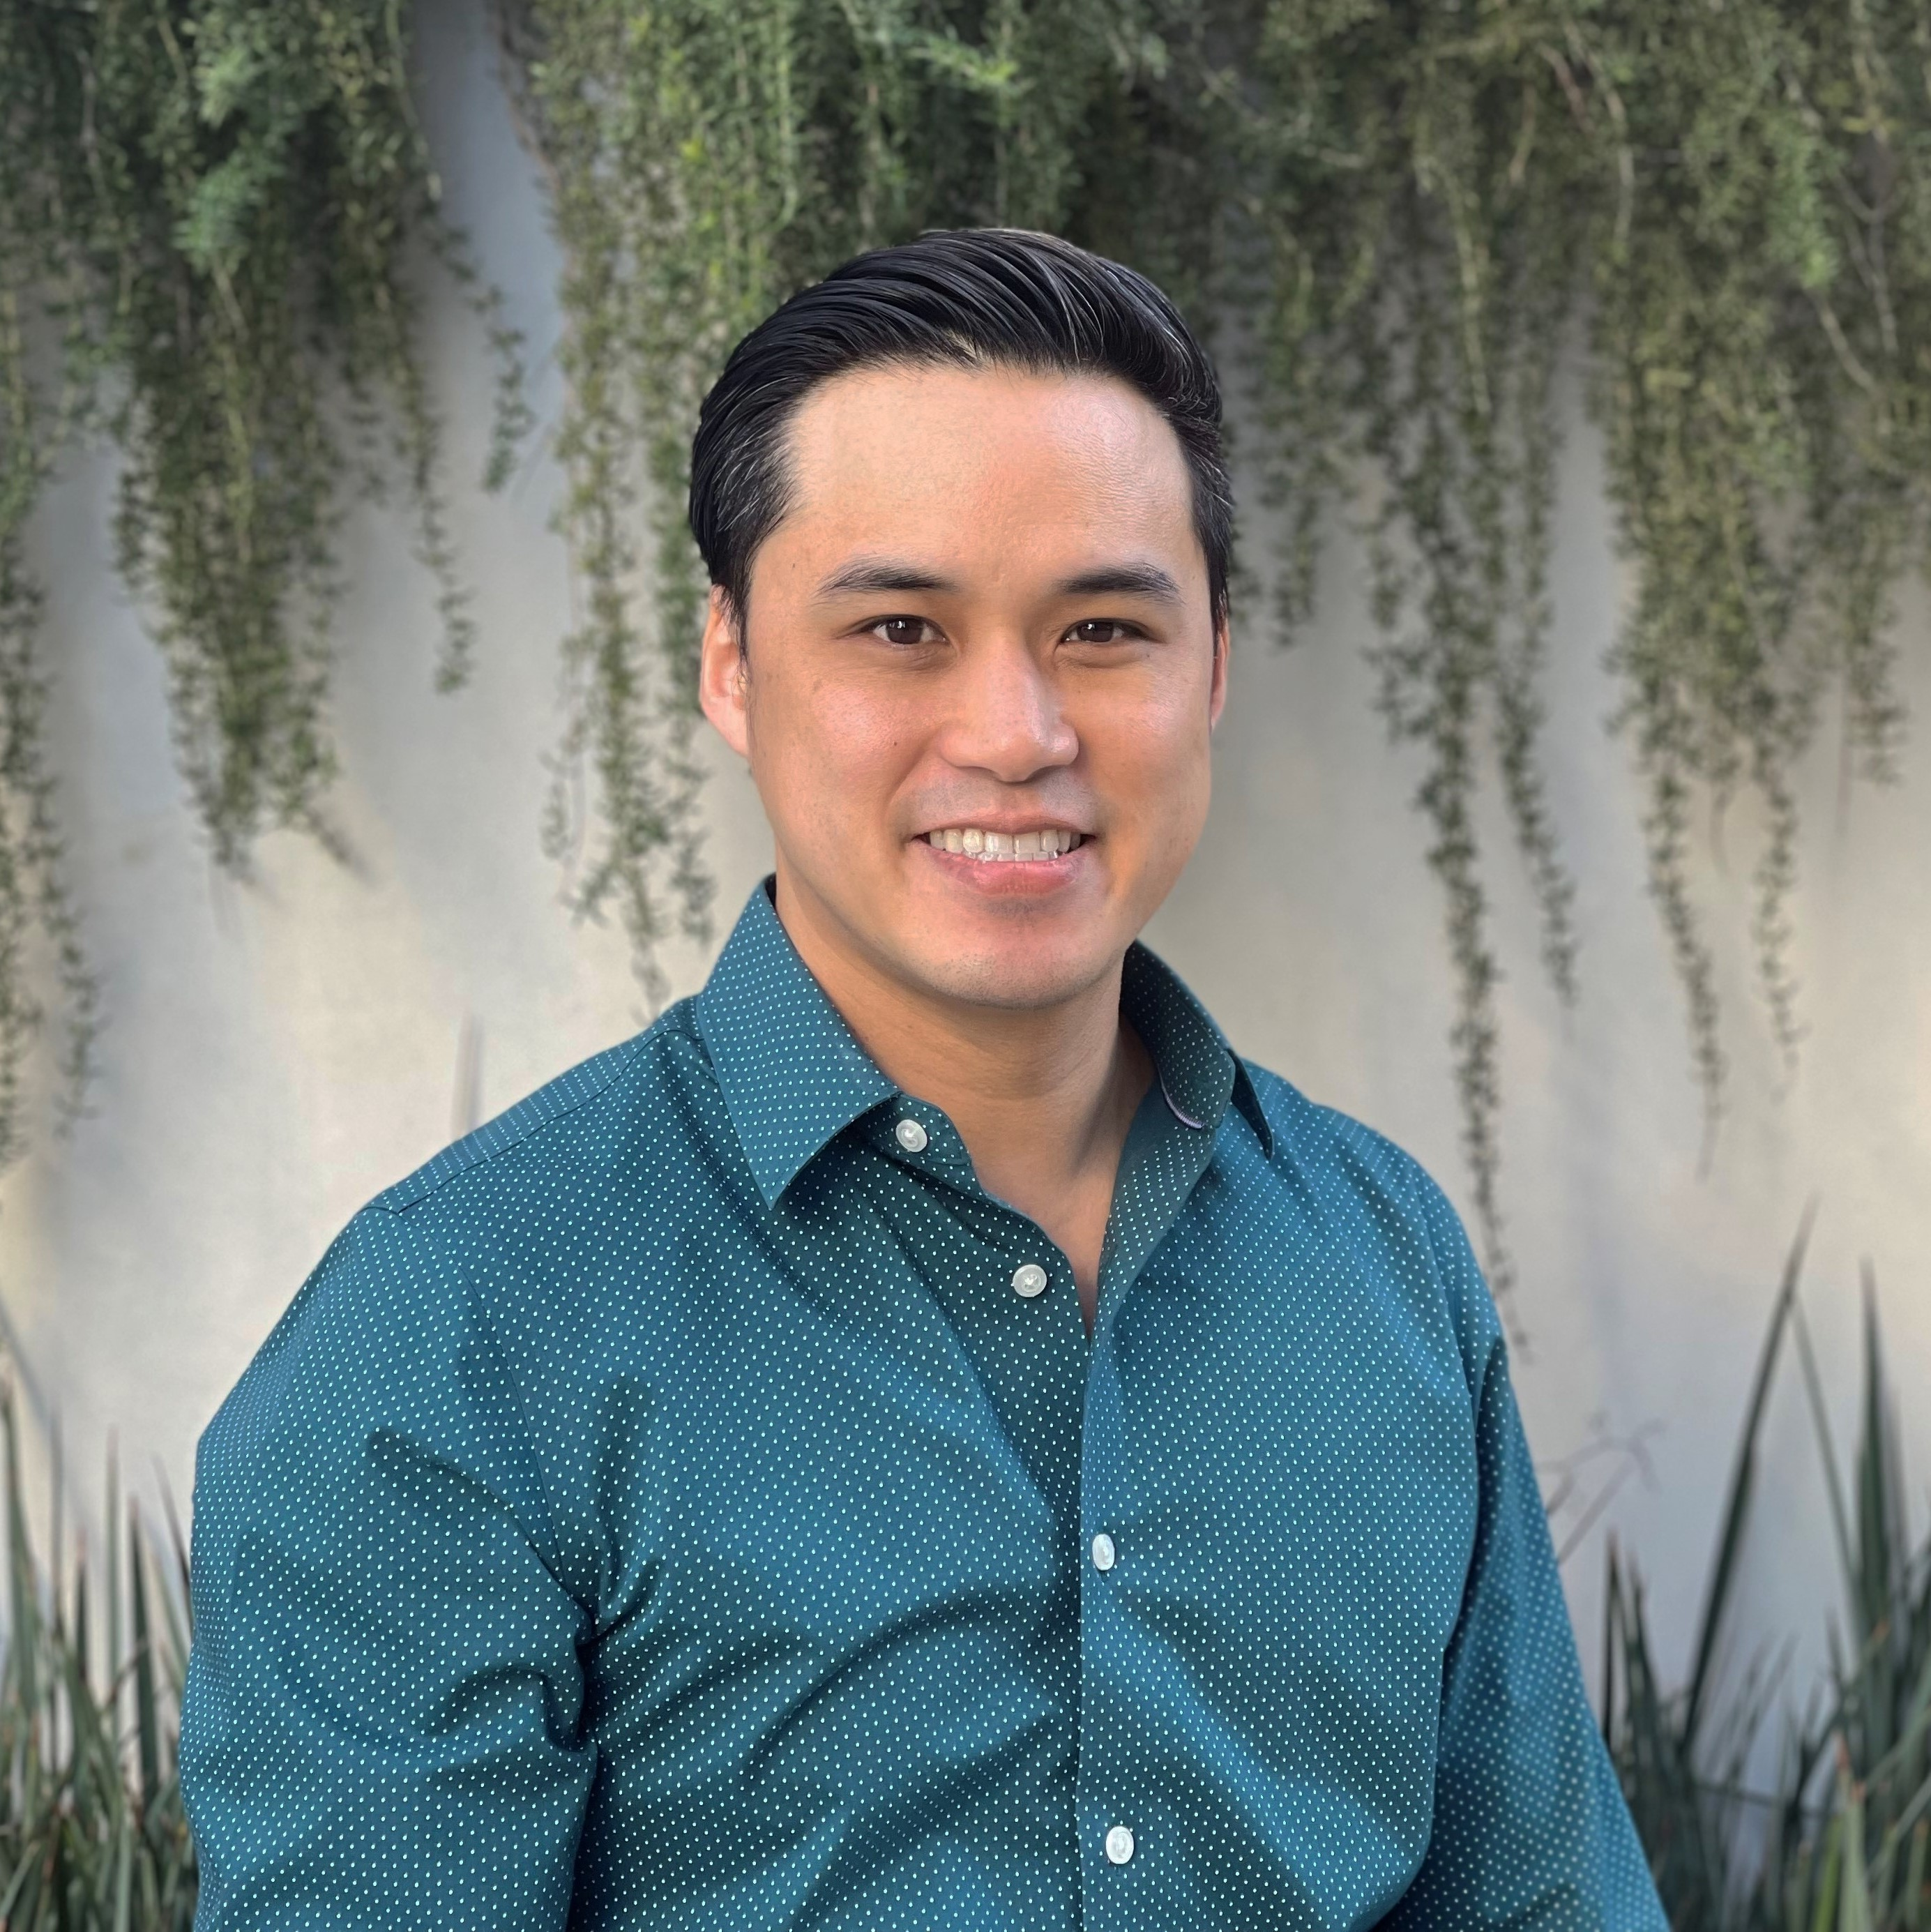
Upcoming Meetings
Next monthly meeting: July 7th
Speaker for July: Dr. Michael Li “A Social Genomics Perspective on Social Adversity and Substance Use Disorders in Communities Impacted by HIV”

