Slide 1
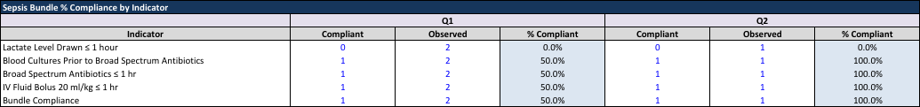
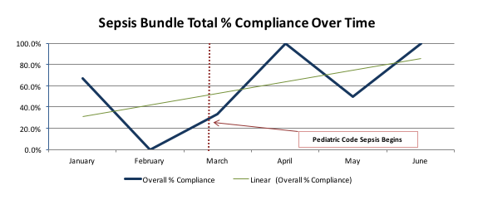
Pediatric Code Sepsis
Grace Sund RN, MSN, CPNP, CPHON, CNS| Janae Sieder RN, BSN
6 North Wing – Pediatrics | Santa Monica UCLA Medical Center
Clinical Issue/ Current Practice
Goals
Results Continued
Clinical Issue:
Pediatric Inpatient clinical team is not consistently meeting the 1 hour goal timeframe for the elements in the pediatric sepsis bundle.
Staff have identified that they need support to ensure proper identification of early clinical deterioration of patients that present with sepsis, severe sepsis and septic shock.
The delays are causing inconsistent, potentially unsafe patient care practices, increase the length of stay in the hospital especially in critical care areas and contribute to the overall mortality rate of our patients.
Current Practice:
RNs inform pediatric physician team when they recognize potential/actual sepsis indicators in their patients. RNs wait to to perform any interventions based on pediatric physician team decision.
To improve the pediatric inpatient rate of bundle compliance (1 hour time limit) for the main sepsis elements (i.e. blood culture, +/- IV fluid bolus, antibiotics).
To support the clinical staff with decision making, education and clinical deterioration and recognize clinical deterioration earlier.
Currently our sample size is small due to fewer Pediatric Code Sepsis activations than anticipated.
The cause is likely contributed to the negative connotation with a “code” and the misconception of the series of events following a pediatric code sepsis.
Interventions
Implementation of “Pediatric Code Sepsis” (#36, Hospitalist/Senior resident/Charge RN paged to come to bedside, no overhead page)
Provide education, support, and resources for staff through educational flyers, staff meeting discussion, weekly huddle updates, skills lab case study, and skills lab simulation
Monthly Pediatric Sepsis Task Force meetings and Pediatric Inpatient Sepsis subgroup meetings
Review “code sepsis” cases and fall out cases
Track order set use and bundle compliance
Conclusion
Based on an overall improvement in meeting defined bundle elements within the 60 minute timeframe, we will continue our “Pediatric Code Sepsis” protocol
Continued education is needed for RNs to confidently recognize clinical deteriorations and overall knowledge regarding code sepsis and bundle elements
Continued work with the interdisciplinary team (MD, RN, lab, pharmacy) to maintain and improve this intiative.
Measured Outcomes/Results
References
Best Practices/Literature Review
Balamuth F, Weiss SL, Neuman MI, et al. Pediatric severe sepsis in U.S. children’s hospitals. Pediatr Crit Care Med. 2014;15(9):798–805. doi: 10.1097/PCC.0000000000000225.
Goldstein B, Giroir B, Randolph A. International pediatric sepsis consensus conference: definitions for sepsis and organ dysfunction in pediatrics. Pediatr Crit Care Med. 2005;6:2–8. [PubMed]
Hartman ME, Linde-Zwirble WT, Angus DC, Watson RS. Trends in the epidemiology of pediatric severe sepsis. Pediatr Crit Care Med. 2013;14:686–693 [PubMed]
Weiss SPB, Bullock M, et al. Defining pediatric sepsis by different criteria: Discrepancies in populations and implications for clinical practice. Pediatric Critical Care Medicine. 2012;13:e219–226. [PubMed]
Mortality associated with sepsis remains high (<30%) and the incidence is increasing worldwide.
Mortality in sepsis is known to increase markedly with delays in therapy.
Early goal directed therapy can reduce mortality. Literature shows that rapid assessment, identification and treatment of patients with signs of SIRS/sepsis and septic shock can greatly reduce mortality.
A dedicated Sepsis Task Force team, trigger tool (screening tool), order set (using bundled ideology), and rapid response teams can improve bundle compliance.
Acknowledgements
Project Champions: Audrey Crummy, Robert Kelly, Amy Goldberg, Sufia Husain, RJ Soliven, Liz Bolanos, Amanda Lum

