Slide 1

Post Award Training
What happens after funds are awarded?
Laura Sheehan
Manager of Research Administration
Department of Family Medicine

Slide 2
Who are the players?
There are dozens of UCLA departments that play a role in managing research or other extramurally funded projects.

Slide 3
ORCA
Office of the Vice Chancellor for Research & Creative Activities
ORA
Office of Research Administration
TDG
Technology Development Group
REO
Research Enhancement Office
RPC
Research Policy & Compliance
Manages most of the alphabet soup:
OCGA, EFM, OHRPP, ORIS, ORDM, and OBFS
Manages Industry (for profit) sponsored research, MTAs, patents, inventions, royalties, etc.
Limited submissions, funding opportunities newsletters and resources, UCLA Grand Challenges, etc.
Animal Research, Conflicts of Interest, Biosafety, Dual Use Review, Export Control, etc.

Slide 4
OHRPP
Office of Human Research Protection Programs
OCGA
Office of Contract and Grant Administration
ORA
Office of Research Administration
EFM
Extramural Fund Management
ORIS
Office of Research Information Systems
ORDM
Office of Research Data Management
OBFS
Office of Business and Financial Services
Notes:
There is also the Clinical Trials Contracts and Strategic Relations Office

Slide 5
Award Set Up Process
Who is responsible for what?

Slide 6
Department
OCGA
If sponsor sends notification of award to the PI, they should forward it to Laura so she can submit it to OCGA/TDG.
Receives award notice and negotiates terms/conditions with the sponsor. Executes award. Completes Award Data Coding Sheet (ADCS) and submits to ORDM.
PI performs scope of work and works with Fund Manager to monitor spending.
EFM
ORDM
Prepares invoices and/or financial reports based on deliverable categories and due dates in PAMS. Collects/process payments. Conducts final closing of fund at the end of the award (in conjunction with Dept).
Takes info from ADCS and inputs into PAMS and Financial System. Assigns fund number, links expenses accounts, and generates Award Snapshot.
Notes:
Rare to actually receive a check

Slide 7
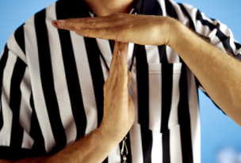
What if I need to start a project but the money isn’t here?
Request for Authorization to Spend (RAS)
Department responsible for any incurred expenses if award falls through
Need applicable authorizations in place (e.g. IRB)
Determine amount and period (cannot exceed $50k or 6 months)
Requires justification

Slide 8
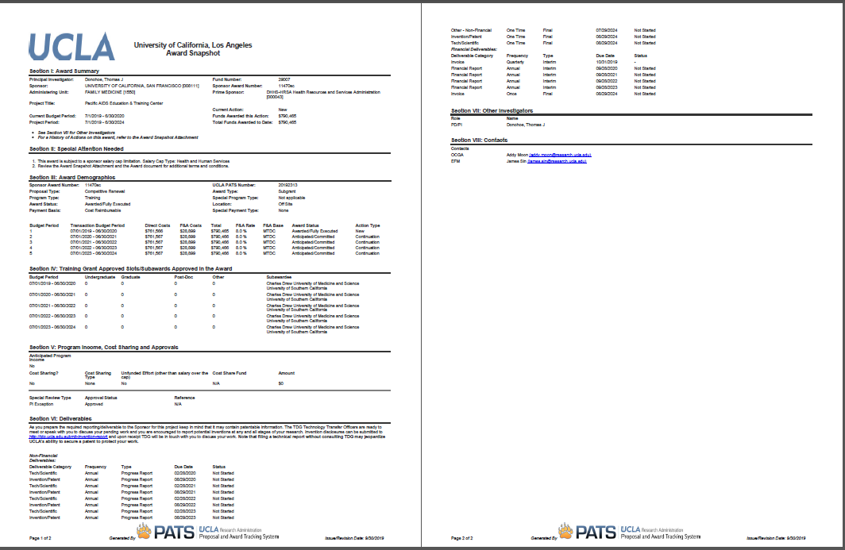
Award Snapshot
AKA – Notice of Award, NOA, Goldenrod
Two Pages
Usually precedes actual agreement document
Notes:
Can be downloaded from ORA Portal, but only Laura, Daphne, and Andrew have access. Can be requested from us. Good to review at first monthly review mtg with fund manager.

Slide 9
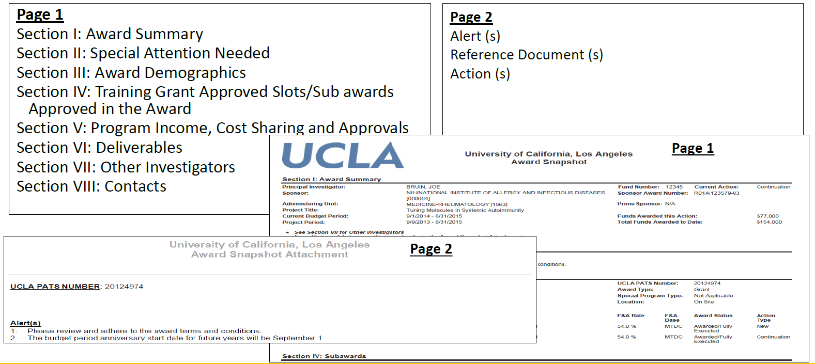

Reading the Award Snapshot

Slide 10
Reading the Award Snapshot
Review the Award Snapshot with your fund manager at your first monthly meeting
Fund number
Budget/project period
Special Attention items and Alerts
Amount awarded
Deliverables (technical reports, financial reports, etc.)
Compliance requirements
Payment basis
Contacts
Notes:
Special attention items: salary caps, restrictions/holds, prior approvals. ACCURACY.

Slide 11
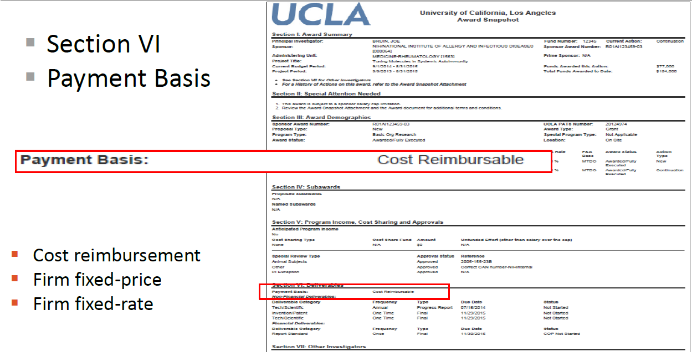
Payment Basis

Slide 12
Payment Basis
Cost Reimbursement
Payment is based on actual costs incurred, most common
Revenue is earned when allowable and applicable costs incurred up to the total budget approved
Unspent funds in the budget must be returned to the sponsor
Firm Fixed-Price
Payment is based on a fixed specified amount, regardless of costs incurred
Unspent funds can be retained by the University in accordance with UCLA policy 913
Firm Fixed-Rate
Payment is based on a fixed rate applied to number of units performed
Unspent funds can be retained by the University in accordance with UCLA policy 913
or a combination of these

Slide 13
How does the money actually get processed?
Sometimes NOA comes with a check, but mostly we invoice
EFM handles the invoicing for the most part.
Based on agreed upon arrangements (e.g. monthly, quarterly, milestone basis, etc.)
May need PI signature or supporting documentation
If milestone-based, PI and Fund Manager will need to update EFM with project progress
If combination, Fund Manager will need to separate out cost-reimbursable items from fixed price/rate expenses

Slide 14

We have the fund number!
Now what?

Slide 15
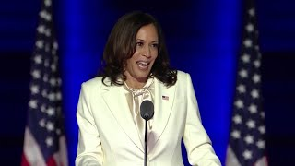
“Now is when the real work begins.”

Slide 16
Responsibilities of PIs and their teams:
Acquisition of appropriate approvals (e.g. IRB, human/animal subjects, biohazardous materials, etc.) and licenses
Scientific/technical conduct and reporting
Fiscal and programmatic management of the project
Understand and comply with all guidelines, restrictions, terms, and conditions
Allocate appropriated funds into applicable budget categories
Review and approve financial transactions
Conduct monthly reconciliation, make necessary adjustments

Slide 17
Policies and Guidelines
Federal Policy and Governmental Law
Sponsor Policies
University Policies
Departmental Policies
Specific Award Terms
Uniform Guidance Subpart E:
“Costs must be allowable, allocable, reasonable, consistently applied and adequately documented.”
LA Times Rule of Thumb

Slide 18
Typical Expenditures
Personnel
  Hiring new personnel
  Effort should match reality
Transfers to other departments and Subawards
  Timing
  Amount
Materials and supplies, paying for services, invoices
Consultants/independent contractors
Travel
Rent
Other

Slide 19
Managing Subawards
Requires set up, paperwork, coordination with Fund Manager
Scope of Work (SOW) should be reflective of all expected deliverables
Review progress regularly
Invoices must be approved by PI’s team

Slide 20

Monthly Meetings with Fund Manager
Are they actually required?
YES!

Slide 21
Monthly Meetings with Fund Manager
First meeting
  Review budget
  Review Snapshot
  Discuss any changes
  Discuss timing of anticipated expenses
  Approve/initiate transfers and subaward set-ups, etc.

Slide 22
Monthly Meetings with Fund Manager
Regular Monthly Meetings
  Review financial reports (aka FR’s, GL)
  Ensure that all recorded expenses are allowable, applicable, complete
  Determine if adjustments need to be made
  Review encumbered items
  Monitor spending rate
Are sister departments/subawards performing as expected? Are they spending down/invoicing? Is the project making progress as expected? If not, is carryforward/NCE necessary/allowed? Is the effort being charged for personnel accurate? Does it need to change in the upcoming months? Is that charge applicable? Are there any applicable charges missing? Why is that item still encumbered?

Slide 23
FAUs: Accounts, Cost Centers, and Fund Numbers
Full Accounting Unit
Comprised of 8 components
  Account: Groups transactions of major activities within Fam Med. First two digits represent the function. Most common are 40- for Instruction, 44- for Research, 62- for Public Service. Remaining digits are almost always -1435 for Fam Med.
  Cost Center – Typically the PI’s initials. However, if you receive supplemental funding, have a split payment basis, or have any other special circumstance, you may have multiple cc’s for the same fund number.
  Fund Number – Discrete monetary source for a particular programmatic or contractual objective. In other words: each grant gets its own fund number. Same number across departments if you transfer funds for the same award.

Slide 24
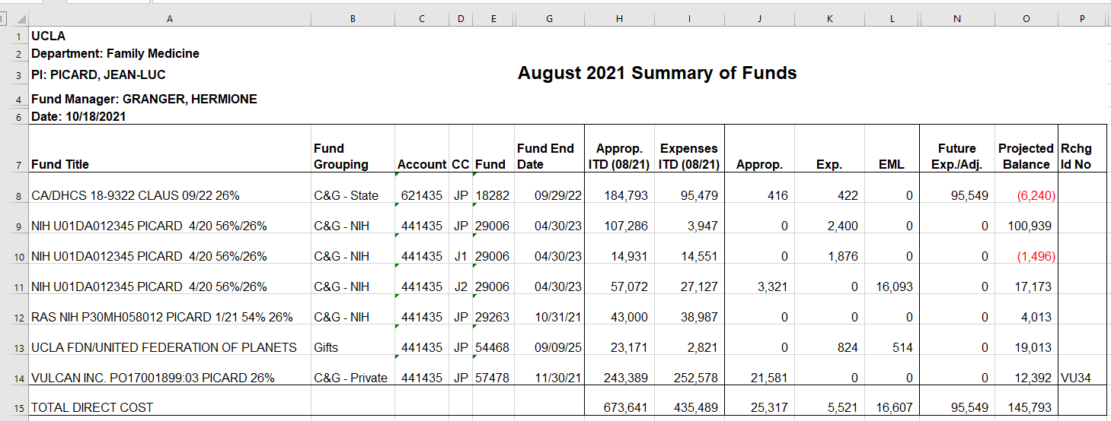
Financial Reports
Sum of Funds

Slide 25
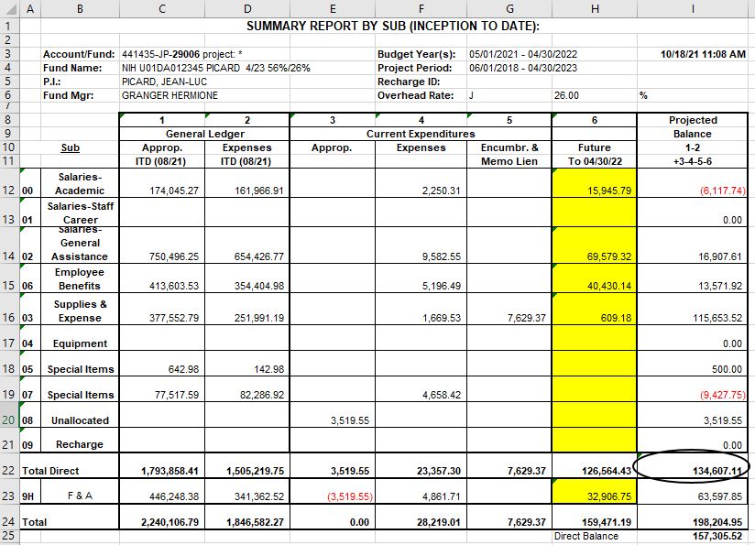
Financial Reports
Summary by Sub

Slide 26
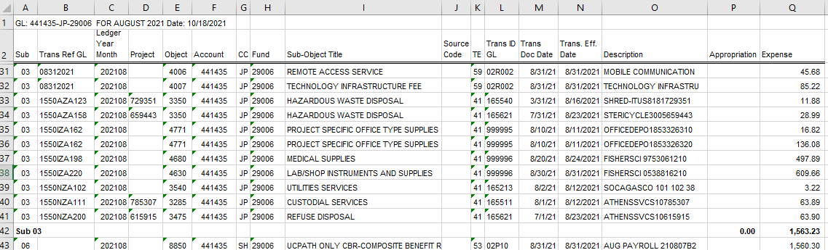
Financial Reports
Closed Expenses

Slide 27
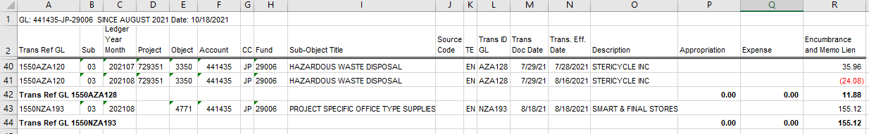
Financial Reports
Open Expenses

Slide 28
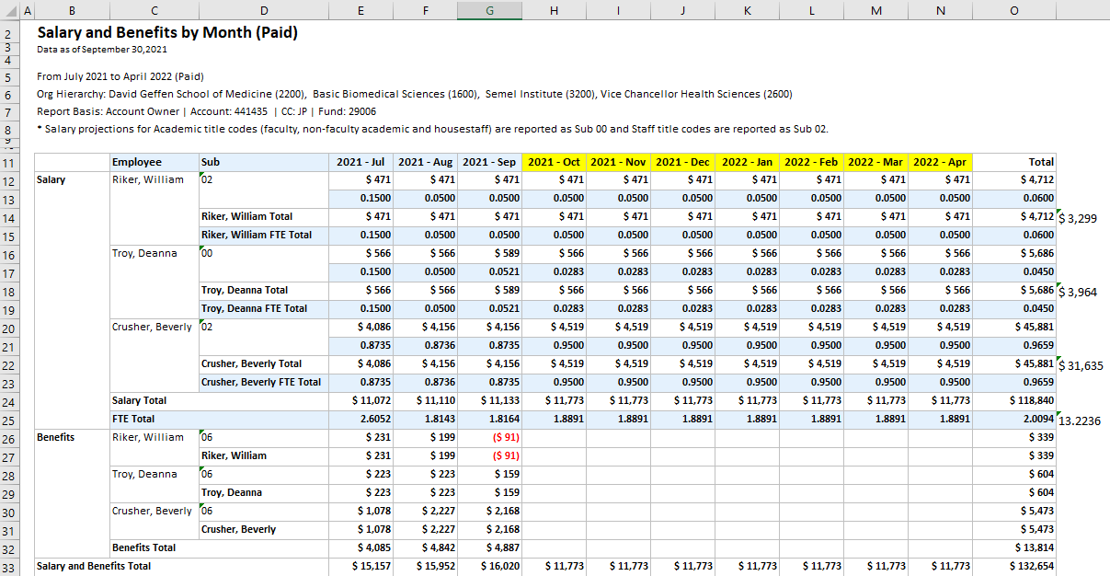
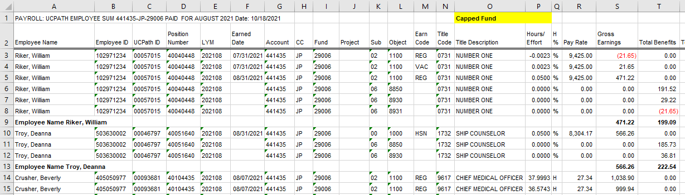
Financial Reports
Salary

Slide 29
Special Considerations
Unallowable costs
Special F&A rules
Split payment basis/special tracking
Supplements/different cost centers
Extreme deviation from original budget

Slide 30


Monthly Meetings with Fund Manager
Look
Back
Look
Ahead

Slide 31
What happens when you are awarded additional funds?
Modifications, Supplements, Continuation funds
Processed same way as original funds, but hopefully faster (OCGA reviews, hopefully negotiations not required, processes)
OCGA will require internal paperwork
    Updated eDGE Tracking Sheet
    EPASS, SOW, Budget, and Justification (if not previously submitted)
Funds are appropriated
Sometimes new cost center is required/recommended
Notes:
Cost centers, carryforwards, annual close outs, invoicing

Slide 32
Re-Budgeting
When does re-budgeting require prior approval from the sponsor?
When the change is greater than 10%
When the change is greater than 25%
It depends on the sponsor and the terms of the agreement
It is always required
When prior approval is required, you will likely need to submit a revised detailed budget, budget justification, and Scope of Work (or ensure no changes in scope).
Notes:
NIH rule: 25%, key personnel. Others 10% or 5%. Others depends on which category. Others ALL changes.

Slide 33


Notices from ORA Reports (portal@research.ucla.edu)
Sent automatically at 90-, 60-, and 30-day mark prior to budget period end date
If you’ve been meeting monthly with your Fund Manager
If you have NOT been meeting monthly with your Fund Manager

Slide 34
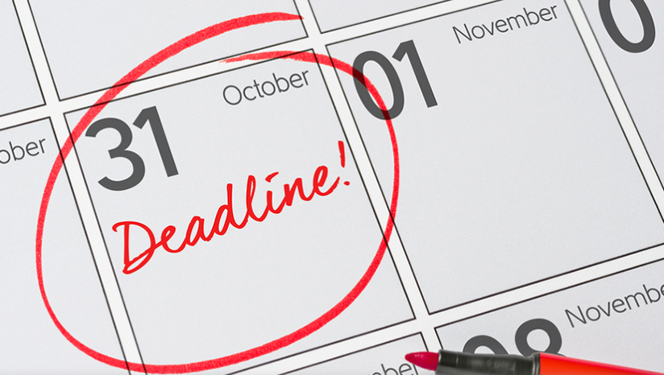
Approaching End Dates
Budget Period End Date
Are you projecting a balance? How big? Is carryforward allowed?
Are you on target in regard to milestones/aims?
Make personnel adjustments (forward and back)
Make applicable purchases, pay applicable invoices
Technical/Scientific Progress Reports
Financial Progress Reports

Slide 35
Approaching End Dates
Project Period End Date
Are you projecting a balance? How big? Is NCE allowed?
Are you on target in regard to milestones/aims?
Make personnel adjustments (forward and back)
Make applicable purchases, pay applicable invoices
Technical/Scientific Final Reports
Financial Final Reports
Is Policy 913 applicable?

Slide 36
Financial Progress Reports & Final Financial Reports (FFRs)
Fund Manager will create
May be combined with Technical/Scientific Reports
If you have massively underspent
  You will likely need to provide a justification, list the remaining balance, and explain how you plan to spend down the funds
  You may be required to return unspent funds
  Subsequent incoming funding may be cut

Slide 37
Effort Reporting
Required for federal funding only
Confirms that amount paid matches actual work performed
Must be certified by PI or person familiar with project/effort
Often comes months after work is performed

Slide 38
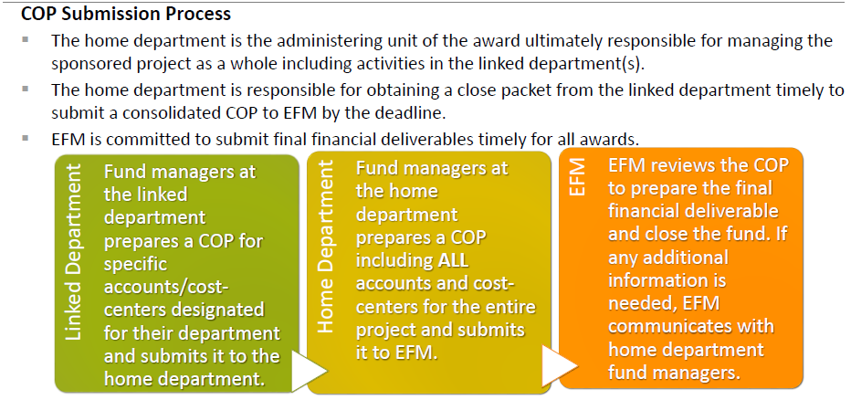
Close Out Packets

Slide 39
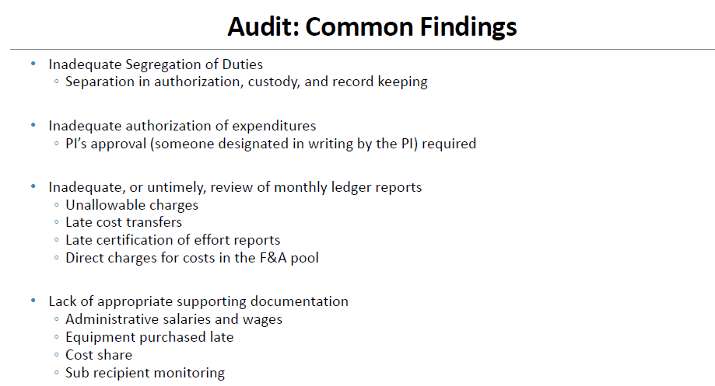

Slide 40


Slide 41
Thank You

