Slide 1

Family Medicine Research Unit
Monthly Meeting - September 2022
Laura Sheehan
Manager of Research Administration, Dept. of Family Medicine

Slide 2
Recently Processed Awards
PI | Award Title | Sponsor | Prime Sponsor | Action Type
Donohoe, Thomas J | Pacific AIDS Education & Training Center | UNIVERSITY OF CALIFORNIA, SAN FRANCISCO | DHHS-HRSA | Continuation
Shoptaw, Steven J | Technology Improving Success of Medication-Assisted Treatment in Primary Care | Q2I LLC | NIH-NIDA | No Cost Extension
Brooks, Ronald Andrew | Evaluating the Feasibility and Acceptability of a Latino MSM Focused PrEP Uptake Intervention | NIH-NIMH National Institute of Mental Health | - | Continuation
Sur, Denise Kc | CalMedForce State Funded Grant | Physicians for a Healthy California (formerly California Medical Association Foundation) | UCOP | Continuation
Nattiv, Aurelia | Screening for Sexual Violence Among College Athletes | AMERICAN MEDICAL SOCIETY FOR SPORTS MEDICINE (AMSSM) | - | New/Transfer
Donohoe, Thomas J | Pacific AIDS Education & Training Center | UNIVERSITY OF CALIFORNIA, SAN FRANCISCO | DHHS-HRSA | Continuation

Slide 3
Recently Submitted Proposals
PI | Title | Sponsor | Prime Sponsor | Proposal Type
Shoptaw, Steven J | CTN-0110 Randomized, double-blind, placebo-controlled trial of monthly injectable buprenorphine (BUP) for methamphetamine (MA) use disorder (MURB) | University of Texas-Southwestern Medical Center at Dallas | NIH | New
Moreno, Gerardo | CMSP Path to Health Pilot Phase 2 Evaluation | County Medical Services Program | - | New
Nattiv, Aurelia | Improving Bone Health and Reducing Incidence of Bone Stress Injuries in Pac-12 Distance Runners: An Implementation Plan Focusing on Health Promotion, Optimal Fueling, and Changing Culture | UCSF | Pac-12 | Modification/ Supplement

Slide 4
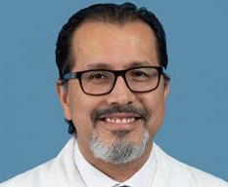
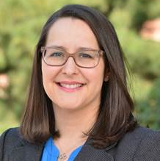
Human Resources/Personnel
Gerardo Moreno, MD, MSHS, appointed as Chair of the Department of Family Medicine, effective August 1, 2022
Number of JEDI Projects: | 36
Total $ Award Amt of all JEDI Projects: | $13,013,508
Percentage of JEDI projects for which Fam Med is the primary dept/ Lead PI: | 67%
Dr. Yelba Castellon-Lopez named Director of JEDI for Department of Family Medicine

Slide 5
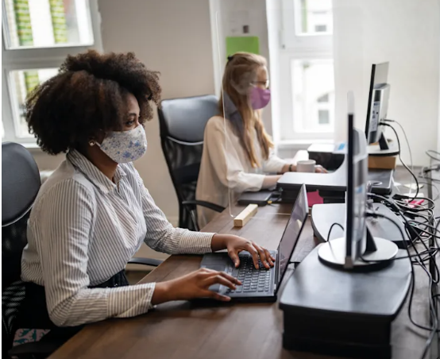
COVID Updates
We are aware that there is confusion about the latest COVID policies, and there is conflicting guidance.
Until we receive further guidance from DGSOM, we have been instructed to stay the course.

Slide 6

Date: Thursday, September 15
Time: 12:30 – 2 p.m.
Location: Geffen Hall Revive Patio
Deadline to Register: Tuesday, September 6
Registration Link: https://uclahs.az1.qualtrics.com/jfe/form/SV_blRvwGBz9sQTYXQ
This event is a great opportunity to:
(Re)connect with colleagues from across the organization
Welcome new team members to the DGSOM community
Celebrate team accomplishments
Recognize colleagues for exemplifying the Cultural North Star in their work, actions, and interactions
Make a personal pledge to embed the Cultural North Star into your daily practices within DGSOM
Supervisors are encouraged to grant employees sufficient release time in addition to their normal lunch period to join this community building event, provided that the absence would not infringe upon the performance of required job duties.

Slide 7

Monday, September 5th is Labor Day

Slide 8

Research Updates
New guidance requires federally-funded research to be Open Access
  OSTP Guidance calls for federal agencies to make taxpayer-supported research publicly available immediately (removes optional 12-month embargo)
  Requires that underlying data be published
  Federal agencies have until end of 2025 to institute guidance
https://www.whitehouse.gov/wp-content/uploads/2022/08/08-2022-OSTP-Public-Access-Memo.pdf
“Lifting the yearlong embargo that some journals have imposed on papers they publish will promote more equitable access to research… The previous policy ‘limited immediate equitable access of federally funded research results to only those able to pay for it or have privileged access through libraries or other institutions.’”

Slide 9

Monthly Meetings with Fund Manager
Are they actually required?
YES!

Slide 10
Monthly Meetings with Fund Manager
  New Funds
  Compare budget with snapshot
  Discuss changes, timing of anticipated expenses
  Approve/initiate transfers, subaward set-ups, etc.
  Existing Funds
  Review financial reports (aka FR’s, GL)
  Ensure that recorded expenses are allowable, applicable, complete
  Determine if adjustments need to be made
  Review encumbered items
  Monitor spending rate
Are sister departments/subawards performing as expected? Are they spending down/invoicing?
Is the project making progress as expected? If not, is carryforward/NCE necessary/allowed?
Is the effort being charged for personnel accurate? Does it need to change in the upcoming months?
Is that charge applicable? Are there any applicable charges missing? Why is that item still encumbered?

Slide 11
Managing Subawards
Coordinate with fund manager for set-up
Ensure that subs are providing expected deliverables
Insist that subs invoice in a timely manner
  New, more stringent close-out policies demand that subs invoice in a timely manner, especially for final invoices
  Consider listing subaward end dates PRIOR to project end date when setting up subs
  Warn subs that failure to invoice on time = no guarantee of payment

Slide 12
Get to Know Your Co-Workers
My favorite things to do: sketch, photography and travel
Four things I can’t do without: God, family, sleep and my hydro flask
Top 2 movies of all time:
  My favorite Disney movie is The Lion King, I re-watch it every chance I get, and can recite lines (BUT I refuse to watch the new Lion King – I don’t want to ruin my favorite memories!)
  Lean on Me! I know the lines in this movie and rewatch Youtube clips at random.
I have one lovely pet, Nahla, who is 12 yrs old
Bucket list: Do a W. Africa tour and skydive!
I studied biology at UCSD, and Global Health at Northwestern University (Masters)

Slide 13
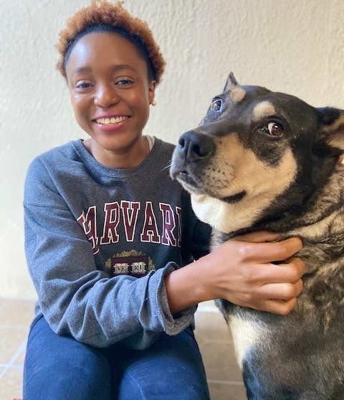
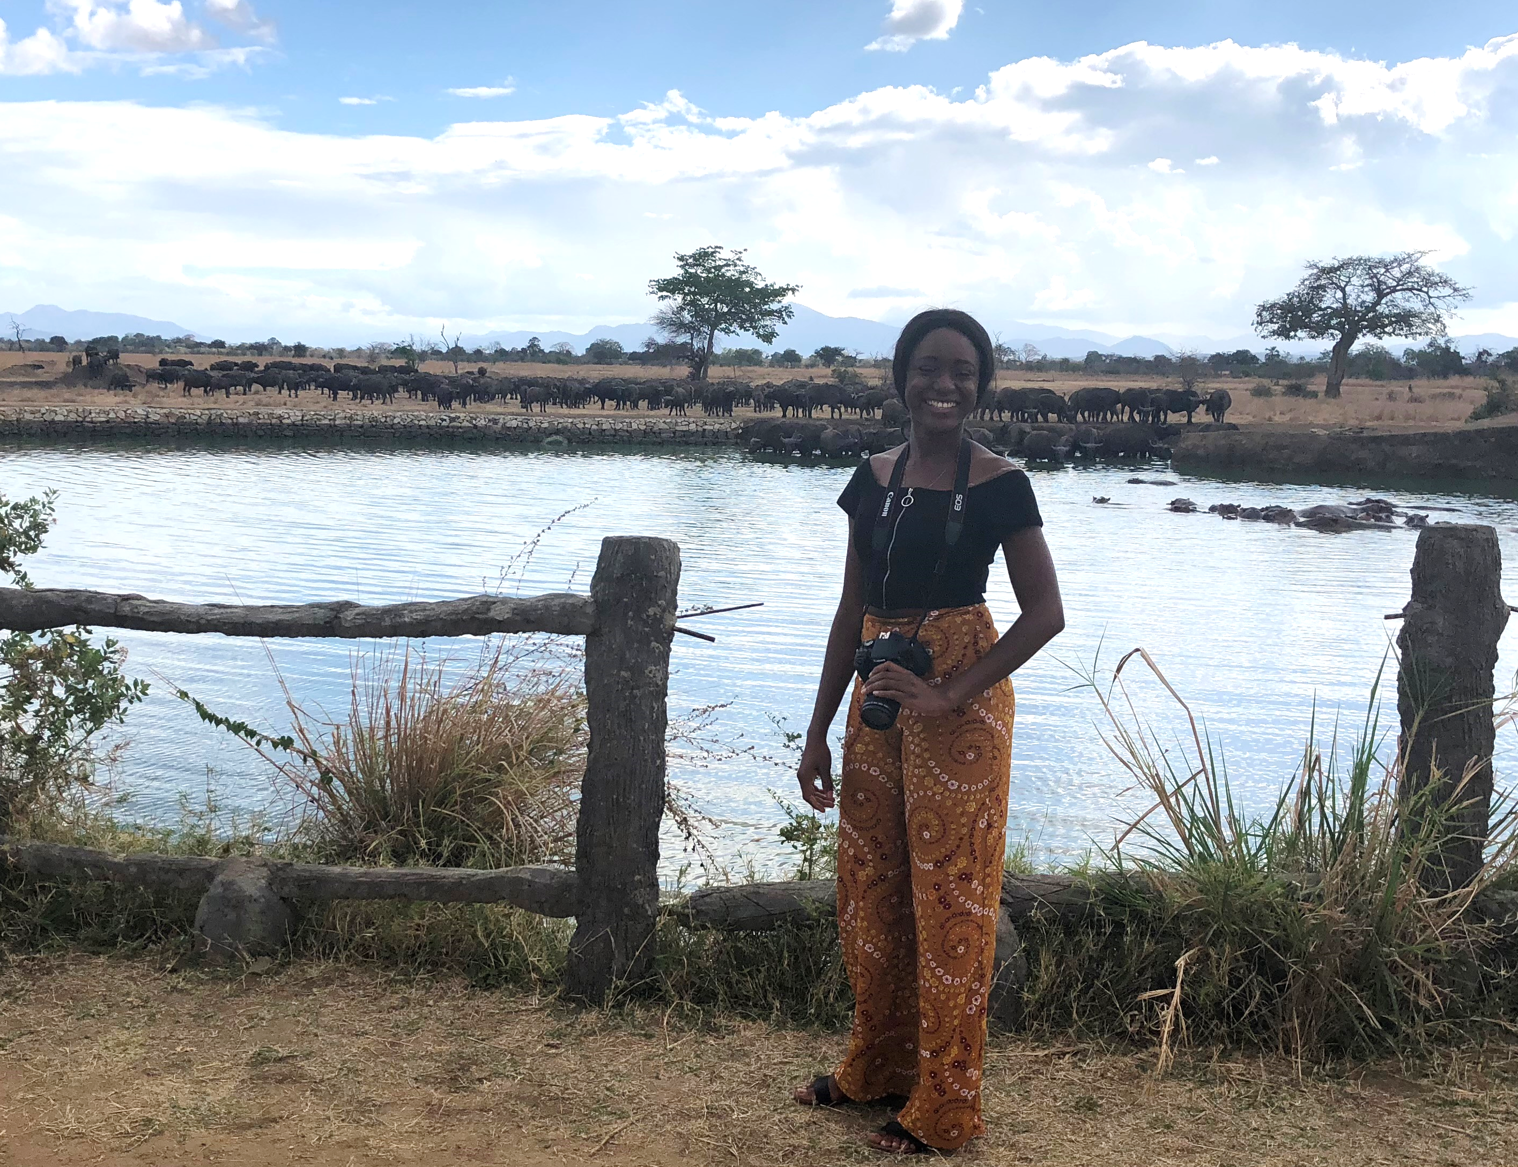
Get to Know Your Co-Workers
Dami jolayemi
5 Truths and 1 Lie
In my first job, I doubled as a cashier and pizza cook (skilled in pizza tossing).
I have 4 sisters and 1 brother
I used to teach elementary school
I went to an all-girls boarding school
I run my own wedding/event planning business

Slide 14
Financial Process
Clarification on Paying Guest Speakers/Panelists (as well as CAB and SAB members)
  Discuss process prior to offer (will need to register with Payment Works)
  Submit paperwork in advance
  Best practice: do not offer pay to UC employees
  Use the Check Request Form, not PO Request Form
  Eligible for coverage under blanket waiver for insurance

Slide 15
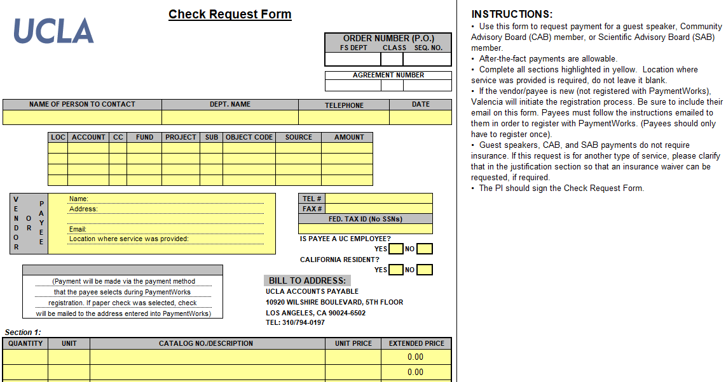
Financial Process

Slide 16

Independent Contractors/Consultants

Slide 17
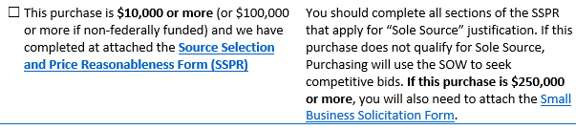
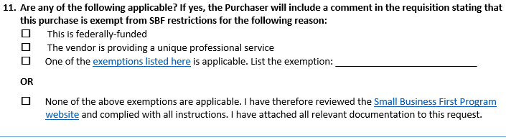
Independent Contractors/Consultants

Slide 18
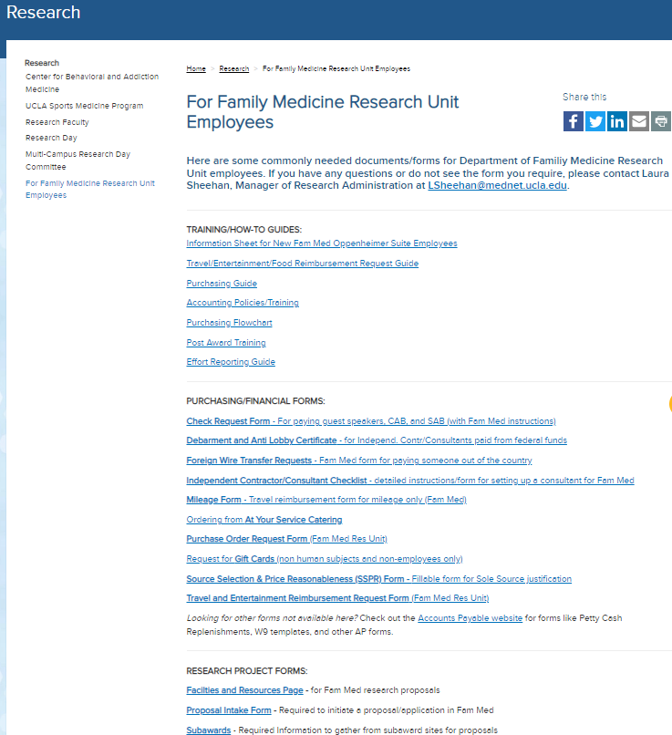
Website

Slide 19
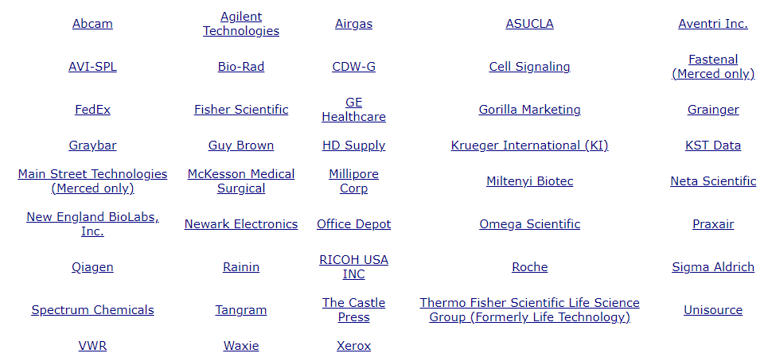
Financial – Upcoming Guidance
Supplier Site Orders (catalog orders)

Slide 20
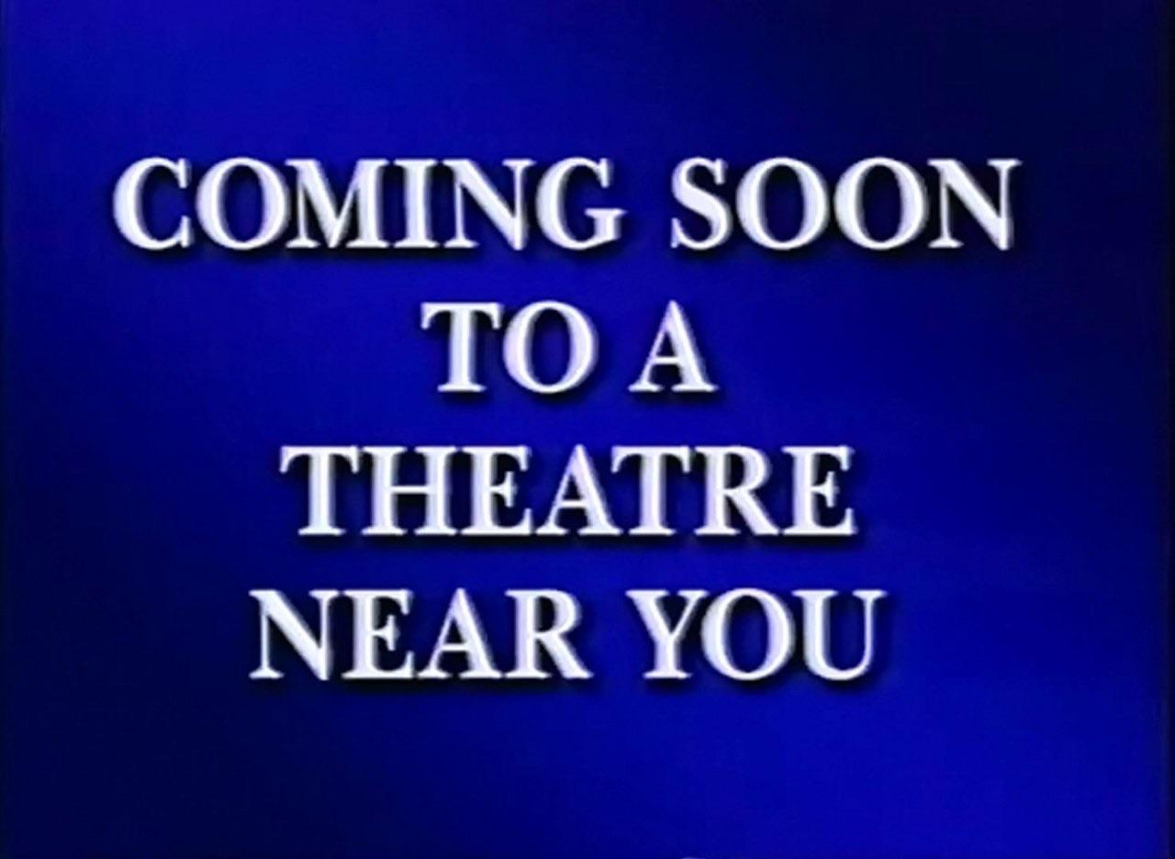
Financial – Upcoming Guidance
Blanket Agreements – explanation and guidance
New Travel/Entertainment guidance
New PO Request Form

Slide 21
P2P Transformation Project
Procure-to-Pay
New Procurement system: JAGGAER
  Replaces BruinBuy, Vendor Invoice Portal, AP Portal, and PAC
  Will integrate with Oracle (Ascend)
  To be launched in 2023

Slide 22
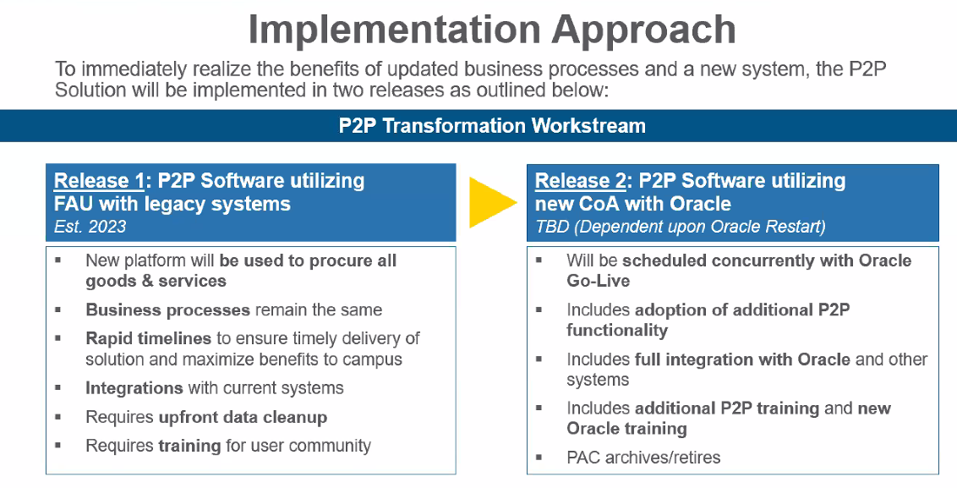
P2P Transformation Project

Slide 23
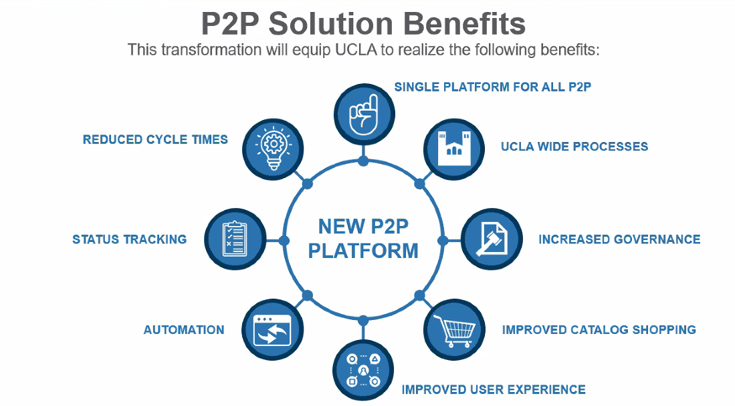
P2P Transformation Project

Slide 24
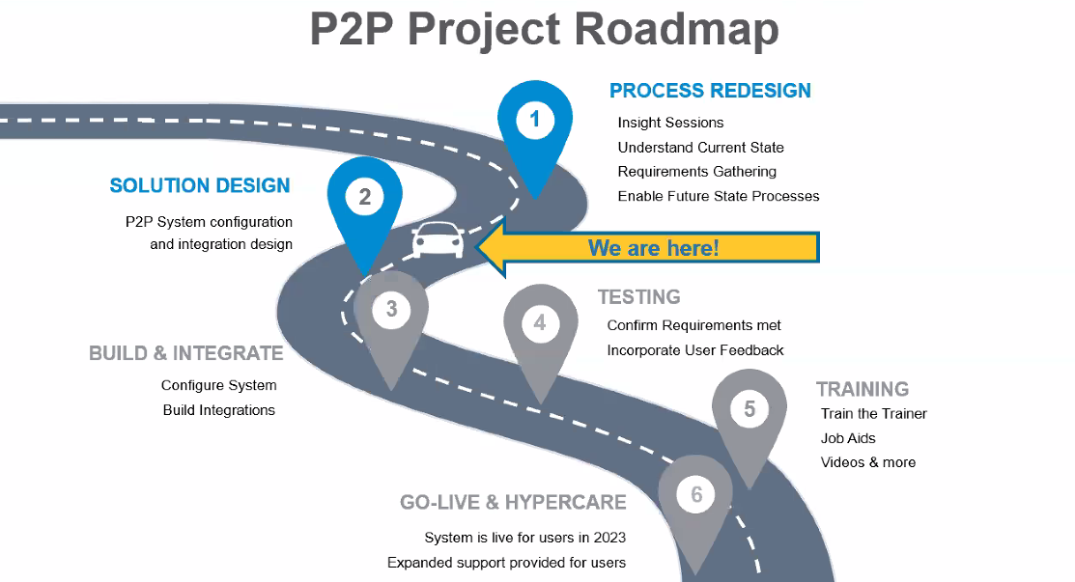
P2P Transformation Project

Slide 25

Meetings/Events
Proposal Basics: Preparing Applications for Research Funding
Thursday, September 22, 2022 from 12:00PM – 1:00PM
Registration is free

Slide 26
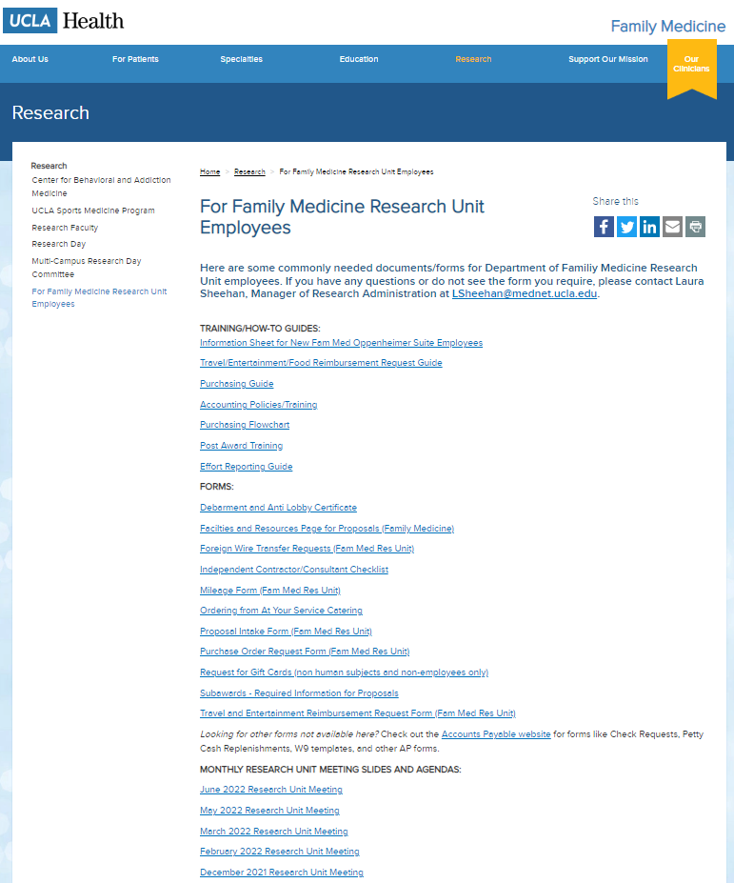
Meetings/Events
Next Monthly Research Unit Meeting: Thursday, October 6
Prior monthly meeting agendas/slides are available on the website

