Slide 1


Slide 2


UCLA Sepsis BPA Functionality
and the Sepsis Careplan
Notes:
Silence phone – stay off your phones during the class (except for online scenario portion of course). Step out if you need to take a call.
2 breaks
4 hr workshop – in order to get credit for attending, you have to stay for the entire 4 hrs; in order to get CEU’s you will need to complete the post-test and evals that are e-mailed to you.

Slide 3
Sepsis BPA:
The target go-live date for our new inpatient Sepsis Best Practice Alert was on December 11, 2018.
Remember, a Best Practice Alert is a directive embedded within Careconnect alerting the nurse that an action needs to be performed.

Slide 4
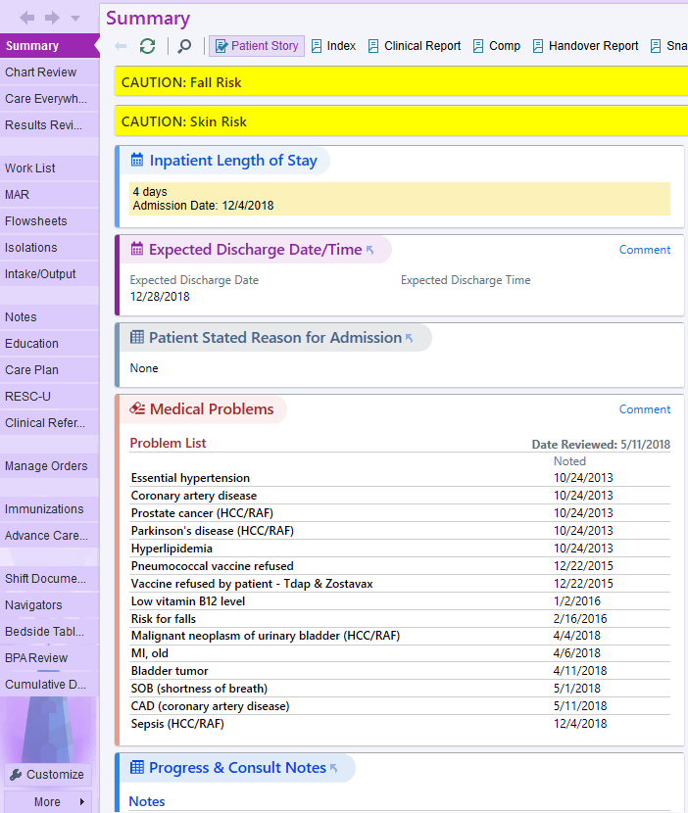
Where Will the BPA be Located?
The Sepsis BPA will be
located within the “Navigators” section of Careconnect.

Slide 5
What Triggers the Sepsis BPA?
Any sepsis-related diagnosis within the patient’s Problem List
will trigger the Sepsis BPA..

Slide 6
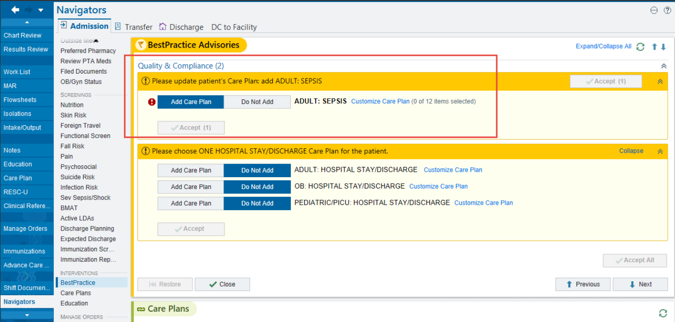
What Does the Sepsis BPA Look Like?
This notifies the nurse that a Sepsis careplan
needs to be created.

Slide 7
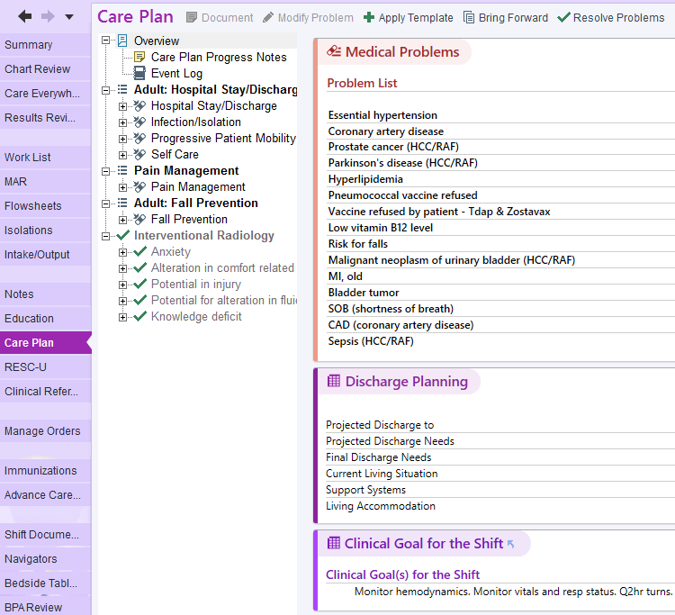
Creation of a Sepsis Careplan:
2
The Sepsis BPA serves as a reminder to always create a Sepsis Care Plan in any patient with a sepsis-related diagnosis.
So . . . Open the “Care Plan” section of Careconnect, then select “Apply Template.”
1

Slide 8
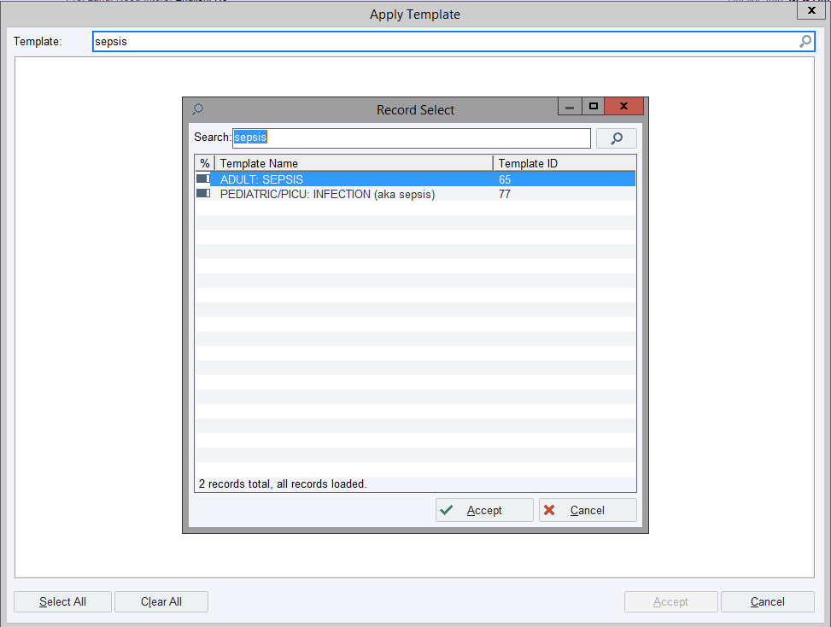
Creation of a Sepsis Careplan:
3
Next, search for “sepsis.”
Then, choose from either the adult or pediatric Sepsis Careplan options.
And last, choose “Accept.”
4
5

Slide 9
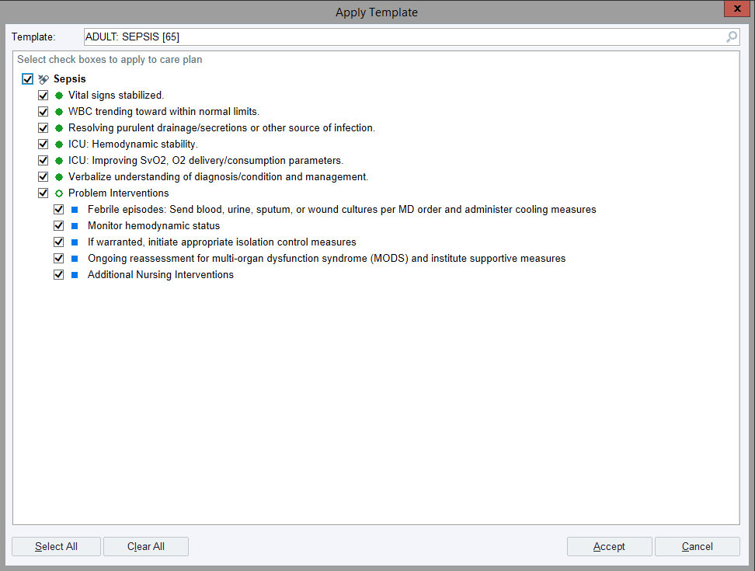
Creation of a Sepsis Careplan:
Using the checkmarks, tailor the list to what is applicable for your patient.
Then, click “Accept” again.
6
7

Slide 10
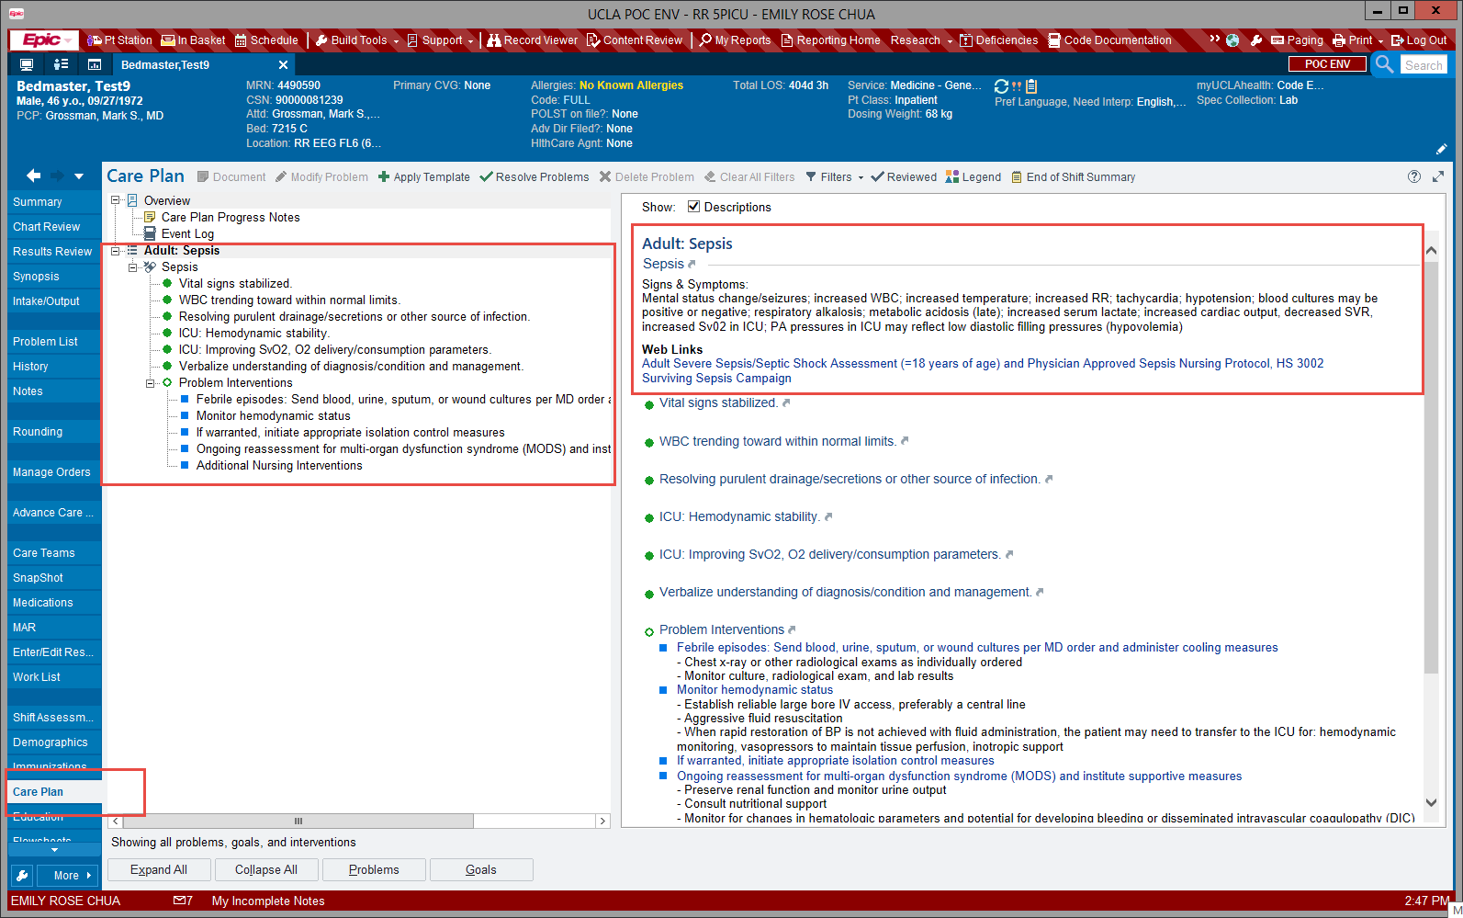
Sepsis Careplan Elements:
This is what the Sepsis Careplan will look like.

Slide 11
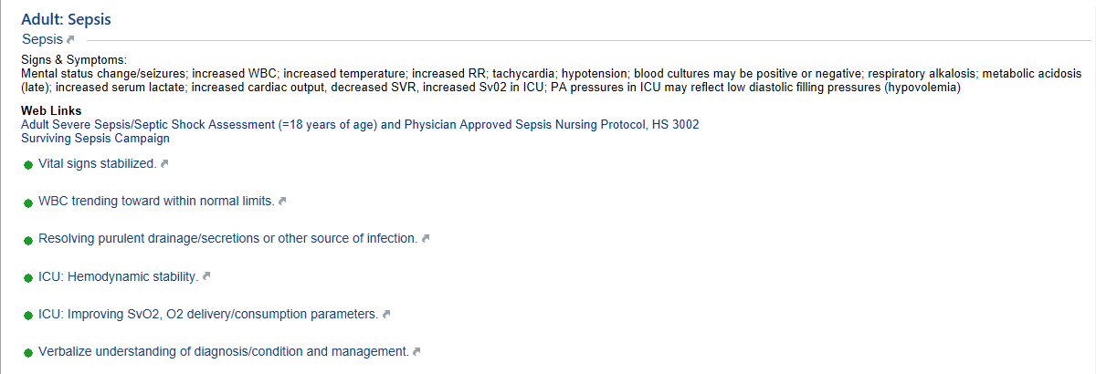
Sepsis Careplan Elements:
It has Web Links to the Adult Severe Sepsis/Septic Shock Assessment, the Physician Approved Sepsis Nursing Protocol, and to the
Surviving Sepsis Campaign.

Slide 12
Sepsis Careplan Elements:
It also lists goals and interventions, as well as signs and symptoms to watch for.

Slide 13
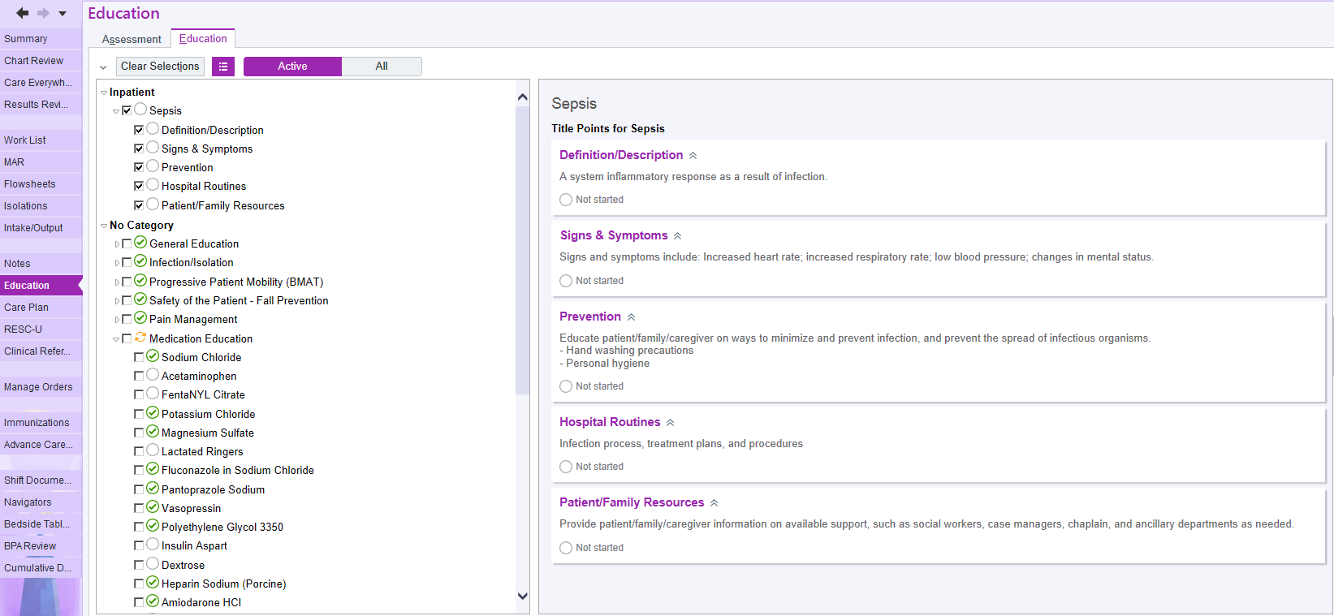
Sepsis Education Elements:
Next, go to the “Education” section of Careconnect, where Educational Title Points for Sepsis will now be available for you to document.

Slide 14
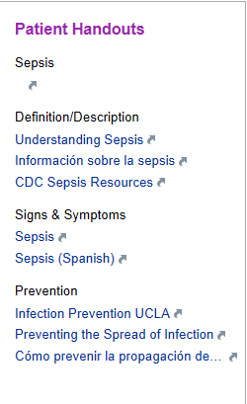
Sepsis Education Elements:
The patient Sepsis Education area will also provide you with links to videos on sepsis and patient handouts.
These videos and handouts are also linked to the patient’s bedside tablet.

Slide 15
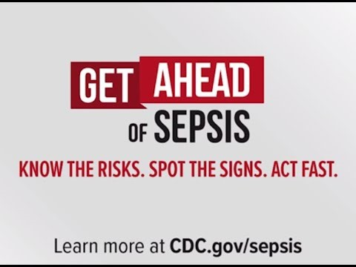
CDC “Get Ahead of Sepsis” Patient Video:
Please become familiar with the latest sepsis video available to patients on their bedside tablets.
cdc.gov/sepsis

