Slide 1
The Severe Sepsis/Septic Shock Bundle: Why is it important?
Mary Lawanson-Nichols, MSN, CNS
SM Adult ICU
Yuhan Kao, MSN, CNS
RR MICU

Slide 2
Objectives
Explain the fundamental pathophysiology of severe sepsis and septic shock and how they related to the treatment strategies
Discuss and identify time of presentation for severe sepsis and septic shock
Discuss the Sepsis Core Measures Requirements

Slide 3
What is Sepsis?
Sepsis is a complex illness involving both infection and inflammation.
Normally, the body’s response to an infection is targeted to the site of the infection. With sepsis, the body’s response, instead of being localized to the site of infection, causes symptoms to occur throughout the body
Sepsis Continuum:
SIRS- Systemic Inflammatory Response Syndrome
Sepsis – Infection PLUS systemic inflammation (SIRS) in response to infection.
Severe Sepsis – Sepsis complicated by organ dysfunction, hypo-perfusion or hypotension (e.g. altered mental status, oliguria, lactic acidosis)
Septic Shock –Severe sepsis complicated by persistent arterial hypotension unexplained by other causes, despite adequate fluid resuscitation.

Slide 4
SIRS – Systemic Inflammatory Response Syndrome
Can be triggered by localized or generalized infection, trauma, burns, or acute pancreatitis (sterile inflammatory process).
Temp >38.3C (101F) or <36C (96.9F)
Pulse > 90 beats/min.
Respirations > 20 resp/min.
WBC >12,000 or < 4,000 or >10% immature bands

Slide 5
Why is it Important to establish if the patient has SIRS vs. Sepsis?
An event can start the SIRS response
These inflammatory response symptoms (SIRS) may occur IN THE ABSENCE of infection
As nurses we need to look at the vital signs and file only true readings and assess for the trends
If an intervention is provided, it might artificially increase or decrease patient’s organ function(s) and influence blood result(s)… remember a positive SIRS does not make them positive for severe sepsis/septic shock .
What happens when SIRS goes down the decompensating pathway to severe sepsis to Septic shock?
With sepsis, the body’s response, instead of being localized to the site of infection, causes symptoms to occur throughout the body
Let's continue…..

Slide 6
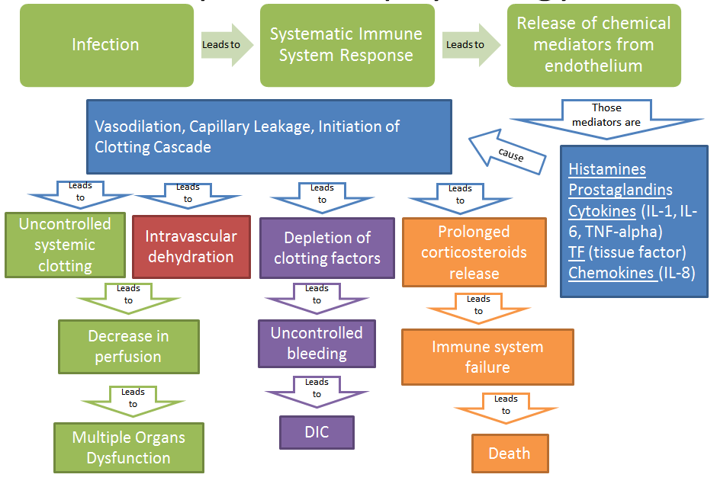
Sepsis Pathophysiology

Slide 7
How do you know if you patient has a suspected or confirmed infection?
Physician progress notes or consult notes: R/O Sepsis/Severe Sepsis/Septic Shock, R/O UTI, R/O PNA etc.
S/P Surgical procedure- Does Interventional Procedures count? How about bedside PICC line insertion?
Stage 3 , Stage 4, and unstageable pressure ulcers
Elevated WBC’s
Immune Suppression
Hx of Hemo-onc or solid organ transplant/bone marrow (BM) transplant
Where do you find these items????
Finding the possible source can help save a patient’s life

Slide 8
Organ dysfunction MYSTERY aka Severe Sepsis
Neurological- ALOC or decreased GCS-First sign in the elderly that they have severe sepsis
Cardiovascular- Systolic BP<90 or MAP<65 OR decrease by 40mmHg from baseline= Highly suspected severe sepsis
What if a patient came in for an AV graph revision. Positive SIRS, SBP from 150 to 110 over 6 hours, would that cause you to worry? SBP is >90.
Respiratory- New Need for mechanic ventilation, BiPAP, or sudden increase in O2 requirement
Patient started on room air with O2sat-95% at 0700. At 1200 patient is placed on 2 liters n/c, O2 sat down to 93% after PT. At 1600- patient on 4 liters n/c to keep sats at 95%, dropped down to 92% for 30 minutes while up in the chair.
Is this patient heading toward severe sepsis?

Slide 9
Organ dysfunction MYSTERY aka Severe Sepsis
Renal – We need to get away from the OLD 30mls/hr…better reference by weight 0.5ml/kg/hr. Pt would have less than the stated output for at least 2 hours OR Creatinine >2.0.
What if the patient has known renal insufficiency on admission. Creatinine was at 4 now at 6. Is this an organ dysfunction? Why or why not?
Hematological- Platelets<100,000 OR INR >1.5 (not on Warfarin) OR aPTT>60
Hepatic- Bilirubin>2.0
What if the patient has a known history of Hepatic failure with chronic thrombocytopenia, Is this an organ dysfunction? Why or Why not?

Slide 10
Organ dysfunction MYSTERY aka Severe Sepsis
Lactate >18mg/dl= Severe Sepsis
Lactate ≥36mg/dl= Severe Sepsis/ Septic Shock that requires fluid resuscitation
Why all the fuss with trending lactates????
Serum Lactate Level (aka Lactic Acid)
Lactate is a measure of tissue perfusion that indicates how cells are being oxygenated regardless of the blood pressure.
*NOTE: Severe lactic acidosis can develop in minutes so frequent monitoring of serum lactate levels for shock are often necessary.
Collect specimen without tourniquet on IV site ( What does this mean?)
Avoid having pt. clench fist while drawing (Why?)
If results > 18 redraw within 3 hrs. (You can place on your work list or call lab )

Slide 11
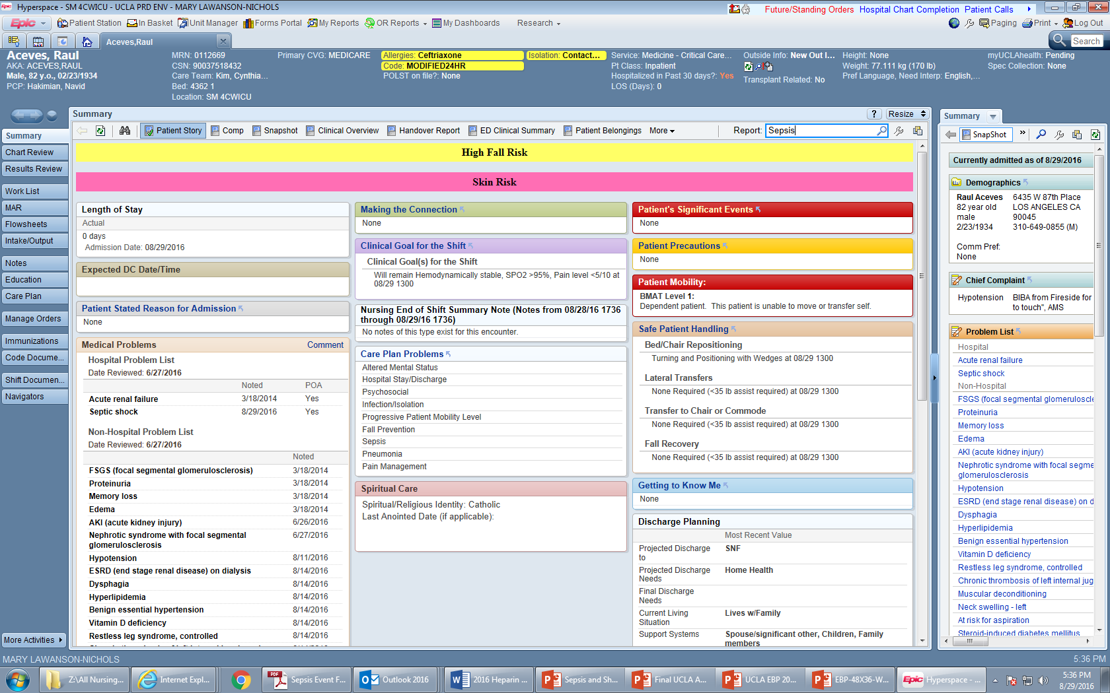

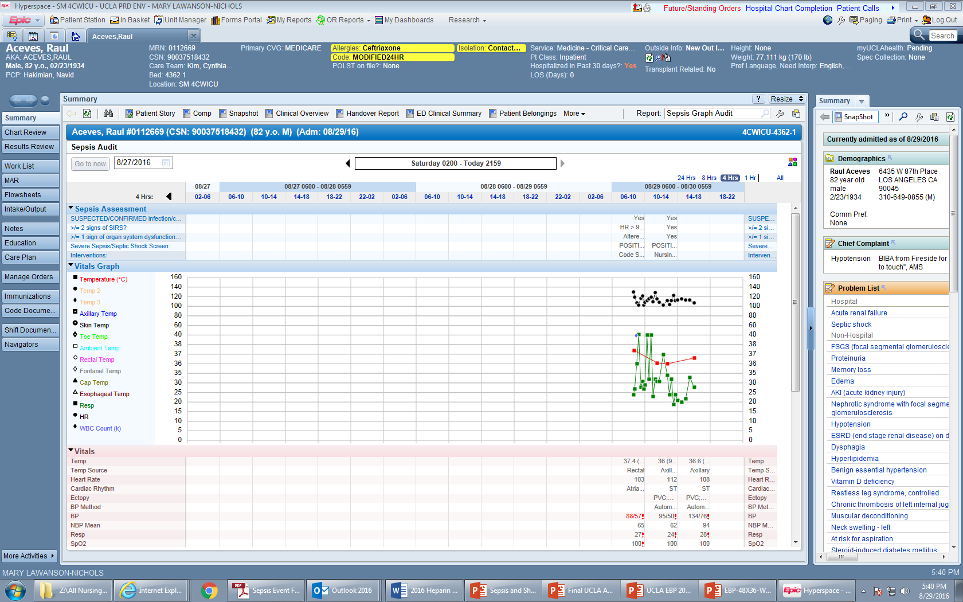
Easier Way to Screen and Trend your Patients!
Go to Patient Summary page – Type in “Sepsis

Slide 12

Easier Way to Screen and Trend your Patients!
Sepsis Audit Report Graph will appear

Slide 13
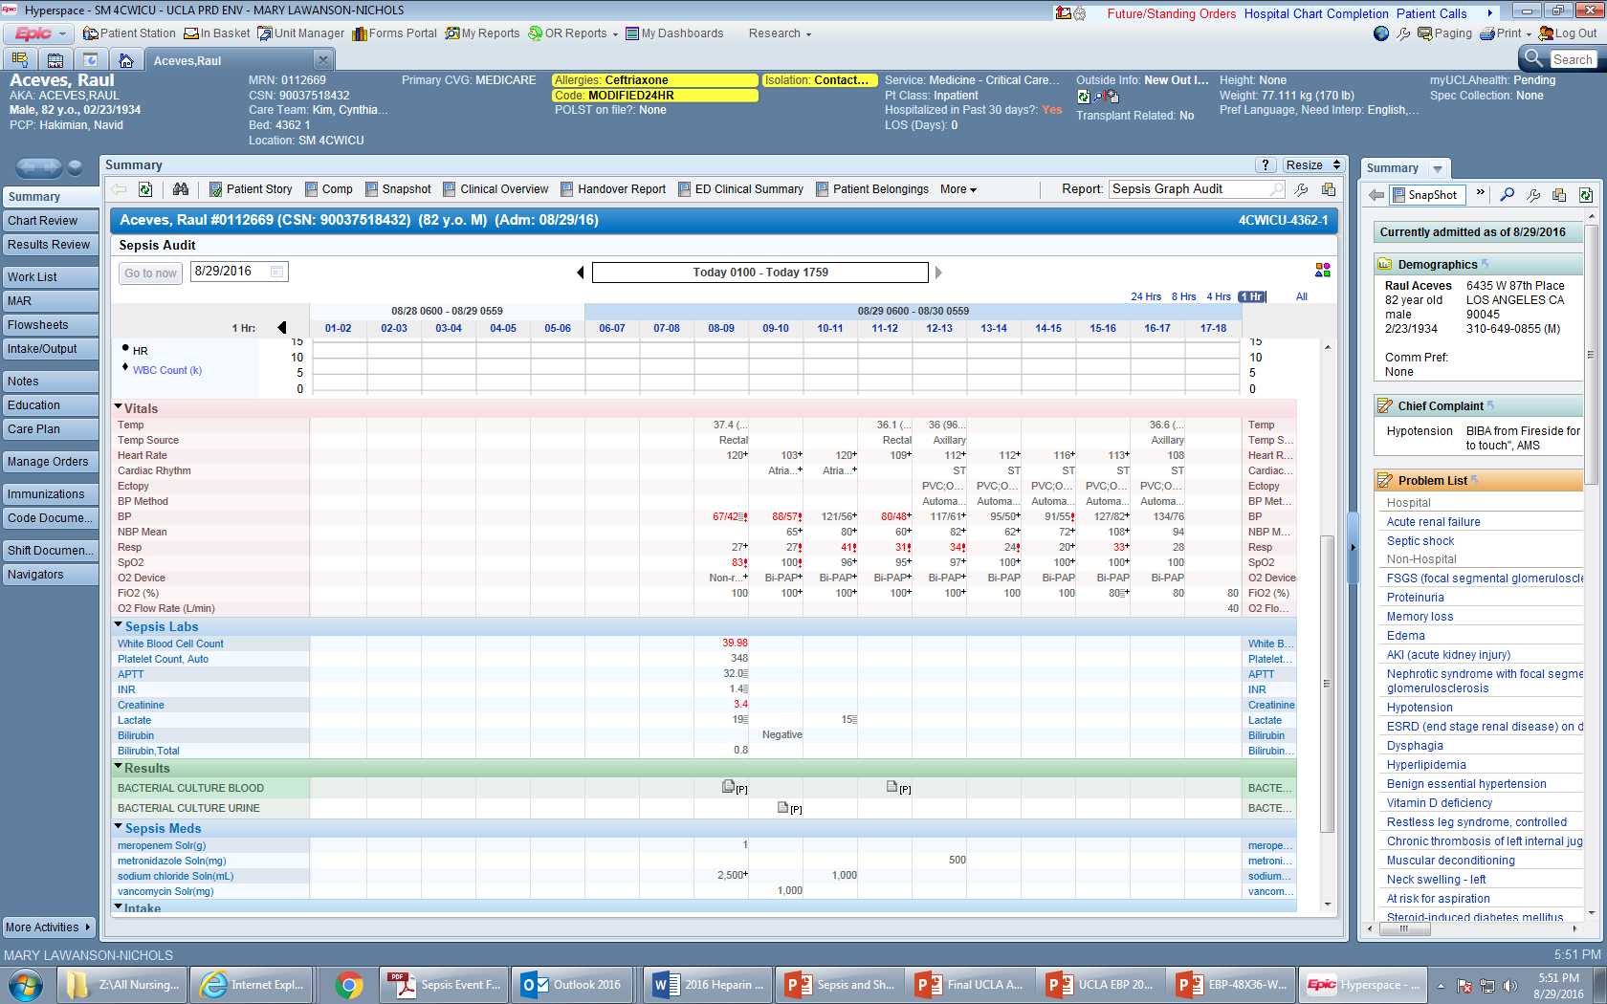
Easier Way to Screen and Trend your Patients!

Slide 14
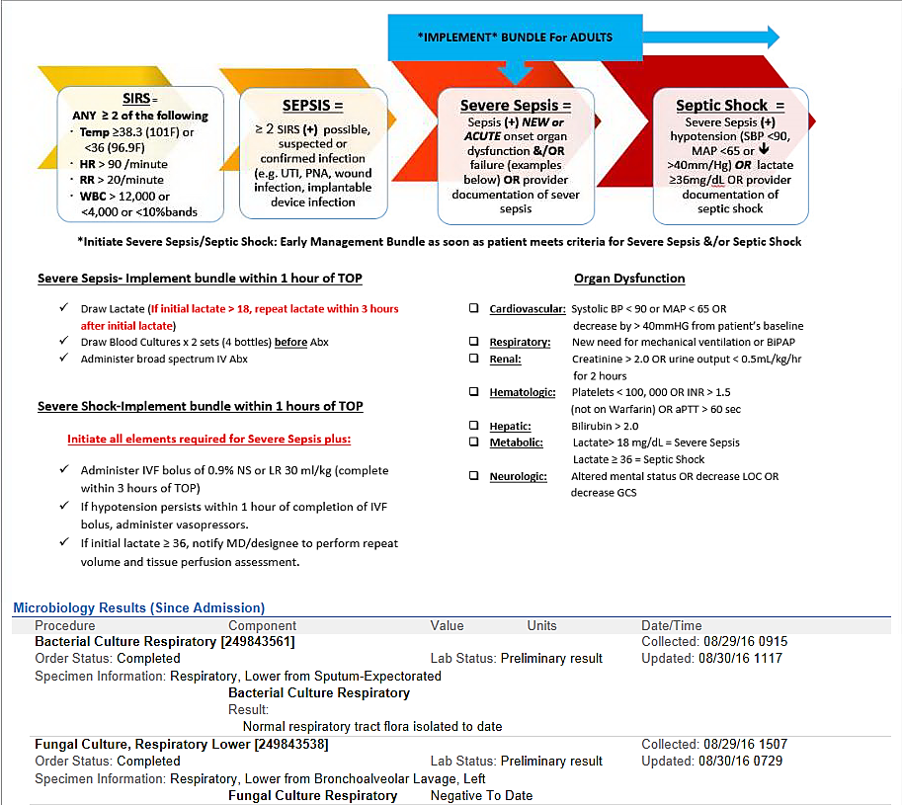
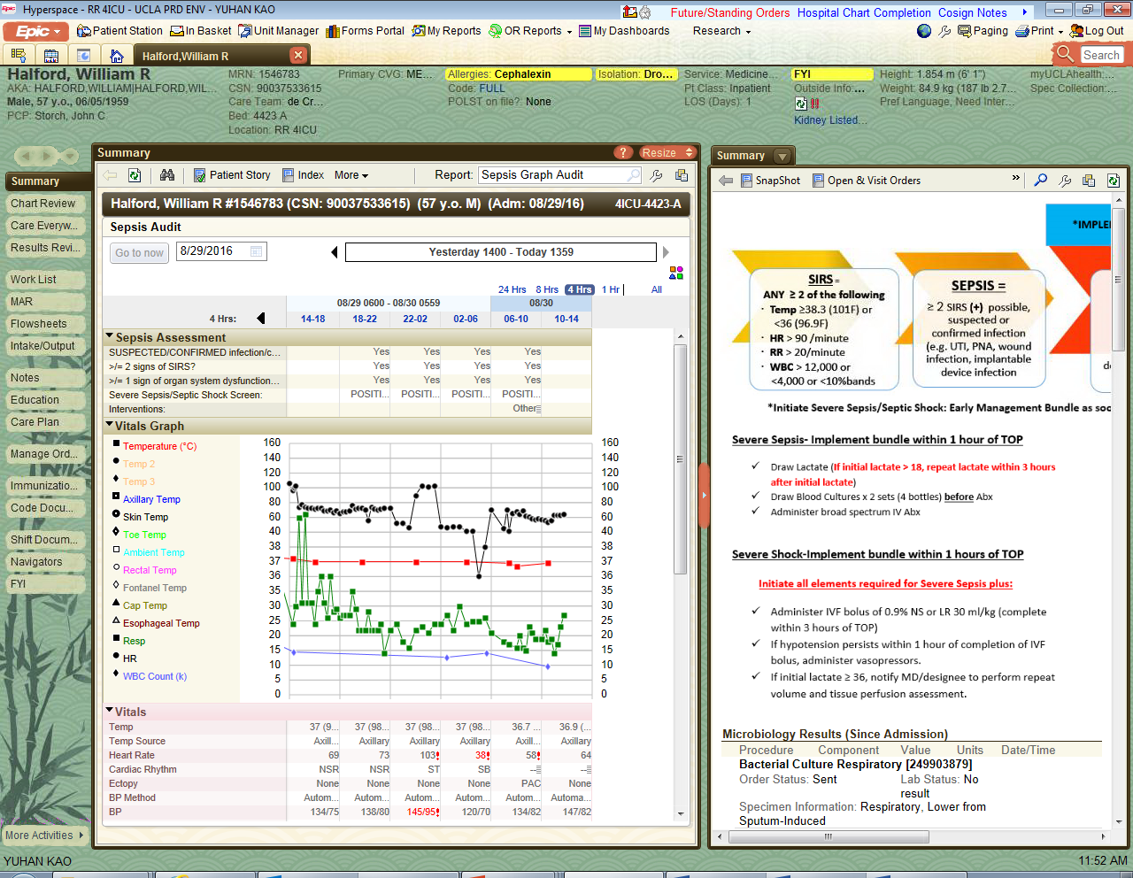
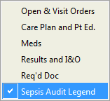
Easier Way to Screen and Trend your Patients!
Utilize the side bar and wrench in “Sepsis Audit legend”

Slide 15
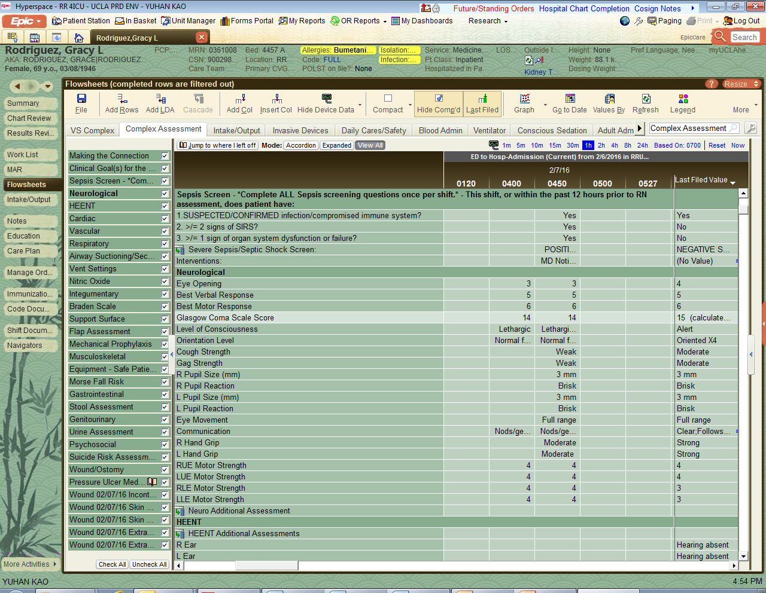
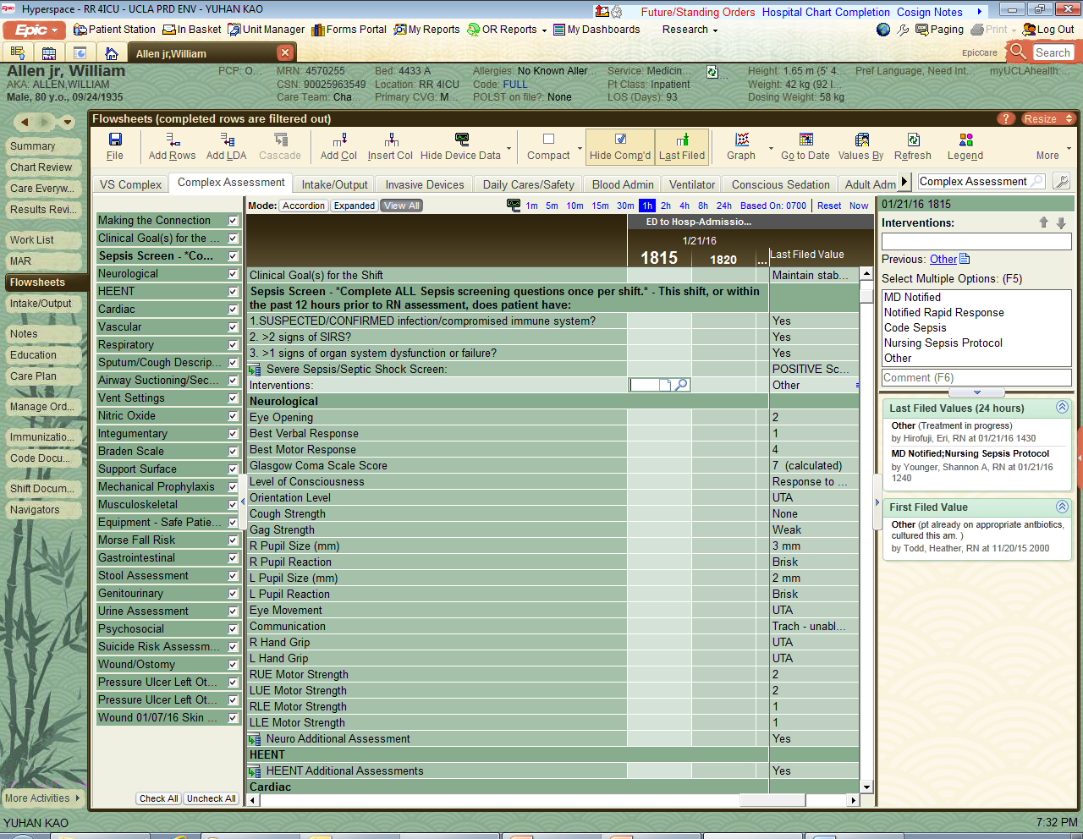
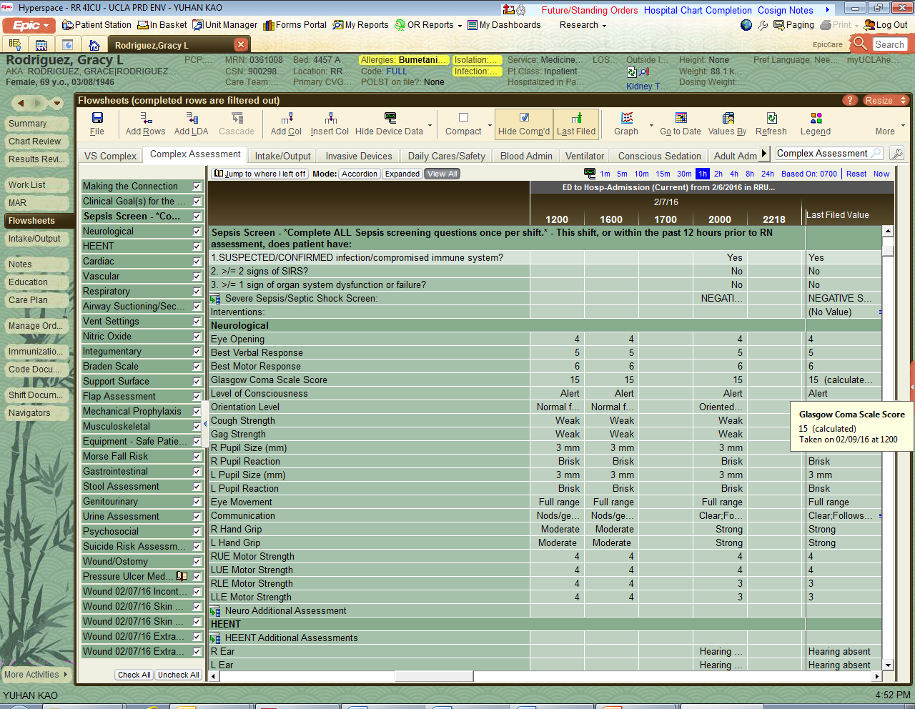
Routine Screening- Complex Assessment Q shift and as needed based on changes in patient’s status
Interventions
If all questions Yes = Positive Screen
Initiate Sepsis Nursing Protocol FIRST!! THEN notify MD/Designees right away! You have 60 mins to complete the protocol.
If any question No = Negative screen. Continue to monitor patient

Slide 16
So now you identified your patient with Severe sepsis/Septic shock, now WHAT??
Do you call the Physician first or do you implement the Nurse Driven protocol? What would be some reasons to call the Physician before instituting the protocol?
Give some examples on how you would alert the Physician for severe sepsis or septic shock. Would you ask for the same treatments for both?
Communication Tools:
SBAR:
S- Situation
B- Background
A- Assessment
R- Recommendation
CUS
I am CONCERNED
I am UNCOMFORTABLE
This is a SAFETY concern

Slide 17
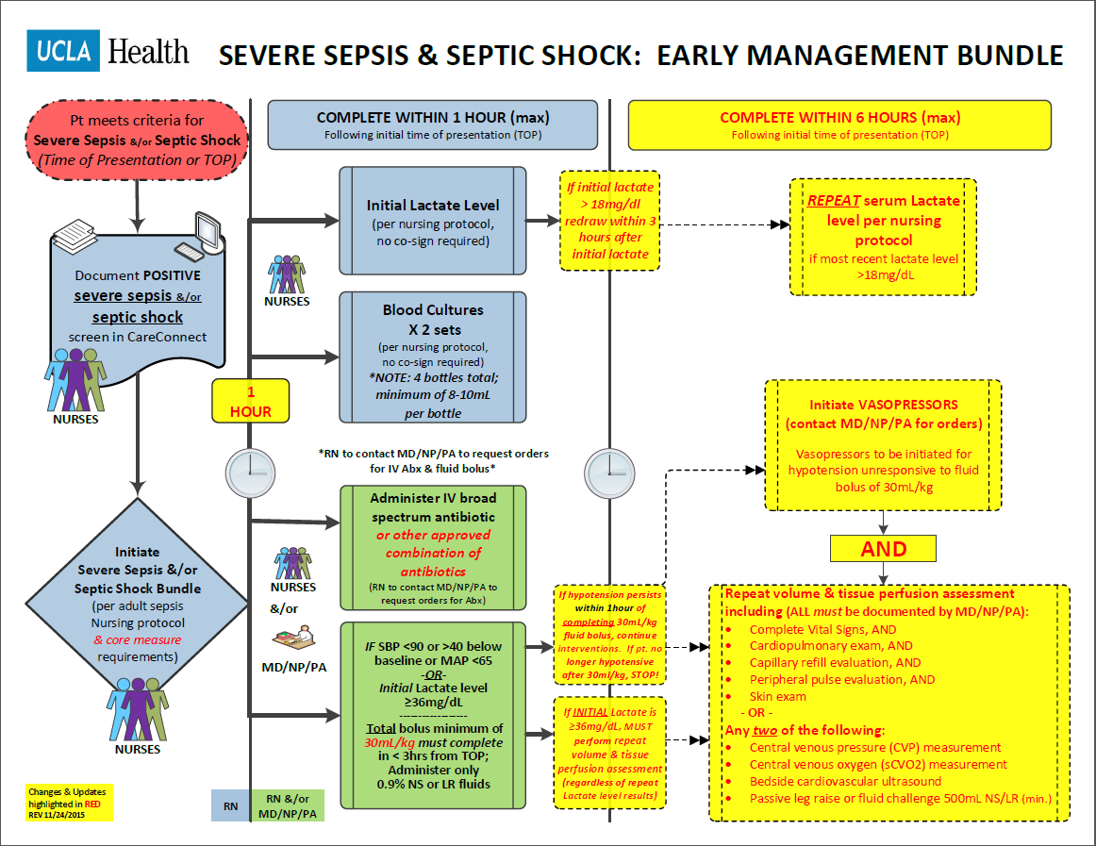

Slide 18
Treating Severe Sepsis & Septic Shock
The Sepsis Bundle
Per the New Core Measure Requirement!
Implement the Sepsis Nursing Protocol
Blood Culture X 2 sets = 4 bottles
Stat Serum Lactate and repeat Lactate if >18mg/dL
IV Broad spectrum antibiotics
IV fluid bolus of 30mL/kg (minimum) if patient has-
SBP<90 or >40 below baseline or MAP <65
OR
Initial Lactate ≥36mg/dL
Fluid bolus must be completed within 3 hours from time of presentation

Slide 19

Severe Sepsis/Septic Shock Bundle
Activate Within ONE hour of presentation
Blood cultures x 2 sets
Drawn before antibiotic and within 1 hr after TOP (time of presentation)
4 bottles total with minimum 8-10 mL/bottle
IV Broad Spectrum Antibiotic
Start within 1 hr after TOP unless given within past 24 hours
Lactate
Drawn within 1 hr after TOP
Require 2-5mL blood in GREY top tube: Immediately put sample on ICE & transport to lab for analysis.
If initial Lactate >18, then repeat within 3 hrs after 1st lactate draw
IV fluid bolus (0.9% NS or LR)
Min 30 mL/kg only if Septic Shock present
Start within 1 hr after TOP and complete within 3 hrs
Physician needs to document when the treatment is contraindicated or patient refused.

Slide 20
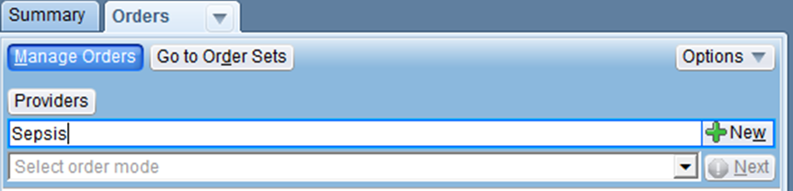
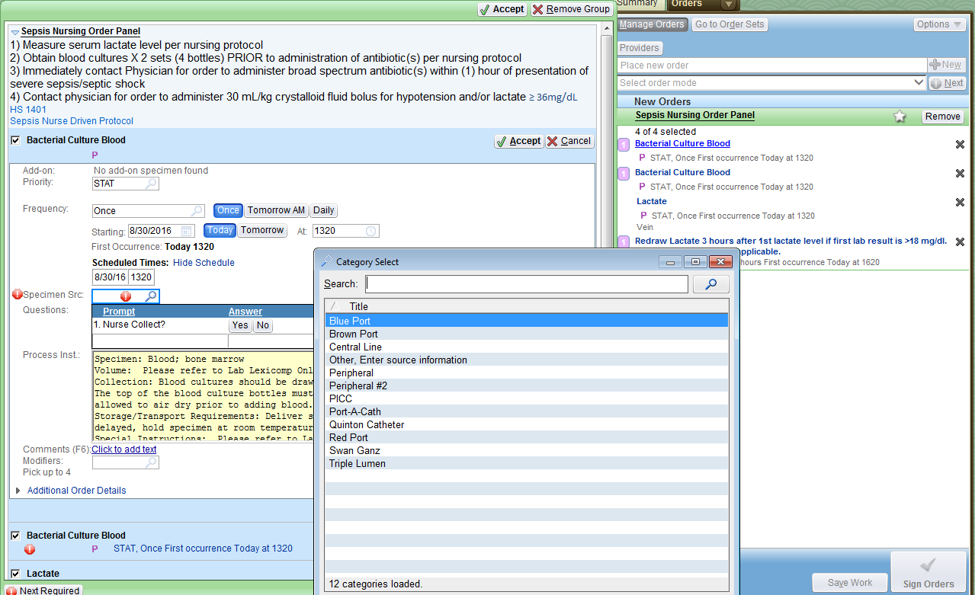
Updates in Sepsis Nursing Order Panel
Go to Order Management
and type in “SEPSIS”
Order Mode will be “Per Protocol: no cosign required”

Slide 21
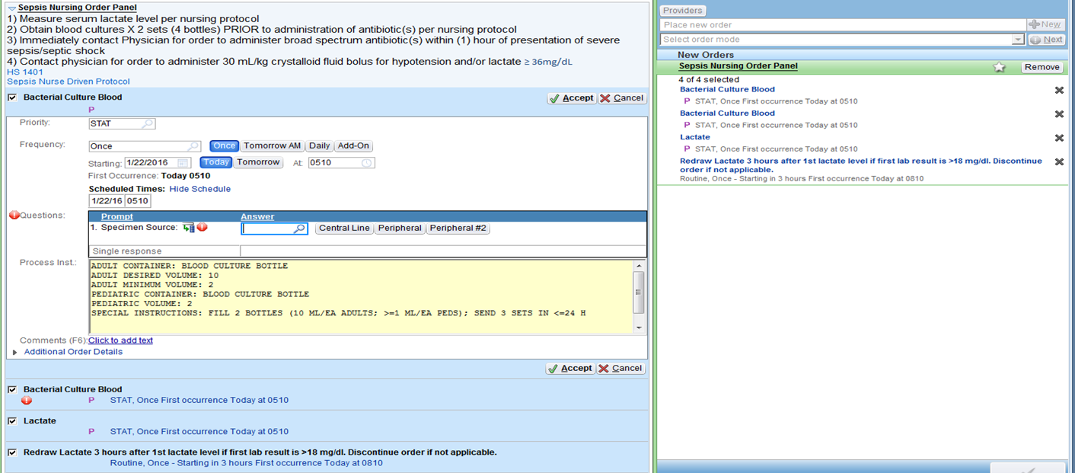
Updates to Sepsis Bundle- Lactate
Lactate - If Initial lactate is >18mg/dl, Redraw lactate within 3 hours after initial lactate.
Tip: Information regarding Lactate will show up on your work list IF you use the Sepsis Lab Order Panel!
Worklist information

Slide 22
Severe Sepsis/Septic Shock Bundle
Redraw Lactate if initial level >18mg/dL
Initiate Vasopressors if hypotension persist despite fluid resuscitation of 30ml/kg
AND
MD/Designee will Repeat volume and tissue perfusion assessment

Slide 23
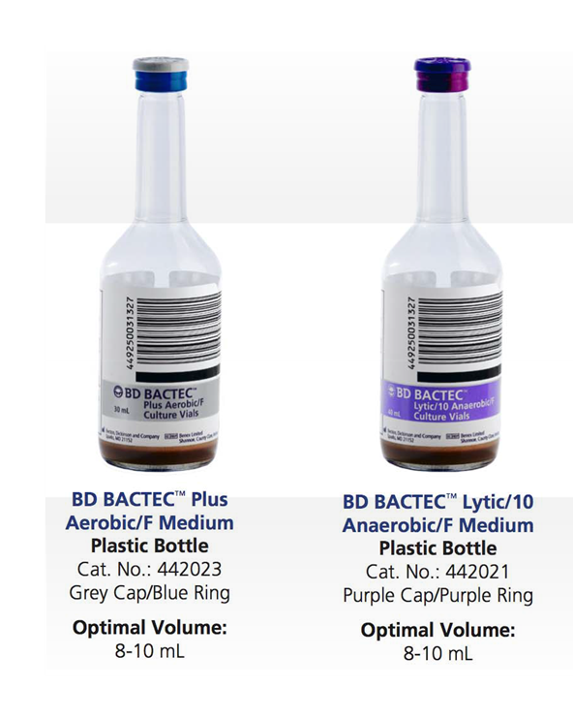
Sepsis Facts
Blood Cultures (X 2 Sets)
Blood Cultures are used to detect microorganisms such as bacteria and fungi present in blood.
COLLECTION: Aerobic bottle FIRST then anaerobic bottle
- Adults require 8-10 mL per bottle X 4 bottles
- Pediatrics require 5 mL per bottle X 4 bottles *
One or more should be percutaneous
One BC from each vascular access in place >48 hrs
Culture other sites as clinically indicated
- Blood cultures should always be drawn prior to start of antimicrobial therapy
*NOTE: Because microorganisms may only be intermittently present in blood, a series of blood cultures is usually done before the result can be considered negative.

Slide 24
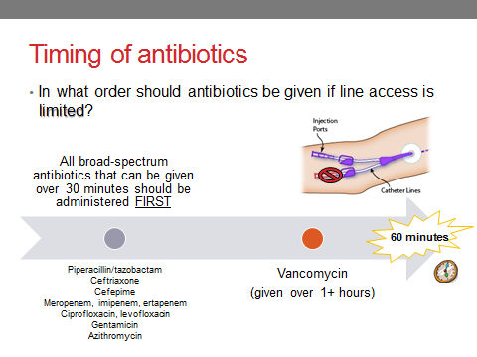
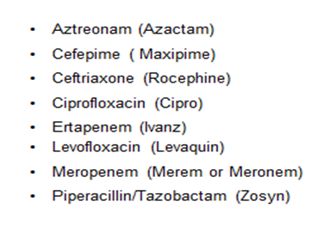
Sepsis Facts
Within 1 hour of Time of Presentation
Examples of commonly used broad spectrum antibiotics
Not the first one to give
*NOTE: PO Antibiotics do not count towards the treatment of severe sepsis or septic shock; IV Abx ONLY!

Slide 25
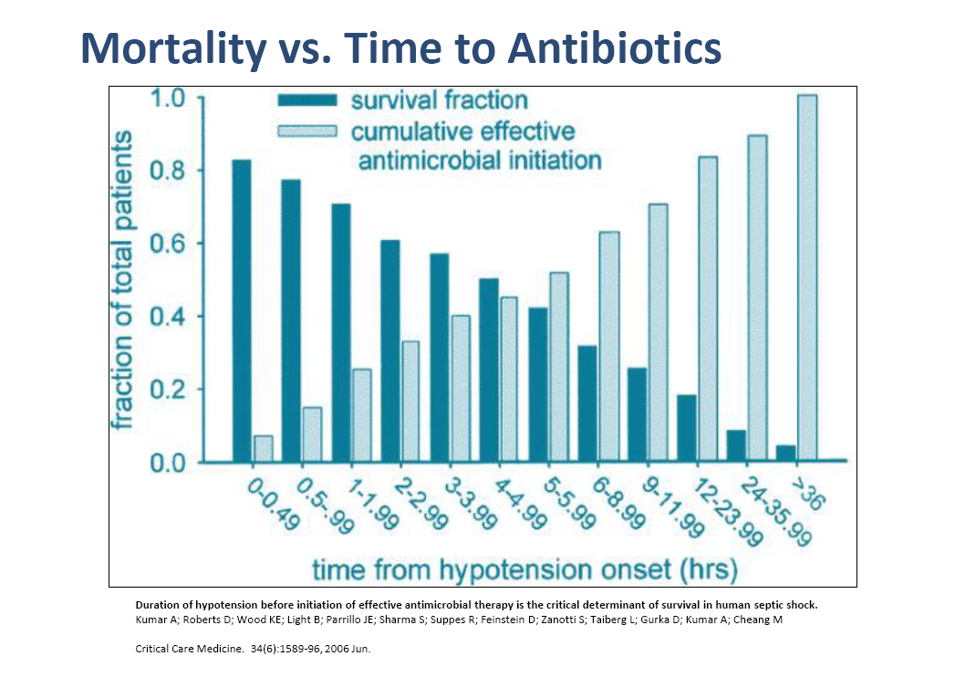
Antibiotic Timing *Timing of the first antibiotic dose matters!
Patients given Antibiotics within 3 hours of TOP are ~80-85% more likely to survive (1)
In both the Pediatric & Adult patient population, after the first (3) hours of severe sepsis or septic shock, every additional hour Antibiotics are delayed significantly increases the patient’s risk of mortality by 8-12% per hour! (1)
1 - Andrew T. Levinson, M.D., M.P.H., Brian P. Casserly, M.D., Mitchell M. Levy, M.D.
DisclosuresSemin Respir Crit Care Med. 2011;32(2):195-205.
Notes:
Initiation of appropriate antibiotics within 1 hour of new-onset or persistent hypotension is associated with a 80% survival rate at hospital discharge
Each hour delay in initiation of appropriate antibiotics after the 1st hour from the time of presentation results in an average of ~8% reduction in survival per subsequent hour delay

Slide 26
Sepsis Facts
IV Fluid Bolus (&/or Vasopressors)
A minimum 30mL/kg IV fluid bolus is required to be started within 1 hour of TOP of Severe Sepsis &/or Septic Shock and must be completed within 6 hours of TOP.
Capillaries: - at any given time can hold about 5L of blood - a normal adult can have about 60,000 miles of capillaries
Total surface 800-1000 square meters ( greater than 3 tennis courts)
If IV fluid bolus of 30mL/kg is contraindicated (with excellent supporting documentation as such), Vasopressors are then required to be administered to treat declining systolic blood pressure or perfusion abnormalities (SBP ≤ 90 or a ⬇ in SBP ≥ 40mm/Hg from baseline BP)
1 - Andrew T. Levinson, M.D., M.P.H., Brian P. Casserly, M.D., Mitchell M. Levy, M.D.
DisclosuresSemin Respir Crit Care Med. 2011;32(2):195-205.

Slide 27
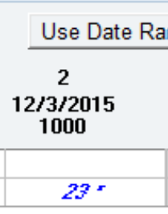
Check your understanding
An initial lactate was drawn on a Severe Sepsis patient at 10 am.
Your result is noted below. What will be your next intervention?
Redraw another lactate at 1pm
Redraw a lactate in 6 hours
Await further instructions by the Physician
Redraw lactate in the morning
Lactate Result

Slide 28
Check your understanding
Name: Gary Monday
Age: 80
Sex: Male
Weight: 68Kg
Primary Dx: Admitted three days ago with c/o cough x 3 wks, weakness, weight loss anorexia
PMH: AKI, jaundice, pancreatic mass, asthma, psoriasis, delirum, and anemia
Today VS @ 0600:
BP=126/60
R=18
T=97.4F oral
HR=95
SPO2=97% on RA
@0606: WBC=20.65; Cr=4.5. D5NS @ 75cc/hr infusing
As the day goes on:
@ 1300: BP=96/46
1317: BP=70/36, HR=104, T=100.3 (vomited during lunch)
1330: CXR=trace L effusion (possible aspiration per MD notes)
1340: NS 500 cc bolus
1421: BP post bolus = 85/49, HR=104, T=98.8F
* D5NS continuous @ 50cc/hr
1505: Levaquin 750 mg
1653: NS 500 cc bolus
1720: Lactate drawn = 22
1729: BP=99/52 (remains @ SBP 90s until 2100)
1743: NS 1 liter bolus (Total bolus 2 liters=ok)
1817: Blood cultures x2 drawn (+)
1829: BP=95/51 post bolus
1832: Meropenem IV given
2019: Repeat lactate = 17
2250: BP=113/56
Based on the information above:
When is the TOP?
When should the Blood cultures and lactate be drawn?
When should the fluid resuscitation starts, when should it ends, and how much?

Slide 29
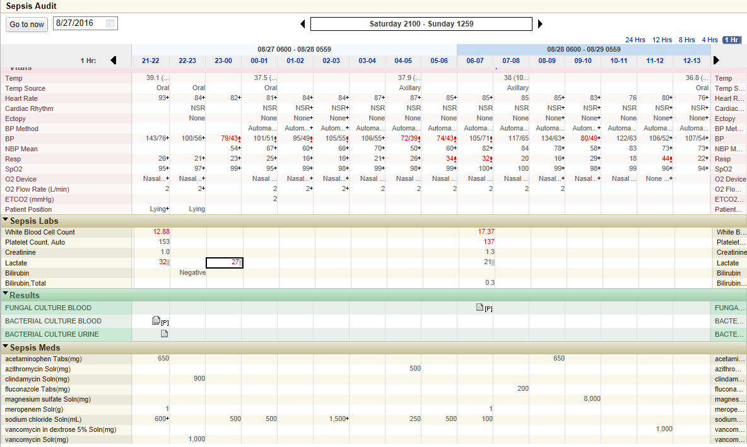
Check your understanding
Based on the information:
When is the TOP?
When should the Blood cultures and lactate be drawn?
When should the fluid resuscitation starts, when should it ends, and how much?

Slide 30


Questions or Comments
Feedback & Suggestions WELCOMED!
Quality Management Services
RR - 310-794-0224
SM – 424-259-8532

Slide 31
References
1. Levy MM, Fink MP, Marshall JC, et al. 2001 Society of Critical Care Medicine/European Society of Intensive Care Medicine/ American College of Chest Physicians/American Thoracic Society/ Surgical Infection Society: international sepsis definitions conference. Intensive Care Med 2003;29:530–8.
2. Angus DC, Linde-Zwirbe WT, Lidicker J, Clermont G, Carcillo J, Pinsky MR. Epidemiology of severe sepsis in the United States: analysis of incidence, outcome, and associated costs of care. Crit Care Med 2001;29:1303–9.
3. Rivers E, Nguyen B, Havstad S, et al. Early goal-directed therapy in the treatment of severe sepsis and septic shock. N Eng J Med 2001;345(19),1368-77.
4. Nguyen HB, Rivers EP, Abrahamian, FM et al. Severe sepsis and septic shock: review of the literature and emergency department guidelines. Ann Emerg Med 2006;48:28-54.
5. Jones AE, Focht A, Horton JM, et al. Prospective external validation of the clinical effectiveness of an emergency department-based early goal-directed therapy protocol for severe sepsis and septic shock. Chest 2007;132:425-32.
6. Dellinger RP, et al. Surviving Sepsis Campaign: International Guidelines for Management of Severe Sepsis and Septic Shock: 2012. Critical Care Medicine 2013;41(2), 580-637.
7. Ramakrishnan K, et al. Diagnosis and treatment of otitis media. American Family Physician. 2007;76:1650.
8. Frey R (2009). Incision care. In B Narins, ed., Gale Encyclopedia of Surgery and Medical Tests: A Guide for Patients and Caregivers, 2nd ed., vol. 4, pp. 835–838. Farmington Hills, MI: Gale.
9. Gupta K, Stamm WE (2008). Urinary tract infections. In DC Dale, DD Federman, eds., ACP Medicine, section 7, chap. 23. Hamilton, ON: BC Decker.
10. Niederman MS (2004). Pneumonia, including community-acquired and nosocomial pneumonia. In JD Crapo et al., eds., Baum's Textbook of Pulmonary Diseases, 7th ed., vol. 1, pp. 424–454. Philadelphia: Lippincott Williams and Wilkins.
11. Bluestein D, et al. Pressure ulcers: Prevention, evaluation, and management. American Family Physician. 2008;78:1186.

