Slide 1
Travel and Entertainment Reimbursement Requests
Department of Family Medicine
Laura Sheehan
Manager of Research Administration
Lsheehan@mednet.ucla.edu; 310-794-8298
Valencia Moody
Purchasing Coordinator
Vmoody@mednet.ucla.edu; 310-794-8952

Slide 2
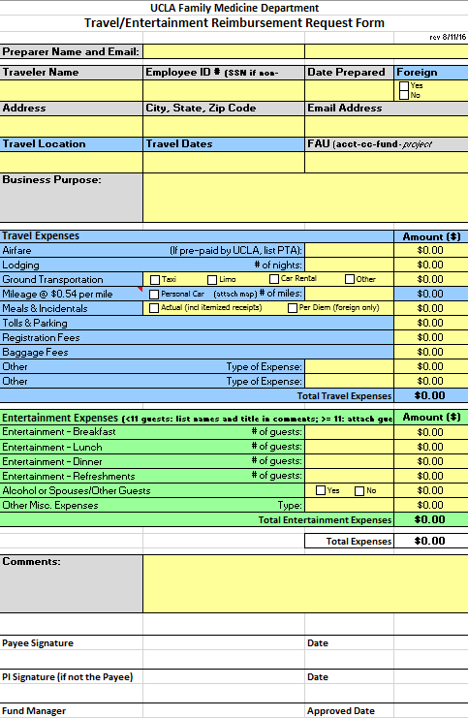
Travel/Entertainment Reimbursement Request Form

Slide 3
Before We Get Started…
Purchase Orders and reimbursements for non-travel/entertainment should use a different form
Travel (blue box): Must be business-related and must take place off-campus
Entertainment (green box): Typically for food/refreshments for meeting or conference for which there are at least 2 attendees
You may need to request both on same form (e.g. if you hosted a business lunch while on business travel)

Slide 4
Things to consider
Organize your reimbursement cleanly and clearly
SAVE ALL RECEIPTS!
Tape receipts to a regular-sized sheet of paper so that they lay flat and can be easily scanned
Don’t use staples
Organize receipts by either type or by day
Write on the paper next to the receipts to clarify items/purpose
If receipt is missing, include a note in the receipt section (e.g. “Lost Receipt: Taxi from hotel to airport on 3/16/16. $20 fare, $3 tip, Total: $23”)
Check for Accuracy
Be sure the amount you are requesting matches the receipts provided (or receipts plus notes).

Slide 5
Things to consider (cont)
Submit in a timely manner
You should prepare your reimbursement immediately upon return
Submit within 30 days of travel
Don’t let the reimbursement requests sit in your Travel Express queue
If request is not successfully approved by Travel Accounting within 45 days, you will need to provide memo and justification for why it is late
Late reimbursements may appear as income on W2

Slide 7
1st box: Preparer information (person completing the form)
2nd box: Payee information (person receiving the reimbursement)
Non-employee travelers: Social Security # mandatory
Foreign Travel: answer required
FAU information: IMPORTANT!
Account #, cost center, fund # (project code optional)
Discuss with PI and fund manager to be sure this is correct
Must be an allowable cost (on the budget)
Must be enough funds remaining to cover the cost
Must be within the allowable time period (after start date, before end date)

Slide 8
Business Purpose/Justification
Incredibly important
Be specific
No abbreviations
Example:
“To attend HPTN conference in DC”
“For the Principal Investigator to present research data at the 2016 Annual HIV Prevention Trials Network conference in Washington, DC” GOOD!
---------------------------------------- WRONG!

Slide 10
Travel (blue box)
Airfare should be pre-paid by PTA
Obtained flight itinerary from Connexxus or Travel
Then email PTA request to Chris/Valencia (provide traveler name, dates, destination, purpose of trip, cost, FAU; plus SSN, email/phone for non-employees)
Refer to Fam Med Research Unit Purchasing Guide for more detailed instructions on how to obtain a PTA
If no PTA, be sure to include original, itemized receipt for airfare
Must include form of payment
Don’t use Expedia, Travelocity, Orbitz, etc. because they do not provide itemized receipts
Must be economy/coach (otherwise, need physician letter and letter from CAO)

Slide 11
Lodging must include itemized receipt
Receipt must show room rate and taxes etc.
Separate other charges and list in the appropriate section (e.g. food, phone, wifi, etc.)
Ground Transportation
Must include reason (e.g. “from home to airport”)
If over $75: receipt and explanation required
Car rental receipts must be original and itemized
Registration receipt required (otherwise need copy of bank/credit card statement and a copy of the meeting agenda).
It’s preferable to pay registration with PO (plan ahead to be sure you have time to request invoice, submit PO request, and have check mailed to vendor)
When in doubt: always include original receipts for everything!

Slide 13
Entertainment (green box)
If 10 or less guests, you must list all attendees in the comments section:
Full names
Titles
Affiliations/institutions
If 11 or more attendees, you can attach a guest list (create the sign-in sheet before the event so that attendees can sign)
Maximums:
As of Nov 2019: Breakfast $27/person, Lunch $47/person, Dinner $81/person, Refreshments $19/person (See https://travel.ucla.edu/policy-resources/reimbursement-allowances-mileage-meals for updated pricing)
Maximum includes labor, tax, delivery, set-up, service fees, tips, etc.
Justification must include type of event, # participants

Slide 15
Total expenses will calculate automatically
Use comment section to explain anything that is unusual
Help us understand the expenses and information provided
The more detail the better
Must be signed by the payee/person who will receive the reimbursement (not the preparer)
Need PI signature if the Payee is not the PI
Submit to Fund Manager

Slide 16
Travel and Entertainment Reimbursement Workflow
If corrections are needed
Preparer – person completing the reimbursement form on behalf of traveler
Department Approver – Fund Manger
Purchasing Coordinator – Valencia Moody
Travel Accounting Queue
Owner Review/Approval – The Traveler
Travel Accounting
Accounts Payable
Preparer
Department Approver
(Fund Manager)
Purchasing Coordinator
Department Approver
(Fund Manager)
Travel Accounting (audit review)
Travel Accounting Queue
Owner Review
Accounts Payable
(Payment issued)

Slide 17
The Fine Print
Reimbursements for travel and entertainment expenses must comply with receipt and documentation requirements specified in the UC Business and Finance Bulletin, G-28, Policy and Regulations Governing Travel or UC Business and Finance Bulletin BUS-79, Expenditures for Entertainment, Business Meetings and Other Occasions. Visit https://travel.ucla.edu/policies to review all UC travel policies.
And sponsor guidelines!

Slide 18
As a Reminder…
The more information, the better
Organize!
Include original receipts for EVERYTHING to be on the safe side
Ask questions before travelling, and before submission
Double-check your work
Convert currency yourself to manage expectations
Submit on time
Review/approve on time
We’re here to help you

