Slide 1


ECFMG Certification
Step by Step Guide

Slide 2
About ECFMG Certification
The Educational Commission for Foreign Medical Graduates (ECFMG), through its program of certification, assesses whether International Medical Graduates (IMGs) are ready to enter residency or fellowship programs in the United States that are accredited by the Accreditation Council for Graduate Medical Education (ACGME)
ACGME requires IMGs who enter ACGME-accredited programs to be certified by ECFMG
ECFMG Certification assures directors of ACGME-accredited residency and fellowship programs, and the people of the United States, that IMGs have met minimum standards of eligibility to enter such programs
ECFMG Certification does not, however, guarantee that these graduates will be accepted into programs; the number of applicants each year exceeds the number of available positions
ECFMG Certification is also one of the eligibility requirements for IMGs to take Step 3 of the three-step United States Medical Licensing Examination (USMLE)
Medical licensing authorities in the United States require that IMGs be certified by ECFMG, among other requirements, to obtain an unrestricted license to practice medicine

Slide 3
Requirements for ECFMG Certification
To be eligible for Certification by ECFMG, IMGs must meet the following requirements:
1) Application for ECFMG Certification
Online Application
Certification of Identification Form (Form 186)
2) Medical Education Credential Requirements
Final Medical Diploma
Two copies of the Medical School Release Request (Form 345)
3) Examination Requirements
Satisfy the Medical Science Examination Requirement (USMLE Step 1 and USMLE Step 2 CK)
Satisfy the Clinical Skills Requirement (USMLE Step 2 CS)

Slide 4
1) Application for ECFMG Certification

Slide 5
ECFMG Certification
Application – Online Part
You must begin with the on-line part, which includes most of the application items
When you begin an on-line application, your application will be assigned an Application Identification Code
The Application Identification Code is different from, and should not be confused with, your USMLE/ECFMG Identification Number
As you move from screen to screen, the information you provide will be saved
If you are unable to answer all application items in one session or you are disconnected from the application, you can return to it later by clicking the link to your saved application on the main Interactive Web Application (IWA) screen

Slide 6
ECFMG Certification
Application – Online Part
Although you do not have to answer all items in one session, you must complete all on-line application items within 14 days of the date you last saved the application - Otherwise, the application will no longer be valid, and you must start another application
After completing the application items for one exam, you will have the opportunity to apply for other exams for which you may be eligible on the same application
When you have completed the on-line part of the application, you will have the opportunity to review all information for accuracy and make any necessary corrections or changes before submitting it
As the last step in the on-line part of the application, you will print your Certification of Identification Form (Form 186)

Slide 7
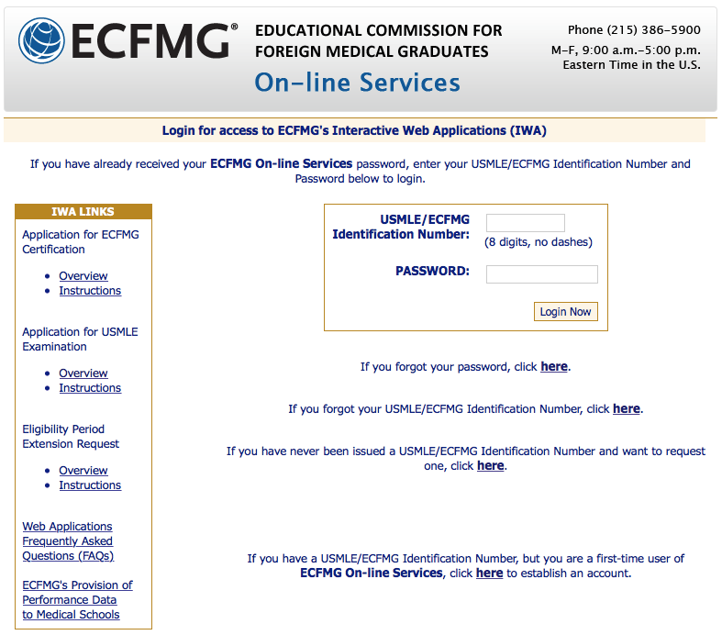
ECFMG Certification
Application – Online Part
To be eligible for ECFMG Certification, you must complete an Application for ECFMG Certification
You can access the Application for ECFMG Certification through IWA at https://secure2.ecfmg.org/emain.asp?app=iwa
Request a USMLE/ECFMG Identification Number

Slide 8

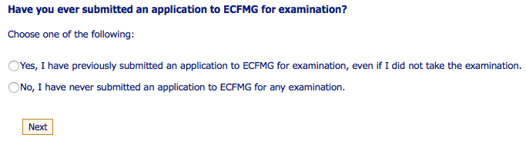
ECFMG Certification
Application – Online Part
Read the information and instructions carefully for ”ECFMG ON-LINE AUTHENTICATION PROCESS”, confirm you have read them and click ”Next”
Now, answer the next question and click “Next”
✓
If you have previously submitted an exam application to ECFMG, you must answer "Yes" to this question
You must answer "Yes" even if you submitted an application under a different name or you did not take the exam for which you applied
You must answer "Yes" regardless of whether you submitted an Interactive Web Application (IWA) or a paper application
If you have never submitted an application to ECFMG for any examination, answer "No"
If you do not answer accurately, this may result in a finding of irregular behavior

Slide 9
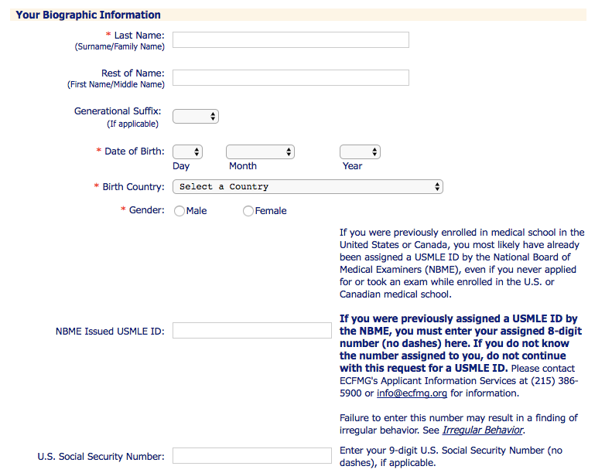
ECFMG Certification
Application – Online Part
Follow the instructions carefully to ensure proper completion of the information required to obtain a USMLE/ECFMG Identification Number If ECFMG determines that the biographic information you enter is inaccurate, not complete or insufficient to assign a USMLE/ECFMG Identification Number to you, your request for the USMLE/ECFMG Identification Number will not be processed
* Denotes required field

Slide 10
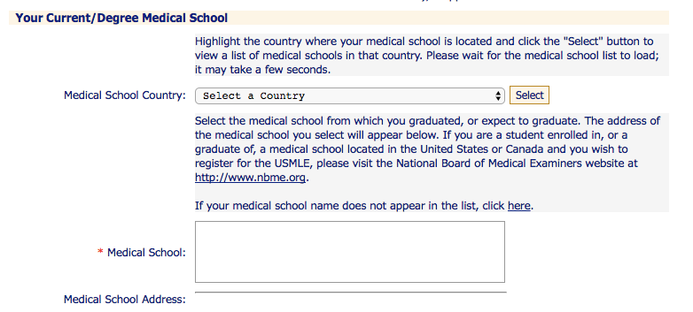
ECFMG Certification
Application – Online Part
Now highlight the country where your medical school is located and click ”Select”
Select your medical school from the list provided and its address will show up automatically
* Denotes required field

Slide 11
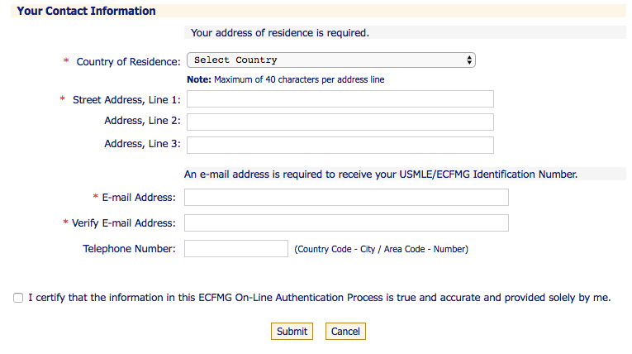
ECFMG Certification
Application – Online Part
Complete your contact information
Certify that your information is correct and click “Submit”
✓
* Denotes required field

Slide 12
ECFMG Certification
Application – Online Part
After you submit your information, ECFMG will perform a thorough search using the information provided and if a USMLE/ECFMG Identification Number already exists for you, your ID number will be sent to your e-mail address of record
If a USMLE/ECFMG Identification Number does not exist for you or the system is unable to identify you, your information will be submitted to ECFMG for processing
Allow 5 business days to process your request
Your USMLE/ECFMG Identification Number and a temporary password will be sent to the e-mail address ECFMG has on record for you
If ECFMG determines that the biographic information you enter is inaccurate, not complete or insufficient to assign a USMLE/ECFMG Identification Number to you, your request for the Identification Number will not be processed

Slide 13
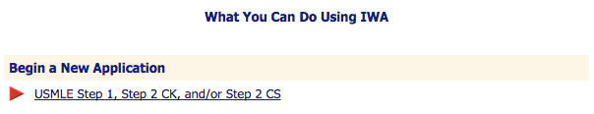
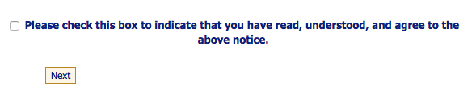
ECFMG Certification
Application – Online Part
Once you get your USMLE/ECFMG Identification number and temporary password via e-mail, go to https://secure2.ecfmg.org/emain.asp?app=iwa, and “Begin a New Application”
Read the “IMPORTANT INFORMATION REGARDING ECFMG’S PROVISION OF PERFORMANCE DATA TO MEDICAL SCHOOLS” carefully, check the box at the bottom of the page, and click “Next”
✓

Slide 14
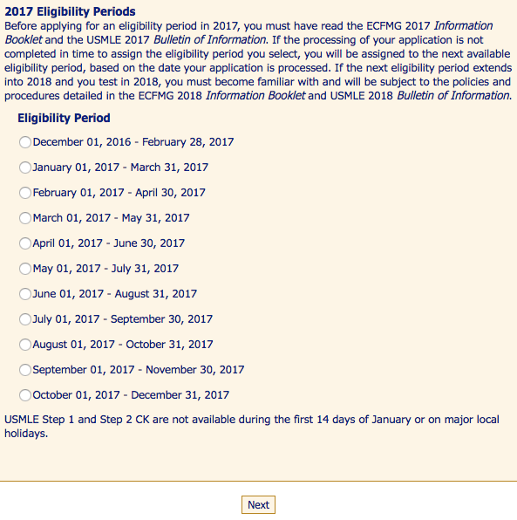
ECFMG Certification
Application – Online Part
Now complete the following Items:
Item 1 - Medical License in the United States: Have you been granted a license by a medical licensing authority in the United States based on previous licensure exams?
Item 2 - Select an Exam: USMLE Step 1
Item 3 - Eligibility Period: Select an eligibility period for Step 1 from the list and click “Next”
SAMPLE ELEGIBILITY PERIOD FOR 2017

Slide 15
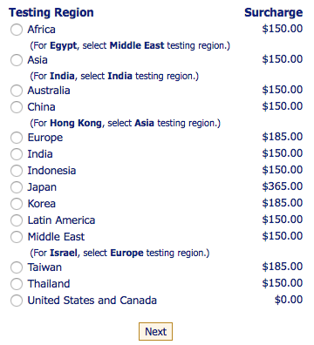
ECFMG Certification
Application – Online Part
Item 4 - Testing Region and International Test Delivery Surcharge, if Applicable: Select a Testing Region for Step 1 from the list, and click “Next”
SAMPLE TESTING REGION FOR 2017
Item 5 - Examinees with Documented Disabilities: Do you have a documented disability as defined by the Americans with Disabilities Act or a documented medical condition and intend to request test accommodations for Step 1?

Slide 16
ECFMG Certification
Application – Online Part
Item 6 - Name of Applicant: Is the name above your correct and current legal name?
Item 7 - Contact Information: You are required to provide a full and complete address for your current residence
ECFMG will use your address of residence as your mailing address
An e-mail address is required
Item 8 - U.S. Social Security Number and/or National Identification Number
Item 9 - Date and Place of Birth: Is the date of birth above your correct date of birth?
Also complete: Birth City, Birth State/Province, and Birth Country
Item 10 - Gender: Is the gender above your correct gender?
Item 11 - Native Language
Item 12 - Other Languages Spoken: Providing this information is voluntary. Choosing a particular answer or answers, or choosing not to answer this question, will not affect the outcome of your application

Slide 17
ECFMG Certification
Application – Online Part
Item 13 A - Citizenship: At birth, upon entering medical school, and now
Also complete: “I am/have been a U.S. Permanent Resident (Green Card Holder)”
Item 13 B - Current Passport: Country that issued current passport, Current passport number, Passport expiration date
Or check “I do not have a current passport”, if applicable
Item 14 - Ethnicity: Providing this information is voluntary. Choosing a particular answer or answers, or choosing not to answer this question, will not affect the outcome of your application
Item 15 A - Present Employment: If you are currently employed, click “YES” and fill out the form
Item 15 B - Postgraduate Medical Training: Have you completed a program of postgraduate medical/surgical training?
Item 16 - The ECFMG Reporter: All applicants should subscribe to The ECFMG Reporter. If you wish to receive The ECFMG Reporter, check the box at right, and then click “Next” at the bottom of the page

Slide 18
ECFMG Certification
Application – Online Part
Item 17 - Medical Education Status: GRADUATE
Item 18 - Medical School Information:
Complete: Medical School Name, Address, City, State/Province, Zip/Postal Code, Country, University Name, and Medical School Student ID
Dates of Attendance: Attended From, Attended To, Number of Years Attended, Graduation Date, Diploma Date, Title of Medical Degree.
Item 19 - Other Medical School(s) Attended: Total number of other medical schools attended, Total number of courses transferred
Item 20 - Other Institution(s) Attended: Total number of other institutions attended, Total number of courses transferred
Item 21 - Clinical Clerkships: Clinical Discipline, Name and Address of Hospital/Clinic, Supervising Physician, Dates of Clerkship

Slide 19
ECFMG Certification
Certification of Identification Form
The Certification of Identification Form (Form 186), which you will print at the end of the on-line part of the application, must be completed by you and certified by the Dean, Vice-Dean or Registrar of your medical school
If you cannot sign the Certification of Identification Form (Form 186) in the presence of a medical school official, you may sign the form in the presence of a Consular Official, Notary Public, or First Class Magistrate
The completed Certification of Identification Form (Form 186), with any other required documentation, must be mailed to ECFMG as soon as possible
The Certification of Identification Form (Form 186) must be received at ECFMG within four months of the date that you submit the on-line part of the application, or your application will no longer be valid - In this case, you must submit a new application
Send your documents by mail or courier service to:
IWA / ECFMG
3624 Market Street
Philadelphia, PA 19104-2685 USA

Slide 20
ECFMG Certification
Certification of Identification Form
ECFMG must receive both the on-line part and the Certification of Identification Form (Form 186) in order to process your application
Your application will not be considered complete and received at ECFMG until both the on-line part and the Certification of Identification Form (Form 186) have arrived at ECFMG
ECFMG processes on-line applications typically within 3 weeks of receipt of both the on-line part and the Certification of Identification Form
Once the Certification of Identification Form (Form 186) is submitted to, and accepted by ECFMG, the form remains valid for a period of five years
During that time, a graduate may apply for the USMLE without submitting another paper certification
Send your documents by mail or courier service to:
IWA / ECFMG
3624 Market Street
Philadelphia, PA 19104-2685 USA

Slide 21
2) Medical School Credential Requirements

Slide 22
ECFMG Certification
Medical School Credential Requirements
Item 22 A - Medical Diploma: ECFMG requires all medical school graduates to submit two copies of their final medical diploma
The photocopies of your medical diploma must be 216 mm x 279 mm (8½ in x 11 in)
The name on your medical diploma must match exactly the name in your ECFMG record - if the name on your diploma does not match the name in your ECFMG record, you must submit documentation that verifies the name on your diploma is (or was) your name. For more information visit http://www.ecfmg.org/2016ib/name-diploma-transcripts.html
The exact degree title of the final medical diploma you must provide is listed in http://www.ecfmg.org/certification/reference-guide.html
Send your documents by mail or courier service to:
IWA / ECFMG
3624 Market Street
Philadelphia, PA 19104-2685 USA

Slide 23
ECFMG Certification
Medical School Credential Requirements
You must send the photocopies of your diploma to ECFMG by mail or courier service - ECFMG does not accept these documents by fax or e-mail
Submit the copies in the original language, containing the issue date and all of the appropriate signatures of the medical school and/or university officials
Documents that are not in English must be accompanied by an official English translation – visit http://www.ecfmg.org/2016ib/english-translation.html for more information
You must send one full-face, passport-sized, color photograph with the photocopies of your medical diploma
The photograph that you send must be current; it must have been taken within six months of the date that you send it
Send your documents by mail or courier service to:
IWA / ECFMG
3624 Market Street
Philadelphia, PA 19104-2685 USA

Slide 24
ECFMG Certification
Medical School Credential Requirements
Item 22 B - You must also complete and submit with your medical diploma two copies of the Medical School Release Request (Form 345)
This form can be found at http://www.ecfmg.org/forms/form345.pdf and is addressed to your medical school
By completing this form, you are authorizing your medical school, if requested by ECFMG, to provide and/or verify your medical credentials and provide information on your medical education
ECFMG will send a copy of your completed Form 345 to your medical school with its request
Send your documents by mail or courier service to:
IWA / ECFMG
3624 Market Street
Philadelphia, PA 19104-2685 USA

Slide 25
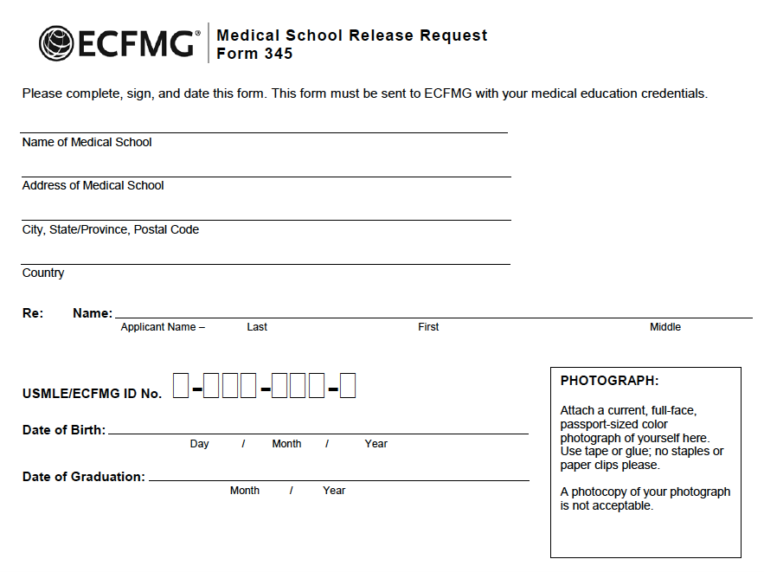
ECFMG Certification
Medical School Credential Requirements
SAMPLE FORM 345
Send your documents by mail or courier service to:
IWA / ECFMG
3624 Market Street
Philadelphia, PA 19104-2685 USA

Slide 26
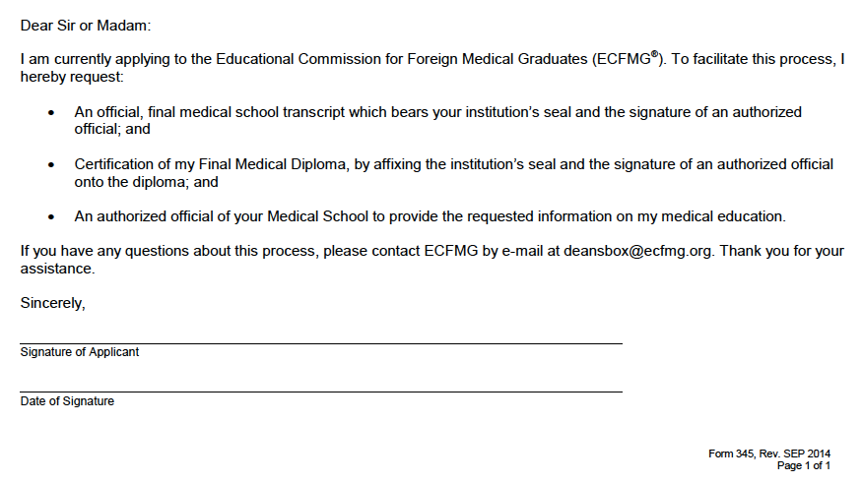
ECFMG Certification
Medical School Credential Requirements
Send your documents by mail or courier service to:
IWA / ECFMG
3624 Market Street
Philadelphia, PA 19104-2685 USA

Slide 27
ECFMG Certification
Medical School Credential Requirements
When ECFMG requests verification of your medical diploma from your medical school, ECFMG will request the medical school to provide your final medical school transcript
If ECFMG is unable to obtain your final medical school transcript directly from your medical school or if ECFMG has previously verified your medical diploma with your medical school but not the final medical school transcript, ECFMG will contact you and request that you submit to ECFMG two copies of your final medical school transcript
ECFMG will then request verification of the final medical school transcript from the medical school
Send your documents by mail or courier service to:
IWA / ECFMG
3624 Market Street
Philadelphia, PA 19104-2685 USA

Slide 28
SUBMITTING YOUR APPLICATION

Slide 29
ECFMG Certification
Item 23 - Certification By Applicant: Check the box at the bottom of the page to certify that you currently meet the examination eligibility requirements and that the information in your application is true and accurate to the best of your knowledge
Checking this box indicates that you have read, understood, and agree to the above statement

Slide 30
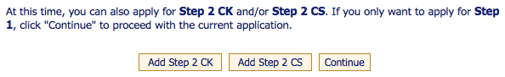
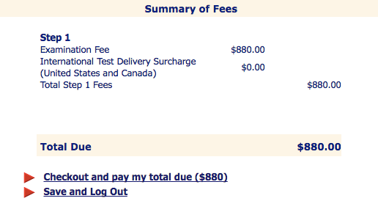
ECFMG Certification
Application Summary and Method of Payment: Read this Application Summary carefully. This is your last opportunity to make changes or corrections before making payment and submitting the on-line part of your application to ECFMG
At this time, click ”Continue”, and then checkout and pay the exam fee
After obtaining the scheduling permit, you may visit the Prometric website to schedule a test date (https://www.prometric.com)
SAMPLE
SUMMARY OF FEES

Slide 31
3) Examination Requirements

Slide 32

ECFMG Certification
Examination Requirements
The United States Medical Licensing Examination (USMLE) is a three-step examination for medical licensure in the United States and is sponsored by the Federation of State Medical Boards (FSMB) and the National Board of Medical Examiners (NBME)
The USMLE assesses a physician's ability to apply knowledge, concepts, and principles, and to demonstrate fundamental patient-centered skills, that are important in health and disease and that constitute the basis of safe and effective patient care
Each of the three Steps of the USMLE complements the others; no Step can stand alone in the assessment of readiness for medical licensure
With the exception of Step 2 CS (which is reported as Pass/Fail), USMLE results are reported on a 3-digit scale The current minimum passing scores are as follows:
Step 1: 192
Step 2 CK: 209

Slide 33
ECFMG Certification
Examination Requirements
Medical Science |  | Clinical Skills
USMLE Step 1 | USMLE Step 2 CK | USMLE Step 2 CS
Step 1 assesses whether you understand and can apply important concepts of the sciences basic to the practice of medicine, with special emphasis on principles and mechanisms underlying health, disease, and modes of therapy
Step 1 ensures mastery of not only the sciences that provide a foundation for the safe and competent practice of medicine in the present, but also the scientific principles required for maintenance of competence through lifelong learning
Step 1 is a one-day examination. It is divided into seven 60-minute blocks and administered in one 8-hour testing session

Slide 34
ECFMG Certification
Examination Requirements
Medical Science |  | Clinical Skills
USMLE Step 1 | USMLE Step 2 CK | USMLE Step 2 CS
Step 2 assesses whether you can apply medical knowledge, skills, and understanding of clinical science essential for the provision of patient care under supervision and includes emphasis on health promotion and disease prevention
Step 2 ensures that due attention is devoted to principles of clinical sciences and basic patient-centered skills that provide the foundation for the safe and competent practice of medicine
Step 2 CK is constructed according to an integrated content outline that organizes clinical science material along two dimensions: physician task and disease category
Step 2 CK is a one-day examination. It is divided into eight 60-minute blocks, administered in one 9-hour testing session. Test item formats may vary within each block

Slide 35
ECFMG Certification
Examination Requirements
Medical Science |  | Clinical Skills
USMLE Step 1 | USMLE Step 2 CK | USMLE Step 2 CS
Step 2 CS is a one-day examination, and consists of a series of patient encounters in which examinees must see standardized patients, take a history, perform a physical examination, determine differential diagnoses, and then write a patient note based on their determinations
Examinees are scored on three separate subcomponents: Communication and Interpersonal Skills (CIS), Spoken English Proficiency (SEP), and Integrated Clinical Encounter (ICE)
Each subcomponent must be passed in a single administration in order to achieve a passing performance

Slide 36
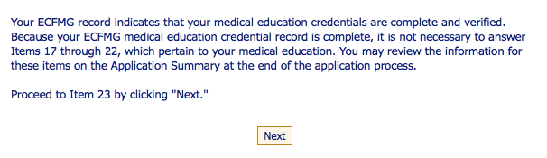
ECFMG Certification
Examination Requirements
After passing USMLE Step 1, go to https://secure2.ecfmg.org/emain.asp?app=iwa, log in using your USMLE/ECFMG Identification Number and Password and “Begin a New Application” for Step 2 CK
Follow the same instructions for USMLE Step 1
Now, your credentials are complete and verified - There’s no need to upload new documents at this point
Click on “Next” and proceed to Item 23

Slide 37
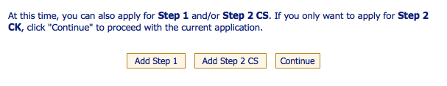
ECFMG Certification
Examination Requirements
Click “Continue”
Item 23 - Certification By Applicant: Check the box at the bottom of the page to certify that you currently meet the examination eligibility requirements and that the information in your application is true and accurate to the best of your knowledge
Checking this box indicates that you have read, understood, and agree to the above statement

Slide 38
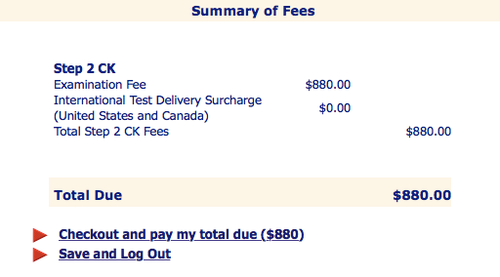
ECFMG Certification
Examination Requirements
Click “Continue”
SAMPLE
SUMMARY OF FEES
Now checkout and pay the exam fee
After obtaining the scheduling permit, you may visit the Prometric website to schedule a test date (https://www.prometric.com)

Slide 39
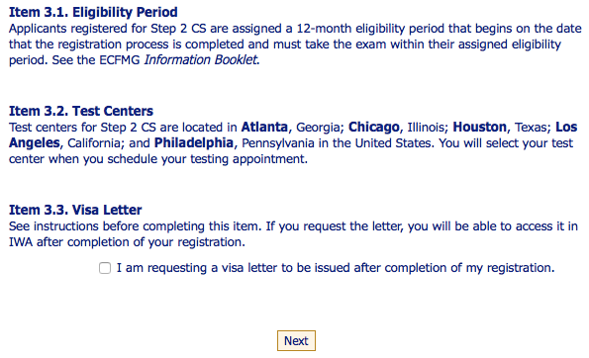
ECFMG Certification
Examination Requirements
After passing USMLE Step 2 CK, go to https://secure2.ecfmg.org/emain.asp?app=iwa, log in using your USMLE/ECFMG Identification Number and Password and “Begin a New Application” for Step 2 CS
Follow the same instructions for USMLE Step 2 CK
New information will show up at this time. Read it carefully and proceed with the next items
Item 3 - Eligibility Period, Test Center, and Visa Letter

Slide 40
ECFMG Certification
Examination Requirements
Now, your credentials are complete and verified - There’s no need to upload new documents at this point
Click on “Next” and proceed to Item 23
Click “Continue”

Slide 41
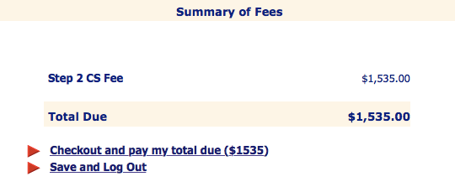
ECFMG Certification
Examination Requirements
Item 23 - Certification By Applicant: Check the box at the bottom of the page to certify that you currently meet the examination eligibility requirements and that the information in your application is true and accurate to the best of your knowledge
Checking this box indicates that you have read, understood, and agree to the above statement
SAMPLE
SUMMARY OF FEES
Now checkout and pay the exam fee

Slide 42

ECFMG Certification
Examination Requirements
After obtaining your scheduling permit, you may visit the Step 2 CS Calendar and Scheduling website at https://secure2.ecfmg.org/emain.asp?app=csess
Log in using your USMLE/ECFMG Identification Number and Password
Select a test center to view the calendar of available test dates within your eligibility period at that center
Follow the instructions on the website and schedule your test date

Slide 43
Requirements for ECFMG Certification
To be eligible for Certification by ECFMG, IMGs must meet the following requirements:
1) Application for ECFMG Certification
Online Application
Certification of Identification Form (Form 186)
2) Medical Education Credential Requirements
Final Medical Diploma
Two copies of the Medical School Release Request (Form 345)
3) Examination Requirements
Satisfy the Medical Science Examination Requirement (USMLE Step 1 and USMLE Step 2 CK)
Satisfy the Clinical Skills Requirement (USMLE Step 2 CS)

Slide 44
ECFMG Certificate
ECFMG issues the Standard ECFMG Certificate to applicants who meet all of the requirements for certification
IMGs must also pay any outstanding charges on their ECFMG financial accounts before their certificates are issued
Standard ECFMG Certificates are sent to applicants approximately two weeks after all of these requirements have been met
Currently, ECFMG sends the Standard ECFMG Certificate to the applicant’s address of record by Federal Express
The Standard ECFMG Certificate includes:
The name of the applicant
The applicant’s USMLE/ECFMG Identification Number
The dates that the examination requirements were met
The date that the certificate was issued

Slide 45
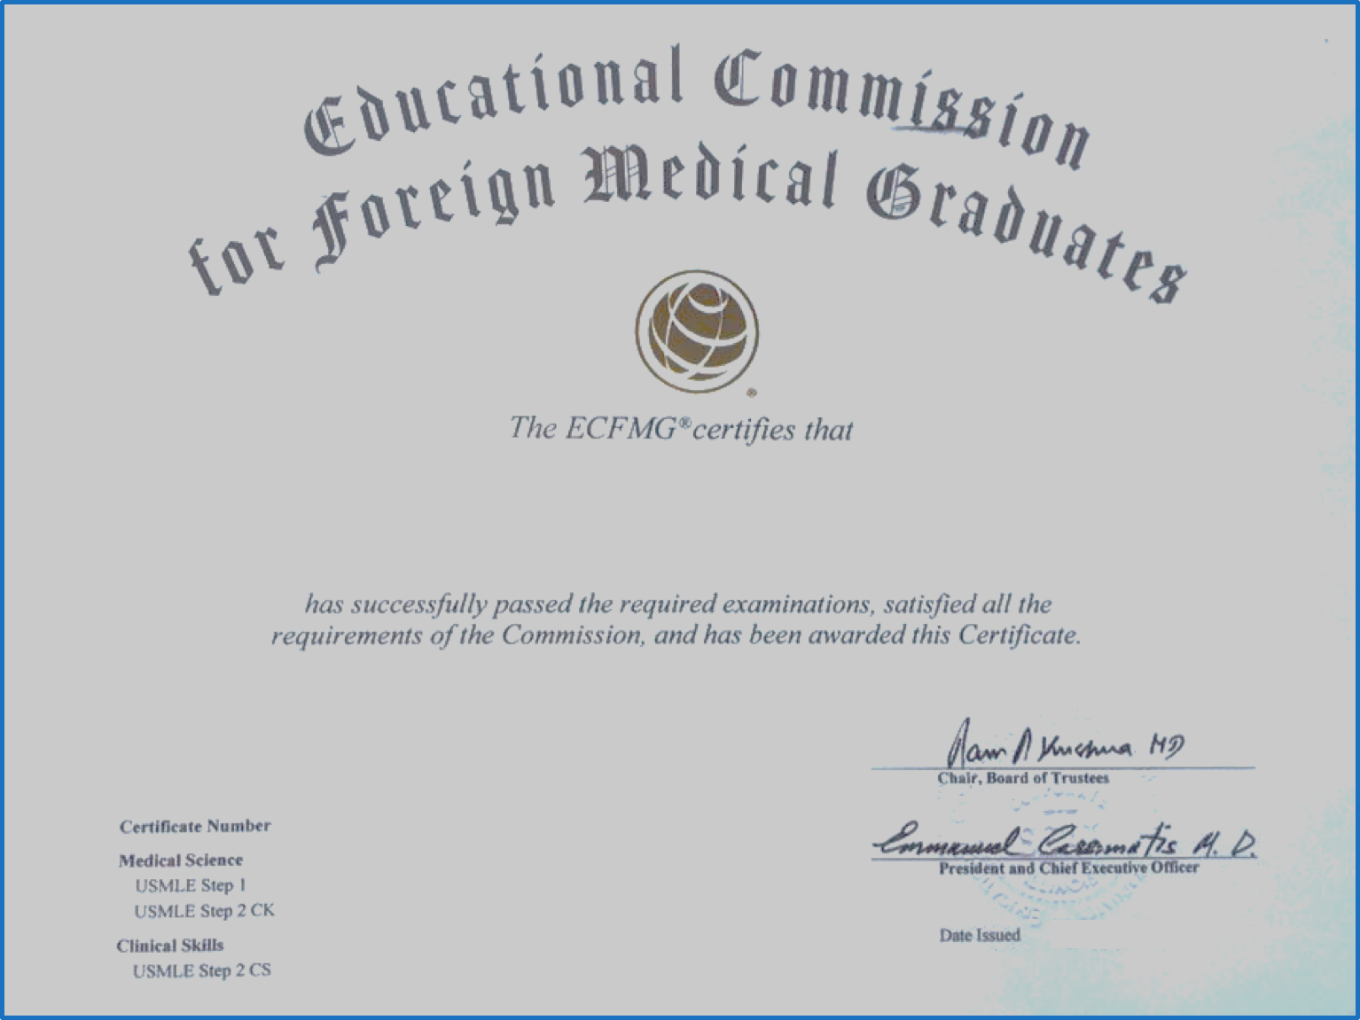
ECFMG Certificate
SAMPLE
ECFMG CERTIFICATE

Slide 46
ECFMG Certification
Step by Step Guide

