Slide 1

License information for
International Medical Graduates
in California
Step by Step Guide

Slide 2



Application information
for a Physician’s and Surgeon’s License
Licensees are authorized to use drugs or devices, to sever or penetrate tissues, and to use any and all methods in the treatment of diseases, injuries, deformities and other physical and mental conditions
To be eligible for a Physician’s and Surgeon’s license, applicants must have received all of their medical school education from and graduated from a medical school recognized or approved by the Medical Board of California (Board)
Some recognized medical schools that teach in their native language are opening English language medical school programs. The English language programs are not recognized unless specifically stated by the Board
The Medical School’s name must exactly match the name on the Board’s list of recognized medical schools
Refer to the Board’s website to verify your medical school is recognized:
http://www.mbc.ca.gov/applicants/medical_schools/schools_recognized.aspx

Slide 3
Physician’s and Surgeon’s License
Application Checklist
1) Application, fees and fingerprints
Application Fee $491
Initial License Fee $808.00 or Reduced Initial License Fee $416.50
Application for Physician’s and Surgeon’s License, Forms L1A-L1F
Fingerprints: Live Scan Form
2) Examination Documentation*
ECFMG Certification Status Report
Official Examination Scores from the Federation of State Medical Boards (FSMB)
*IMGs who have been issued a PTAL have already met the educational requirements. Once the postgraduate training and final examination requirements have been met, additional forms will be needed to complete the application for licensure

Slide 4
Physician’s and Surgeon’s License
Application Checklist
3) Medical Education Documentation*
Certificate of Medical Education, Form L2
Official Medical School Transcript
Certified Copy of Medical School Diploma
Certified English Translations (if applicable)
Certificate of Clinical Training, Form L5
Certificate of Individual Clinical Clerkship Training, Form L6 (if applicable)
4) Postgraduate Training Documentation
Certificate of Completion of ACGME Postgraduate Training, Forms L3A-L3B
Current Postgraduate Training Enrollment, Form L4
*IMGs who have been issued a PTAL have already met the educational requirements. Once the postgraduate training and final examination requirements have been met, additional forms will be needed to complete the application for licensure

Slide 5
Physician’s and Surgeon’s License
Application Checklist
5) Verification of Medical License(s)
License Verification (if applicable)
6) Other Items
Curriculum Vitae (CV)
Timeline of Activities
Birth Month Licensure Request
Explanation to Application Question (if applicable)

Slide 6
1) Application, fees and fingerprints

Slide 7
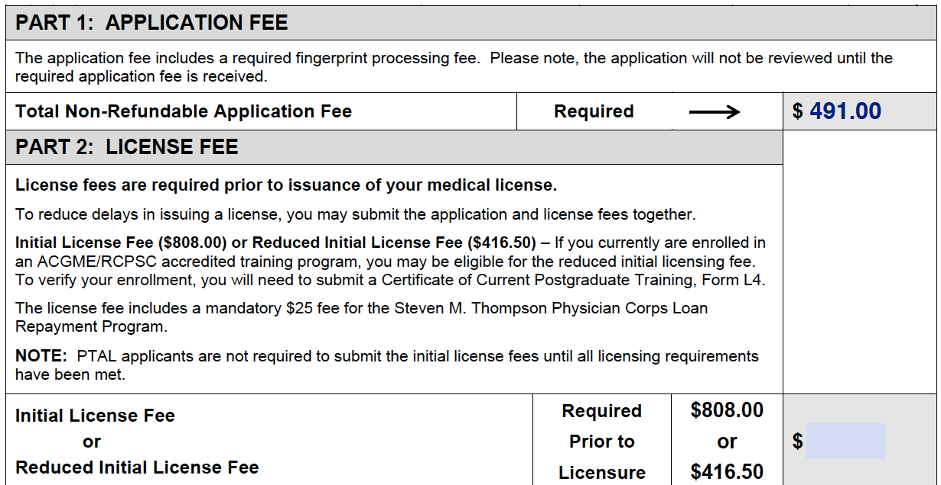
Physician’s and Surgeon’s License
Application and Initial License Fee
SAMPLE APPLICATION FEE
The application fee is non refundable
Address: 2005 Evergreen, Suite 1200, Sacramento, CA 95815-3831
Phone: (916) 263-2382 or (800) 633-2322
Fax: (916) 263-2487
Website: www.mbc.ca.gov

Slide 8
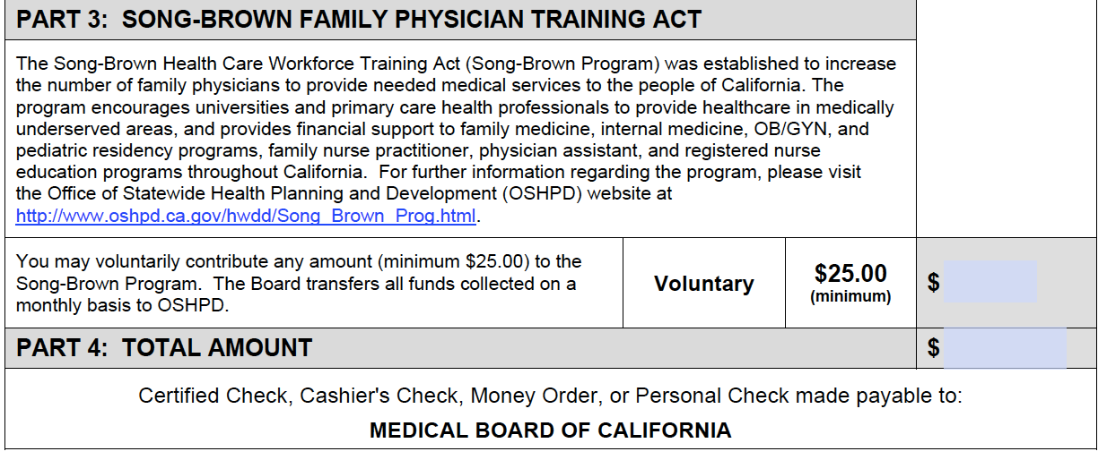
PTAL
Physician’s and Surgeon’s License
Application and Initial License Fee
SAMPLE APPLICATION FEE
The application fee is non refundable
Address: 2005 Evergreen, Suite 1200, Sacramento, CA 95815-3831
Phone: (916) 263-2382 or (800) 633-2322
Fax: (916) 263-2487
Website: www.mbc.ca.gov
491.00

Slide 9
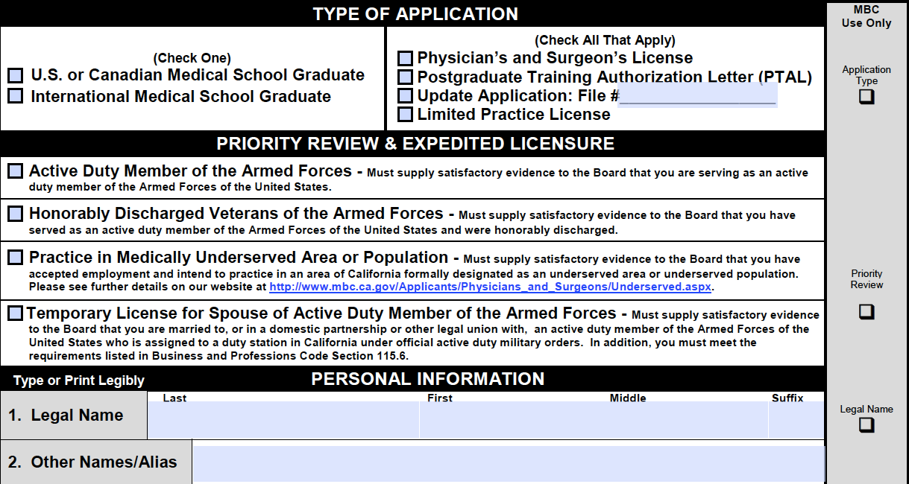
Physician’s and Surgeon’s License
Application: Forms L1A-L1F
✓
✓
SAMPLE L1A
Complete all fields, answer all questions and have the application notarized
All six forms must be submitted together
Address: 2005 Evergreen, Suite 1200, Sacramento, CA 95815-3831
Phone: (916) 263-2382 or (800) 633-2322
Fax: (916) 263-2487
Website: www.mbc.ca.gov

Slide 10
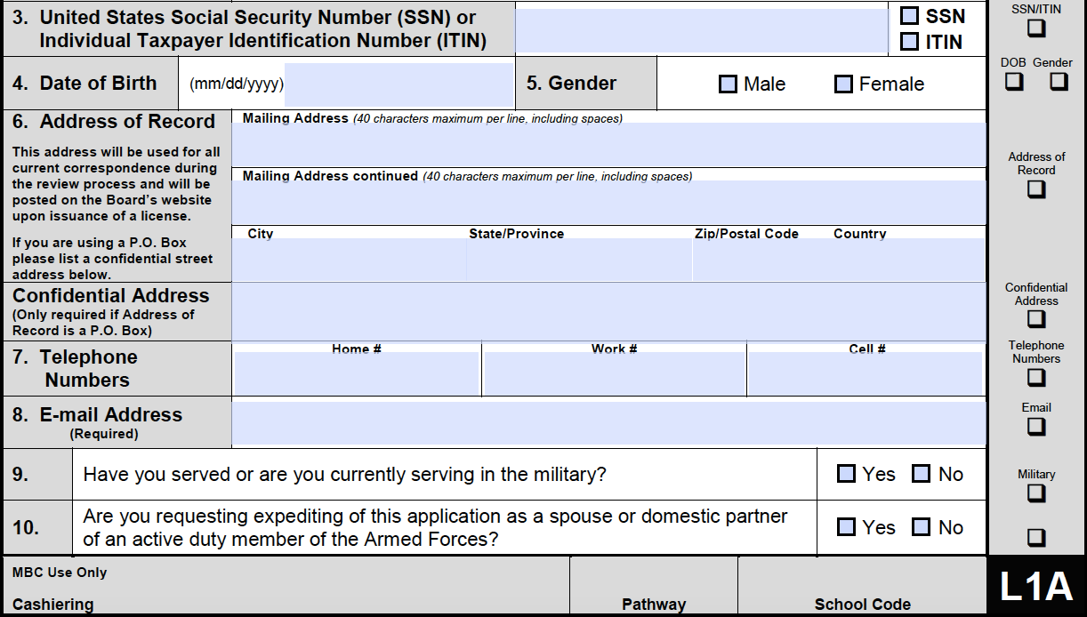
PTAL
✓
Physician’s and Surgeon’s License
Application: Forms L1A-L1F
✓
SAMPLE L1A
Complete all fields, answer all questions and have the application notarized
All six forms must be submitted together
Address: 2005 Evergreen, Suite 1200, Sacramento, CA 95815-3831
Phone: (916) 263-2382 or (800) 633-2322
Fax: (916) 263-2487
Website: www.mbc.ca.gov

Slide 11
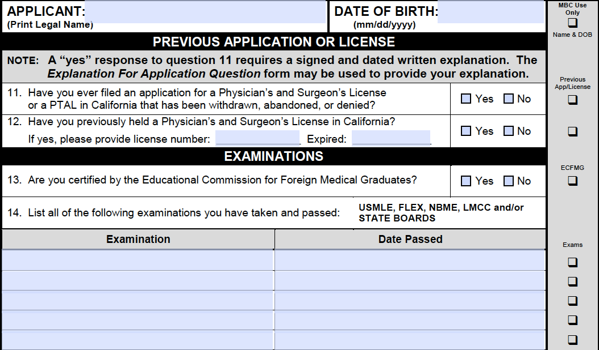
PTAL
✓
Physician’s and Surgeon’s License
Application: Forms L1A-L1F
✓
SAMPLE L1B
✓
USMLE Step 1
USMLE Step 2 CS
USMLE Step 2 CK
USMLE Step 3
mm/dd/yy
mm/dd/yy
mm/dd/yy
mm/dd/yy
Complete all fields, answer all questions and have the application notarized
All six forms must be submitted together
Address: 2005 Evergreen, Suite 1200, Sacramento, CA 95815-3831
Phone: (916) 263-2382 or (800) 633-2322
Fax: (916) 263-2487
Website: www.mbc.ca.gov

Slide 12
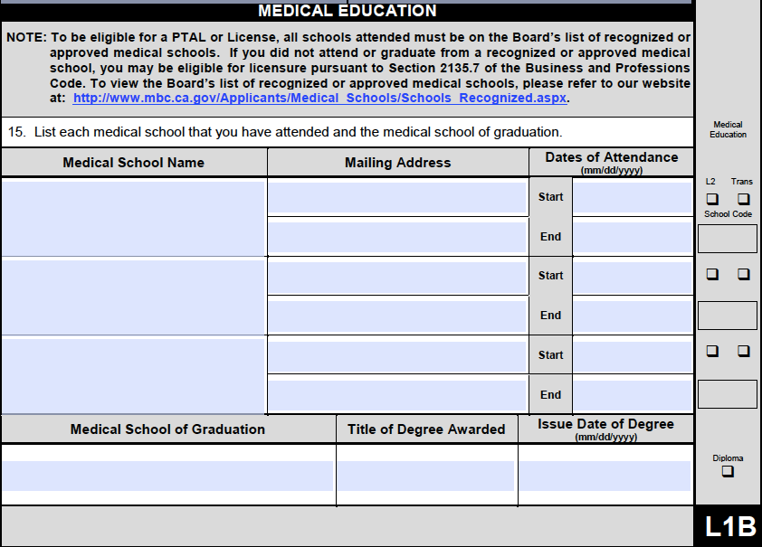
PTAL
✓
Physician’s and Surgeon’s License
Application: Forms L1A-L1F
SAMPLE L1B
Complete all fields, answer all questions and have the application notarized
All six forms must be submitted together
Address: 2005 Evergreen, Suite 1200, Sacramento, CA 95815-3831
Phone: (916) 263-2382 or (800) 633-2322
Fax: (916) 263-2487
Website: www.mbc.ca.gov

Slide 13
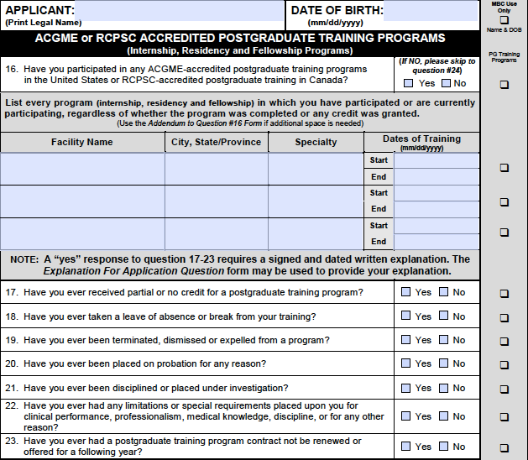
PTAL
✓
Physician’s and Surgeon’s License
Application: Forms L1A-L1F
✓
SAMPLE L1C
Complete all fields, answer all questions and have the application notarized
All six forms must be submitted together
Address: 2005 Evergreen, Suite 1200, Sacramento, CA 95815-3831
Phone: (916) 263-2382 or (800) 633-2322
Fax: (916) 263-2487
Website: www.mbc.ca.gov

Slide 14
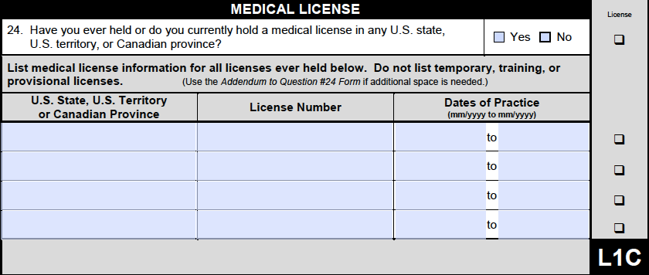
PTAL
✓
Physician’s and Surgeon’s License
Application: Forms L1A-L1F
✓
SAMPLE L1C
Complete all fields, answer all questions and have the application notarized
All six forms must be submitted together
Address: 2005 Evergreen, Suite 1200, Sacramento, CA 95815-3831
Phone: (916) 263-2382 or (800) 633-2322
Fax: (916) 263-2487
Website: www.mbc.ca.gov

Slide 15
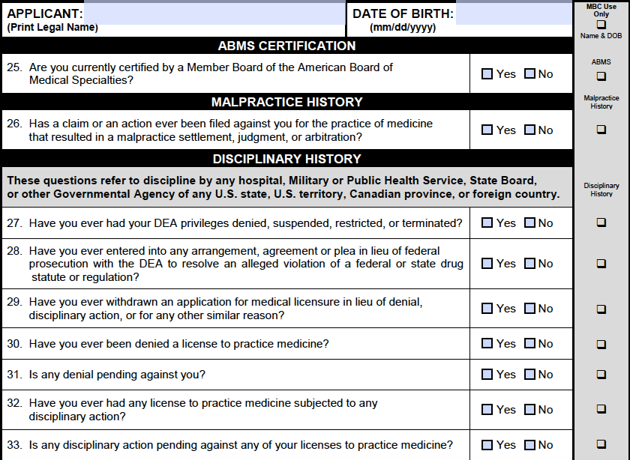
PTAL
✓
Physician’s and Surgeon’s License
Application: Forms L1A-L1F
SAMPLE L1D
Complete all fields, answer all questions and have the application notarized
All six forms must be submitted together
Address: 2005 Evergreen, Suite 1200, Sacramento, CA 95815-3831
Phone: (916) 263-2382 or (800) 633-2322
Fax: (916) 263-2487
Website: www.mbc.ca.gov

Slide 16
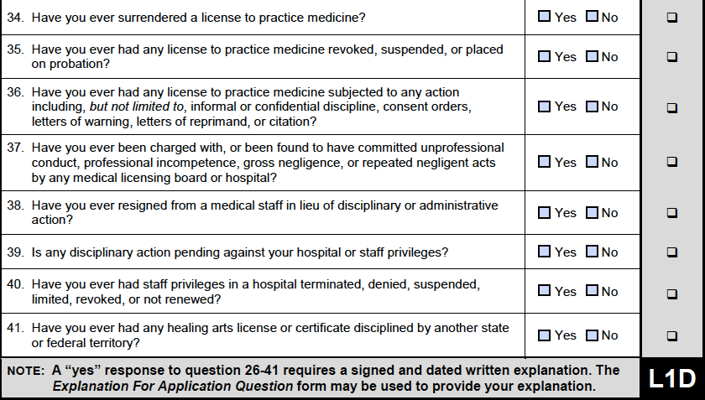
✓
✓
Physician’s and Surgeon’s License
Application: Forms L1A-L1F
SAMPLE L1D
Complete all fields, answer all questions and have the application notarized
All six forms must be submitted together
Address: 2005 Evergreen, Suite 1200, Sacramento, CA 95815-3831
Phone: (916) 263-2382 or (800) 633-2322
Fax: (916) 263-2487
Website: www.mbc.ca.gov

Slide 17
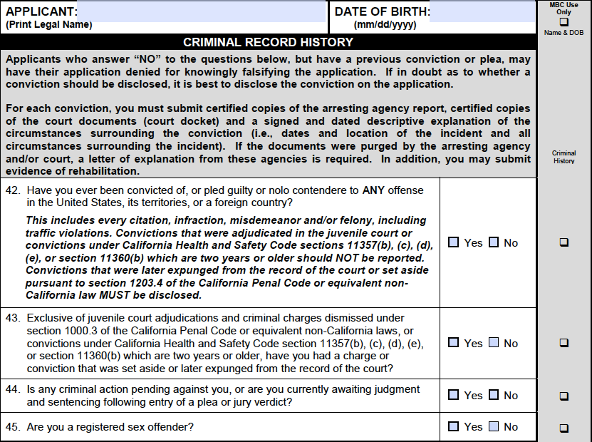
PTAL
✓
✓
Physician’s and Surgeon’s License
Application: Forms L1A-L1F
SAMPLE L1E
Complete all fields, answer all questions and have the application notarized
All six forms must be submitted together
Address: 2005 Evergreen, Suite 1200, Sacramento, CA 95815-3831
Phone: (916) 263-2382 or (800) 633-2322
Fax: (916) 263-2487
Website: www.mbc.ca.gov

Slide 18
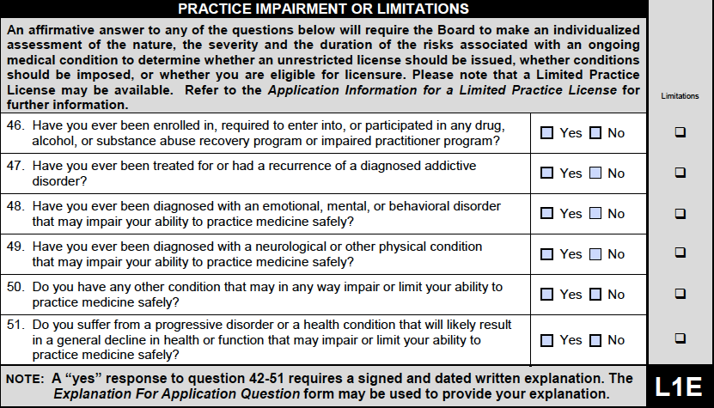
✓
✓
Physician’s and Surgeon’s License
Application: Forms L1A-L1F
SAMPLE L1E
Complete all fields, answer all questions and have the application notarized
All six forms must be submitted together
Address: 2005 Evergreen, Suite 1200, Sacramento, CA 95815-3831
Phone: (916) 263-2382 or (800) 633-2322
Fax: (916) 263-2487
Website: www.mbc.ca.gov

Slide 19
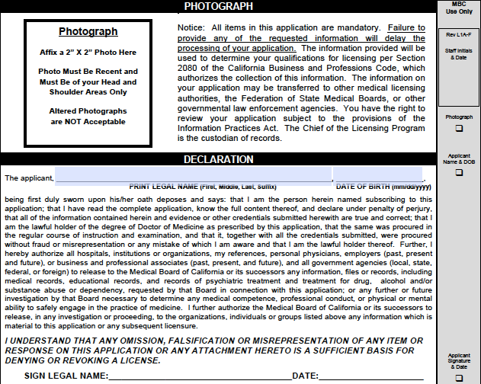
PTAL
✓
✓
Physician’s and Surgeon’s License
Application: Forms L1A-L1F
SAMPLE L1F
Complete all fields, answer all questions and have the application notarized
All six forms must be submitted together
Address: 2005 Evergreen, Suite 1200, Sacramento, CA 95815-3831
Phone: (916) 263-2382 or (800) 633-2322
Fax: (916) 263-2487
Website: www.mbc.ca.gov

Slide 20
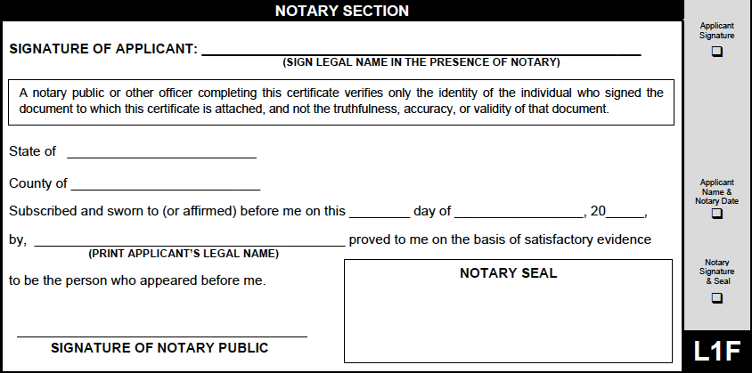
PTAL
✓
✓
Physician’s and Surgeon’s License
Application: Forms L1A-L1F
SAMPLE L1F
Complete all fields, answer all questions and have the application notarized
All six forms must be submitted together
Address: 2005 Evergreen, Suite 1200, Sacramento, CA 95815-3831
Phone: (916) 263-2382 or (800) 633-2322
Fax: (916) 263-2487
Website: www.mbc.ca.gov

Slide 21
PTAL
✓
✓
Physician’s and Surgeon’s License
Fingerprints: Live Scan Form
Criminal Records Check from both the California Department of Justice and The Federal Bureau of Investigation must be received prior to the issuance of a Physician’s and Surgeon’s medical license
NOTE: If you have ever been convicted, the record of conviction will be reported to the Board as a result of your fingerprint inquiry. The Board receives results for all convictions: misdemeanors, felonies, infractions and citations. If in doubt, it’s better to answer “yes” on the L1E form and include an explanation
The “Request For Live Scan Service” form is required to have your fingerprints processed by Live Scan. This form must be completed in triplicate
Ensure that all personal data (name, AKA’s, date of birth, sex, height, weight, eye color, hair color, place of birth, Social Security Number or Individual Taxpayer Identification Number, California’s driver’s license number and home address) is provided on each of the three forms
The last section of the form requires information from the fingerprint agency; please ensure this information is completed or the forms will be void
It your responsibility to ensure that the person scanning the fingerprints submits TWO digital prints, one for the DOJ and one for the FBI
Access the website http://ag.ca.gov/fingerprints/publications/contact.html
to obtain the names, location, and fees
of approved fingerprint sites
Address: 2005 Evergreen, Suite 1200, Sacramento, CA 95815-3831
Phone: (916) 263-2382 or (800) 633-2322
Fax: (916) 263-2487
Website: www.mbc.ca.gov

Slide 22
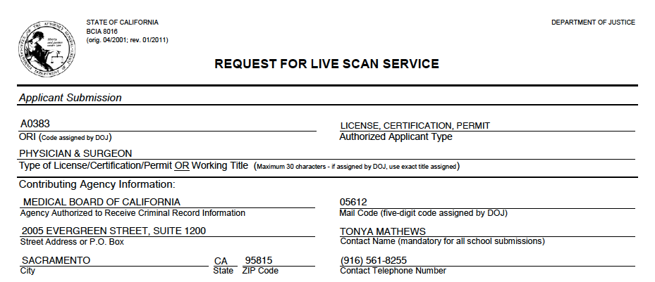
PTAL
✓
✓
Physician’s and Surgeon’s License
Fingerprints: Live Scan Form
SAMPLE LIVE SCAN FORM
Address: 2005 Evergreen, Suite 1200, Sacramento, CA 95815-3831
Phone: (916) 263-2382 or (800) 633-2322
Fax: (916) 263-2487
Website: www.mbc.ca.gov

Slide 23
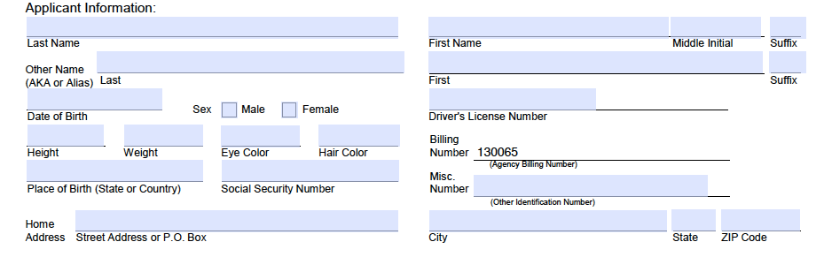
PTAL
✓
✓
Physician’s and Surgeon’s License
Fingerprints: Live Scan Form
SAMPLE LIVE SCAN FORM
Address: 2005 Evergreen, Suite 1200, Sacramento, CA 95815-3831
Phone: (916) 263-2382 or (800) 633-2322
Fax: (916) 263-2487
Website: www.mbc.ca.gov

Slide 24
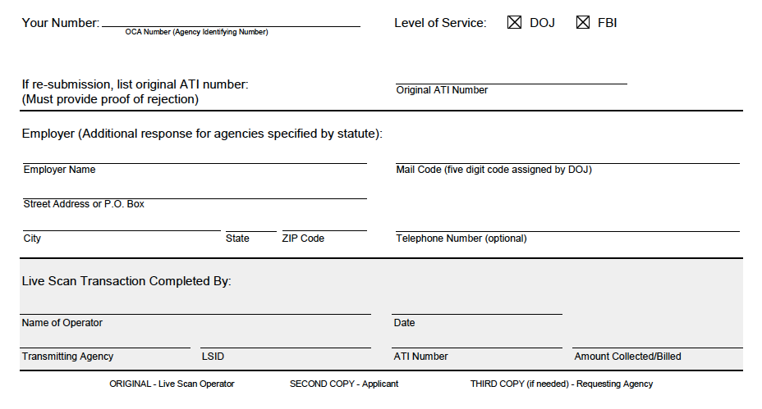
✓
✓
Physician’s and Surgeon’s License
Fingerprints: Live Scan Form
SAMPLE LIVE SCAN FORM
Address: 2005 Evergreen, Suite 1200, Sacramento, CA 95815-3831
Phone: (916) 263-2382 or (800) 633-2322
Fax: (916) 263-2487
Website: www.mbc.ca.gov

Slide 25
✓
2) Examination Documentation
IMGs who have been issued a PTAL have already met the educational requirements. Once the postgraduate training and final examination requirements have been met, additional forms will be needed to complete the application for licensure

Slide 26
3) Medical Education Documentation
✓
IMGs who have been issued a PTAL have already met the educational requirements. Once the postgraduate training and final examination requirements have been met, additional forms will be needed to complete the application for licensure

Slide 27
4) Postgraduate Training Documentation

Slide 28
Physician’s and Surgeon’s License
Certificate of Completion of ACME Postgraduate Training, Forms L3A-L3B
A Certificate of completion of ACGME Postgraduate Training, Form L3A-L3B, is required to verify the completion of each year of accredited training
The form may not be signed and dated prior to the last day of the training year that will be used to meet the two years of ACGME accredited postgraduate training required for licensure
A Form L3A-L3B must be submitted to each postgraduate training program for completion
The current program director must provide all of the required information and responses on the form, sign and date the form, and affix the hospital seal. If a hospital seal is not available, the program director must sign in the presence of a notary and the notary seal must be affixed
A “yes” response to any of the Unusual Circumstances questions on Form L3A requires a signed and dated letter of explanation from the current program director
The completed Form L3A-L3B must be mailed directly from the program to the Board to be acceptable. Any letters of explanation must be provided on program letterhead, signed by the program director and mailed directly to the Board
Address: 2005 Evergreen, Suite 1200, Sacramento, CA 95815-3831
Phone: (916) 263-2382 or (800) 633-2322
Fax: (916) 263-2487
Website: www.mbc.ca.gov

Slide 29
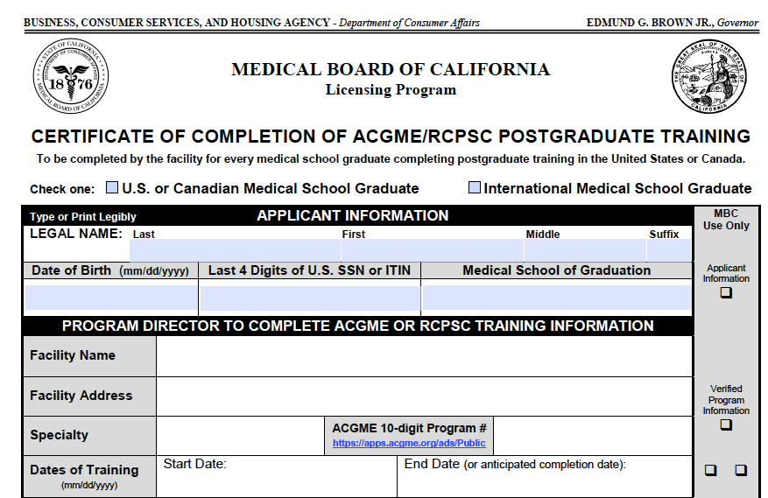
Physician’s and Surgeon’s License
Certificate of Completion of ACME Postgraduate Training, Forms L3A-L3B
SAMPLE L3A
✓
Address: 2005 Evergreen, Suite 1200, Sacramento, CA 95815-3831
Phone: (916) 263-2382 or (800) 633-2322
Fax: (916) 263-2487
Website: www.mbc.ca.gov

Slide 30
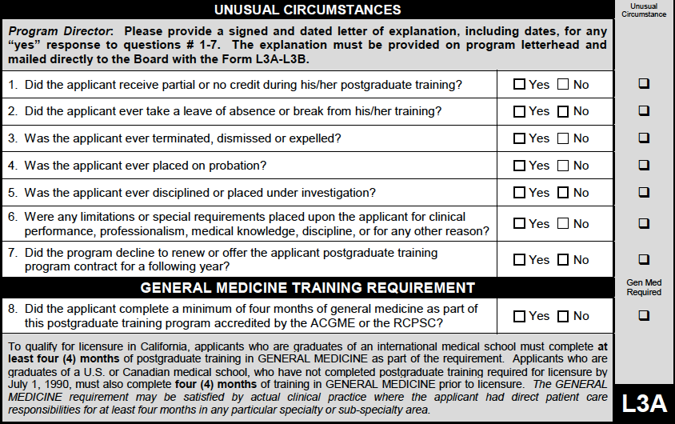
Physician’s and Surgeon’s License
Certificate of Completion of ACME Postgraduate Training, Forms L3A-L3B
SAMPLE L3A
Address: 2005 Evergreen, Suite 1200, Sacramento, CA 95815-3831
Phone: (916) 263-2382 or (800) 633-2322
Fax: (916) 263-2487
Website: www.mbc.ca.gov

Slide 31
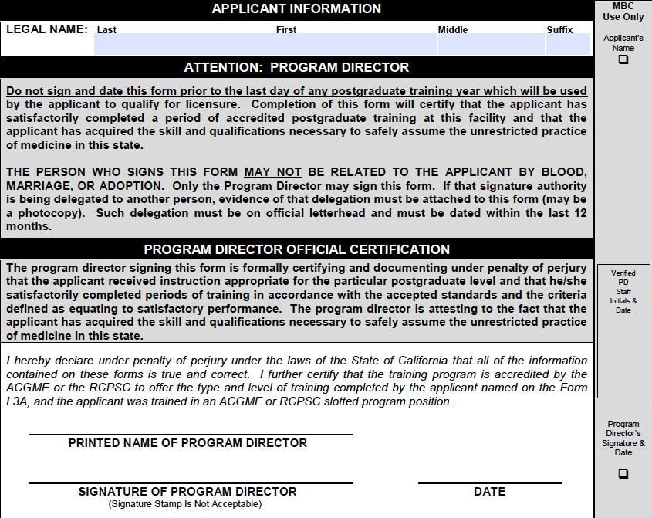
Physician’s and Surgeon’s License
Certificate of Completion of ACME Postgraduate Training, Forms L3A-L3B
SAMPLE L3B
Address: 2005 Evergreen, Suite 1200, Sacramento, CA 95815-3831
Phone: (916) 263-2382 or (800) 633-2322
Fax: (916) 263-2487
Website: www.mbc.ca.gov

Slide 32
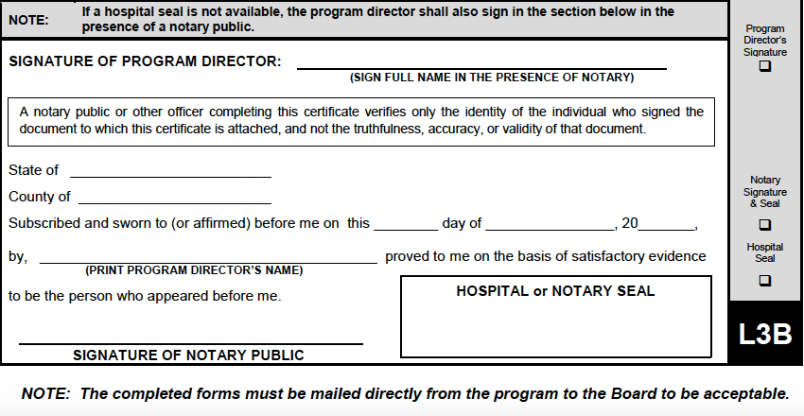
Physician’s and Surgeon’s License
Certificate of Completion of ACME Postgraduate Training, Forms L3A-L3B
SAMPLE L3B
Address: 2005 Evergreen, Suite 1200, Sacramento, CA 95815-3831
Phone: (916) 263-2382 or (800) 633-2322
Fax: (916) 263-2487
Website: www.mbc.ca.gov

Slide 33
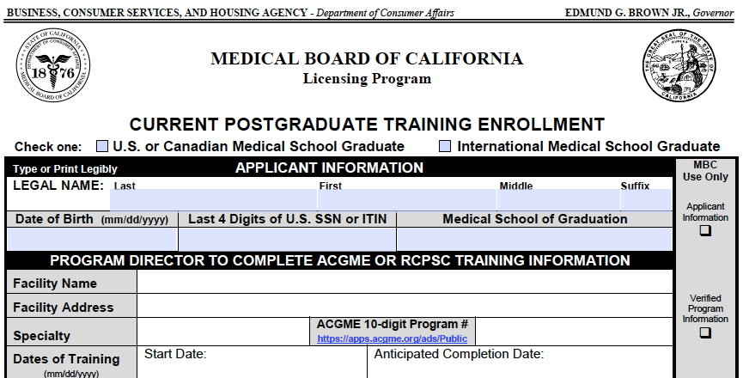
Physician’s and Surgeon’s License
Current Postgraduate Training Enrollment, Form L4
SAMPLE L4
✓
Address: 2005 Evergreen, Suite 1200, Sacramento, CA 95815-3831
Phone: (916) 263-2382 or (800) 633-2322
Fax: (916) 263-2487
Website: www.mbc.ca.gov

Slide 34
Physician’s and Surgeon’s License
Current Postgraduate Training Enrollment, Form L4
If you are enrolled in an accredited training program at the time of application, this form is necessary to be eligible for the reduced initial licensing fee
Complete the top section and submit the form to your current training program for completion
The current program director must provide all of the required information and responses on the form, sign and date the form, and affix with the hospital seal. If a hospital seal is not available, the program director must sign in the presence of a notary and the notary seal must be affixed
The completed Form L4 must be mailed directly from the program to the Board to be acceptable
Address: 2005 Evergreen, Suite 1200, Sacramento, CA 95815-3831
Phone: (916) 263-2382 or (800) 633-2322
Fax: (916) 263-2487
Website: www.mbc.ca.gov

Slide 35
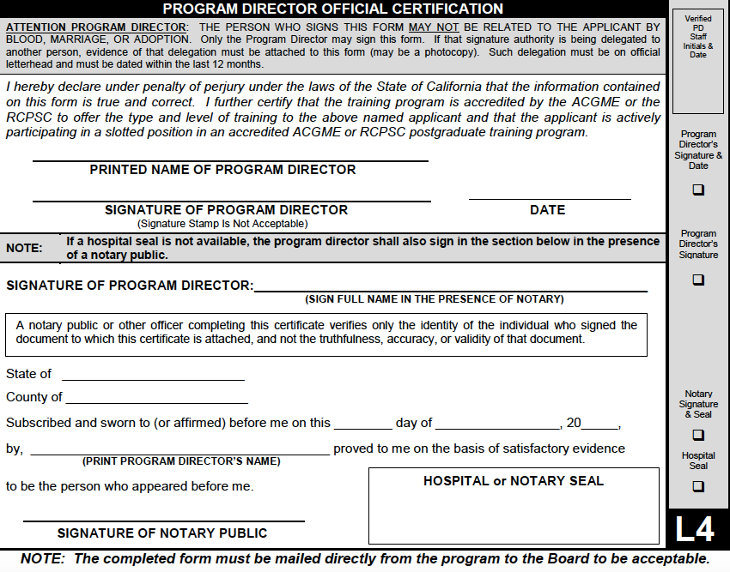
Physician’s and Surgeon’s License
Current Postgraduate Training Enrollment, Form L4
SAMPLE L4
Address: 2005 Evergreen, Suite 1200, Sacramento, CA 95815-3831
Phone: (916) 263-2382 or (800) 633-2322
Fax: (916) 263-2487
Website: www.mbc.ca.gov

Slide 36
5) Verification of Medical License(s)

Slide 37
Physician’s and Surgeon’s License
License Verification (if applicable)
License verification is required from each state or Canadian province in which you hold or have held a medical license
Verification of temporary, training, or provisional license(s) are not required
The official license verification must be sent directly from the licensing authority to the Board
Address: 2005 Evergreen, Suite 1200, Sacramento, CA 95815-3831
Phone: (916) 263-2382 or (800) 633-2322
Fax: (916) 263-2487
Website: www.mbc.ca.gov

Slide 38
6) Other Items

Slide 39
Physician’s and Surgeon’s License
Curriculum Vitae (CV)
Submit a signed and dated current CV with your Application
Example
Name, MD
Address
Contact Number
E-mail
EDUCATION
CLINICAL EXPERIENCE
RESEARCH AND PUBLICATIONS
CO-CURRICULAR ACTIVITIES
COURSES AND CONFERENCES
REFERENCES
Address: 2005 Evergreen, Suite 1200, Sacramento, CA 95815-3831
Phone: (916) 263-2382 or (800) 633-2322
Fax: (916) 263-2487
Website: www.mbc.ca.gov

Slide 40
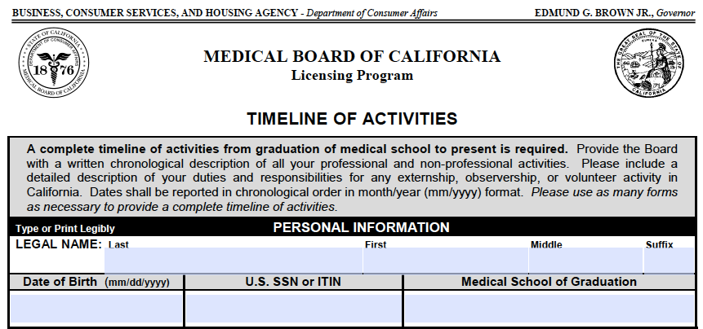
Physician’s and Surgeon’s License
Timeline of Activities
SAMPLE TIMELINE OF ACTIVITIES
Address: 2005 Evergreen, Suite 1200, Sacramento, CA 95815-3831
Phone: (916) 263-2382 or (800) 633-2322
Fax: (916) 263-2487
Website: www.mbc.ca.gov

Slide 41
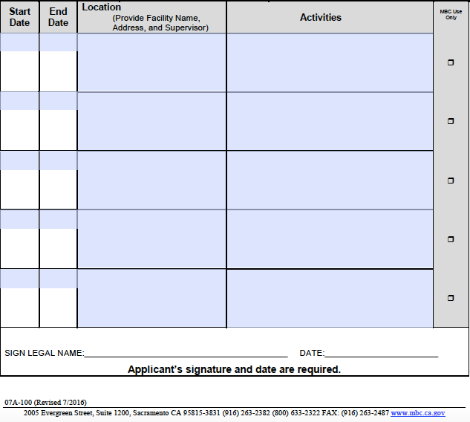
Physician’s and Surgeon’s License
Timeline of Activities
A complete timeline from the graduation of medical school to present is required.
Provide the Board with a written chronological description of all your professional and non-professional activities with no gaps.
If you have completed any externships, observerships, or volunteers activities in California, please include a detailed description of your duties and responsibilities along with the location and name of the supervising physician.
Mail your signed and dated timeline of Activities form directly to the Board
SAMPLE TIMELINE OF ACTIVITIES
Address: 2005 Evergreen, Suite 1200, Sacramento, CA 95815-3831
Phone: (916) 263-2382 or (800) 633-2322
Fax: (916) 263-2487
Website: www.mbc.ca.gov

Slide 42
Physician’s and Surgeon’s License
Birth Month Licensure Request
California licensing regulations specify that a license expires at 12 midnight on the last day of the birth month of the licensee during the second year of a two year term
If you are licensed in your birth month, your initial license will be valid for a full 24-month term
If you are licensed in a month other than your birth month, the term of your initial license will be less than 24-months
Complete the Birth Month Licensure Request form indicating your preference
and submit the form directly to the Board
Address: 2005 Evergreen, Suite 1200, Sacramento, CA 95815-3831
Phone: (916) 263-2382 or (800) 633-2322
Fax: (916) 263-2487
Website: www.mbc.ca.gov

Slide 43
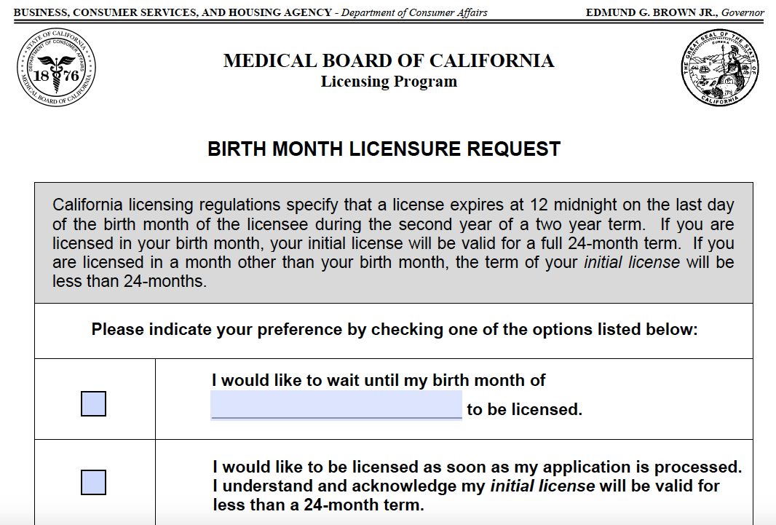
Physician’s and Surgeon’s License
Birth Month Licensure Request
SAMPLE BIRTH MONTH LICENSURE REQUEST
Address: 2005 Evergreen, Suite 1200, Sacramento, CA 95815-3831
Phone: (916) 263-2382 or (800) 633-2322
Fax: (916) 263-2487
Website: www.mbc.ca.gov

Slide 44
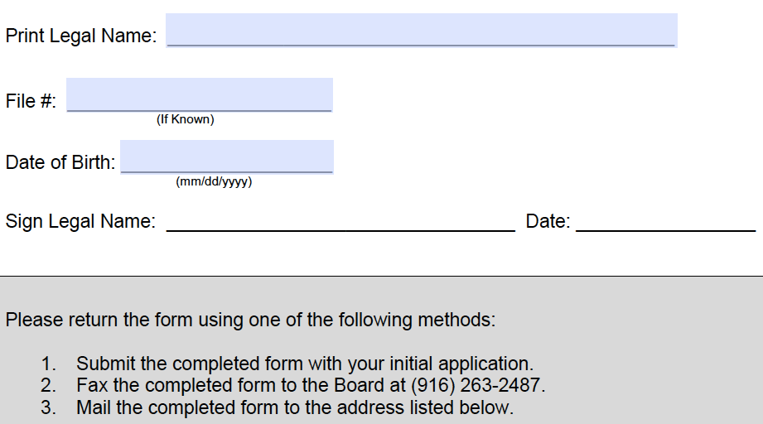
Physician’s and Surgeon’s License
Birth Month Licensure Request
SAMPLE BIRTH MONTH LICENSURE REQUEST
Address: 2005 Evergreen, Suite 1200, Sacramento, CA 95815-3831
Phone: (916) 263-2382 or (800) 633-2322
Fax: (916) 263-2487
Website: www.mbc.ca.gov

Slide 45
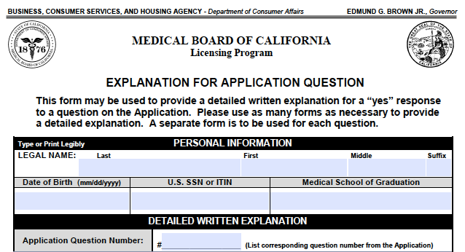
Physician’s and Surgeon’s License
Explanation to Application Questions
(if applicable)
SAMPLE EXPLANATION TO APPLICATION QUESTIONS
Address: 2005 Evergreen, Suite 1200, Sacramento, CA 95815-3831
Phone: (916) 263-2382 or (800) 633-2322
Fax: (916) 263-2487
Website: www.mbc.ca.gov

Slide 46
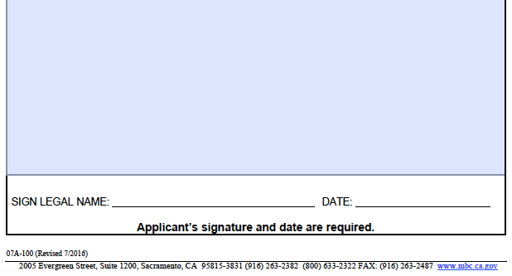
Physician’s and Surgeon’s License
Explanation to Application Questions
(if applicable)
SAMPLE EXPLANATION TO APPLICATION QUESTIONS
Address: 2005 Evergreen, Suite 1200, Sacramento, CA 95815-3831
Phone: (916) 263-2382 or (800) 633-2322
Fax: (916) 263-2487
Website: www.mbc.ca.gov

Slide 47
ADDITIONAL INFORMATION

Slide 48
Physician’s and Surgeon’s License
Additional Information
A license cannot be issued to an IMG until the applicant has passed USMLE Step 3
California law requires that the applicant must pass Step 3 of the USMLE within not more than four attempts
An IMG must complete 24 months of training to be eligible for licensure; the final 12 months used towards eligibility must be continuous and in a single program
An IMG must be licensed by the end of the 36th month of training
In calculating these months, the Board counts all approved training in the US, whether or not credit was granted
Allow 2-4 weeks from the date of issuance to receive your pocket identification card and wall certificate
Address: 2005 Evergreen, Suite 1200, Sacramento, CA 95815-3831
Phone: (916) 263-2382 or (800) 633-2322
Fax: (916) 263-2487
Website: www.mbc.ca.gov

Slide 49
License information for
International Medical Graduates
in California
Step by Step Guide

