Slide 1
The Project LIFE program: Long- Acting Injectable Buprenorphine to End Overdose:
OPPORTUNITIES FOR ADDRESSING EQUITY IN SUBSTANCE USE DISORDER TREATMENT IN OVERLOOKED POPULATIONS
Ruchi Fitzgerald, MD FAAFP
RUSH UNIVERSITY MEDICAL CENTER
PCC Community Wellness Center
Notes:
Ruchi

Slide 2
Objectives
Describe the current landscape of the overdose epidemic in an urban community.
Analyze how harm reduction approaches can be of benefit to engaging patients in substance use disorder treatment.
Gain confidence in practical low threshold long acting buprenorphine initiation for patients at high risk of overdose.
Notes:
Ruchi

Slide 3
Disclosures:
PCC Community Wellness Center/West Suburban Medical Center’s Addiction Medicine Consult Service and the Rush Addiction Medicine Fellowship are funded in full or in part through the State Opioid Response Grant (TIO83278) and the State Block Grant to the Illinois Department of Human Services, Division of Substance Use Prevention and Recovery, from the US Department of Health and Human Services, Substance Abuse and Mental Health Services Administration.
Notes:
Ruchi

Slide 4
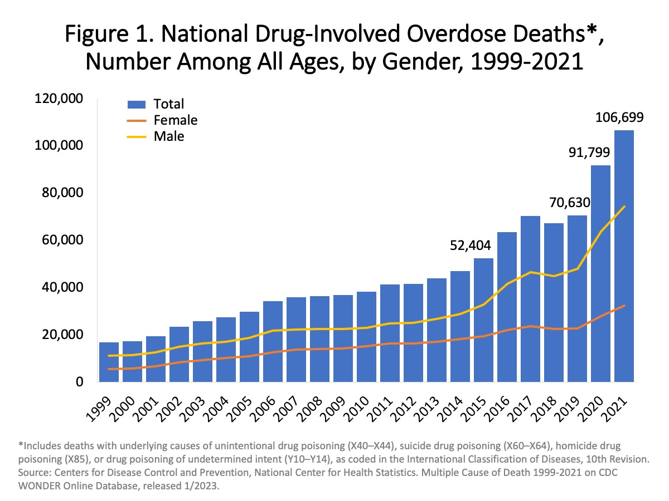
Drug Overdose Death Rates in the United States are Rising
CDC data
Fentanyl
Stimulants
Treatment gap
Role of FM
Disagreements in
US drug policy

Slide 5
The Addiction Crisis in Chicago
Notes:
Chicago, unfortunately, is known to have significant morbidity and mortality from gun violence. This is frequently reported upon on the news and discussed among political circles.
However, when the medical examiner of Cook County was collecting data on fatalities, opioid related fatalities far outweigh firearm homicides
Even at the peak gun violence in 2021, opioid related mortality was double those due to firearms
With fentanyl and other novel drugs entering the supply, opioid related fatalities continue to increase

Slide 7
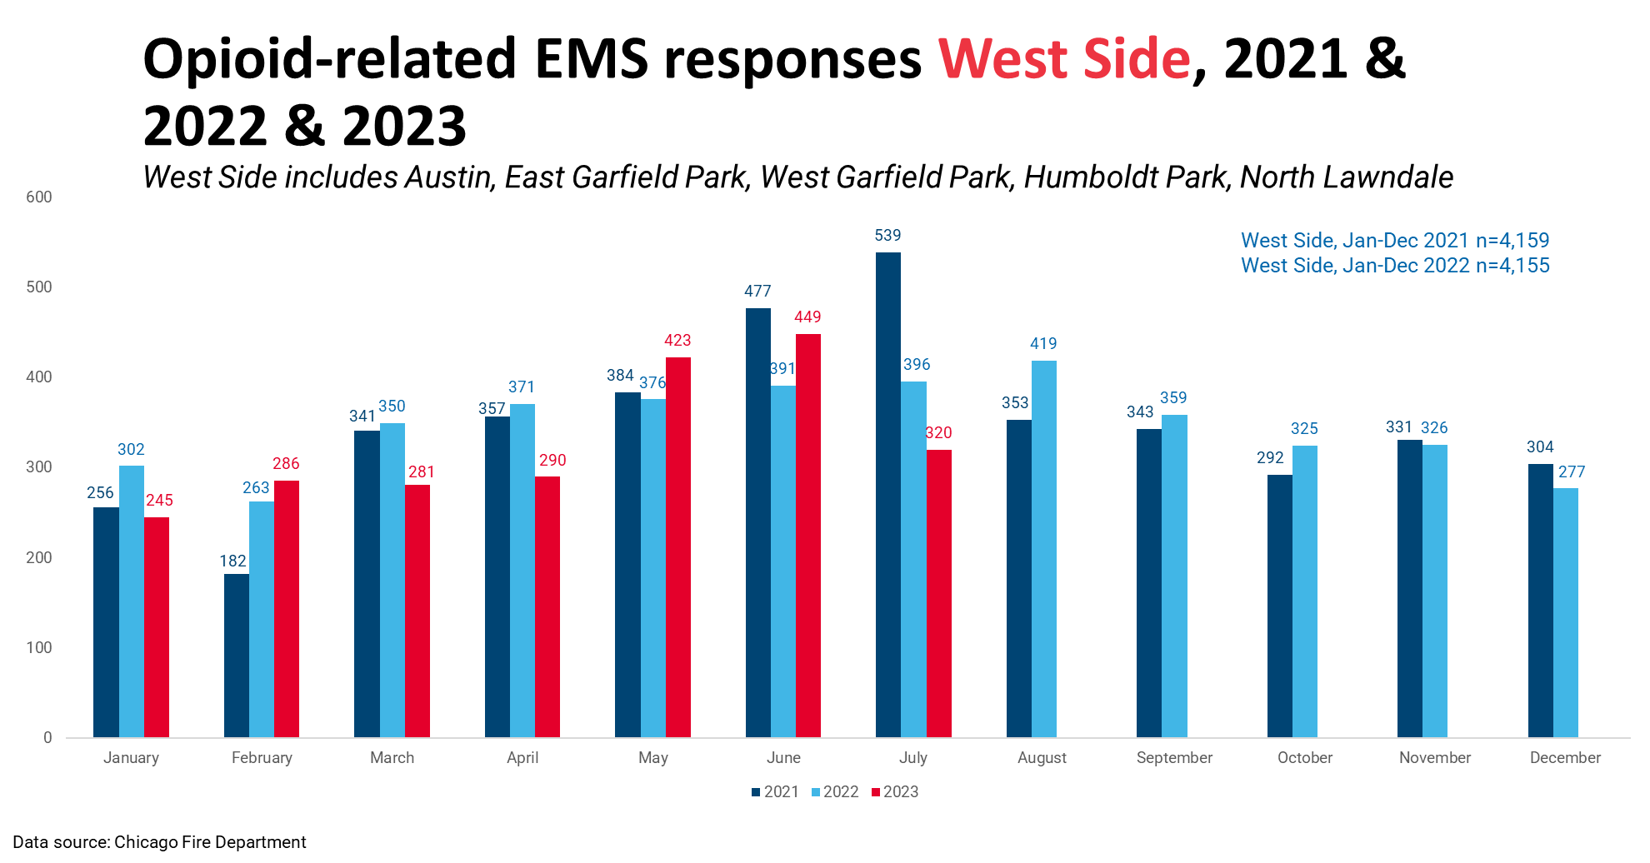
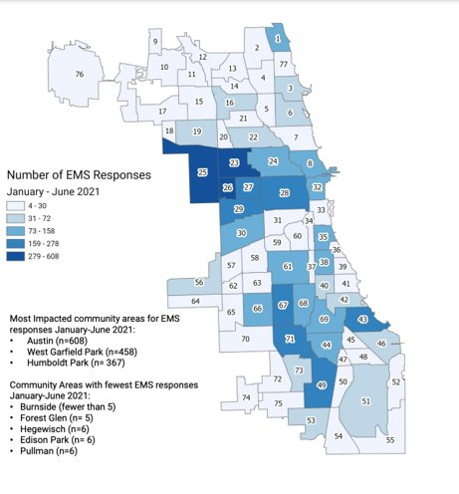
Inequity of Chicago's Addiction Crisis
Health Alert; 2021 Midyear report; CDPH; 8/13/2021;
https://www.chicagohan.org/documents/14171/234367/2021_MidYr_Opioid_Report_AUg2021.pdf
Notes:
178 neighborhoods within 77 community areas
The distribution of opioid overdose is not even throughout Chicago with pockets on the south and west side experiencing higher overdose rates than other community areas
These community areas tend to have a higher percentage of black and Hispanic populations
The community areas that experience the highest EMS call volume for Opioid Overdose are the Austin, West and East Garfield Park and Humbolt Park community areas

Slide 8
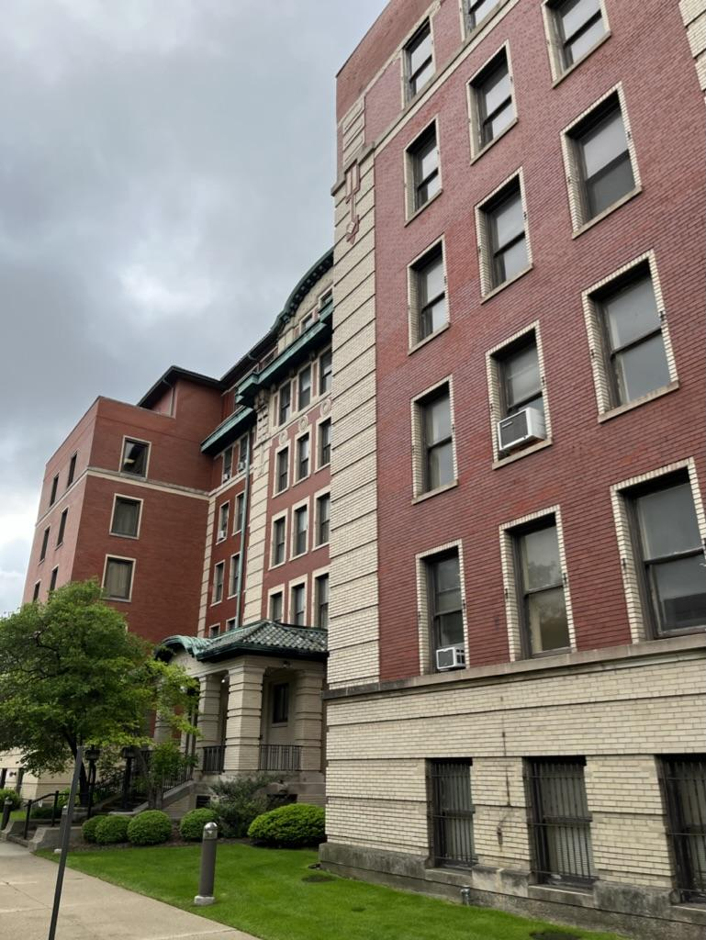
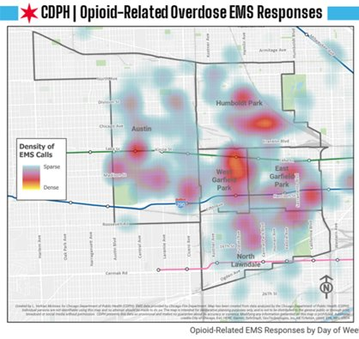
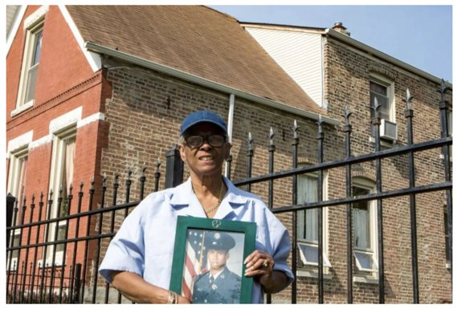
West Suburban Medical Center
Notes:
Ruchi
Within these four community areas, EMS run data has demonstrated sites where frequency for opioid overdose is hyperlocalized
Adjacent to one of these hot spots is West Suburban Medical Center, a 334 bed community hospital, where our team works
High need area
80% of patients at WSMC are insured by either Medicare or Medicaid

Slide 9
Illinois Statewide Fatality Rate by Race/Ethnicity 2021
Black patients with OUD are
8.7x
less likely to receive Buprenorphine after non-fatal overdose or other complication of OUD.
Race | Fatality Rate (Per 100,000)
Non-Hispanic White | 20.5
Non-Hispanic Black | 60.8
Hispanic/Latinx | 16.6
Non-Hispanic Other | 3.0
Barnett ML, Meara E, Lewinson T, Hardy B, Chyn D, Onsando M, Huskamp HA, Mehrotra A, Morden NE. Racial Inequality in Receipt of Medications for Opioid Use Disorder. N Engl J Med. 2023 May 11;388(19):1779-1789. doi: 10.1056/NEJMsa2212412. PMID: 37163624; PMCID: PMC10243223.
Notes:
Ruchi
The uneven distribution of opioid overdose rates across Chicago correlate with the disparities we see for race based mortality data
Black Illinois residents experience a three fold higher mortality rate than their white counterparts
This disparity is likely due to many of the same racial disparities affecting Black Amercians in their approach to healthcare
Data has shown that Black Americans are much less likely than white Americans to receive MOUD after an overdose

Slide 10
Treatment of Opioid Use Disorder
Medications are FDA approved: Buprenorphine, Buprenorphine-naloxone (Suboxone); Methadone, and extended-release naltrexone.
Evidence based for treatment of OUD; 2018 study from MA demonstrated that buprenorphine and methadone reduce all cause mortality.
Numerous studies show meds are under-prescribed due to stigma, regulatory barriers, institutional barriers and lack of clinician training.
The DATA 2000 waiver was eliminated in January 2023 allowing all DEA registered clinicians to prescribe buprenorphine.

Slide 11
Rising Overdoses Amongst Black Older Adults in Illinois
Statewide Semiannual Overdose Report Illinois Department of Public Health October 2023, IDPH
https://dph.illinois.gov/content/dam/soi/en/web/idph/publications/idph/topics-and-services/opioids/idph-data-dashboard/semiannual-overdose-report_102023.pdf
Notes:
Ruchi

Slide 12
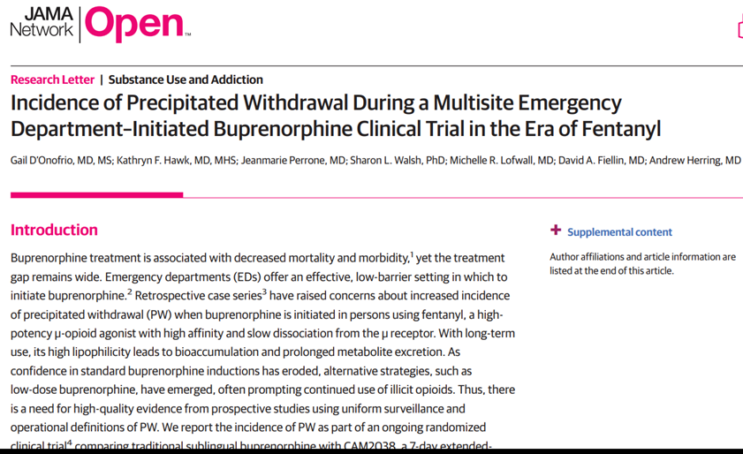
Emerging Research: Treating Patients Post-Overdose in Hospital Setting
Notes:
Ruchi
Fortunately, early access to MOUD has been shown to be feasible and improve outcomes for those initated on treatment
Knowing this, our team began offering addiction medicine treatment & harm reduction education in the ED/hospital setting (addiction medicine consult service) with warm handoff to outpatient FQHC or methadone clinic.

Slide 13
B
A
R
R
I
E
R
S
B
A
R
R
I
E
R
S
22%
6 Month Follow-Up Rate
Notes:
Ruchi
Patients with OUD seen by AMCS before LAIB program
After two years, patients seen our addiction medicine consult service had low follow up rates (22-25%).
Often did not fill or were interested in buprenorphine prescriptions.
Low percentage successfully linked to an opioid treatment program from the hospital.
Barriers: housing, stigma, transportation, pharmacy, and easy access to drugs in the community.
Frequently readmitted for medical complications, overdose or withdrawal.

Slide 14
Health Justice Framework
Individual
Necessary Disruption
Community
Intersection of policy, social, legal, and economic determinants of health impact the individual community member
Redistribute medical resources for community members most impacted by social and structural determinants of health
Prioritize greatest need communities
Include community input in program development
Dismantle the policies that do not align with health justice
Identify and overcome the specific policies that impede health equity and promote disparity.
Notes:
Policy is multilevel; institutional (pharmacy); housing (SNF may not allow MOUD); and local/state/federal laws - all may require change in order for the community members to have access to evidence based treatment for SUD.

Slide 15
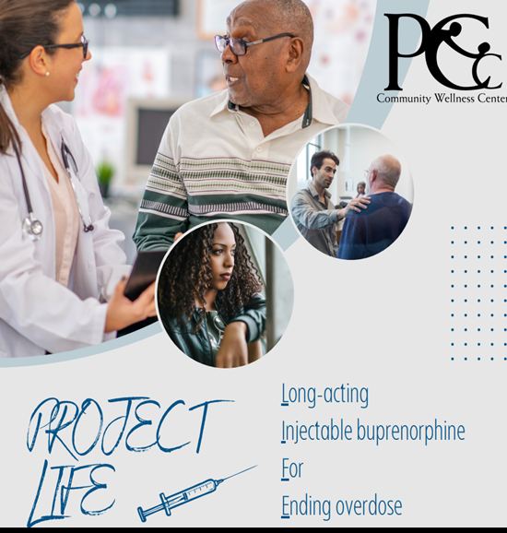
Inpatient rapid delivery and administration of long-acting injectable buprenorphine (LABI) for patients at high risk of overdose and death.
Easier than SL buprenorphine
Avoid rehospitalization for overdose and complications
Engage in continuity care
Notes:
Ruchi
Project LIFE: Long-acting Injectable buprenorphine For Ending overdose
Goal
Why Project life: easier than SL bup (daily med, difficulty with taste or aversion due to hx of precipitated withdrawal), Rehospitalization (protection from overdose for 30 days, decrease cravings), monthly follow ups move care from ED to CDC and PCP

Slide 16
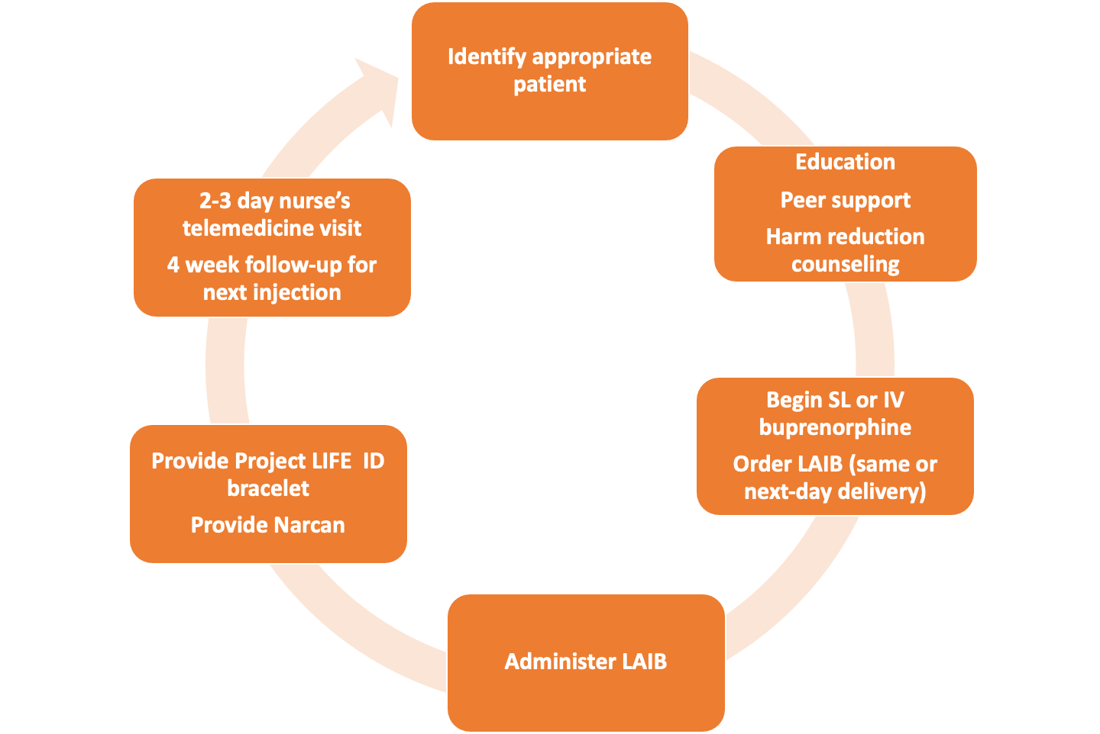
Project LIFE Workflow
Naloxone
Notes:
Ruchi

Slide 17
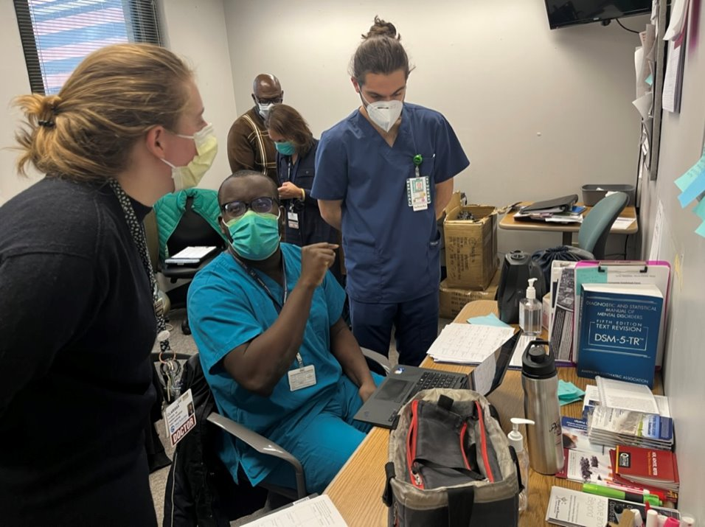
Our Team: Multidisciplinary Approach
Physicians
Nurses
Residents
Medical Students
Social Work
Peer Support
Notes:
Mistead

Slide 18
Project LIFE Patients
Opioid withdrawal or at risk of opioid withdrawal
Persons with HIV who have unstable SUD
Older adults = target population
Unstable housing
Postpartum patients prior to discharge
Methadone transitions:
*Cannot take methadone anymore or
want to switch
SELECT pregnant patients –
must meet criteria
Post overdose patient s/p naloxone reversal
History of leaving before medical treatment completed
SNF Placement
Notes:
Mistead

Slide 19
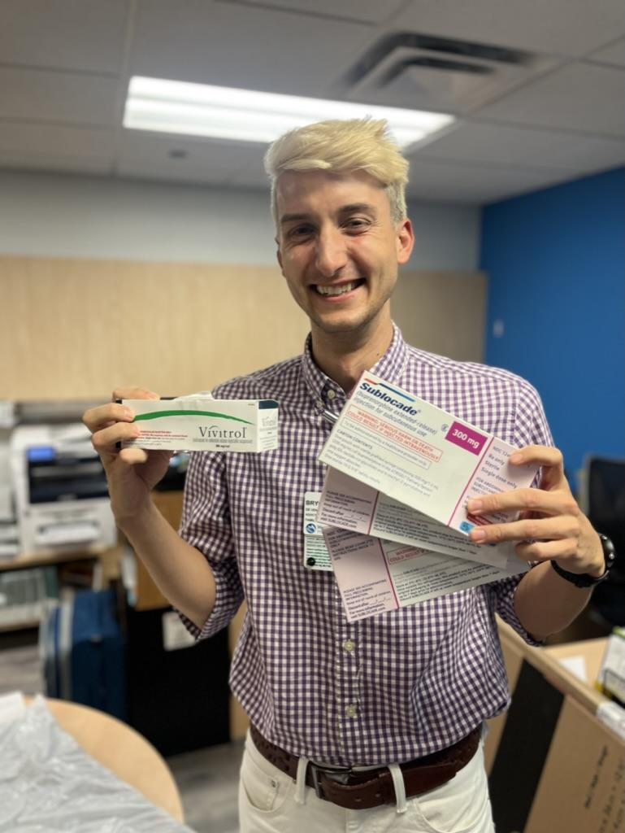
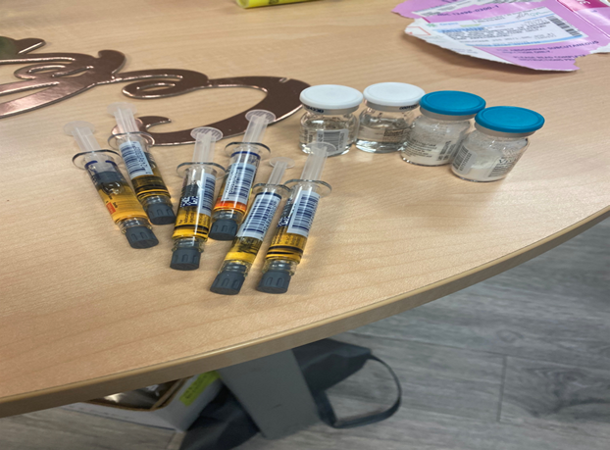
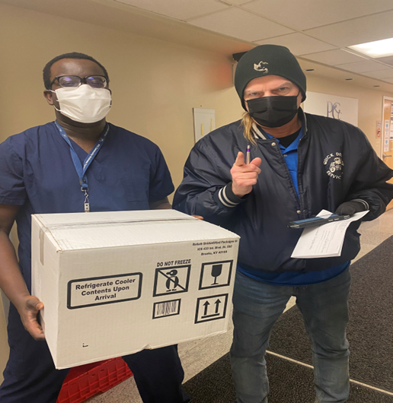
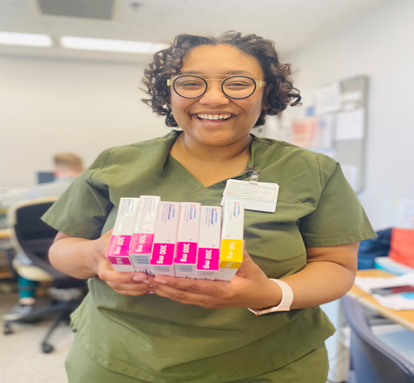
Daily Courier; High Volume; Teamwork to Prevent Med Waste
Notes:
Mistead– how popular it was
-it’s important for the program to be coordinated on a daily basis, outpatient appts coordinated to prevent medication waster
-refridgerated med
Other programs in the nation that do similar work: Highlands Hospital, Prevention Point, Cooper Health.

Slide 20
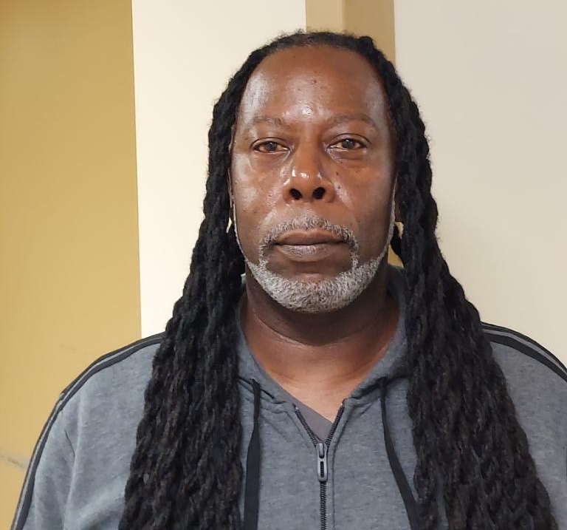
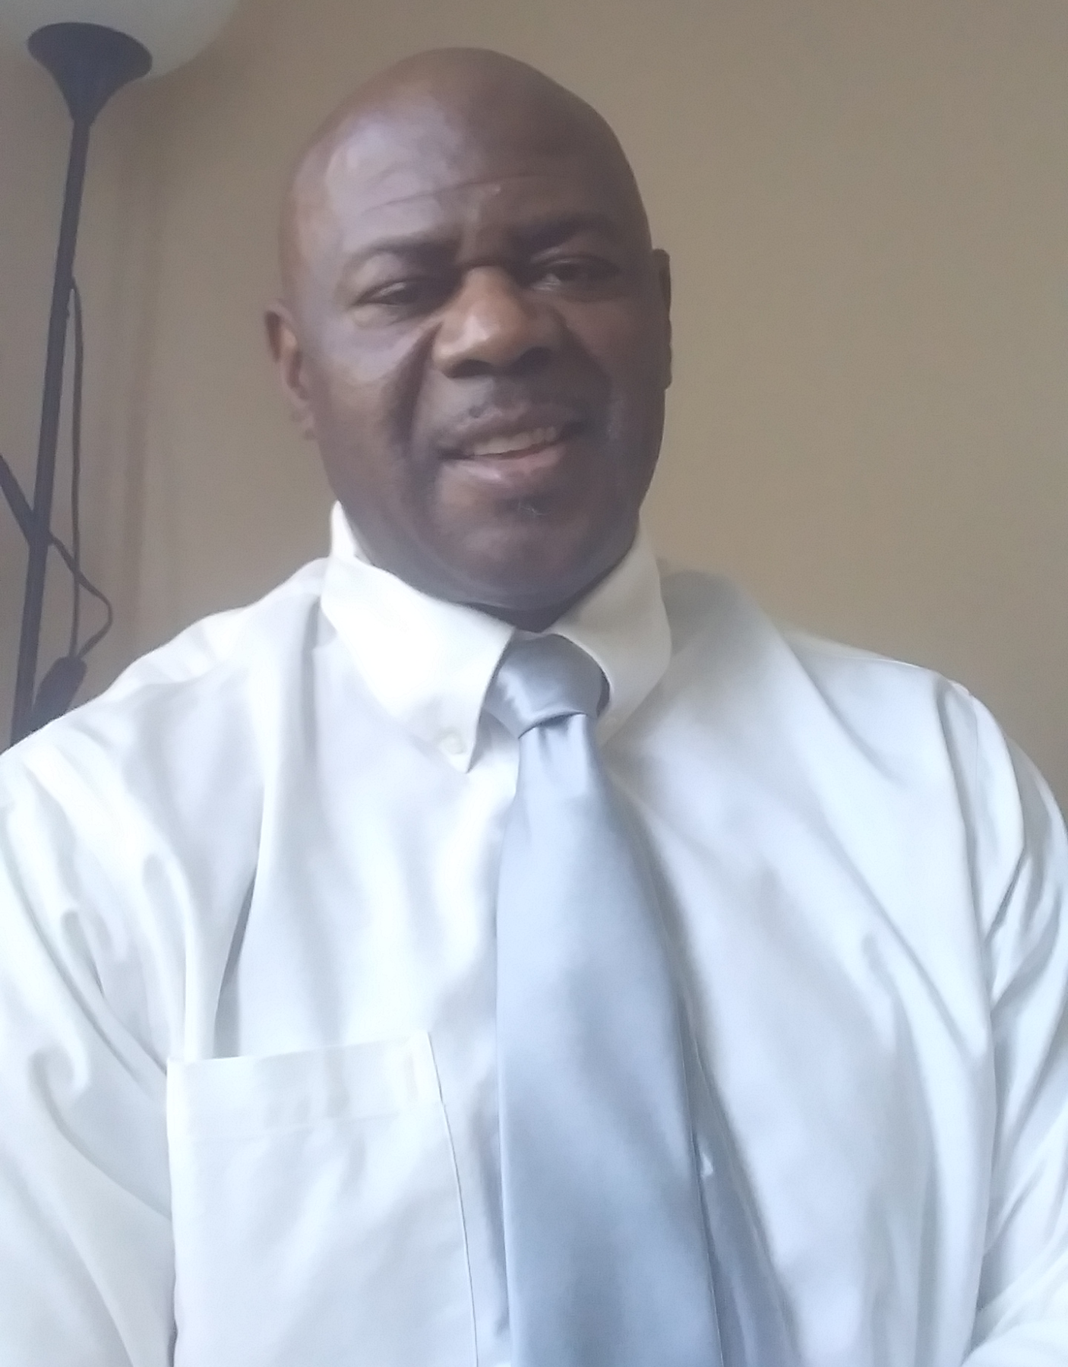
Peer Counselors' Perspective
“In my view, long-acting buprenorphine has had the greatest impact in reducing deaths attributed to opiate related overdoses. It’s a game changer because you can’t recover from the grave.”
– Tony Strong
“Long-acting injectable buprenorphine is an effective medication. That is a miracle changer. Changing individuals’ maladaptive behaviors for the better.”
– Darryl Clark
Notes:
Mistead

Slide 21
Pharmacy
LAI Buprenorphine must come from a specialty pharmacy (due to REMS)
Partnership with local specialty pharmacy offering daily delivery—now working on 340b partnership.
Our process: (once a pt agrees to LAI Buprenorphine)
Order LAI Buprenorphine in EMR and send electronic RX.
Managing administrative complexities:
1. DEA of prescriber address should match where LAI Buprenorphine is delivered to.
2. Order must come from that address as well (the address on EMR).
LAI Buprenorphine delivered to PCC (clinic, co-located in hospital)
LAI Buprenorphine picked up by Addiction Medicine team and brought to inpatient pharmacy. An order is placed on the hospital EMR for a "home med"
Inpatient pharmacy puts sticker on medication for inpatient administration
LAI Buprenorphine scanned by RN and administered to pt.
Notes:
Ruchi

Slide 22
Induction Approaches:
Low-Dose Buprenorphine to LAIB (1 day)
IV Buprenorphine
0.1 mg IV q3 hours ; start induction early in AM.
Full agonist
Oxycodone 10-20 mg PO q4 hours scheduled
LAIB
LAIB 300 mg SQ in mid afternoon.
As needed
lorazepam, clonidine, ondansetron
Notes:
Ruchi
The use of IV buprenorphine plus a full agonist has significantly improved patient comfort and success with the induction process.

Slide 23
Evaluation of Project LIFE
2 IRB-approved research studies
Retrospective chart review
Qualitative study/patient centered outcomes.
Research team: residents, Rush medical students, collaborators from Mount Sinai (NYC)-- Dr. Ethan Cowan and Dr. Siri Shastry
Notes:
Clarissa
IRB approval
research team, Mt Sinai collaboration, Rush medical students
methods
-ASAM posters
-written manuscripts are in progress
-multiple oral presentations requested

Slide 24
Inpatient Initiation of Long-Acting Injectable Buprenorphine At a Community Hospital: A Retrospective Case Series
Primary Outcome: hospital follow-up appointment attendance
First 46 patients to receive LAIB at WSMC
August 4 - December 28, 2022
Manual data abstraction from inpatient and outpatient EMRs
Demographic information
History of OUD
Prior MOUD
How long on SL or IV-BUP before injection
Notes:
importance of engagement

Slide 25
Results:
Age, mean (range) | 57 (29-71)
Female, n (%) | 24 (52%)
Race, Black, n (%) | 42 (91%)
Medicaid, n (%) | 39 (86.7%)

Slide 26
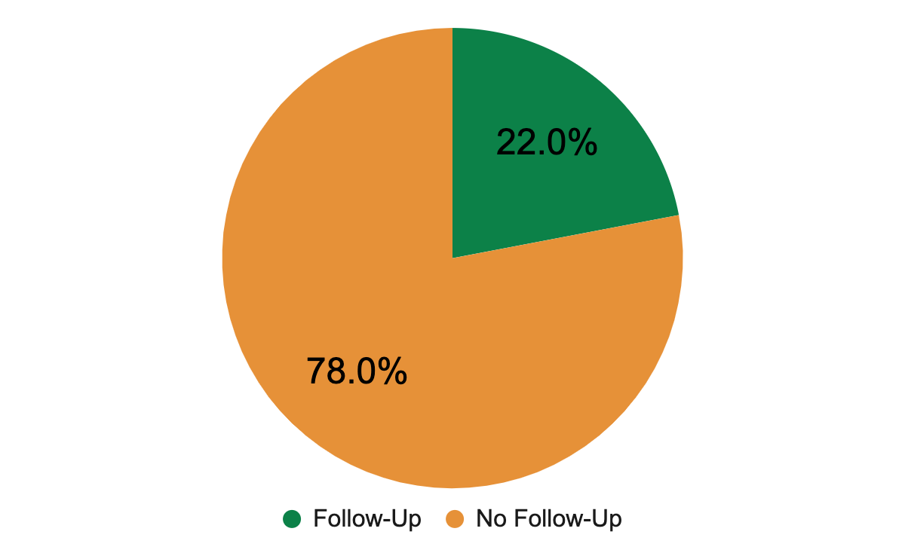
Before Project LIFE Started:
Notes:
11/1/2020-7/31/2022: patients with OUD who were seen by the addiction medicine consult service in the hospital attended a follow-up appointment in the outpatient clinic within six months
-just SL-BNUP

Slide 27
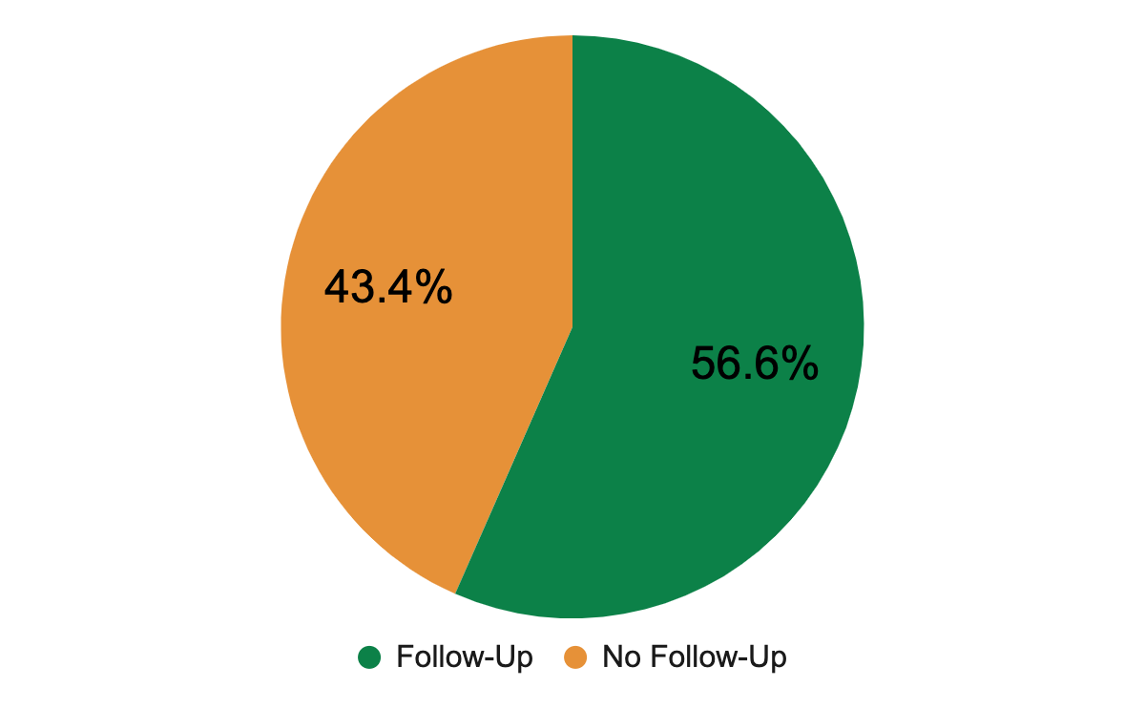
Results:
48% of patients received more at least one additional LAIB injection after discharge
Notes:
Dr. Cowan

Slide 28
Patient Perspectives on Hospital Initiation of Long-Acting Injectable Buprenorphine
Methods:
18 patients who received LAIB while hospitalized were interviewed
Two researchers independently coded the transcripts using an iterative, open-coding approach
Key themes and quotes were analyzed by the research team
Demographics:
Median age: 59
95% Black

Slide 31
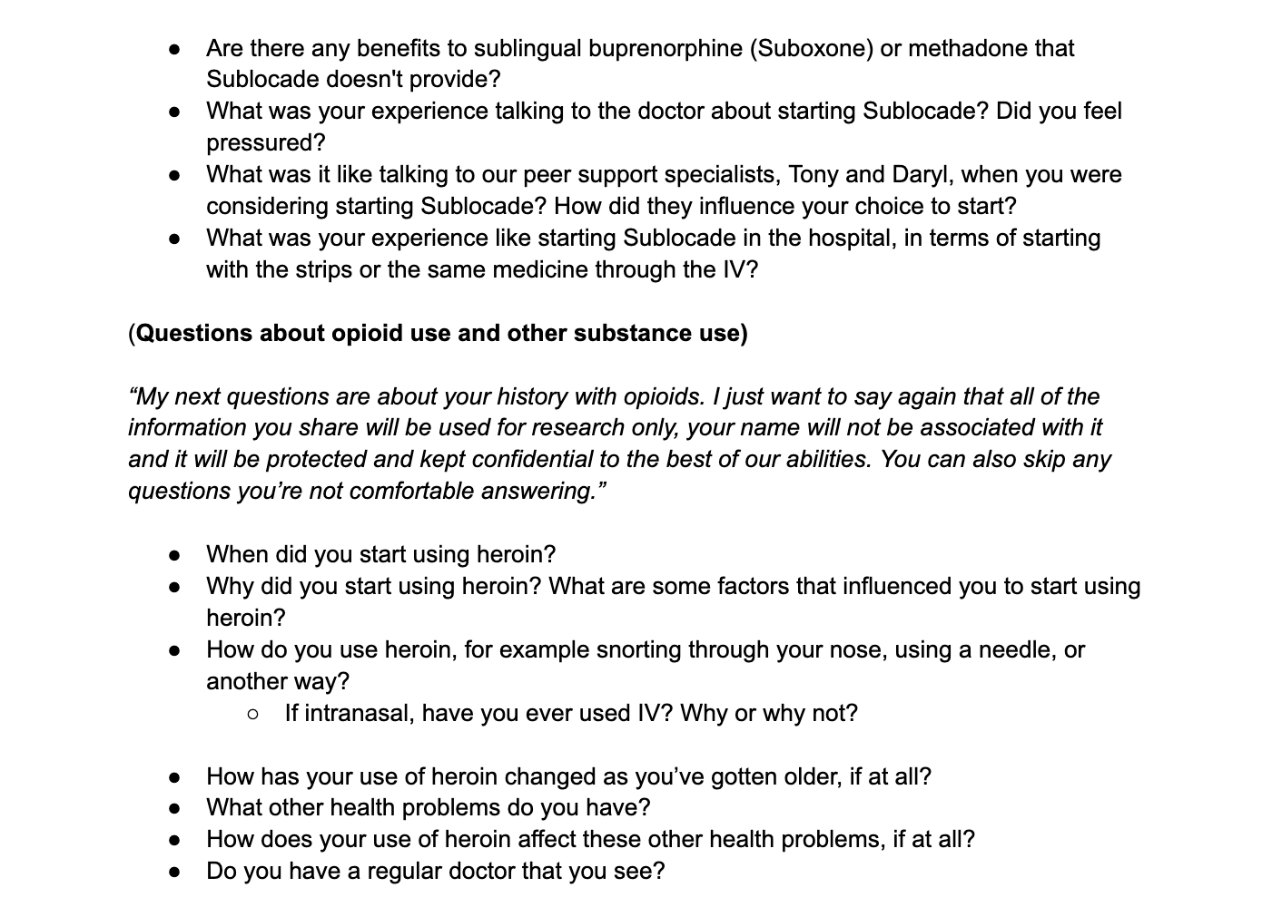

Slide 32
Key Themes:
Hospitalization
“I didn't never even know anything about [LAIB] until I got here.” (Participant 7)
“Yes. I wish I did start it early. I wish I knew about it, instead of coming to the hospital to find out about it, you know, I would've did something different.” (Participant 14)
Notes:
The majority of patients did not know about LAIB before hospitalization (56)

Slide 33
Peer Support
“Darryl was the one who influenced me to get the shot. He spoke to me and you know, about his past and, you know, his, his, you know, his journey, what he'd been on and stuff, that road he been on, and you know how he got himself back up on his feet and stuff, you know, where he was and what he was doing and things.” (Participant 19)
“I talked to a guy when I was in the hospital and he called me a couple of times on the phone. So he gave me a lot of moral support about the [LAIB]. He gave me a lot of moral support because I was like leaning towards against it at first. And he was like, well, just give it a try, you know? So I, he was very helpful to me for that.” (Participant 14)

Slide 34
Counseling
“They asked me to get it, I took it. And then when I came back, this guy, she was trying to give it to me. The lady was trying to get me take it too. It's like, I just didn't want trust her. I ain't remember you took two shots. It was one. She kept telling me, you gotta take one shot, the lidocaine or something so it won't hurt or something… That kinda made me didn't wanna mess with it too.” (Participant 10)
“At first I did, but I know they was just trying to help me.” (Participant 11)
“He was explaining, you know, explaining it to me. I was like, I was still sick and in pain, you know, at the time when he was telling me so I really wasn't hearing what he was saying. And you know, but he asked me, he told me he was going to give me the shot and I was like telling him, no, let me wait for a minute. Let me wait for a minute. And you know, he just forced it upon me and just did it anyway, so. I didn't like that because I asked him to wait. Right. And he did it really without my approval at the time…. Well I guess it turned, it didn't cause any problems, so turned out better.” (Participant 18)
Notes:
about halfway through, we started asking about this, 3 patients

Slide 35
Drug Supply
“I'm not really good with trying new things, but I said give it. You been trying this, they got fentanyl. I never had fentanyl. Down here fentanyl taking people out left and right. You might as well try this here. You try the fentanyl.”
(Participant 3)
Overdose
“I wanted to stop using drugs because my friend OD'ed off of it and that could have been me. So it scared me, you know, when you wake up next to a person that's dead, it do something to you, so that's what made me want to get clean.”
(Participant 7)

Slide 36
Disadvantages
“I thought it was gonna be something like that if you take the heroin, it'll make you sick. Like ‘I ain't doing that no more,’ you know, or whatever, so you stay off of it. No, it still the same or whatever. Maybe I didn't get as high, but I got high.” (Participant 10)
“Yes. I got a big lump here. And then, and then one time I had about four or five lumps where they would gimme shots at. And it makes you kinda scared and stuff. But you can, I can live with that lump and I can live because I don't have to wake up and be sick or nothing.” (Participant 19)
Notes:
one person it didn’t work for
only one person talked about the lump
only one person talked about pain of injection
decreasing dose
wearing off

Slide 37
Benefits
“I got grandkids now and I retired and I'm able to wake up and tend to my grandkids normally, not wake up and all while I got to get this and do it. And so I can feel normal.” (Participant 6)
“I feel so much better now. I'm eating right and everything.” (Participant 5)
Notes:
appetite
stability
mood
family
health

Slide 38
“I never heard of this. A lot of people have it, but I never heard of it. But now that I know I'm gonna let many people I know possible cause it's lifesaving.”
“And now it's up to me to take advantage of the shot before the heroin kills me. And the shot trying to save me. And then I got a support team behind the shot. I don't have nothing behind the heroin, but the dope pusher, just trying to get my money from my pocket. Now with the shot, I'm keeping my money in my pocket.”
“This 30 day shot, it'll pick you up. It works wonders. It makes you feel whole and human again.”
“They told me what they expect and what it was gonna do. And I was like, he must have just came up with this because, uh, only times I been using for these 40 years, I never heard no physician tell me I got something that might help you from killing yourself. Furthermore, keep you alive and keep you from ODing and then will not have you craving, sitting there about to jump out your skin to get a fix. Okay. So I said, it can't be no worse than what you already been through. So I said, give it a drive.”
"It feels like I have never done drugs before"
“You got a chance to basically feel normal for a change.”
“I feel like the shot is stronger. Like, I don't know how to explain it. I just like, I don't have like the thought like thoughts and cravings. Like I just feel good and energized and like I could do things and that's, that was my problem with the methadone. I had no motivation and I was tired all the time and depressed. So because I was so tired, I was, I couldn't do anything and it made me in a depressed mood and then I wanted to use. So it's nice just to have energy.”
“I recommended to one of my friends, he come down he started the shot what, maybe about two weeks ago. Told one of my friends that was using to come up to West Suburban to get their shot. He came and started on the shot.”
“No, I haven't used since I took the shot since I've been out. Like I said, I haven't smoked a cigarette. I haven't had a craving or used or nothing like that.
Notes:
Mistead

Slide 39
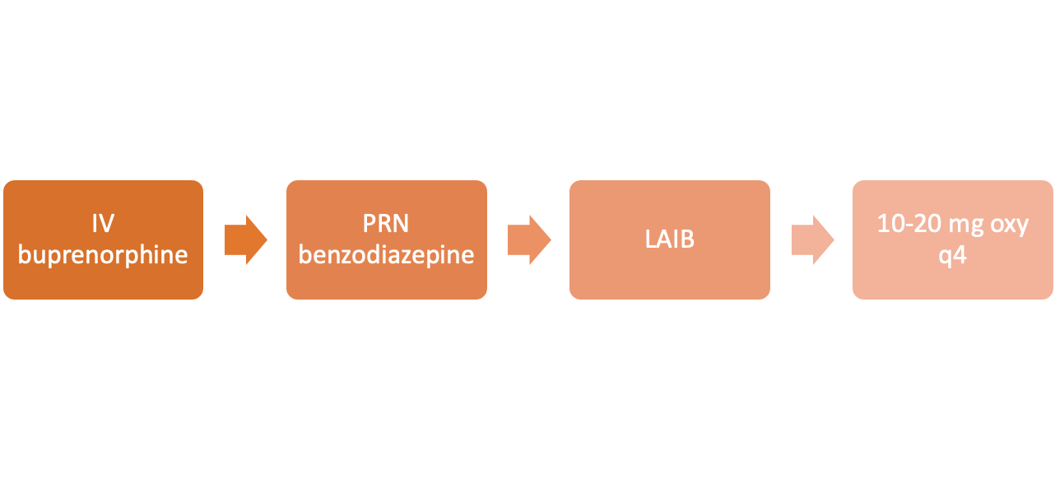
Induction Approaches:
High Dose Buprenorphine to LAIB in Sixty Minutes
**Patients in severe withdrawal or Precipitated Opioid Withdrawal**
4.2 mg IV buprenorphine infusion over 1 hour or 16-32 mg sublingual
14 vials (0.3 mg/vial)
Equivalent to 13 mg sublingual
2 mg lorazepam prn (may repeat)
Administer 300 mg LAIB during infusion
Do not have to wait until infusion has completed prior to administering injection; and give additional 16mg SL buprenorphine if patient agrees.
Expect ongoing withdrawal
Can use oxycodone or IV hydromorphone for 24-48 hours post LAIB or supplemental buprenorphine.
Notes:
Fran
Worked on this protocol with national team (Highlands, Ventura County) that included pharmacists.

Slide 40
Methadone to LAIB (2-3 days)
Switch methadone to oxycodone 10-30 mg PO q4 hours scheduled
Start IV buprenorphine 0.1 mg/hour x24 hours infusion
Administer LAIB 300 mg SQ; continue oxycodone x 24-48 hours.
DAY 2
DISPO
DAY 1
DAY 3
Increase IV buprenorphine to 0.3 mg IV q4 hours. IF patient is discharging, give LAIB and discharge with oxycodone
Ensure naloxone, follow up appts, and that patient returns leftover methadone to their program.
Notes:
Fran

Slide 41
Long Acting Injectable Buprenorphine Considerations
Health Justice is not achievable without addressing:
Restricted distribution REMS medication | Requires specialized process to obtain med.
Cold storage - sometimes arrives warm | Safety net settings unable to set up formulary or buy and bill due to cost
Prior Authorization or refusal to cover medication - Commercial insurance may not cover; very limited options for uninsured | Many Medicare pts; or patients on brink of going on Medicare→many patients go without the med.
Painful especially for the malnourished and thin person | We often run out of injection sites for our thin patients and recognize that in thin patients, it may be less effective
Dose may not be sufficient for people who use IV fentanyl or patients who are use heavily; use of other substances. | Unable to give higher doses, or a second dose within 28 days. Seeing uptick in overdose.
Delivery setting: Health care only | No mobile options; no home health options
Notes:
Mistead
REMS: A Risk Evaluation and Mitigation Strategy (REMS) is a drug safety program that the U.S. Food and Drug Administration (FDA) can require for certain medications with serious safety concerns to help ensure the benefits of the medication outweigh its risks. REMS are designed to reinforce medication use behaviors and actions that support the safe use of that medication. While all medications have labeling that informs health care stakeholders about medication risks, only a few medications require a REMS.

Slide 42
Addiction Medicine Consult Service
45-80 patients with OUD seen every month
Actively see patients in the Emergency Department; sometimes multiple patients after nonfatal overdose
664 patients seen between 7/1/2022 and 5/31/2023
536 patients had severe OUD
Notes:
Fran

Slide 43
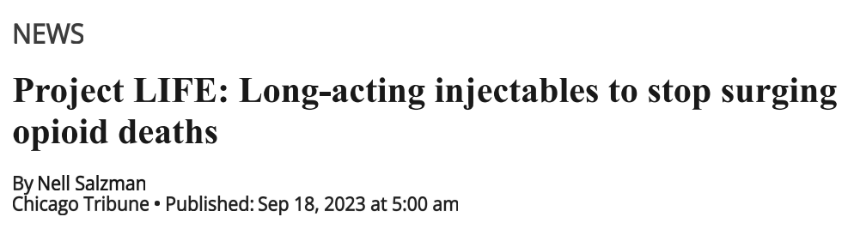
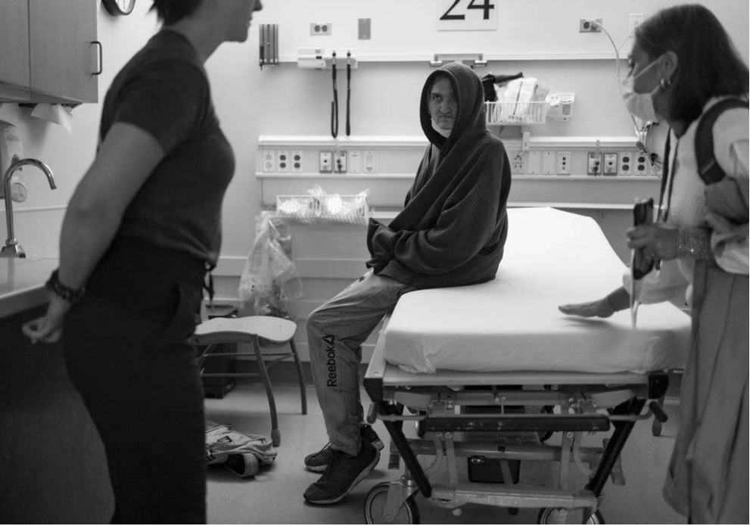
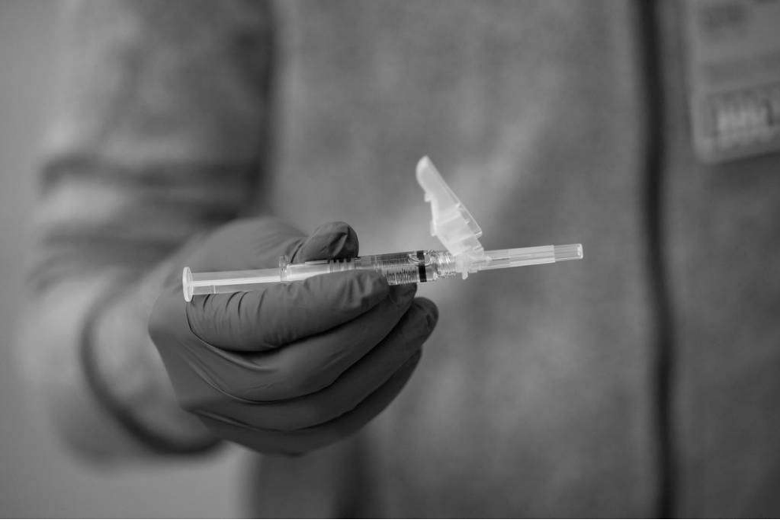
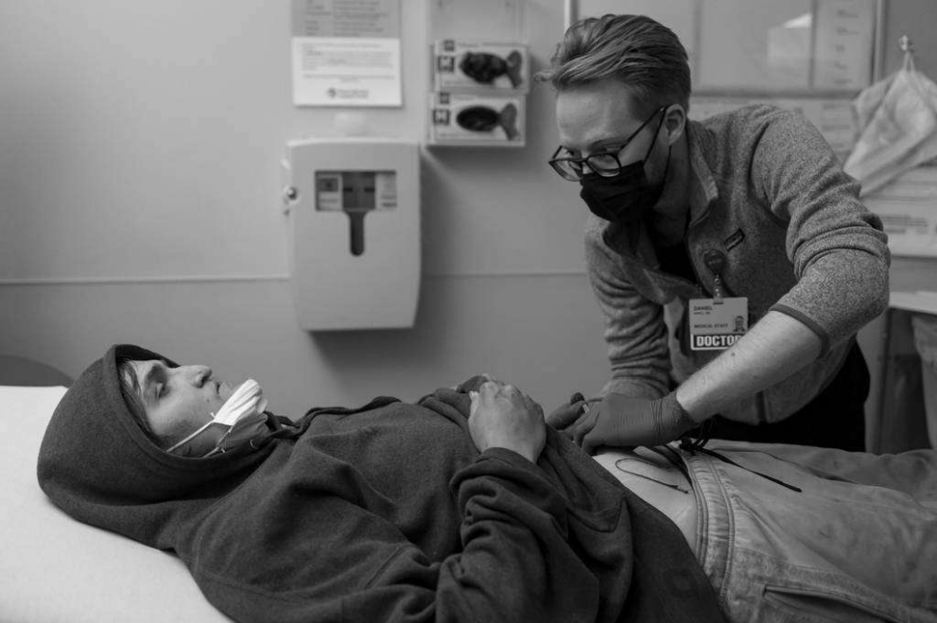

Slide 44
Gratitude
Shai Farhi, MD (Rush)
Emma Klug, MS4 (Rush)
Ethan Cowan, MD (Mt Sinai)
Andrew Merker, Pharm D (Midwestern))
Tran Tran, PharmD (Rush/Midwestern)
Tipu Khan, MD (Ventura County)
Andrew Herring, MD (UCSF)
Erik Anderson, MD (Highlands Hospital)
Lauren Roller, PharmD (Highlands Hospital)
Dorothy Manuel, Sarah Hogue, Hannah Moore (PI Department, PCC Community Wellness Center)
Jerrard Walker, Chief of Population Health, PCC Community Wellness Center
Our patients and their families
AMC TEAM and Project LIFE/ PCC Chemical Dependency Center
Ruchi Fitzgerald, MD, Service Chief
Katie McDonough, MD , Outpatient Director
Francesco Tani, DO, Assistant Service Chief
Takara Wallace, Director of CDC Care Coordination
Clarissa O’Conor, MD
Lauren Harriett, MD
Mistead Sai, LSW (PCC)
Aria Armstrong, MS2 (Rush)
Notes:
Bryce

Slide 45
Notes:
Project LIFE: Long-acting Injectable buprenorphine For Ending overdose
Engages a multi-disciplinary approach including Peer Recovery Coaches, Social Workers and Addiction specialists
To educate and coach patients admitted to the hospital on long acting injectable (LAI) buprenorphine.
Built on inspiration of work done within Ward 86/Project SPLASH. SPLASH is (Special Program on Long-Acting Antiretrovirals to Stop HIV), a regimen of monthly injections to administer long-acting anti-retroviral therapies, with promising findings of using CAB/RPV LA is a combination of two injectable prescription medications used together to treat HIV-1 infection in adults and adolescents 12 years and older. CAB/RPV LA contains two different medications: cabotegravir, an integrase strand transfer inhibitor (INSTI), and rilpivirine, a non-nucleoside reverse transcriptase inhibitor (NNRTI) in non-virally suppressed patients.

