Slide 1


Family Medicine Research Unit
Monthly Meeting
May 2024

Slide 2

Recently Submitted Proposals / Processed Awards

Slide 3

Upcoming Holidays
Monday, May 27

Slide 4
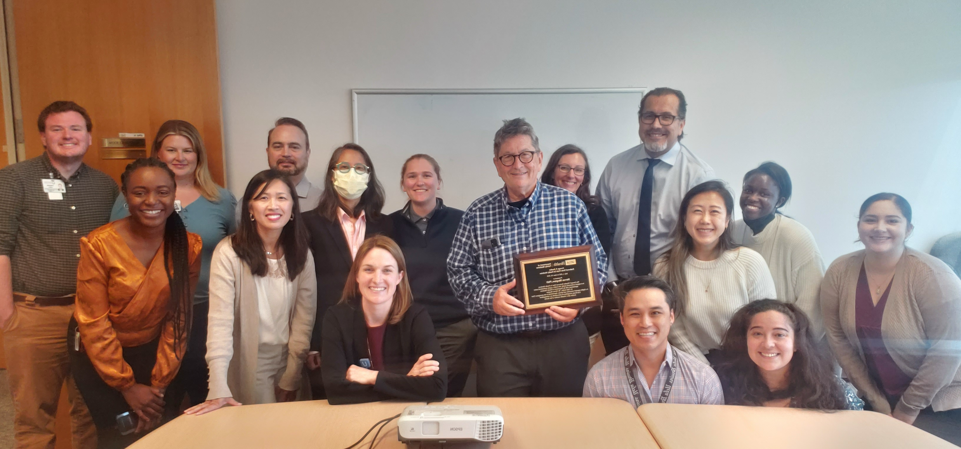
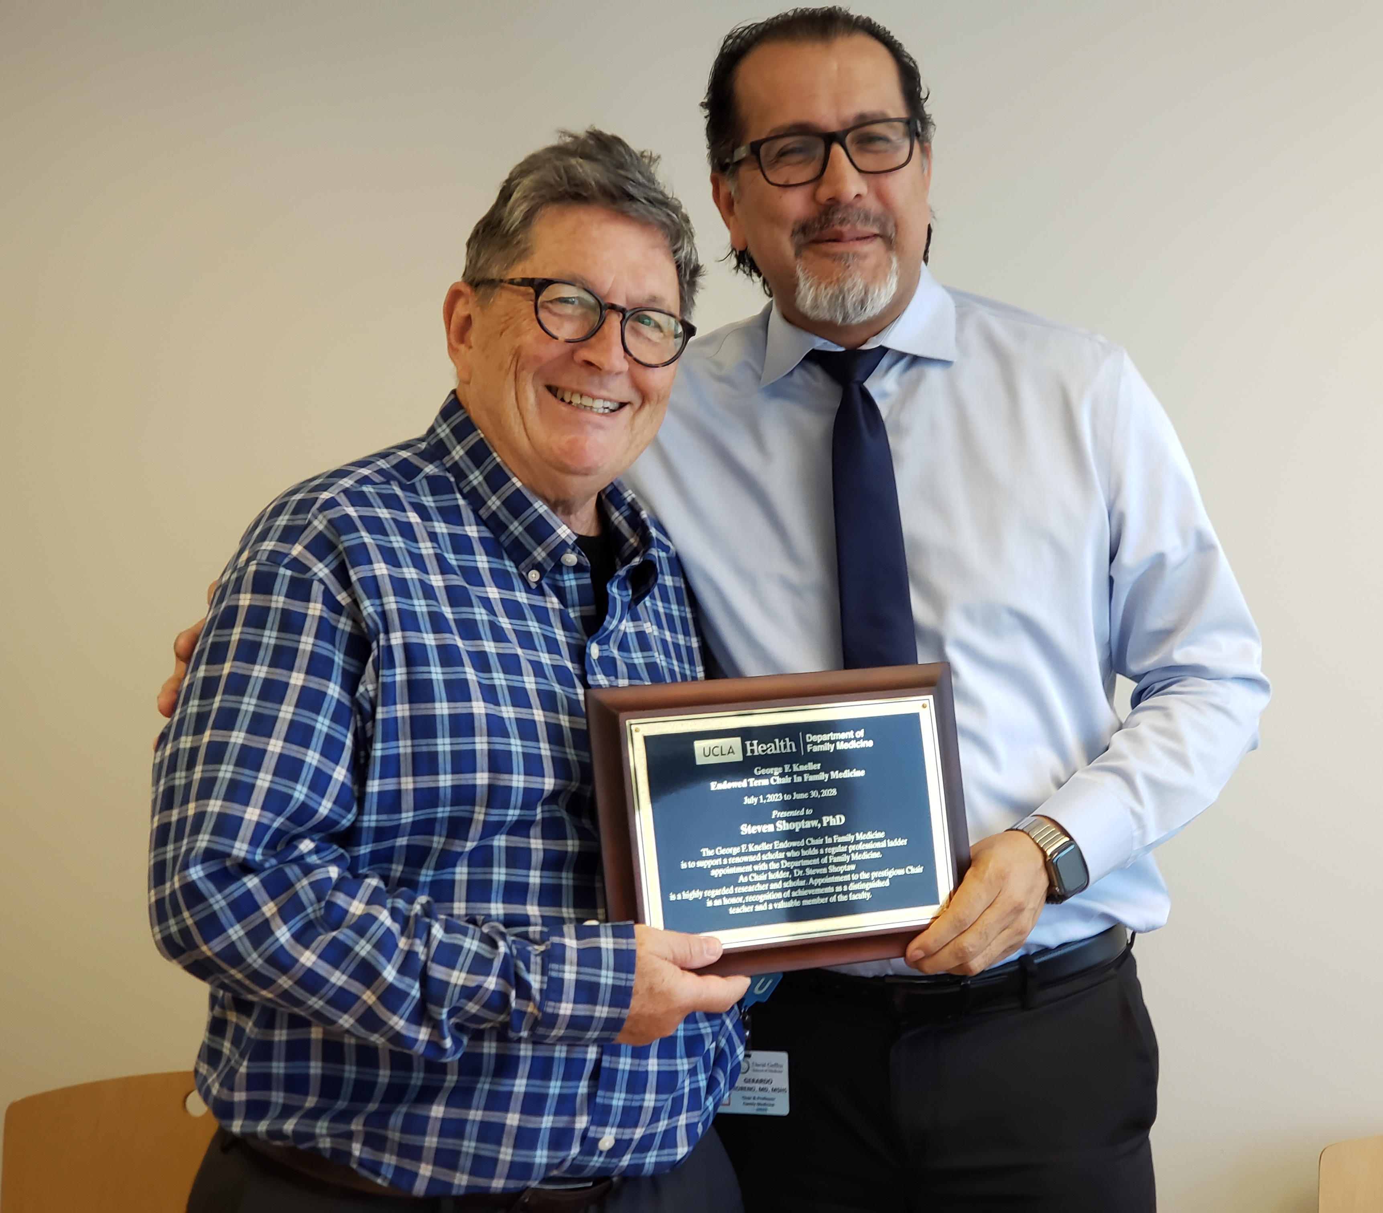
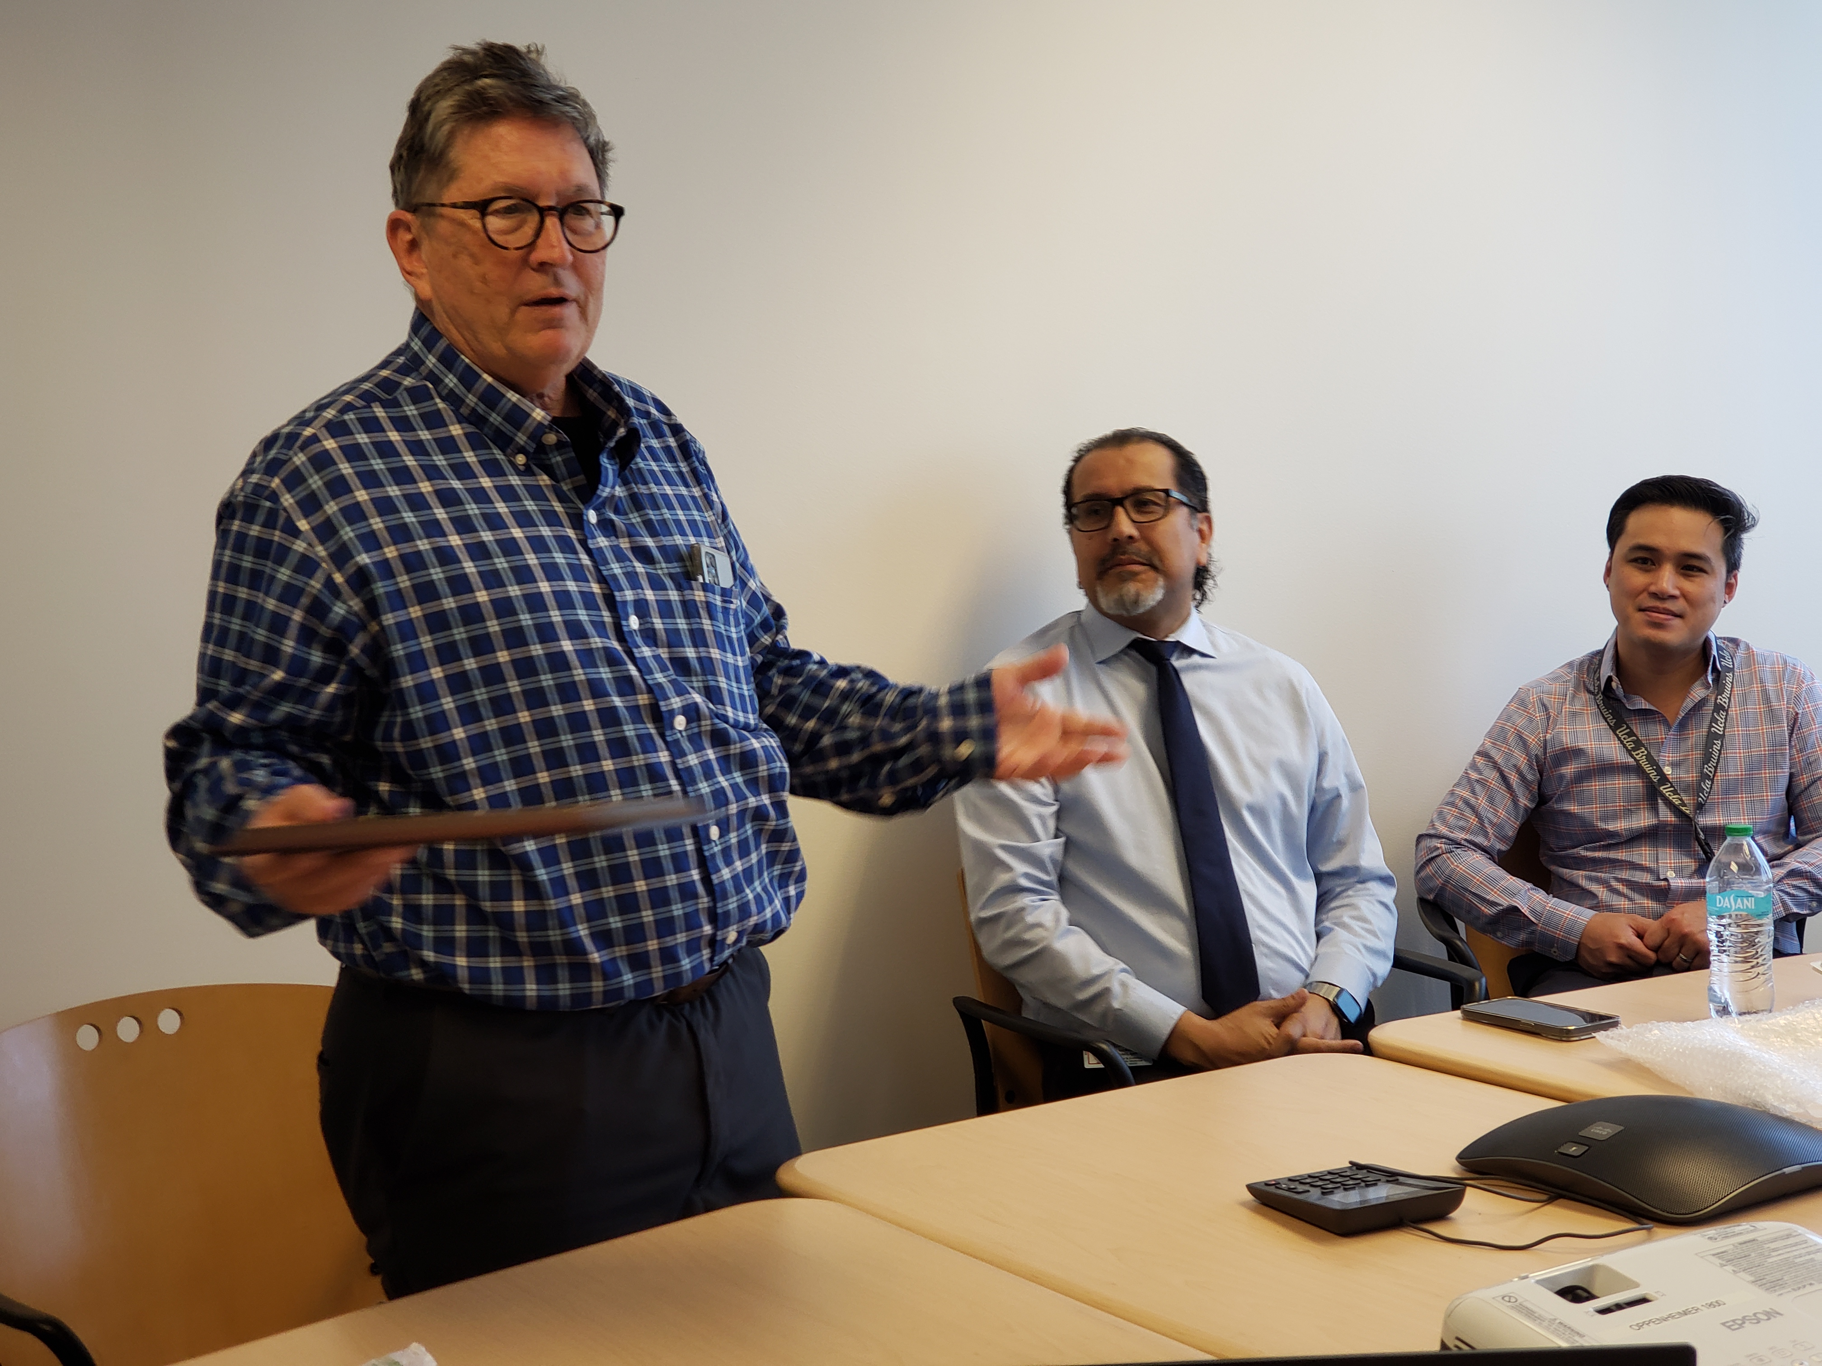
Shoptaw – Kneller Chair
Congratulations!

Slide 5
Performance Evaluations
Final evaluations with both manager and employee signatures for all union-represented employees are due to HR on May 6
For career staff in non-represented, non-academic positions:
                Managers should have submitted evals for Leadership review already. If not: must be submitted ASAP.
                Managers will get calibrated reviews back after May 12.
                Managers should meet with employees to review/sign off between May 12-June 9.

Slide 6
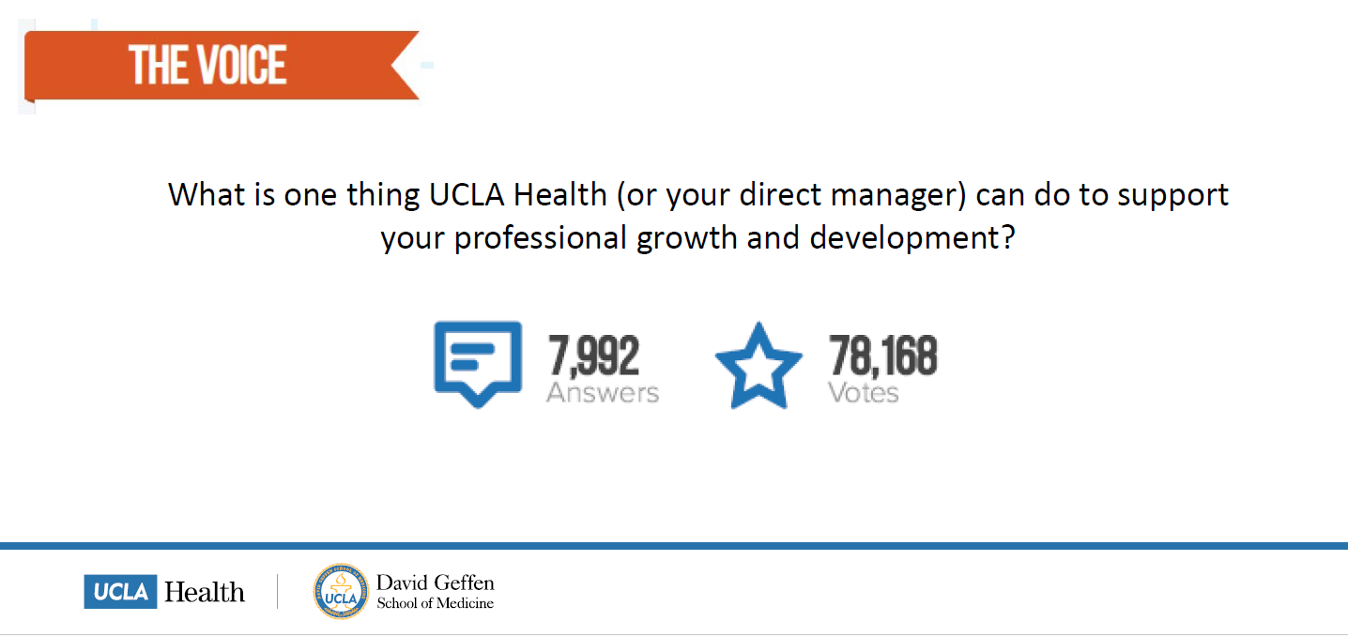
Employee Engagement Survey Results

Slide 7
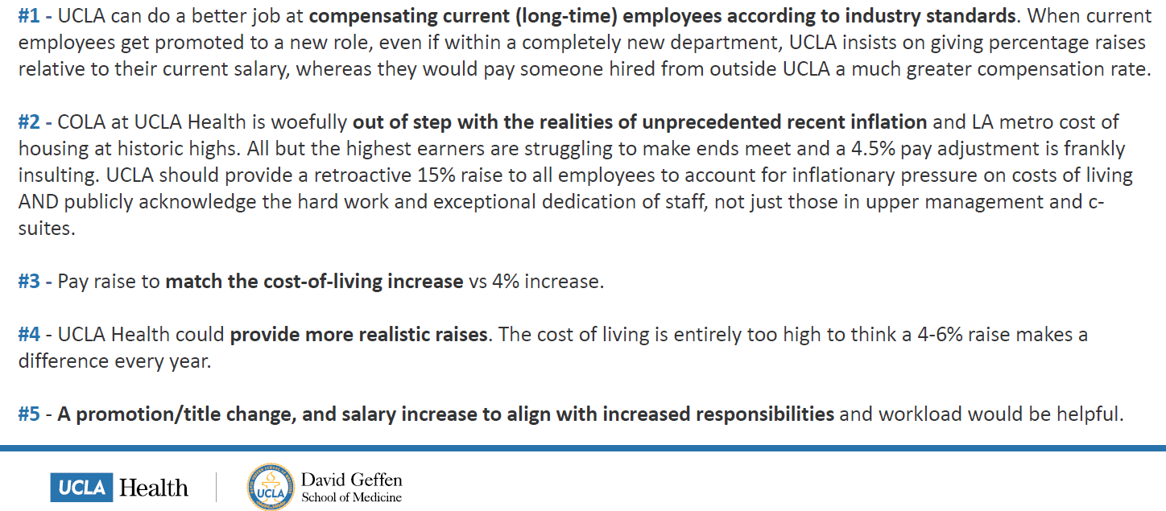
Employee Engagement Survey Results

Slide 8
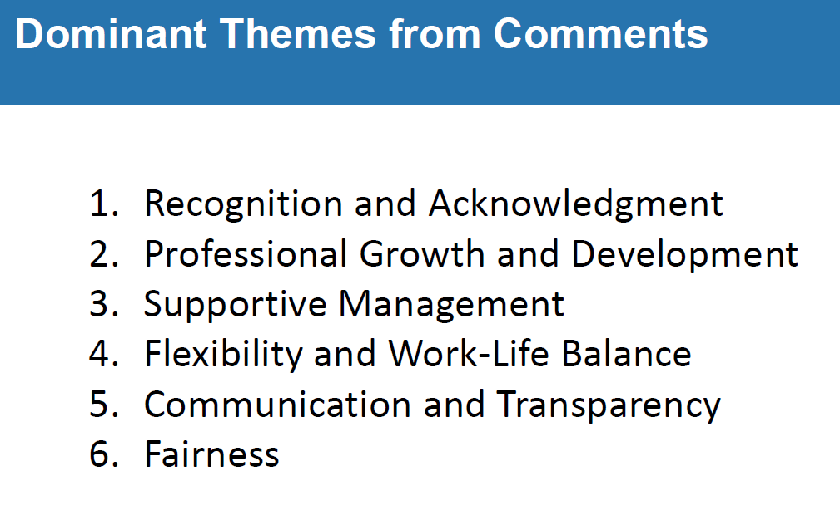
Employee Engagement Survey Results

Slide 9
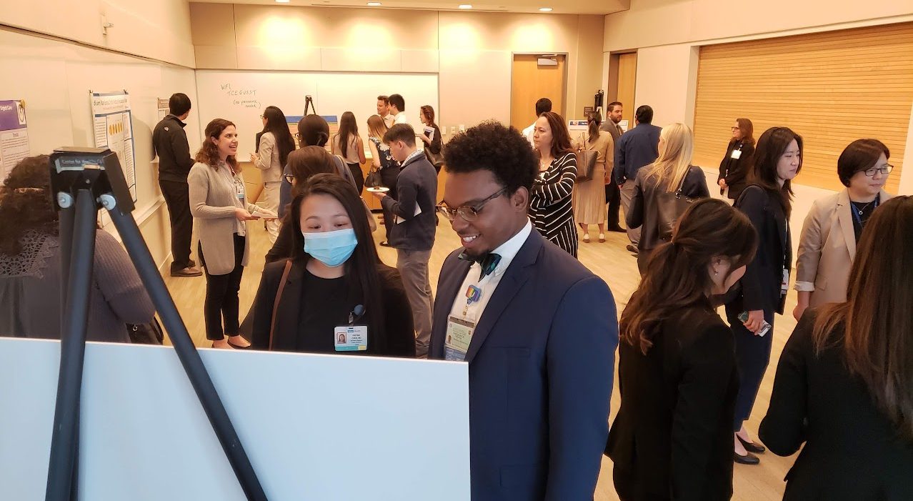
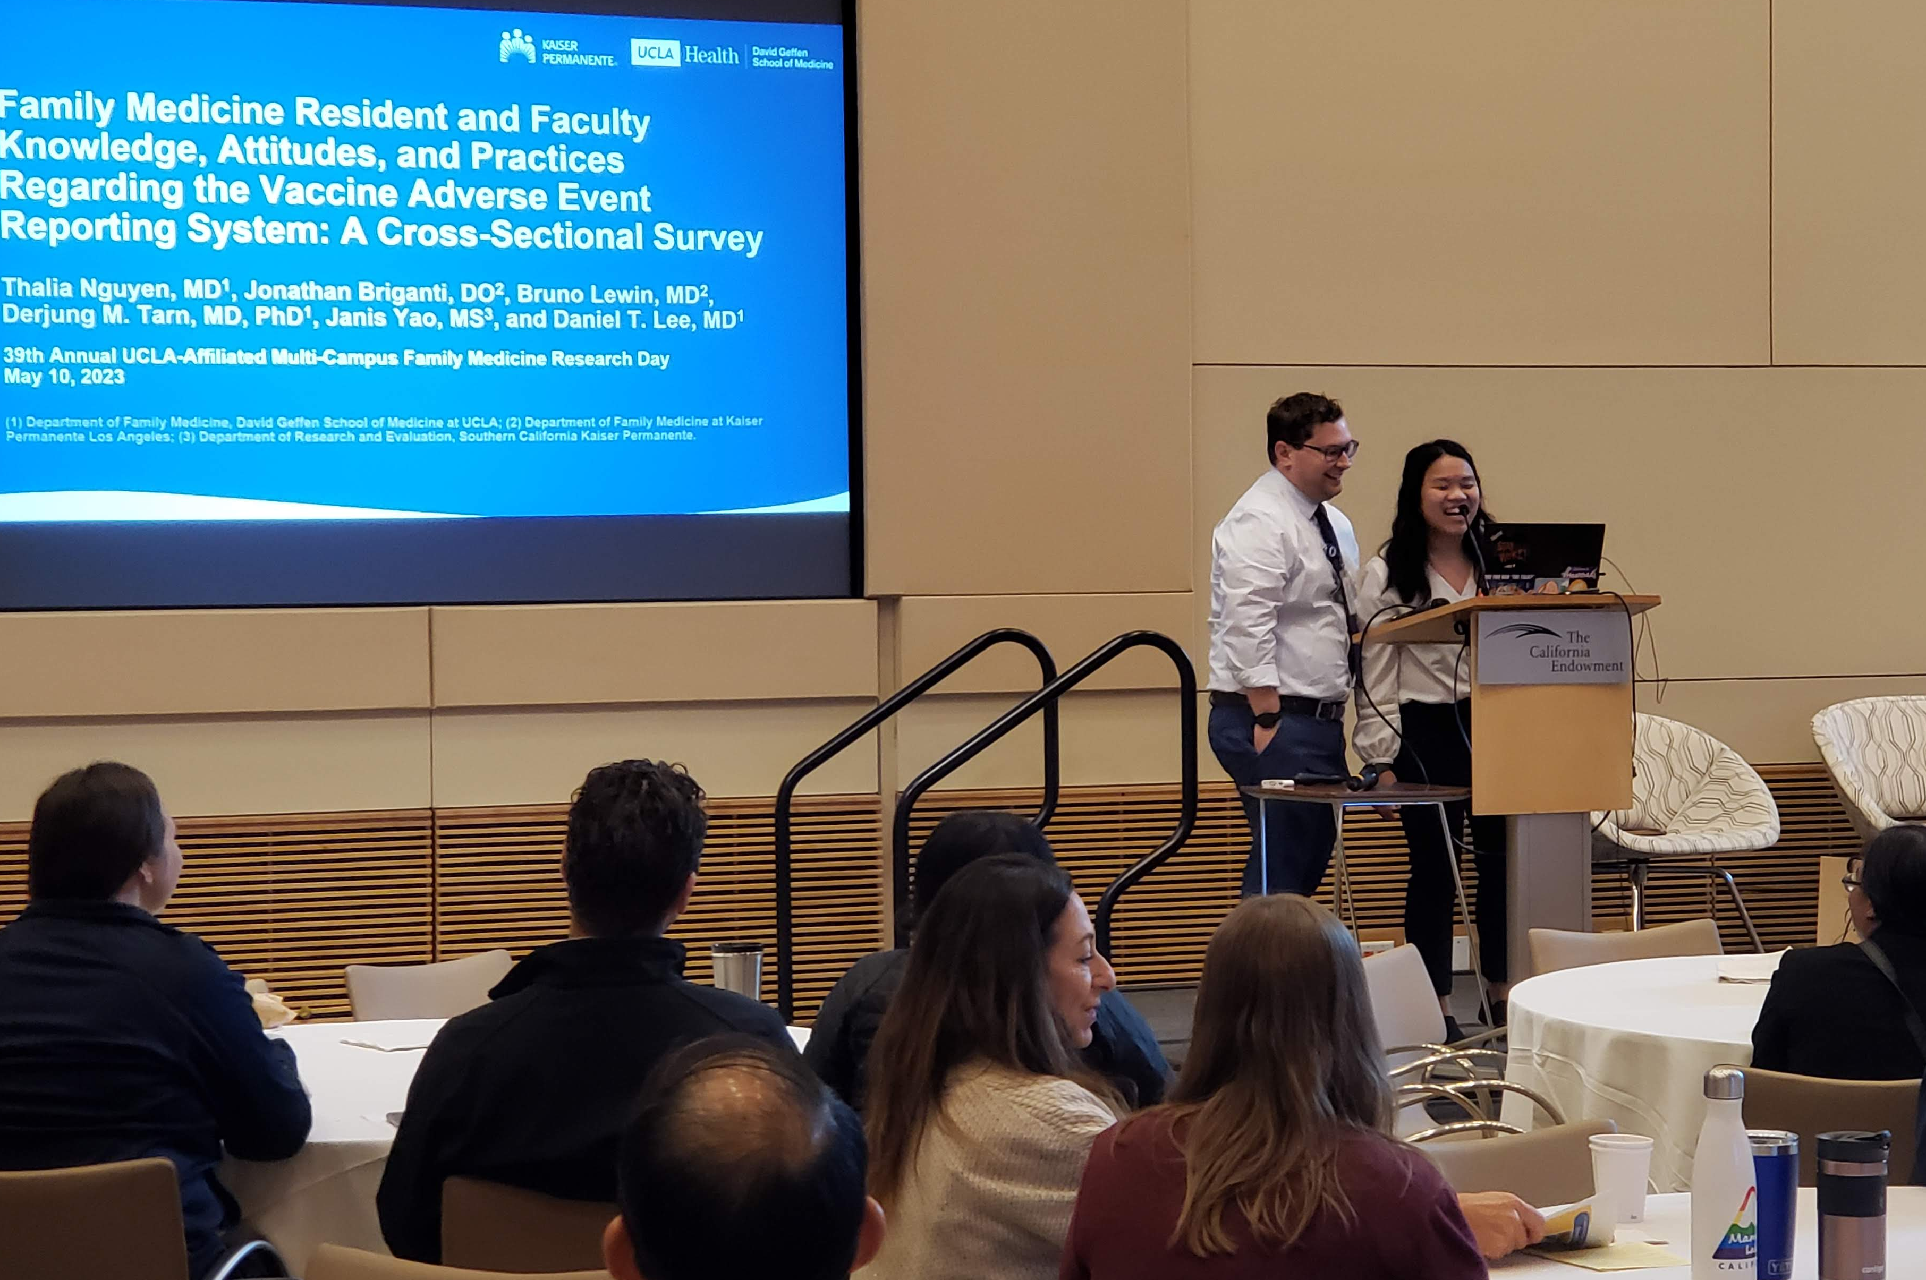
Research Day
In-person at the California Endowment downtown
Wednesday, May 22, 2024; 11:30a-4pm
Keynote Speaker: Dr. Tony Kuo
Contact Authors should have received acceptance letters and instructions for posters/lecterns
Visit website for more info: https://www.uclahealth.org/departments/family-medicine/research/research-day
Please RSVP by May 7!

Slide 10
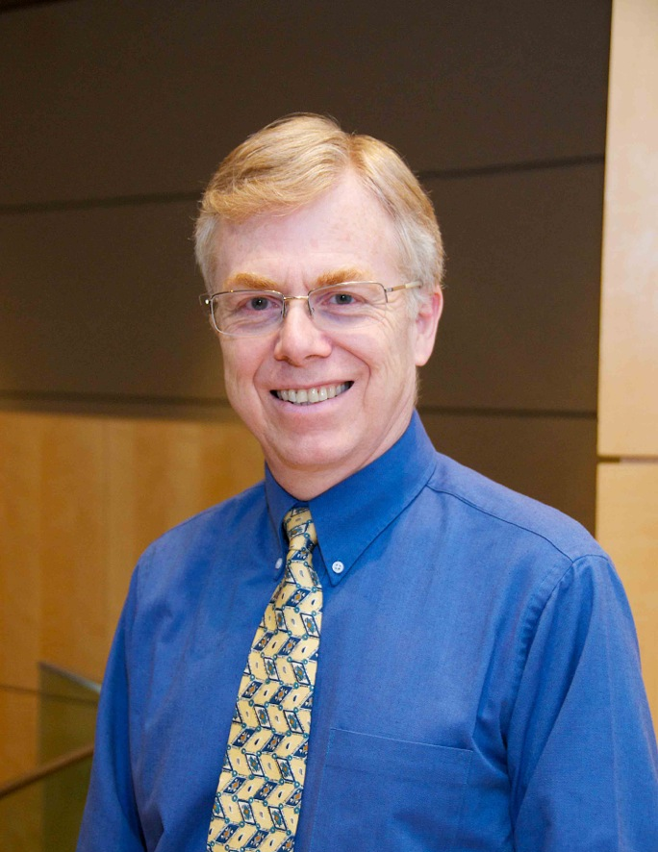
Grand Rounds
May Grand Rounds
Friday, May 24, 2024
12:00pm-1:00pm
Dr. Kurt Stange
How Family Medicine and Primary Care Contributes to Population Health

Slide 11
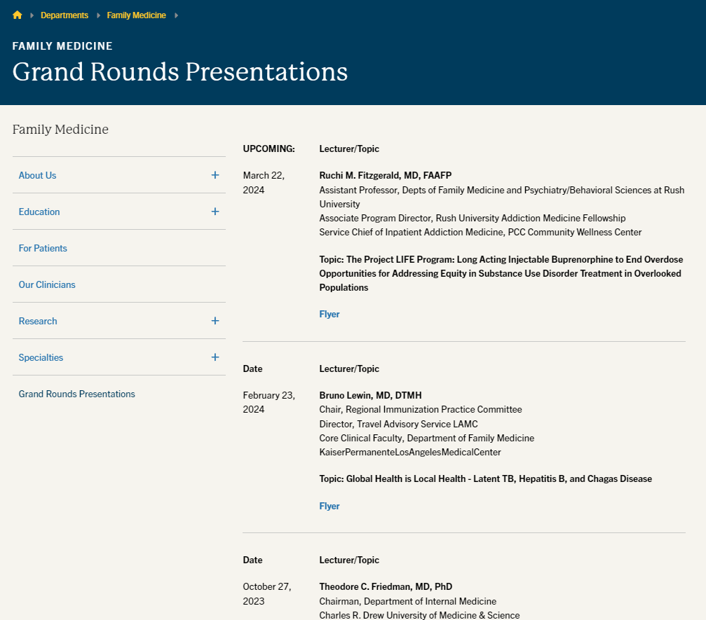
Grand Rounds Website is now live (with speaker/topic information, flyers, and selected slide decks)

Slide 12
Research Faculty Meet the Residents
Wednesday, July 17, from 8-11am
  Faculty are required to attend, or send proxy
  Opportunity to meet the residents, introduce yourself and your research foci
  Each faculty member will have approximately 10-15 mins; PowerPoint optional
  RSVP to Laura and let her know which time slot you prefer
  Will be conducted via Zoom

Slide 13
Fund Manager Updates – The Bad News
Lois
Hi!
Bye!
Lois Hernandez, our brand new fund manager who started April 1, was just offered her dream job and will be leaving us May 19.
If you have any urgent fund manager needs, please work with her over the next two weeks to get as many issues resolved as possible.
Pediatrics is also experiencing a fund manager shortage and will not be able to assist as they did previously.

Slide 14
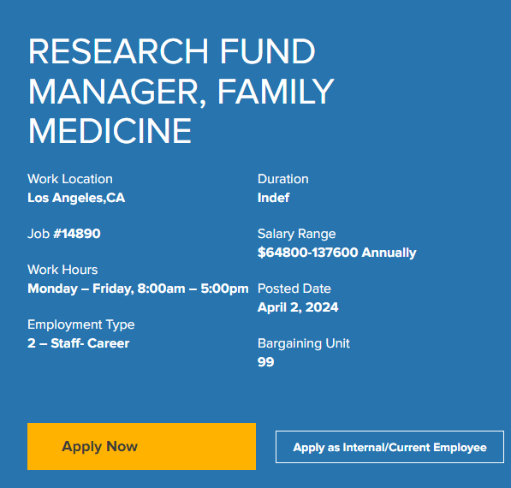
Fund Manager Updates – The Good News
We already had a 2nd Fund Manager position posted, and we are already conducting interviews.
We hope to have at least one of our two open fund manager positions filled sometime in June.
We are working on contingency plans for the short-term.

Slide 15
Fund Manager Updates
If your fund manager is not Chris/Andrew: For now, not much will change since Lois was still in training anyway.
You or your approver should continue to reach out to Laura and Valencia for procurement approvals (gift cards, purchase requests, travel reimbursements)
Laura will help create financial reports for review
Laura and Valencia will help set-up/manage subawards
Laura will submit Close-Outs until another solution is found
Please take extra initiative to manage your own financial portfolio as best you can and schedule meetings with Laura if you need assistance

Slide 16
Plan Ahead
Laura was scheduled for a 2-week vacation June 10-21.
In light of recent events, she will instead be doing a reduced-work load during that period:
If you are planning any proposals that are due during this period, or the end of June, please reach out to her and Chris NOW to get those proposals submitted prior.
If you have any major fund management needs (e.g. subaward set-ups, fund closures, massive purchases), please reach out to her/Lois now to get them resolved or create a workplan.

Slide 17

Off-site Furniture, Computers, Equip, etc.
Supervisors: Please create inventory of any furniture (desks, chairs), computers/ peripherals (laptops, keyboards, mice), cell phones/tablets, and any other equip/devices that your employees have at home/off-site.
Upon separation, it will be your responsibility to make sure the employee returns these items (along with ID badge, office keys, and building access card)

Slide 18
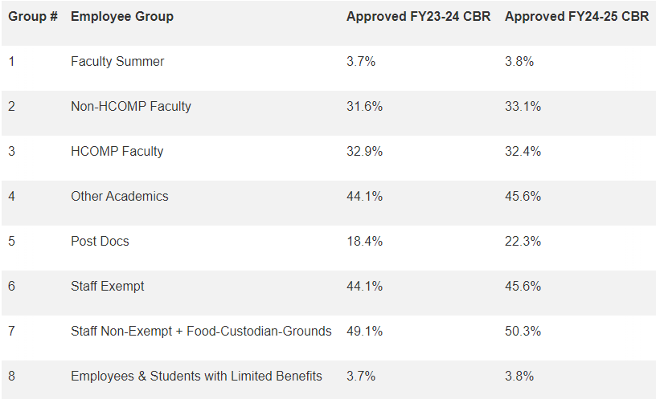
Updated F&A Rate Agreement – CBR Rates
An updated F&A Rate Agreement (dated April 22, 2024) reflecting recently approved FY24/25 Composite Benefit Rates (CBRs) has been posted to OCGA’s website. Effective immediately these rates should be included in proposal budgets.

Slide 19
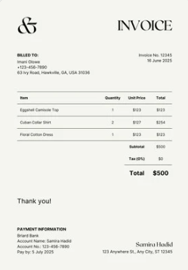

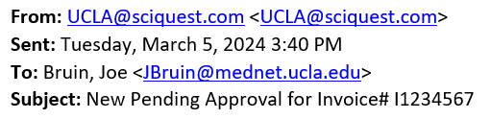
Managing Subawards – PI Responsibilities
Principal Investigators are required to review and approve invoices for their subawards/ subcontracts in BruinBuy Plus.
PIs SHOULD receive an email notification when a subaward/subcontract invoice requires their review and approval. (PI’s can also log in directly to approve within the BruinBuy Plus application)
If PI doesn’t receive the notification, the fund manager will obtain signature on the PDF form instead.

Slide 20
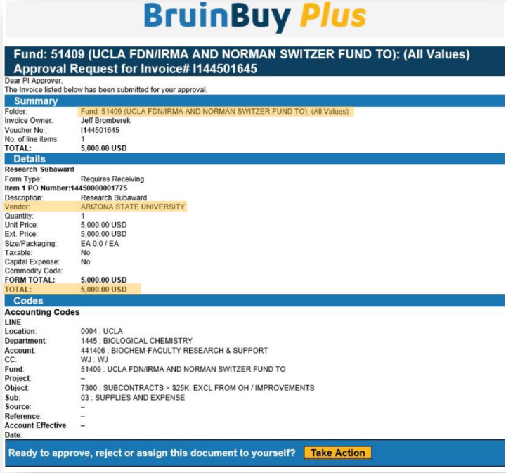
Review Invoice
Upon email receipt, review for accuracy and to ensure that the subsite is appropriately billing for work completed.
Select the Take Action hyperlink within the email, which will direct you to a new window of your web browser.

Slide 21
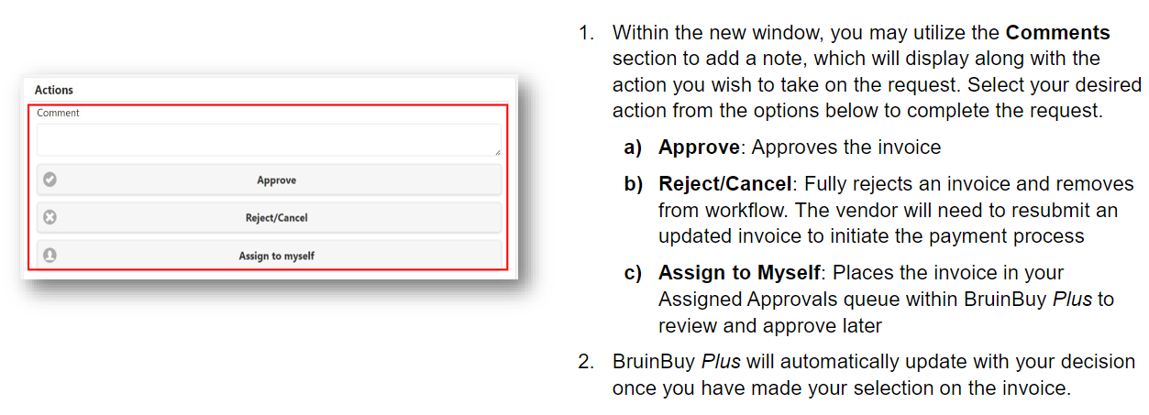
Approve or Reject Invoice

Slide 22
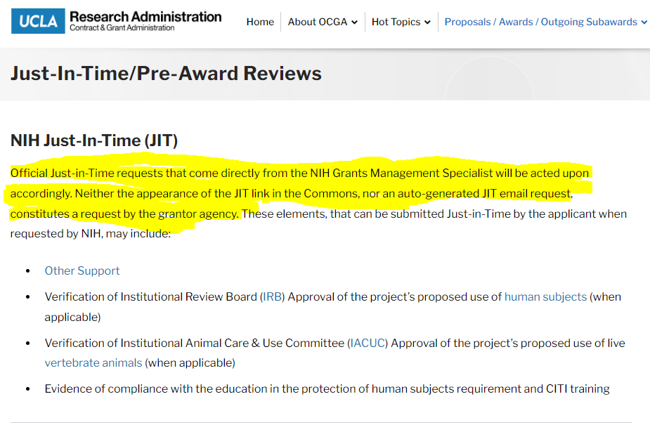
NIH Just-in-Time (JIT) Notifications
Official JIT notice vs auto-generated (email to CA 4/1)

Slide 23
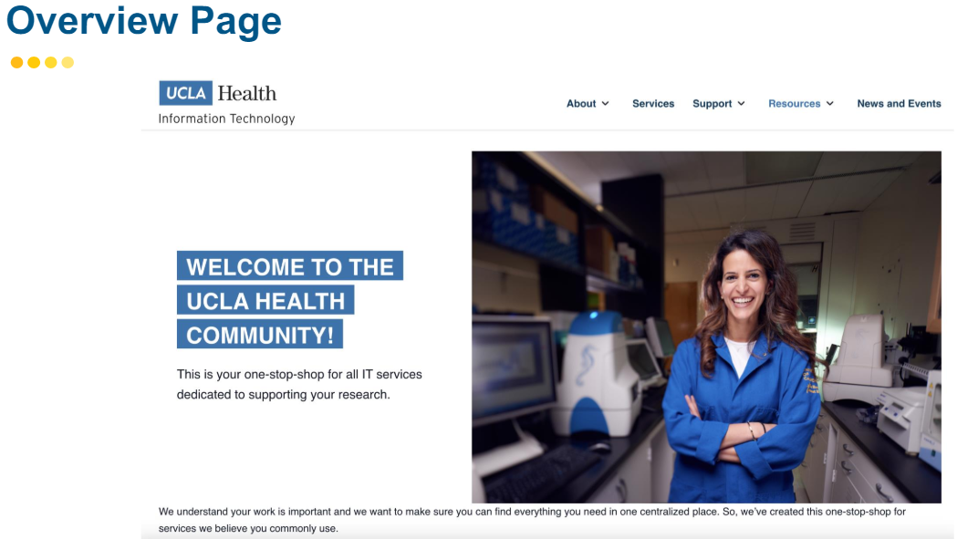
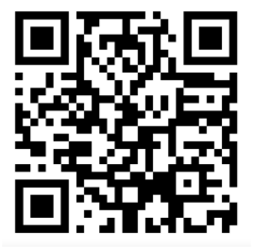
Front Door for Research
https://it.uclahealth.org/resources/resources-for-researchers

Slide 24
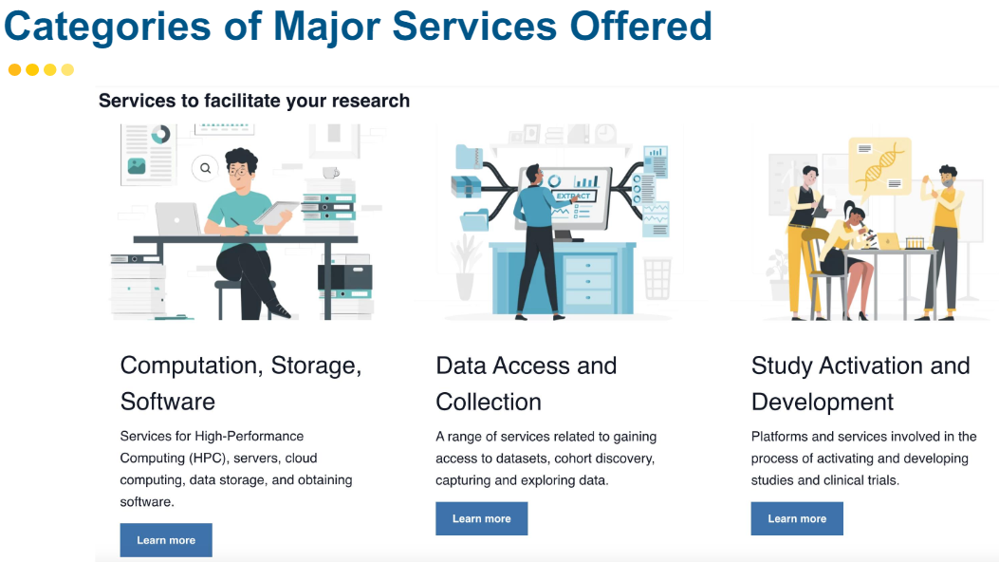
Front Door for Research

Slide 25
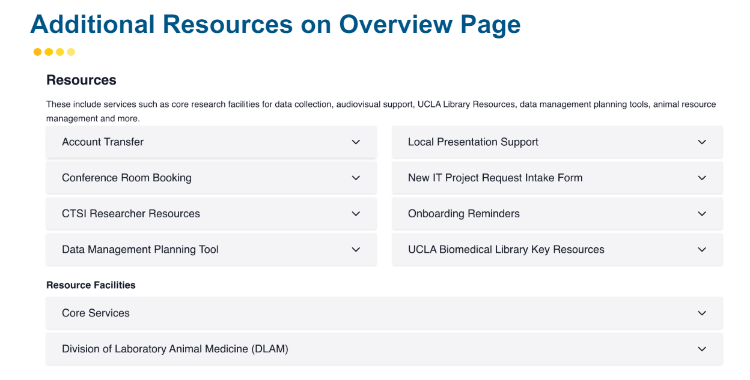
Front Door for Research

Slide 26
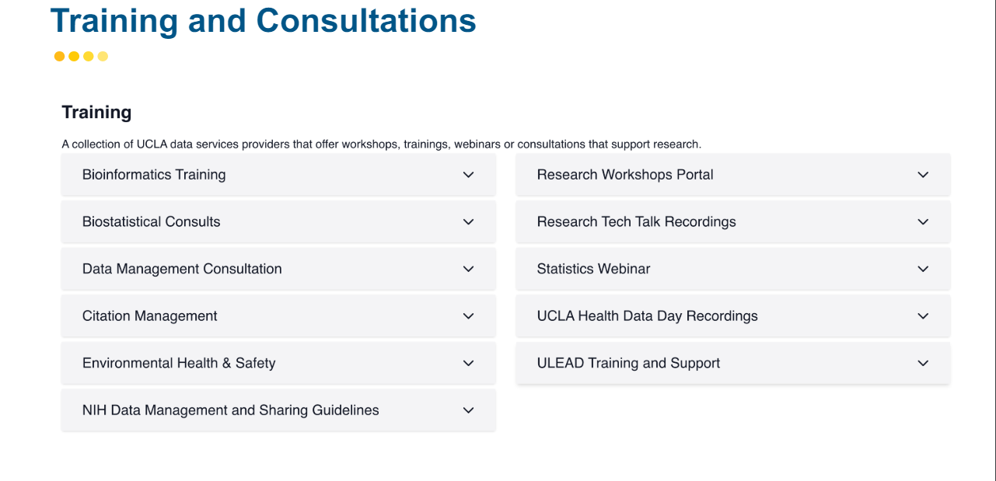
Front Door for Research

Slide 27
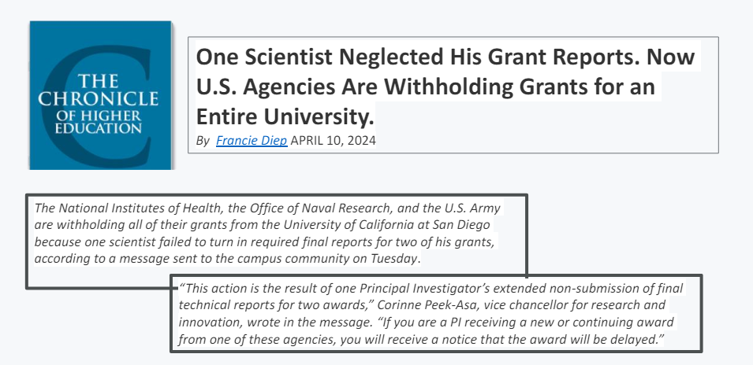
Technical / Progress Reports: Submit on time!

Slide 28
General Procurement Guidance - New Vendors
We no longer have the ability to register anyone in PaymentWorks ahead of time.
Now we have to initiate a transaction first, and then if the vendor is not registered, the system will add a step to the processing timeline.
For example, if you are trying to pay a guest speaker, instead of getting routed for payment after we submit a Direct Pay request, the payment request is put on hold while the system sends PaymentWorks registration information to the vendor/recipient.
The vendor must complete their PaymentWorks profile/registration in order to get paid. Once they do, the payment process will resume and the payment should be processed.

Slide 29
General Procurement Guidance - New Vendors
What does that mean for you?
This means that you no longer need to obtain W9s or anything like that to attempt to register a vendor/recipient ahead of time.
Instead, you just want to make sure that you include the vendor’s/recipient’s correct email address when you submit your check request form (or Purchase Request Form).
You should also make sure the vendor/recipient understands that they will be getting an automated email with instructions on how to register with PaymentWorks and they MUST complete that process in order to be paid.

Slide 30
General Procurement Guidance – PO’s
You should never purchase an item or have a service rendered until there is an active Purchase Order in place. There are some exceptions that can be paid using the "direct pay" feature or Pcard, and we've covered those in previous research meetings (e.g. utility invoices, guest speaker fees, memberships, etc.)
We no longer have the ability to create PO's automatically at the department level. All PO's that we "create" actually have to be submitted as requisitions first, and then after review by Purchasing, a PO will be created centrally.
Submitting a Purchase Request Form or having that form “approved” is not the same thing as having an active PO. PO numbers (almost) always start with 1550.

Slide 31
Vendor Invoices
Once a PO has been created, the vendor will automatically receive a copy of it. They can then provide the item/service and then submit their invoice.
They can do that in one of two ways:
Submit their invoice directly to noreply@invoices.ucla.edu
Submit the invoice to you, and you (or Valencia, if you prefer) submit it to noreply@invoices.ucla.edu

Slide 32

Vendor Submitted Invoices – Pros and Cons
PROS Recommended by BB+ Easy for vendors to remember (same inbox for entire University) Fastest (in theory) | CONS Invoices are auto-scanned, so errors will prevent proper processing. We have no way to track them if they don’t match in the system. Harder to keep track of remaining funds (for Declining Balance POs) Vendor will be paid whether or not item was delivered/service was rendered, unless PO was set up to mandate Receiving

Slide 33
Vendor Invoices – Helpful Tips
Invoices should be PDFs and must be standard 8.5 x 11 in size.
Only one invoice per PDF. The invoice can be more than 1 page, but you can’t have more than 1 invoice in the same attachment.
The PO # must be clearly typed on the invoice. It cannot be handwritten. If it is fuzzy, or has weird spacing or parenthesis, or anything else that may confuse an automated scan, re-type the PO # in big, clear font.
Having the PO # in the filename doesn’t matter. The PO # must be typed on the invoice itself.
It can take up to 5 business days to “match” in the system, but I’ve seen it happen in minutes as well.

Slide 34
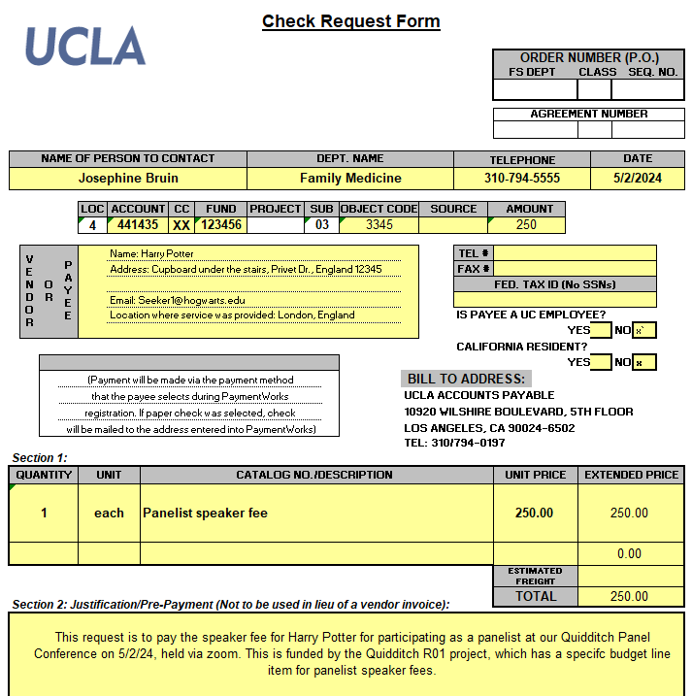
Guest Speakers
Complete and submit a Check Request Form
Be sure to include the email address of the speaker and the location of service

Slide 35
Catering/Conferences/Events – Reserving a Room
Obtain permission from your PI/approver to conduct the event and determine the correct funding source.
Work directly with event location vendor (e.g. The California Endowment) to find an available date for your event. Typically they will then send you a contract with Terms & Conditions (T&C) for signature. Event location vendors also may require a room reservation deposit. DO NOT SIGN ANYTHING YOURSELF.
Send the following to your fund manager and Valencia:
  The T&C/contract document requiring signature
  FAU to charge
  Business Justification
  Event Details. Must include:
    Event name
    Event date/time
    Event purpose
    The number and type of expected attendees (attach invite list if you have it)
    Agenda/flyer if you have it
The fund manager will review/approve. Valencia will then submit a via BruinBuy Plus (BB+).
Travel Accounting will review/approve in BB+ and will issue a signed contract/T&C to the vendor and your reservation should now be complete.

Slide 36
Catering/Conferences/Events – Reserving a Room
Obtain permission from your PI/approver to conduct the event and determine the correct funding source.
Work directly with event location vendor (e.g. The California Endowment) to find an available date for your event. Typically they will then send you a contract with Terms & Conditions (T&C) for signature. Event location vendors also may require a room reservation deposit. DO NOT SIGN ANYTHING YOURSELF.
Send the following to your fund manager and Valencia:
  The T&C/contract document requiring signature
  FAU to charge
  Business Justification
  Event Details. Must include:
    Event name
    Event date/time
    Event purpose
    The number and type of expected attendees (attach invite list if you have it)
    Agenda/flyer if you have it
The fund manager will review/approve. Valencia will then submit a via BruinBuy Plus (BB+).
Travel Accounting will review/approve in BB+ and will issue a signed contract/T&C to the vendor and your reservation should now be complete.

Slide 37
Catering/Conferences/Events – Food
If you will be using a separate vendor for food, Valencia must submit a separate request via BB+.
Detailed guidance is forthcoming.
Please note that we will need at least the following:
  Catering Invoice
  Guest list with names and affiliations
  Entertainment Worksheet. Note: must have separate worksheet for each type of meal (e.g. breakfast, lunch).
  Event Details. Must include:
    Event name
    Event date/time
    Event purpose
    The number and type of expected attendees (attach invite list if you have it)
    Agenda/flyer if you have it

Slide 38
Gift Cards
Ordering Gift Cards was covered during the December Research Unit Meeting, however there is updated guidance.
4 3 Types of Allowable Gift Card Purchases:
IRB Approved Research Payment Request
Non-IRB Research Payment Request
Employee Recognition Request
Non-Employee Disbursement Request
They are no longer accepting “Non-IRB Research Payment Requests.”
Instead, we are instructed to use “Non-Employee Disbursement Request” and to attach the IRB Exemption.

Slide 39
 | Research Payment Request (IRB Approved) | Employee Recognition Request (ERRP) | Non-Employee Disbursement Request (G42)
Description | Disbursement requests for research payments that are approved by the Institutional Review Board (IRB). Must provide current IRB approval number. | Disbursement requests for the Employee Recognition and Reward Program (ERRP) in which non-cash awards are distributed for the purchase of goods (not services). | Disbursement requests for non-cash awards presented to non-employees (see UC Policy G-42) Will need to provide OHRPP exemption notice, if provided/applicable.
Forms of Payment | Gift cards/e-codes Bruincard deposits Cash Max amount: $5,000 | Gift cards/e-codes Bruincard deposits Max amount: $75 per award/employee | Gift cards/e-codes Bruincard deposits Max amount: $600 per individual
Instructions | IRB Approved Research Payment Request | How to Submit an Employee Recognition Request | How to Submit a Non-Employee Disbursement Request

Slide 40
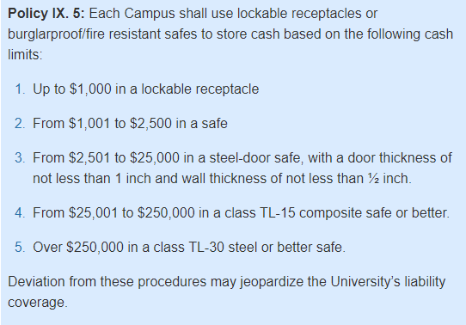
Physical Security of Cash and Cash Equivalents
Learn more about UCLA's guidelines for physical security of cash and requirements for cash handling and storage here. If you have questions, please visit the PSC website for answers or reach out to them on the MyUCLA Message Center to ask a question.

Slide 41
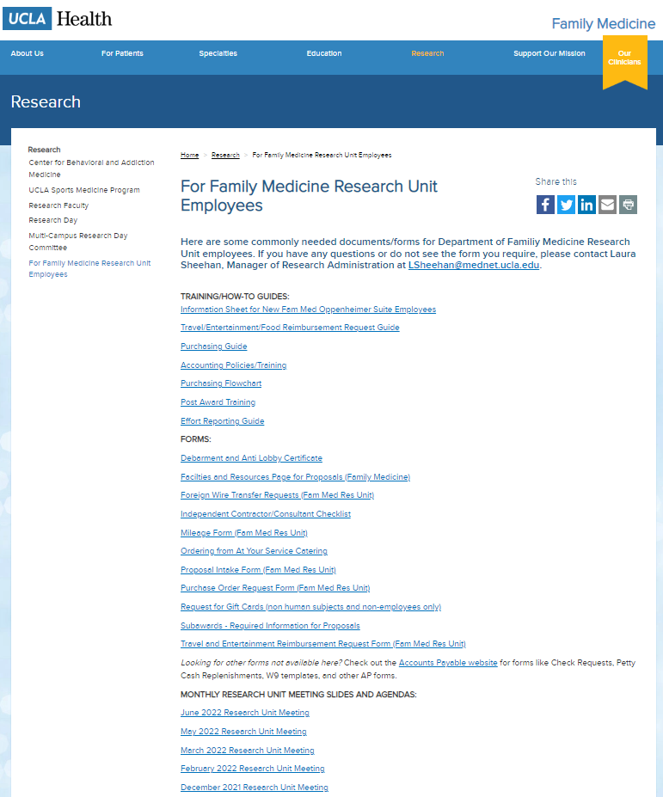
Upcoming Meetings/Events
  Next Research Unit Meeting: June 6
  Next Grand Rounds: May 24
  Research Faculty Meet the Residents: July 17
Prior monthly meeting agendas/slides are available on the website

