Slide 1

Accounting Overview
Department of Family Medicine
What staff and faculty need to know to ensure that we are all proper stewards of University resources

Slide 2

Checks and Balances
Good accounting practices incorporate a system of checks and balances to ensure that no one person has control over all parts of a financial transaction.
This means the person requesting the financial transaction must be different from the person who approves it and that person is different from the one who processes it.
Why is this important?
UCLA is a state agency, funded in large part by tax dollars. In addition, many of our research projects are federally funded. Both of these factors mean there is an extra layer of scrutiny over how we spend money and it’s important that we have systems in place to prevent fraud and abuse.

Slide 3
Whose money is it, anyway?
All funds belong to the University, whether they are grant funds or unrestricted donations.
The Regents of the University of California are the ones who receive the money and they are entrusted with proper oversight and spending by its faculty and staff.
The funds do not belong to the Principal Investigator (PI), so although they must approve all transactions from their assigned accounts, it is ultimately the University who has the final say on what is/is not allowable.
If funds are awarded to the University via contract or grant agreement, the University is required to abide by the agreement language regarding usage of funds.
If a PI or employee asks you to purchase an item that is not in compliance with University or sponsor restrictions, you have the right to refuse. Discuss with the Fund Manager, your supervisor, Department leadership, or another trusted source.

Slide 4
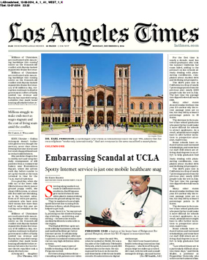
Laura’s LA Times Rule
FAKE
If the newspaper were to publish details regarding the expense, would you or the University be embarrassed? If yes, do not proceed with the expense.
Business justifications should be detailed, comprehensive, accurate, and always included in your expense documentation/purchase requests.

Slide 5
General Accounting Procedures
All transactions must be pre-approved before an expense can be incurred. This is achieved by completing a Purchase Request Form and obtaining approvals before the University commits to spend funds. (You should not be purchasing items and then seeking reimbursement or payment of vendor invoices after the fact; with the exception of travel or emergency scenarios)
Anyone who is aware of fraudulent or illegal business transactions conducted in the name of the University must report them immediately.
Documentation should be organized and maintained for reconciliation and auditing purposes.

Slide 6
Authorized Signatures/Signing Officials
Only Authorized Officials (AO) are allowed to sign off of contracts. Typically AO’s are senior staff in OCGA or Purchasing.
If a vendor has terms and conditions (T&C) attached to their quote, that is considered a contract and requires AO signature. You should include the T&C (or any other contract) when you submit a Purchase Request Form so that AO signature can be obtained prior to the creation of a Purchase Order (PO).
PI’s, research personnel, fund managers, purchasers, the CAO… none of these people are Authorized Officials. (They can only sign off when given explicit permission to do so from an AO).

Slide 7
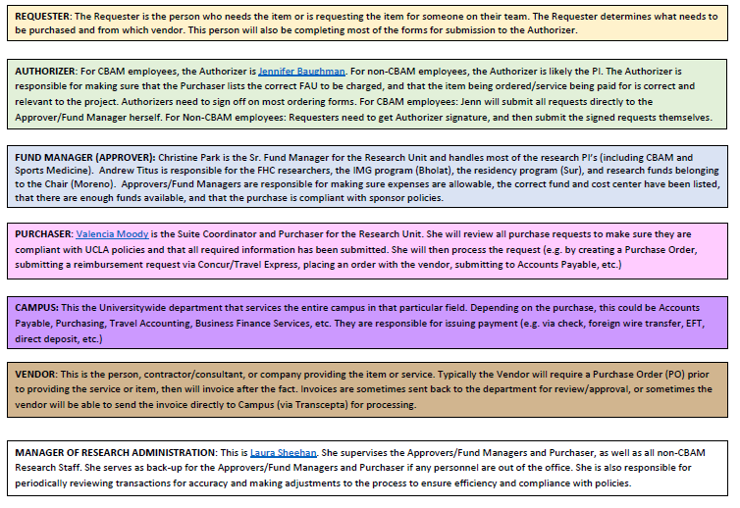

Slide 8
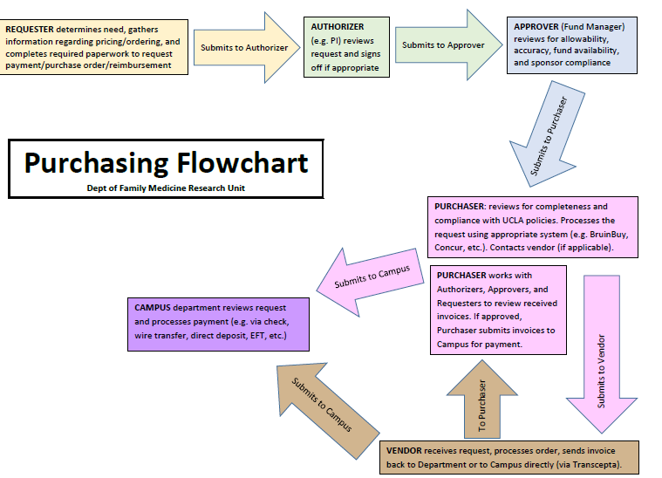

Slide 9

Forms/Processes
Every transaction that requires payment, must be pre-approved and signed off by someone with authorization to spend. That applies to ordering supplies, hiring a consultant, purchasing flights, utilizing parking services on campus, securing a venue for an event, paying a guest lecturer, utilizing a campus lab, etc.
Unfortunately, UCLA has multiple forms and processes that are used for different kinds of transactions. Knowing which one to use can be confusing. The next slide provides some general guidance.

Slide 10
What Do You Need? Use this form/process
Supplies Purchase Request Form
Contractors/Consultants Contractor and Consultant Checklist
UCLA Campus Services Varies depending on campus unit
Airfare 1. Contact UCLA travel for itinerary, 2. Obtain FAU and approval from Authorizer, 3. Email itinerary, justification, and FAU to Approver and Purchaser to obtain a PTA
Off-Campus Event Space Purchase Request Form, often requires AO signature on T&C
Travel Reimbursement Travel & Entertainment Reimbursement Form
Entertainment/Catering Travel & Entertainment Reimbursement Form
Computers/Software Obtain quote from DGIT, then Purchase Request Form
Gift Cards Depends on purpose (Human Subjects vs. Non-IRB requests)
Guest Speaker Fees Check Request Form
Mileage Reimbursement Mileage Reimbursement Form
Notes:
If a vendor gives you a formal quote, contract, or other document, you must include it with your Purchase Request form

Slide 11
Timeline and Additional Review/Approval
The University gives each Department approval authority within certain limits. For any purchases made within those limits, a purchase order can be generated within 2-5 days after the Authorizer has signed off.
All other items require approval by campus and processing times vary significantly. Examples of items that require campus approval before a PO number can be created:
Consultants
Service contracts (more time required for vendors that will have access to PHI)
Any order exceeding $10,000 on a federal grant or $100,000 on an unrestricted account

Slide 12
Quiz
1. Who can sign contracts?
Only Authorized Officials having signing authority. Occassionally AO’s will grant permission to others to sign, but this permission must be received prior to signing off on any agreement.
Do I need to obtain approval before purchasing a campus service?
Yes, all purchases, whether external or internal, require prior approval.
3. Do I need to maintain copies of what I’ve submitted?
Yes, requesters and/or PI’s must maintain copies of submitted purchase requests and supporting documentation for reconciliation and auditing purposes.
Funds belong to:
  The faculty member or PI to whom the account is assigned
  The Regents of the University of California
  The person requesting the purchase
  The Department of Family Medicine

