Slide 1


Family Medicine Research Unit
Monthly Meeting
November 2023

Slide 2

Recently Processed Awards and Submitted Proposals

Slide 3
WebClock
Effective November 12, ALL non-exempt (bi-weekly) employees must utilize WebClock Timekeeping System (not TP Timesuite). This affects both union and non-union personnel.
Timesheets will now autofill from WebClock
Overtime is not allowed unless approved in advance
Members of RX union: cannot exceed 8 hours in a day without triggering overshift pay
Members of other unions and non-union members: cannot exceed 40 hours per work week without triggering overtime pay

Slide 4
WebClock
You must clock in at the start and clock out at the end of your shift
Clock in/out within 5 minutes of your assigned work hour time; it will round up/down at the 7.5 min mark (e.g. if you clock in after 8:07am, it will round this to 8:15am)
1-hour lunch is required and automatically deducted
If you are going to take a shorter/longer lunch break, you must clock in and out for lunch to register those adjustments
Vacation, sick, and errors: must be added as NOTES. Supervisor will then need to manually make these additions/corrections
If you forget to log in/out, do so as soon as you remember and then add a note for your supervisor with the correct time.

Slide 5
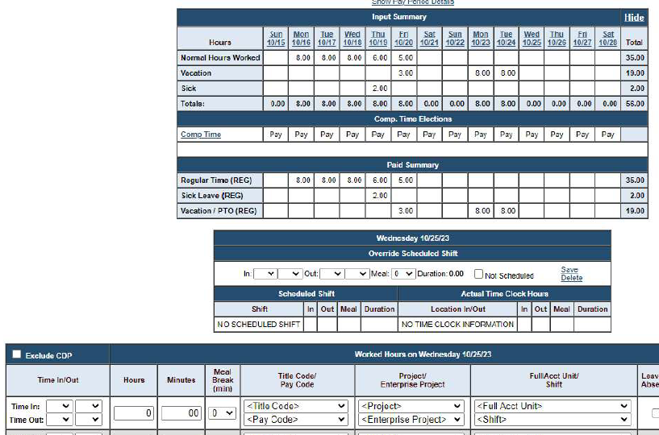
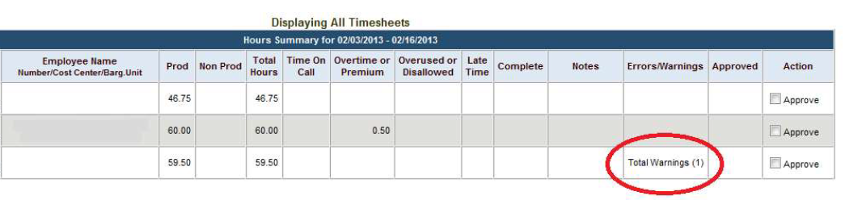
WebClock
SUPERVISORS:
Look out for warnings/errors
You must manually enter vacation and sick time for your employees. Errors must also be manually entered by you.

Slide 6


Slide 7
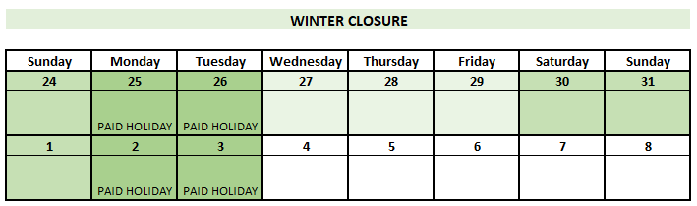
Winter Closure
    Sat Dec. 23 – Tues Jan. 2
    Includes 4 paid holidays (Dec 25-26, and Jan1-2)
    Wed-Fri, Dec 27-29 should be reported as vacation (or leave without pay)
    Must have supervisor permission to work during closure

Slide 8
Grand Rounds
No Grand Rounds
in November, December, or January
In the future: Slides will be made available on our website for all speakers who agree to share their presentations.
Suggestions for 2024 line-up are welcome!

Slide 9

Farewell Christine Park
Last day: Friday, Nov 3
Transferring to GSEIS
Tentative coverage plan:
Fund Manager | Faculty
Mindy Huynh | Steven Shoptaw, PhD
Mindy Huynh | Jesse Clark, MD
Monica Gonzalez | Ronald Brooks, PhD
Monica Gonzalez | Thomas Donohoe, MBA
Monica Gonzalez | Michael Li, MD
Monica Gonzalez | Dilara Uskup, PhD
Monica Gonzalez | Lillian Gelberg, MD
Andrew Titus | Aurelia Nattiv, MD
Andrew Titus | Joshua Goldman, MD
Andrew Titus | Michelle Bholat, MD
Andrew Titus | Denise Sur, MD
Chris Ashikyan | Gerardo Moreno, MD
Chris Ashikyan | Derjung (Mimi) Tarn, MD
Monthly Meetings: Laura will attend
Plan ahead
PI’s: take ownership

Slide 10

Outgoing Proposals
Chris Ashikyan is now your point of contact for all outgoing proposals
Plan to submit to OCGA by COB on the 6th business day prior to deadline
Aim to submit a complete proposal, not just minimum documents required
If you are the lead investigator, proposal must be submitted through Fam Med

Slide 11
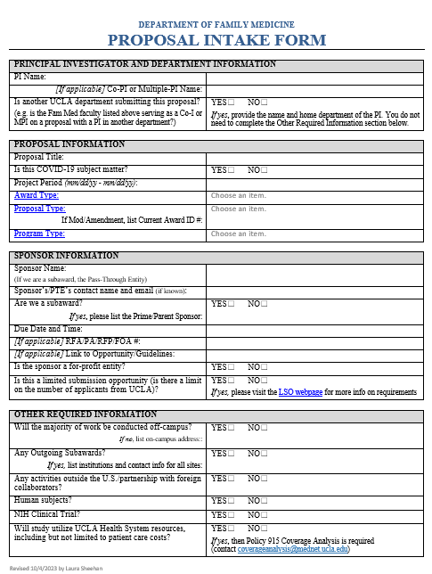
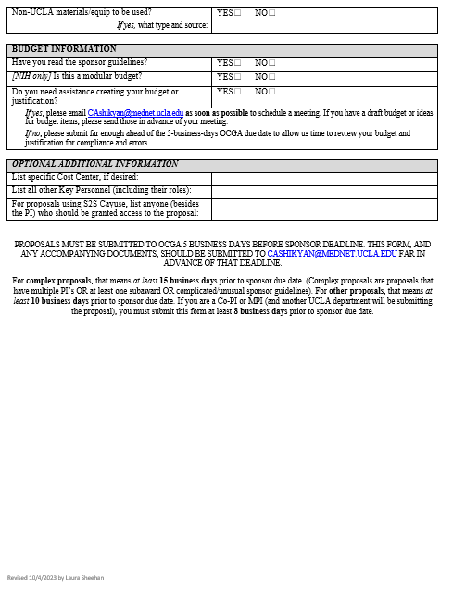
Updated Proposal Intake Form

Slide 12


Other Support Pages
Overlap section should not be blank (state “No overlap” if applicable)
Three types:
Scientific
Budgetary
Effort
Overlap
NOTE: Do NOT state “No scientific overlap.” State either “None” or “No scientific, budgetary, or effort overlap.”

Slide 13


Other Support Pages
Both ScienCV and the UCLA PI Portal can help generate your OS page
Be sure to review for accuracy and details

Slide 14
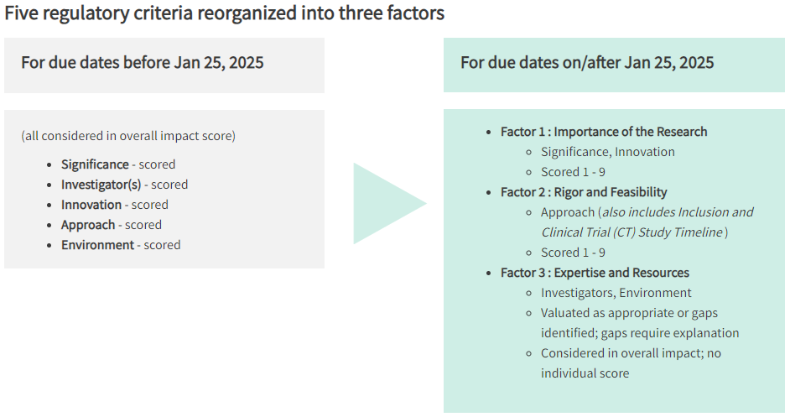
Updated NIH Criteria and Weighting
Scored 1-9
Evaluated as sufficient or not
https://grants.nih.gov/policy/peer/simplifying-review/framework.htm#:~:text=The%20Simplified%20Framework%20for%20NIH,will%20be%20evaluated%20for%20sufficiency

Slide 15
Preparing for BruinBuy Plus
The Ascend 2.0 Program is launching BruinBuy Plus, UCLA’s new procure-to-pay system, on January 2, 2024
BruinBuy Plus brings modernized, streamlined, and efficient procurement processes that will benefit the current and future Bruin community
BruinBuy Plus will further support Accounts Payable (AP) efforts currently underway to provide faster payments and less payment uncertainty
End-user training kicks off on October 30, 2023

Slide 16
Preparing for BruinBuy Plus
There will be a procurement blackout/shut down from December 23 through January 2
You will not be able to place orders during this time unless they are emergent, and those will require special approval and processing
Please plan ahead! We encourage you to place supply orders, pay invoices, set up subawards, etc. no later than early December
Delay non-urgent requests in December until after roll-out

Slide 17
Preparing for BruinBuy Plus
The invoicing process will change. PO’s will be automatically sent to the vendor and they will be instructed to submit invoices to a centralized email address
Starting December 14, vendors must submit invoices through the new centralized email address. Transcepta and the Invoice Submission Portal will be decommissioned on this date!
Non-procurement transactions (e.g. guest speaker fees) will follow a different process, which will be announced shortly
All active vendors will be notified of these changes in the coming weeks

Slide 18
Third-Party Risk Management (TPRM)
Third-party risk management (TPRM) assesses third-party vendors and service providers to help departments identify, manage, and mitigate potential risks.
UCLA Health IT has aligned with campus Purchasing and IT to collaborate on the Third-Party Risk Management (TPRM) assessment process.
UCLA Health’s departments/units can now submit a TPRM Triage using campus’ Governance, Risk and Compliance ServiceNow system.
Departments that engage with third parties should be familiar with the UCOP Data Classification standard for Data Protection and Availability Level.
TPRM will work with the requesting department to confirm appropriate Data Protection Level so that appropriate cybersecurity language is included. View Data Security and Privacy Appendix
UC expects suppliers to have basic cybersecurity elements in place: Expectation of Supplier.

Slide 19

Third-Party Risk Management (TPRM)
Q: What suppliers do we need to get TPRM for?
A: Suppliers that:
Access, create, receive, maintain and/or transmit UC data;
Process credit card transactions on behalf of UC;
Access any UC system(s) or will connect to the UC system(s);
All equipment with software that is either hosted, on premise or embedded and will have remote access;
All transactions that involve technology, including web applications, all software subscriptions/licenses, mobile apps, website design/development, wearable technology and kiosks.

Slide 20
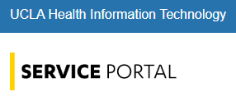
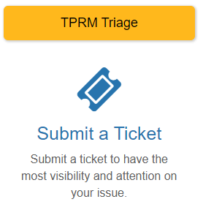
Third-Party Risk Management (TPRM)
As a requester, YOU must submit the TPRM Request (as it requires project-specific information/data-related questions)
  Detailed instructions: https://uclahsprod.service-now.com/it_portal?id=service_sc&sys_id=f586caf71bf0fdd0d244759f034bcb09
  Office Hours: Click here to register for the office hours on Zoom→

Slide 21
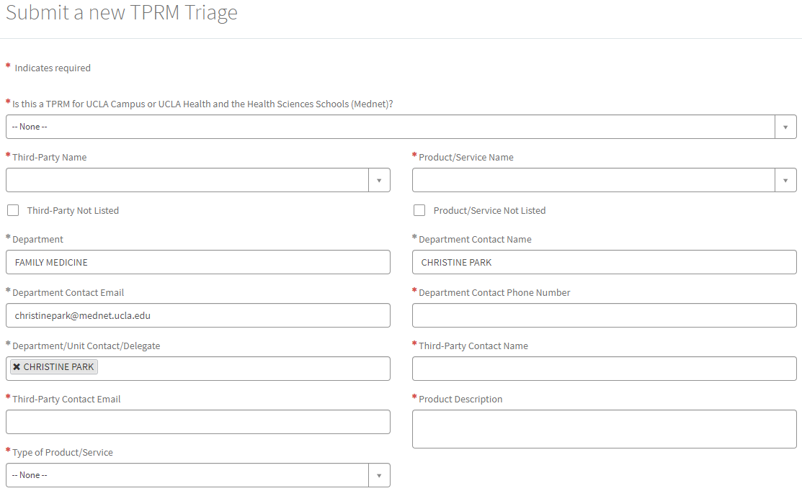
Third-Party Risk Management (TPRM)

Slide 22
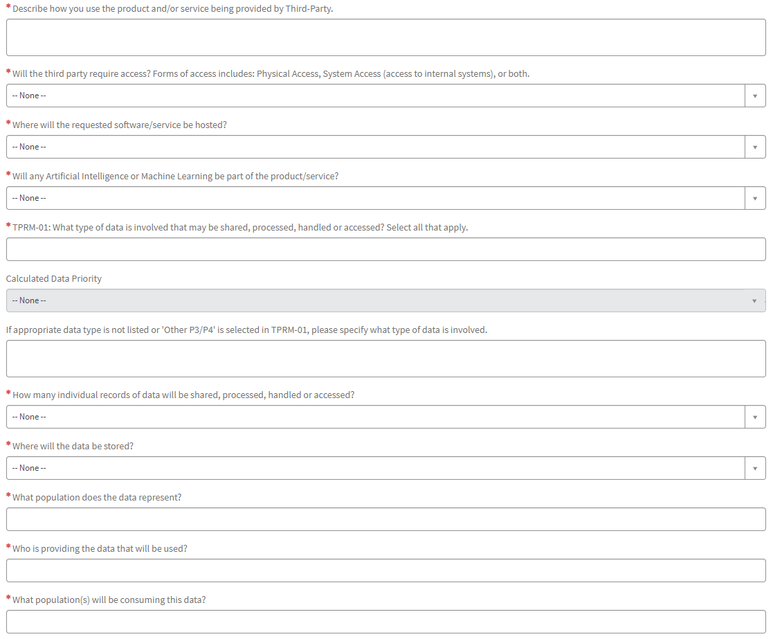
Third-Party Risk Management (TPRM)

Slide 23
Paying individuals who are not US citizens
Individuals being compensated for Independent Personal Services, who are not U.S. Citizens or Permanent Residents, are required to have entered the U.S. on a visa/status that is eligible to receive compensation for the services that they are providing.
Honorarium — an award granted in recognition of a special service or distinguished achievement. It is a monetary gift which requires no services rendered to the University.
Lecture fee — a payment for a one time lecture or a series of lectures that occur in a span of two weeks or less.
Performance fee — made to an individual or group for professional services not directly related to an academic function.
Consultant Fee — payments made for consulting services. Consulting service payments must be approved through Purchasing.
Professional Services — payments made for professional services performed by an independent contractor, per UC policy.

Slide 24
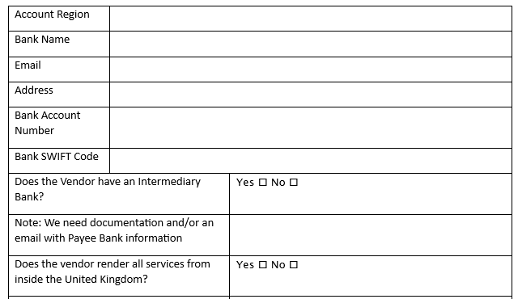
Paying individuals who are not US citizens
Here is the information we will need to process these types of payments:
Name of Nonresident
Address (country of residence)
Phone
Email address
Event details (name, date, location, and purpose of the event)
Payment Amount
Visa status for the Payee (we need to attach proof)
Will the Payee receive more than 5 payments in the US within 6 months (yes/no?)
Bank information (provided via email, so the preparer can upload into system)
Service location / possible tax implications (we need the address)
Payment method (check/wire transfer)
Independent Personal Service payments to nonresidents are reviewed and tax coded by the Central Resource Unit. Taxes are withheld from the payment when processed.

Slide 25

Pcards for Advertising
The department credit card (Pcard) can now be used to purchase advertising, as long as the vendor is domestic

Slide 26
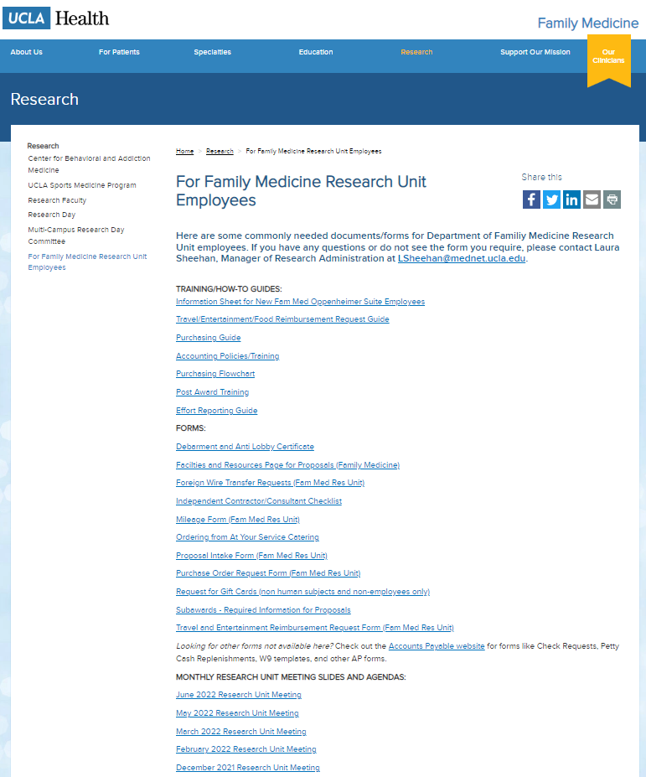
Upcoming Meetings/Events
  Next Research Unit Meeting: Thu Dec 7
  Next Grand Rounds: FEBRUARY 2024
Prior monthly meeting agendas/slides are available on the website

