Slide 1
Family Medicine Research Unit
Monthly Meeting
March 2024

Slide 2
Recently Submitted Proposals (since February)
PI | Title | Sponsor | Prime Sponsor | Type
Tarn, Derjung | Unlocking Insights: Understanding Motivators and Barriers to Clinical Trial Participation among Asian Adults | UNIVERSITY OF CALIFORNIA, SAN FRANCISCO | NIH-NIA | New
Gelberg, Lillian | Effectiveness of the Diabetes Homeless Medication Support (D-HOMES) program on diabetes management | Hennepin Healthcare Research Institute | NIH | Resubmission - New
Rosen, Allison Diane | Development of Ketamine to Increase Buprenorphine Induction and Adherence by Attenuating Precipitated Opioid Withdrawal Symptoms in Fentanyl Users | UNIVERSITY OF HOUSTON | NIH | New

Slide 3
Recently Processed Awards (since February)
PI | Award Title | Sponsor | Prime Sponsor | Action Type | Project Period Begin Date | Project Period End Date
Clark, Jesse Lawton | Mirtazapine for Methamphetamine Use Disorder: Drug-Drug Interaction Study | HELUNA HEALTH | NIH-NIDA | 06/01/2021 | 05/31/2024 | Modification/ Amendment
Donohoe, Thomas J | Ending the HIV Epidemic: A Plan for America – Technical Assistance Provider | Cicatelli Associates | DHHS-HRSA | 03/01/2024 | 02/28/2025 | Continuation
Shoptaw, Steven J | Contingency Management Pilot Program | Shine BC-LA | CONRAD HILTON FOUNDATION | 03/23/2023 | 12/31/2023 | New
Shoptaw, Steven J | Racial Equity in Systems to Treat Opioid Use Disorder for Everyone (RESTORE) | SAN DIEGO STATE UNIVERSITY RESEARCH FOUNDATION | NIH-NIDA | 09/01/2023 | 07/31/2024 | New

Slide 4
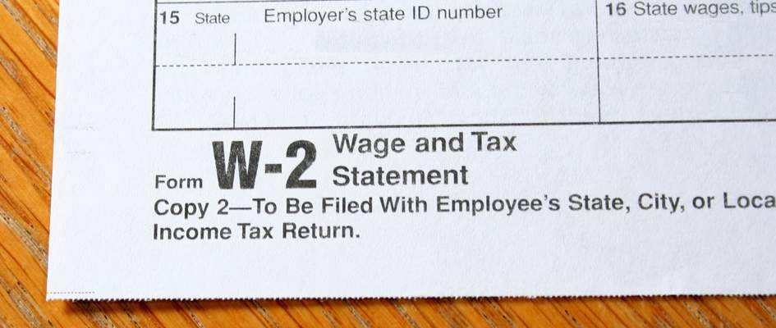
W2’s
If you signed up to receive your W2 electronically, you should have received an email letting you know it is available for download in UCPath.
UCLA will never email or text
you your W2.
If you did not sign up to receive
it electronically, it will be
mailed.

Slide 5
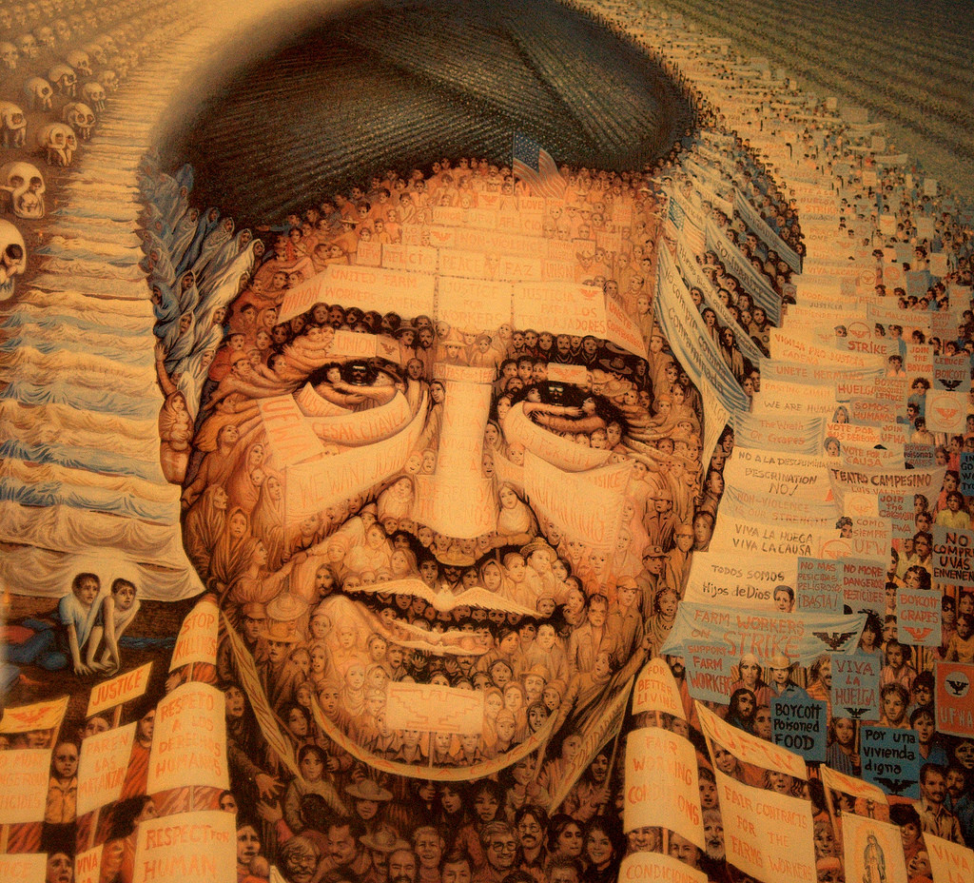
Upcoming Holidays
March 29, 2024
Cesar Chavez Day

Slide 6
Performance Evaluations
For UCLA Health career staff in non-represented, non-academic positions across the health system and the David Geffen School of Medicine hired on or before December 31, 2023
The self-evaluation period runs from March 4 -17. Employees have been notified via Cornerstone to initiate self-evaluations.

Slide 7
Performance Evaluations
For Union-represented, non-academic positions across the health system and the David Geffen School of Medicine hired on or before December 31, 2023
The self-evaluation period runs from March 9 -19. Employees will receive an email with a PDF of the evaluation form to initiate self-evaluations.
TIMELINE FOR UNION-REPRESENTED EMPLOYEES:
March 9, 2024 – March 19, 2024: Employee completes self-evaluation.
March 20, 2024 – April 11, 2024: Supervisor/Manager completes evaluation.
April 12, 2024 – May 3, 2024: Supervisor/Manager meets with employee for official evaluation.

Slide 8
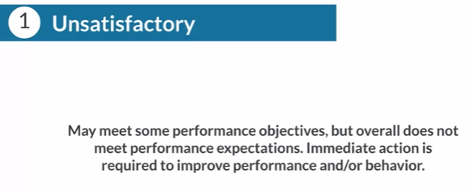
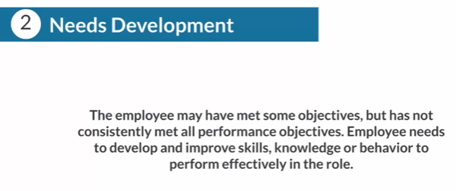
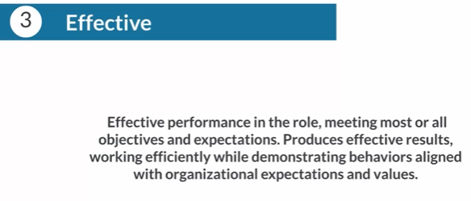
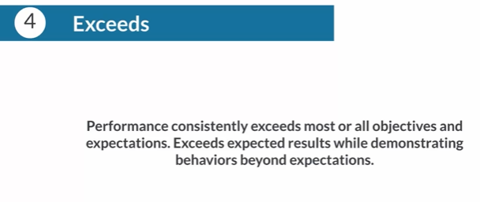
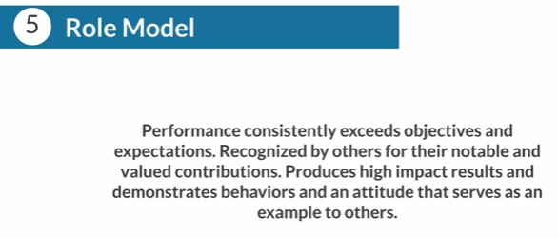
Performance Evaluations
Five-point rating system
Any “1” or “5” rating must be accompanied with comments. “5” or “Role Model” rating should only be used after the employee has consistently exceeded expectations in previous reviews.

Slide 9
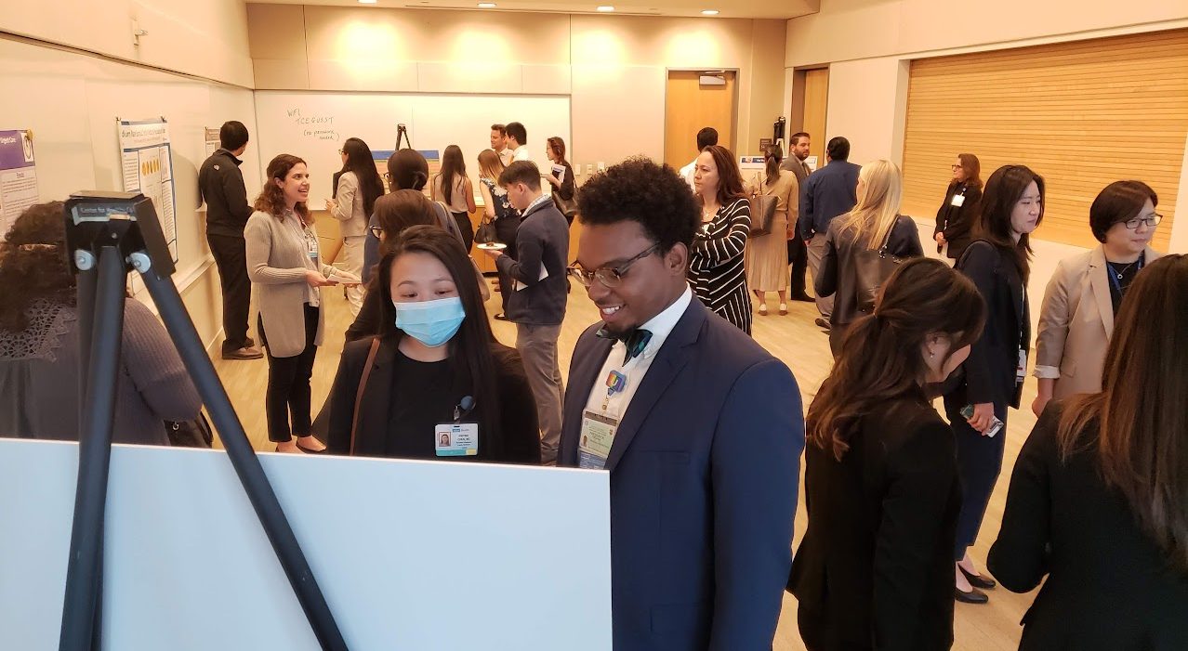
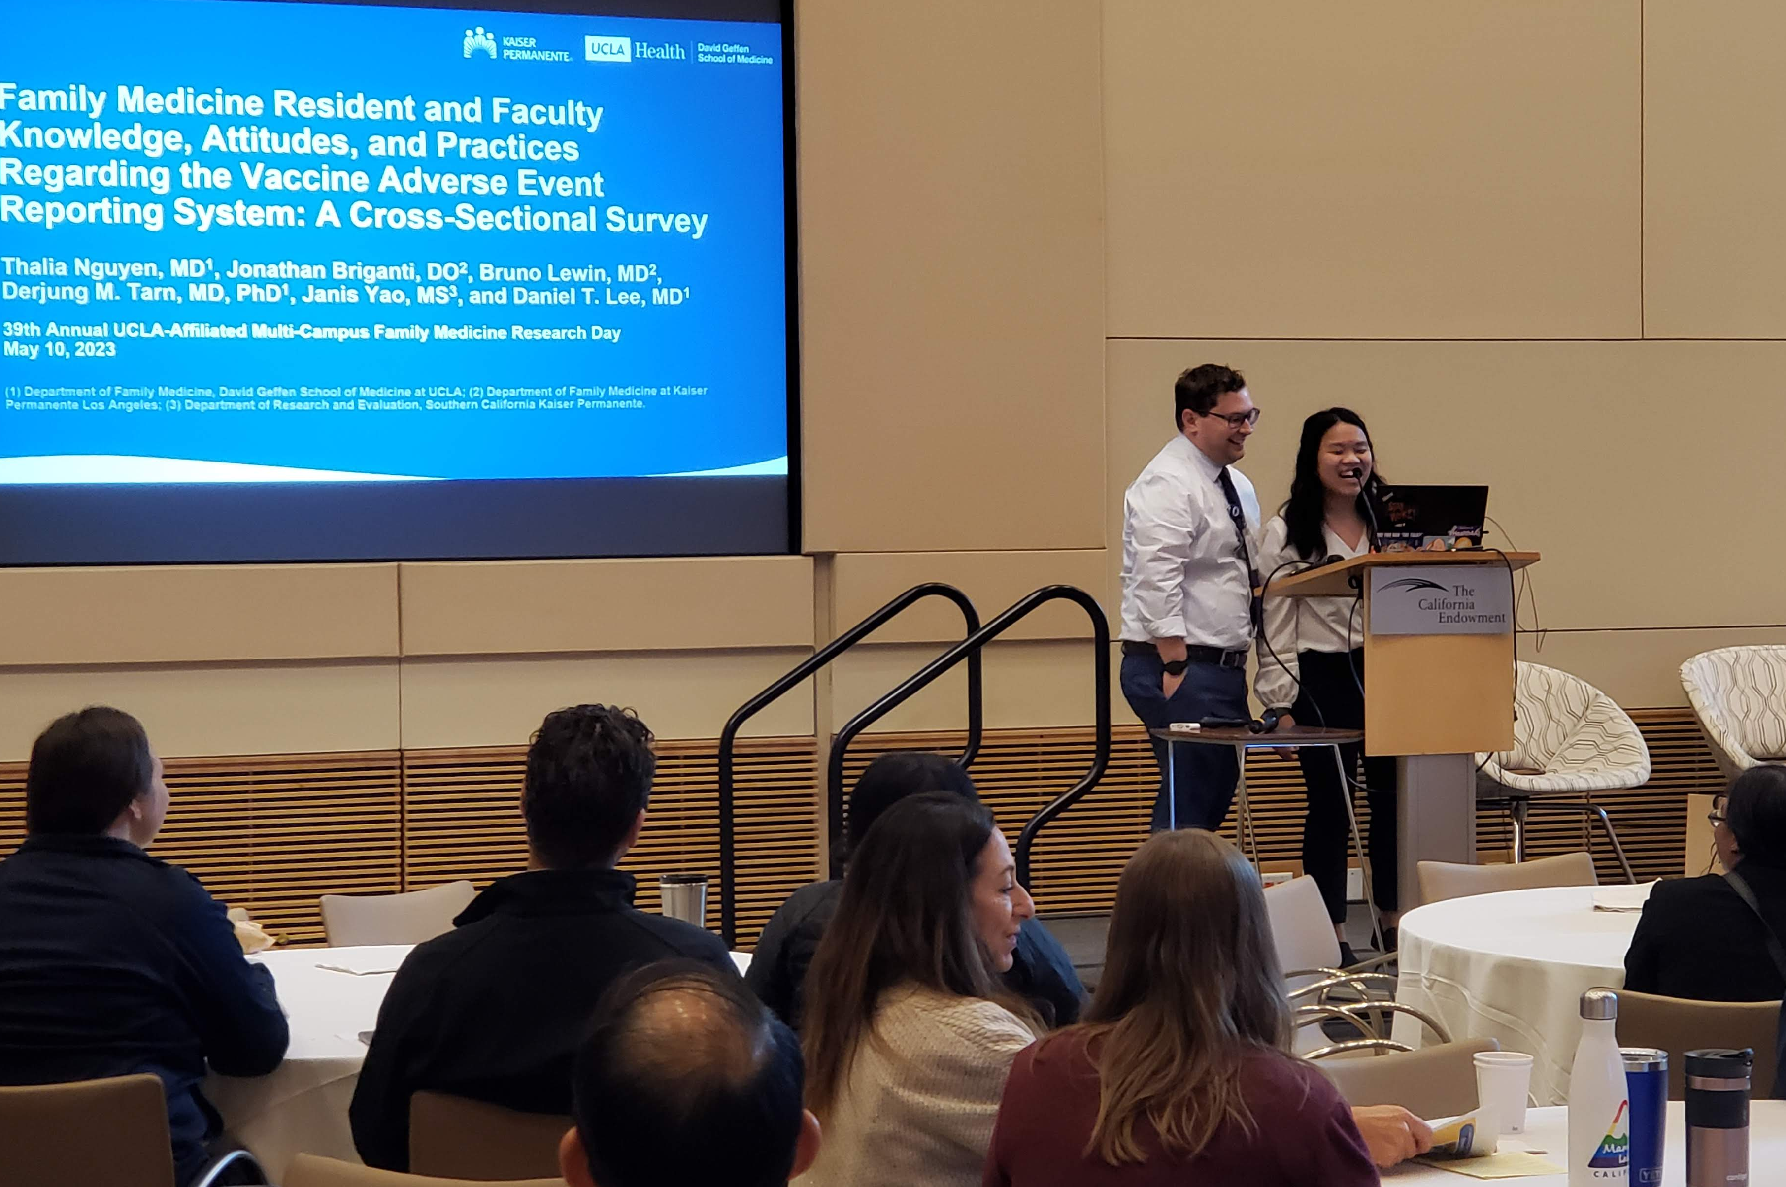
Research Day
2024 Meeting Information
In-person at the California Endowment downtown
Wednesday, May 22, 2024
Keynote Speaker: Dr. Tony Kuo
Abstract Submissions
Submission Guidelines and other info can be found on our website
Abstracts must be submitted via the Submission Portal by April 15, 2024

Slide 10
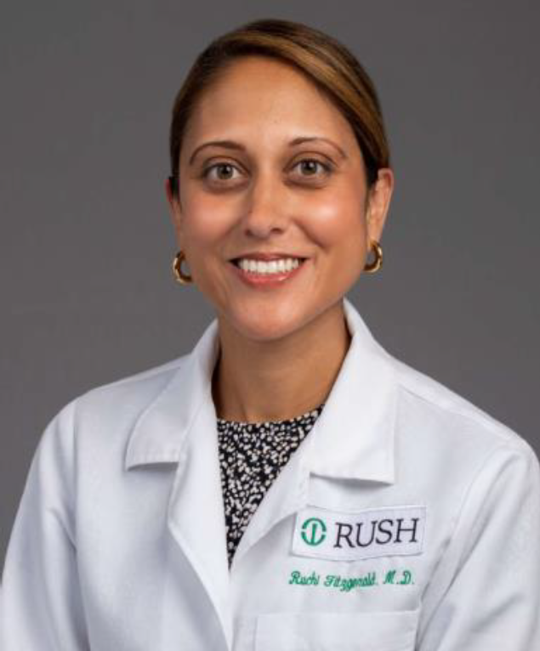
Grand Rounds
March Grand Rounds
Friday, March 22, 2024
12:00pm-1:00pm
Dr. Ruchi Fitzgerald
The Project LIFE Program: Long Acting Injectable Buprenorphine to End Overdose
Opportunities for Addressing Equity in Substance Use Disorder Treatment in Overlooked Populations

Slide 11
Grand Rounds Website is now live (with speaker/topic information, flyers, and selected slide decks)

Slide 12
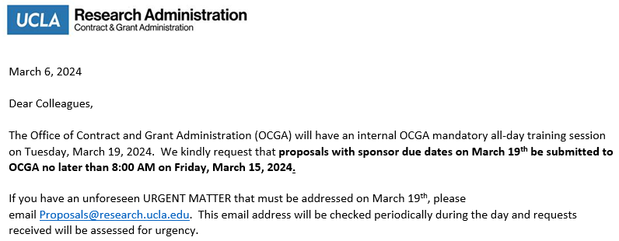
OCGA Closure – March 19

Slide 13
Outgoing Proposals
Chris Ashikyan is your point of contact for all outgoing proposals
You must include a Proposal Intake Form when you contact Chris
Plan to submit to OCGA by COB on the 6th business day prior to deadline
Aim to submit a complete proposal, not just minimum documents required
If you are the lead investigator, proposal must be submitted through Fam Med
SIX is the new FIVE
(business days)

Slide 14
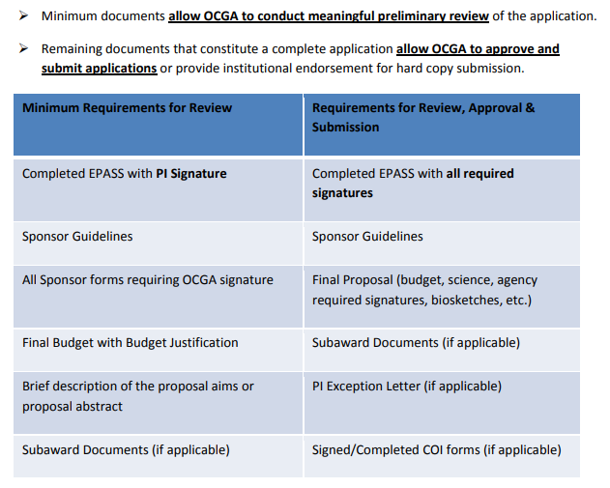

Slide 15
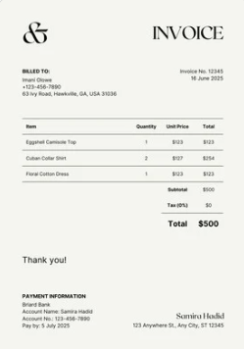
Managing Subawards – PI Responsibilities
Principal Investigators are required to review and approve invoices for their subawards/ subcontracts in BruinBuy Plus.
PIs will receive an email notification when a subaward/subcontract invoice requires their review and approval. (PI’s can also log in directly to approve within the BruinBuy Plus application)

Slide 16
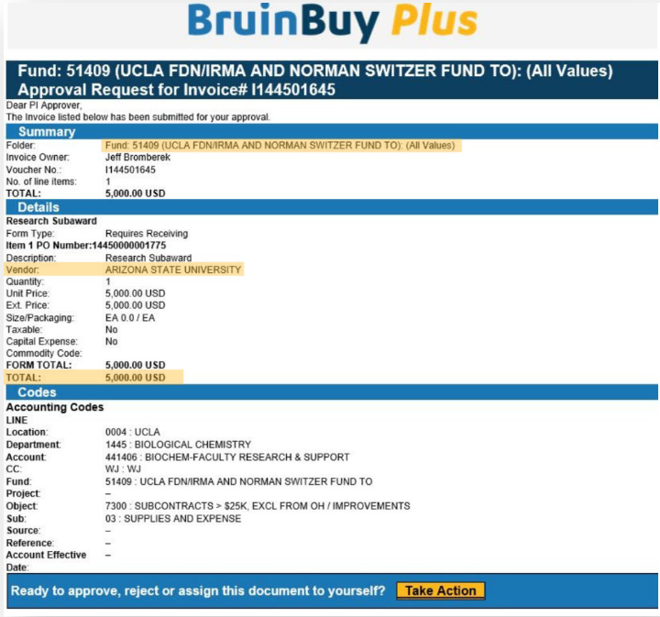
Review Invoice
Upon email receipt, review for accuracy and to ensure that the subsite is appropriately billing for work completed.
Select the Take Action hyperlink within the email, which will direct you to a new window of your web browser.

Slide 17
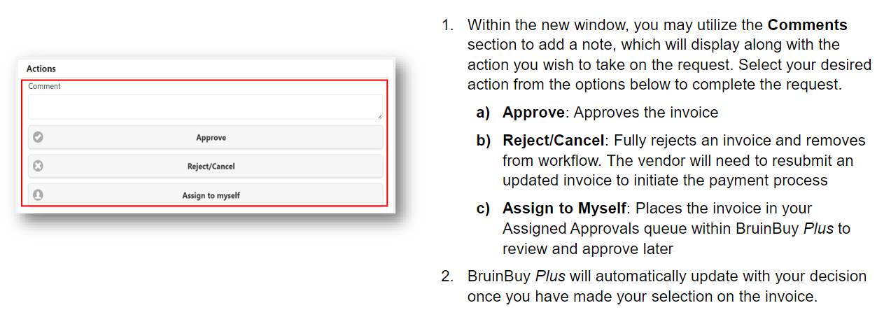
Approve or Reject Invoice

Slide 18
BruinBuy Plus Training For PI’s and PAN Reviewers
https://purchasing.ucla.edu/bruinbuy-plus-hub

Slide 19
BruinBuy Plus
Please be patient with us while we navigate through the new systems/procedures.
Submit far in advance and expect delays.
Keep track of submitted requests and follow-up as needed.

Slide 20
Ordering Supplies
When you need to order supplies, we recommend using one of the approved vendors that already have catalogs with UCLA wherever possible. (These vendors include Amazon, Office Depot, Fisher, Grainger, and more; full list included on later slide)
The next several slides focuses on those types of orders.
You can place these orders in one of two ways:
Current Way: Utilizing the Purchase Request Form
New Option: Creating a Shopping Cart directly on BruinBuy Plus

Slide 21
Current Way: Purchase Request Form
Requester
Finds item using general websites/catalogs and makes note of item #’s, cost, unit of measure, etc.
Obtains Authorizer (PI) approval
Fund Manager
Reviews cart for 4 A’s (allowability, allocability, availability, accuracy)
Emails approval to Valencia
Valencia
Takes info from form and uses it to create a shopping cart in BB+
Emails the Purchase Request form to Fund Manager and Valencia
Uses the Purchase Request Form to input FAU, business justification, shipping information, and any other info
Submits the cart and creates the order

Slide 22
New Option: Creating Cart in BB+
Requester
Creates cart in BB+ using punch-out catalog
Obtains Authorizer (PI) approval
Fund Manager
Reviews cart for 4 A’s (allowability, allocability, availability, accuracy)
Assigns cart to Valencia
Valencia
Enters in FAU information, shipping details, and other items from internal notes into the system
Submits the cart and creates the order
Assigns cart to Fund Manager
Uses the “Internal Note” to input FAU, business justification, shipping information, and any other info

Slide 23
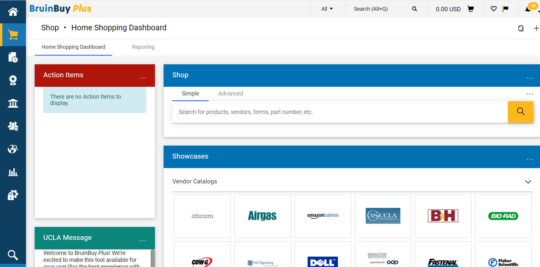
New Option: Creating Cart in BB+
Go to https://bruinbuyplus.ucla.edu/ and log in

Slide 24
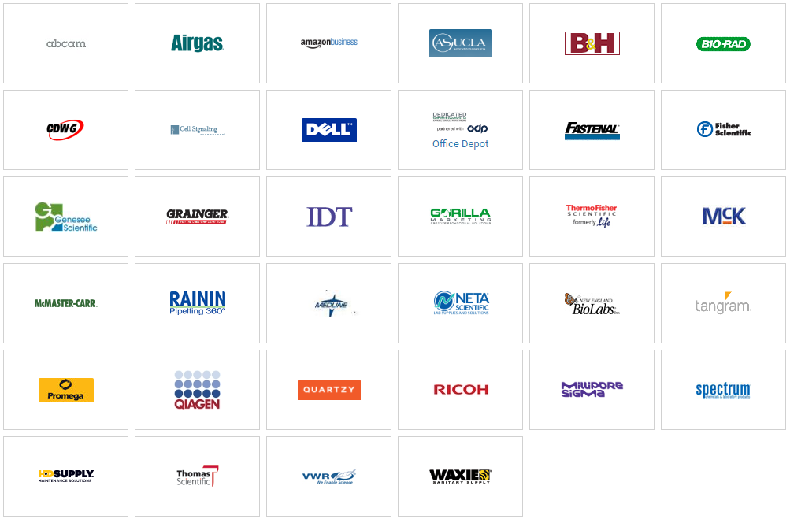
Vendor Catalogs

Slide 25
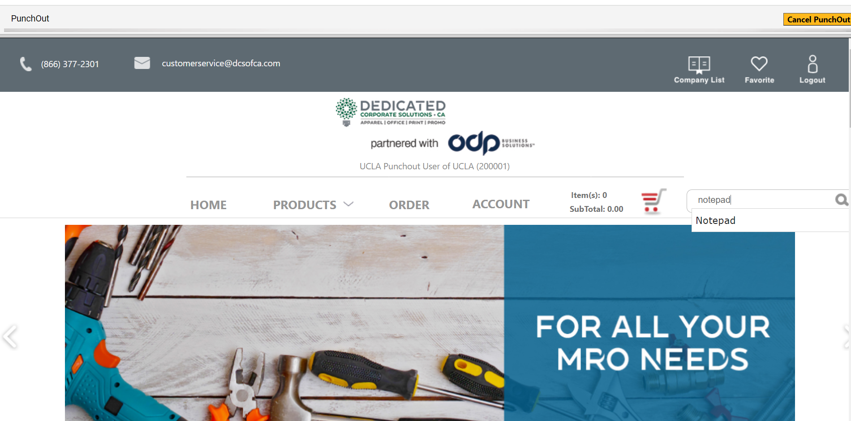
Vendor Catalogs

Slide 26
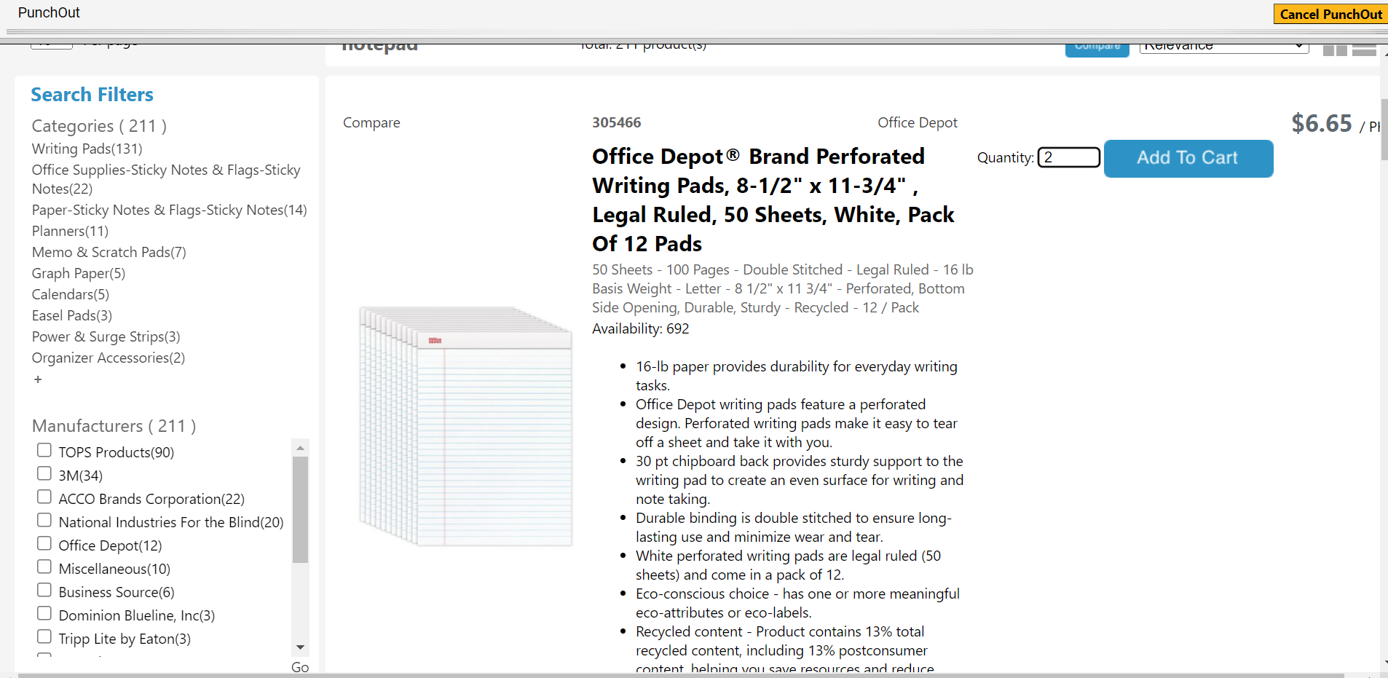
Vendor Catalogs

Slide 27
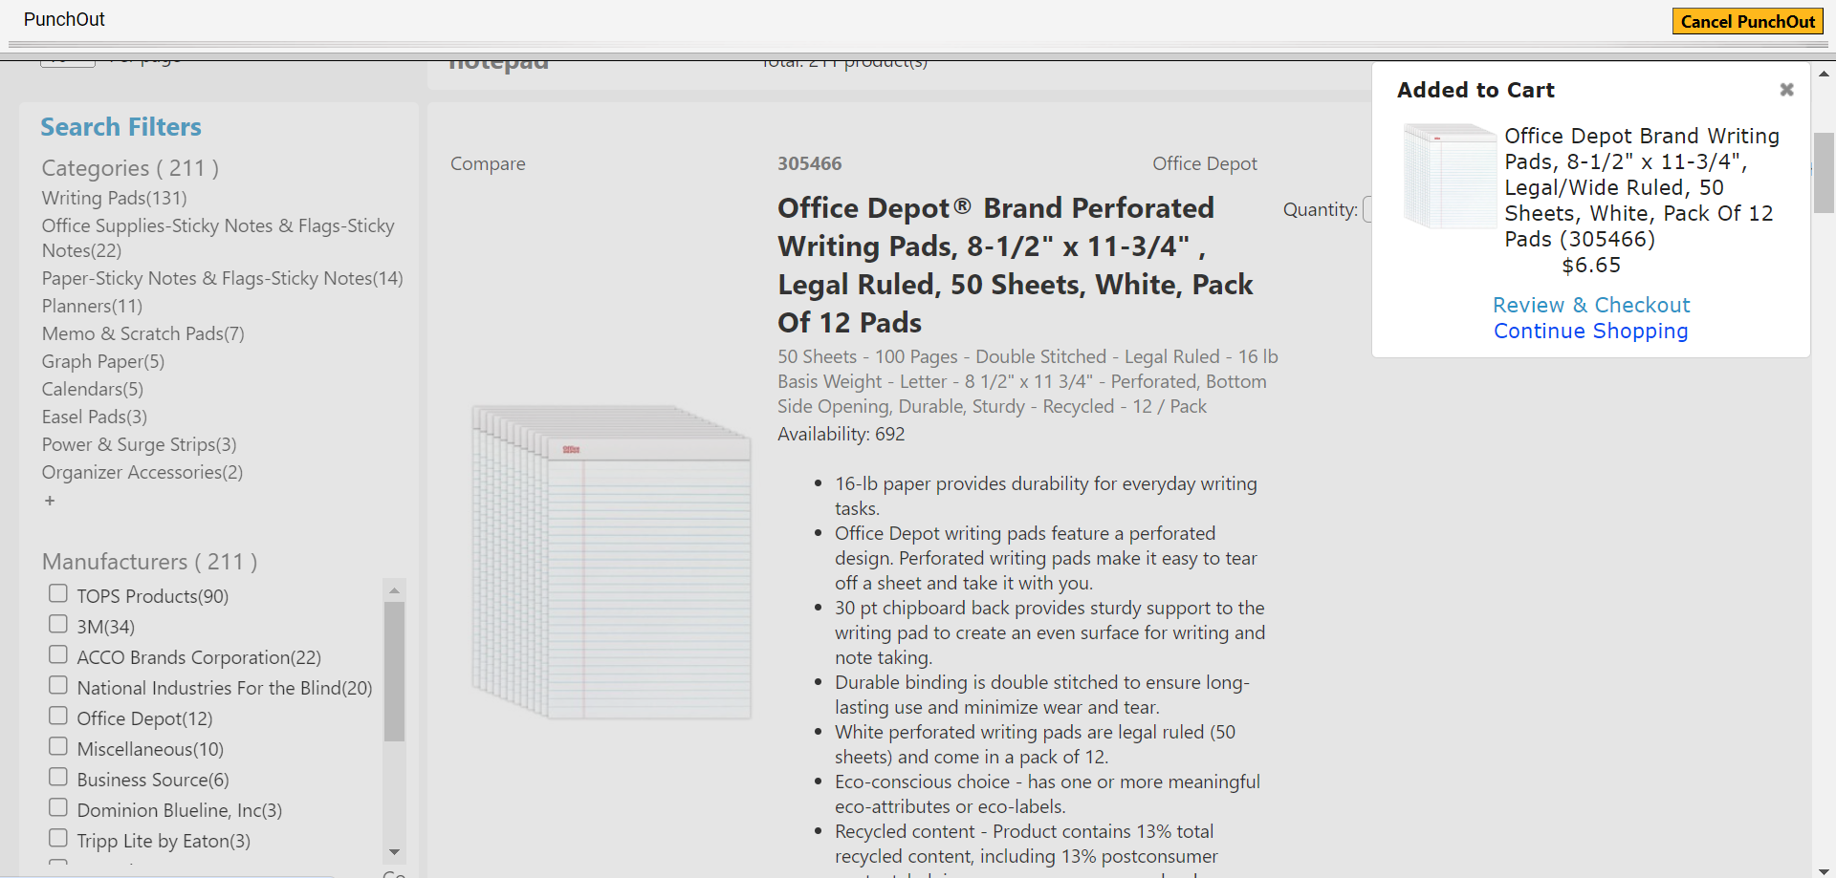
Vendor Catalogs

Slide 28
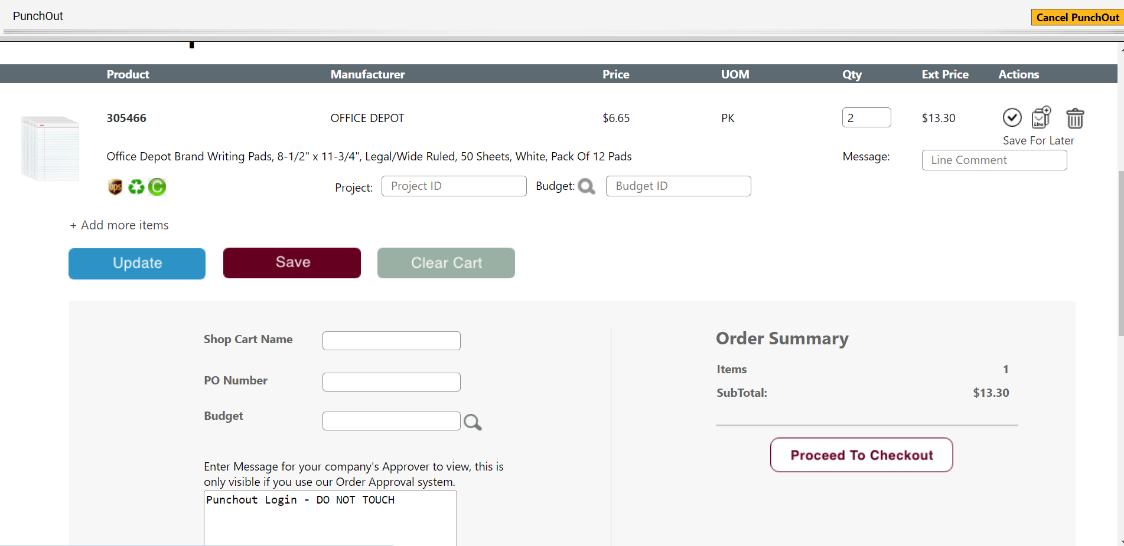
Vendor Catalogs

Slide 29
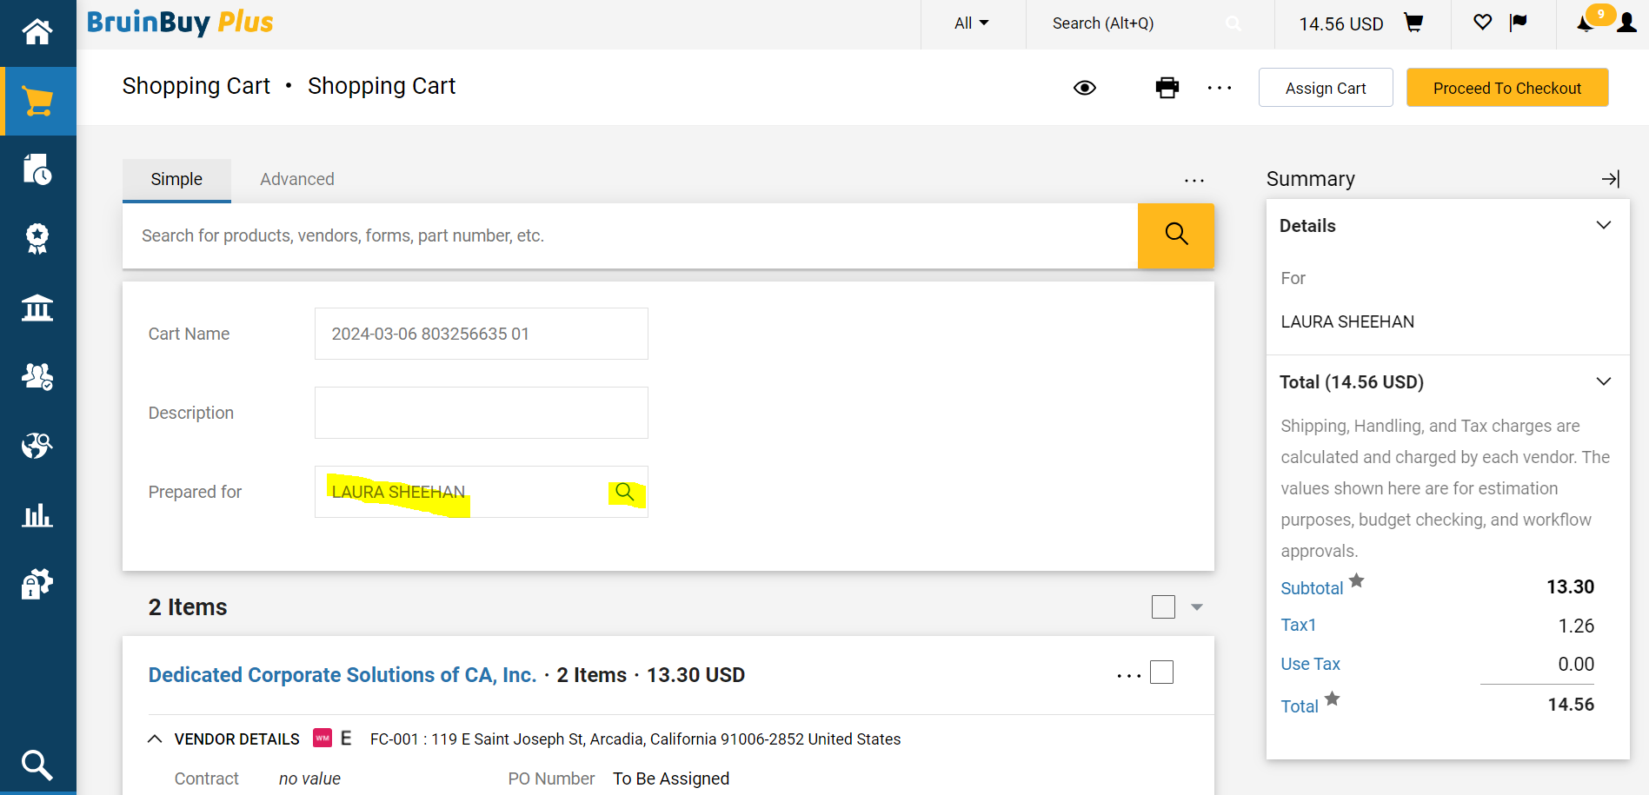
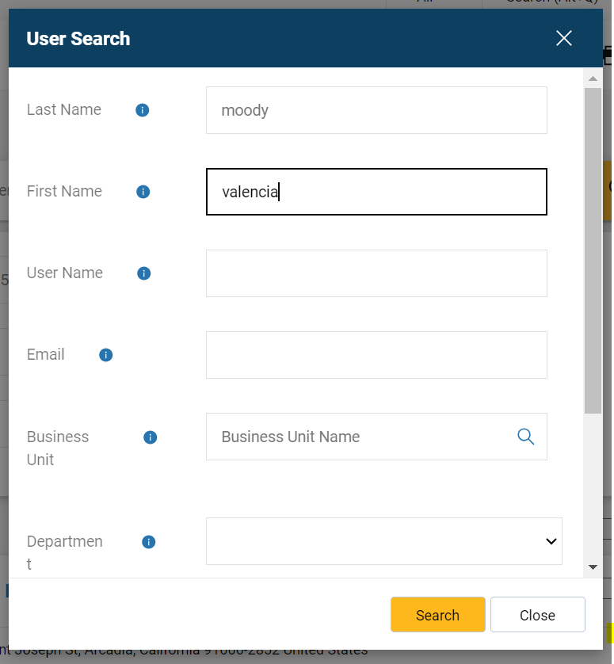
Vendor Catalogs

Slide 30
Vendor Catalogs

Slide 31
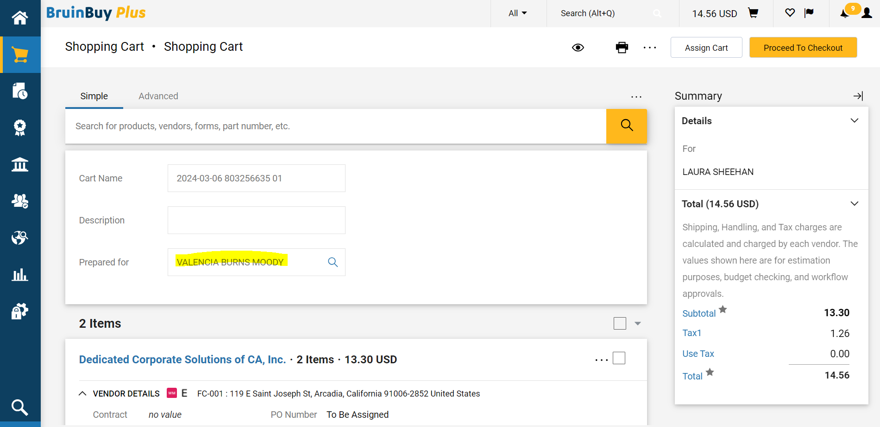
Vendor Catalogs

Slide 32
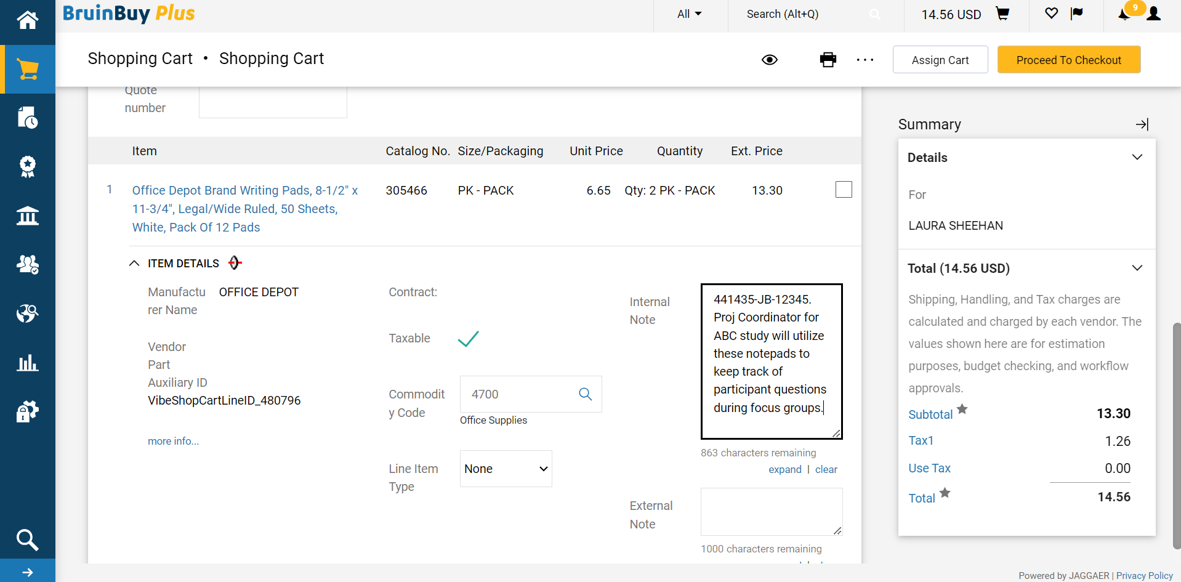
Vendor Catalogs

Slide 33
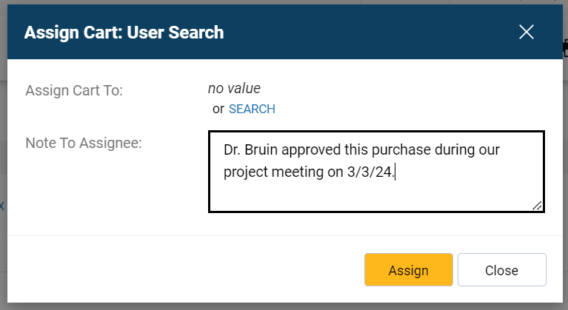
Vendor Catalogs

Slide 34
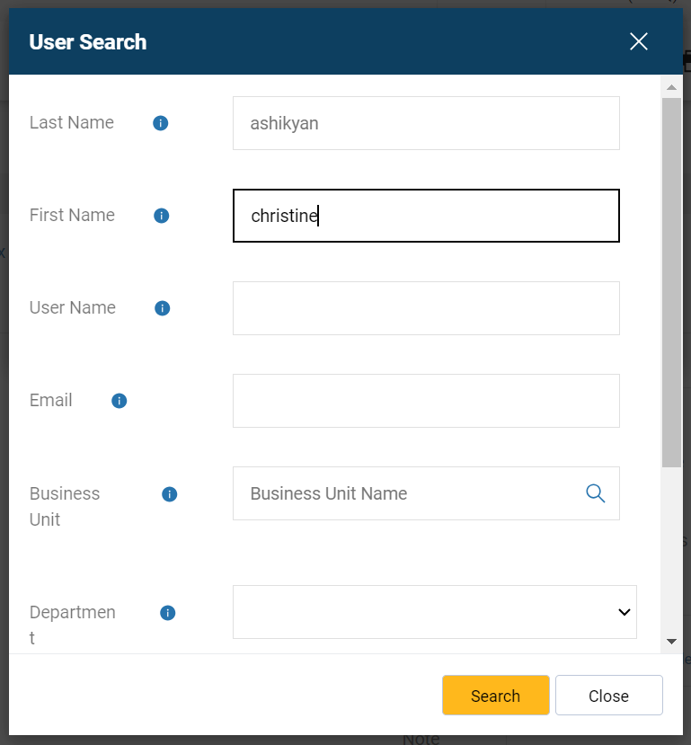
Vendor Catalogs

Slide 35
Vendor Catalogs

Slide 36
Vendor Catalogs

Slide 37
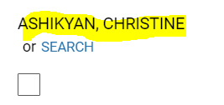
Vendor Catalogs

Slide 38
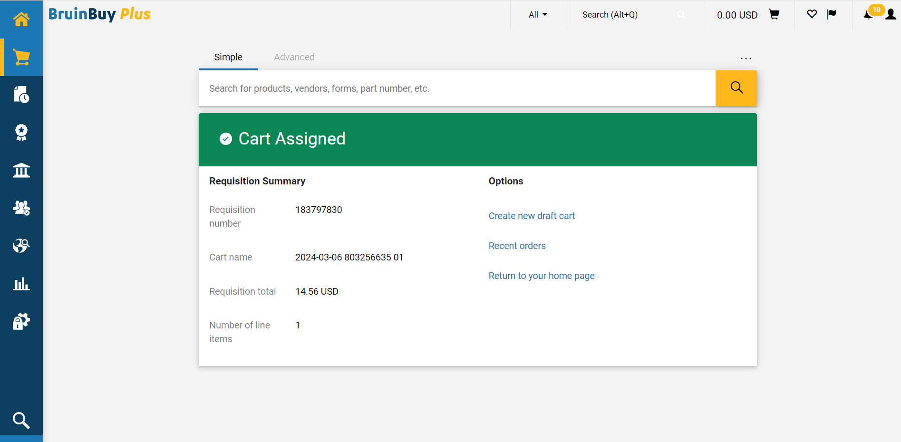
Vendor Catalogs

Slide 39
Punch-out Cart Process Review
Requester
Creates cart in BB+ using punch-out catalog
Obtains Authorizer (PI) approval
Fund Manager
Reviews cart for 4 A’s (allowability, allocability, availability, accuracy)
Assigns cart to Valencia
Valencia
Enters in FAU information, shipping details, and other items from internal notes into the system
Submits the cart and creates the order
Assigns cart to Fund Manager
Uses the “Internal Note” to input FAU, business justification, shipping information, and any other info

Slide 40
General Purchasing Guidance
We no longer have the ability to create PO's automatically at the department level. All PO's that we "create" actually have to be submitted as requisitions first, and then after review by Purchasing, a PO will be created centrally.
There are some types of purchases that used to require a PO that can now be paid using the "direct pay" feature, and we've covered those in previous research meetings (e.g. utility invoices, guest speaker fees, memberships, etc.)
If you are trying to buy a tangible item, using a vendor that has a punch-out catalog is the easiest, and we’ve just described how to do that.

Slide 41
General Purchasing Guidance
But what if there is no punch-out catalog, or if I’m not trying to pay for a tangible item, but rather a service?

Slide 42
General Purchasing Guidance
For some of those, we are allowed to pay using the Pcard (must be domestic vendors):
Abstract or Journal Publication Fees
Advertisements
Appreciation Gifts
Books
Certification Fees
Conference Fees
Office Supplies
Subscriptions
Online webinars/courses
License renewals
Some vendors: Iron Mountain, Fedex, Cintas, Linde, etc.

Slide 43
General Purchasing Guidance
If we can't order using the PCard and there isn't a punch-out catalog, we will need to create a requisition and procurement will need to review it before the PO will be generated.
Vendors that have campus-wide agreements (previously known as K-agreements) already have negotiated T&C in place, and so the procurement review process will be shorter. The full list of those vendors can be found at https://purchasing.ucla.edu/strategic-sourcing/contracts, and include vendors like:
QIAGEN
Salesforce
Apollo Couriers
Calico Custodial Services
Tangram Interiors
Owens & Minor
CPM One Source
Castle Press
Stericycle/Shred-It
Lyft

Slide 44
General Purchasing Guidance
If the vendor doesn't already have a campus-wide agreement, it will take a bit longer, but we can still submit the requisition and if it passes procurement review, they will generate a PO.
The process to create a requisition/PO for both vendors with and without campus-wide agreements is the same as it’s been:
Create a Purchase Request Form, get PI/approver approval, submit to your fund manager and Valencia for processing.

Slide 45
Previous Monthly Research Unit Meeting Slides

Slide 46
Previous Monthly Research Unit Meeting Slides
Ordering Gift Cards was covered during the December Research Unit Meeting, however there is updated guidance.
There are 4 types of gift cards you can order; be sure you are following the correct guidance for the type of GC you would like to purchase:
IRB Approved Research Payment Request
Non IRB Research Payment Request
Employee Recognition Request
Non-Employee Disbursement Request

Slide 47
Previous Monthly Research Unit Meeting Slides
Gift Card Types: | Research Payment Request (IRB Approved) | Research Payment Request (IRB determined approval not required) | Employee Recognition Request (ERRP) | Non-Employee Disbursement Request
Description | Disbursement requests for research payments that are approved by the Institutional Review Board (IRB). Must provide current IRB approval number. | Disbursement requests for research payments that are not approved by the Institutional Review Board (IRB) but still qualify as a research payment. Must provide OHRPP rejection letter, scope of work, and budget. | Disbursement requests for the Employee Recognition and Reward Program (ERRP) in which non-cash awards are distributed for the purchase of goods (not services). | Disbursement requests for non-cash awards presented to non-employees (see UC Policy G-42)
Forms of Payment | Gift cards/e-codes Bruincard deposits Cash Max amount: $5,000 | Gift cards/e-codes Bruincard deposits Cash Max amount: $5,000 | Gift cards/e-codes Bruincard deposits Max amount: $75 per award/employee | Gift cards/e-codes Bruincard deposits Max amount: $600 per individual
Instructions | IRB Approved Research Payment Request | Non-IRB Research Payment Request | How to Submit an Employee Recognition Request | How to Submit a Non-Employee Disbursement Request

Slide 48
Fund Manger Updates
We have successfully hired a new fund manager!
Lois Hernandez will start April 1

Slide 49
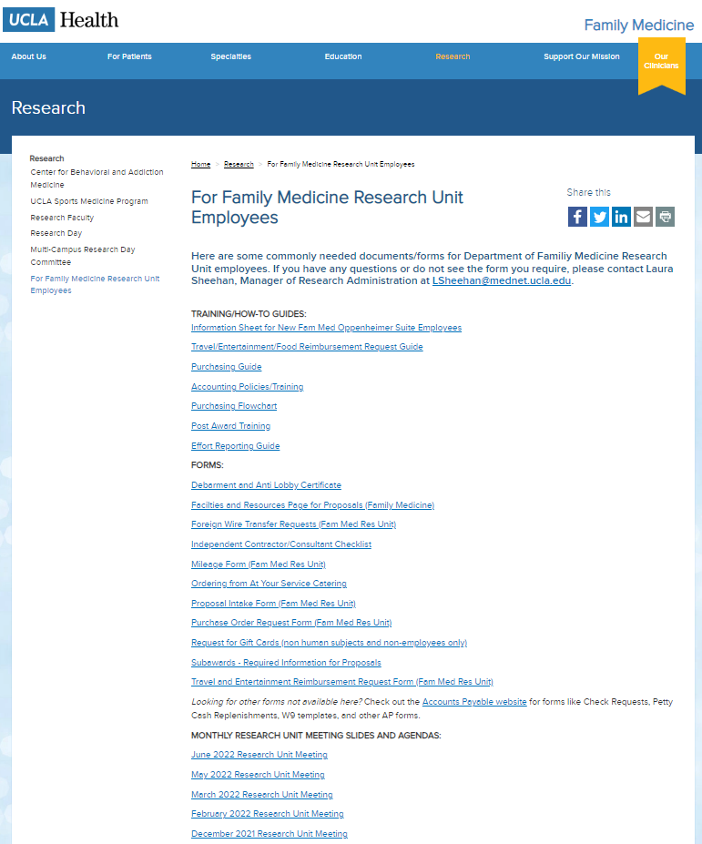
Upcoming Meetings/Events
Next Research Unit Meeting: April 4
Next Grand Rounds: March 22, 2024
Prior monthly meeting agendas/slides are available on the website

