Slide 1


Family Medicine Research Unit
Monthly Meeting
April 2023

Slide 2
Recently Processed Awards
PI | Award Title | Sponsor | Prime Sponsor | Action Type
Donohoe, Thomas J | Rapid Antiretroviral Therapy (ART) Start in the Ryan White HIV/AIDS Program - Dissemination Assistance Provider (DAP) | Cicatelli Associates | DHHS-HRSA | Continuation
Goldman, Joshua Timothy | The Effect of Sleep and Breathing Interventions on the Performance of NCAA Division I Collegiate Athletes | WHOOP, Inc. | - | No Cost Extension
Shoptaw, Steven J | CA Bridge Research | PUBLIC HEALTH INSTITUTE | Battery Foundation, The | No Cost Extension
Bholat, Michelle Anne | UCLA Dept. of Family Medicine International Medical Graduate Program | EAST BAY COMMUNITY FOUNDATION (THE) | - | Continuation
Shoptaw, Steven J | Alcohol Cue Human Laboratory Study Testing ASP-8062 | NIH-NIAAA National Inst. on Alcohol Abuse & Alcoholism | - | Modification/Amendment
Shoptaw, Steven J | Phenotyping Substance Use Disorder | UNIVERSITY OF ROCHESTER | - | New
Tarn, Derjung | LatinX/HIspanic Attitudes and Perspectives on Investigations and Studies- of New Therapeutics: The LAPIS Study | UNIVERSITY OF CALIFORNIA, SAN FRANCISCO | DHHS-FDA | New

Slide 3
Recently Submitted Proposals
PI | Title | Sponsor | Prime Sponsor | Type
Li, Michael (and Pauline Nguyen) | Midwest Integration of the National HIV Curriculum (MINHC) Grant | UNIVERSITY OF ILLINOIS | DHHS-HRSA | New
Shoptaw, Steven | UCLA Rapid, Relevant, Rigorous Implementation Science Hub | NIH-NIMH National Institute of Mental Health | - | Supplement
Shoptaw, Steven | Preparing for Implementation of the ATN CARES Evidence-Based Intervention Package for PrEP Uptake and Syndemic Factors among Youth | NIH-NIMH National Institute of Mental Health | - | Supplement
Shoptaw, Steven | Addressing intimate partner violence, mental health burdens, and other syndemic factors to support engagement in HIV prevention services in a trans community center | NIH-NIMH National Institute of Mental Health | - | Supplement

Slide 4
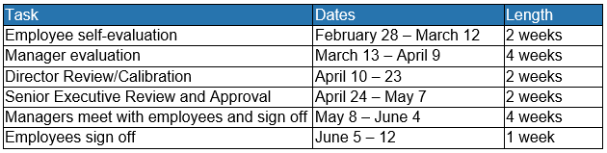
Performance Evaluations
For career staff in non-represented, non-academic positions
Manager Evaluations now available in Cornerstone

Slide 5
Career Tracks
New UC-wide job classification structure. Comprised of new job classification titles organized in a structure that is more closely aligned with current practices in the labor market.
Provides managers and employees at UCLA Health and the UC System with:
Better defined, market based job classification titles
More clearly defined career paths
Increased information for jobs across job families and functions
Salary ranges that reflect the local market for similar positions
Will support efforts to recruit, develop, and retain qualified employees.
NOTE: Career Tracks only pertains to staff not represented by a union.

Slide 6
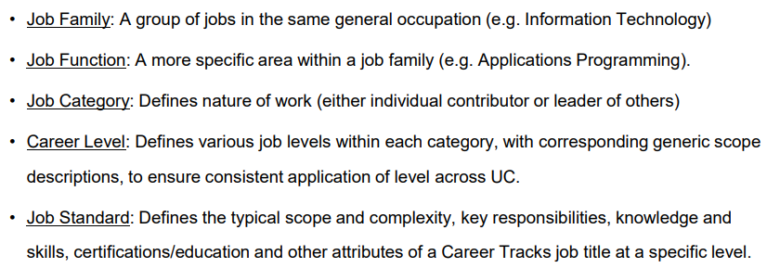
Career Tracks

Slide 7
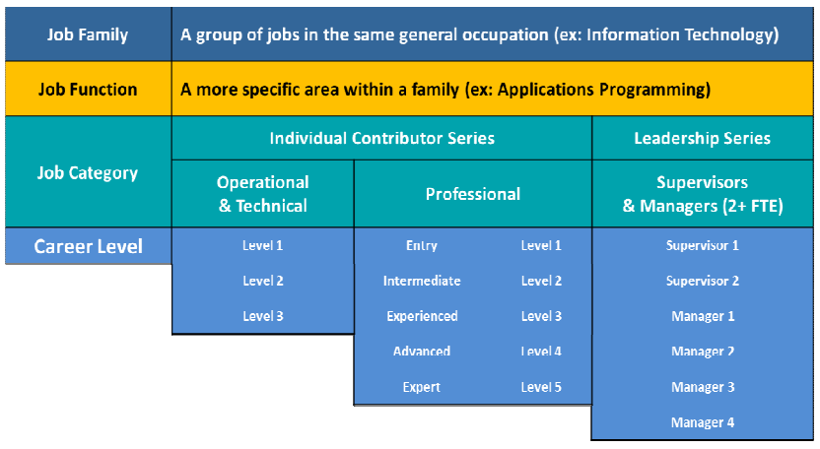
Career Tracks

Slide 8
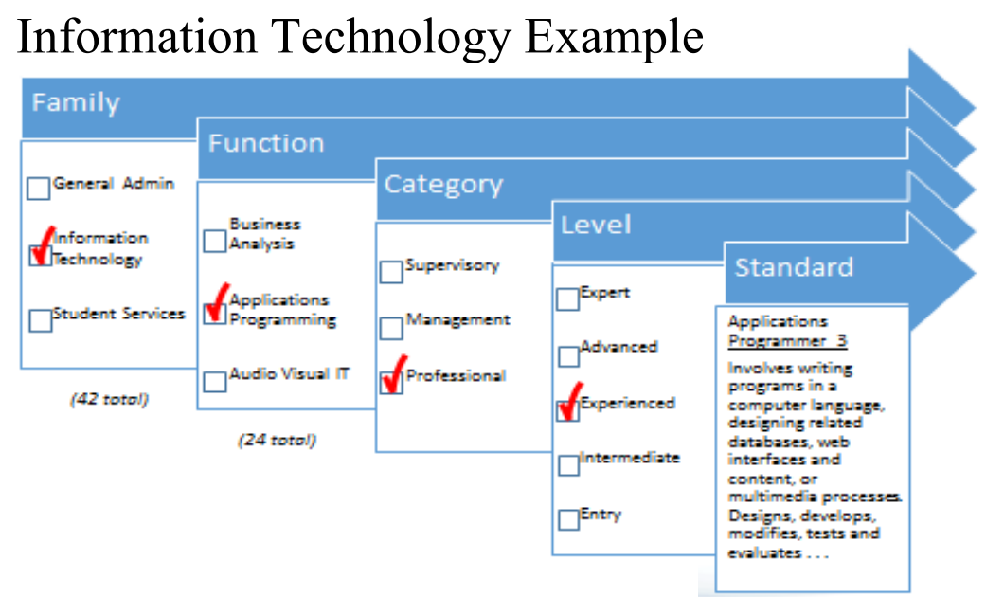
Career Tracks

Slide 9
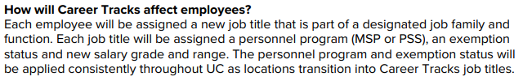
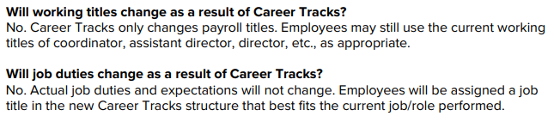
Career Tracks

Slide 10


Career Tracks

Slide 11
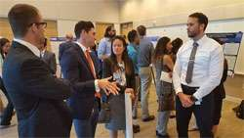

Research Day
2023 Meeting Information
In-person at the California Endowment (Center for Healthy Communities Los Angeles)
Wednesday, May 10, 2023
Keynote Speaker: Dr. Steve Shoptaw
Abstract Submissions
Submission Guidelines and other info can be found on our website
Abstracts must be submitted via the Submission Portal by April 7, 2023.

Slide 12
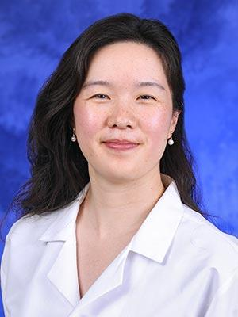
Grand Rounds
Fourth Friday of every month, from 12-1pm
Via Zoom (email Denise Acelar if you do not already have the invite)
Faculty, staff, and students are encouraged to attend
Next Grand Rounds: Friday, April 28, 2023
April Grand Rounds Speaker: Alice Zhang, MD

Slide 13
Upcoming Faculty Meetings
Research Faculty Meeting: Friday (4/7) at noon
Meet-and-Greet with the Residents: Wednesday, June 21, from 8-11am
  Faculty are required to attend, or send proxy
  Opportunity to meet the residents, introduce yourself and your research focci
  Each faculty member will have approximately 10-15 mins; PowerPoint optional
  RSVP to Laura and let her know which time slot you prefer

Slide 14
Oppenheimer Building Updates
Increased Fees:
Replacement/New Security Access Card - $50.00
Key - $40.00
  Building Safety Training
  Time to renew/complete your Oppenheimer building training!
  Link for returning users
  Link for new users. If you are a new hire/user, please use this dept. specific registration code: 765229D
Thank you Andraya, Cristina B., Elena, Jenn, Patricia, Cage, and Valencia!

Slide 15


Oppenheimer Building Updates
Thank you Andraya, Cristina B., Elena, Jenn, Patricia, Cage, and Valencia for keeping your Building Training up to date!
Everyone else: You need to complete your training (e.g. training has expired)

Slide 16
Research Participant Payment Requests
IRB-Approved Research Participant Payment Requests will now be processed by Student Finance Solutions through the Research Payment Portal on MyUCLA. Users must be connected to a UCLA Network/VPN to access portal.
Please be advised that the previous IRB Approved Research Payment Request PDF will no longer be accepted.
Step-by-Step instructions on how to utilize the portal can be found here: https://ucla.app.box.com/s/juwzx97yylfcqk01ji8dkhddvv2y4941

Slide 17
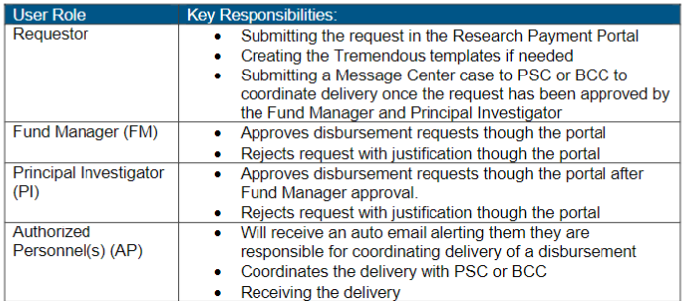
Research Participant Payment Requests

Slide 18
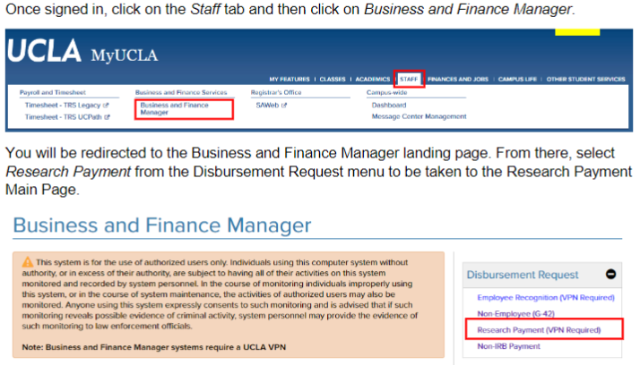
Research Participant Payment Requests
Log into MyUCLA portal at http://www.my.ucla.edu/ with UCLA Logon ID and password

Slide 19
Research Participant Payment Requests

Slide 20
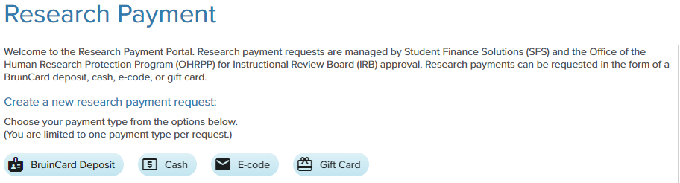
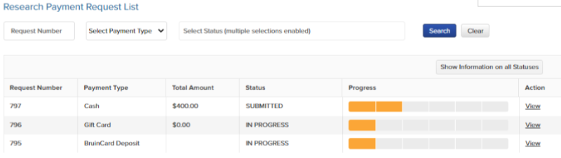
Research Participant Payment Requests

Slide 21
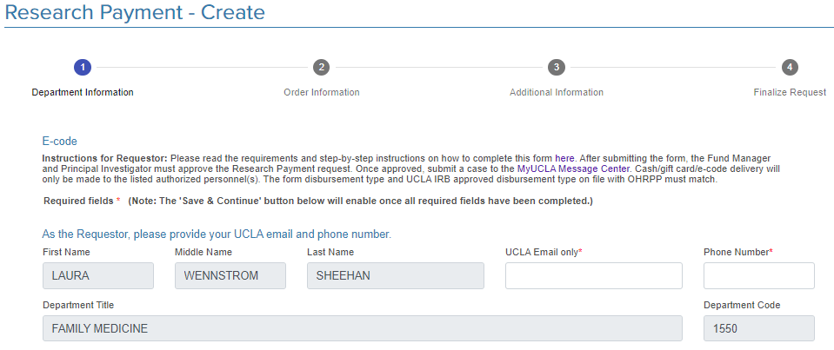
Research Participant Payment Requests

Slide 22
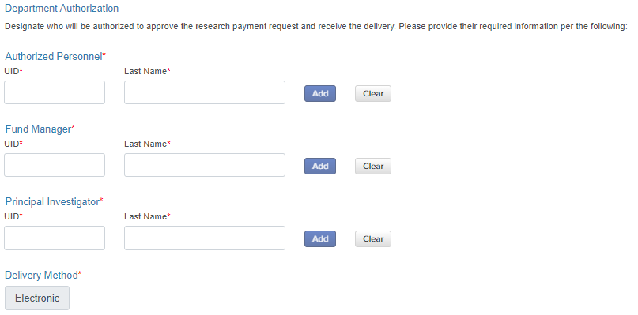
Research Participant Payment Requests
The remaining sections depend on the type of disbursement (e.g. cash will need delivery address and denominations; e-codes will need Auth Personnel email, vendor, $, Qty, etc.)
You will also need:
FAU
IRB approval #
IRB expiration date

Slide 23
Research Participant Payment Requests
Once the Requestor submits, the Fund Manager will receive an automated email to review
Once FM has approved, the PI will receive an automated email to review
Both FM and PI have ability to reject, which will send an auto email back to the Requestor who can then edit and resubmit
Once approved by both FM and PI, the Requestor will receive an automated email with instructions for submitting the request to the MyUCLA Message Center. Separate emails are also sent to Authorized Personnel.
Requestor then submits a case to the MyUCLA Message Center, and must include the Research Payment request number
SFS will review and either approve or reject. Gift card requests may take up to 4 weeks after SFS has approved.

Slide 24
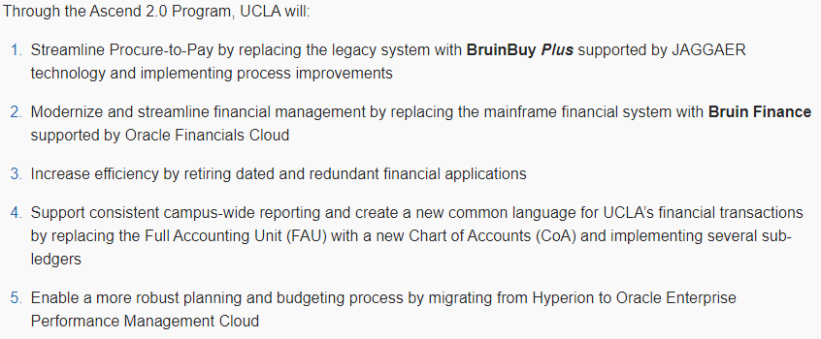
Ascend 2.0
Multi-year initiative to re-imagine the landscape of UCLA’s financial systems, which will:

Slide 25
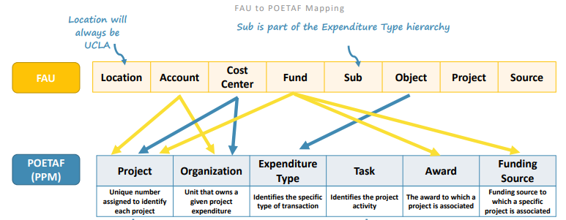
Ascend 2.0

Slide 26
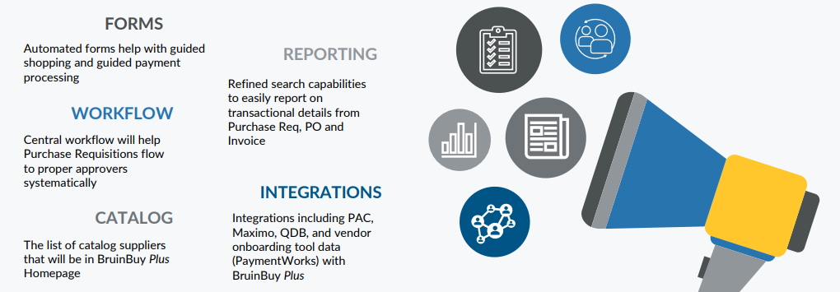
BruinBuy Plus
A Procure-to-Pay (P2P) platform that will manage shopping, ordering, receiving, and invoice management in a single environment

Slide 27
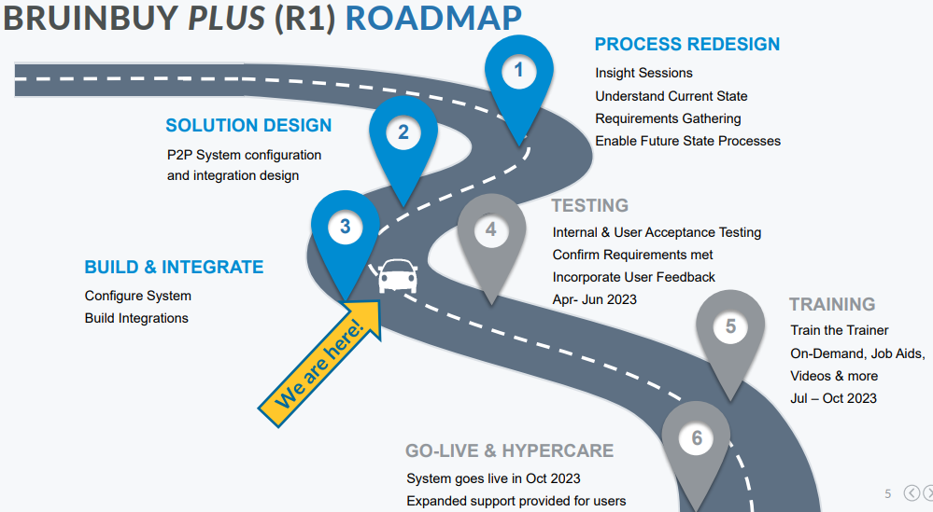
BruinBuy Plus

Slide 28
Concur Expansion
At this time, Concur is utilized for travel and entertainment (T&E) reimbursements, as well as direct-billed airfare, lodging, and T&E card requests.
In the future, the system will also handle:
Non-T&E Employee/Guest Business Expense Reimbursements
Monthly PCard Statement Reconciliation
Travel Cash Advances

Slide 29

H&I Initiative
Vendor invoices are sometimes put on Hold or Incomplete (H&I) status when there is some cause for a delay in payment to vendors (such as an invoice unit price that is greater than the unit price that was listed to create the Purchase Order [PO], or missing/closed PO, or PO was created for a different vendor)
Accounts Payable has established a new H&I Invoice Resolution Initiative, and our department will be working with them to resolve all existing H&I invoices over the next few months
Please remind your vendors to include the (correct) PO on all invoices
Please track your blanket PO’s to make sure
you have enough funds to cover all incoming
invoices

Slide 30
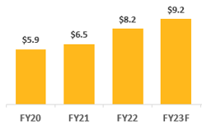
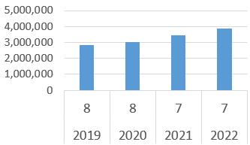
Contract and Grant Statistics
C&G Expenditures
NIH Awards and Ranking

Slide 31
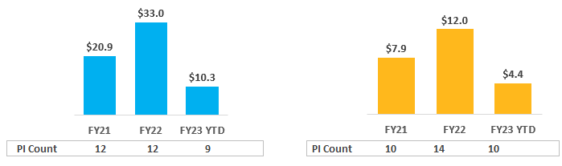
Contract and Grant Statistics
Proposals
Awards

Slide 32
NIH Updates
NIH to Host Virtual Listening Session on NIH Plan to Enhance Public Access to the Results of NIH-Supported Research (NIH OSP) NIH will host a virtual, public listening session to hear community feedback on the NIH Plan to Enhance Public Access to the Results of NIH-Supported Research (NIH Public Access Plan). The NIH Public Access Plan is currently available for public comment until April 24, 2023. The virtual listening session will take place April 12, 2023, from 1:00 pm – 3:00 pm ET and will be viewable through NIH Videocast. Visit their website for more information.
NIH Clinical Trials Reporting Compliance: A Shared Commitment (NIH Open Mike) NIH issued the NIH Policy on Dissemination of NIH-Funded Clinical Trial Information to establish our expectation that summary results of NIH-supported clinical trials be submitted to ClinicalTrials.gov for posting within 365 days of the actual primary completion date. This policy is complementary to a 2016 updated HHS regulation aimed at further increasing the availability of information about clinical trials. https://nexus.od.nih.gov/all/2023/03/24/nih-clinical-trials-reporting-compliance-a-shared-commitment/
Analyses of Demographic-Specific Funding Rates for Type 1 Research Project Grant and R01-Equivalent Applications (NIH Open Mike) In this post, we analyze funding rates for Fiscal Year (FY) 2010 to FY 2022 Type 1 Research Project Grant (RPG) and Type 1 R01-Equivalent applicants according to the race-ethnicity of designated Principal Investigators (PIs). We used data from frozen, official, NIH success rate files. https://nexus.od.nih.gov/all/2023/03/16/analyses-of-demographic-specific-funding-rates-for-type-1-research-project-grant-and-r01-equivalent-applications/

Slide 33
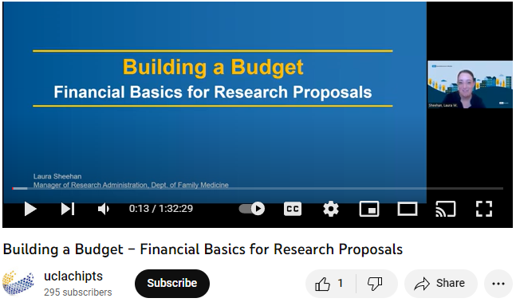
Building a Budget
Available online at https://www.youtube.com/watch?v=hVaL7sttiF8

Slide 34
Funding Opportunities
Faculty Career Development Award
Assistant Professors in the regular rank and In-Residence series are invited to apply. Deadline to submit to Chair: May 1, 2023.
Request for Applications (RFA): Revision Applications to Support Research on Prevention and Cessation of Menthol Cigarette Use in Populations that Experience Health Disparities (R01, Clinical Trial Optional)
Due June 19, 2023
NIDA Avant-Garde Program for HIV and Substance Use Disorder Research (DP1 Clinical Trial Optional)
(PAR-23-269)

Slide 35
In the News
White House science adviser welcomes more agile research agencies with 'big bold goals' (Science) https://www.science.org/content/article/white-house-science-adviser-welcomes-more-agile-research-agencies-big-bold-goals
Bipartisan legislation that unleashed wave of American innovation is now at risk (The Hill, Opinion) https://thehill.com/opinion/congress-blog/3920657-bipartisan-legislation-that-unleashed-wave-of-american-innovation-is-now-at-risk/
Congressional Panel Approves Bill To Streamline Marijuana And Psychedelics Research While Ramping Up Fentanyl Criminalization (Marijuana Moment) https://www.marijuanamoment.net/congressional-panel-approves-bill-to-streamline-marijuana-and-psychedelics-research-while-ramping-up-fentanyl-criminalization/

Slide 36
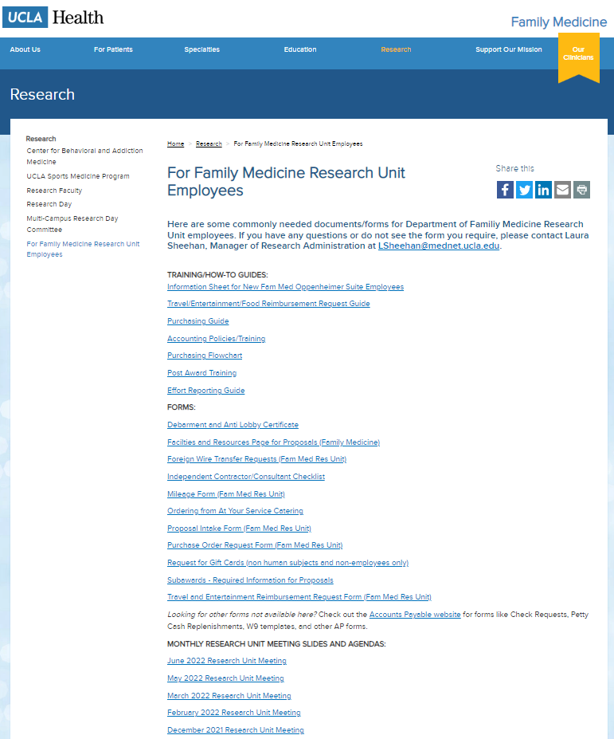
Upcoming Meetings/Events
  Next Research Unit Meeting: May 4
  Next Grand Rounds: Friday, April 28
Research Day: May 10, 2023 at the California Endowment (downtown)
Prior monthly meeting agendas/slides are available on the website

